Slide 1
Corporate Control of Public Health:
Case Studies and Call to Action
Martin Donohoe

Slide 2
Am I Stoned?
A 1999 Utah anti-drug pamphlet warns:
“Danger signs that your child may be smoking marijuana include excessive preoccupation with social causes, race relations, and environmental issues”

Slide 3
Corporations
“The [only] social responsibility of business is to increase its profits.”
- Milton Friedman

Slide 4
Corporations
“Corporations [have] no moral conscience. [They] are designed by law, to be concerned only for their stockholders, and not, say, what are sometimes called their stakeholders, like the community or the work force…”
-Noam Chomsky

Slide 5
Outline
Corporate Domination of World Economy
Corporate Taxation
Corporate Crime
Corporations and Education
Corporations and the Media
International Non-Cooperation and Isolationism

Slide 6
Outline
Case Studies
  GE-NY Presbyterian Hospital Technology Agreement
  American Council on Science and Health
Other Examples of Corporate Meddling in Public Health
Discussion
Solutions

Slide 7
Corporations Dominate the Global Economy
Almost 6 million corporations
  ¼ non-profits
90% of transnational corporations headquartered in Northern Hemisphere
500 companies control 70% of world trade

Slide 8
Corporations Dominate the Global Economy
53 of the world’s 100 largest economies are private corporations; 47 are countries
  GM is larger than Denmark and Turkey
  Wal-Mart is larger than Israel and Greece

Slide 9
Corporations
Internalize profits
Externalize health and environmental costs

Slide 10
Corporate Taxation
Corporations shouldered over 30% of the nation’s tax burden in 1950 vs. 8% today
Nearly 1/3 of all large U.S. corporations pay no annual tax

Slide 11
Reasons for Inadequate Corporate Taxation
Corporate tax breaks/loopholes
Corporate welfare
Cheating and under-payment common
Offshore tax havens shelter capital

Slide 12
“White Collar” (Corporate) Crime vs. “Blue Collar” (Street) Crime”
Each year in America, we lose;
  $3.8 billion to burglary and robbery
  $100-$400 billion to health care fraud; $40 billion to auto repair fraud, $15 billion to securities fraud, etc.; the S and L fraud cost between $300 billion and $500 billion; the current economic meltdown involves fraud in the hundreds of billions of dollars

Slide 13
Why So Much Corporate Crime
Fines meager, often considered a cost of doing business
Corporate crime under-prosecuted, prosecutors under-funded

Slide 14
Corporate Crime
“Corporation: An ingenious device for obtaining individual profit without individual responsibility.”
Ambrose Bierce
“A criminal is a person with predatory instincts who has not sufficient capital to form a corporation.”
Howard Scott

Slide 15
Consequences of Corporatization
Increasing industry consolidation/mergers
Inflation
Rising unemployment

Slide 16
Consequences of Corporatization
Rise of the “permatemp”
Expatriation of jobs
  Overseas factories often lack adequate occupational health and safety and environmental standards
Decline in labor union membership

Slide 17
Labor
27 million enslaved laborers
Over 250 million child laborers
Minimum Wage ≠ Living Wage
¼ of US jobs pay less than a poverty-level income

Slide 18
Exorbitant CEO Pay
CEO salaries up 500% since 1980
The average CEO makes 350-400X the salary of the average U.S. worker (1960 - 41X)
  Mexico 45:1
  Britain 25:1
  Japan 10:1

Slide 19
Outsourcing the Government
More than ½ of federal jobs now outsourced to private corporations
Outsourcing of military

Slide 20
Worrisome Trends
WTO, World Bank, and IMF policies which promote privatization of social resources and export-oriented development
MAI, GATT, NAFTA, CAFTA, other trade agreements

Slide 21
Worrisome Trends
SLAPP Lawsuits
“Tort Reform”

Slide 22
Corporate Involvement in Education

Slide 23
Would You Sign a Petition to Ban Dihydrogen Monoxide?
1. It can cause excessive sweating and vomiting
2. It is a major component in acid rain
3. It can cause severe burns in its gaseous state
4. It can kill you if accidentally inhaled
5. It contributes to erosion
6. It decreases effectiveness of automobile brakes
7. It has been found in tumors of terminal cancer
patients

Slide 24
Geographic/Scientific Ignorance, Pseudoscience
Percent of US teens unable to locate the following on a map:
  United States – 11%
  Pacific Ocean – 29%
  Japan – 58%
20% of Americans don’t know the earth revolves around the sun (1999)
Half of US citizens do not believe in evolution and do believe that humans and dinosaurs coexisted (2007)

Slide 25
Public Education in Disarray
U.S. Schools ranked lowest among western nations
Inadequate funding, decaying infrastructure
National HS graduation rate stagnant at 65-70%
College tuition costs rising

Slide 26
Television and the Media
The average American youth spends 900 hrs/yr in school, 1,500 hrs/yr watching TV
By age 65, the average American will have spent 9 yrs watching TV

Slide 27
Corporate PR Tactics
Advertising
Astroturf - artificially-created grassroots coalitions
Corporate front groups
  National Wilderness Institute
  The Foundation for Clean Air Progress

Slide 28
Corporate PR tactics
Invoke poor people as beneficiaries
Characterize opposition as “technophobic,” anti-science,” and “against progress”
Portray their products as environmentally beneficial despite evidence to the contrary

Slide 29
Greenwash
Public relations / ad campaigns
  Chevron’s “People Do” Campaign
  BP invests $100 million annually in clean energy = amt. it spends annually to market itself as moving “Beyond Petroleum”

Slide 30
Sponsored Environmental
Education Materials (Examples)
International Paper
-“Clearcutting promotes growth of trees that require full sunlight and allows efficient site preparation for the next crop”
Exxon’s “Energy Cube”
-“Gasoline is simply solar power hidden in decayed matter”
-“Offshore drilling creates reefs for fish”

Slide 31
Academics/Professional Organizations Affected
Increasing corporatization of academia
  ↑Private commercial funding of university research:
  Secrecy/Gag Clauses
Pseudoscience
  AAPG Notable Achievement in Journalism prize to Michael Crichton for State of Fear (which denies global warming)

Slide 32
The Media
Most media organizations owned by multinational, multi-billion dollar corporations that are involved in a number of businesses apart from the media, such as forestry, defense, real estate, oil, agriculture, steel production, railways, and water and power utilities

Slide 33
The Media
2005: 5 corporations control majority of US media (down from 50 in 1983)
Stories suppressed
Video news releases

Slide 34
Global Warming: Controversial?
Of 928 articles in peer-reviewed scientific journals, none were in doubt as to the existence or cause of global warming
Of 636 articles in the popular press (NY Times, Washington Post, LA Times, WSJ), 53% expressed doubt as to the existence (and primary cause) of global warming
Science 2004;306:1686-7
(Study covers 1993-2003)

Slide 35
Lobbying
38,000 full-time lobbyists in Washington, DC
Lobbying groups spent just under 2.5 billion in 2006
All single issue ideological groups combined (e.g., pro-choice, anti-abortion, feminist and consumer organizations, senior citizens, etc.) = $76 million

Slide 36
Corporate Influence Leads to Large Taxpayer Subsidies to Polluting Industries
Nuclear power - $10.5 billion/yr
Coal - $8 billion/yr
Oil and gas - $550 million/yr

Slide 37
The Decline of Democracy
True democracy demands an informed citizenry (education), freedom of the press (media), and involvement (will, time, money)
Democracy is critical to the success of public health

Slide 38
International Non-Cooperation/Isolationism
Failure to sign or approve:
  Kyoto Protocol on Climate Change
  International Covenant on Economic, Social, and Cultural Rights
  Convention on the Prohibition of Anti-Personnel Land Mines

Slide 39
International Non-Cooperation/Isolationism
Failure to sign or approve:
  Convention on the Rights of the Child
  Convention on the Elimination of Discrimination Against Women

Slide 40
International Non-Cooperation/Isolationism
Failure to sign or approve
  The Stockholm Convention on Persistent Organic Pollutants
  The Basel Convention on the Control of Transboundary Movements of Hazardous Wastes
  The Cartagena Protocol on Biosafety (re GM foods)

Slide 41
Case Studies

Slide 42
Bringing Bad Things to Life
The alliance between GE Medical Systems and NY-Presbyterian Hospital

Slide 43
The Partners
NY-Presbyterian Hospital
  one of the largest academic health care institutions in the U.S.
GE Medical Systems
  Subsidiary of General Electric

Slide 44
The Agreement
10-year, $500 million agreement
Requires NYP to purchase products and services from GEMS in exchange for purported discounts on medical supplies and the promise of enhanced technological standardization and simplification

Slide 45
General Electric
World’s largest company by market share
  2008 net after-tax profits of $17 billion

Slide 46
General Electric
Makes household appliances, plastics (including bisphenol A), lighting, and medical equipment
Produces jet engines and military hardware
Has built 91 nuclear power plants in 11 countries
Investments include for-profit prison enterprises

Slide 47
General Electric
Operates coal-burning power plants
  Major releasers of toxic mercury
Operates a financial services group
Owns a $43 billion media empire
  Including NBC, Telemundo, and Universal Studios

Slide 48
GE’s Record
The Patient Channel
  Shown in hospital rooms throughout country
  Advertising vehicle for drug companies
  Criticized by JCAHO for manipulative marketing practices

Slide 49
GE’s History
Conducted unethical human subject experiments on prisoners, involving testicular irradiation, from 1940s to 1960s
Intentionally-released excessive radiation from its Hanford, WA nuclear reactor in the 1980s, to determine how far it would travel
  May have contributed to increased thyroid cancer risk in “Downwinders”

Slide 50
GE’s Record
America’s largest corporate polluter
75 Superfund sites nationwide
13 in NY

Slide 51
GE’s Record
Between 1947 and 1977, two of its capacitor manufacturing plants dumped 1.3 million pounds of PCBs into the Hudson River
  Probable human carcinogens with adverse effects on liver, kidney, nervous system, and reproductive organs (EPA)
  200 mi of Hudson Superfund site

Slide 52
GE’s Record
Has spent millions to avoid Hudson cleanup and to weaken or eliminate Superfund Law
Contributes to corporate front groups

Slide 53
GE’s Record
Tremendous influence of environmental, energy, and health policy
Spent over $19 million on lobbying in 2008
Many members of board of directors have government ties
Huge tax breaks

Slide 54
GE’s Record
Has eliminated 150,000 jobs in last 15 years
  While receiving billions in federal contracts and millions in state and local subsidies
One of nation’s top out-sourcers of jobs

Slide 55
GE’s Record
Continues to under-fund employee pension plan, despite very generous compensation packages for executives
Continues to shift health care costs onto workers, despite growing profits

Slide 56
GE’s Record
Cited by Human Rights Watch for “systematic workers’ rights violations” in the U.S. and abroad
Cited for numerous OSHA workplace violations
Cited by Project on Government Oversight as repeat offenders for defrauding U.S. taxpayers

Slide 57
GE’s Record
In 1990s, Pentagon’s Defense Contract Management Agency created special investigations office specifically for GE
Nevertheless, company has been awarded increasingly costly reconstruction contracts in Iraq and Afghanistan

Slide 58
Concerns About the Agreement
Provides GE with financial incentives to promote high technology purchases
Hospital prohibited from purchasing more effective equipment from other companies

Slide 59
Concerns About the Agreement
Augments trend in academic medical centers to promote the use of expensive, high-technology care at expense of preventive care and public health measures

Slide 60
Concerns About the Agreement
Patients with developmental anomalies and cancers caused by GE’s pollution diagnosed with GE scanners and treated with GE-manufactured therapeutic devices, increasing GE’s profit

Slide 61
A macabre twist on “cradle to grave care”

Slide 62
Confronting Pseudoscience and Threats from a Corporate Front Group:
The American Council on Science and Health

Slide 63
Background
2007: Essay describing health and environmental consequences of global warming for Medscape
Described ACSH as a corporate front group and criticized its selection of author Michael Crichton as recipient of its 2005 Sound Science Medal

Slide 64
ACSH and Global Warming
Leader referred to “belief” that burning fossil fuels has caused global warming as pseudoscience
Criticized environmental scientists as “doomsayers” and “fearmongers”

Slide 65
ACSH Response
Threatened litigation against Medscape
Medscape briefly pulled article, then published with comments removed, then republished with additional material
?Loss of potential readership?

Slide 66
Dr Elizabeth Whelan:
President and co-founder
Early writing career included:
  Freelance writing assignment for Pfizer criticizing the FDA
  Consumer magazine pieces
  Books include Panic in the Pantry and Toxic Terror
Whelan’s 2003 salary = $326,612

Slide 67
Dr Gilbert Ross:
Medical/Executive Director
Spent 1996 in federal prison after being sentenced to 46 months for
  Medicaid fraud
  Perjury
  Obstruction of justice
  Not mentioned on his bio on ACSH website

Slide 68
ACSH:
Dr Gilbert Ross’ Career
Barred by the DHHS for 10 years from participating in either Medicare or Medicaid
Now in charge of all scientific projects, publications, and personnel issues involving scientific staff at ACHS

Slide 69
ACSH
ACHS Board of Directors includes anti-regulatory Individuals (2001 Survey)
George Lundberg, former editor of JAMA, current editor of Medscape, on board of advisors
Funding from right wing foundations, corporations
Accepted money to write and disseminate pro-industry “studies”

Slide 70
Corporate Front Groups
Promote corporate agendas
Strong financial and advisory links with corporations
Disseminate misinformation/lies under guise of “science”
Promote pro-business, conservative ideology

Slide 71
ACSH:
Pseudoscience and Misinformation
Attacked the precautionary principle
  “anti-science,” “elitist,” and “theology”
Minimized the effects of environmental tobacco smoke (ETS) on human health
  40,000 deaths/yr in U.S.

Slide 72
ACSH:
Pseudoscience and Misinformation
Denied many of the adverse neurological effects of lead exposure
Denied endocrine-disrupting effects of PCBs
Claimed court ordered-cleanup of Hudson River by GE based on false claims of PCBs causing cancer
Claimed uncertainty regarding effects of agricultural antibiotics on food-borne, antibiotic-resistant human infections

Slide 73
ACSH:
Pseudoscience and Misinformation
Called warnings regarding tuna consumption by pregnant women “unfounded health scare”
Critiqued health concerns re trans fatty acids
  “There is no such thing as junk food”
  “There is insufficient evidence of a relationship between diet and any disease.”

Slide 74
ACSH:
Pseudoscience and Misinformation
Claimed “irradiated food is safe, wholesome and nutritious” and “no radioactive isotopes are involved”
Denied link between dioxins and pesticides and adverse health effects
Supported use of human volunteers in pesticide toxicity studies

Slide 75
“Phony Health Scares”
Flame retardant traces found in blood and breast milk
Diesel exhaust fumes from school busses
Arsenic in drinking water
Phthalates in medical devices and children’s toys

Slide 76
ACSH: Attacks on Scientists and the Scientific Enterprise
Threat of litigation against Medscape antithetical to the rules of science
  requires the free exchange of information and opinion in pursuit of the truth

Slide 77
ACSH: Attacks on Scientists and the Scientific Enterprise
ad hominem attacks
  environmentalists = “toxic terrorists”
  Whelan criticized Dr. Barry Levy and citizen-activist Erin Brockovich

Slide 78
Implications of Attacks on Science and Scientists
ACSH has broad media presence
Web site attracts large numbers of individuals
  100,000 hits per month for 2005
Dr. Whelan has been featured on NBC’s Today Show, CNN Live, and CNBC’s Business Insiders

Slide 79
Implications of Attacks on Science and Scientists
Editorials by Whelan and Ross have appeared in the New York Times and Wall Street Journal
Publications in Medscape, other journals

Slide 80
Implications of Attacks on Science and Scientists
Mislead public
May cause alterations in lifestyle and/or purchasing habits
  Adverse health consequences
Threats of litigation distract, intimidate, and deplete the scientific, legal, and financial resources of individuals and groups committed to public health

Slide 81
Implications of Attacks on Science and Scientists
Faulty pronouncements influence elected officials
Threats of litigation divert the valuable time of health care providers, editors, and legal departments away from their more productive missions of research, teaching, writing, and patient care

Slide 82
Implications of Attacks on Science and Scientists
Scientists and health care advocates may decide it is wiser to avoid conflict than publish content to which ACSH and other such groups might object

Slide 83
Other Examples of Corporate Meddling in Public Health

Slide 84
WHO Tobacco Treaty
U.S. attempted to undermine treaty through Bush administration appointees with strong ties to tobacco industry

Slide 85
Medical Technologies Industry
Successful lobbying effort against Medicare physician payment policies relevant to unproven imaging studies
  Whole body CT scans (scams)

Slide 86
Corporate Agribusiness
Successful campaign against Oregon’s Proposition 27 (labeling of GM foods)
Lobbying for pre-emptive labeling laws re GMOs, rBGH

Slide 87
Corporate Agribusiness
Supports spread of GMOs to developing world
Keeps GM seeds from non-corporate academic researchers
Promoting agriculture bills which provide large subsidies to large industrial farms

Slide 88
Medical Care
Sponsor luxury care consortiums, clinics
Facilitate medical tourism
Niche in “medical transfer market,” facilitating medical repatriations of undocumented immigrants (e.g., MexCare)

Slide 89
Prison-Industrial Complex
Construction and management of prisons
Providing (substandard) health care to inmates

Slide 90
Pharmaceutical Industry
Influence over physicians through control of CME, gifts, research funding
Conduct seeding trials to alter prescribing patterns
Secrecy, statistical torturing of data sets, selective publication

Slide 91
Pharmaceutical Industry
Effectively lobbied and threatened trade sanctions against developing countries in order to prevent production and importation of much cheaper, generic versions of life-saving anti-AIDS drugs

Slide 92
Pharmaceutical Industry
Opposes legislation aimed at limiting pharmaceutical industry influence by publicizing gifts to providers
Opposes Federal Research Public Access Act, which would require federal agencies that fund over $100 million in external research per year to make their study results publicly available online

Slide 93
Chemicals Industry
Chisso Corporation
Methylmercury poisoning
Minimata Disease

Slide 94
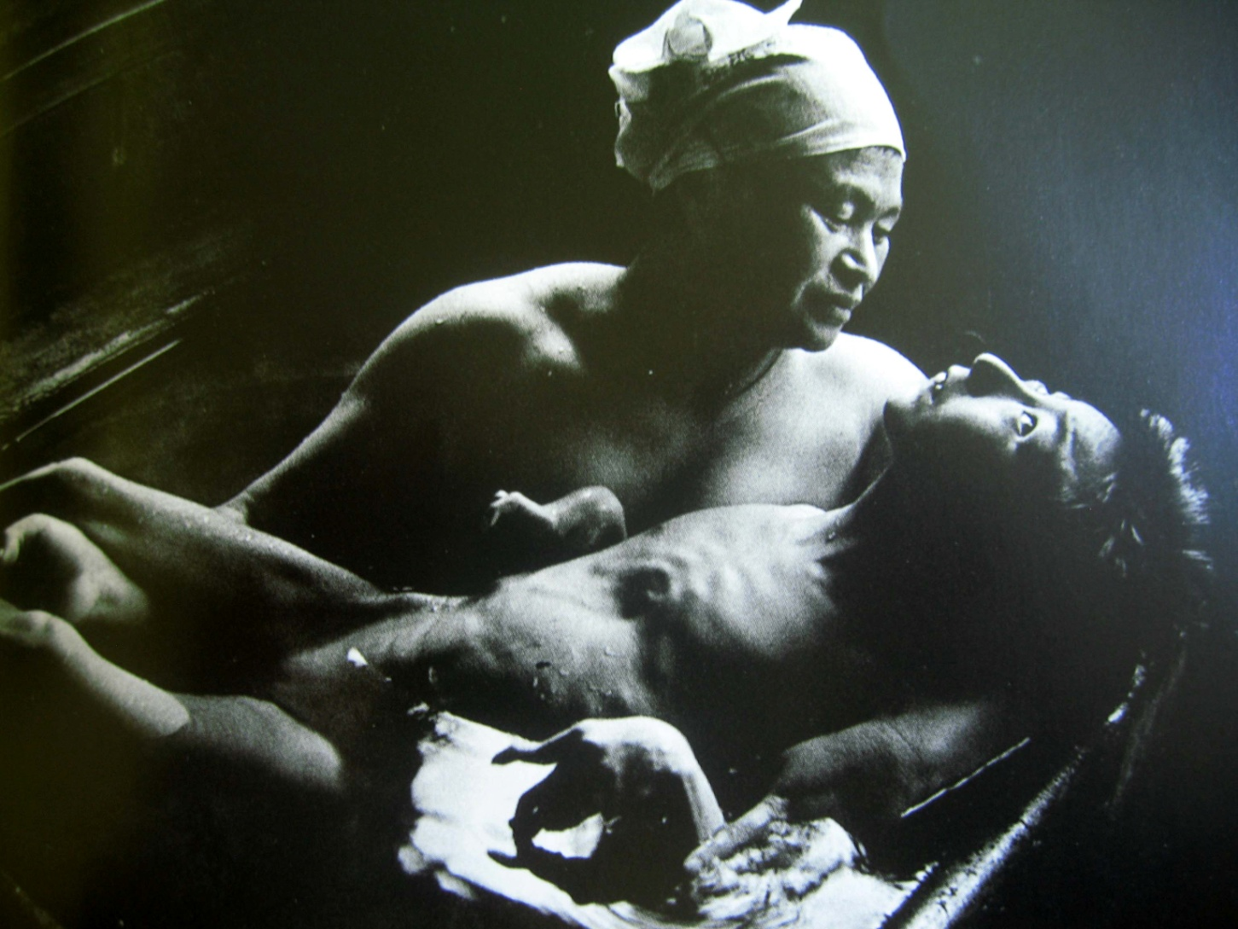
Minimata Disease
W Eugene Smith

Slide 95
Solutions
Restructure tax system
Punish corporate scofflaws with large fines and jail time
Increase enforcement budgets to combat corporate crime
Living wage laws

Slide 96
Solutions: Fair, Representative Elections
Publicly financed campaigns and campaign finance reform
Open debates, free air time for candidates
Proportional representation
Instant runoff voting/cumulative voting/range (rating) voting

Slide 97
Solutions: Vote
US voter turnout low
  Wealthy vote at almost twice rate of poor
  Whites > Blacks > Hispanics
  Old > Young
  Property owners > Renters
  Physicians < general population

Slide 98
Solutions
Activism / Letter writing / Protesting / Whistleblowing
Join community groups – become involved in local as well as national issues
Lobby legislators
Run for office

Slide 99
Solutions
Increase funding of public education
Independent scientific review of school curricula
Prohibit use of sponsored curricula

Slide 100
Solutions
Establish safeguards re corporate involvement in academic research
Higher standards of journalism
Support alternative media

Slide 101
Solutions: Education
Medical ethics overemphasizes fascinating dilemmas involving expensive technologies (e.g., gene therapy, cloning, face transplants)
Medical ethics underemphasizes the psychological, cultural, socioeconomic, occupational, and environmental contributors to health

Slide 102
Solutions: Education
IOM recommends ¼ to ½ of medical students earn the equivalent of an MPH
  Only 10% of students at US public health schools are physicians, down from 60% in the 1960s

Slide 103
Solutions
Multidisciplinary improvements in education
  Literature
  History
  Law
  Photography
  Community Service
  Research-based activism courses
Collaborative training between professional schools

Slide 104
Solutions
Based on Precautionary Principle
Recognize nature’s net worth
Calculate economic prosperity based on Genuine Progress Index or Global Happiness Index, rather than Gross Domestic Product

Slide 105
Voltaire
“The comfort of the rich rests upon an abundance of the poor”

Slide 106
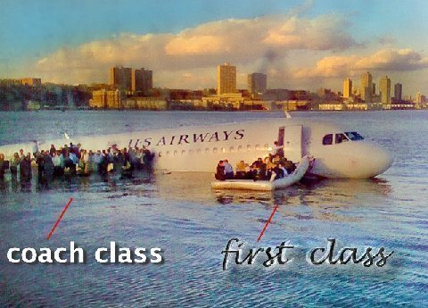
Hudson River, 2009

Slide 107
Primo Levi
“A country is considered the more civilized the more the wisdom and efficiency of its laws hinder a weak man from becoming too weak or a powerful one too powerful.”

Slide 108
Günter Grass
“The first job of a citizen is to keep your mouth open.”

Slide 109
Anita Roddick
"If you think you are too small to have an impact, try going to bed with a mosquito in your tent"

Slide 110

The Face of Public Health

Slide 111
Discussion Questions

Slide 112
Discussion
What is the appropriate role of institutional ethics committees in vetting university financial agreements with private corporations?
How can we improve the public health profession’s use of the media to better educate the public?

Slide 113
Discussion
How can scientists confront abuses of science by the media and government?
Should physicians discuss political issues with their patients?

Slide 114
Discussion
What is the appropriate role of the state in delivering and monitoring research and health care delivery?
What is the appropriate role of the profit motive in research, medical care, and public health?

Slide 115
Contact Information and References
Public Health and Social Justice Website
http://www.publichealthandsocialjustice.org
http://www.phsj.org
martindonohoe@phsj.org

