Slide 1
The Environment and Health
Chapter Seven
Notes:
Chapter 7: The Environment and Health

Slide 2
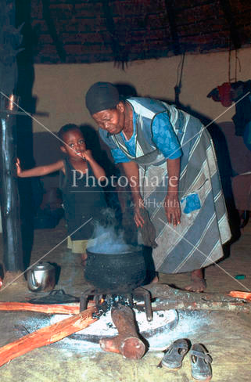
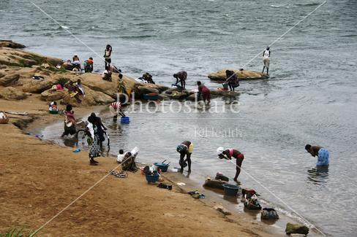
The Importance of Environmental Health
Burden of the disease in low and middle-income countries
Unsafe water, hygiene, and excreta disposal
Urban air pollution
Indoor smoke from household use of solid fuels
Leading causes of death in low- and middle-income countries linked with environmental factors:
3rd-Lower respiratory infection
6th-Chronic obstructive pulmonary disease
7th-Diarrheal disease
Notes:
8.4% of the total burden of disease in low and middle income countries are result of three environmental conditions and they are unsafe water, hygiene, and excreta disposal. Among the leading causes of death in low and middle income countries, lower respiratory infections, obstructive pulmonary disease and diarrhea bear significant share and all these are very closely related with environmental factors.

Slide 3
Key Concepts
Environment - “external physical, chemical, and microbiological exposures and processes that impinge upon individuals and groups and are beyond the immediate control of individuals.”
Environmental health - efforts that are “concerned with preventing disease, death, and disability by reducing exposure to adverse environmental conditions and promoting behavior change. It focuses on the direct and indirect causes of disease and injuries and taps resources inside and outside the healthcare system to help improve health outcomes.
Notes:
When we try to define environment in the context of health, it usually define everything around us except the genetic factors. Now if say environmental health, we usually refer to a set of public health efforts that are directed to prevent disease, death, and disability and promote health by informing about the resources existed within and outside of health care system that have the potential to achieve the desired goals of health.

Slide 4
Environmental Health in Low- and Middle-income Countries
Populations residing in these settings have an increased exposure to poor air quality, hazardous waste and pollutants, and elevated levels of contaminated water and soil (See: Evans & Kantravitz, 2002; WHO, 2011; Calderon et al., 1993, Sigman & Stafford, 2010; Ezzati et al., 2005).
Socioeconomic status is associated with environmental risk exposure which inversely contributes to adverse health effects (See: Evans & Kantrowitz, 2002).
Exposures often have a long latency period and effects vary according to the amount of time an individual has been exposed (See: Marmot, 2006).

Slide 5
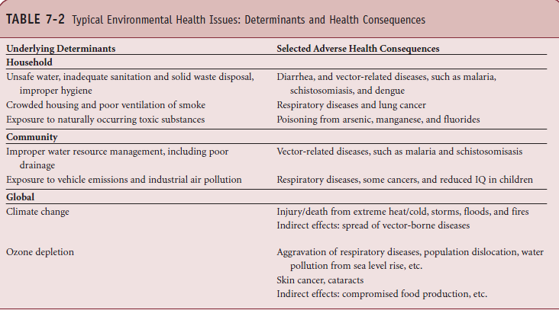
Typical Environmental Health Issues
Source: Adapted with permission from The World Bank. Environmental Health. Available at: http://web.worldbank.org/WBSITE/EXTERNAL/
TOPICS/EXTHEALTHNUTRITIONANDPOPULATION/EXTPHAAG/0,,contentMDK:20656146~menuPK:2175463~pagePK:64229817~piPK:6422
9743~theSitePK:672263,00.html. Accessed October 27, 2006.
Key Concepts
97515_
Notes:
This table highlights some examples of environmental health issue, their determinants and consequences.

Slide 6
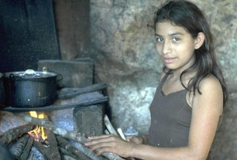
Key Environmental Health Burdens
Indoor Air Pollution
Half of all people in the world depend on solid fuel for cooking and heating.
Poorer people tend to use open stoves that are not vented to the outside.
Short-term problems include conjunctivitis, upper respiratory infection, acute respiratory infection, and carbon monoxide poisoning.
Long-term associations include cardiovascular disease, chronic obstructive pulmonary disease, and cancer.
Notes:
Half of the world’s population uses solid fuel like fossil fuel coal, biomass fuel of cow dung, wood logging waste, for their cooking and heating. Poorer families where people cannot afford improved stoves are the most health risk ones. Biomass fuels leave behind particles, various gas and chemicals that causes conjunctivitis, UTI, and acute respiratory infections. In the long run exposure to such indoor pollution leads to cardiovascular disease, COPD, adverse reproductive outcome and cancer.
The WHO estimates that in 2005 some 4 million people died of COPD with exposure to biomass fuels as the biggest risk factor in low and middle income countries.

Slide 7
Key Environmental Health Burdens
Outdoor Air Pollution
Common effects are respiratory systems, including cough, irritation of nose and throat, and shortness of breath
Older and younger people tend to be more susceptible
Deadly London Fog (13:49)
http://www.youtube.com/watch?v=Vkx-2mT1-q4
Notes:
Like indoor air pollution, outdoor air pollution is also responsible for significant adverse health effect like respiratory conditions starting from irritation of eyes and nose, shortness of breath etc. Outdoor air pollution exacerbates the existing diseases like asthma. Heavy outdoor air pollution even for a short period of time has proven to be associated with considerable mortality. The highly cited example is London fog, which occurred on 1952 in London, England. Because of temperature inversion, a dense fog, full of pollutant hung over the city center for several days and caused death rate more than four times of normal death rate of that period.

Slide 8
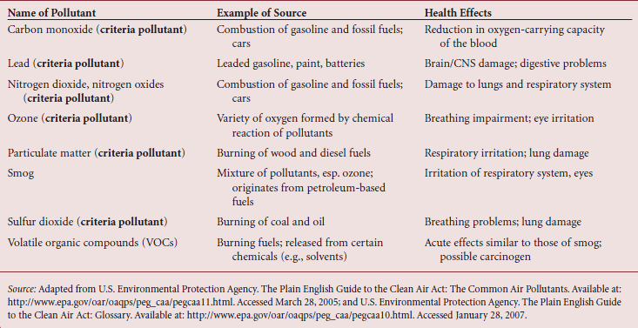
Common Air Pollutants
Notes:
This table indicates some of the most common pollutants in outdoor air, their sources and the most important health effect.

Slide 9
Key Environmental Health Burdens
Sanitation, Water, and Hygiene
Only 60% of people in the world have access to improved sanitation.
Poor sanitation leads to increase in pathogens through oral-fecal route, spread of parasitic worms, and trachoma.
One billion people lack access to safe water sources.
Waterborne pathogens are associated with diarrhea and other gastrointestinal problems.
Notes:
Only 60% of the world’s population has access to safe water. Many of the large cities in Africa do not have modern sanitation system, a large share of people in Asia do not have access to sanitary disposal of human waste. Failure to dispose human waste properly is associated with diseases like diarrhea, intestinal parasites, and trachoma. Failure to improved sanitation is also responsible for the diseases that we just mentioned. More than a billion of people on low and middle income countries do not have access to safe water within a reasonable distance from home and the water that they have access to even if seems safe contains significant number of pathogens.

Slide 10
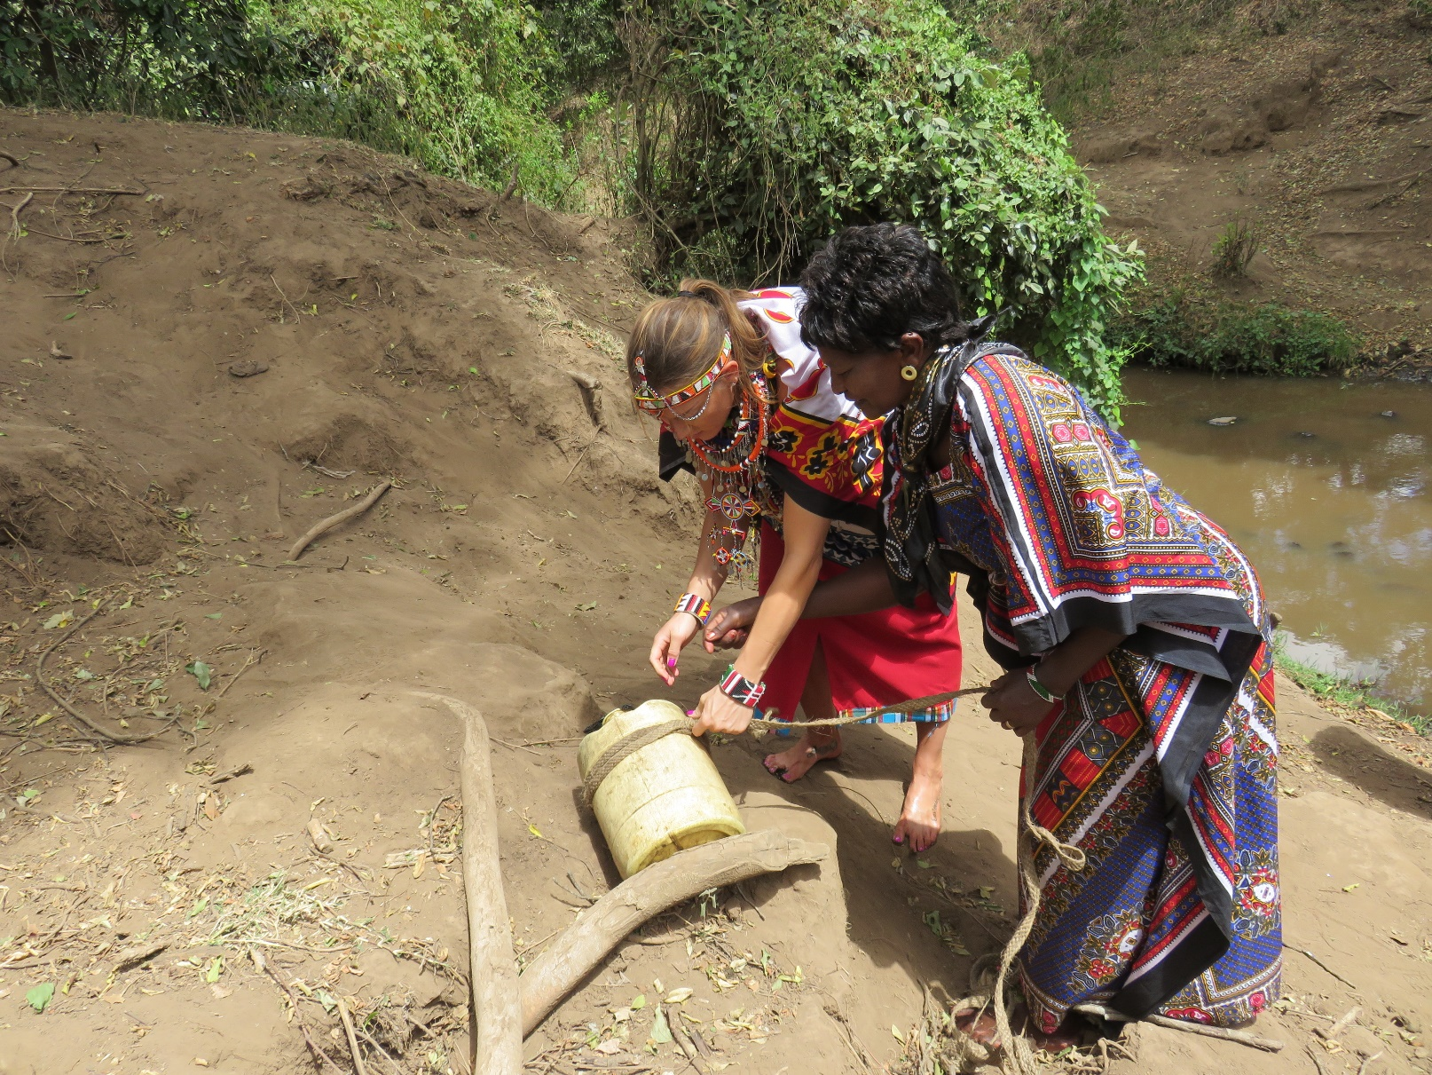
Poor access to water, as shown in Narok, Kenya.
Notes:
In this picture, I went and gathered water with the local tribe in the village in Kenya.

Slide 11
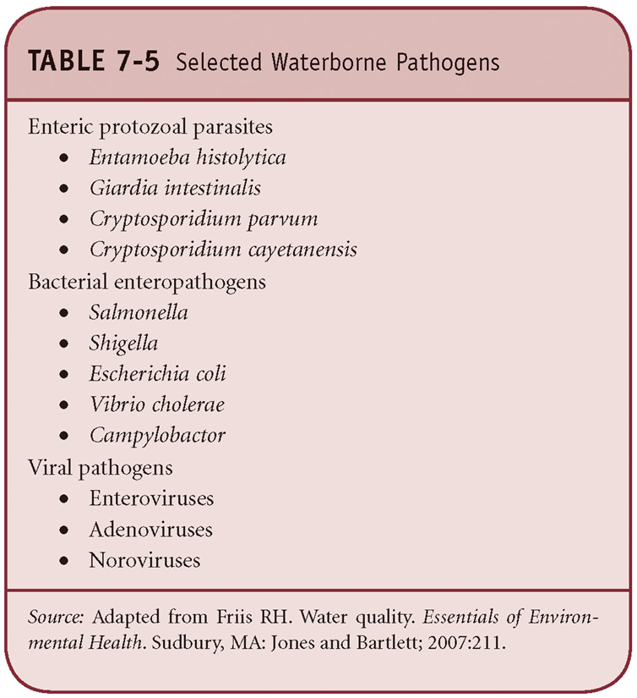
Waterborne pathogens
And
Water-related infections
Notes:
These two tables listed here show some selected waterborne pathogens and classification of water related infections.

Slide 12
Burden of Environmentally Related Diseases
Sanitation, Water, and Hygiene
3.2% of annual deaths, 3.7% of burden of disease.
Poor and less well-educated of South Asia and sub-Saharan Africa are the victims.
Closely linked with diarrheal disease.
Indoor Air Pollution
3.7% of annual deaths.
3rd most important risk factor in high mortality low- and middle-income countries.
59% of all deaths attributable to indoor air pollution are among females.
Urban Outdoor Air Pollution
1.5% of annual deaths, 0.5% of burden of disease.
India and China have major burdens of disease related to outdoor air pollution, along with other countries in Asia and Eastern Europe.
About 8% of the global burden of disease is associated with environmental factors.
Notes:
Though it was thought that outdoor pollution is responsible for respiratory diseases, in reality exposure from indoor air causes 1.6 million death in low and middle income countries. It is also estimated that 59% of all the deaths that are due to indoor air pollution are occurring among women. The next victim of indoor air pollution is children as they are being carried by the mother or they spent time indoor with mother while they cook.
As for outdoor pollution, India and China have major burden of the disease that is related with outdoor pollution. It is estimated that low and middle income countries in Asia share about two thirds of the global burden of diseases that are caused by outdoor pollution.

Slide 13
The Costs and Consequences of Key Environmental Health Problems
Social and economic consequences are enormous.
Burden falls disproportionately on relatively poor people.
Negative consequences on productivity.
Notes:
The social and economic consequences of environmental health problems are enormous. On top of that, burden falls disproportionately on relatively poor people. It is the poor people who cook with biomass fuel and suffer the consequences. Similarly, low income countries suffers the burden most, not the high income ones. Environmental health burdens have negative consequences on productivity. Women and children suffer the most from the diseases that are emerged from being in unhealthy environment and their morbidity, mortality, and disability are the most.

Slide 14
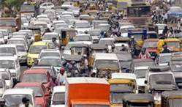
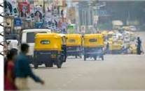
Reducing the Burden of Disease
Outdoor Air Pollution
Introduction of unleaded gasoline.
Low-smoke lubricant for or banning of two-stroke engines.
Shifting to natural gas to fuel public vehicles.
Tightening emissions inspections.
Reducing the burning of garbage.
It will be cost-effective for countries without a significant burden yet to minimize pollution, instead of mitigating its effects later.
Notes:
Some of the measures that already have been taken by couple of low income and middle income countries to reduce outdoor air pollution are-
Introduction of unleaded gasoline
Low-smoke lubricant for or banning of two-stroke engines
Shifting to natural gas to fuel public vehicles
Tightening emissions inspections
Reducing the burning of garbage

Slide 15
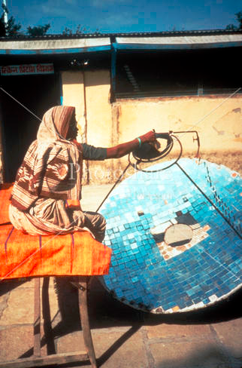
Reducing the Burden of Disease
Indoor Air Pollution
Improved cooking devices.
Use of less polluting fuels.
Reducing need for fuels by using solar cooking and heating.
Mechanisms for venting smoke.
Using dried fuels for cooking.
Keeping children away from cooking area.
Public policies that encourage these practices.
Notes:
There are a number of ways that could be adopted to reduce the burden of indoor air pollution in low income countries. Among them are to reduce the use of biofuel, using improved cooking device, using solar energy, keeping children away from the cooking place, moving away the kitchen from the main parts of the house and above all, having government policies or incentives to implement such thoughts into action. In this picture, a woman uses hand made solar cooker in India.

Slide 16
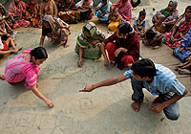
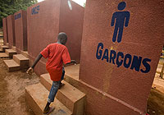
Reducing the Burden of Disease
Sanitation
Simple methods of sanitation and excreta disposal are low-cost and relatively effective.
Barriers include lack of knowledge, cost, construction, and local laws.
Government subsidies and regulations for installing latrines.
Promotion through public-private partnerships headed by NGOs.
Notes:
Sanitation could range from the simple technology of bucket latrines to modern urban sewerage system. Latrines like pour flush, simple pit, and ventilation improved ones could be constructed for about $60. Even this small amount of money may not be an option for low income countries where people live for $2/day . So work has been going to find more cost effective latrines and in Bangladesh, they already developed one which cost only 27 cents per household. Even with the low cost, improved sanitation implementation remains challenge as there could be barriers like lack of knowledge or local laws. Government needs to come forward and take necessary steps to promote the use of sanitary latrines and to provide subsidies if needed for the needy ones for the betterment of the society.
In these pictures, a community hygiene promoter in northern Bangladesh, assists residents in drawing a water and sanitation social map
Separate latrines for girls and boys in a UNICEF supported school in Senegal

Slide 17
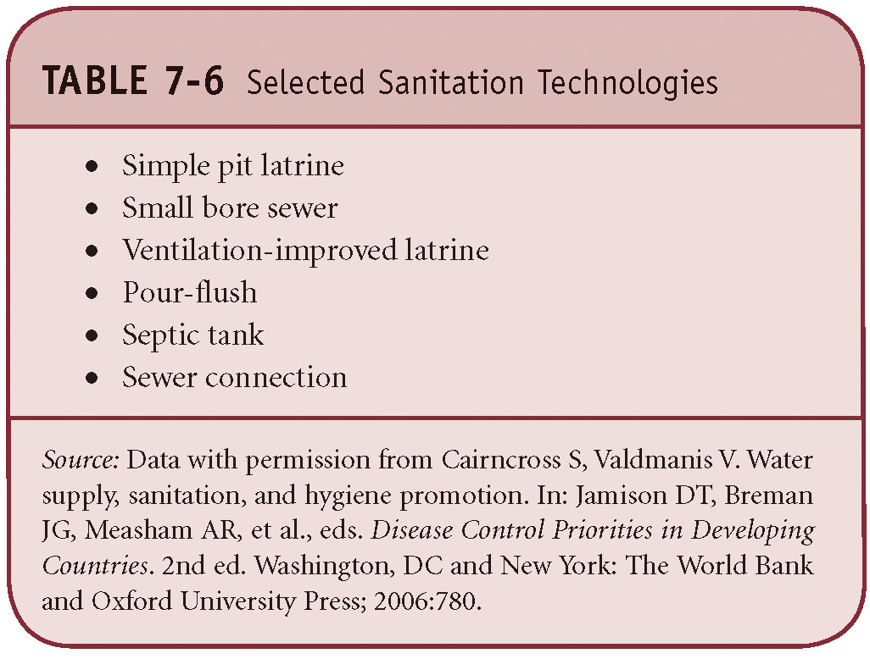
Selected Sanitation Technologies
Data from Cairncross S, Valdmanis V. Water Supply, Sanitation, and Hygiene Promotion. In: Jamison DT, Breman JG, Measham AR, et al., eds. Disease Control Priorities in Developing Countries. 2nd ed. Washington, DC and New York: The World Bank and Oxford University Press; 2006:780.
Notes:
This table lists some different approaches to excreta disposal.

Slide 18
Reducing the Burden of Disease
Water Supply
Continuous supply of water with good bacteriological quality can reduce morbidity of a number of diseases.
However:
Largest reductions in diarrhea morbidity come from investments in sanitation only, sanitation and water, or hygiene only.
Lowest reductions in diarrhea morbidity come from investments in water only.
Don’t forget hygiene if you want to capture water and sanitation benefits.
Notes:
Improving water supply can lead to variety of health benefits. Continuous water supply with good bacteriological quality can reduce the number of morbidity. Though the quality of the water matters, it was shown through research that significant success in disease morbidity comes from sanitation only, water and sanitation or hygiene only. This is why it is critically important to integrate hygiene and sanitation with the quality of water for the maximum benefit.

Slide 19
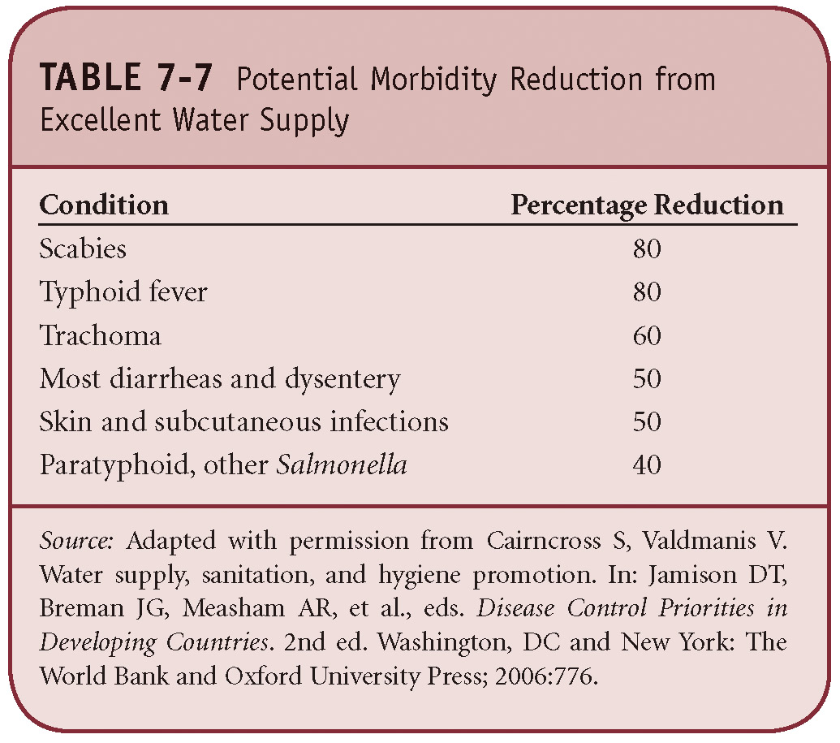
Potential Morbidity Reduction from Excellent Water Supply
Adapted from Cairncross S, Valdmanis V. Water Supply, Sanitation, and Hygiene Promotion. In: Jamison DT, Breman JG, Measham AR, et al., eds. Disease Control Priorities in Developing Countries. 2nd ed. Washington, DC and New York: The World Bank and Oxford University Press; 2006:776.
Notes:
This table lists here potential morbidity reduction that could be achieved from quality water supply.

Slide 20
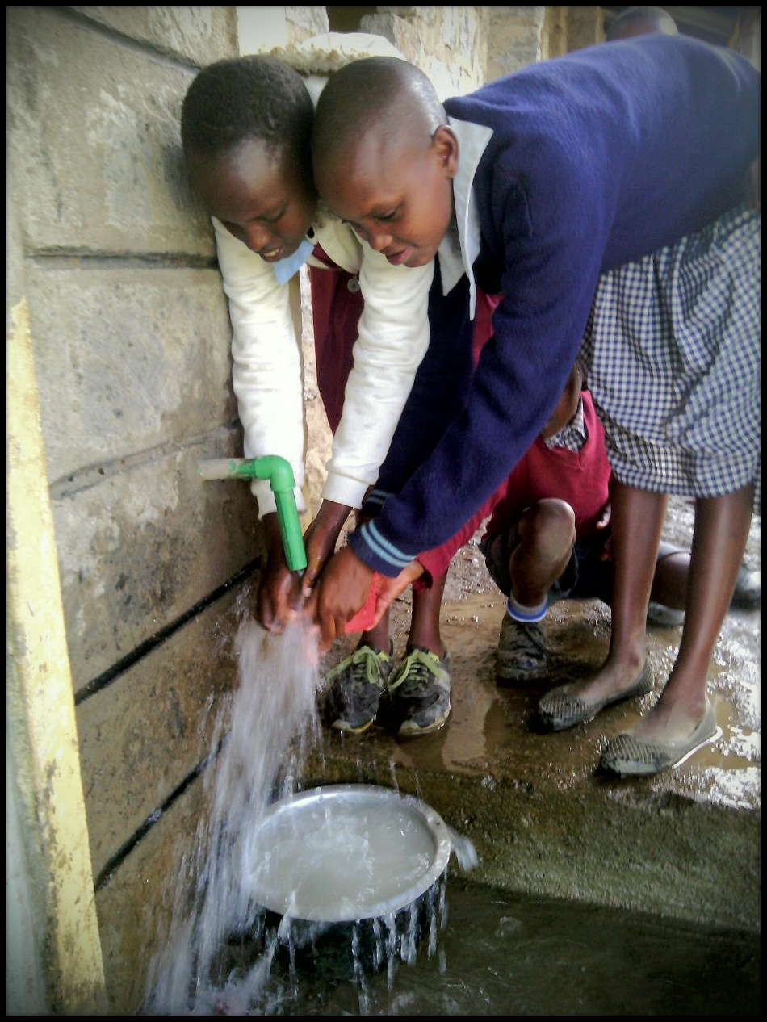
Clean Water
A household tap has been piped to a nearby school in Narok, Kenya. This tap serves 500 children who attend this primary school.
The Shepherd’s Village is an example of a successful nonprofit working to provide access to quality water in Kenya.
A professor at National University is the Vice President, see more info http://www.theshepherdsvillage.org/
Notes:
Here is an example of safe water supply in a village of Kenya. There are over 44 million people in Kenya. Approximately 45% of this population does not have access to quality water and 71% does not have access to proper sanitation.

Slide 21
Reducing the Burden of Disease
Hygiene
Hygiene promotion can lead to a 33% reduction in diarrhea morbidity.
Focus should be on simple messages about hand washing and enabling hand washing.
Washing hands for health (2:17):
http://www.youtube.com/watch?v=Hfnx--r05qE
Notes:
Investing in hygiene could lead to 33% reduction in diarrhea. Simple measure like hand wash could reduce the incidence of water borne and respiratory diseases.

Slide 22
Reducing the Burden of Disease
Integrating Investment Choices about Water, Sanitation and Hygiene
Hygiene - important for its own sake and to maximize effect of other investments.
Sanitation - government promotion of low-cost sanitation schemes.
Water - development of low-cost water supply schemes.
Notes:
Promotion of hygiene, promotion of sanitation, and construction of low cost water supply systems are likely to be very cost effective in low income countries.

