Slide 1
Ethical and Human Rights Concerns in Global Health
Chapter Four
Notes:
Chapter four: Ethical and human rights concerns in global health.
As with any area of health, global health is affected by the issues of ethics and right for sound health outcome. In this chapter we will explore ethical and human rights concerns, some of the central treaties and conversions related to human rights, some historically significant cases in human subject research and key principles for making critical decisions in health research.

Slide 2
The Importance of Ethical and Human Rights Issues in Global Health
Failure to respect human rights is often associated with harm to human health
Health research with human subjects puts people at risk for the sake of other people’s health
Health investments must be made in fair ways since resources are limited
Notes:
Access to the health care is human right and failure to respect this right might causes harm for health. For example, the stigma associated with HIV, TB and leprosy makes it difficult for the patient to obtain necessary health care, it not only cause harm to individual health but as a whole community health even. For example, if a TB patient remains untreated by the health care workers, then that individual could be a source of infection for other people.
Health research with human subject in particular in low income countries where study participants may not have other option to obtain the medication might become a proxy of clinical trial for other people .Lastly, fair decision in health investment is critical because in low income countries where health resources are scare difficult decisions need to be made depending on the priority and severity of disease.

Slide 3
The Foundations for Health and Human Rights
Universal Declaration of Human Rights and other legally binding multilateral treaties
Governments are obliged to respect, protect, and fulfill the rights they state
Notes:
International Bill of Human Rights is the cornerstone for human rights. This bill include couple of documents including the Universal declaration of human rights that was officially declared in 1948, that place obligation on Government to respect , protect, and fulfill the rights of the state.

Slide 4
Selected Human Rights
The Rights-Based Approach
Assess health policies, programs, and practices in terms of impact on human rights
Analyze and address the health impacts resulting from violations of human rights when considering ways to improve population health
Prioritize the fulfillment of human rights
Notes:
In considering human right, first we are going to examine the issue of right based approach. Some global health advocates argue that this approach, which thinks that fulfillment of people’s human right is conducive to their health, should be followed in global health. This means we need to assess health policies, programs or practices in terms of its impact on human right and analyze the health impacts from the perspective of violation of human rights

Slide 5
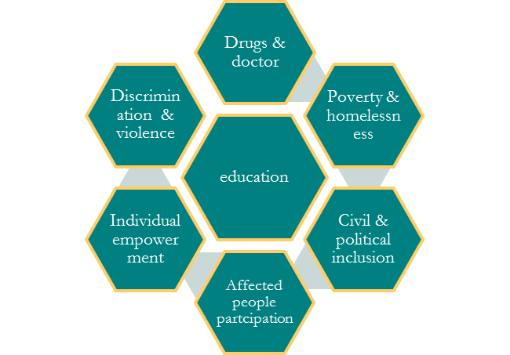
Notes:
The right based approach reminds us that promoting health is a synergistic approach where doctors and drugs, education, discrimination against violence, addressing the issues of poverty and homelessness, individual empowerment and the participation of affected people in health promotion intervention design each plays their role effectively.

Slide 6
Selected Human Rights
Limits to Human Rights
Circumstances in which someone’s rights may be temporarily suspended
Suspension of rights should be as narrow as possible
Suspension should be carried out with due process and monitored
Notes:
As it is important to protect human right, sometimes it is also important to limit rights to serve the bigger purpose. For instance, in influenza epidemic government might limit people’s right to leave their homes, go to work or travel to some other places for limiting the spread of the disease. However, the suspension of such right should be as narrow as possible, only practice in case of an emergency and it should be carried out with due process and monitoring.

Slide 7
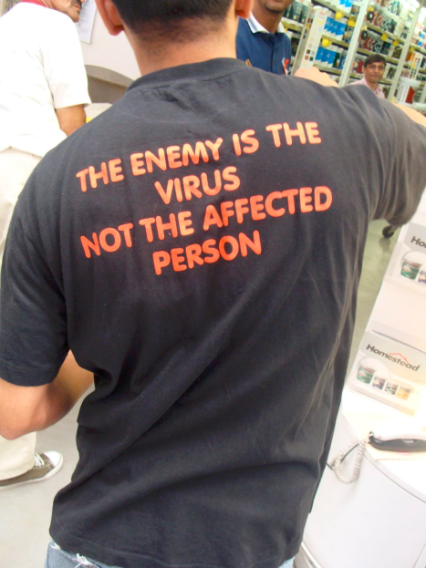
Selected Human Rights
Human Rights and HIV/AIDS
Health condition that is stigmatized and discriminated against.
Protecting the rights of people who are HIV-positive to employment, schooling, and participation in social activities.
Ensuring access to care.
Policies regarding testing.
Protection of confidentiality.
Notes:
HIV/AIDS is a health condition that is considered with stigma and discrimination in many parts of the world. As a result the HIV positive encounter discrimination in employment, schooling and participation in social activities. In some parts of the world the health care workers are poorly informed about HIV, as a result they are afraid to provide care for the affected people. Policies regarding HIV testing also faces questions related to protecting people’s well-being while respecting human rights. For many years HIV testing was voluntary and confidential. However, concerns have been raised regarding the voluntary option as it spreading through the people who do not know their status and increasing the chance of infecting many by having multiple partners.
Issues regarding the confidentiality are questionable too as by not disclosing the information to the spouse , the healthcare system may risk spreading of the infection to apparently healthy partner, on the other hand if the information is shared with the partner specially if wife is diagnosed with HIV/AIDS , husband/family might harm her, reject her or throw her out of the house.

Slide 8
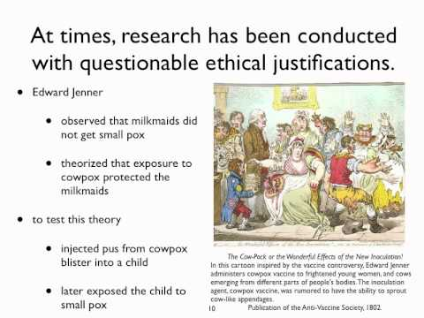
Research on Human Subjects
Most research studies don’t benefit the people who participate in them
Ethical concerns about putting participants at risk for the sake of other people’s health
Notes:
Heath research generate some ethical problems. Most research studies are not designed to benefit the participants, rather to gather knowledge and use them in future. This jeopardize the benefits of research.

Slide 9
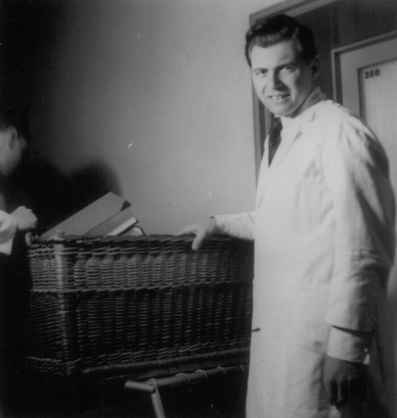
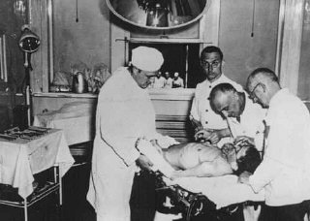
Key Human Research Cases
Nazi Medical Experiments
Conducted experiments on euthanasia victims, prisoners of war, occupants of concentration camps.
International Scientific Commission investigated and documented abuses after war.
Questions over whether it is ethical to use data the Nazis generated.
Josef Mengele -twin camp, Auschwitz
Experiments on POWs
Notes:
Now we’ll be talking about some research studies on human subject in medical history that raised ethical concern and encourage developing a guideline for future research. The Nazi Medical Experiment is the first of this kind. Hitler’s Nazificaion not only included German society but also research institutions, universities, and the medical profession. German medical researchers conducted many experiments on euthanasia victims, prisoners of war, occupants of concentration camp by deliberately infecting prisoners with diseases like TB and malaria. Josef Mengele, as a camp doctor, studied around 900 children and conducted operations on children without anesthetics, killed children’s siblings and infected children with disease agents. Following the end of 2nd world war , 23 scientist were charged with war crime and crime against humanity of whom seven were sentenced to death and hanged.
Most of the scientist were not prosecuted and as a matter of fact they went on with their career. The data that were gather from Nazi research evoked some ethical concern regarding its qualitative value and ethical use.

Slide 10
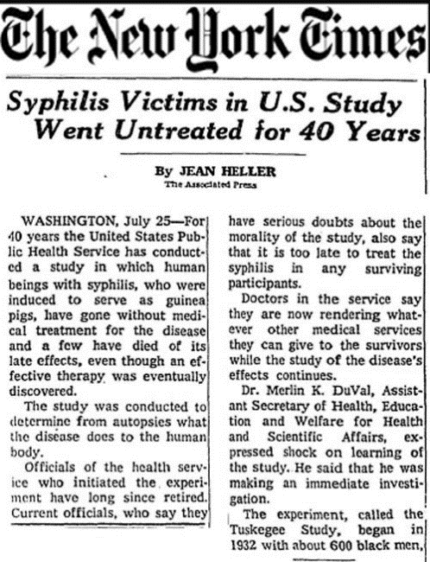
Key Human Research Cases
The Tuskegee Study
US Public Health Service conducted a study on the natural history of syphilis in African American men.
Participants were told they were being treated for “Bad Blood”
Study Sample: 399 with Syphilis, 201 without
Study went on for 40 years
Subjects were never given treatment
Movie made: Miss Evers’ Boys
Eventually led to regulations for human research subjects.
Notes:
U.S Public Health Services began a study in collaboration with the Tuskegee institute to justify the creation of syphilis treatment for African American.
600 African American men with and without syphilis took part in the study and they were told that they were being treated for “Bad Blood” a term used to describe syphilis, anemia and fatigue. However, they only received iron tonics to make them think that they were being treated. The original plan of the study was to watch the natural history of the disease for six month-it ended up continuing for 40 years. Participants had limited access to doctors and treatment options available, after world war II when penicillin was widely available, the PHS actively intervene to prevent them from getting the treatment. It was only 1972 when an article was published in NY times about the story of Tuskegee study, US Assistant Secretary for Health and Scientific Affairs appointed a committee to review the study. The study quickly brought to the end and in response to the class-action lawsuit filed by National Association for the Advancement of Colored People, the US government settled the lawsuit outside of court in $9 million.

Slide 11
Key Human Research Cases
The “Short-Course” AZT Trials
Trials of a “short-course” AZT regimen to prevent mother-to-child transmission of HIV
Some people thought that poor people were being exploited since the trials were taking place in low-income countries
Studies remain controversial
Notes:
After the recognition of effectiveness of antiretroviral therapy during pregnancy, a therapy which was able reduce the mother to child transmission by two thirds, it became the standard of care in developed countries. However, countries where HIV/AIDS rates are higher for them antiretroviral therapy became too complex and too costly to administer. As 15 trials were organized in developing countries through a meeting arranged by WHO, a test of short course AZT (antiretroviral drug Zidovudine) was introduced in Sub Saharan Africa. Controversy has started since then-those who oppose the short course regimen made a point that this would not be acceptable in developed countries, so they accused the sponsors of the short course AZT trials of ethical double standard. Those who are proponents of regimen defined their situation by saying that the regimen would not be accessible to the study participants in any other case and the reason of having a placebo groups are to prove the hypothesis that short course regimen is better than nothing at all and to assess the comparativeness of HIV mother to child transmission across different population.

Slide 12
Ethics Vs Life
Video:
http://video.pbs.org/video/1990304722
Medical Cost-Benefit Ethics
Expensive cancer-fighting drugs are sparking ethical debate about the tremendous costs and small benefits of some new treatments.
Notes:
Watch the video to see the ethics related to a costly cancer treatment.

Slide 13
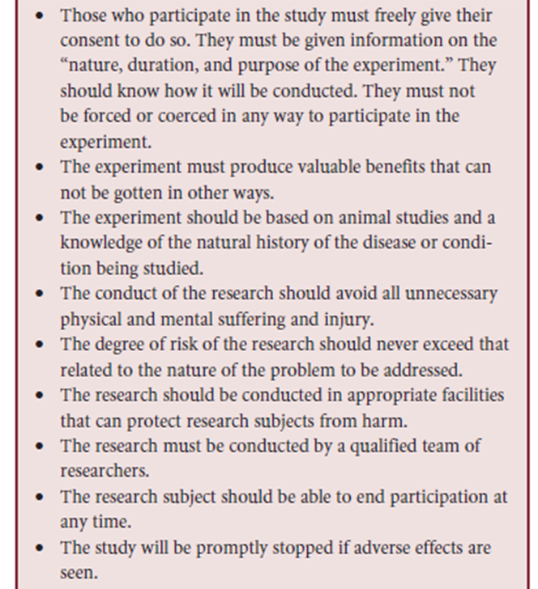
Research Ethics Guidelines
The Nuremberg Code
First document to specify ethical principles that should guide physicians engaged in human research
“Voluntary consent of the human subject is absolutely essential”
Notes:
Nuremberg trial lead the US judges to issue Nuremberg Code. This was the first document that specify the ethical principles that should guide physicians engaged in human subject research. It made sure that voluntary consent of the human subject is absolutely essential.

Slide 14
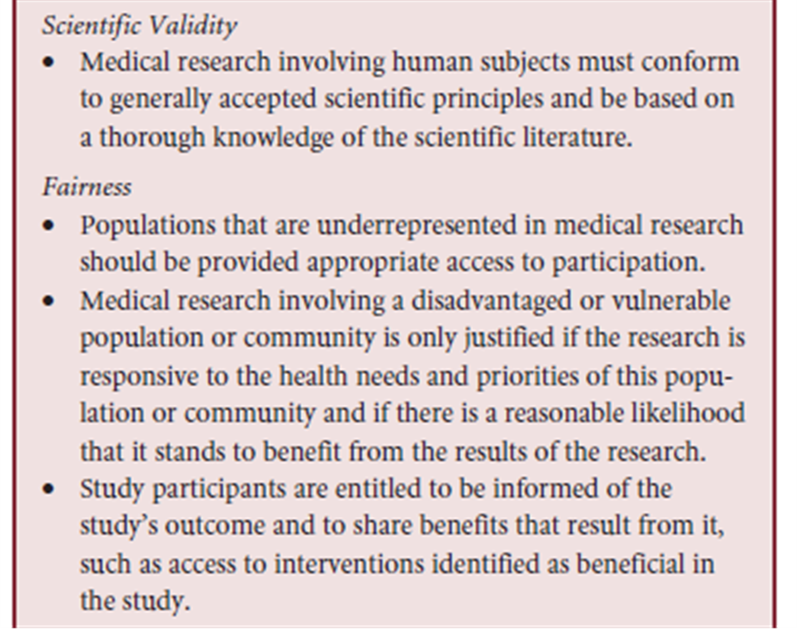
Research Ethics Guidelines
The Declaration of Helsinki
Developed ethical principles to guide physicians conducting biomedical research on humans
Principles apply equally to non-physicians
Notes:
In 1964, World Medical Association developed a set of guidelines for the physician conducting biomedical research with human subjects. This set of guidelines went through several revisions with including the non-physician as well to follow these guidelines.

Slide 15
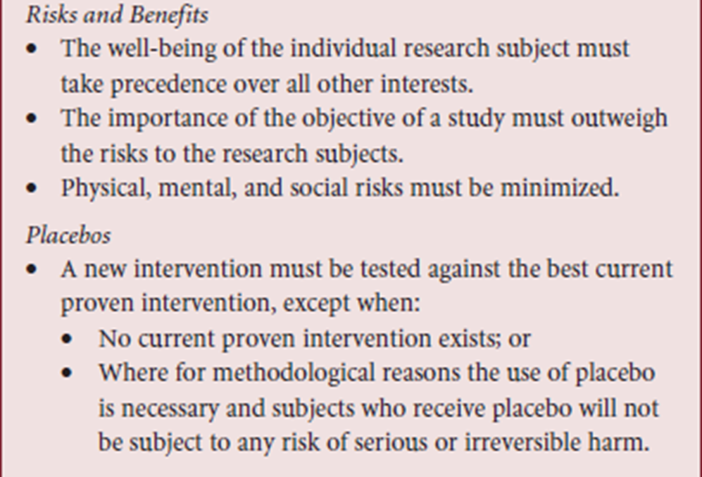
The Declaration of Helsinki: Key Principles (cont.)
Notes:
Discuss this slide

Slide 16
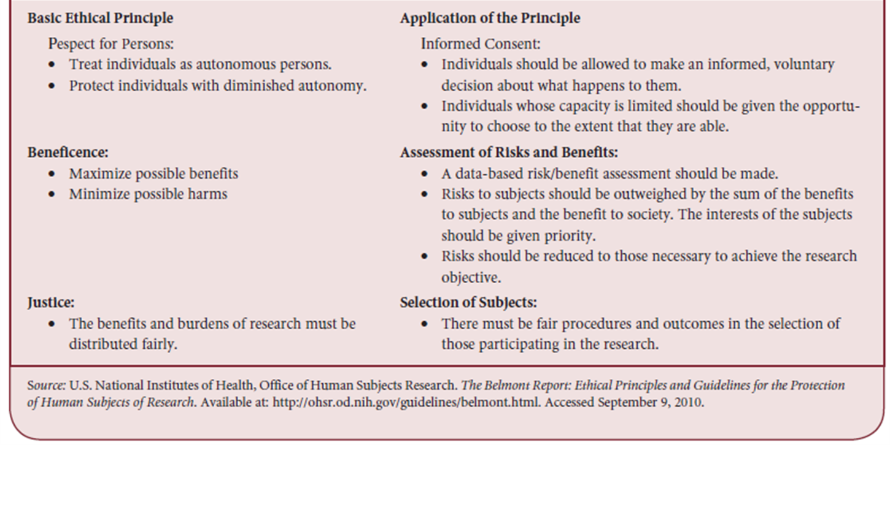
Research Ethics Guidelines
The Belmont Report
US National Commission for the Protection of Human Subjects of Biomedical and Behavioral Research
Identified basic ethical principles
Developed guidelines for research
Notes:
The Belmont report was created by U.S. National Commission for the protection of human subjects of biomedical and behavioral research. The commission also developed guidelines for the researchers so that all human research would conform to the principles identified.

Slide 17
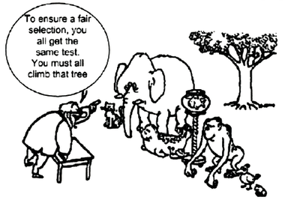
Evaluating the Ethics of Human Subjects Research
Clinical research protocol must satisfy six conditions:
Social value
Scientific validity
Fair subject selection
Acceptable risk/benefit ratio
Informed consent
Respect for enrolled subjects
Notes:
The framework for research mentioned here is developed based on Belmont Report which should help one to systemically think through the ethical process of research. A study should be of social value meaning it should ask the questions that are important and beneficial for the society. It should also have scientific validity by ensuring proper methodology. Subject selection should be fair with caution regarding the vulnerable populations. The risk of participating in the study should be thoroughly checked and should be as minimum as possible. Voluntary informed consent is a must, participants should make aware about all the key elements of research. Researcher must respect the participant’s right to withdraw from the study any time, protect their confidentiality and show respect to any other situation as they arise.

Slide 18
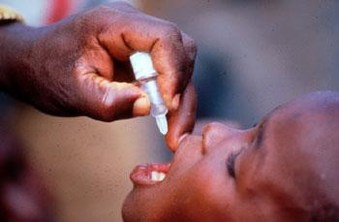
Evaluating the Ethics of Human Subjects Research
Research in Low- and Middle-Income Countries
Important issues when the subjects are likely to be poor, under-educated and without access to good care:
Standard of care
Post-trial benefits
Ancillary care
Notes:
Some important issues come up as the research is done in low and middle country setting. In cases of new drug trial where one group of participants receive a new drug while the other group does not, or receive the established treatment or placebo that raises a lot of debate. In cases where patients do not receive any care after the trial ends, and there is chance that without the medication, the patient might deteriorate, that poses ethical dilemma. In most of the low and middle income countries the clinical trial may be the only source of medication for the poor. As for ancillary care, they are not the part of the original design of the trial however, researchers are faced with providing ancillary care for the patients other than what disease they are studying. This again happens in low and middle income countries where diseases like pneumonia, diarrhea, parasitic infections are very common.

Slide 19
Evaluating the Ethics of Human Subjects Research
Human Subjects Research Oversight Today
Ethical review by a research ethics committee(REC)
Safeguard against exploitation
Regulations vary from country to country
Notes:
In majority of the countries it is a legal requirement for most clinical research to undergo independent ethical review by a research ethics committee. They are also named as research ethics board, institutional review board or an independent ethics committee. Such committees are deigned to provide safeguard for human subjects in research. The regulations designed by the ethics committee differ from country to country.

Slide 20
Ethical Issues in Making Investment Choices in Health
Resources will always be fewer than needed to meet everyone’s health needs.
Government ministries have tight budgets and need to decide how to allocate funds among options.
Better that the choices be made according to explicit, publicly justified criteria.
Cost-effectiveness analysis.
Notes:
A central issue in global health is the need to make right choices that can enhance the health of a population. Resources will always be fewer than needed to meet everyone’s health needs and government ministries always have tight budgets and need to decide how to allocate funds among options. It is better that the investment choices, that are made in heath, be made according to explicit, publicly justified criteria. Cost effective analysis is an important tool for making health investments.

Slide 21
Ethical Issues in Making Investment Choices in Health
Principles for Distributing Scarce Resources
Most plausible allocation proposals is justified by at least one of these ethical principles:
Health maximization
Equality
Priority to the worst off
Personal responsibility
Notes:
When allocating resources like health, it is best if one could follow at least one of the three principles mentioned here. Health maximization is the way that when resources is allocated the beneficial impact on health should be as large as possible. Principals of equity tells us we should try to ensure that everyone has an equal chance at receiving health care resources. In make the equity process easier, it is advisable by some that priority should not be given to the worst off because it makes existing health disparity ever more serious. Lastly it is suggested that personal responsibility should be a basis for allocation of health resource.

Slide 22
Ethical Issues in Making Investment Choices in Health
Fair Processes
Transparency about how decisions are made.
Representation from stakeholders affected.
Appropriate use of scientific data.
Notes:
Fairness is expected everywhere, in politics, in justice, in health. A fair process will involve transparency about how decisions are made and representation from stakeholders affected.

Slide 23
Future Challenges
Students of global health get insufficient exposure in their training to ethical issues.
No mechanisms of enforcement of humans rights.
Shortage of trained personnel for reviewing research.
Lack of reviews of how investments are made.
Unsolved ethical problems.
Notes:
To incorporate ethics and right into global health workforce there remain a number of challenge. First, students of global health get insufficient exposure in their training to ethical issues. They do not understand the concept of research and how an institutional review board works. Second, there is no established measurement guideline to assess the extent of compliance to human right in biomedical research. There is shortage of trained personnel for reviewing research-research committee are often underfunded, understaffed and underdeveloped. The final challenge global health workers face is unsolved ethical problem. There is no clear definition regarding the human rights in global research in particular in low and middle income countries.

