Slide 1
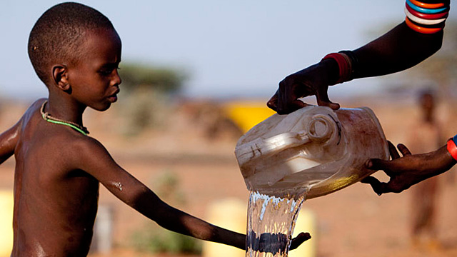
Water and Relationships: A qualitative study in Kitui, Kenya Tara Rava Zolnikov, PhD, MS, MS National University

Slide 2
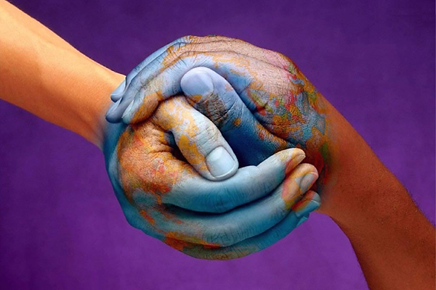
Introduction.

Slide 3
11% of the world’s population
(780 million people)
lack access to safe or affordable drinking water. ^{(WHO, 2012)}

Slide 4
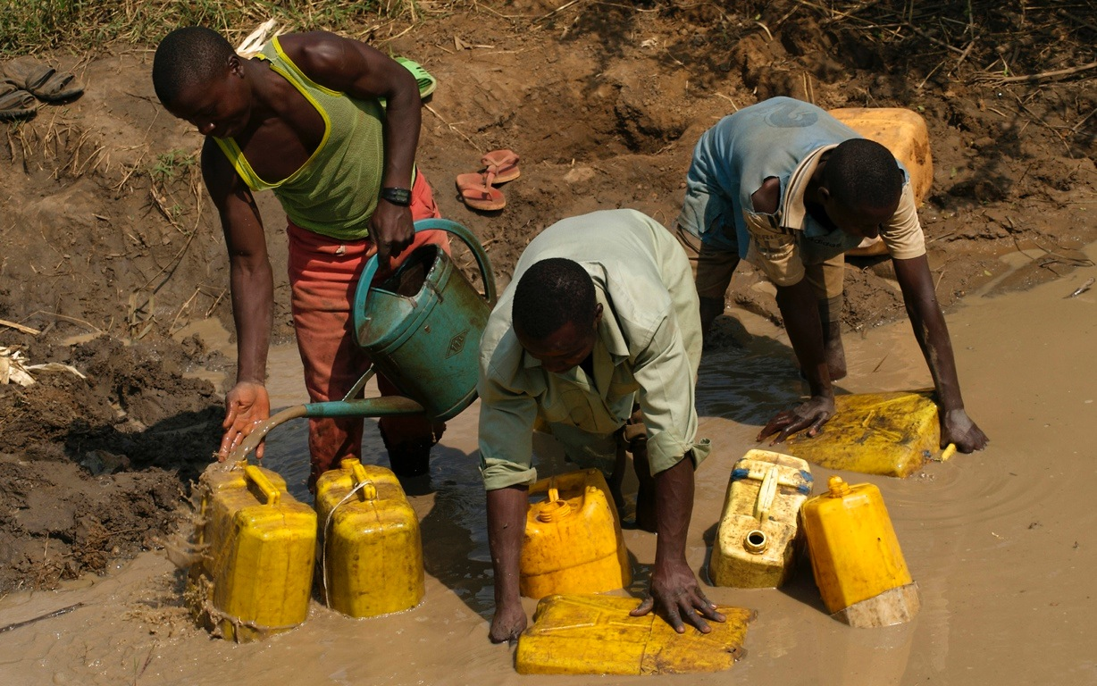
Water.

Slide 5
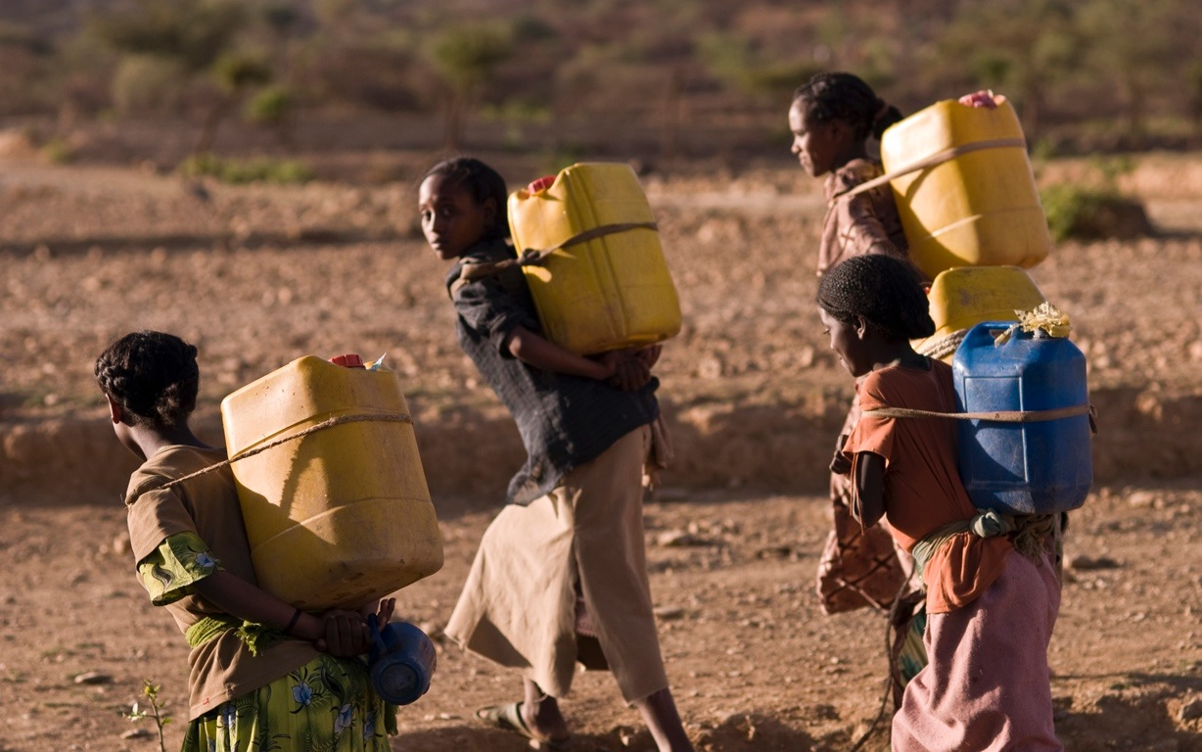

Slide 6
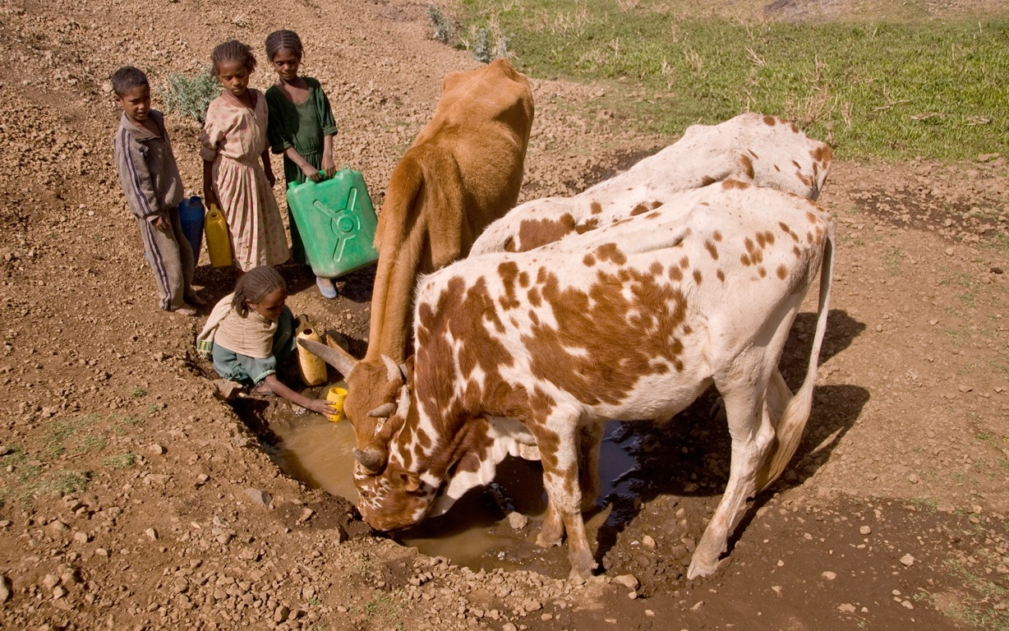

Slide 7
Purpose.
Providing nearby access to safe drinking water is a primary public health concern and a frequent public health intervention throughout Sub-Saharan Africa; access to water eliminates long gathering and transport time and provides an individual with more personal time.

Slide 8
Purpose.
This study used a phenomenological approach to expose relationship experiences among primary water gatherers and their families after the implementation of a water intervention in the community.

Slide 9
Methods.

Slide 10
Methods.
52 semi-structured interviews of households were conducted in Kitui, Kenya.
Households included 2 heads of households and 2 children.
Notes:
You can delete the bit about informed consent

Slide 11
Interviews, records, codes, themes.
Interviews were conducted and audio recorded.
Audio records of each interview were transcribed, complete with additional contextual information.
Interviews were hand-coded and later developed into a theme.
Themes were analyzed and rechecked by the researcher.

Slide 12
Kitui, Kenya.
Ikutha

Slide 13
Interview Questions.
Q’s depended on position in household, a few general Q’s included:
How have things in your house changed since the water project?
Do you like the water project?
Since the water project, has your relationship with any family members changed?
Do you have the same amount of time with your family?
Do you feel there are changes in your family because of the water project?
Since the water project, has your relationship with any of your friends changed?

Slide 14
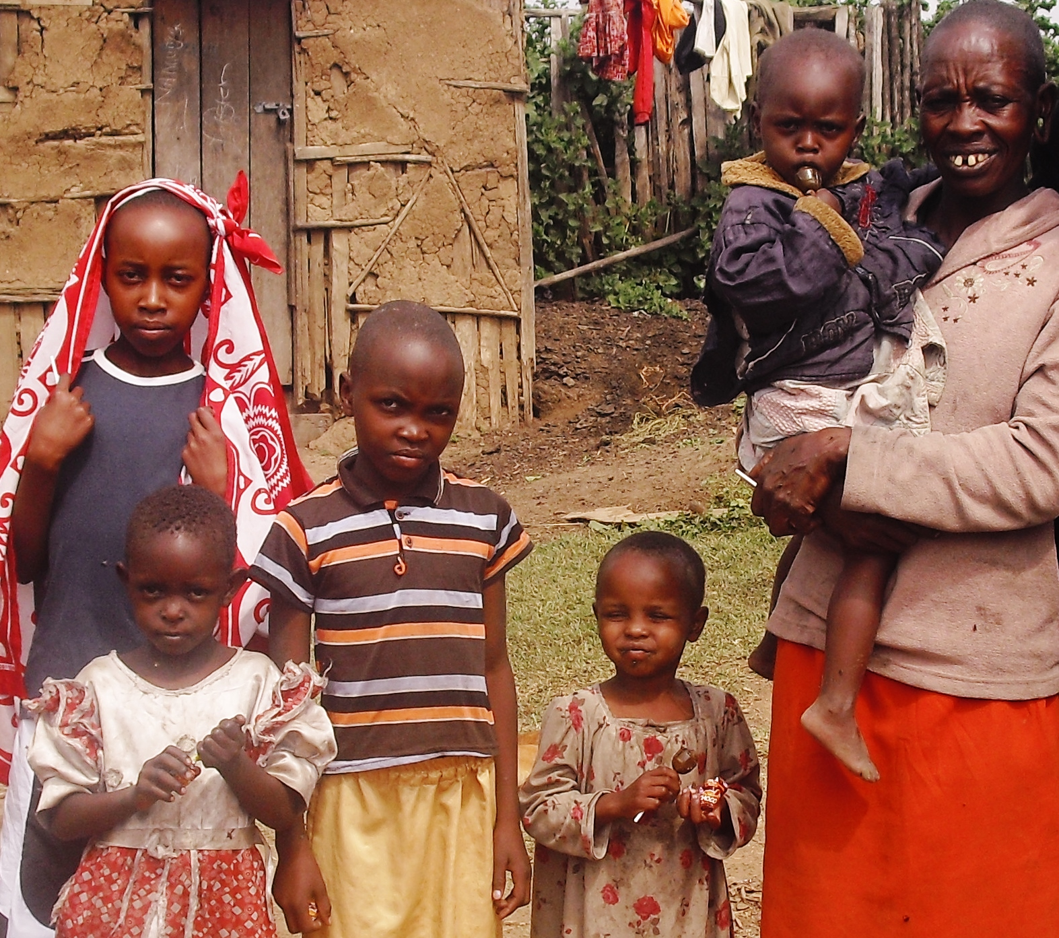
Results.

Slide 15
Participants.
52 community members (25 males and 27 females) were recruited.
The average family size was 9 individuals.
Ethnically, all participants were from the Kamba tribe.
Participants lived within various socioeconomic statuses.
Participants were broken up into three groups: head of household, primary water collector, and children.
13 head of households were interviewed; the average age of the household head was 52.
15 primary water gatherers were interviewed; 4 were children and 11 were female head of household; the average age was 36 years old.
24 children were interviewed; the average age was 16.

Slide 16
First research development.
Improved relationships in Eastern Kenya from water interventions and access to water
Notes:
4.3 IF
Social change

Slide 17
Before the water.
“I like that water. And, I even lack words to explain… because as I said, previously I used to go to Athi River for 4 hours and come back with 25 liters of water. Imagine 25 liters of water with a family of 10 people. This… you wouldn’t have water to bath, to clean the clothes, it was only for cooking and drinking. So, I can’t fail to love and like this water. And everybody in this community is like me because we were all facing the same thing.” (Participant 12.4)
Notes:
Do you say anything about the results before or after reading the quotes?

Slide 18
Before the water.
“We had little opportunity to talk because I was busy- I had to cook, had to go to the farm, had to prepare… there was no time to talk and be together.” (Participant 13.2)

Slide 19
After the water.
“We have more time because the time taken to collect water is not more than an hour. So, me and my family, we are able to have more time together- discuss and agree on issues regarding the development of our family. I think the water has brought us more closer together as a family.” (Participant 3.1)

Slide 20
After the water.
“She [my wife] is getting more time now to be with our family because previously, you couldn’t find both [of us] in the home because she had gone to collect water and I had to go do work. We had minimal time to stay together. Now, with the water nearby, you can find us all at home.” (Participant 2.1)

Slide 21
After the water.
“We find our mom here, our dad comes from school and after, we are all here as a family. Nobody has gone to collect water. We feel, as a family, we are closer. We talk with our parents. If we have anything we were taught at school, we discuss. If we talk about a school fee we need, we can talk about it. At times, we used to talk to mom when she was cooking, she would say, ‘no wait- I’ll listen to you later’ and then she would forget. So, I feel better now. We have more time.” (Participant 13.3)

Slide 22
Second research development.
Access to water provides economic relief through enhanced relationships in Kenya
Notes:
Piggybacking
5.25 IF

Slide 23
Before the water.
“I used to lose business because when I went to the river, I would have to close my shop.”
(Participant 5.1)

Slide 24
After the water.
“I discussed with my husband last month that we would look for money to buy a greenhouse. This is way of scaling up to produce more fruit and vegetables to sell. People now are going to Ikutha to get these vegetables and fruits and instead, they can come here. We will be able to make money…” (Participant 5.1)

Slide 25
After the water.
“But towards the rains… I take that time to prepare my farm with my husband, in anticipation of the rains.” (Participant 15.2)
“Now I can go and prepare the farm before the rains come. Even when there is rain I can work in the farm and collect water in the evening- or I can collect in the morning and spend the rest of the time in the farm. So, this will make my crops grow well and I will have a good harvest.” (Participant 13.2)

Slide 26
After the water.
“When we discuss, we are able to share experiences and ways to help face those challenges. We support each other in activities like constructing a house, making bricks, digging terraces in the farm.” (Participant 15.4)

Slide 27
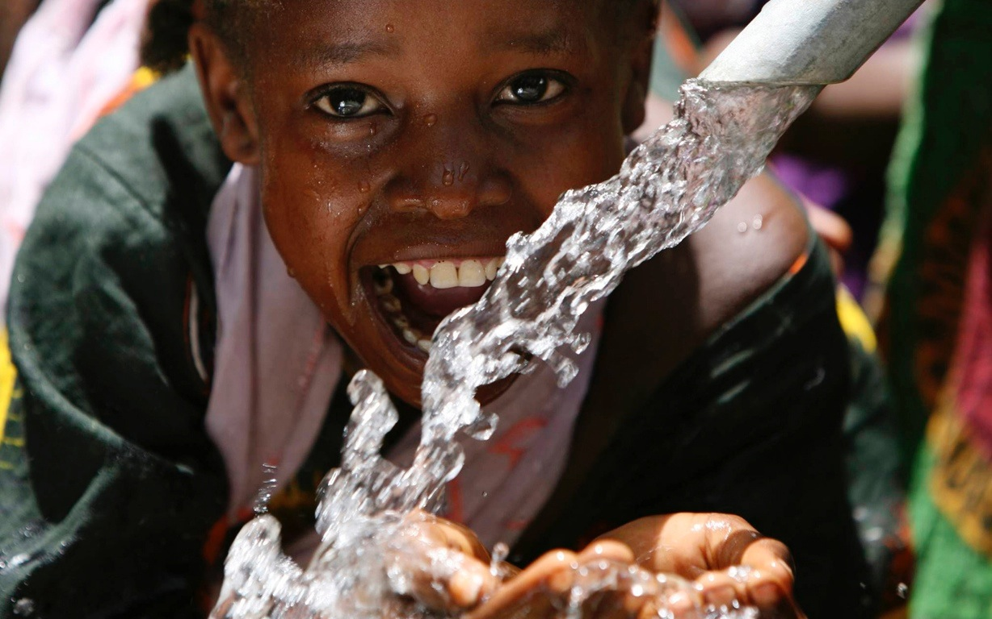
Discussion.

Slide 28
Water Interventions
Health Benefits
Less contaminants
Less waterborne diseases
Social Benefits
Economic benefits
Enhanced relationships

Slide 29
Discussion.
Results from this study indicated enhanced relationships by having more time together within household family units after H20.

Slide 30
Discussion.
Additional personal time → re-build relationships.
Newly established relationships → growth through family discussions and conversations understanding and providing solutions to economic or individual challenges.

Slide 31
Discussion.
In fact, when asked the simple question regarding changes in the family after receiving water, the majority of participants discussed their collaborations together as a family to work beyond economic challenges they experienced as a family.
Family resilience- families can move beyond life’s adversities and move together to avoid and reduce adverse outcomes and enhance functioning and well-being.
→Such resilience can aid in efforts to strengthen families in crisis and actually move beyond the issue and in this case, low socioeconomic conditions and gainful economic activities.
Basically, the re-established relationships resulting from access to water promoted a more active, stronger family through shared efforts.
Notes:
Can you condense this a little?

Slide 32
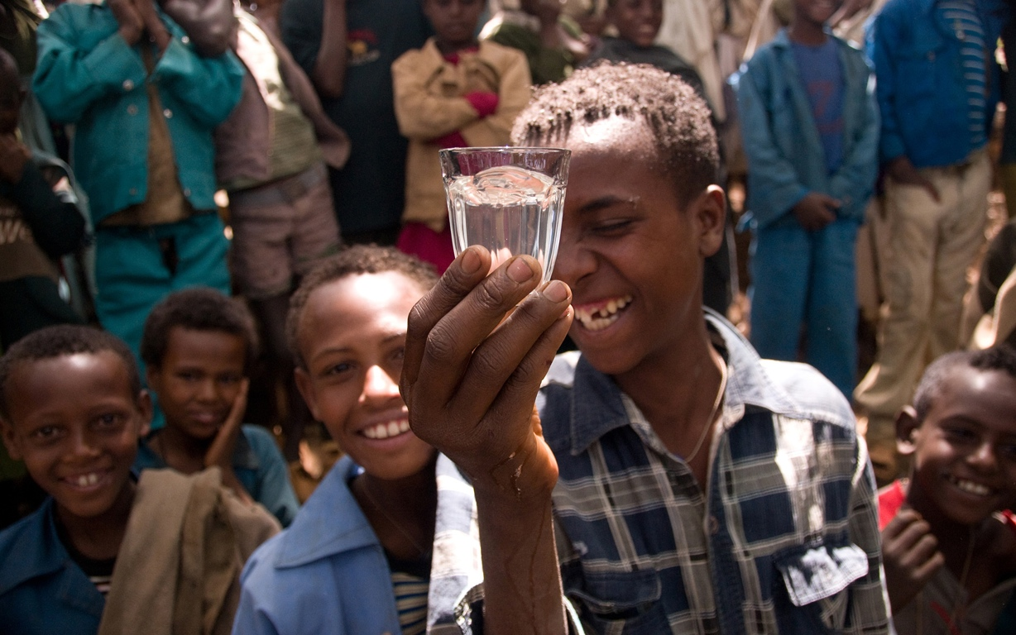
Conclusion.

Slide 33
Community members’ experiences after implemented water interventions reveal enhanced relationships.

Slide 34
These enhanced relationships provided economic relief.

Slide 35
Limitations.
Translation.
The translator later became the audio-tape translator.
Population may not be representative of all Kenyans, Africans, or individuals living in low and middle income countries who experience water interventions.

Slide 36
Future direction.
Parent’s role in children’s development after having access to water.
Perhaps parenting styles were altered from permissive (due to lack of time) to more authoritative.
Understand if children’s self-regulation changed because they were able to spend more time with their parents (parenting style) and in school.
Gather additional data and applying it to quantify the results of this study.

Slide 37
Conclusion.
This research provides evidence of an increased need for access to quality water for communities throughout the world in order to positively contribute to
constructive family relationships.

Slide 38
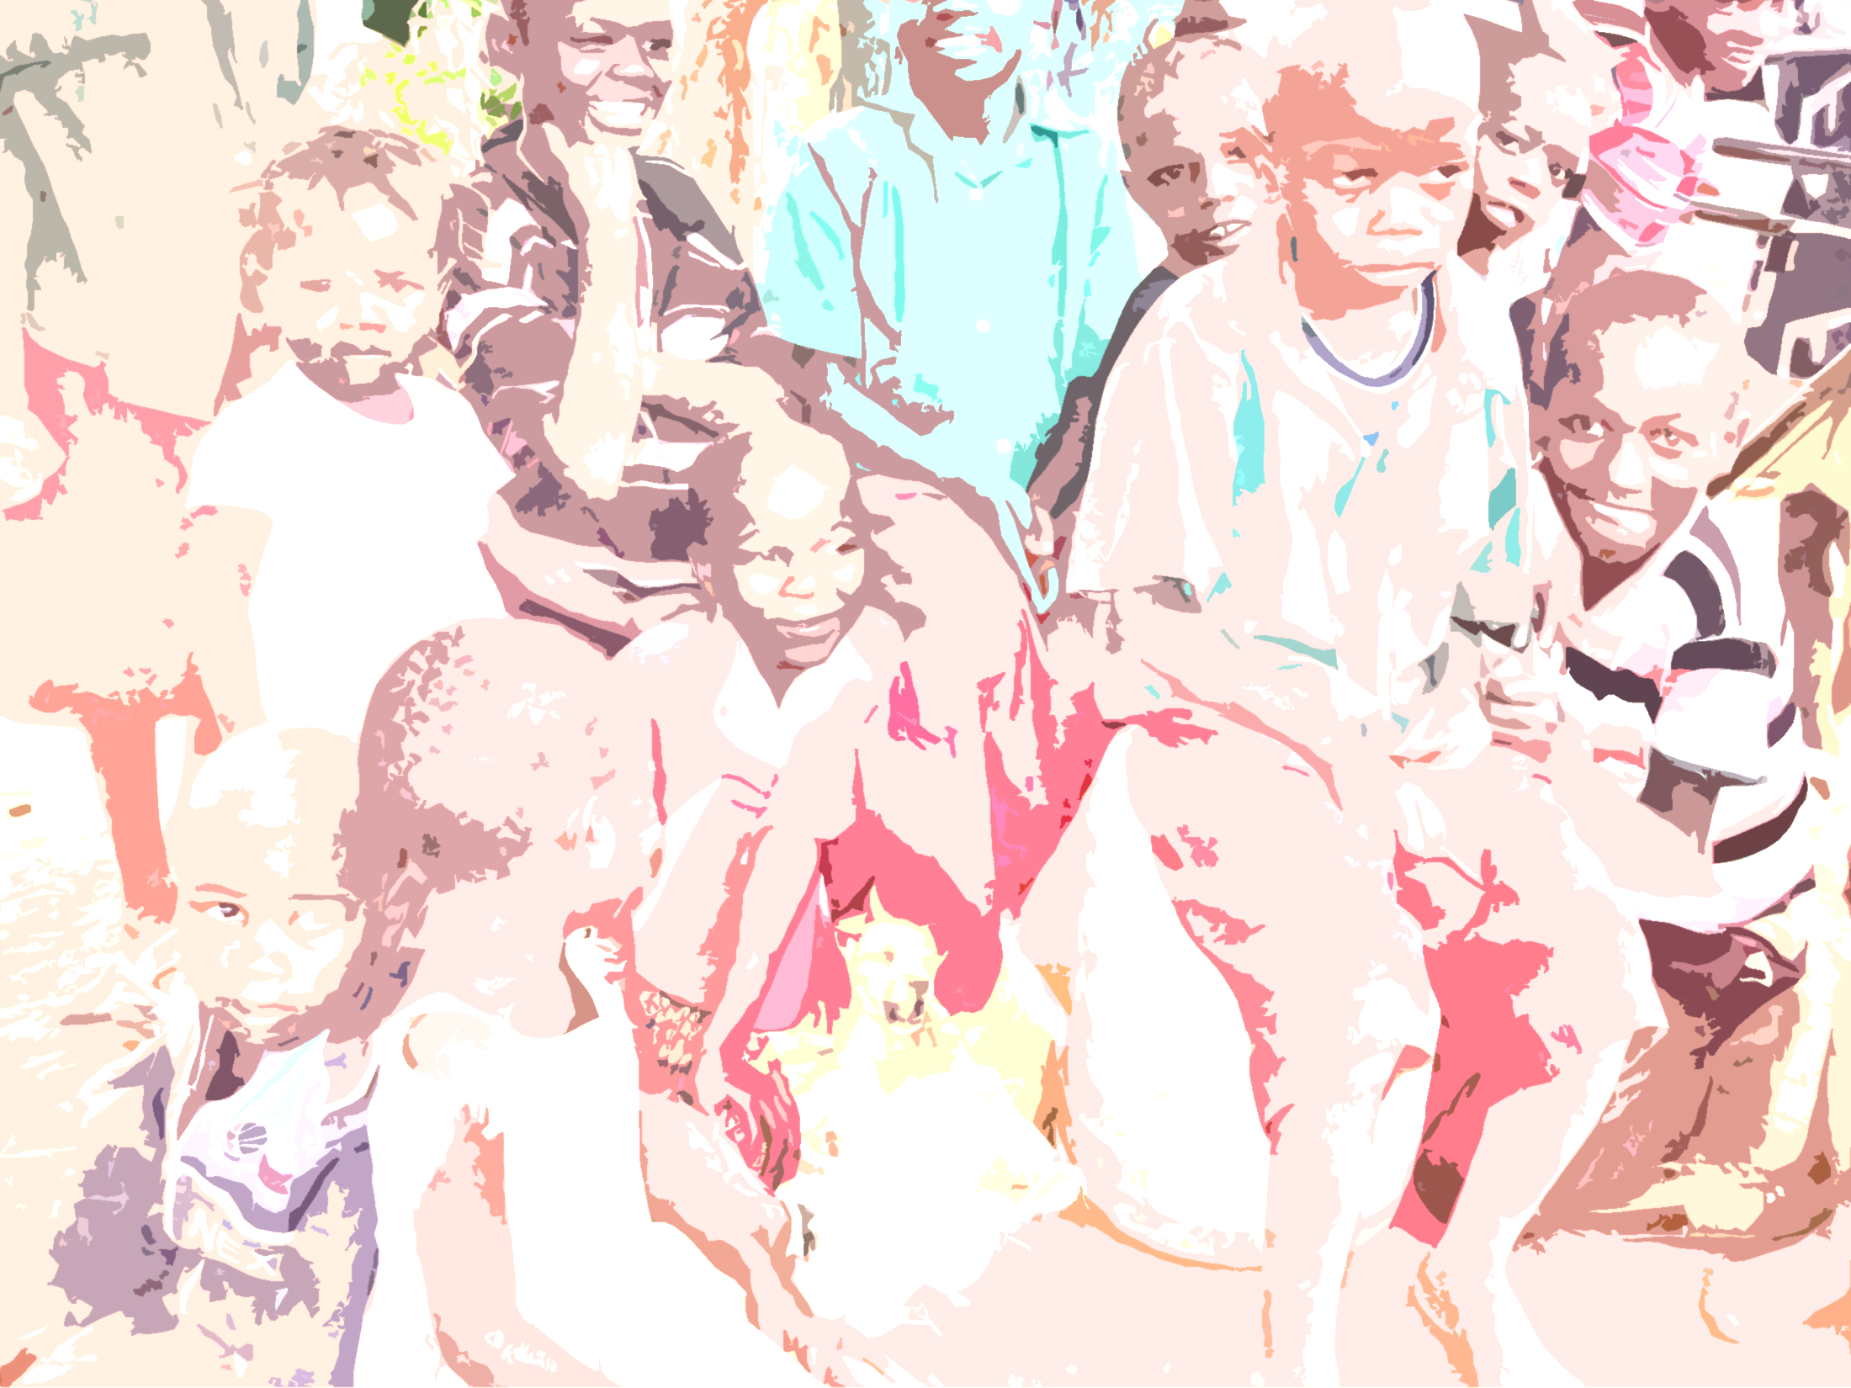
Questions?
Special thank you to all participants in this study, to
the Kenya Red Cross for providing volunteers and funding for this research.
Questions?
Email: tarazolnikov@gmail.com

