Slide 1
The Business Case for Medicare for All
Roger LaBonte, MD
Ed Weisbart, MD
Richard Master

Slide 2
My Career Has Been About Medicine, Business, and Politics
Family Medicine
Physician
Express Scripts
Chief Medical Officer
Physicians for a
National Health Program
Large urban academic practice
Surrounded by like-minded progressives
Conservatives were the outliers
Stereotyped conservatives as less informed, less generous, cold-hearted
Then I moved to Missouri…
Forced to reconcile that most of these conservatives were decent, generous, educated, and tried to do the right thing.
1982 – 2003
Practice in Chicago at Rush Medical University
2003 – current
Washington University internal medicine volunteer faculty
2003 – 2010
Fortune 100 company in St Louis MO with $15B revenue and 12,000 employees
Responsible for clinical integrity of all products and services
PNHP nationally:
Established 1987, 21,000+ members
MO chapter chair:
Founded in 2012, now reaches more than 3,000 people
Also advocates for Medicaid expansion

Slide 3
Liberals and Conservatives Often Think Differently
George Lakoff
“Moral Politics”

Slide 4
Lakoff Identified Two Cognitive Models
Nurturant
Mother
Two-Framed
Strict
Father
Equality
Diversity
Helping hand
Both frames are active
Looks undecided
Hierarchical
Social Darwinism
Consequences
20% of Americans
60% of Americans
20% of Americans
Liberals
Independents
Conservatives

Slide 5
Lakoff Identified Two Cognitive Models
Prudence
Apply the free market to delivery of care
Insurers have perverted our free market.
Doctors now compete for insurers, not patients.
Insurance adds nonprodutive overhead to care.
Less wasteful for you to buy insulin than dialysis
Use anecdotes to hit both of their frames:
Talk about the the business of practice.
Nurturing + freedom = more patient choice
Join “Business Leaders Transforming HC”
Connect us with other business leaders
Liberals
Independents
Conservatives

Slide 6
Moral Foundations Questionnaire
Jonathan Haidt
“The Righteous Mind”
Online survey of 132,000 Americans
Identified five moral values
Compared individual scores with where people stood on the political spectrum
Haidt, Jonathan. The Righteous Mind. 2013.

Slide 7
Five Moral Pillars
Fairness
Reciprocal altruism, justice, rights, autonomy
Caring
Empathy, kindness, gentleness, nurturance
Loyalty
Patriotism, self-sacrifice, “one for all, all for one”
Authority
Deference to leadership, respect for traditions
Sanctity
Bodies are temples desecrated by immorality
Haidt, Jonathan. The Righteous Mind. 2013.

Slide 8
Our Moral Foundations Vary With Our Politics
Strongly
Endorse
Fairness
Caring
Both sides believe
they hold the
moral high ground.
“You heartless
bastards don’t care.”
“Your lack of morals will destroy our society.”
Loyalty
Authority
Sanctity
Strongly
Reject
Very Liberal | Slightly Liberal
Moderate
Slightly Conservative | Very Conservative
Chart from Haidt, Jonathan. The Righteous Mind. 2013.
(Commentary by Ed Weisbart)

Slide 9
Five Moral Pillars of “Cover Everybody”
Do not expect
these two arguments
to persuade conservatives.
Fairness
Healthcare is a human right
Caring
Protect the vulnerable
Loyalty
Temper data about poor outcomes with reasons for national pride
Play your doctor card; explain how insurance disrupts the business of actually delivering care.
Authority
Sanctity
Physicians and patients are far more autonomous with NHI

Slide 10
Medicare Means
Healthier Americans
1
3
5
7
9
11
13
15
17
Medicare is a crown jewel of America.
Expanding it makes good business sense.
USA
Rank
Age 65
Women
Men
0-1 | 1-4 | 5-9 | 10-14 | 15-19 | 20-24 | 25-29 | 30-34 | 35-39 | 40-44 | 45-49 | 50-54 | 55-59 | 60-64 | 65-69 | 70-74 | 75-79 | 80-84 | 85-89 | 90-94 | 95-99
Institute of Medicine. Shorter Lives, Poorer Health.
Fig 1-9: Ranking of US mortality rates by age group among 17 peer countries, 2006-2008. 2013
Peer nations are Australia, Austria, Canada, Denmark, Finland, France, Germany, Italy, Japan, Norway, Portugal, Spain, Sweden, Switzerland, Netherlands, United Kingdom
Age

Slide 11
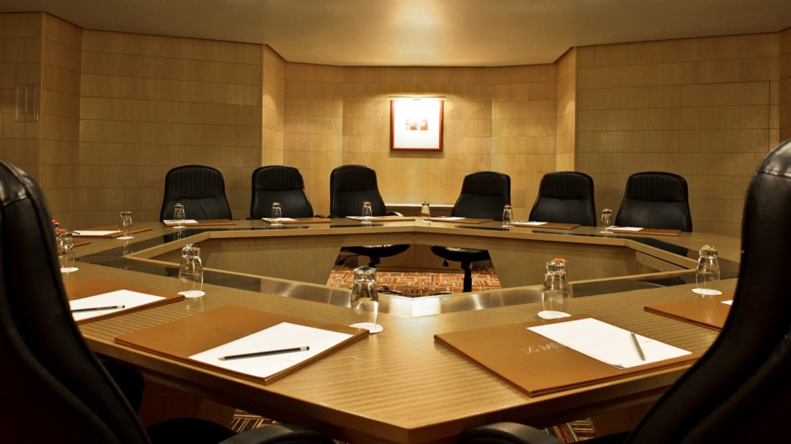
Tribalism Trumps Moral Pillars
“Moral Tribes”
Joshua Greene

Slide 12
Tribalism Trumps Moral Pillars
“Our brains were
designed for tribal life,
for getting along with
a select group of others (Us) and for
fighting off everyone else (Them).”

Slide 13
Tribalism Trumps Moral Pillars
“What appears to be a philosophical opposition to ‘big government’ is, I suspect, largely just tribalism.
“Government programs such as Medicare, which very visibly and directly help Us, are sacrosanct among social conservatives.”

Slide 14
Our Perspective Depends On How We Define Our “Tribe”
My planet
The best strategies, e.g., Medicare for All,
do not require us
to choose
among our tribes.
My nation
My business
My family

Slide 15
“Most of you know me as
the neighborhood pediatrician
but you may not realize
I also run a small business.”
Translation: I’m in your tribe
Lakoff frames: Nurturing + heirarchy
Moral Pillars: Loyalty and Authority
Engagement: 1st and 2nd person pronouns
PNHP workshop participant
Nov. 3, 2017

Slide 16
One Good Example
Translation:
“I’m in your tribe”
Lakoff frames:
Nurturing + heirarchy
Moral Pillars:
Loyalty and Authority
“Most of you know me as the neighborhood pediatrician
but you may not realize
I also run a
small business.”
PNHP workshop participant
Nov. 3, 2017

Slide 17
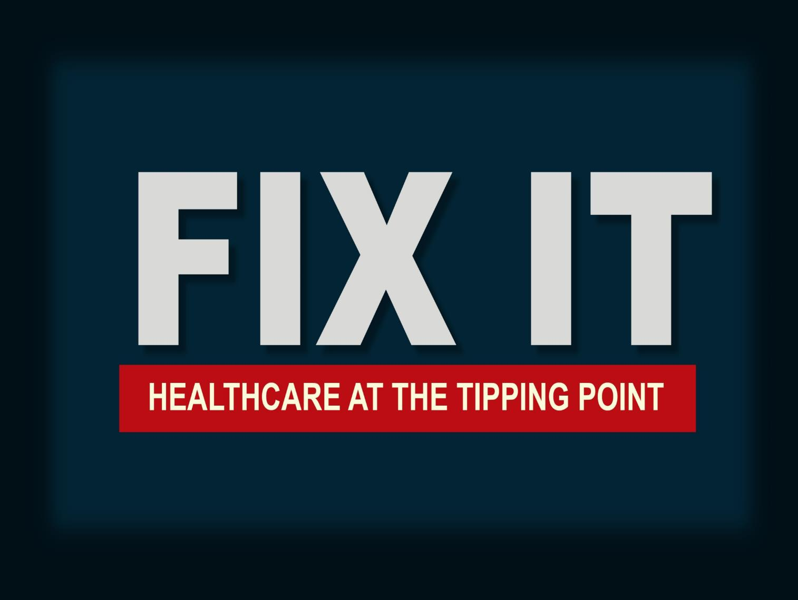
Notes:
Email your request to stan@fixithealthcare.com for this PowerPoint presentation
Or
Visit www.fixithealthcare.com
for additional information.

Slide 18
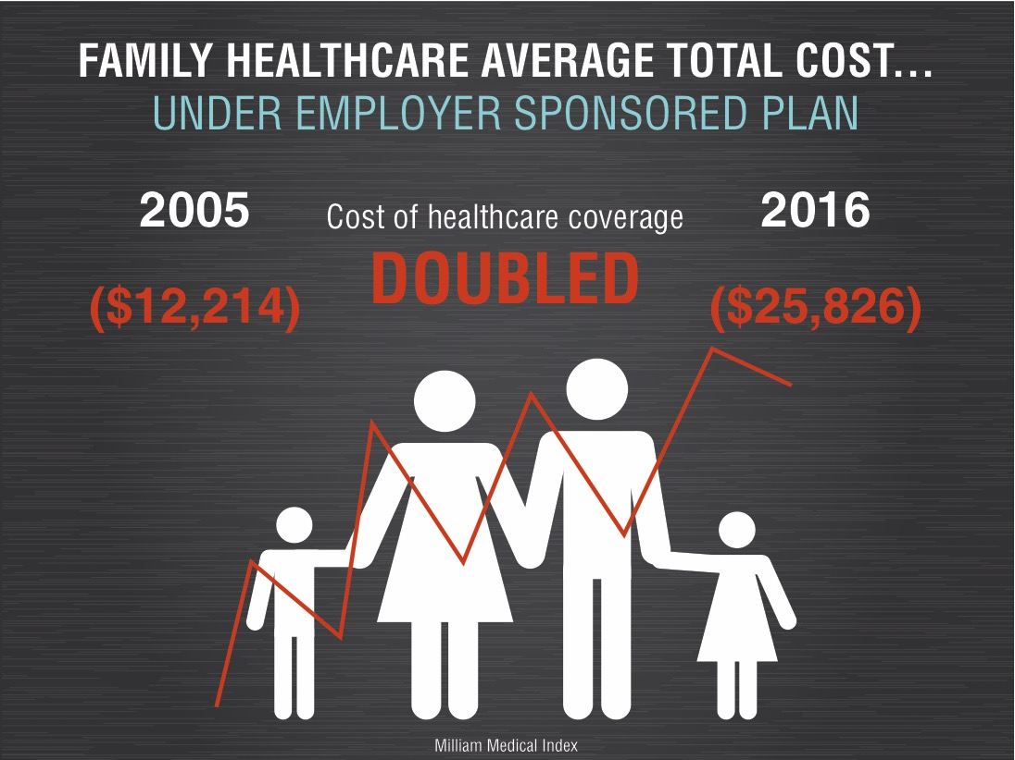
Notes:
Note the 2015 increase to approximately 257% ($24,700). Minimum wage for an entire year barely covers the expenses.

Slide 19
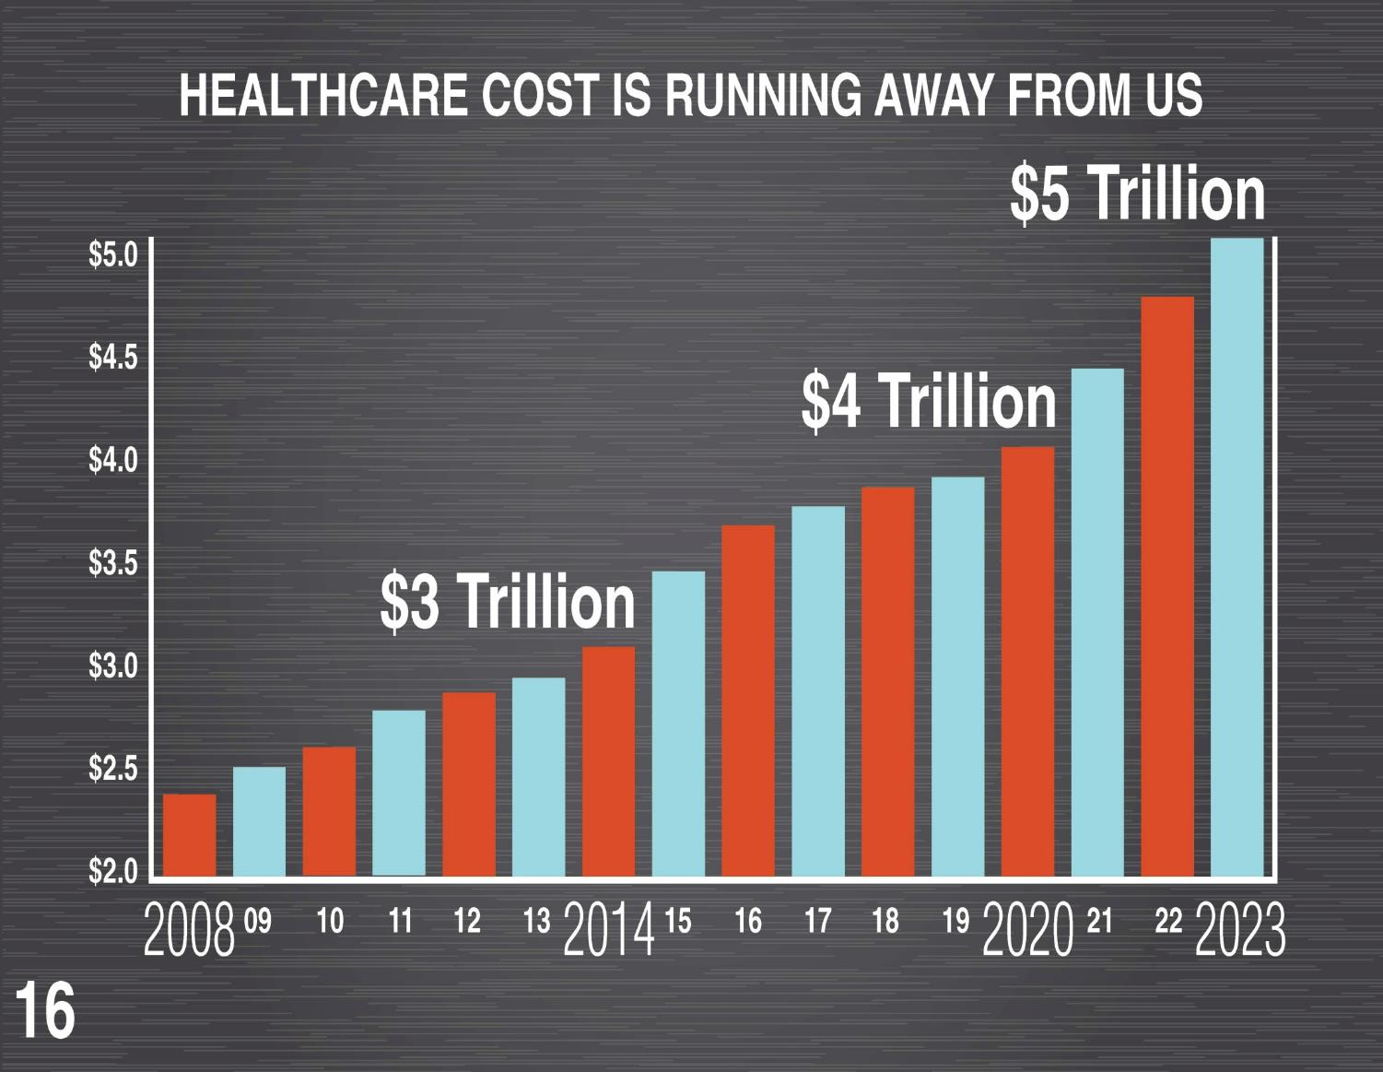
Notes:
Now over $3 Trillion, on the way to $5 Trillion – is this sustainable?

Slide 20
Notes:
The gap between healthcare costs and GDP continues to widen – this is undermining our capacity to compete globally.

Slide 21
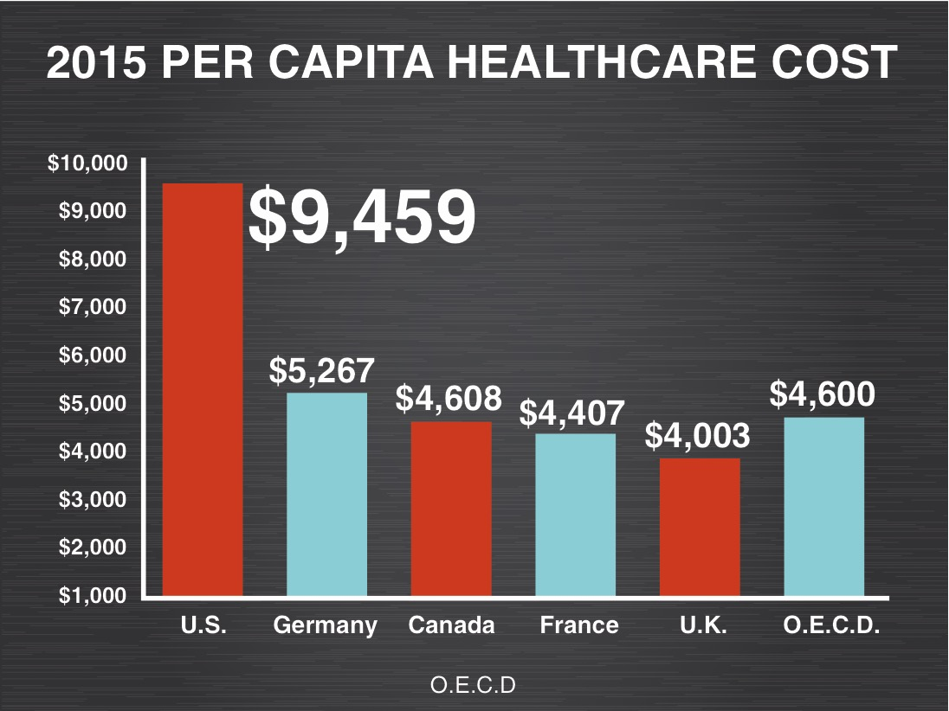

Slide 22
Notes:
The most expensive healthcare system in the World for businesses trying to compete.

Slide 23
Notes:
At almost 30% of our federal budget, healthcare leaves little room for America’s needs.

Slide 24
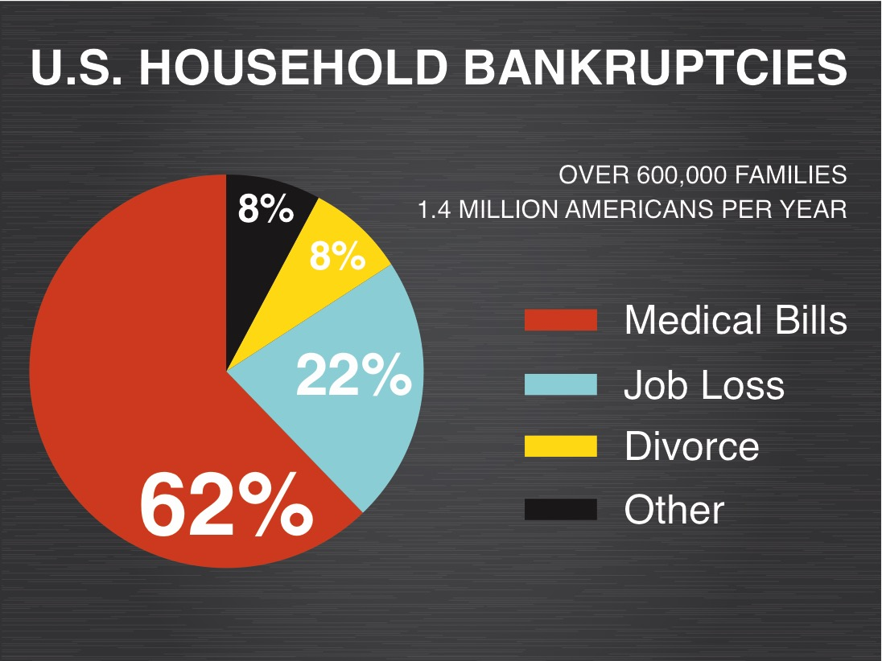
Notes:
The impact on families is substantial – nearly 2000 families/day succumb to healthcare costs they simply cannot afford.

Slide 25
Notes:
Medicare has about 3% administration expense.

Slide 26
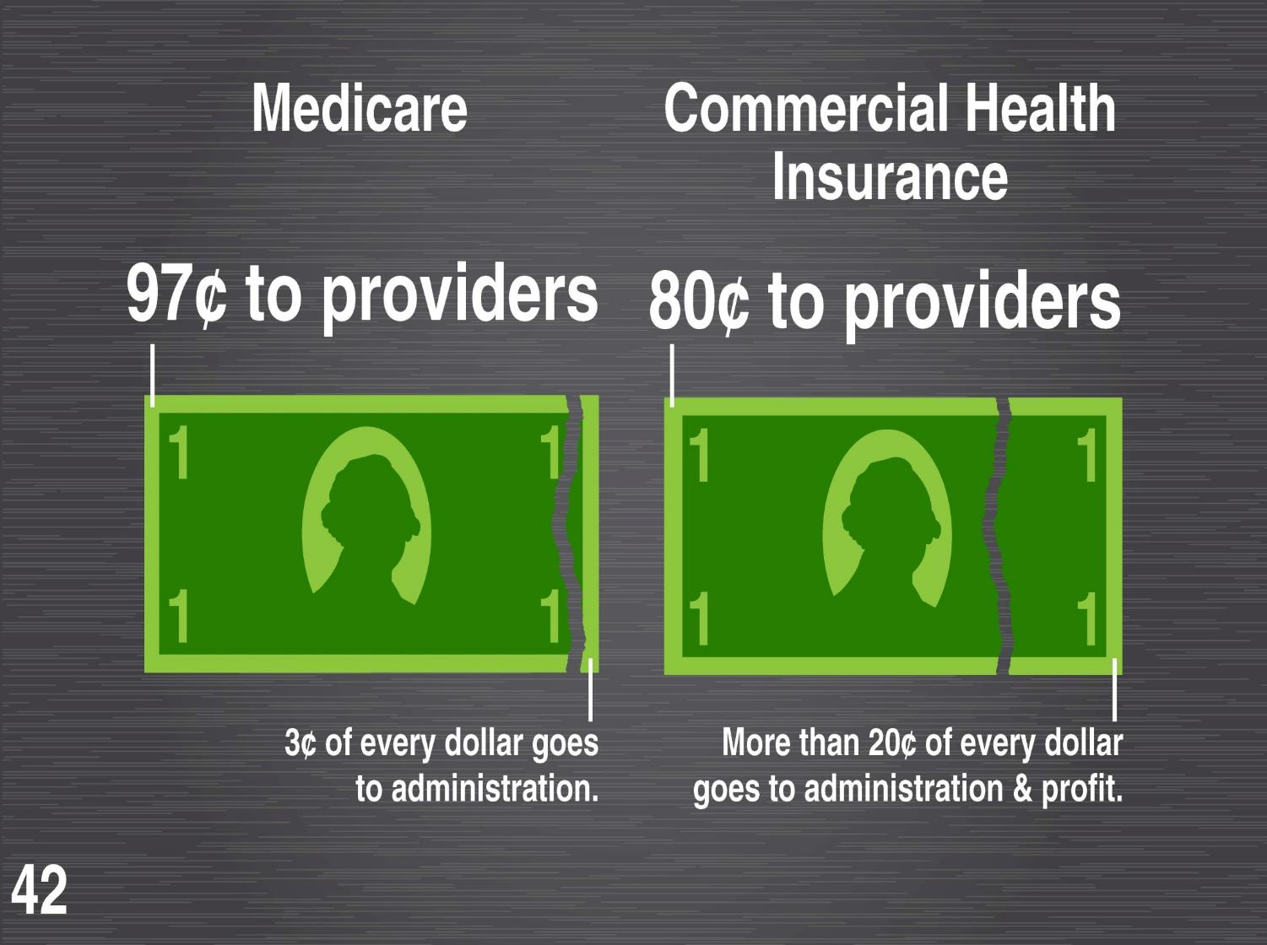
Notes:
Taking care of the oldest and sickest – at substantially less.

Slide 27
Notes:
Single-payer is the recognized international standard in healthcare system structure for modern industrialized economies.

Slide 28
Notes:
Note the overall savings less the costs for universal coverage and increased utilization = $504 billion Net Savings.

Slide 30
www.fixithealthcare.com
Notes:
Please visit our website and see the documentary – Fix It: Healthcare at the Tipping Point.

