Slide 1
War and Peace
Martin Donohoe

Slide 2
Am I Stoned?
A 1999 Utah anti-drug pamphlet warns:
“Danger signs that your child may be smoking marijuana include excessive preoccupation with social causes, race relations, and environmental issues”

Slide 3
Beginnings of Large-Scale, Organized Warfare
10,000 yrs ago – agriculture
Expanding populations
Hierarchical society
Division of labor
Ruling Class
Artisan Class
Warrior class
Subjugation of women
Infectious/chronic diseases
Private property, Money

Slide 4
Weapons of War
3500 yrs ago – bronze weapons and armor
2200 yrs ago – iron
1900 yrs ago – widespread use of horses

Slide 5
Weapons of war
Ninth Century China - bombs
Thirteenth Century China – rockets
Forgotten until the 19th Century
1783 – Balloon

Slide 6
Weapons of war
1903 – Airplane
Hiroshima, August 6, 1945
15 kiloton bomb, 140,000 deaths
“The day that humanity started taking its final exam” – Buckminster Fuller
Nagasaki, August 9, 1945
22 kiloton bomb, 70,000 casualties

Slide 7
20th/21st Century Warfare
Small arms
Landmines
Nuclear weapons
Chemical and biological weapons
Weaponization of space
Nanotech weapons
Robotic soldiers
Cyberwarfare

Slide 8
Militarism Fuels Wars
Positively correlated with:
Conservatism
Nationalism
Religiosity
Patriotism
Authoritarianism

Slide 9
Militarism Fuels Wars
Negatively correlated with:
Respect for civil liberties
Tolerance of dissent
Democratic principles
Sympathy and welfare toward the troubled and poor
Foreign aid for poorer nations
Subverts other societal interests (health, environment, education, social programs)

Slide 10
Hermann Goering (at the Nuremberg Trials, shortly before being sentenced to death)
“Of course the people don't want war. But…it is the leaders of the country who determine the policy, and it is always a simple matter to drag the people along, whether it is a democracy, or a fascist dictatorship, or a parliament, or a communist dictatorship . . .

Slide 11
Hermann Goering
…Voice or no voice, the people can always be brought to the bidding of the leaders…All you have to do is to tell them they are being attacked, and denounce the pacifists for lack of patriotism and exposing the country to danger.”

Slide 12
Epidemiology of Warfare: Rising Casualties, Especially Among Civilians
Deaths in war:
17th Century = 19/million population
18th Century = 19/million population
19th Century = 11/million population
20th Century = 183/million population
Increasing casualties to civilians
85-90% in 20th Century (vs. 10% late 19th Century)

Slide 13
Contemporary Wars
250 wars in the 20th Century
Incidence of war rising since 1950
Most conflicts within poor states
Over 30 separate civil wars currently underway
Most involve U.S.-supplied weapons

Slide 14
Contemporary War Deaths

Slide 15
Josef Stalin
The death of one man is a tragedy. The death of millions is a statistic.

Slide 19
Legacies of Colonial Exploitation
Christopher Columbus’ log entry upon meeting the Arawaks of the Bahamas:
“They…brought us…many…things…They willingly traded everything they owned…They do not bear arms…They would make fine servants…With fifty men we could subjugate them all and make them do whatever we want.”

Slide 20
Legacies of Colonial Exploitation
Winston Churchill (speaking in favor of RAF’s “experimental” bombing of Iraqis in 1920s, which killed 9,000 people with 97 tons of bombs):
“I am strongly in favor of using poisoned gas against uncivilized tribes to spread a lively terror…against recalcitrant Arabs as an experiment”

Slide 21
Legacies of Colonial Exploitation
Cecil Rhodes (Rhodesia – now Zimbabwe, Rhodes Scholarship, DeBeers Mining Company):
“We must find new lands from which we can easily obtain raw materials and at the same time exploit the cheap slave labour that is available from the natives of the colonies. The colonies would also provide a dumping ground for the surplus goods produced in our factories.”

Slide 22
John Wayne
“I don't feel we did wrong in taking this great country away from them. There were great numbers of people who needed new land, and the Indians were selfishly trying to keep it for themselves.”

Slide 23
Consequences of War
Deaths, injuries, physical and psychological sequelae
Famine
Collapse of health care system affecting those with acute and chronic illnesses

Slide 24
Displaced Persons
66 million forcibly displaced persons worldwide
Refugees, internally-displaced person, asylum seekers
Approximately ¾ of world’s refugees are hosted by developing countries

Slide 25
Consequences of War
Environmental degradation
Increasing poverty and debt
Increasing social, legal, educational, and political marginalization of women
All lead to recurrent cycles of violence

Slide 26
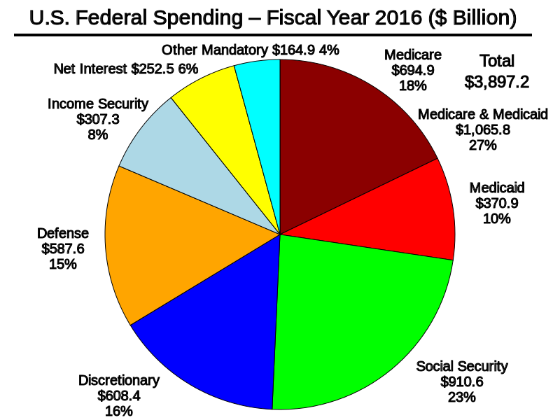

Slide 27
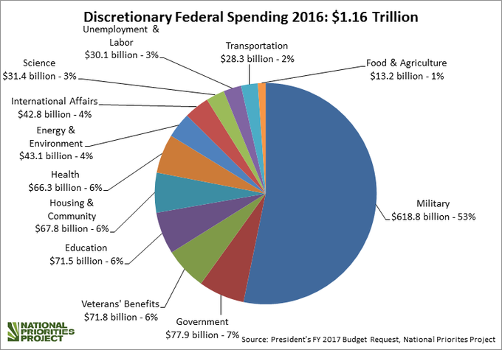

Slide 29
We’re Number One
U.S. #1 in military spending
#17 in education
#26 in infant mortality
#35 in life expectancy and overall health

Slide 30
Dwight Eisenhower
“The problem in defense spending is to figure out how far you should go without destroying from within that which you are trying to protect from without”

Slide 31
Social Injustices
29 million Americans lack health insurance (resulting in 28,000 deaths/yr)
22% of US children live in poverty
Homelessness, public educational system a shambles, increasing jail populations, etc.
Mass extinction, global warming
2.5 billion people worldwide live in abject poverty (earn less than $500 per year, lack access to clean drinking water)

Slide 32
Social Injustices
650 million people lack access to clean drinking water
2.3 billion lack adequate sanitation services
21,000 people starve to death daily (1 Hiroshima/7 days)

Slide 33
Overconsumption (“Affluenza”)
U.S. = 4.5% of world’s population
Owns 50% of the world’s wealth
U.S. responsible for:
25% of world’s energy consumption
33% of paper use
72% of hazardous waste production

Slide 34
Maldistribution of Wealth
Richest 1% own 46% of the world’s wealth
Top 62 billionaires worldwide worth $1.8 trillion, the combined income of bottom 3.5 billion people (1/2 of world’s population)

Slide 35
Maldistribution of Wealth
U.S: Richest 1% of the population owns 40% of the country’s wealth -poorest 90% own 30% -widest gap of any industrialized nation

Slide 36
Hudson River, 2009

Slide 37
Income Inequality Kills
Higher income inequality is associated with increased morbidity and mortality at all per capita income levels
Notes:
37

Slide 38
Environmental Destruction
400,000 deaths/yr worldwide from global warming (expected to double by 2030) (UN)
U.S. farm workers suffer up to 300,000 pesticide-related acute illnesses and injuries per year; 25 million/yr wordwide (EPA)
Pesticides in food could cause up to 1 million cancers in the current generation of Americans (NAS)
1,000,000 people killed by pesticides every 6 years (WHO); 200,000 deaths/yr worldwide (UN) – almost all in developing world where use of obsolete pesticides is common

Slide 39
Environmental Consequences of Militarization
World’s single largest polluter
8% of global air pollution
2-11% of raw material use
Almost all high and low level radioactive waste

Slide 40
The US Military
Owns an amount of land equal to North Korea or Kentucky (25 million acres)
Much of it polluted
Cleanup cost estimates in the hundreds of billions

Slide 41
Health Costs of Militarization
3 hours of world arms spending = annual WHO budget
½ day of world arms spending = immunization for all the world’s children
3 days of US arms spending = amount spent on health, education and welfare programs for US children in one year

Slide 42
Health Costs of Militarization
3 weeks of world arms spending = primary health care for all in poor countries, including safe drinking water and full immunizations
Brain drain: 2/3 of US scientists work in military-industrial complex (similar in Russia during cold war; much work has widespread applicability)

Slide 43
Skewed Priorities
The world spends $1.8 trillion/year on military goods and services
For 25% of this, we could:
Eliminate starvation and malnutrition
Provide shelter for all
Eliminate illiteracy
Provide clean and safe water
Prevent soil erosion

Slide 44
Skewed Priorities
Prevent global warming
Stop deforestation
Aid all refugees
Retire developing nations’ debt
Provide clean, safe energy (through efficiency and renewables)

Slide 45
Skewed Priorities
Prevent acid rain
Fix the ozone hole
Stabilize world population
Provide basic universal health care and AIDS control
Eliminate nuclear weapons and land mines

Slide 46
Dwight Eisenhower
“Every gun that is made, every rocket fired, signifies in the final sense a theft from those who hunger and are not fed, those who are cold and not clothed”

Slide 47
Martin Luther King
“A nation that continues year after year to spend more money on military defense than on programs of social uplift is approaching spiritual death.”

Slide 48
The US: Rogue Nation
History: Native Americans, slavery, current excesses, disparities and injustices
Co-opting Nazi and Japanese WWII scientists
Minimum 277 troop deployments by the US in its 240 year history

Slide 49
The US: Rogue Nation
Over 1,000 bases worldwide today (737 in 69 other countries)
All other countries combined occupy only 30 foreign bases
54 countries helped facilitate CIA’s secret detention, rendition, and interrogation program

Slide 50
The US: Rogue Nation
Since the end of WWII, the US has bombed:
China, Korea, Indonesia, Cuba, Guatemala, Congo, Peru, Vietnam, Laos, Cambodia, Nicaragua, El Salvador, Grenada, Libya, Panama, Afghanistan, Sudan, Yugoslavia, and Iraq

Slide 51
The US: Rogue Nation
Conservative estimate = 8 million killed
US invasions/bombings often largely at behest of corporate interests
Military policy designed to promote economic policies

Slide 52
The US: Rogue Nation
In 2016, the US spent about $1,882 per US citizen on defense
vs. a few dollars per capita on peacekeeping efforts

Slide 53
Foreign Aid
In total dollars: U.S. #1
As a % of GDP, U.S. ranks 21st among the world’s wealthiest nations
U.S. Aid: Over 1/3 military, 1/4 economic, 1/3 for food and development
Most U.S. aid benefits U.S. corporations
Notes:
53
53

Slide 54
Foreign Aid
0.19% of the total federal budget, vs. UN target of 0.7%
Americans think that 24% of the federal budget goes toward foreign aid
Notes:
54
54

Slide 55
U.S. Charitable Giving
2.5% of income
2.9% at height of Great Depression
Notes:
55
55

Slide 56
Poverty and Priorities
Amount of money needed each year (in addition to current expenditures) to provide water and sanitation for all people in developing nations = $9 billion
Amount of money spent annually on cosmetics in the U.S. = $8 billion
One week of developed world farm subsidies = Annual cost of food aid required to eliminate world hunger

Slide 57
International Non-Cooperation/Isolationism
Failure to sign or approve:
Kyoto Protocol on Climate Change
Convention on the Prohibition of Anti-Personnel Land Mines
Convention on Cluster Munitions
Comprehensive Nuclear Test Ban Treaty

Slide 58
International Non-Cooperation/Isolationism
Failure to sign or approve:
Convention on the Rights of the Child
Convention on the Elimination of Discrimination Against Women
Convention on Economic, Social and Cultural Rights

Slide 59
International Non-Cooperation/Isolationism
Failure to sign or approve:
UN Declaration of the Rights of Indigenous Peoples
Convention for the Suppression of Traffic in Persons
UN Convention on the Rights of Disabled Persons

Slide 60
International Non-Cooperation/Isolationism
Failure to follow World Court Decisions
Failure to recognize International Criminal Court
Largest debtor to the UN (only 40% of dues paid)

Slide 61
Martin Luther King, Jr.
“Our only hope today lies in our ability to recapture the revolutionary spirit and go into a sometimes hostile world declaring eternal hostility to poverty, racism, and militarism.”

Slide 62
Günter Grass
“The first job of a citizen is to keep your mouth open.”

Slide 63
African Proverb
If you think you are too small to have an impact, try going to bed with a mosquito in your tent

Slide 64
Perspective
The earth spins at 1,038 mph at the equator, between 700 mph and 900 mph at mid-latitudes
The earth rotates around sun at 18.5 miles/sec
The solar system orbits the center of the Milky Way Galaxy at 137 miles/sec
One rotation per 225 million years

Slide 65
Perspective
The sun is one of hundreds of billions of stars in the Milky Way Galaxy
The Milky Way is one of over one hundred billion galaxies in the known universe
The universe may be one of an infinite number of universes

Slide 66
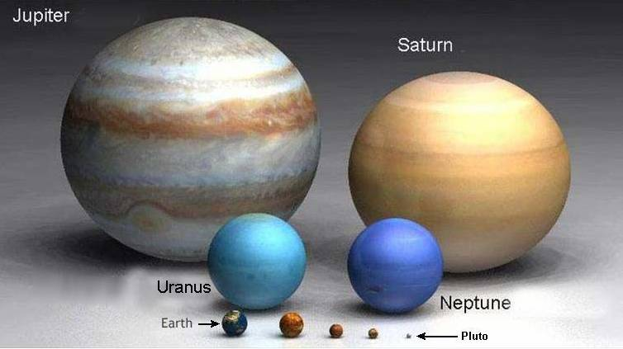
The Planets

Slide 67
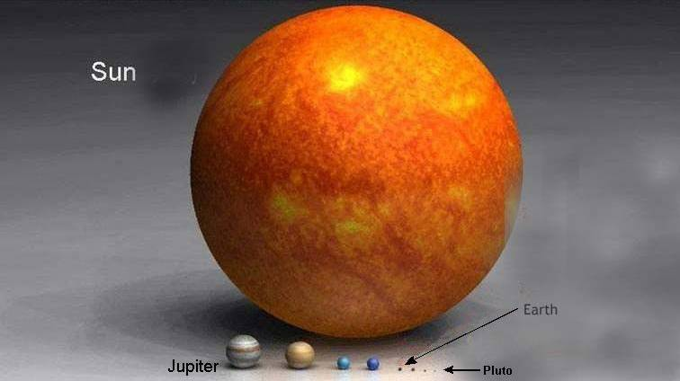
Our Solar System

Slide 68
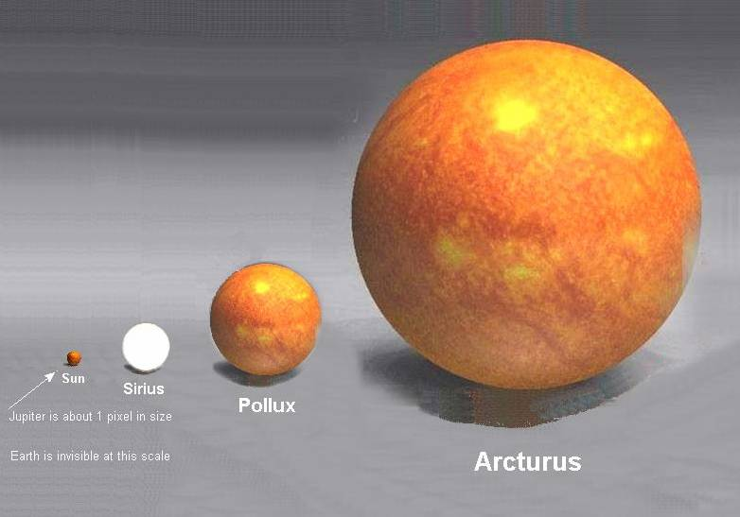
Jupiter = one pixel, Earth = invisible

Slide 69
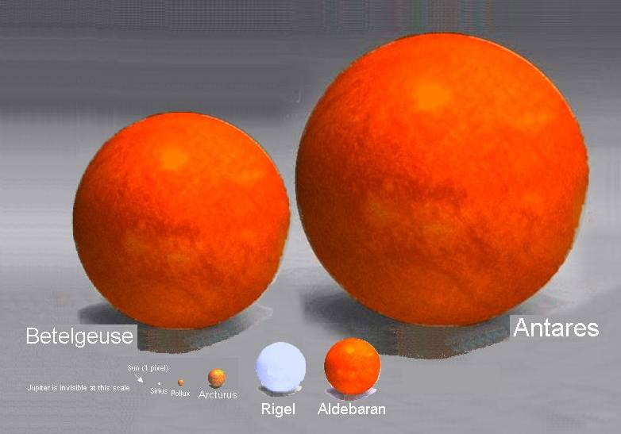
Sun = one pixel, Jupiter = invisible

Slide 70
Our Home

Slide 71
Earth/Moon Seen by Voyager Spacecraft through Saturn’s Rings

Slide 72
Pastor Niemoller
“First they came for the Jews, and I did not speak up, for I was not a Jew.
Then they came for the communists, and I did not speak up, for I was not a communist.
Then they came for the trade unionists, and I did not speak up, for I was not a trade unionist.
Then they came for me, and there was no one left to speak up for me.”

Slide 73
At the Un-National Monument along the Canadian Border William Stafford
This is the field where the battle did not happen,
where the unknown soldier did not die.
This is the field where grass joined hands,
where no monument stands,
and the only heroic thing is the sky.

Slide 74
At the Un-National Monument along the Canadian Border William Stafford
Birds fly here without any sound,
unfolding their wings across the open.
No people killed—or were killed—on this ground
hallowed by neglect and an air so tame
that people celebrate it by forgetting its name.

Slide 76
Contact Information
Public Health and Social Justice Website
http://www.publichealthandsocialjustice.org
http://www.phsj.org
martindonohoe@phsj.org
Prescription for Justice TV
https://www.youtube.com/channel/UCJt34I9c5vT2RpZtkg6Im2A

