Slide 1
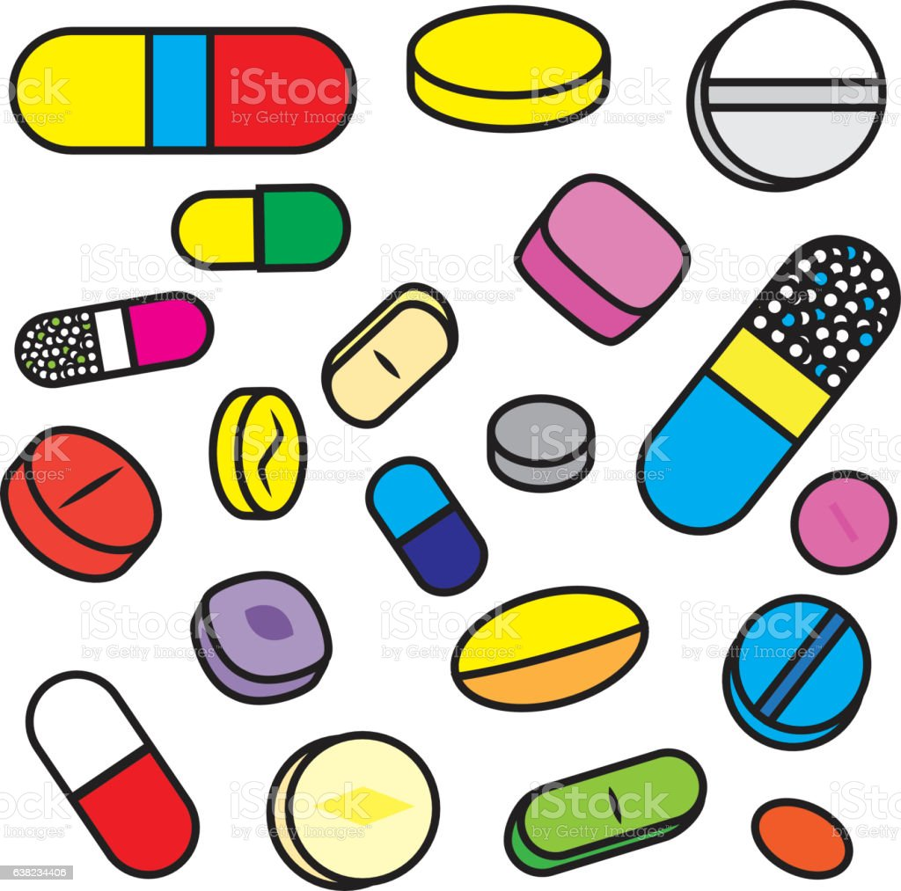
Why Do Drugs Cost So Much? What can be done about it?
Joshua Freeman, MD
Professor and Chair Emeritus, Family Medicine, KUMC
Clinical Professor, Family Medicine, University of Arizona

Slide 2
Disclaimer
I have tried to keep this presentation updated as new information comes out, but it is hard because almost every day there is some new revelation about abuse, profiteering, and human suffering.

Slide 3
Outline
Drugs cost a lot in the US
Why drugs cost a lot in the US
Examples of drugs illustrating different ways of charging a lot
Neurological and Neuromuscular Drugs
Impact on patients
What can doctors do?
How could the whole problem be fixed?

Slide 4
Drugs cost a lot in the US
More than in the rest of the world
Because other countries have regulation of drug prices
US has a free (if slightly rigged) market that allows pharmaceutical manufacturers, once a drug is approved by the FDA, to charge whatever they think the market will bear
And they do
And they raise the prices each year, by several times the rate of inflation, often 5% or more.

Slide 6
What about recouping the cost of drug development?
Thanks for this and other slides to Steffie Woolhandler MD and David Himmelstein, MD

Slide 7
Revenues and Expenses, 15 largest drug companies, 1999-2018 Angelis A, et al., BMJ 2023;380:e071710, Published: 15 February 2023 http://dx.doi.org/10.1136/bmj-2022-071710

Slide 8
It’s actually worse than that…
Much of the drug companies’ R&D Costs are actually borne by the public including
Initial drug discovery financed by NIH
Direct subsidies to Pharma for drug development
To truly assess the impact need to know the net R&D costs, funds that actually come from the drug companies.
Hard to find!
Darrow JJ and Light DW, Beyond The High Prices Of Prescription Drugs: A Framework To Assess Costs, Resource Allocation, And Public Funding, Health Affairs 40(2);281-288 (2021)

Slide 10
More recent (2020)

Slide 12
Some other considerations…
The longer a drug is on the market, the greater the profit/manufacturing ratio becomes
Some companies have newer drugs, so the (already favorable) profit profile will get even better

Slide 13
Regulation cuts cost to consumers
VA and Tri-Care negotiate rates: lower prices
Medicare, the largest purchaser of drugs in the US, is forbidden by law (from the Part D law passed under President G.W. Bush) from negotiating prices with drug companies
Insurance companies in theory could negotiate lower prices, but none (other than Medicare) has sufficient market share to do so without risking their patients being excluded from meds
The insurance companies have greatly increased “patient responsibility”– that is patient out-of-pocket cost, often to 50% or more

Slide 14
Expired drugs
Millions or billions of $$ spent on disposing of and restocking drugs that have reached in hospitals and physician practices.
Many of these drugs have far longer efficacy than their marked expiration
FDA investigations of samples of lots for Defense Department shows, e.g.,
CIPROFLOXACIN has shelf life of about 18 years.
https://www.drugs.com/article/drug-expiration-dates.html

Slide 15
Examples of drug price hikes
Colchicine: Thousands of years old – ancient Egypt!
Was widely available as an unpatented drug
Price hiked from pennies to $4/mo to $5 a pill after studies done on <1000 pts to show – surprise! – it worked for gout
Daraprim® (pyrimethamine): Available for over 60 years; effective for Toxoplasmosis (impt for HIV).
Martin Shkreli and Turing raised the price from $13.50 to $750 a pill
Epipen: Heather Bresch and Mylan, increase to over $600
Doxycycline: Became cheap when went off patent. Until: it “went from $20 a bottle in October 2013 to $1,849 by April 2014.” A 9200% increase

Slide 16
How about insulin?
Banting and Best sold the patent for insulin in the 1920s for $1 to Eli Lilly, because they thought it should be available to save the lives of people with DM
For much of my career, insulin was relatively cheap. Now for the cheapest form, with a discount card, it is over $100/mo. And for many formulations, much more.

Slide 17
Cost is a barrier for patients: This is the major factor in ‘non-adherence’

Slide 21
Review of ways Drug Companies get around regulation
Gaming the patent system
Studying long-used unpatented drugs
Studying drugs for new – but rare – indications
Studying drugs for children
Threatening insurers with lack of access
Orphan Drug Act

Slide 22
Aduhelm® (aducanamab)
Drug for treatment of Alzheimer’s dementia approved by FDA in 2021
Scientific review committee recommended AGAINST approval.
“There’s no way to recover the opportunity to understand whether or not
the product really works in the post-approval setting.” (G. Caleb Alexander)
3 members of that committee resigned after approval granted
Price estimated to be $56,000/ year. Later reduced some.
Congressional Inquiry into Alzheimer’s Drug Faults Its Maker and F.D.A.
Lecanamab (Lequembi®) approved for Alzheimer’s in Jan 2023
‘modest cognitive benefit for patients with early AD ―
but at a cost of increased risk for amyloid-related edema and effusions.’
‘No formal FDA advisory committee meeting on lecanemab prior to approval.’
One way to do it!
$26,000 a year

Slide 23
Humira® (adalimumab)
How a Drug Company Made $114 Billion by Gaming the U.S. Patent System
https://www.nytimes.com/2023/01/28/business/humira-abbvie-monopoly.html
Blocked competitors from entering the market
Paid off potential competitors to delay
Keep getting patents for new, less common, indications
Prices rose for 6 years AFTER competitors should have entered market
‘$114 billion in revenue for AbbVie just since the end of 2016.’
“Most lucrative franchise in pharmaceutical history.”
‘Medicare, which in 2020 covered the cost of Humira for 42,000 patients, spent $2.2 billion MORE on the drug from 2016 to 2019 than it would have if competitors had been allowed to start selling their drugs promptly.’

Slide 24
Cost of manufacture of drugs is low
After initial investment recouped (quickly) all is profit
Therefore discounting the cost of drugs to individuals (especially after bad publicity) still makes profit
If patients are insured and insurer has a high “patient responsibility” the drug companies can even write off that whole patient cost while getting a lot (50% say) of the money from the insurer

Slide 25
Co-pay accumulators: If you get past the Pharma greed…you get insurer greed!
A copay accumulator is used to prevent manufacturer copay assistance coupons used by insurance companies and pharmacy benefit managers (PBMs) from being utilized to cover:
the deductible
the maximum amount you must pay out of pocket.

Slide 26
Orphan Drug Act (1983)
Intended to encourage development of drugs to treat rare diseases.
Incentives to manufacturers: additional time for exclusivity from FDA
For both new drugs as well as new indications for existing drugs.
Drugs can only be marketed for approved indications (although they might be used off-label).
Drug companies look for narrow indications for a drug that might even have other uses.
“Salami-slicing” to get approved for narrow indications
(<200,000 people annually, not expected to recoup its development costs).
HHS OIG Study: High-expenditure Medicare drugs often qualified for Orphan Drug Act incentives designed to encourage the development of treatments for rare diseases https://oig.hhs.gov/oei/reports/OEI-BL-20-00080.asp

Slide 27
Expensive Neuromuscular Drugs
Often recombinant DNA drugs
There may be no alternative treatment
Can be promoted as first-line treatment when they are not
ALS: Riluzole, radicava, amylyx
Myasthenia gravis: Eluclizumab, Efgargigimoid, Ravulizumab, rituximab: very expensive.
Spinal muscular atrophy: Nusinersen, Risdipalm, Onasemnogene abeparvovec
DMD: Etiplersin: approved by the FDA against the advisory board recommendation due to lack of efficacy. Several advisory board members resigned. Not approved by European Medicines Agency. Cost: ~$300,000 / year

Slide 28
High Drug Costs Exclude Most Neurology Patients From Cutting-Edge Treatment
“Costs and Utilization of New-to-Market Neurologic Medications”
Reynolds, Gallagher, et al., Neurology, Nov 22, 2022
May not be more effective than existing drugs
If more effective, many people do not have access because of cost
Often drugs approved because of pressure from advocacy groups (aduhelm, etiplersin) despite limited evidence of effectiveness
These are bad diseases; people want hope

Slide 29
Non-neurological example of Makena ® (hydroxyprogesterone caproate) for preterm birth
FDA advisers vote to recommend preterm birth drug Makena be removed from market, 14-1 vote
Withdrawn from market just now, April 6, 2023
“It is brutally painful that there’s nothing available in 2022 in the United States of America” – Pt rep on panel
BUT…
Because a disease is bad is not a reason to approve ineffective drugs especially at huge cost
Conversely, when a drug is effective, huge costs should not be a barrier

Slide 30
REALLY high cost drugs…
‘Onasemnogene abeparvovec (Zolgensma®), a gene therapy approved by the US Food and Drug Administration in 2019 for spinal muscular atrophy, was at the time of approval the most expensive drug ever, with a price of over $2M for a single dose treatment.‘
Angelis, et al., BMJ http://dx.doi.org/10.1136/bmj-2022-071710

Slide 31
Firdapse® (3,4 diaminopyridine)
Effective treatment for Lambert-Eaton (LEMS)
Available as compassionate Rx from Jacobus® for 20 years
"First and foremost we wanted to make the drug available to the patients and the physicians," Jacobus says. "That was our No. 1 priority, so that was what we did.”
Catalyst® gets approval to market 3,4 DAM
Current cost: $30,000/month ($360,000/year)
‘Company officials said they could earn from $300 million to $900 million in revenue each year from the drug; represent a "peak opportunity.“’ (NPR)
The projections are based on a generous estimate of the number of patients who could use the drug, and an assumption that Firdapse will be approved for other uses. Still, the figures suggest the company will charge from $37,500 to well over $100,000 per LEMS patient, per year.
Editorial by NM docs (Burns, Smith, et al.) in Muscle and Nerve 53:165-8,2016
“Akin to trying to patent a ladder”. But they do. Shades of colchicine.

Slide 32
Impact on patients
People may be unable to get/afford drugs that have no good alternative
May be paying a lot for a drug for which there is a good alternative
Paying an outrageous amount out of their own pockets which most people can not afford
Even when insurance does pay, the high cost raises the cost of insurance for everyone, businesses and individuals, thus raising the already high cost of US healthcare(2-4x that of all other OECD countries per capita)

Slide 33
‘The Medicine Is a Miracle, but Only if You Can Afford It’
‘April Crawford never thought she’d be begging for help on GoFundMe, but she has run out of options. She has multiple sclerosis, and Mavenclad®, the drug that could slow her decline, has a list price of $194,000 a year. Her Medicare insurance will pay for most of it, but she has a co-pay of $10,000.’
Question: Is GoFundMe the way we should be funding people’s medicines, especially while drug companies are making billions in profit??

Slide 34
What about the cost of development?

Slide 36
A story from this week..
At the migrant “Welcome Center” in Tucson…
A young woman with Leukemia…
The Border Patrol took her drugs…
She needed a new a prescription…
Pharmacy says cost is $17,000/month!
In the Dominican Republic it was paid for by the government…and was certainly a lot less!
The Dominican Republic is not a wealthy country!

Slide 37
What can and should physicians do?
Advocacy for patients
Advocating for individual patients vs. advocating for systemic change
‘Agency and Activism: Rethinking Health Advocacy in the Medical Profession’, Dobson, Voyer, Regehr, Acad Med 2015
Commentary: Advocacy by Physicians for Patients and for Social Change’ Freeman J, AMA J Ethics, Sept 2016
AMA Declaration of physician personal responsibility: ‘“Advocate for social, economic, educational, and political changes that ameliorate suffering and contribute to human well-being”
AAN Code of Professional Conduct
Firdapse editorial is activism (for systemic change) as well as advocacy for individual patients

Slide 38
Profit / Patient benefit Ratio out of balance
Profits far exceed cost of R&D
Cost of drugs limits access of patients who need those drugs, and
Often generates huge profits from patients who don’t really need those specific drugs
Systems (international and VA/Tricare in US) that negotiate drug prices can help make them affordable
Insurance companies do not have sufficient motivation to counter drug prices
Government regulation is not sufficient, effective, and has many loopholes

Slide 39
What is to be done?
Medicare should negotiate and regulate drug prices – and professional societies should advocate
Physicians should advocate for their patients
Single-payer national health insurance would create the structure to solve this and other problems in health care financing and delivery
At least 338,000 Covid deaths in the United States + $105B -- from COVID alone -- could have been prevented by universal health care (Proceedings of the National Academy of Sciences USA, Jun 13, 2022).

Slide 40
The result
“In the money-making struggle between insurers and drug manufacturers, as with health systems, the real losers are those who are not players: the patients.”

Slide 41
Thank you!

