Slide 1
Literature, Photography, and Social Justice in Medicine
Martin Donohoe

Slide 2
Am I Stoned?
A 1999 Utah anti-drug pamphlet warns:
“Danger signs that your child may be smoking marijuana include excessive preoccupation with social causes, race relations, and environmental issues”
Notes:
2

Slide 3
Perspective
The earth spins at 1,038 mph at the equator, between 700 mph and 900 mph at mid-latitudes
The earth rotates around sun at 18.5 miles/sec
The solar system orbits the center of the Milky Way Galaxy at 137 miles/sec
One rotation per 225 million years

Slide 4
Perspective
The sun is one of hundreds of billions of stars in the Milky Way Galaxy
The Milky Way is one of between two hundred billion and 2 trillion galaxies in the known universe
Ordinary visible matter accounts for only 5% of the universe (95% dark matter/dark energy)
The universe may be one of an infinite number of universes

Slide 5
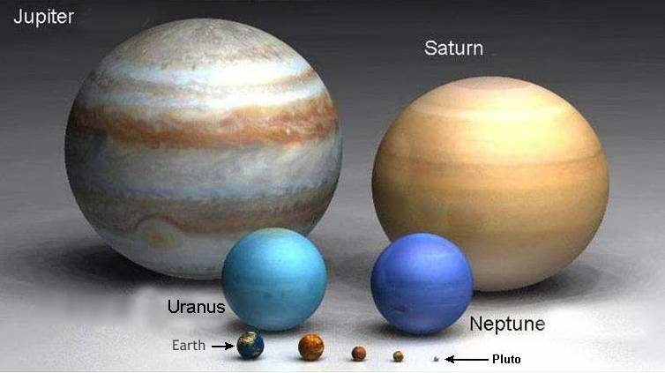
The Planets

Slide 6
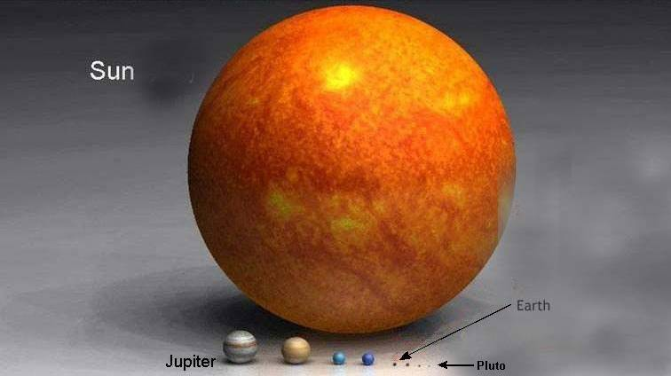
Our Solar System

Slide 7
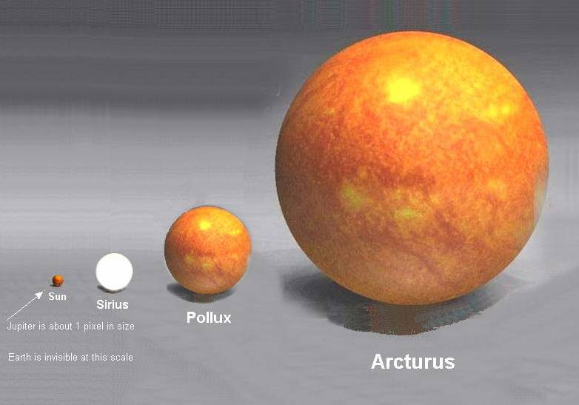
Jupiter = one pixel, Earth = invisible

Slide 8
Earth/Moon Seen by Voyager Spacecraft through Saturn’s Rings

Slide 9
“No matter where I might find myself, every sort of individual which it is possible to imagine in some phase of his development, from the highest to the lowest, at some time exhibited himself to me.”
- William Carlos Williams

Slide 10
Rudolph Virchow
Argued that many diseases result from “the unequal distribution of civilization’s advantages”
Advocated public provision of medical care for the indigent
Promoted universal education

Slide 11
Rudolph Virchow
Worked to outlaw child labor
Improved water distribution and sewage system
Enhanced food inspection process
Published study of skull volumes to dispute myth of larger Aryan brains

Slide 12
Rudolph Virchow
Passed hygiene standards for public schools
Set new standards of training for nurses
Improved local hospital system

Slide 13
Rudolph Virchow
“Doctors are natural attorneys for the poor … If medicine is to really accomplish its great task, it must intervene in political and social life…”

Slide 14
Headline from The Onion
Uninsured Man Hopes His Symptoms Diagnosed This Week On House

Slide 15
Contributors to Morbidity and Mortality
Global Warming – 400K deaths/yr worldwide
Air Pollution – 8M deaths/yr worldwide
Pesticides 200K deaths/yr worldwide, over 1M CAs in current generation of Americans
Maldistribution of wealth (gap is higher in the U.S. than in any other industrialized nation)
Associated with 880,000 deaths per year over expected number if gap was same as in Western European nations
BMJ 2009;339:b4471

Slide 16
Racial Disparities in Health Care: African-Americans
Equalizing the mortality rates of whites and African-Americans would have averted 686,202 deaths between 1991 and 2000
Whereas medical advances averted 176,633 deaths
AJPH 2004;94:2078-2081

Slide 17
Christopher Columbus Upon meeting the Arawaks of the Bahamas
They…brought us…many…things…They willingly traded everything they owned…They do not bear arms…They would make fine servants…With fifty men we could subjugate them all and make them do whatever we want.

Slide 18
Colonial Exploitation
Cecil Rhodes (Rhodesia, Rhodes Scholarship, DeBeers Mining Company):
“We must find new lands from which we can easily obtain raw materials and at the same time exploit the cheap slave labour that is available from the natives of the colonies. The colonies would also provide a dumping ground for the surplus goods produced in our factories.”

Slide 19
Colonial Exploitation
Winston Churchill (speaking in favor of RAF’s “experimental” bombing of Iraqis in 1920s, which killed 9,000 people with 97 tons of bombs):
“I am strongly in favor of using poisoned gas against uncivilized tribes to spread a lively terror…against recalcitrant Arabs as an experiment”

Slide 20
Primo Levi
“A country is considered the more civilized the more the wisdom and efficiency of its laws hinder a weak man from becoming too weak or a powerful one too powerful.”
Notes:
20

Slide 21
Voltaire
“The comfort of the rich rests upon an abundance of the poor”
Notes:
21

Slide 22
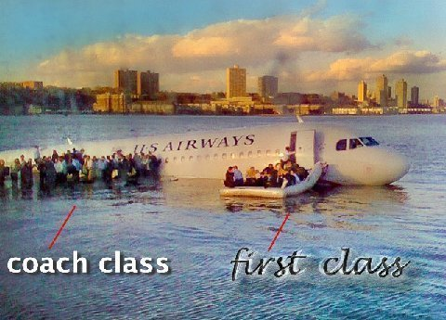
Hudson River, 2009

Slide 23
“The role of the physician … in the preservation and promotion of peace is the most significant factor for the attainment of health for all.”
- World Health Organization

Slide 24
Dwight D. Eisenhower
Every gun that is made, every warship launched, every rocket fired signifies, in the final sense, a theft from those who hunger and are not fed, those who are cold and not clothed.

Slide 25
Thomas Jefferson
“Information is the currency of democracy”

Slide 26
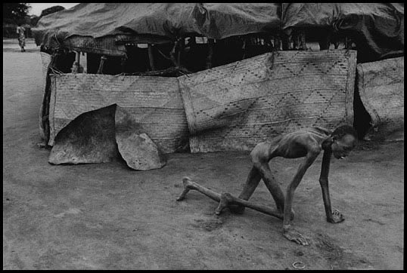
James Nachtwey

Slide 27
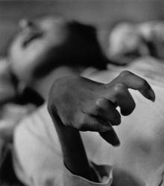

Slide 28
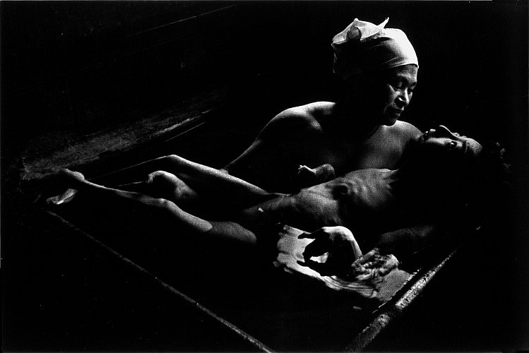

Slide 29
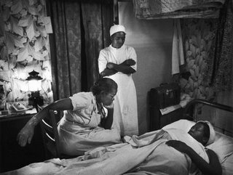

Slide 30
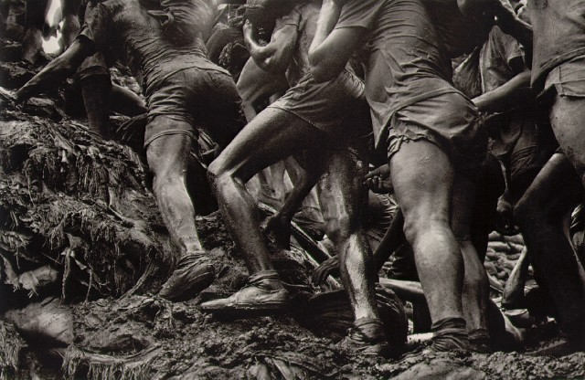

Slide 31
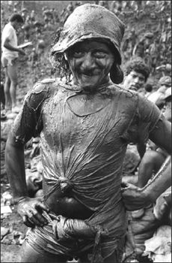

Slide 32
Advice for Students
Appreciate the privilege of practicing medicine
Be humble / know your limits
Contemplate life and death, comfort the grieving
Take care of yourself
Cherish your relationships
Continue your lifelong education
Strive for justice

Slide 33
“First they came for the Jews” by Pastor Niemoller
“First they came for the Jews, and I did not speak up, for I was not a Jew.
Then they came for the communists, and I did not speak up for I was not a communist.
Then they came for the trade unionists, and I did not speak up, for I was not a trade unionist.
Then they came for me, and there was no one left to speak up for me.”

Slide 34
Günter Grass
“The first job of a citizen is to keep your mouth open.”

Slide 35
African Proverb
"If you think you are too small to have an impact, try going to bed with a mosquito in your tent"

Slide 36
Public Health and Social Justice Website and Book
http://www.publichealthandsocialjustice.org
http://www.phsj.org
martindonohoe@phsj.org

