Slide 1
Your Body, Inside and Out
Primary School STEAM Presentation
Martin Donohoe

Slide 2
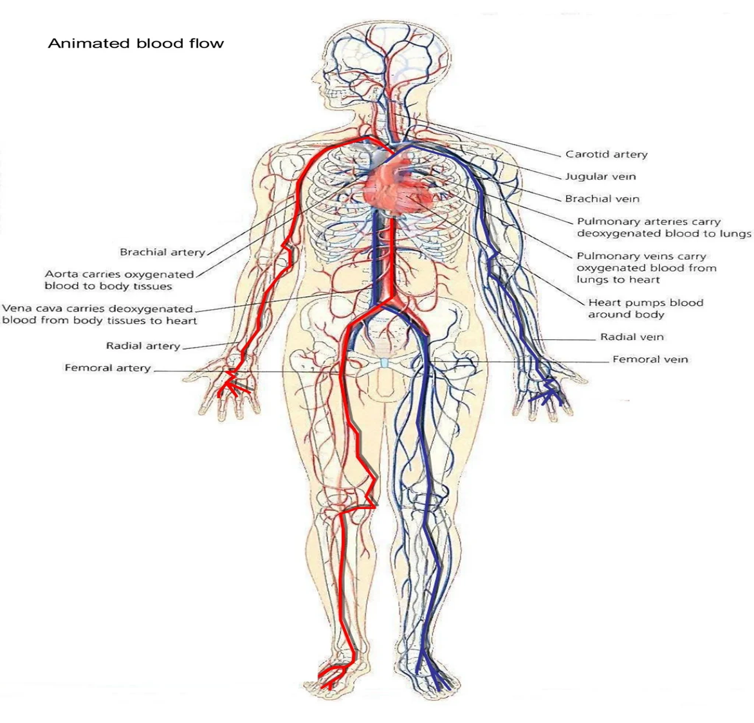
The Circulatory System
Carries oxygen, blood cells and nutrients to the entire body
Controlled by the heart and by nerves that wrap around your blood vessels
You have 97,000 km of blood vessels, enough to go around the equator more than twice

Slide 3
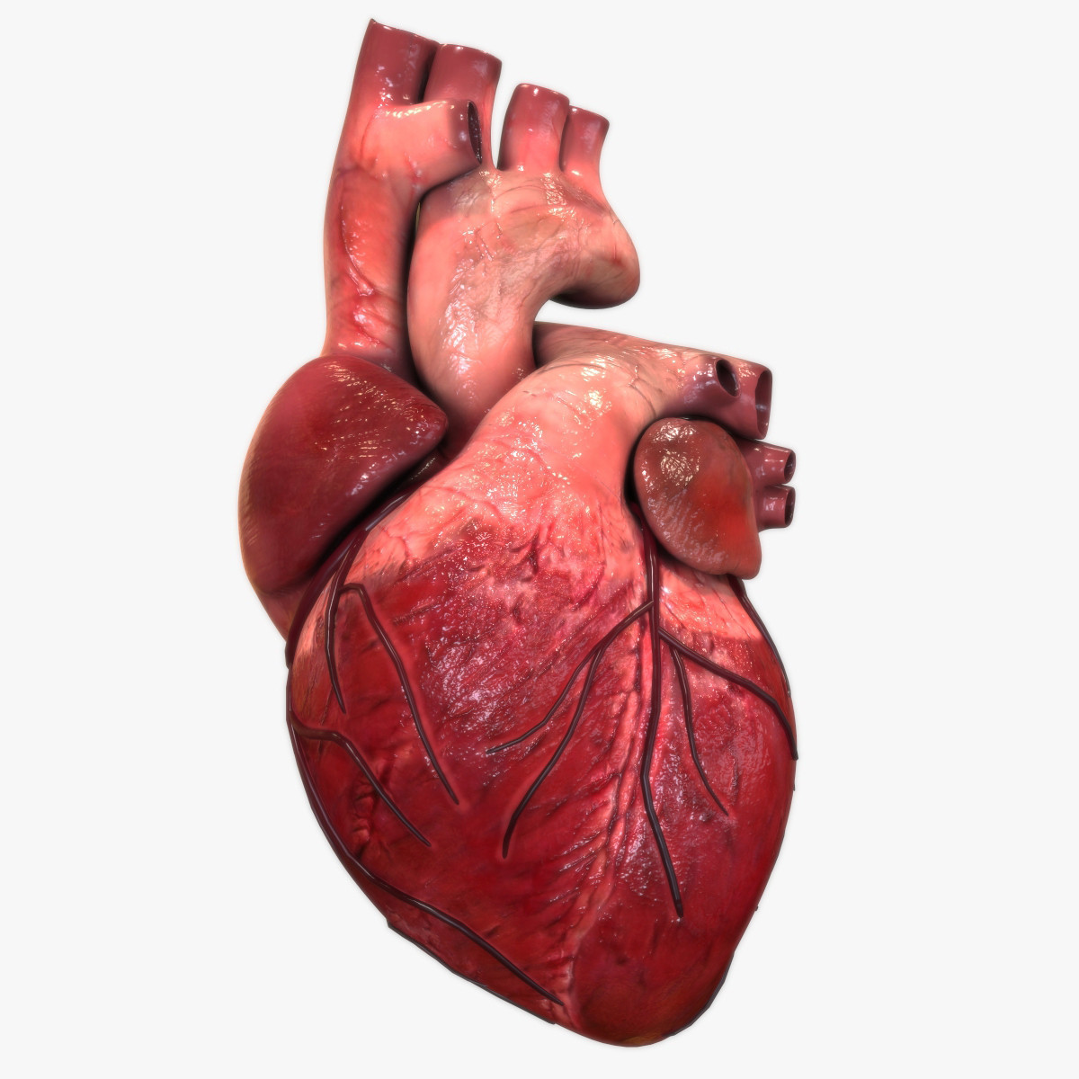
About as big as your fist
Beats 100,000 times per day
Has its own blood supply
Centuries ago, people thought the heart did what we now know the brain does
The animal with the biggest heart is the blue whale (180 kg)

Slide 4
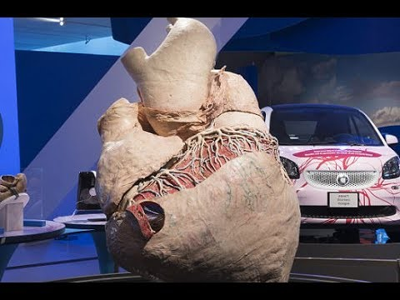
A blue whale’s heart

Slide 5
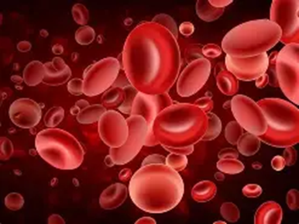
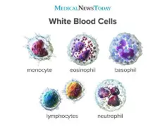
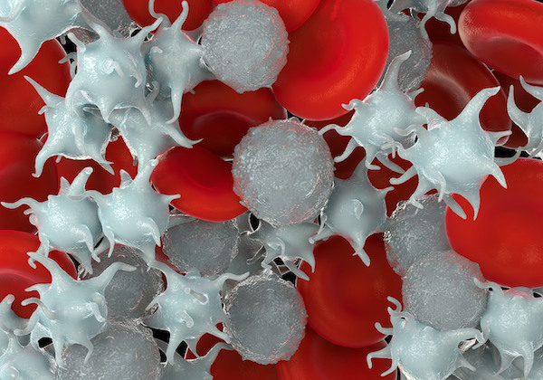
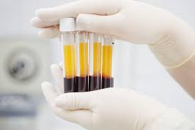
What is in your blood (5 liters volume)
Top left - Red blood cells – carry oxygen to your body
  Top right - White blood cells – fight infections
Bottom left - Platelets –help your blood clot when you get cut
  Bottom right - Red blood cells at the bottom; plasma the blood’s fluid) at the top

Slide 6
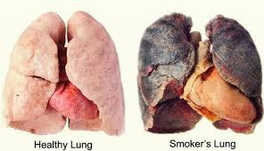
The Lungs
How we breath in oxygen and exhale carbon dioxide (20,000 times a day, without even thinking about it)
Plants then “breathe in” carbon dioxide and “exhale” oxygen
Thus, plants and animals need each other
Smoking and pollution damage the lungs

Slide 7
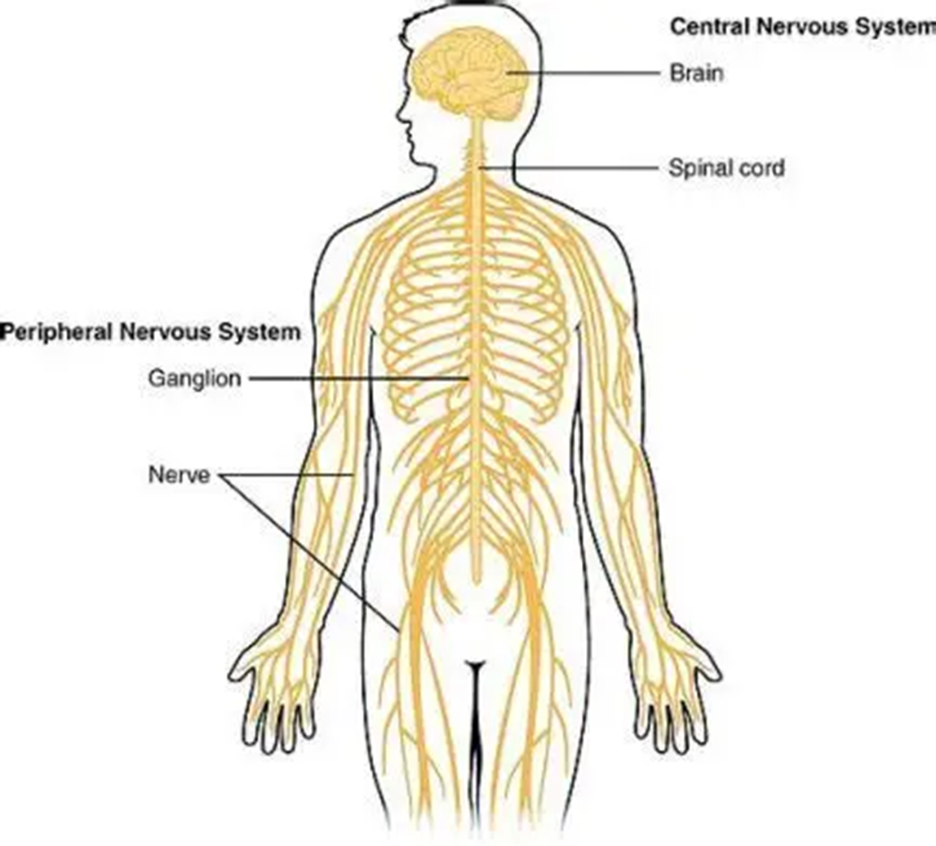
The Nervous System

Slide 8
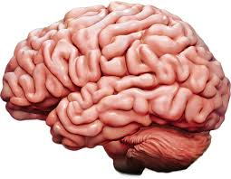
The Brain
The most complex object in the universe
The body’s command and control center
Weighs 1.4 kg
Uses 15% - 20% of the blood pumped by the heart (only the kidneys get more (20% - 25%)

Slide 9
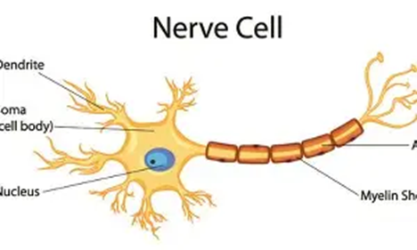
Nerves – How we feel, move, taste, see, and think
Nerve cells work through electricity and chemical messengers
Nerve signals travel very fast (like when you touch a hot pot and remove your hand)
The longest nerve in your body goes from the spinal cord in your lower back to the tips of your toes

Slide 10
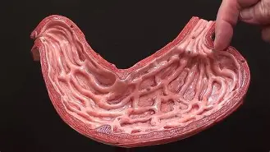
The Stomach
It churns and dissolves food with strong acid, but it does not digest itself thanks to a protective mucous layer
Cows, sheep, and deer have four stomachs
Leeches have ten

Slide 11
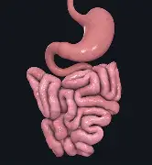
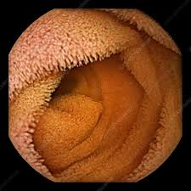
The Small Intestine
Where you absorb nutrients from your food
Food spends most of its time in here
About 5 meters long
Inside are loads of tiny pillars to aid absorption

Slide 12
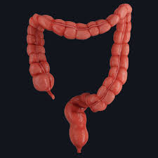
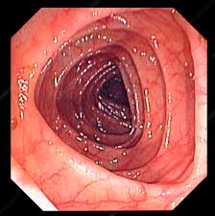
The Large Intestine [ aka The Colon – not the punctuation sign : ]
1.5 meters long, but larger diameter than the small intestine
Water removed from undigested food
Undigested food broken down by trillions of bacteria
End-product is poop – its dry weight contains 50% undigested food and 50% bacteria

Slide 13
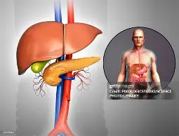
The Liver
The liver cleans the blood and helps you digest food
The pancreas also helps you digest food
Both can be transplanted if yours stops working (so can kidneys)

Slide 14
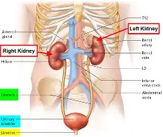
The Kidneys
Filter the blood to make urine and send it to the bladder, which stores it until you are ready to pee
Get the highest percentage of blood flow (20% to 25% of each heartbeat)
Look like kidney beans (hence the name)
Each are the size of a fist
You have two, but can live with only one
Some people have only one that is shaped like a horseshoe

Slide 15
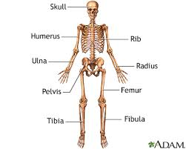
Bones
206 in the adult human body
The last one to finish growing is your clavicle (age 25)
Blood cells are made inside your biggest bones
Strongest bone in body is thigh bone or femur
Teeth are like bone and can last millions of years

Slide 16
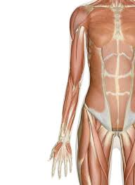
Muscles
Over 600 in your body
The strongest is the masseter of jaw muscle
The hardest working is the heart muscle
Without muscles, we would all fall down

Slide 17
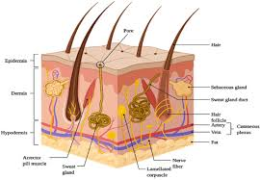
The Skin
Contains protective layers, sweat glands, hair (like an animal’s fur), muscles, blood vessels and nerves
The body’s largest organ by weight (2.7 kg)
Holds everything in and keeps bad stuff out

Slide 18
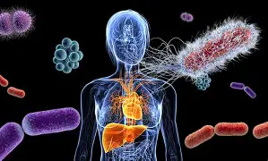
The Microbiome
The 100 trillion bacteria, viruses, and fungi that live on and in us
These creatures outnumber us - there are 1.3 times as many of them as there are human cells in our body
We cannot live without them (and vice versa)
They are important in preventing and causing disease

