Slide 1
Public Health and Social Justice
Martin Donohoe

Slide 2
Perspective
The earth spins at 1,038 mph at the equator, between 700 mph and 900 mph at mid-latitudes
The earth rotates around sun at 18.5 miles/sec
The solar system orbits the center of the Milky Way Galaxy at 137 miles/sec
  One rotation per 225 million years

Slide 3
Perspective
The sun is one of hundreds of billions of stars in the Milky Way Galaxy
The Milky Way is one of between two hundred billion and 2 trillion galaxies in the known universe
The universe may be one of an infinite number of universes

Slide 4
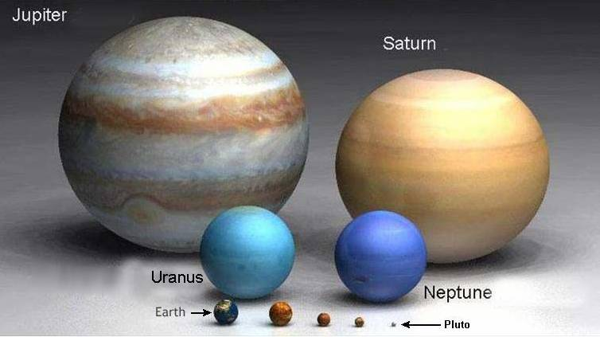
The Planets

Slide 5
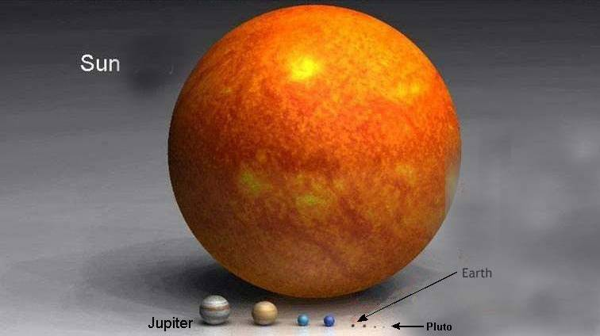
Our Solar System

Slide 6
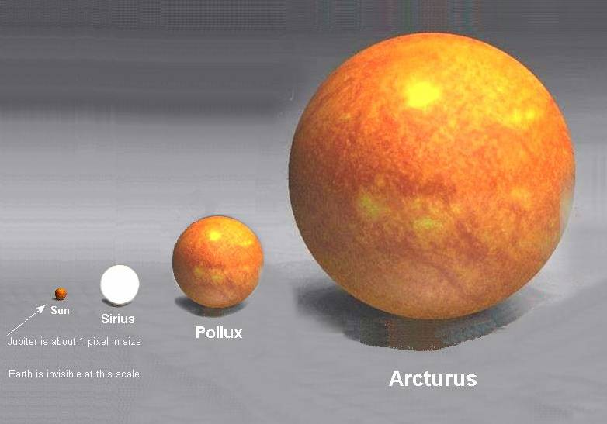
Jupiter = one pixel, Earth = invisible

Slide 7
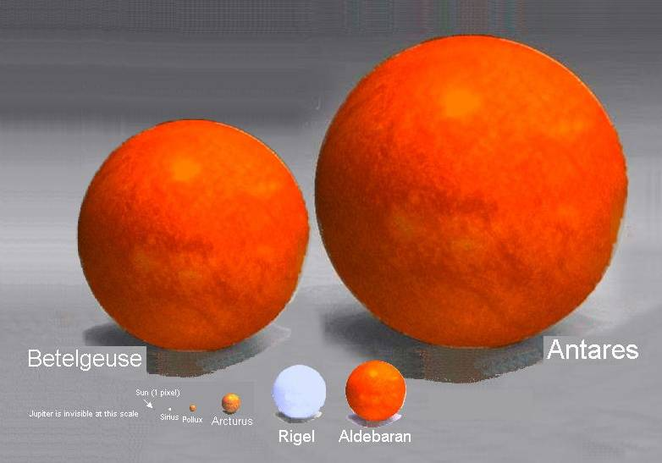
Sun = one pixel, Jupiter = invisible

Slide 8
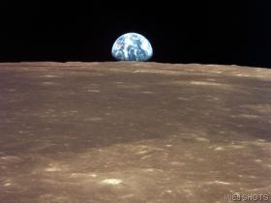
Our Home

Slide 9

Earth/Moon Seen by Voyager Spacecraft through Saturn’s Rings

Slide 10
Am I Stoned?
A 1999 Utah anti-drug pamphlet warns:
“Danger signs that your child may be smoking marijuana include excessive preoccupation with social causes, race relations, and environmental issues”

Slide 11
The State of U.S. Health Care
U.S. health care system ranks 37th/191 countries
U.S. has poorest health among all rich nations
14% of Americans live in poverty
19% of US children live in poverty
Rates of poverty in Blacks and Hispanics = almost 3X Whites

Slide 12
The State of U.S. Health Care
US ranks near the bottom among westernized nations in overall population health, life expectancy, infant and maternal mortality, etc.
  38th in life expectancy (78.9 yrs)
  Infant mortality 76% higher than in other wealthy countries

Slide 13
The State of U.S. Health Care
26 million (8%) uninsured patients
  Approximately 26,000 deaths/year due to lack of health insurance, estimated 200,000 due to underinsurance
Millions more underinsured
  Remain in dead-end jobs
  Go without needed prescriptions due to skyrocketing drug prices

Slide 14
Headline from The Onion
Uninsured Man Hopes His Symptoms Diagnosed This Week On House

Slide 15
Hunger and Poverty
Hunger rate increasing nationally and globally
Poverty associated with worse physical and mental health, poor cognitive development, less sleep

Slide 16
Homelessness
1.5 million homeless over one year (580,000 on average night)
  7% lifetime prevalence
  111,000 chronically homeless (decreasing)
  44% of homeless adults work
Laws criminalizing homelessness; hostile architecture increase stress
Housing subsidies decrease homelessness
Combined income of 10 richest Americans could pay one year’s rent for every homeless person

Slide 17
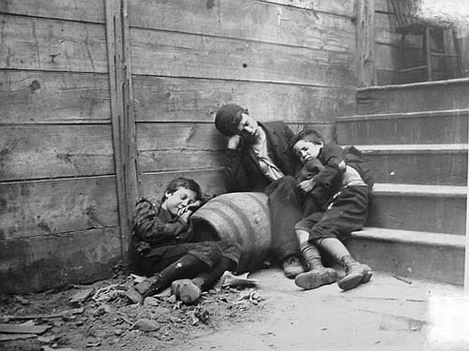
Jacob Riis

Slide 18
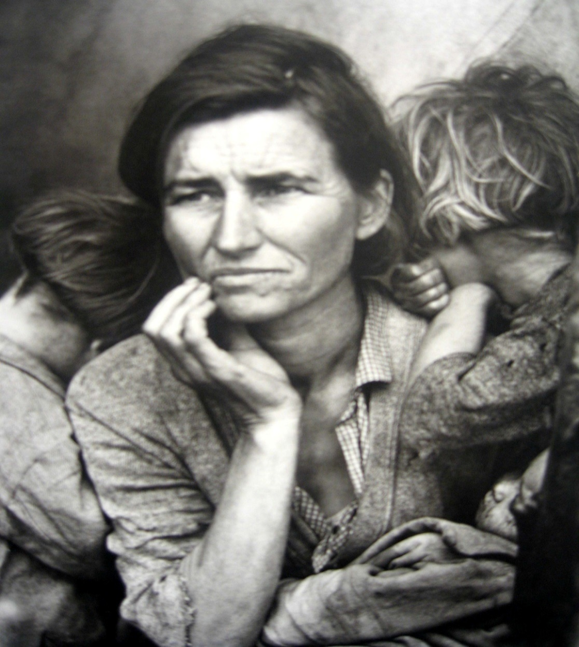
Dorothea Lange

Slide 19
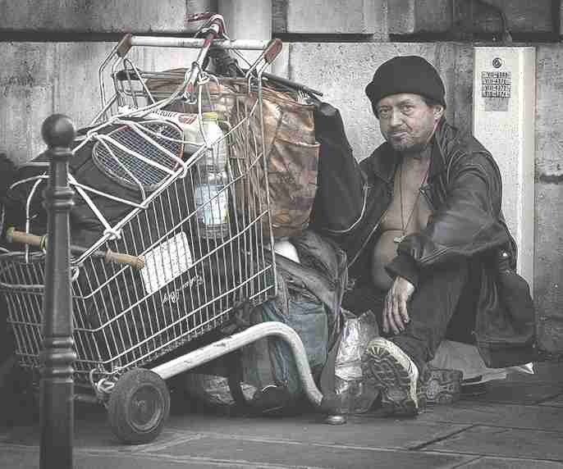

Slide 20
Economic Disparities
Women 85 cents/$1 Men
Median income of black U.S. families as a percent of white U.S. families 62%
  60% in 1968
63% for Hispanic families
Median net worth of white households 10X higher than black households and Latino households

Slide 21
Status of Women
Women do 67% of the world’s work
Receive 10% of global income
Own 1% of all property

Slide 22
Worldwide, every minute
380 women become pregnant (190 unplanned or unwanted)
110 women experience pregnancy-related complications
40 women have unsafe abortions
1 woman dies from childbirth or unsafe abortion
Reason: Lack of access to reproductive health services

Slide 23
Racial Disparities in Health Care Coverage
Percent uninsured:
  Whites = 6%
  Asians = 6%
  African-Americans = 10%
  Hispanics = 18%

Slide 24
Racial Disparities in Health Care:
African-Americans
Higher maternal and infant mortality
Higher death rates for most diseases
Shorter life expectancies
Undergo fewer diagnostic tests / therapeutic procedures
Notes:
24
24

Slide 25
Racial Disparities in Health Care:
Latinos
Higher rates of:
  Overweight and obesity
  Certain cancers
  Stroke
  Diabetes
  Asthma/COPD
  Chronic liver disease/cirrhosis
  HIV/AIDS
  Homicide

Slide 26
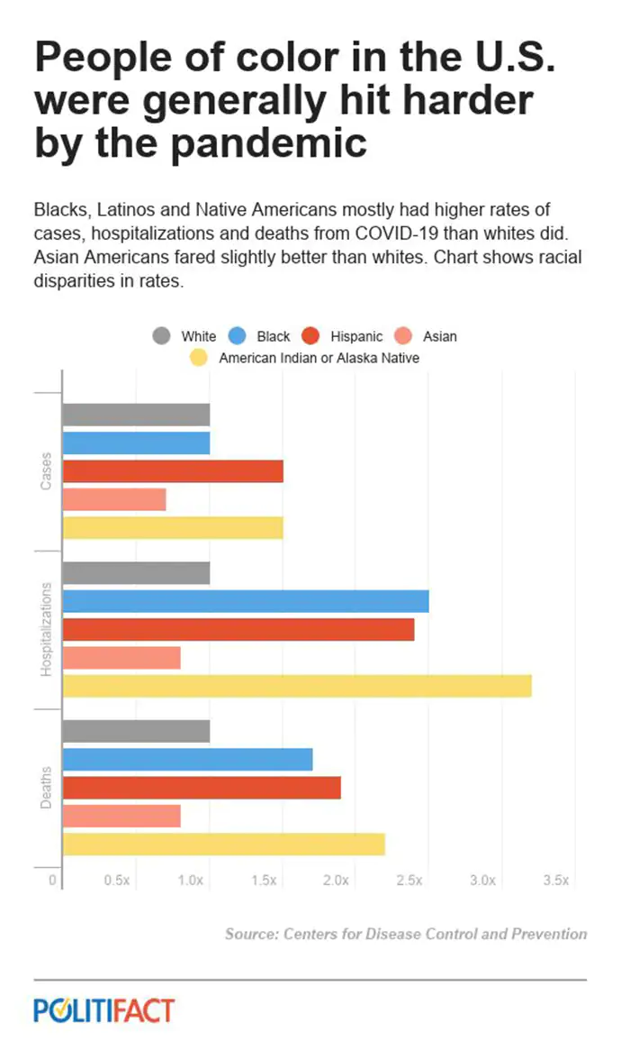

Slide 27
Racial Disparities in Health Care:
African-Americans
Equalizing the mortality rates of whites and African-Americans would have averted 686,202 deaths between 1991 and 2000
  Whereas medical advances averted 176,633 deaths
    AJPH 2004;94:2078-2081

Slide 28
Racism in the Criminal Justice System
Persons of color are more likely than whites to be:
  Stopped by the police (e.g., “Driving while black”)
  Abused by the police
  Arrested
  Denied bail
  Charged with a serious crime
  Convicted
  Receive a harsher sentence

Slide 29
Race and Detention Rates
African-Americans: 1,815/100,000
  More black men behind bars than in college
Latino-Americans: 609/100,000
Caucasian-Americans: 235/100,000
Asian-Americans: 99/100,000

Slide 30
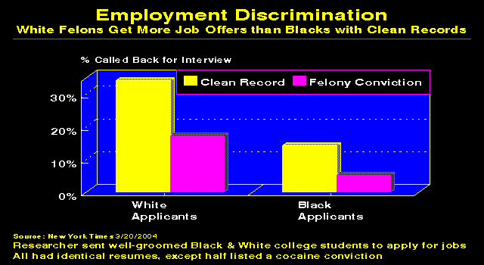

Slide 31
Environmental Degradation:
Causes
Overpopulation
Pollution
Deforestation
Global Warming
Unsustainable Agricultural/Fishing Practices
Overconsumption / Affluenza
Militarization

Slide 32
Environmental Degradation
Consequences
Increased poverty and overcrowding
Famine
  Loss of arable land - Ecological footprint (22 hectares/person) exceeds Earth’s biological capacity (16 hectares/person)
Weather extremes, storms, fires
  5 million deaths/year

Slide 33
Consequences of
Environmental Degradation
Species loss
Medical illnesses
  Including infectious diseases
Death (1/6 of world’s yearly deaths linked to contaminated air, water, soil, and workplaces)
War
Unsustainable

Slide 34
Consequences of Pesticides
EPA: U.S. farm workers suffer up to 300,000 pesticide-related acute illnesses and injuries per year (EPA)
  25 million cases/yr worldwide
Pesticides in food could cause up to 1 million cancers in the current generation of Americans (NAS)
  Linked to autism, Parkinson’s Disease, Alzheimer’s disease, diabetes, obesity (with prenatal exposure), depression, ADHD, breast cancer
1,000,000 people killed by pesticides every 6 years (WHO); 200,000/yr worldwide (UN)
Notes:
34
34

Slide 35
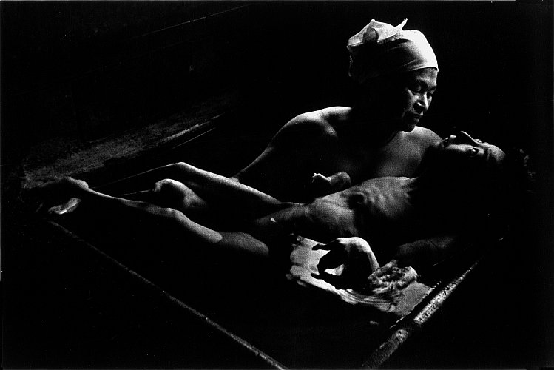
W Eugene Smith: Minamata Disease
Methylmercury Poisoning

Slide 36
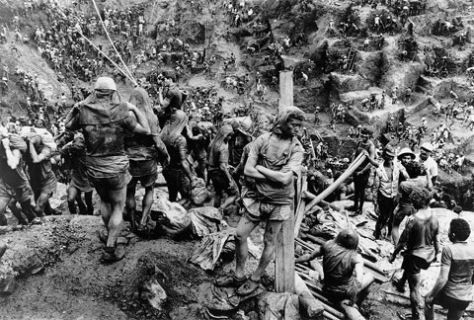
Sebastiao Salgado: Mining

Slide 37
Overconsumption (“Affluenza”)
U.S. = 4.5% of world’s population
  Owns 50% of the world’s wealth
U.S. responsible for:
  25% of world’s energy consumption
  33% of paper use
  72% of hazardous waste production

Slide 38
But Are We Happier?
U.S. ranks 24th in citizen satisfaction with quality of life
Average American works 200 more hrs/yr than in 1960 (#1 in world)
Vacations shorter
Notes:
38
38

Slide 39
But Are We Happier?
No federally guaranteed paid sick or maternity leave
  Although many cities, some states now guarantee
8/10 Americans want a new job
Fewer close friends
More loneliness/depression
  Loneliness linked to physical illness and functional and cognitive decline and eclipses obesity as a predictor of early death

Slide 40
Meanwhile, Outside the US…
700 million people lack access to safe, clean drinking water
2.3 billion lack adequate sanitation services
25,000 people starve to death daily (1 Hiroshima every 2.5 days)
Gaza, South Sudan

Slide 41
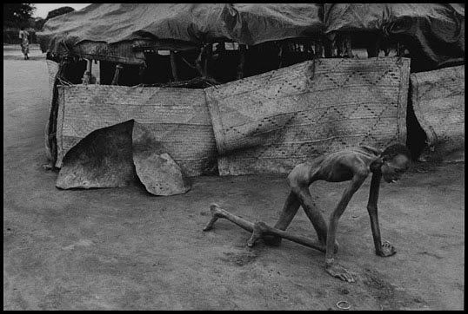
James Nachtwey

Slide 42
Maldistribution of Wealth - Worldwide
Richest 1% (net worth of $800,000+) owns 48% of the world’s wealth
Top 26 billionaires worth $1.4 trillion, the combined income of bottom 3.8 billion people (1/2 of world’s population)

Slide 43
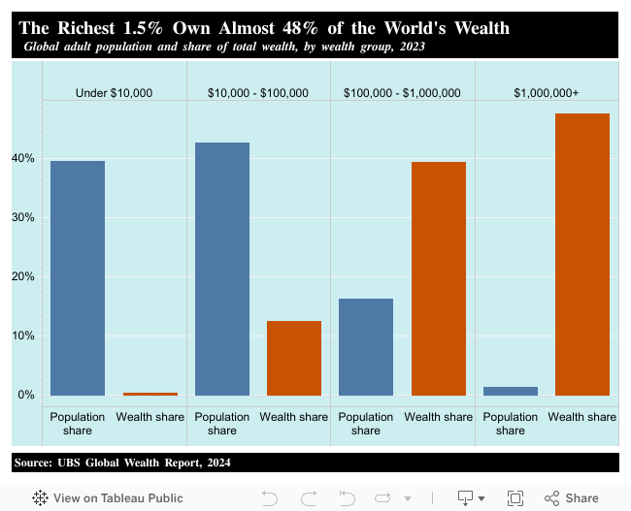

Slide 44
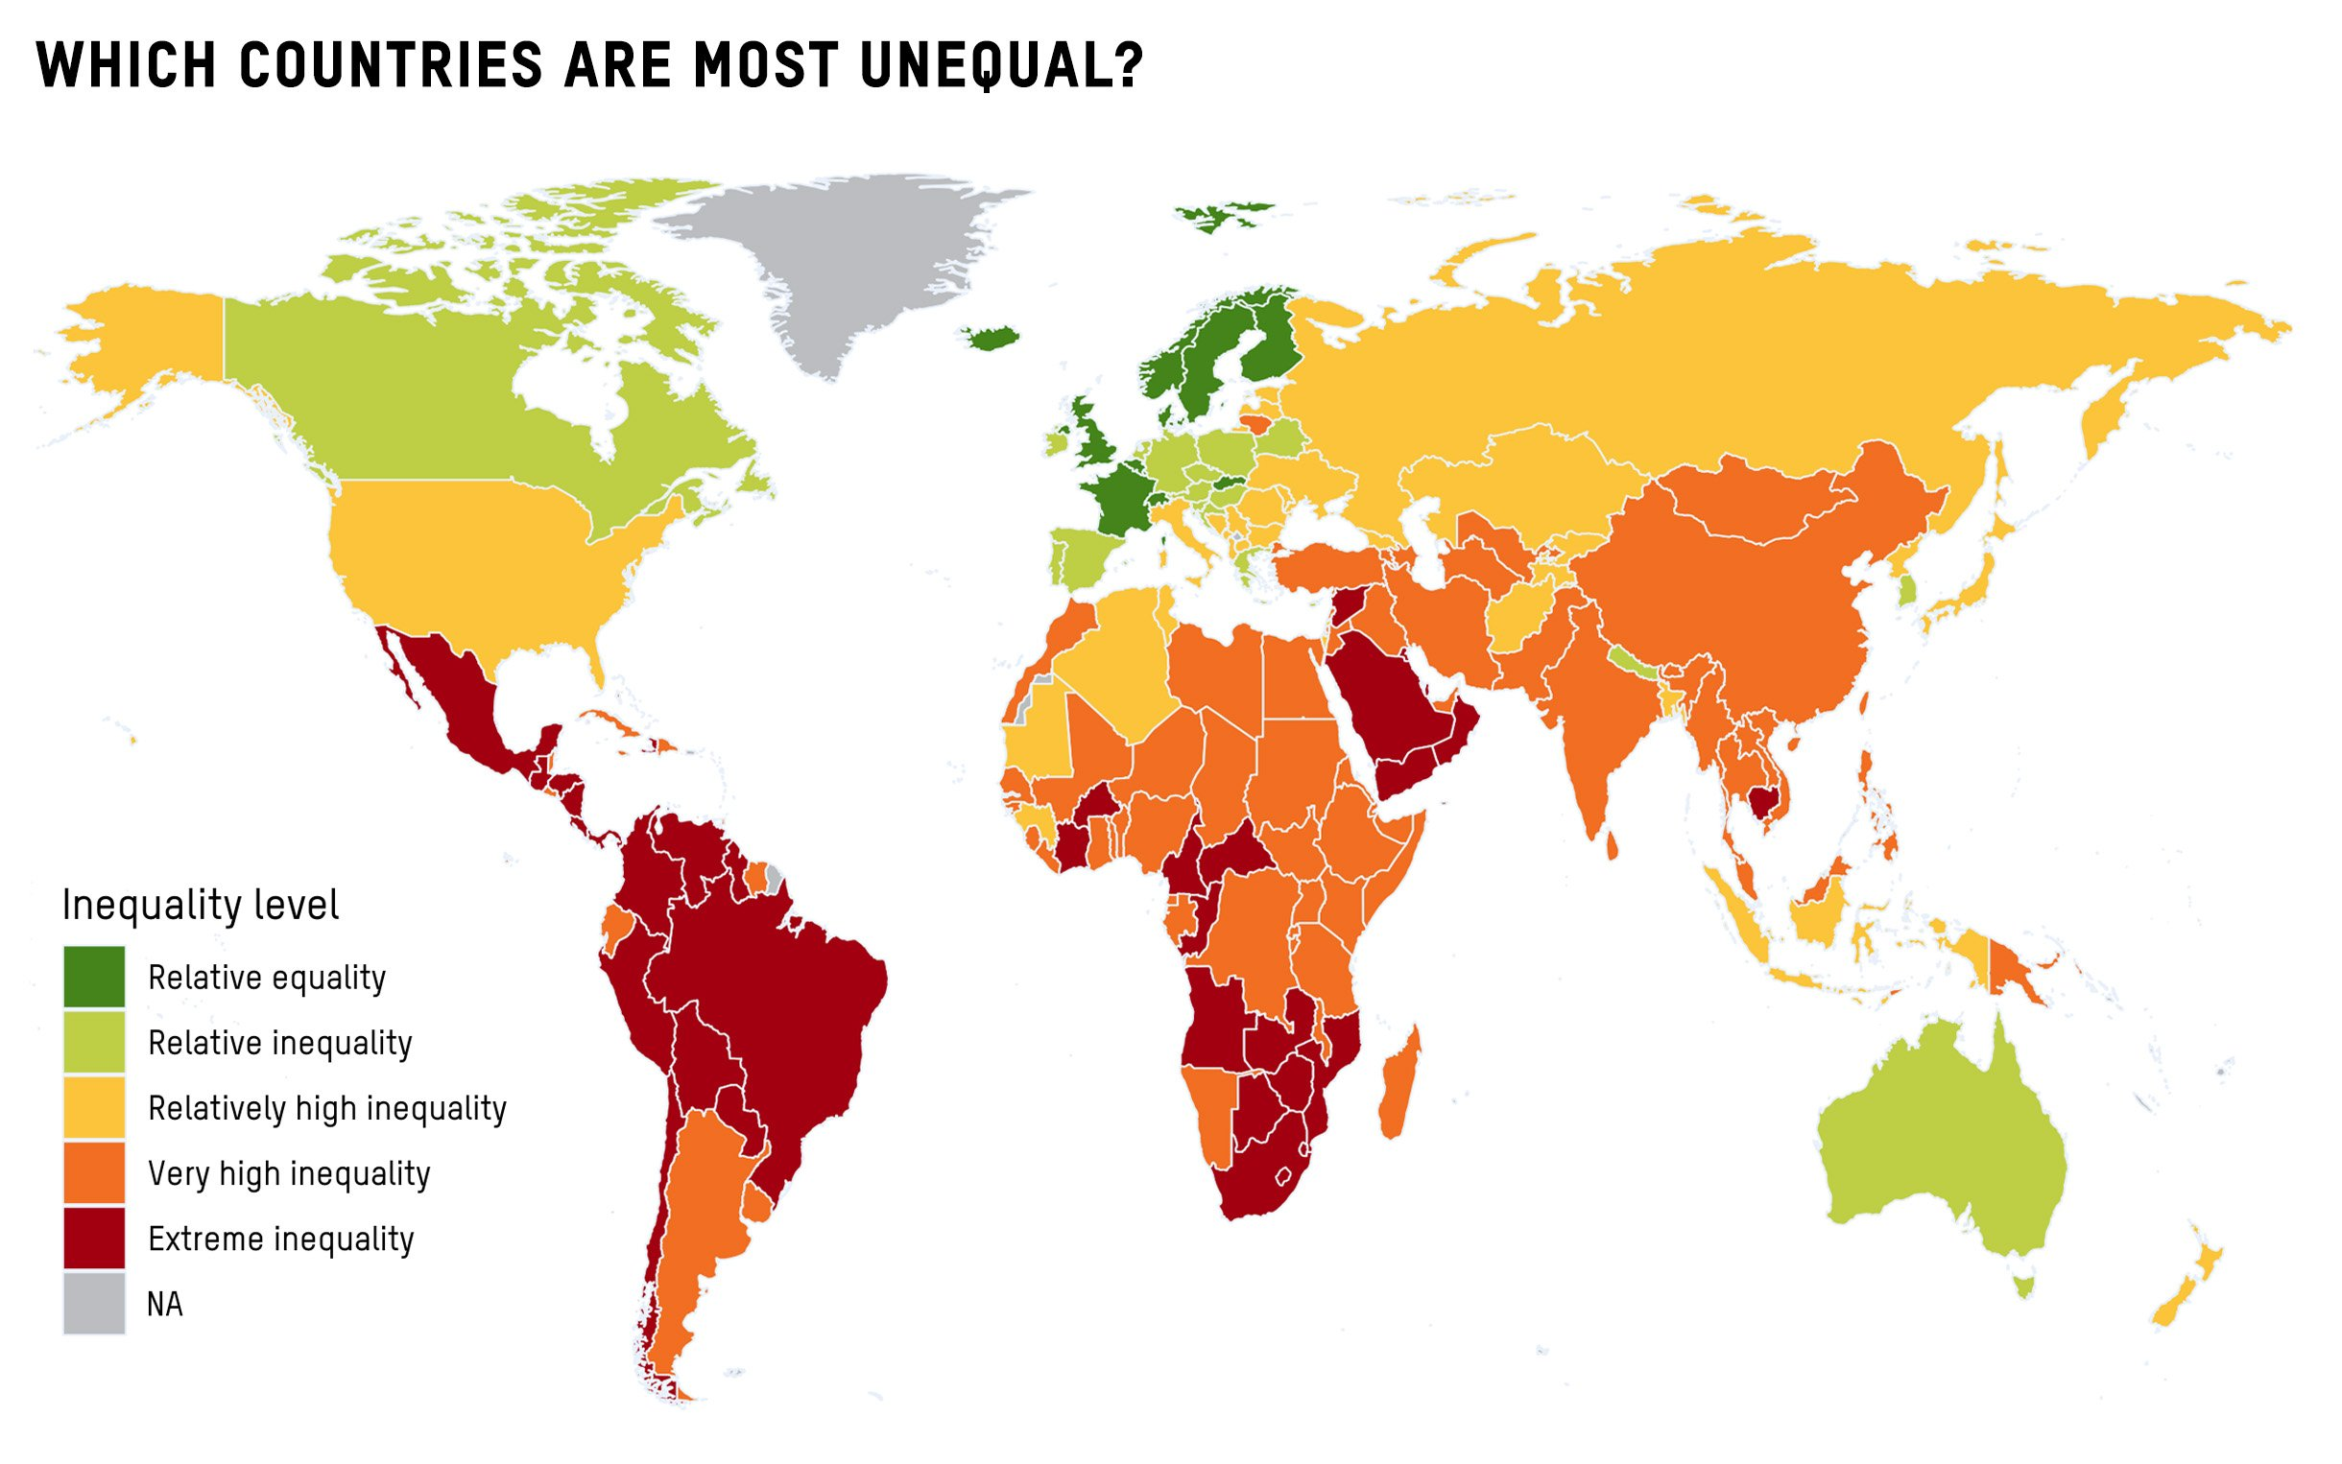

Slide 45
Maldistribution of Wealth - US
U.S: Richest 1% of the population owns 50% of the country’s wealth; poorest 90% own 30%
  Widest gap of any industrialized nation
  3 richest men in the US have more wealth than 50% of the population

Slide 46
Income Inequality Kills
Higher income inequality is associated with increased morbidity and mortality at all per capita income levels
Notes:
46

Slide 47
Maldistribution of Wealth is Deadly
Up to 880,000 deaths/yr in U.S. would be averted if the country had an income gap like Western European nations, with their stronger social safety nets
  Popul Res Policy Rev. 2023 Mar 22;42(2):27
Another 500,000 from mishandling of covid epidemic
  JAMA Health Forum: 2025; 6(5)
  Other estimates up to 1 million

Slide 48
Voltaire
“The comfort of the rich rests upon an abundance of the poor”

Slide 49
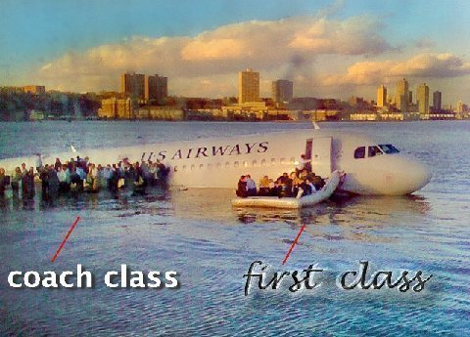
Hudson River, 2009

Slide 50
Primo Levi
“A country is considered the more civilized the more the wisdom and efficiency of its laws hinder a weak man from becoming too weak or a powerful one too powerful.”

Slide 51
Wars
Over 250 wars in 20th Century
Most deaths among civilians
Militarism and war divert financial and intellectual resources away from social needs
Weapons of mass destruction

Slide 52
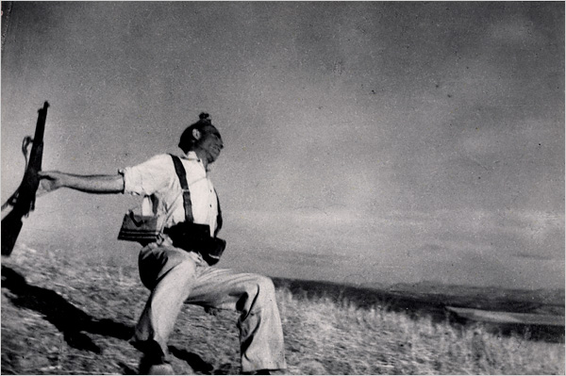
Robert Capa

Slide 53
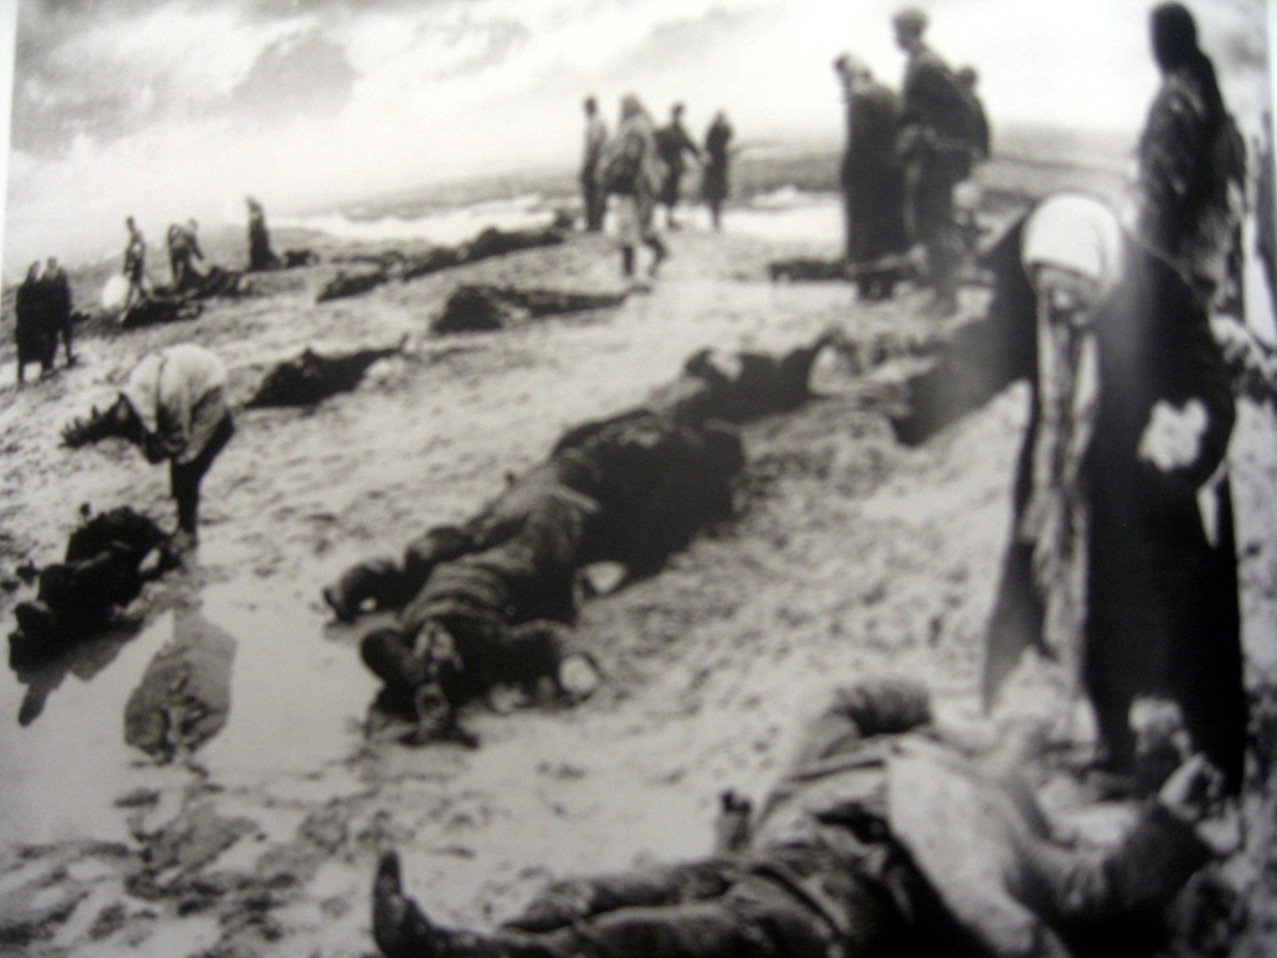

Slide 54
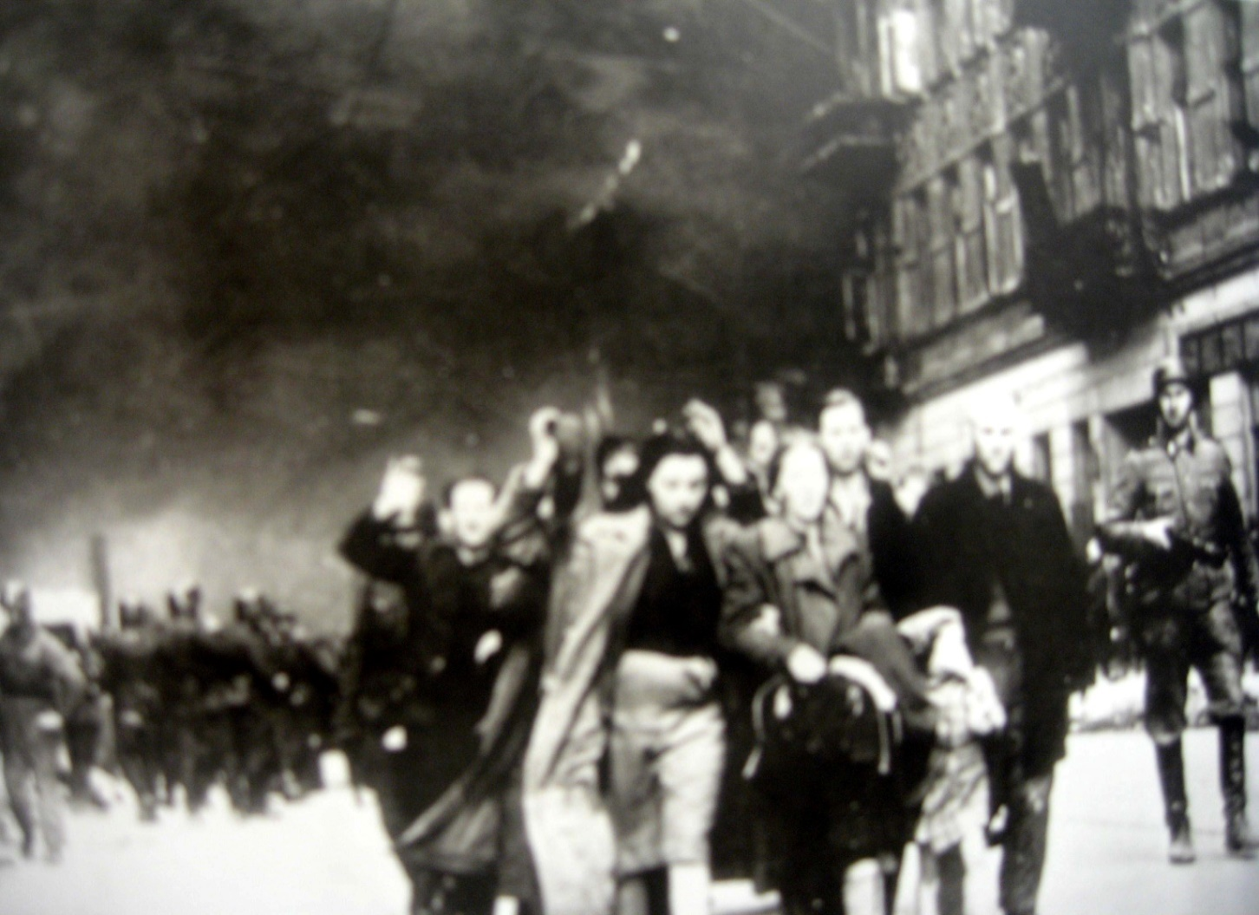

Slide 55
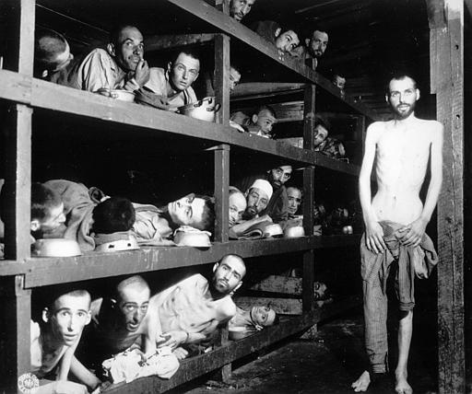

Slide 56
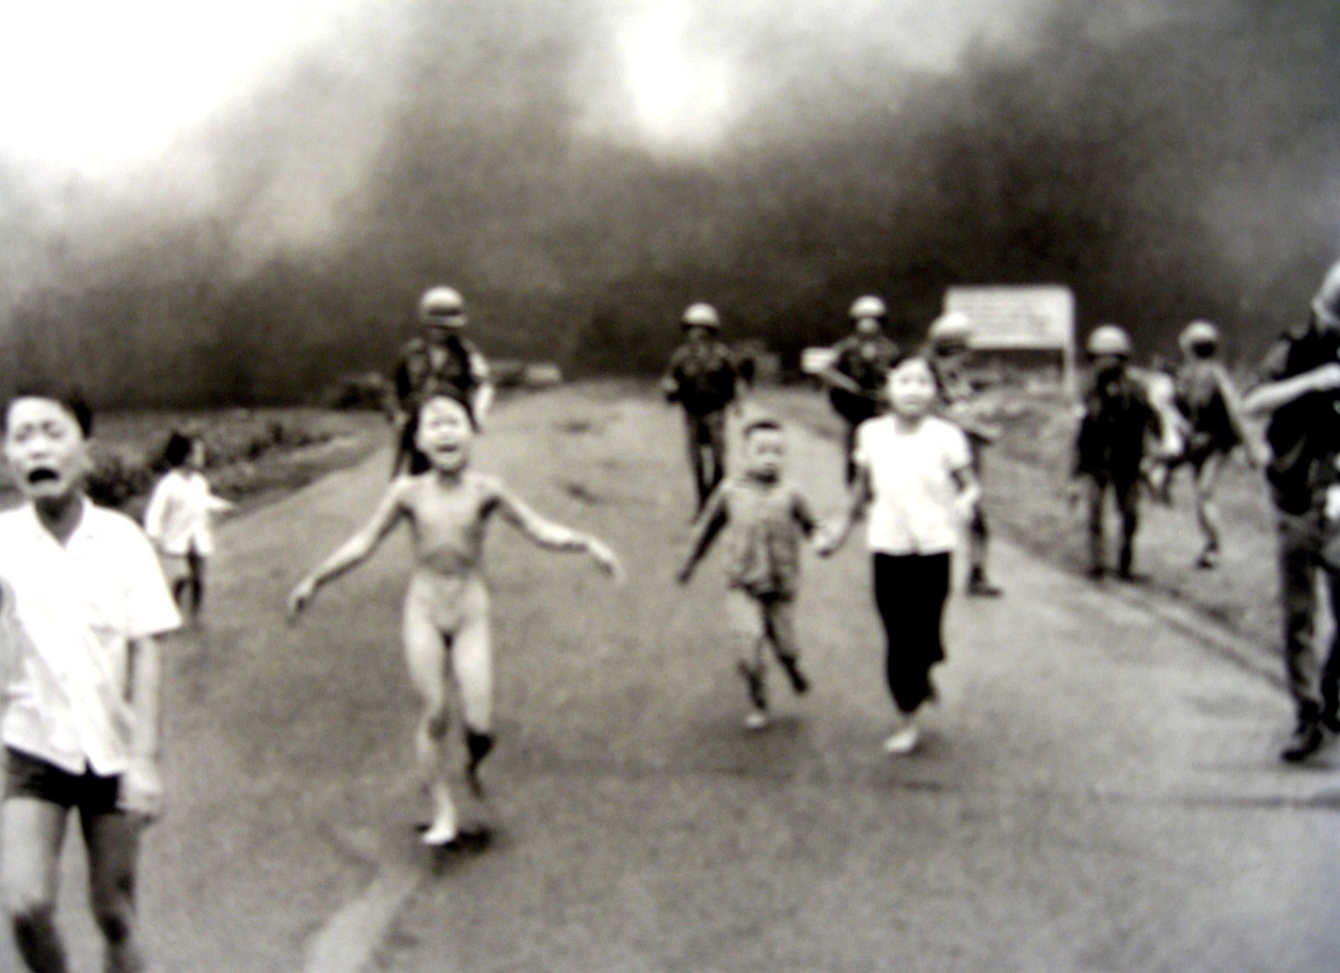

Slide 57
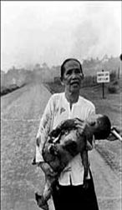

Slide 58
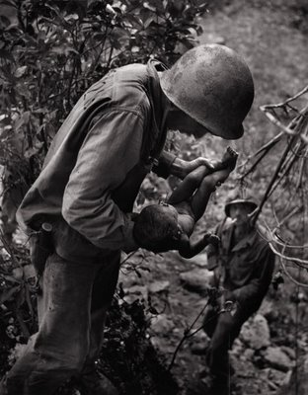
W Eugene Smith

Slide 59
Competitive Strategies of Financially-Strapped Academic Medical Centers
Close public and charity hospitals
Charging the uninsured higher prices
Recruit wealthy, non-U.S. citizens as patients
Increase cash services and reimbursable, covered services
Develop concierge clinics

Slide 60
The Medical Brain Drain
U.S. (4.5% of world’s population) has 8% of world’s doctors and 7% of world’s nurses
U.S. – 280 physicians/100K people (vs. sub-Saharan Africa – 20/100K people)
Five times as many migrating doctors flow from developing to developed nations than in the opposite direction

Slide 61
Corporations Dominate the Global Economy
69 of the world’s 100 largest economies are private corporations; 31 are countries
  Wal-Mart has more annual revenue than Spain and Australia
  Royal Dutch Shell > Mexico
  United Health Group > Denmark and Saudi Arabia

Slide 62
Corporations
90% of transnational corporations headquartered in Northern Hemisphere
500 companies control 70% of world trade
Corporations shouldered over 30% of the nation’s tax burden in 1950 vs. 8% today

Slide 63
Corporations
Purpose: Make money for shareholders
Internalize profits
Externalize health and environmental costs

Slide 64
The Stock Market
The top 1% of Americans owns 35% of all stocks, bonds, and mutual fund assets
48% of Americans own no stock
Consequences of Differential Stock Ownership
  Corporations are answerable to their shareholders
  Governments are answerable (at least in theory) to their citizens (either through elections or revolutions)

Slide 65
Ignorance, Pseudoscientific Beliefs, and Misconceptions Widespread
Geographical
Environmental
Basic science
Health care
  Reproductive care
  Vaccines

Slide 66
Scientific Ignorance - US
Would you sign a petition to ban dihydrogen monoxide?
1. It can cause excessive sweating and vomiting
2. It is a major component in acid rain
3. It can cause severe burns in its gaseous state
4. It can kill you if accidentally inhaled
5. It contributes to erosion
6. It decreases effectiveness of automobile brakes
7. It has been found in tumors of terminal cancer
patients

Slide 67
Ignorance, Pseudoscientific Beliefs, and Misconceptions Widespread
Fueled by proliferation of fake news, poor reporting, religious superstitions, advertising, corporate public relations, politicians, and inadequate education
See Science and Pseudoscience page of phsj website for extensive slide show

Slide 68
Trump Administration
Trump: narcissistic, sociopathic, xenophobic, racist, ignorant, anti-science, ecocidal, misogynistic, convicted felon, adjudicated sex offender
President, agency heads, Congress and Supreme Court undoing decades of public health advances
Lies and misstatements (31,000 total - 21/day during first term)

Slide 69
Bad Policies Kill
Extremely conservative estimate (JAMA 2018;319:2261-2) is that Trump environmental agenda will lead to 80,000 extra deaths/decade and respiratory problems for many more than 1 million people
Updated ProPublica study (https://www.propublica.org/article/trump-climate-rollbacks-heat-deaths - 2025) estimates 1.3 million additional temperature-related deaths over the next decade

Slide 70
Bad Policies Kill
Botching of coronavirus pandemic (US deaths could have been 40% lower had our rates mirrored those of other high-income nations, meaning 180,000 fewer lives lost – Lancet, 2-10-2021)

Slide 71
Mahatma Gandhi
“You must be the change you want to see in the world”

Slide 72
Political Solutions
Vote
Run for office
Lobby legislators (visits > calls > letters > emails)

Slide 73
Power to the People, Not the Corporations
Support living wage laws
Restructure tax system
Combat corporate crime

Slide 74
Campaign for Fair and Representative Elections
Publicly financed campaigns and campaign finance reform
Proportional representation
Instant runoff (ranked choice) voting/cumulative voting/range (rating) voting
Halt disenfranchisement, overturn voter restriction laws

Slide 75
Save the Planet Together
Combat environmental degradation and global warming
  E.g., reduce/reuse/recycle
Support local economies and fair trade policies
Base solutions to environmental threats on the precautionary principle

Slide 76
Solutions
Overcome legacy of exploitation
Encourage international cooperation

Slide 77
Colonial Exploitation
Christopher Columbus’ log entry upon meeting the Arawaks of the Bahamas:
“They…brought us…many…things…They willingly traded everything they owned…They do not bear arms…They would make fine servants…With fifty men we could subjugate them all and make them do whatever we want.”

Slide 78
Colonial Exploitation
Cecil Rhodes (Rhodesia, Rhodes Scholarship, DeBeers Mining Company):
“We must find new lands from which we can easily obtain raw materials and at the same time exploit the cheap slave labour that is available from the natives of the colonies. The colonies would also provide a dumping ground for the surplus goods produced in our factories.”

Slide 79
U.S. International Non-Cooperation/Isolationism
Failure to sign or approve:
  Kyoto Protocol on Climate Change
    Paris Agreement signed, then revoked by Trump, then re-joined by Biden
  Convention on the Prohibition of Anti-Personnel Land Mines
  Convention on Cluster Munitions
  Comprehensive Nuclear Test Ban Treaty

Slide 80
U.S. International Non-Cooperation/Isolationism
Failure to sign or approve:
  Convention on the Rights of the Child
  Convention on the Elimination of Discrimination Against Women
  Convention for the Suppression of Traffic in Persons
  UN Declaration of the Rights of Indigenous Peoples

Slide 81
U.S. International Non-Cooperation/Isolationism
Failure to sign or approve
  UN Convention on the Rights of Disabled Persons
  The Stockholm Convention on Persistent Organic Pollutants
  WHO International Code of Marketing of Breast Milk Substitutes
  Treaty on the Prohibition of Nuclear Weapons

Slide 82
Promote Fairness and Prevention
More equitable distribution of medical research funds and health care dollars
Focus on prevention
  40% of US mortality due to tobacco, obesity, and alcohol abuse
  Every $1 invested in prevention saves $5.60 in health care costs

Slide 83
Foreign Aid
US ranks 1st in total dollars ($35 billion in 2019 = $95.52/person), but 21st in the world in foreign aid as a percentage of GDP
More money flows out of developing countries in the form of interest payments, profits of foreign corporations, and clandestine investments in financial markets of rich countries than flows into them as loans, aid, and foreign direct investment

Slide 84
Foreign Aid
Americans think that 25% of the federal budget goes toward foreign aid (reality = 1.2%)
Americans spend more each year/person on candy ($150) than the government spends/person on foreign aid ($144)
Notes:
84
84

Slide 85
Foreign Aid
U.S. Aid: Over 1/3 military, 1/4 economic, 1/3 for food and development
Most U.S. aid benefits U.S. corporations
Notes:
85
85

Slide 86
U.S. Charitable Giving
2.5% of income
2.9% at height of Great Depression
Notes:
86
86

Slide 87
Poverty and Priorities
Amount of money needed each year (in addition to current expenditures) to provide water and sanitation for all people in developing nations = $9 billion
Amount of money spent annually on cosmetics in the U.S. = $8 billion
One week of developed world farm subsidies = Annual cost of food aid required to eliminate world hunger

Slide 88
Eliminating Hunger
UN FAO: enough food produced daily to provide every living person with over 2700 calories/day
  Half the world’s food is wasted (UN FAO)
Hunger: solution requires political will

Slide 89
Recommendations for Medical Education and Practice
Free medical school tuition, possibly associated with service requirements
Increased focus on the patient (bedside teaching, patient education)
Decrease disparities in pay between generalists and subspecialists; increase pay for cognitive work

Slide 90
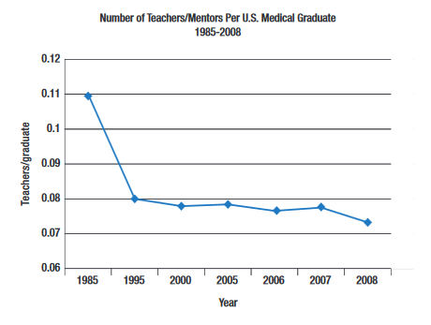
More Teachers/Mentors
(Pharos 2018:32-4)

Slide 91
Recommendations for Medical Education and Practice
Improve prevention, identification, and treatment of mental illness and burnout
  Physicians have the highest suicide rate of any profession; more than twice that of the general population
  Burnout symptoms in over 50% of U.S. physicians

Slide 92
Moral Injury
The accumulation of moral injustices that occur when we are forced to perpetrate, bear witness to, or fail to prevent acts that transgress our deeply held moral beliefs, due to conflicting demands and allegiances involving multiple stakeholders beyond the patient

Slide 93
Recommendations for Medical Education and Practice
Greater attention to public health and social justice
Increased focus on the arts and humanities, including the rich history of medicine

Slide 94
Become Active
Community partnerships
Volunteering
Advocate for the rights of women and minorities
Find your passion

Slide 95
Advice for Students
Appreciate the privilege of practicing medicine
Be humble / know your limits
Contemplate life and death, comfort the grieving
Take care of yourself
Cherish your relationships
Continue your lifelong education
Strive for justice

Slide 96
Work Together
“Never doubt that a small group of thoughtful, committed people can change the world. Indeed, it is the only thing that ever has.“
- Margaret Mead

Slide 97
Speak Up for the Disenfranchised
“The first job of a citizen is to keep your mouth open.”
Günter Grass

Slide 98
Nathan Francis Mosell, MD
Co-founder of NMA and NAACP
“If you have never been called a radical,… you should begin to examine your conscience. It means that you have never done anything for anyone but yourself.”

Slide 99
“First they came for the Jews” by Pastor Niemoller
“First they came for the Jews, and I did not speak up, for I was not a Jew.
Then they came for the communists, and I did not speak up for I was not a communist.
Then they came for the trade unionists, and I did not speak up, for I was not a trade unionist.
Then they came for me, and there was no one left to speak up for me.”
Notes:
99

Slide 100
Have Faith in Your Ability to Affect Change
"If you think you are too small to have an impact, try going to bed with a mosquito in your tent“
- African Proverb
Notes:
100

Slide 101
Public Health and Social Justice Website
http://www.publichealthandsocialjustice.org
http://www.phsj.org
martindonohoe@phsj.org

