Slide 1
Health Care:
U.S. and Worldwide
Martin Donohoe
(Including some slides thanks to PNHP and Drs. Adam Gaffney, Steffie Woolhandler, and David Himmelstein)

Slide 2
Determinants of Health
Era
Socioeconomic status
Sex
Race
Location
Environment
Genetics
Health Habits
Access to Care
Quality of Care

Slide 3
Health Care
Prevention
Diagnosis
Treatment

Slide 4
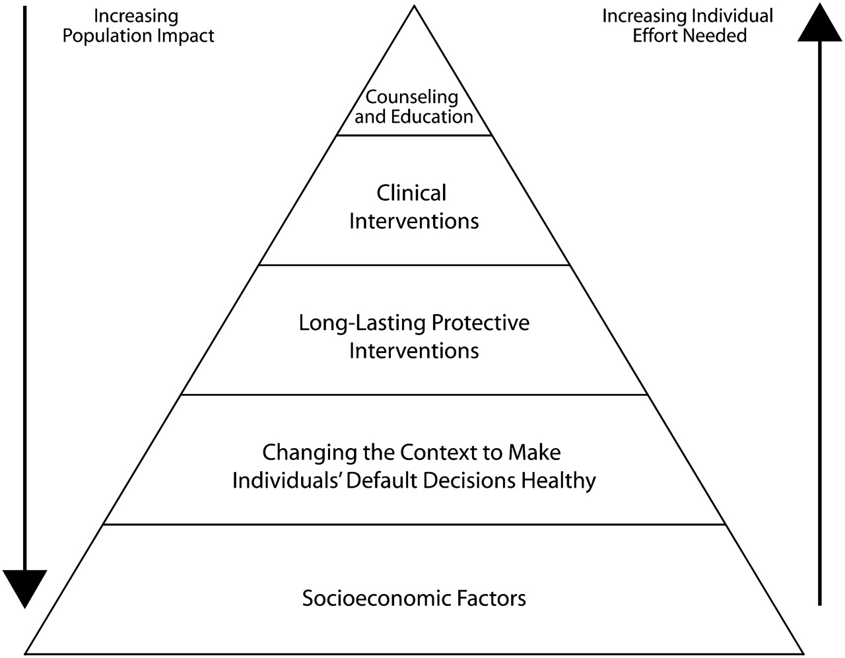

The health impact pyramid
Frieden, T. R. Am J Public Health 2010;100:590-595
Copyright ©2010 American Public Health Association

Slide 5
The State of U.S. Health Care
Before PPACA: 42 million (13%) uninsured and 45,000 deaths/year
  Now 26 million uninsured (8%, 2023)
  Estimated 45,500 deaths/yr (2023)
    Much of rise due to US mishandling of Covid pandemic
    US mortality rate 3rd worst in world, over 1 million victims

Slide 6
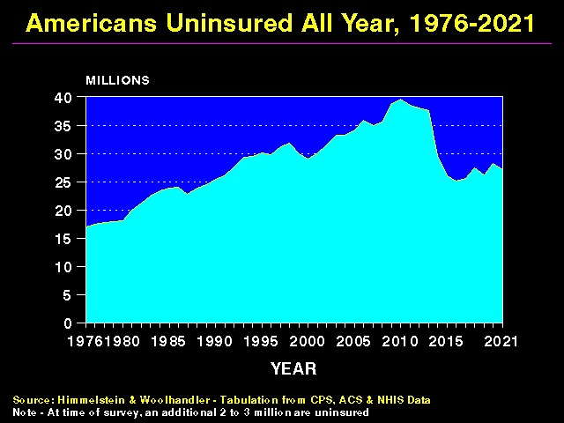

Slide 7
The State of U.S. Health Care
43% of individuals aged 19-64 are underinsured
  Remain in dead-end jobs
  Go without needed care and/or prescriptions
  Marry

Slide 8
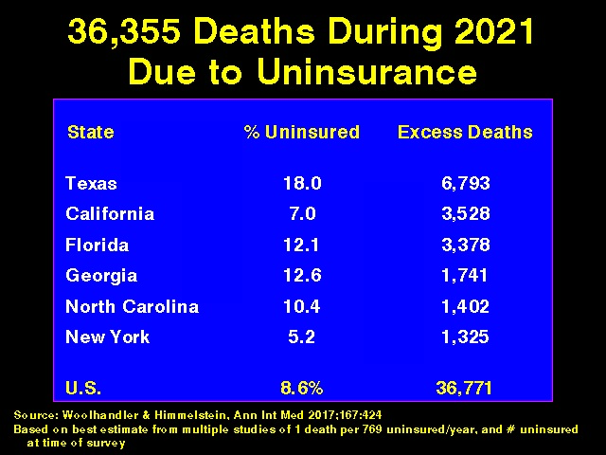

Slide 9
The State of U.S. Health Care
106 million Americans lack dental insurance
  ¼ U.S. adults has untreated dental caries
  ¼ Americans cannot pay for needed dental care
  Only 20% of dentists treat Medicaid patients
Fewer than 20% of adults with hearing loss report hearing aid use; many cannot afford up-to-date eyeglasses
  2022: Hearing aids now can be sold OTC, prices drop

Slide 10
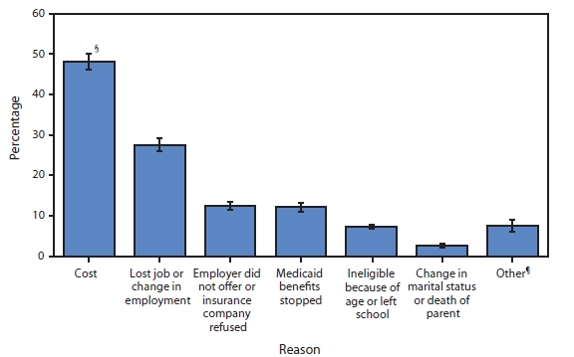
Reasons for No Health Insurance Coverage (2009, pre-PPACA)

Slide 11
Underinsured Non-Elderly Adults:
Number and proportion among those insured all year
2010 | 2012 | 2014 | 2016 | 2018 | 2020
Source of data: The Commonwealth Fund. I draw on three reports: “U.S. Health Insurance Coverage in 2020: A Looming Crisis in Affordability — Findings from the Commonwealth Fund Biennial Health Insurance Survey, 2020,” 2020; Collins SR, Gunja MZ, Doty MM. How Well Does Insurance Coverage Protect Consumers from Health Care Costs? The Commonwealth Fund 2017; Sara Collins, Herman Bhupal, and Michelle Doty, “Health Insurance Coverage Eight Years After the ACA.”

Slide 12
Difficulty Paying Medical Bills
(2018 Survey)
More than ½ of patients with serious chronic illnesses (even though over 90% had insurance)
69% reported physicians did not discuss costs of care
31% had difficulty understanding what their insurance covered

Slide 13
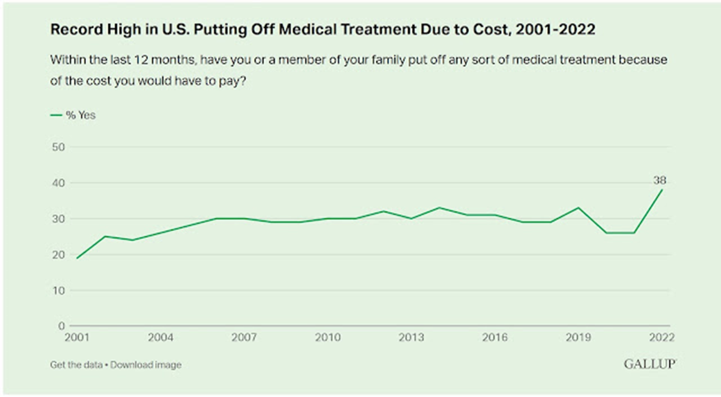

Slide 14
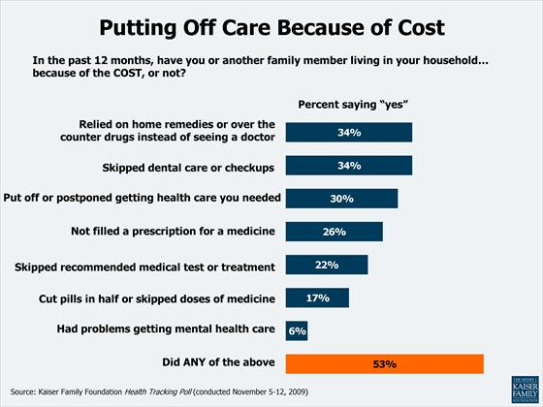

Slide 15
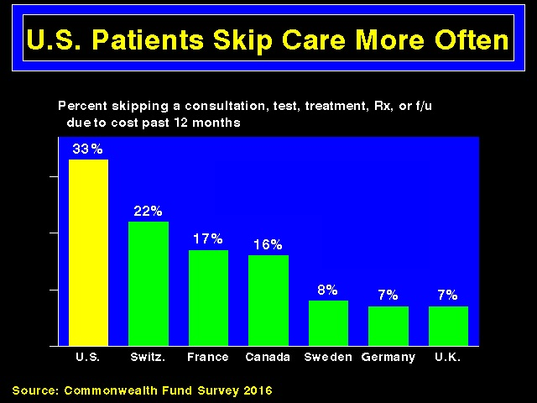

Slide 16
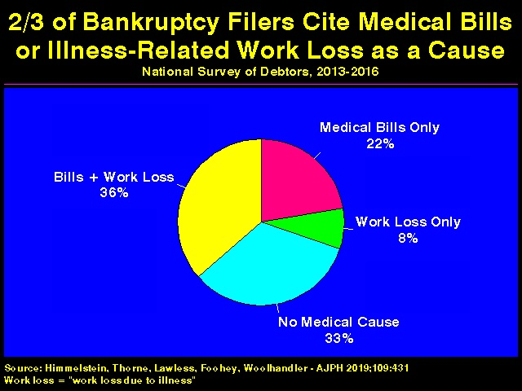

Slide 17
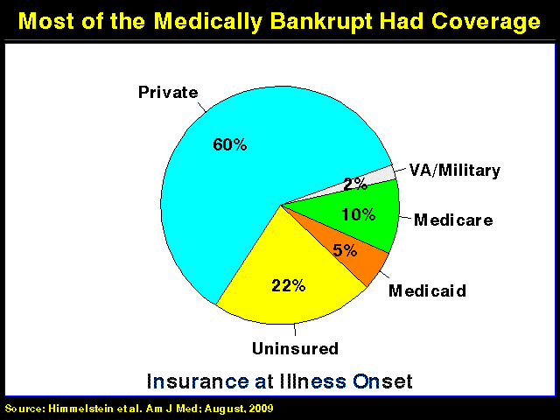

Slide 18
The State of U.S. Health Care
US ranks near the bottom among westernized nations in overall population health, life expectancy, infant and maternal mortality, etc.
  60th in life expectancy (76.5 yrs)
  Infant mortality 76% higher than in other wealthy countries

Slide 19
The State of U.S. Health Care
U.S. health care system ranks 69th/191 countries (between Armenia and Algeria)
U.S. has poorest health among all rich nations
Red states have worse health care/outcomes than Blue states
12% of Americans live in poverty (including 1.7 million health care workers and their children)
16% of US children live in poverty

Slide 20
The State of U.S. Health Care
US has highest chronic disease burden, suicide rate, number of preventable hospitalizations, and the highest rate of avoidable deaths c/w other OECD countries
We outperform other countries in vaccination rates (#2, UK #1), and breast cancer screening (#1), yet CDC funding for state vaccination programs decreased in 2023

Slide 21
The State of U.S. Health Care
Covid vaccination in U.S. prevented over 18 million hospitalizations and 3 million deaths, but low vaccination rates relative to other countries means much unnecessary suffering and death
    Surge in excess mortality (450,000 in 2021)
    Decreased screening tests during pandemic
Single payer health care would have prevented 338,000 lives from covid alone between start of pandemic and 3/22 (+ $106 billion in covid-hospitalization costs + $438 billion savings from non-pandemic benefits

Slide 22
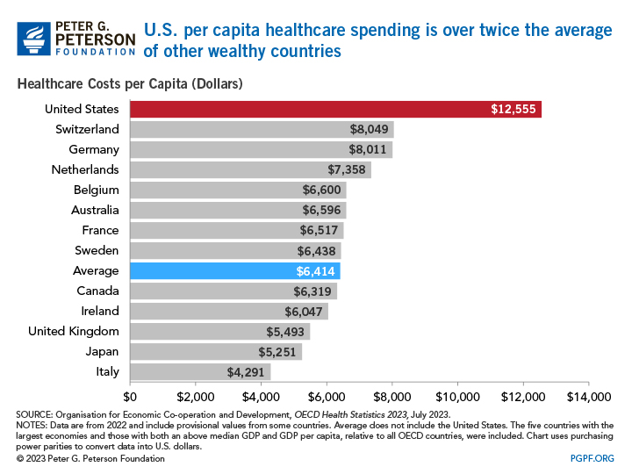

Slide 23
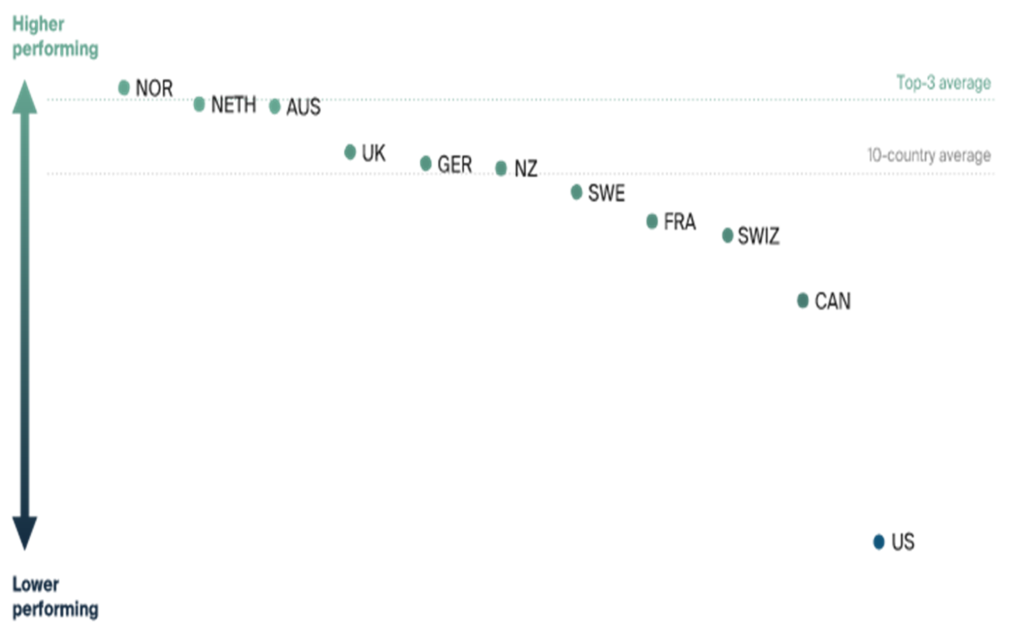
Comparative Health Care System Performance Scores (2021, Commonwealth Fund)

Slide 24
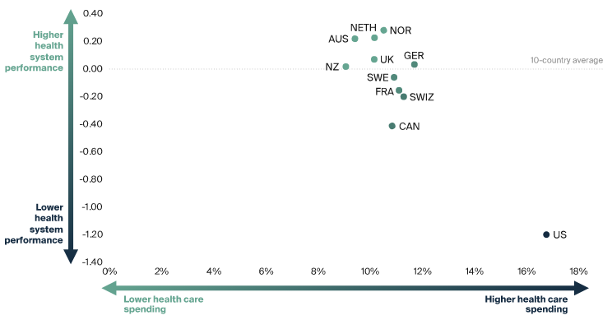
Health Care System Performance Compared to Spending, (2021, Commonwealth Fund)

Slide 25
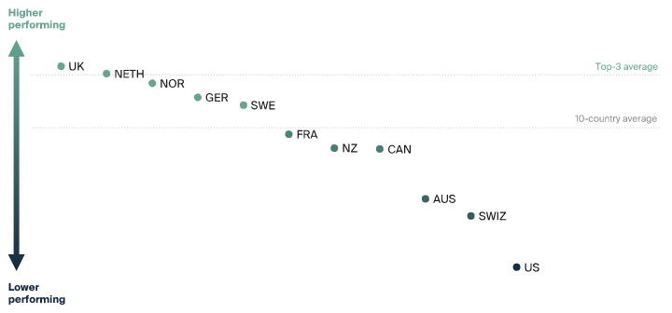
Health Care System Performance Scores: Affordability (2021, Commonwealth Fund)

Slide 26
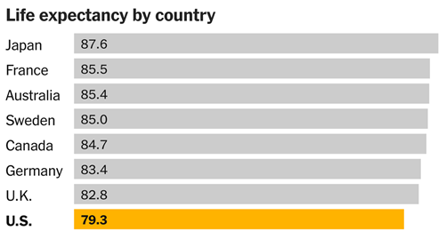
World Bank, 2021 Data

Slide 27
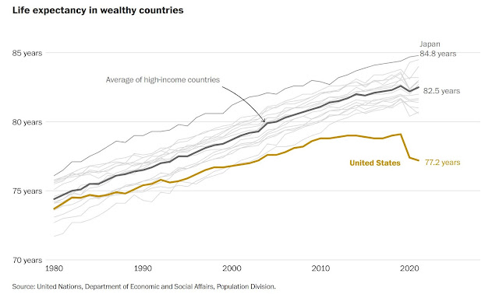

Slide 28
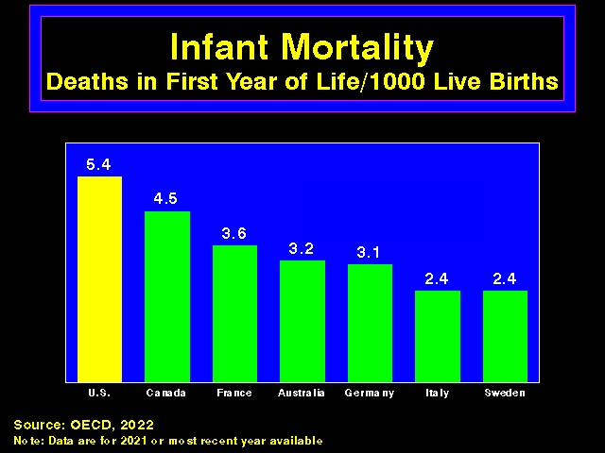

Slide 29
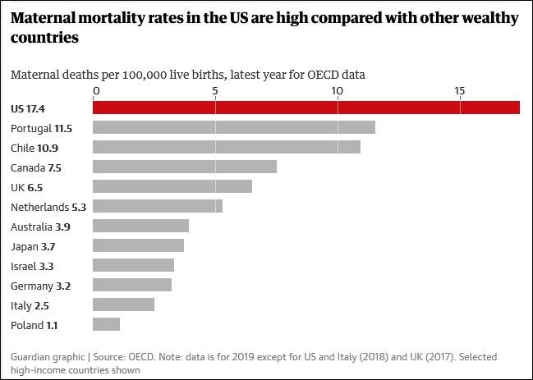

Slide 30
National Health Expenditures Rose by
$365 Billion to $4.1 Trillion from 2019 to 2020
$4 Trillion
$3 Trillion
$2 Trillion
$1 Trillion
Structures + Equipment
Personal Healthcare
Total Admin + Net Cost of Health Insurance
Public Health Activity
Research
Center for Medicare and Medicaid Services, National Health Expenditures Account.

Slide 31
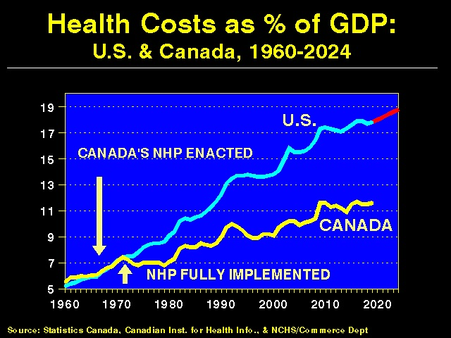

Slide 32
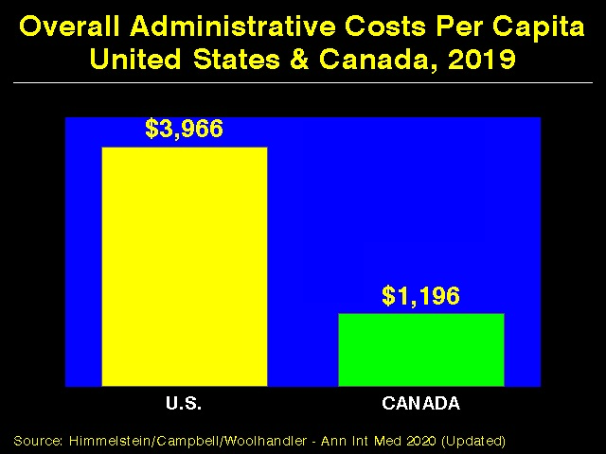

Slide 33
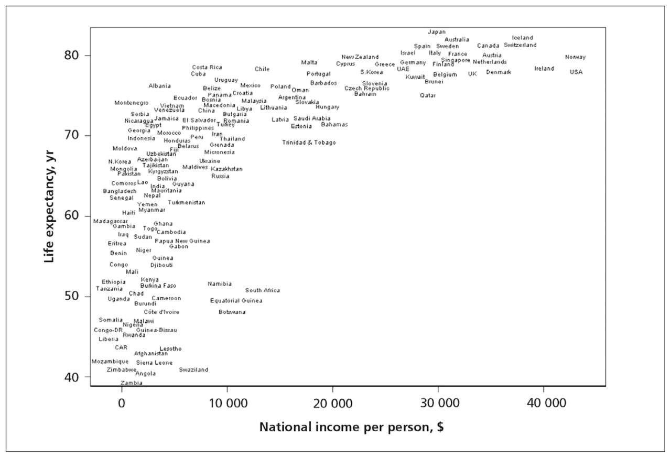

Slide 34
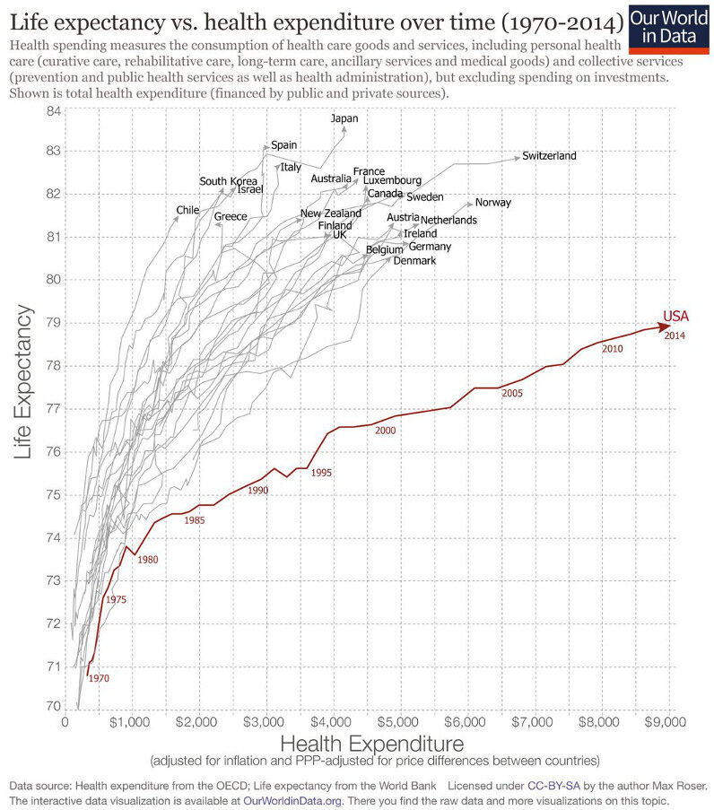

Slide 35
Who Pays for Health Care?
Government (federal, state, and local)
  Medicare, Medicaid, VA, IHS, jails and prisons
Private insurance:
  Over 800 companies, each with an assortment of plans
  Just 2 companies control over 50% of the market in 45 states, 5 control 83% of US market
  Primarily employer-based
    ¼ of patients not on same plan after one year in one study
    Benefits brokers incentivized by insurance companies

Slide 36
Who Pays for Health Care?
Out-of-pocket
  ¾ of hospitals use point-of-service collections (i.e., prepay before non-emergent treatment)
  Hits poor hardest
  Health insurance premiums third highest living expense (after housing and childcare)

Slide 37
Who Pays for Health Care?
Out-of-pocket
  Medical debt constitutes majority of American’s debt ($195 billion, 41% of Americans/57% of those with household incomes under $40,000/yr, 2022)
  Mean debt $22,000; median debt $2,000 (per person, 2023)
  Medical credit cards (common for cosmetic surgery) prey on poor, charge high interest rates
  2022: Credit reporting agencies drop medical debt from reports

Slide 38
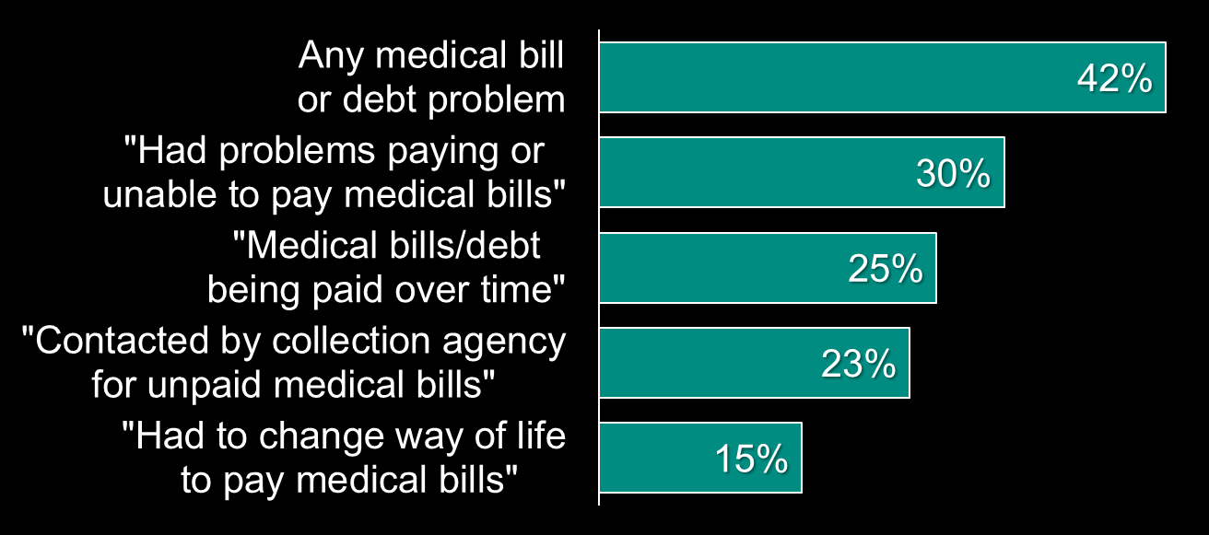
In 2022, nearly half of Americans between ages 19 and 64 had
Medical Bills or Debt
Any medical bill
or debt problem
“Had problems paying or
unable to pay medical bills”
“Medical bills/debt
being paid over time”
“Contacted by collection agency
for unpaid medical bills”
“Had to change way of life
to pay medical bills”
Source: Collins S, Haynes L, Masitha R. The State of U.S. Health Insurance in 2022. Commonwealth Fund [Internet]. 2022 Sep 29 [cited 2022 Nov 2]; Available from: https://www.commonwealthfund.org/publications/issue-briefs/2022/sep/state-us-health-insurance-2022-biennial-survey

Slide 39
Who Pays for Health Care?
Out-of-pocket
  Many turning to crowdfunding platforms to pay for medical care (8 million patients and 12 million relatives/friends as of early 2020)
    RIP Medical Debt company profits by buying back debt for pennies on the dollar
Huge variability in charges
  Hospital charges 2.5X higher for self-pay patients than insured patients charged, nearly 3X amount allowed by Medicare
  Chargemaster

Slide 40
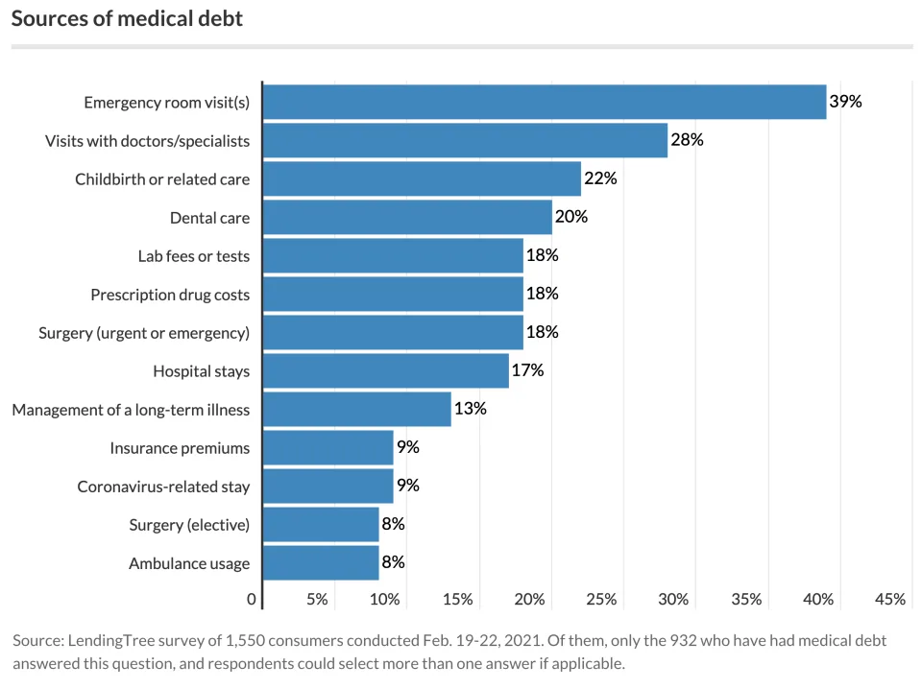

Slide 41
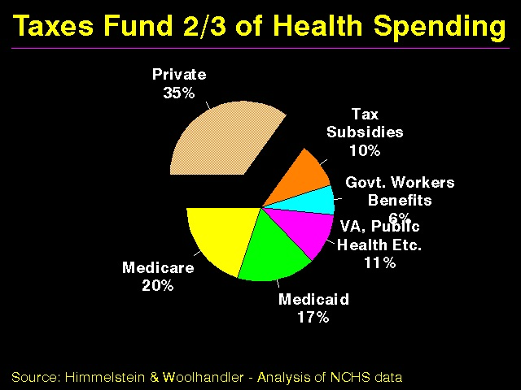

Slide 42
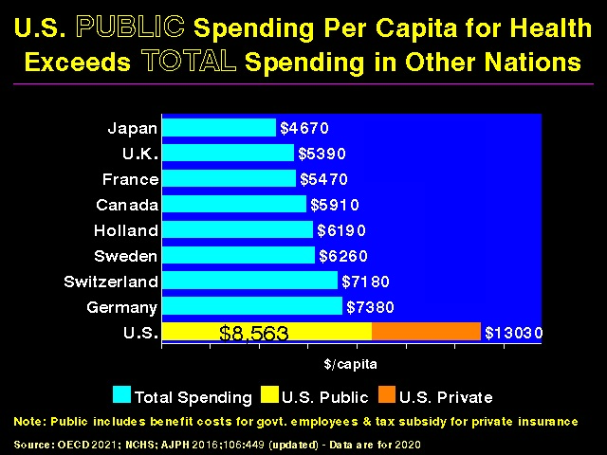

Slide 43
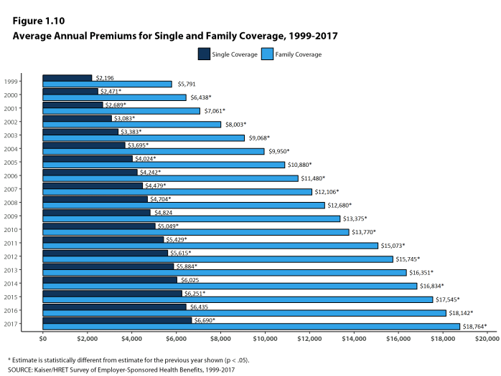

Slide 44
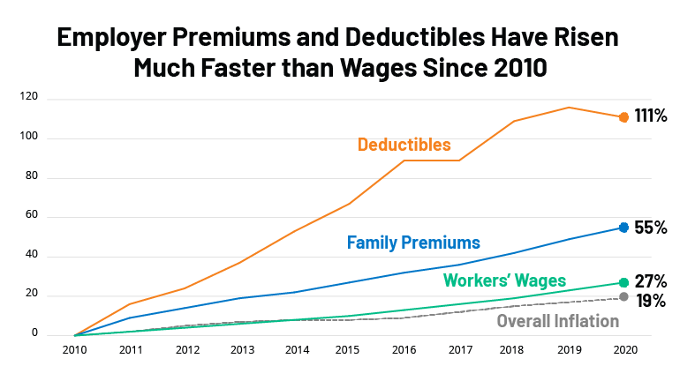

Slide 45
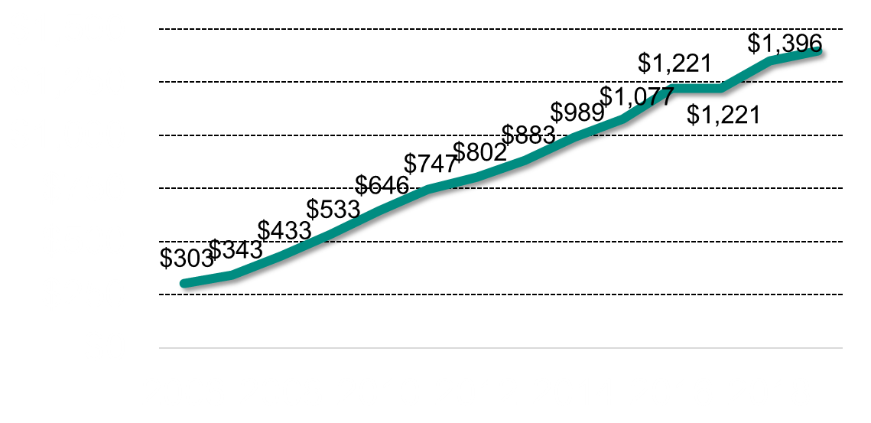
Almost All Workers Now Have
An Annual Deductible
Average general annual deductible for all covered workers (single coverage)
Employer Health Benefits 2019 Annual Survey. The Kaiser Family Foundation. 2019.
Available at: http://files.kff.org/attachment/Report-Employer-Health-Benefits-Annual-Survey-2019
Notes:
85% have deductible in 2018

Slide 46
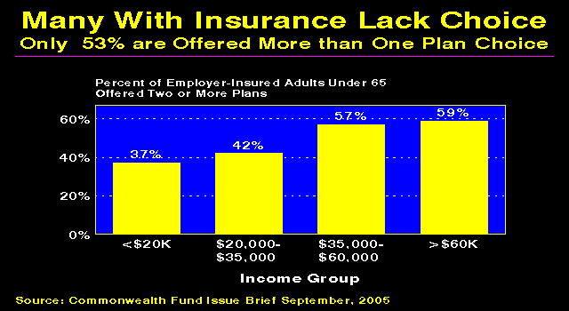

Slide 47
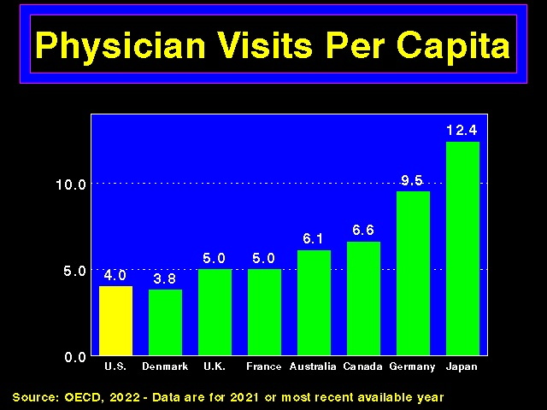

Slide 48
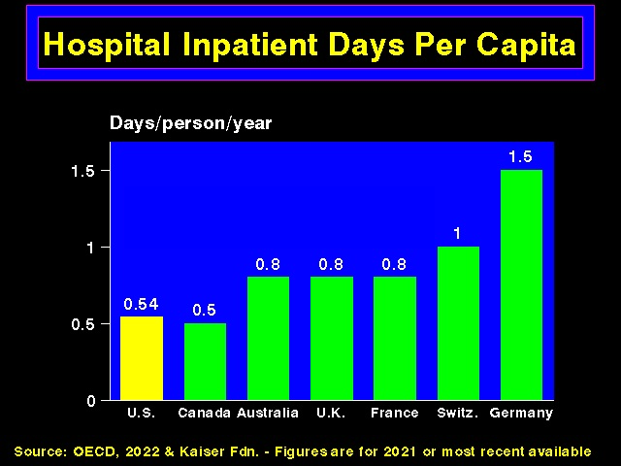

Slide 49
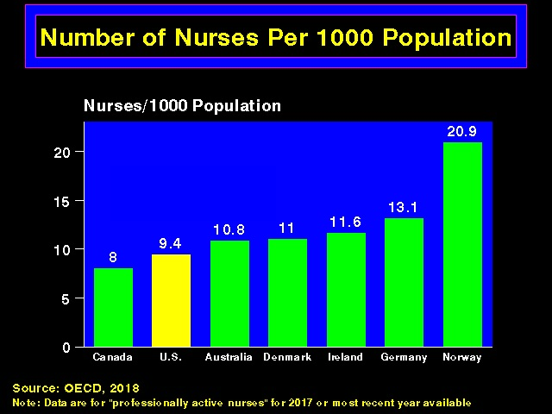

Slide 50
Health Insurance Industry
Consolidation leading to higher prices
Pre-existing conditions (illegal under PPACA)
Delisting
“Cherry picking” (since 5% of people account for 50% of health care costs, and 1% account for 20%); “lemon dropping”
  E.g., have no specialist in network for a given specialty; limit access to needed meds (e.g., anti-HIV or chemo drugs)
  Doctors being forced out of “narrow networks”
    In response, many states have passed “any willing provider” laws

Slide 51
Surprise Medical Bills
Millions of Americans receive each year from health care providers that they are not able to select (e.g., ER physicians, anesthesiologists, ambulances)
  Including 1/5 elective surgeries, 1/5 ER visits, 1/6 in-network hospitalizations
Average charge $1,200 - $2,000, can be as high as $100,000
High “trauma” fees for ER visits for minor injuries

Slide 52
Private Equity Takeover of Medicine
Private equity firms buying hospitals, physician practices, hospices, and ER doctor groups and moving the providers out of network to bill larger fees (then cut costs, “increase efficiencies” (often by staffing cuts and replacing MDs with mid-level providers), and sell in avg. 5 yrs for profit)
  Investments tripled over 2010s
Patchwork of state laws
Inferior care

Slide 53
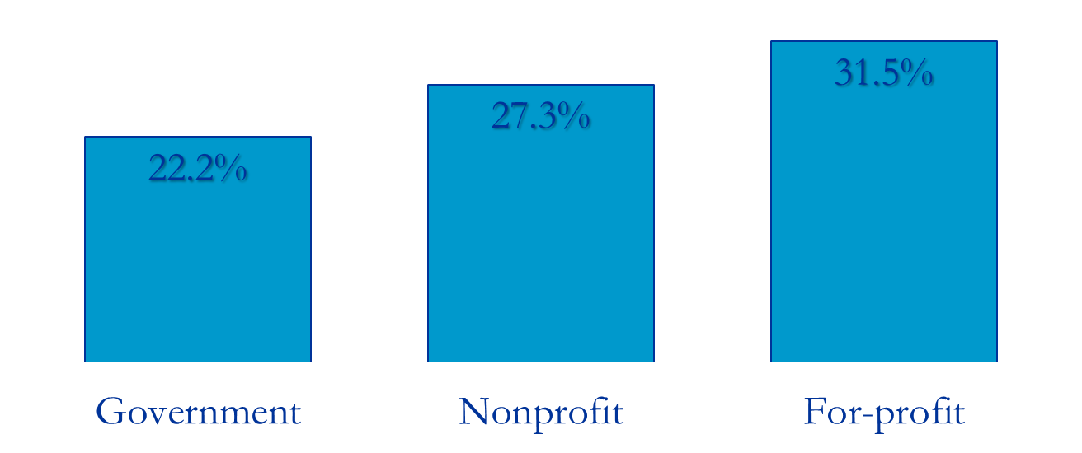
Likelihood of offering a profitable (vs. unprofitable) Service by Hospital Ownership
Data from: Horwitz JR, Nichols A. Hospital Service Offerings Still Differ Substantially By Ownership Type.
Health Affairs. 2022 Mar;41(3):331–40.

Slide 54
Percent of health systems with high relative levels of “Overuse” of Low-Value Services
”High” levels of overuse as defined by following authors, who noted that hospitals in the fourth and fifth category of their overuse index (>=0.5 SD over mean) can be considered to be “health systems that are overusing relative to the average health system.”
Segal JB, Sen AP, Glanzberg-Krainin E, Hutfless S. Factors Associated With Overuse of Health Care Within US Health Systems: A Cross-sectional Analysis of Medicare Beneficiaries From 2016 to 2018. JAMA Health Forum. 2022 Jan 14;3(1):e214543.

Slide 55
Surprise Medical Bills
2020 federal No Surprises Law requires health care providers to work with insurers to settle on a fair price, limits patient responsibility for out-of-network care (implementation 2022, ground ambulances exempt)
Federal law (2021) requires hospitals to disclose prices they quietly negotiate with insurers (prices vary greatly, most patients unaware, many hospitals have ignored law since penalties minimal)
2022 : only 1/5 hospitals compliant; only 2 fined as required

Slide 56
Prior Authorization
Onerous prior authorization requirements also delay (and deny) care
  2022: 90%/97% of oncology/radiation oncology services required prior authorization under Medicare Advantage
2024: CMS rule requires prior authorization decisions be sent to patients and providers within 72 hours for expedited requests and within 7 calendar days for standard requests
Utilization management costs approximately $100 billion/yr, patients pay most of this

Slide 57
Denials of Claims
Millions/yr
Insurance company medical directors can rule on 10,000+ requests/yr
  Identities often hidden, experience and qualifications sketchy, hx malpractice claims hound many
  Often “unfightable,” except for later malpractice lawsuits (cost of doing business)
  Cigna used algorithm to reject 300,000 claims over 2 months (without any MD review)

Slide 58
Health Insurance Industry
Drug tiering (keeps sickest patients away)
Charging uninsured 2-3X more
Hiring debt collection agencies, which sometimes hound patients in the ER (in violation of EMTALA)

Slide 59
Health Insurance Industry/Bureaucracy
Multiple transaction nodes: hospitals, physicians, insurance companies, middlemen, fees charged to providers for accepting electronic payment
Typical service industry has 0.85 administrative workers per specialized workers (e.g., education, law, financial industry)
  Twice as many administrators as physicians
In health care, as opposed to say widget production, inefficiency is profitable

Slide 60
Health Insurance Industry/Bureaucracy
High administrative costs
  34% in 2020 (vs. 2-3% for Medicare and Medicaid; private Medicare plans = 14%)
  $471 billion/yr for billing and insurance related costs alone
  No change with PPACA
  Hospital bureaucracy consumes just over ¼ of hospital budgets
    Highest at for-profit hospitals
    No effect on quality of care

Slide 61
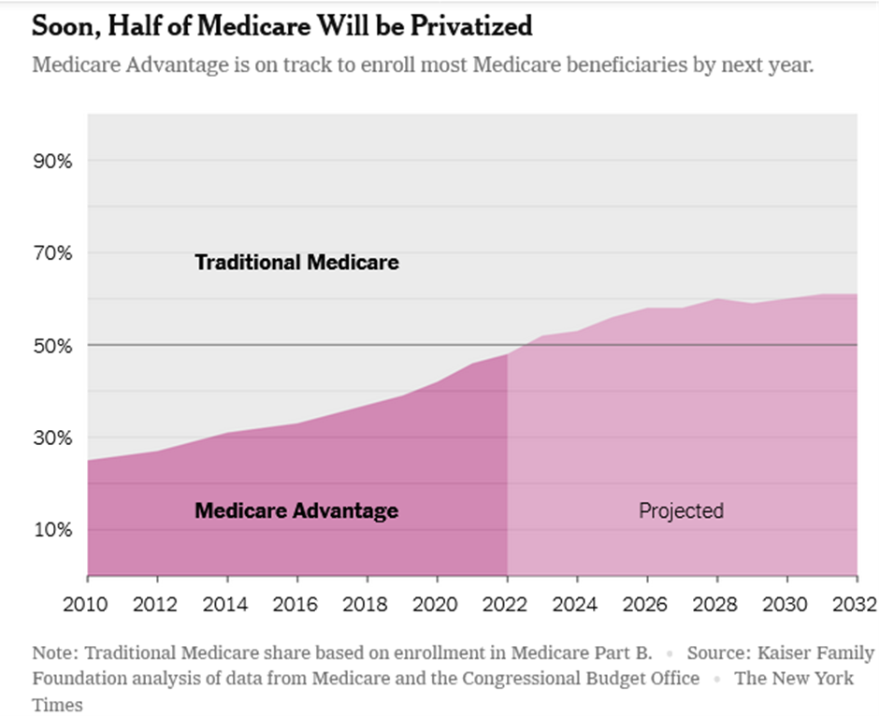
Medicare Advantage https://www.nytimes.com/2022/10/08/upshot/medicare-advantage-fraud-allegations.html
As of 2023, covers half of all eligible beneficiaries

Slide 62
Medicare Advantage
Run by private companies
Over 40% of Americans enrolled in 2021, number rising
More expensive than traditional Medicare
2024: overcharges taxpayers between $88 billion and $140 billion annually
CMS audits have highlighted widespread and persistent denials of service and payment, disenrollment of dying patients

Slide 63
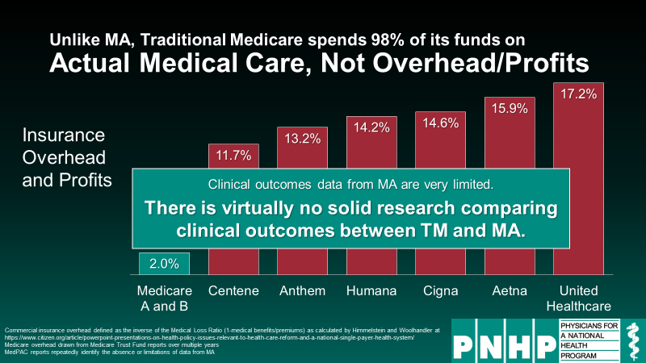

Slide 64
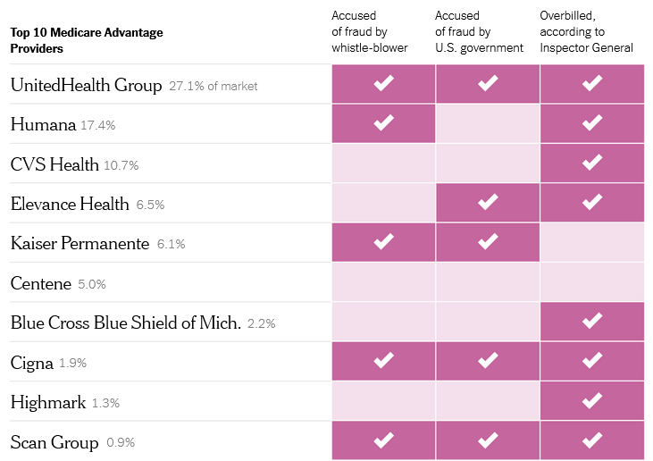
Insurers Have Exploited Medicare for Billions https://www.nytimes.com/2022/10/08/upshot/medicare-advantage-fraud-allegations.html

Slide 65
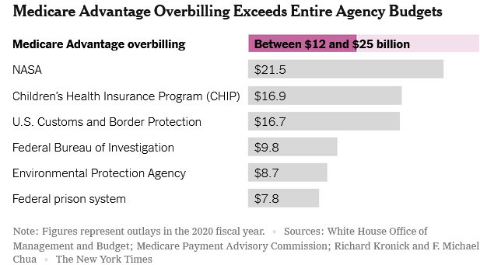

Slide 66
Health Insurance Industry/Bureaucracy
High administrative costs
  Average full-time physician spends nearly $100,000/yr on billing and insurance functions
  17,849 different billing codes (in 2011) - now 141,058
  Administrative costs vary by type of visit/procedure

Slide 67
Administrative Work
Average doctor spends 17% of working hours (8.7 hrs/wk) on administration (not including charting, patient phone calls, usual care)
IM residents spent 5 hrs/d on e-charting; e-charting can decrease productivity
  But specialist e-consultations can save time and costs
Doctors spending more time on administration have lower career satisfaction (and primary care doctors have the highest administrative loads, as well as the lowest salaries and highest rates of burnout)

Slide 68
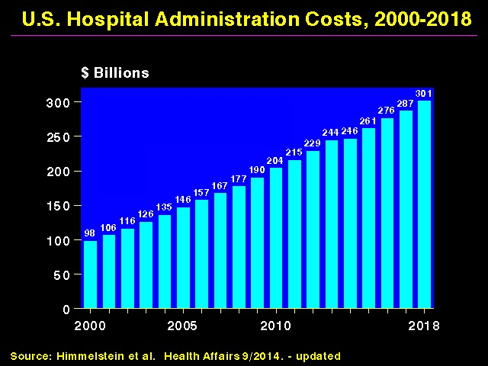

Slide 69
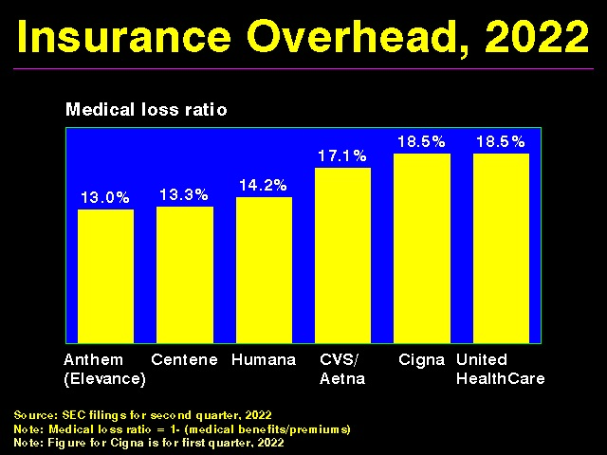

Slide 70
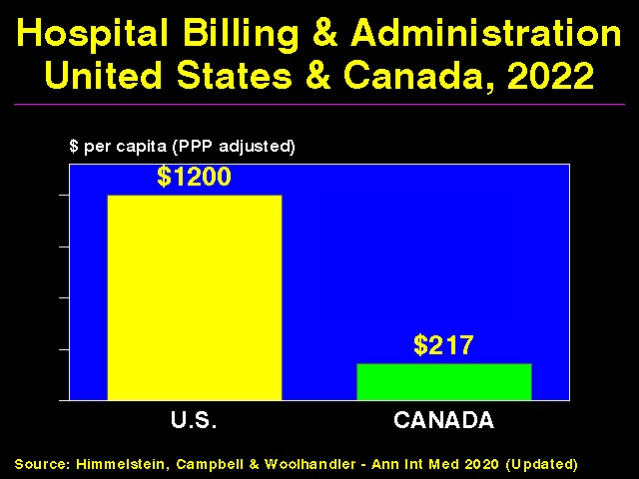

Slide 71
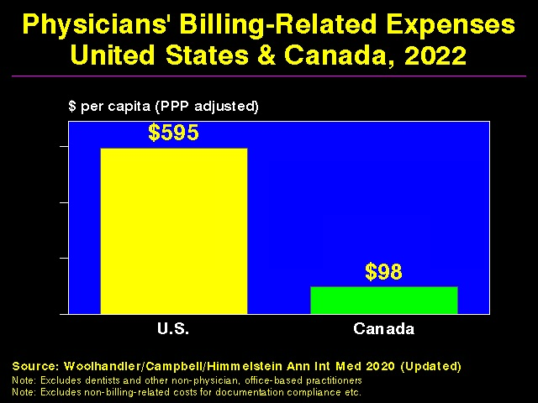

Slide 72
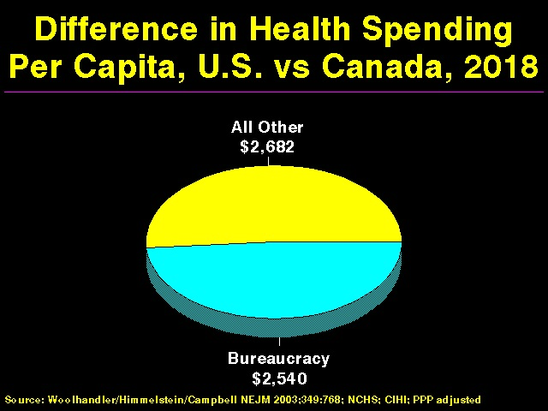

Slide 73
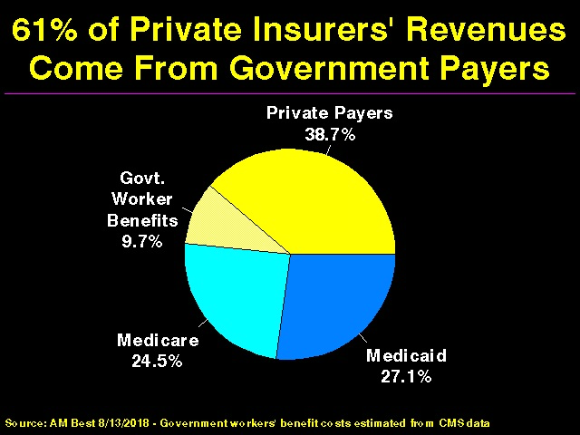

Slide 74
Health Insurance Industry
Large profit margins
Nation’s 5 largest health insurers control 83% of the insured market
Corruption
Loyalty: shareholders (not patients)
Amount actually spent on patient care referred to as “medical loss ratio”

Slide 75
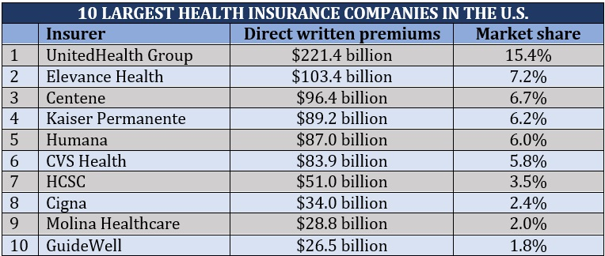

Slide 76
Largest Federal Lobbying Organizations, 1999-2018 (JAMA May 2020:68)
US Chamber of Commerce
National Assn of Realtors
American Hospital Association
General Electric
PhRMA
Blue Cross Blue Shield Assn
AARP

Slide 77
Health Insurance Industry
Excessive CEO pay
  Median compensation of health care CEOs = $7.7 million (2018); 14 CEOs made more than $46 million each
    Highest in the S and P 500
    Up 50% over last 10 years (vs. 10% for physicians)
  Cumulatively, the 113 heads of 70 of the largest U.S. health care companies earned $10 billion between 2010 (when the ACA was enacted) and 2016 (109 men, 4 women )
  Healthcare CEOs passed bankers as best paid (2011)

Slide 78
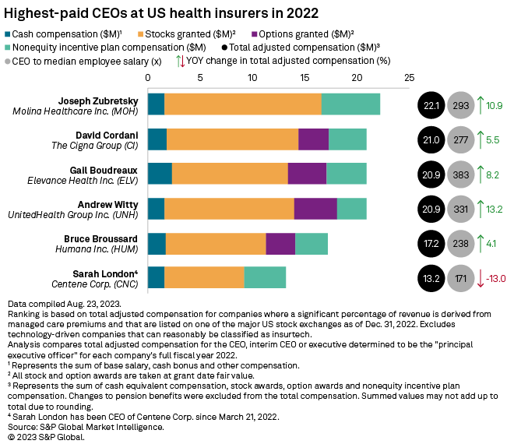

Slide 79
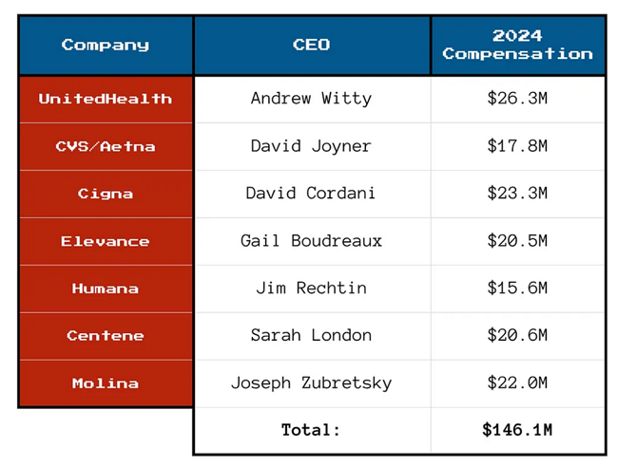
Health Care CEO Compensation, 2024

Slide 80
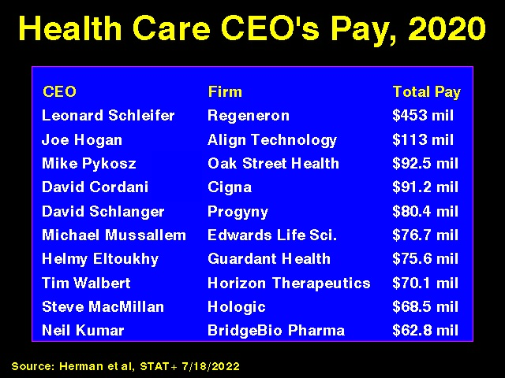

Slide 81
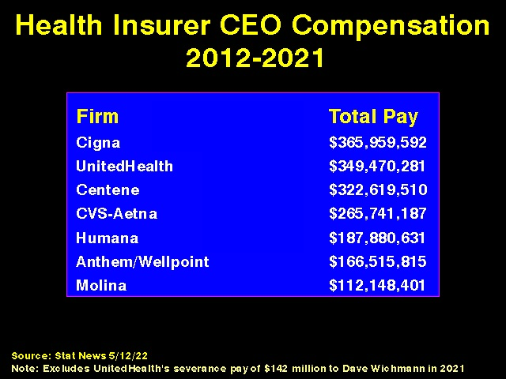

Slide 82
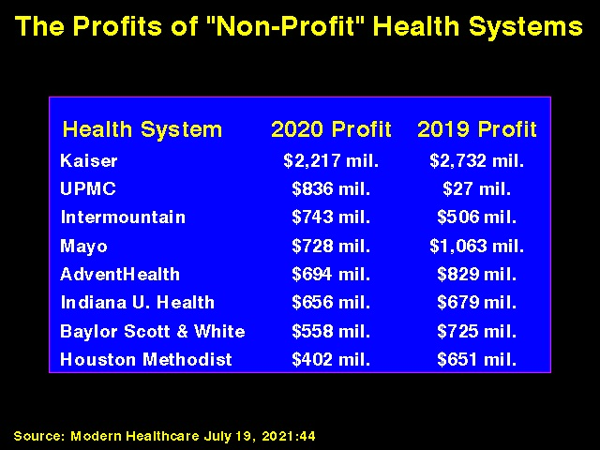

Slide 83
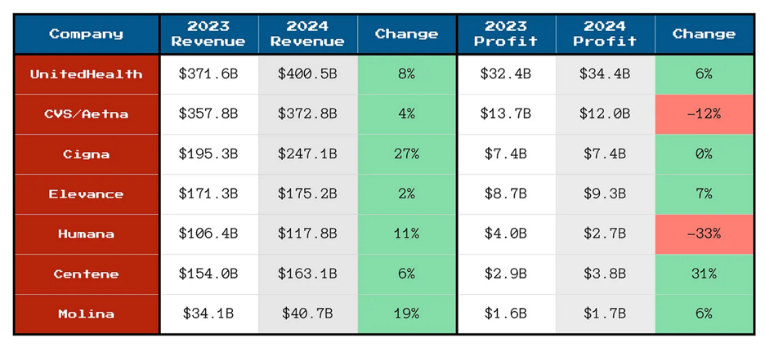
Health Insurance Company Profits

Slide 84


Slide 85


Slide 86
Academic Leaders on For-Profit Health Corporations’ Boards
Academic Position | # of Directorships | Pay per Directorship (median) | Shares Owned (mean)
Hosp/system CEO | 21 | $221,000 | 42,445
Dean | 17 | $268,000 | 32,113
Dept. Chair | 18 | $103,000 | 65,574
Professor | 131 | $160,000 | 171,856
Trustee | 83 | $227,000 | 342,198
Any | 309 | $193,000 | 193,629
Source: BMJ 2015;351:H4826

Slide 87

For-Profit Hospitals Cost 19% More
Source: CMAJ 2004;170:1817
Notes:
87

Slide 88


Slide 89


Slide 90


Slide 91


Slide 92
FFor-Profit Dialysis Clinics’ Death Rates are 7% Higher
3800 Excess Death Annually
Source: Dickman, Mirza et al. Int J Health Serv 2021;51:371

Slide 93


Slide 94
Most Influential People in Health Care (Modern Healthcare, 2023)
Chosen for leadership skills and impact
Vast majority heads of insurance companies, pharmaceutical companies, and large hospital systems
A few legislators
A few researchers
Head of APHA (#47) and NIH (#53) and National Academy of Medicine (#97) lower on list
Very few health policy experts, advocates for patients, social justice issues, etc.

Slide 95


Slide 96


Slide 97

For-Profit Hospitals’ Death Rates are 2% Higher
Source: CMAJ 2002;166:1399
Notes:
97

Slide 98
For-Profit Hospitals Cost 19% More
Source: CMAJ 2004;170:1817
Notes:
98

Slide 100


Slide 101
Dialysis
Davita and Fresenius dominate market (80% of dialysis patients) – highly profitable
Together provide most funding to American Kidney Foundation, which helps non-Medicare patients get insurance (which pays 4x more for HD), ensuring profit of $3.50 for every dollar donated
  CA law attempting to reign in, held up in courts
History of adjusting epo dosing to reimbursement scheme, not clinical need

Slide 102
FFor-Profit Dialysis Clinics’ Death Rates are 7% Higher
3800 Excess Death Annually
Source: Dickman, Mirza et al. Int J Health Serv 2021;51:371

Slide 103


Slide 104


Slide 105


Slide 106


Slide 107


Slide 108


Slide 109


Slide 110


Slide 111


Slide 112


Slide 113


Slide 114


Slide 115


Slide 116
Some Reasons for Rising Health Care Costs
Aging population
  Chronic diseases
Technological advances
Exploding drug costs
Increasing specialist referrals
  RVUs/pay much higher for procedural services
  Specialists provide 40% of primary care
  Only ½ of PCPs get notified by specialists of changes in medication or care plans for their patients

Slide 117
Complex Patients
Hospitalized patients more complex today than 15 yrs ago:
  3 yrs older, twice as likely to have kidney disease, 70% more likely to have DM, much more likely to be admitted through the ER, longer lengths of stay
  Inpatient mortality stable, but post-discharge mortality higher

Slide 118


Slide 119
Wasteful Health Care Spending
Annual Median Estimate (AJPH Dec 2020:1746)
Overuse: $451 billion
Missed prevention opportunities: $310 billion
Administrative waste: $281 billion
Clinical inefficiencies: $202 billion
Fraud and abuse: $185 billion
Excessive prices: $169 billion

Slide 120
Overuse
Overuse of diagnostic tests, medications, and therapeutic procedures
  $765 billion wasted annually
    $210 billion on unnecessary testing alone
    Unnecessary testing causes up to 30,000 deaths/yr
    See Scans and Scams webpage of phsj.org for a slide show covering unnecessary testing
  Procedural variability

Slide 121


Slide 122


Slide 123

Medicaidlobby

Slide 124

Distribution of National Health Expenditures

Slide 125


Slide 126
Corporatization of Medical Boards
American Board of Medical Specialties
  Nonprofit organization funded primarily by physician members
  Fiduciary responsibility to match revenue and expenditures
  Revenue for most ABMS member boards far surpasses expenses (mean annual growth rate of 10% between 2003 and 2013

Slide 127
Corporate Structure of American Board of Internal Medicine (member of ABMS)
Annual budget over $50 million
Lobbied Congress to ensure that physicians participating in Maintenance of Certification through ABIM eligible for incentive payment under ObamaCare

Slide 128
Corporate Structure of American Board of Internal Medicine
2022 revenue = $72 million; spending $58 million
Conflicts of interest common among prior leadership (e.g., Christine Cassel, Robert Wachter)
CEO Richard Baron received $688,000 in compensation and $55,000 in deferred compensation (2024), while ABIM was over $50 million in debt
  2020: Salary of $1,385,563
Furman McDonald appointed CEO 09/24, no salary information available online

Slide 129
Corporate Structure of American Board of Internal Medicine
Salary determined by Board of Directors
Baron: “If they were trying to hire somebody to do this job, what other job would they be doing and what would people in comparable organizations be paid”

Slide 130
Corporate Structure of American Board of Internal Medicine
Controversies surrounding Maintenance of Certification
  Utility and cost
Alternatives (e.g., National Board of Physicians and Surgeons)
Class action suit filed against ABIM by 4 internists on behalf of 100,000 doctors (2018)
  Dismissed by court (similar result for antitrust complaint against American Board of Radiology, 2019)

Slide 131
Pharmaceutical Industry
U.S. 4.5% of world’s population, accounts for 40% of global drug spending
US prescription drug costs high
  $577 billion drug spending in 2021
  36% increase in brand name drug costs between 2016 and 2020, 4X rate of inflation
  Average cost of new drugs $2,115 in 2008, 180,007 in 2021
  256% higher prices than in peer countries

Slide 132
Pharmaceutical Industry
US prescription drug costs high
  Median annual profit margins of pharmaceutical companies almost double that of mean of other S and P 500 companies
  Middlemen (pharmacies, pharmacy benefit managers, and hospitals and clinics that dispense drugs) account for 1/3 of costs
  PBM market dominated by 3 companies

Slide 133


Slide 134


Slide 135


Slide 136


Slide 137

Drug Companies’ Cost Structure

Slide 138

Innovation:
Published Research Leading to Drugs

Slide 139
Pharmaceutical Industry
Only 10% of new drugs treat life-threatening conditions
92% of new drugs little or no better than pre-existing agents (or cause harm)
Thus only 1% of new drugs “life-saving”
Drug trials run by primary investigators with industry ties more then 3X likely to report positive results (after adjustment for multiple variables)

Slide 140
Pharmaceutical Industry
40% of finished drugs and 80% of active drug ingredients made overseas
  FDA oversight inadequate per GAO
  FDA oversight also inadequate for medical devices
Falsified and substandard drugs account for up to 10% of all medicines in low- and middle-income countries
  300,000 children die each year due to poor-quality or outright fake medicines

Slide 141
Pharmaceutical Industry
Pay-for-delay costs consumers and taxpayers $3.5 billion in additional drug costs/yr
Patent trolls delay access to medications (by not developing drugs but suing companies for copyright infringement)
  PATENT act awaiting vote in Congress
Selling patents to Native American tribes to delay market entry

Slide 142
Pharmaceutical Industry
Salami slicing (obtaining multiple “orphan drug” status approvals helps increase profits by prolonging market exclusivity (e.g., 33 for IFN, 7 for Gleevec)
  GAO estimates nearly 1/3 of all pharmaceutical spending in U.S. will be on so-called orphan drugs by 2020
Over 40,000 drug-related deaths not reported to FDA, as required, over last decade

Slide 143
Pharmaceutical Industry
Often quoted cost of developing new drugs (Tufts study) based on myriad biased/unreal assumptions =$1.3 billion
  Actual median cost to drug company = $60 million (DW Light, Biosciences 2011;6:1-17)
  Medicins sans Frontiere estimates $50 million, $186 million if failed drug candidate costs included

Slide 144
Pharmaceutical Industry
Some drug prices have gone up dramatically
  Others: Epi-pen [although generic now available], metformin, propranolol, colchicine, doxycycline, hepatitis C drugs, hydroxychloroquine
  Oncology drugs (financial conflict of interest for oncologists, who are reimbursed additional 6% by Medicare Part B for “variations in acquisition price and overhead”
    Problem compounded by oncology drug shortages

Slide 145
Pharmaceutical Industry
Cancer drugs increasingly expensive
  11/12 FDA approved anti-cancer agents cost over $100,000/yr (2014)
  High profile cancer patient advocacy organizations have a median of 7 biopharmaceutical funders (money buys silence)

Slide 146
Pharmaceutical Industry
Cancer drugs increasingly expensive
  Many U.S. cancer centers exploit false hope through misleading advertising
  42% of patients diagnosed with cancer between 2000 and 2012 depleted their assets within 2 yrs (before most of the newer, more expensive drugs available)
  Drugs without overall survival benefit account for 52% of spending (2018)

Slide 147
Pharmaceutical Industry
Adacanumab approved for Alzheimer’s Disease (2021), yet limited evidence of efficacy and risk of side effect
  Annual cost $56,000 = annual cost of home health aide

Slide 148


Slide 149
Pharmaceutical Industry
Some drug prices have gone up dramatically
  Price of insulin tripled between 2006 and 2013
    Even though original patent sold by discoverers to University of Toronto for $1
    Insulin analogues have largely replaced NPH/Regular insulins, yet cost up to 10X more than, yet offer no better control and same risk of sever hypoglycemia

Slide 150
Pharmaceutical Industry
Some drug prices have gone up dramatically
  Price of insulin tripled between 2006 and 2013
    ¼ diabetics rations or skips doses due to cost
    2022: consortium of hospitals, insurers and philanthropists announce plan to manufacture and sell less expensive insulin
    2023: CA begins to manufacture its own insulin
    2025: Medicare Part D costs capped at $2,000/year

Slide 151

1.3 million American adults in 2021
Rationed Insulin Due to Cost
Data inclusive of all adults with diabetes who use insulin in 2021
Gaffney A, Himmelstein DU, Woolhandler S. Prevalence and Correlates of Patient Rationing of Insulin in the United States: A National Survey. Ann Intern Med [Internet]. 2022 Oct 18 [cited 2022 Oct 17];
http://www.acpjournals.org/doi/10.7326/M22-2477

Slide 152


Slide 153
Government Paid Twice for Vaccines
Funded most of the basic science research underlying mRNA vaccines and that characterized the spike protein.
Spent at least $18 billion subsidizing vaccine makers’ research and production, purchased all doses used in US.
Firms refused to share vaccine recipe, limiting global production capacity and leaving billions unprotected.
Cost to manufacture mRNA vaccine: ~$2/dose for Moderna, ~$1/dose for Pfizer. Sale price ~$25/dose. (J Royal Soc Med 2021;114:502)
“Pfizer, BioNTech and Moderna will make pre-tax profits of $34 billion this year between them, which works out as over a thousand dollars a second.” (Peoples Vaccine Alliance)

Slide 154


Slide 155
Pharmaceutical Industry
There is little correlation between the price of a particular drug and a company’s R&D investment, nor between a drug’s price and the cost of its production
Drug prices rising despite Trump tax cut lowering permanent tax rate from 35% to 21%

Slide 156
Pharmaceutical Industry
Universal drug coverage with tiered pricing would be cost-saving
Many states allow drug donation, but little invested in programs, so hundreds of millions of dollars wasted on unused nursing home medications alone
Inflation Reduction Act (2022) allows US government to negotiate prices on a small number of select drugs

Slide 157
Pharmaceutical Industry
Takeover of generic drug industry
  Drug companies now largely control the generic market through “authorized generics”
    Generics account for 84% of drugs sold in US, but only 12% of drug costs
  Broad investigation of illegal price-fixing by at least 16 companies involving 300 drugs underway
  May be largest cartel in U.S. history

Slide 158
Pharmaceutical Industry
Some insurance/PBM plans prohibited pharmacists from telling patients about cheaper alternatives
  Prohibited in a 20 states, federal legislation banned (2018)
Many states passing Drug Price Transparency Laws
2018: Many major hospitals/hospital systems join together to create non-profit generic drug company, Civica Rx
  VA considering same

Slide 159
Drug Company Malfeasance
The pharmaceutical industry is the biggest defrauder of the federal government, as determined by payments made for violations of the federal False Claims Act (FCA)
  Accounted for 25% of all FCA payouts between 2000 and 2010
  Defense industry – 11%
Federal criminal penalties decreased by 88% between 2012-13 and 2016-17: $2.7 billion to $317 million

Slide 160


Slide 161

Drug Company Penalties for Illegal Activities (JAMA Nov 20, 2020:1995)

Slide 162
Pharmaceutical Industry
Influence over physicians through control of CME, gifts, research funding
  Physician Payments Sunshine Act – reporting requirements
    Report accuracy good, but many physicians do not mention in publications, guidelines
  $10 billion paid to physicians and teaching hospitals in 2019
  Leaders of medical societies receive large amounts

Slide 163
Pharmaceutical Industry
Influence over physicians through control of CME, gifts, research funding
  48% of physicians received $2.4 billion in industry payments in 2015, of which only $75 million were for research
  Physicians with relationships/funding more likely to prescribe companies’ drugs (temporal and dose-response relationship)
  Close to 50% of physicians do not permit access to medical industry salespeople

Slide 164
Open Payments, CMS, 2019
Physicians receiving payments: 615,000
  General Payments: $2.29 Billion
  Value of Ownership: $1.24 Billion
  Research Payments: $72.13 Million
Top 1% of oncologists paid average $150K/yr
Majority of physicians receiving highest payments do not disclose industry ties in their publications (JAMA Surg. 2018;153(11):997-1002)

Slide 165
Drug Company Malfeasance
The pharmaceutical industry gives billions in gifts, speaking fees, and research grants to about ¾ of physicians
Donates over $100 million to patient advocacy groups (AHA< ACS, ADA, Komen Foundation, rare disease foundations) – may contribute to higher drug costs
  See Women’s Health page of phsj.org for slide show entitled, “rBGH, hormones in meat and milk, breast cancer, and pink ribbons,” which explores the Komen Foundation

Slide 166
Pharmaceutical Industry
60% of US physicians serving as panel and task force members of the DSM-5-TR received over $14 million in publicly-undisclosed funding
Conduct seeding trials to alter prescribing patterns

Slide 167
Pharmaceutical Industry
Secrecy, statistical torturing of data sets, selective publication
  Industry-sponsored cost effectiveness analyses twice as likely to be positive as independent studies
Data mining of prescribing practices
  OK’d by SCOTUS in Sorrell v. IMS Health
Unethical trials in developing world

Slide 168
Pharmaceutical Industry
Inappropriate donations of nearly-expired, unnecessary drugs to poor countries, disaster areas, conflict zones to get tax writeoffs
  Aid organizations responsible for security/disposal
Sending drug-spiked water to treatment plants, which are not designed to degrade drugs, leading to increased levels in water supply

Slide 169
Pharmaceutical Industry
Patient Assistance Programs “independent charitable organizations” funded by drug companies
  Almost all require insurance coverage
  Annual cost of covered drugs per beneficiary much higher than non-covered drugs (steer patients toward profitable agents)
  Fund off-patent brand name drugs much more than equivalent generic drugs
  Increase pharmaceutical industry profits
  May violate anti-kickback laws (similar to pharmaceutical rebates to PBMs and insurance companies)

Slide 170
Pharmaceutical Industry
Opposes Improving Access to Affordable Prescription Drugs Act, which would increase transparency around drug prices and R and D, reduce monopoly power for corporations that defraud the government, allow Medicare to negotiate lower prices for seniors, and curb monopoly abuses
  AKA Affordable Meds Act

Slide 171
Pharmaceutical Industry
Opposes Stop Price Gouging Act, which would prohibit dramatic medication price increases
Avoided $7 billion in US taxes in 2012 by shifting profits overseas

Slide 172
Pharmaceutical Industry
Opposes Federal Research Public Access Act, which would require federal agencies that fund over $100 million in external research per year to make their study results publicly available online
Poor compliance with Clinical Trials Registry rules

Slide 173
Pharmaceutical Industry
Drug companies spent $5.9 billion on prescription drug advertising in 2019 (including $4.5 billion on television ads), $8.1 billion in 2022
  Often steers patients to high-cost drugs of limited (additional) value
Average American TV viewer sees 9 drug ads/day (30 hrs/yr)
Trump administration rule (2019) would have required drug companies to include cost information in TV ads (for drugs costing $35 or more for a course of treatment or for a month’s supply for long-term medications)
  Federal judge blocked implementation (2019)

Slide 174
Lobbying
Health insurance ($11.3 million), pharmaceutical industry ($30 million), American Hospital Association ($20 million), and organized medicine (AMA – $19 million) spend huge sums of money to influence legislation and policy (2021)
  More than twice the amount spent by the defense, aerospace, and oil and gas industries combined
  More than 1/3 of state legislators take pharmaceutical industry contributions

Slide 175
Health Care Fraud
Examples beyond the pharmaceutical industry:
  Clinician-run pill mills, false claims, kickbacks for prescribing drugs, medically-unnecessary tests, hospital/nursing home/hospice/dialysis/equipment manufacturer overcharges

Slide 176
Corporations Dominate the Global Economy
69 of the world’s 100 largest economies are private corporations; 31 are countries
  Wal-Mart has more annual revenue than Spain and Australia
  Royal Dutch Shell > Mexico
  United Health Group > Denmark and Saudi Arabia

Slide 177
Premature Deaths in the U.S.
10% due to inadequate medical care
60% due to behaviors, social circumstances, and environmental exposures

Slide 178
Address Social Factors Responsible for Illness and Death
Deaths in 2000 attributable to:
  Low education: 245,000
  Racial segregation: 176,000
  Low social support: 162,000
  Individual-level poverty: 133,000
  AJPH 2011;101:1456-1465

Slide 179
Address Social Factors Responsible for Illness and Death
Deaths in 2000 attributable to:
  Income inequality: 119,000 (population-attributable mortality – 5.1%)
  Area-level poverty: 39,000 (population-attributable mortality – 1.7%)
  AJPH 2011;101:1456-1465

Slide 180
Address Social Factors Responsible for Illness and Death
Deaths in 2000 attributable to:
  AMI – 193,000
  CVD – 168,000
  Lung CA – 156,000
  AJPH 2011;101:1456-1465

Slide 181
Deaths per year
Tobacco = 438,000 (+ 42,000 ETS)
Obesity = 300,000
Alcohol = 100,000
Microbial agents = 90,000
Toxic agents = 60,000 (likely higher)
Firearms = 35,000
Sexual behaviors = 30,000
Motor vehicles = 25,000
Illicit drug use = 20,000

Slide 182
Major Contributors to Illness and Death
Estimated that medical care accounts for only 10% of overall health
  Social, environmental, behavioral, and genetic factors = 90%
  Few physicians screen for SDOH
40% of US mortality due to tobacco, poor diet, physical inactivity, and misuse of alcohol
  Every $1 invested in programs covering above items saves $5.60 in health care costs

Slide 183
Prevention
2-4% of national health care expenditures
Every $1 spent on building biking trails and walking paths would save nearly $3 in medical expenses
Every $1 spent on wellness programs, companies would save over $3 in medical costs and almost $3 in absenteeism costs by some estimates
  Another study showed increased health behaviors but no differences in self-reported health, health care markers/use/spending, absenteeism, economic, or employment outcomes

Slide 184
Public Health Spending
Public health spending minimal
  1.4% in 1960, 3.2% in 2002, 2.4% in 2019
Other wealthy OECD countries spend average of $2 on social services for every $1 spent on medical care (U.S. = $0.55)
Mortality rates fall 1-7% for every 10% increase in public health spending
If US welfare state was average (c/w OECD countries), life expectancy would be 3.8 yrs longer

Slide 185
Public Health Spending
Covid global death toll (through 4-24) = 7.1 billion (1.1 billion in US)
The US and the world are not prepared for future pandemics
Experts estimate $20 billion/yr cost to “pandemic proof the planet;” cost of covid pandemic to US through 8-21 = $16 trillion = approximately 90% of annual GDP
  $29 trillion global cost (as of 1-23)

Slide 186
Compliance
33% of prescriptions go unfilled
Only 50-65% of patients take medicines as prescribed
Noncompliant patients more likely to be hospitalized and to die
Noncompliant patients have twice the annual medical care costs of those who are compliant
Cost, health literacy contribute to noncompliance
  25% of Americans functionally illiterate; large majority health care-illiterate

Slide 187
Poverty and Hunger
US: 14% of residents and 19% of children live in poverty
Rates of poverty in Blacks and Hispanics = 2.5X Whites
Poverty associated with worse physical and mental health
  Poverty = fourth leading cause of death in US, after heart disease, cancer, and smoking
Income inequality associated with higher death rates among those at low end of economic spectrum

Slide 188
Economic Disparities
Women 75 cents/$1 Men
Median income of black U.S. families as a percent of white U.S. families 62%
  60% in 1968
63% for Hispanic families
Median net worth of white households 13X higher than black households; 10X higher than Latino households

Slide 189


Slide 190
Educational Apartheid
High levels of de facto school segregation by race and SES
Gross discrepancies in per-pupil spending and teacher salaries
Achievement and graduation gaps growing

Slide 191
Patient Education
Patient education materials typically written at 10th-14th grade level
  Average patient reads at 8th grade level
<50% of visits for major illnesses involve health education (across all provider types)

Slide 192
Language Barriers
2011 Communities Survey:
  More than 60 million people in the U.S. speak a language at home other than English
  42% of these speak English less than “very well”
Limited English proficiency associated with more liberal use of medical testing and higher rates of unplanned visits to the ER after hospital discharge
Civil Rights Act requires hospitals receiving federal money to provide language assistance, but underutilized

Slide 193
Education
Medical advances averted a maximum of 178,000 deaths between 1996 and 2002
Correcting disparities in education-associated mortality would have save 1.3 million lives during the same period
AJPH 2007;97:679-83

Slide 194
Benefits of Education
For every $1 spent on early childhood education, up to $17 are saved from increased school achievement, improved health, reduced crime, and reduced reliance on public assistance
Income increases 11% for every year of education
College graduates live 5 years longer than high school dropouts

Slide 195
Harms of Pseudoscience/Misinformation
Dramatic rise under Trump
Increasing polarization of U.S. society
Politicians, the media, religions all play role
Lack of health education at all levels
Especially notable during Covid epidemic

Slide 196

Mortality/Incidence of Covid vs Community Vaccine Uptake (pre-delta variant)

Slide 197

Mortality/Incidence of Covid vs Community Vaccine Uptake (including delta variant)

Slide 198
Urban/Rural Disparities
25% of the U.S. population lives in rural areas
Only 10% of U.S. physicians practice in rural areas

Slide 199
Racial Disparities: Health Care
Higher maternal and infant mortality
Higher death rates for most diseases
Shorter life expectancies for African-Americans
  Not for Hispanic Americans (healthy immigrant effect and Hispanic paradox may be relevant, but largely due to decreased tobacco use)
Discrimination still common

Slide 200
Racial Disparities: Health Care
Shorter visits/fewer diagnostic tests / therapeutic procedures / pain medications
US spending on cystic fibrosis R & D/patient advocacy = 3X spending on sickle cell disease
  CF afflicts 1/3 as many US citizens as SCD

Slide 201


Slide 202


Slide 203
Health Disparities Among Latinos
Higher rates of:
  Overweight and obesity
  Certain cancers
  Stroke
  Diabetes
  Asthma/COPD
  Chronic liver disease/cirrhosis
  HIV/AIDS
  Homicide

Slide 204


Slide 205
Racial Disparities in Health Care:
African-Americans
Equalizing the mortality rates of whites and African-Americans would have averted 686,202 deaths between 1991 and 2000
  Whereas medical advances averted 176,633 deaths
    AJPH 2004;94:2078-2081

Slide 206
Racial Disparities in Health Care Coverage
Percent uninsured:
  Whites = 7%
  Asians = 8%
  African-Americans = 11%
  Hispanics = 16%

Slide 207
Racial Disparities in Health Care Coverage
Percent uninsured:
  Undocumented immigrants = 40% (emergency care exception)
    CA Proposition 189 (1994) – sought to limit care to undocumented immigrants by requiring health care providers to report patients’ citizenship status; over-ruled by courts
    2024: CA to provide health care coverage to all undocumented immigrants

Slide 208
Physicians and Dentists
5% of doctors and 3% of dentists are African-Americans (12% of U.S. workforce)
6% of doctors and dentists are Hispanic (16% of U.S. workforce)
FMGs account for 22% of U.S. doctors, 18% of academic physicians, and lead 18% of clinical trials

Slide 209
Physician Salary Discrepancies
White/black female physicians earn similar salaries (less than men), but white physicians make average 25% more than black physicians (after adjustment for specialty and years in practice)
  May be due to racism, practice location, patient population, etc.

Slide 210
Undocumented Immigrants
21 million non-citizens in U.S.
  11-12 million undocumented
    80% of these in labor force
    Constitute 30-50% of agricultural and 20% of meat processing/food service workforce
  2/3 have been in the U.S. for more than 10 yrs.
  40% lack health insurance, 2/3 lack source of non-emergency care (and many afraid to visit emergency rooms)

Slide 211
Undocumented Immigrants
25% of documented and 46% of undocumented immigrants uninsured
5 year wait for Medicaid eligibility
FQHCs/charitable organizations help
Some states have waived Medicaid requirements
  Problem – immigrant laborers more mobile
California offering low-income residents free or low-cost health care, regardless of immigration status
Florida requires hospitals accepting Medicaid to ask all patients on admission if they are US citizens or in the country lawfully

Slide 212
Immigrants
Immigrants (documented plus undocumented) account for 12.6% of premiums paid to private insurers, but only 9.1% of insurer expenditures (2014)
  Annual premiums exceed care expenditures by $1,123/enrollee, which offsets a deficit of $163/U.S.-born enrollee
Surplus premiums of immigrants = $174 billion (for period 2008-2014)

Slide 213


Slide 214
Undocumented Immigrants
Between 2012 and 2018, immigrants contributed $201 billion more in private insurance premiums than insurers spent on their care
  Non-citizen immigrants accounted for nearly $117 billion of that surplus.

Slide 215
Immigrants and Health Care
JAMA Netw Open. 2022;5(11):e2241166
Immigrants contributed $58.3 billion more in premiums and taxes in 2017 than insurers and government paid for their health care
  Undocumented immigrants accounted for most (89.0%) of the surplus
  US-born citizens incurred a net deficit of $67.2 billion

Slide 216
Immigrants and Health Care
Intl J Hlth Serv 2018;48(4)
Immigrants use far less health care than non-immigrants (1/2 to 2/3 across all age groups) and make larger out-of-pocket payments
Immigrants effectively subsidize private insurance and some public insurance programs such as Medicare because they constitute a low-risk pool that pays more into the system (by way of premiums and tax contributions) than is paid out for their care

Slide 217


Slide 218


Slide 219
Outside the US
2 billion people lack clean drinking water and 3.6 billion lack adequate sanitation
  13,000-15,000 deaths per day worldwide from water-related diseases
Hunger kills as many individuals in eight days as died during the atomic bombing of Hiroshima

Slide 220
Water
Amount of money needed each year (in addition to current expenditures) to provide water and sanitation for all people in developing nations = $9 billion
Amount of money spent annually on cosmetics in the U.S. = $8 billion

Slide 221

Human Poverty

Slide 222

Percentage of population living on less than one dollar per day

Slide 223

HIV Prevalence

Slide 224

Malaria Deaths

Slide 225
Overpopulation
World population - exponential growth
1 billion in 1800
2.5 billion in 1950
6 billion in 2000
8.1 billion in 2024
est. 9.8 billion by 2050

Slide 226
Status of Women
Women do 67% of the world’s work
Receive 10% of global income
Own 1% of all property

Slide 227
Worldwide, every minute
380 women become pregnant (190 unplanned or unwanted)
110 women experience pregnancy-related complications
40 women have unsafe abortions
1 woman dies from childbirth or unsafe abortion
Reason: Lack of access to reproductive health services

Slide 228
Deaths in War
18th Century = 19/million population
19th Century = 11/million population
20th Century = 183/million population
Civilian Casualties:
  10% late 19th Century
  85-90% in 20th Century

Slide 229
Contemporary Wars/Gun Violence
250 wars in the 20th Century
Most conflicts within poor states
  Many over oil
Increasing incidents of violence, shootings, deaths in hospitals
  Increase security costs, psychiatric stress among providers
  Safety from Violence for Healthcare Employees (SAVE) Act tied up in Congress (mid 2024)

Slide 230

War Deaths, 1945-2000

Slide 231
The Medical Brain Drain
U.S. is largest consumer of health care personnel
U.S. (4.5% of world’s population) accounts for 42% of global health care spending, has 8% of world’s doctors and 7% of world’s nurses
Five times as many migrating doctors flow from developing to developed nations than in the opposite direction
  Even greater imbalance for nurses

Slide 232
The Medical Brain Drain
2022: WHO estimates developing world shortage of 6.4 million doctors
  Europe: 310 physicians/100K population
  US and Canada: 260/100K
  Australia: 460/100K
  India: 70/100K
  Sub-Saharan Africa: 10-30/100K

Slide 233
The Medical Brain Drain
Sub-Saharan Africa:
  Almost all of the countries within this region have significantly less than 2.3 physicians or nurses per 1,000 people, which is widely regarded as the minimum threshold required to deliver basic health services
  This region carries nearly 24% of the world’s disease burden while containing only 3% of its healthcare workforce and only 1% of its financial resources for healthcare

Slide 234
The Medical Brain Drain
Example of “inverse care law”:
  Those countries that need the most health care resources are getting the least
Voluntary WHO Global Code of Practice on the International Recruitment of Health Care Personnel (adopted 2010)
  U.S. working on implementing

Slide 235
Tobacco
Cigarettes most heavily marketed products in the world
  $9.1 billion/year in the U.S. (2018)
  U.S. leading exporter of cigarettes

Slide 236
Tobacco – Weapon of Mass Destruction
Direct medical costs = $170 billion/yr (worldwide $1.4 trillion)
Lost productivity = $156 billion/yr
Medical care and lost productivity due to tobacco use costs each U.S. citizen approximately $1,020/yr

Slide 237
Consequences of Environmental Destruction
Global warming: 160,000 deaths and 5.5 million disability-adjusted life years lost per year (will double by 2020)
Causes 200,000 premature deaths/yr. in U.S. (8.9 million worldwide = 1/8 deaths)

Slide 238
Consequences of Environmental Destruction
Pesticides in food → 1,000,000 deaths over the last 6 years; 1 million cancers in current generation of Americans
Lead and mercury exposure multi-billion dollar problems
Other toxins – linked with heart disease, asthma, cancer, infertility, Parkinson’s disease, Alzheimer’s, autism, etc.

Slide 239
Toxic Pollutants
¼ US citizens live within 4 miles of a Superfund site
Environmental Racism
  Waste dumps/incinerators more common in lower SES neighborhoods
  e.g., “Cancer Belt” (Baton Rouge to New Orleans)

Slide 240
Extinction/Species Loss
Mass Extinction
More than 1/2 of the top 150 prescription drugs from plants, other living organisms
More than 250,000 known flowering species
  <0.5% surveyed for medicinal value

Slide 241
Overconsumption (“Affluenza”)
U.S. = 4.5% of world’s population
  Owns 50% of the world’s wealth
U.S. responsible for:
  25% of world’s energy consumption
  33% of paper use
  72% of hazardous waste production

Slide 242

New Remote Control Can Be Operated by Remote: No More Leaning Forward To Get Remote From Coffee Table Means Greater Convenience For TV Viewers

Slide 243
But Are We Happier?
Stress up / satisfaction with life down
  U.S. ranks 24th in citizen satisfaction with quality of life
Average American works 200 more hrs/yr than in 1960 (#1 in world)
Vacations shorter
Notes:
243
243

Slide 244
But Are We Happier?
No guaranteed paid sick or maternity leave
  Although many cities, some states now guarantee
8/10 Americans want a new job

Slide 245
But Are We Happier?
Fewer close friends
Loneliness - common among the elderly
  Linked to physical and cognitive decline and eclipses obesity as a predictor of early death
Pharmaceutical fixes

Slide 246
But are we happier?
8% of U.S. population suffers from depression
Anti-depressant use doubled between 1993 and 2005

Slide 247
Foreign Aid
US ranks 21st in the world in foreign aid as a percentage of Gross National Income (0.16%)
Foreign Aid:
  1/3 military
  1/3 economic
  1/3 food and development

Slide 248
Charitable Donations (2019)
Giving by individuals = $309.66 billion
  0.1% of GNI
  Poor donate higher percentage of their incomes than rich; blacks more than whites
  Most stays in US
Giving by foundations = $75.69 billion
Giving by bequest = $43.21 billion
Giving by corporations = $21.09 billion

Slide 249
US Charity Care Suffering
Hospitals provide very little charitable care (<1% when adjusted for Medicare charges; includes bad debt)
Total hospital profit = $88 billion = amount Americans borrowed to pay for health care (2018)
Non-profit hospitals flourishing
  Tax breaks; net income up; subsidized care as low as 1.4% of total expenses in many (or 1/2 of profits)
  Early 2020s: Mayo Clinic CEO wrote memo prodding staff to prioritize care for patients with the best paying insurance

Slide 250


Slide 251
US Charity Care Suffering
Only 42% notify patients about their charity care policies before trying to collect unpaid bills
Public hospitals and ERs closing
  Long waits mean many leave before being seen
  Pediatric hospitals and bed availability decreasing (children less lucrative)

Slide 252
US Charity Care Suffering
Free clinic demand increasing, more patients being turned away
Hospitals consolidating
  Decreases competition, can increase costs
Hospitals turning to lucrative initiatives to improve financial situation
  Cosmetic surgery, luxury clinics, aggressive billing practices (including charging uninsured more than insured and employing harsh debt collection practices), recruiting wealthy foreign patients

Slide 253
Maldistribution of Wealth
Top 62 billionaires worldwide worth $1.8 trillion, the combined income of bottom 3.5 billion people (1/2 of world’s population)
U.S: Richest 1% of the population owns 50% of the country’s wealth
-poorest 90% own 30%
-widest gap of any industrialized nation

Slide 254


Slide 255


Slide 256
Income Inequality
Lower life expectancy
Higher rates of infant and child mortality
20 million deaths per year worldwide
Short height
Poor self-reported health
AIDS

Slide 257
Steady Rise in US Life Expectancy Until 2020
USA Life Expectancy at Birth
(Years)
1960-2018:NCHS Data Visualization Gallery - Mortality Trends in the United States. 2020. https://www.cdc.gov/nchs/data-visualization/mortality-trends/index.htm
2019: Kochanek KD, Xu J, Arias E. Mortality in the United States, 2019. 2020 Dec;(395):8.
2020-2021: Arias E, Tejada-Vera B, Kochanek K, Ahmad F. Provisional Life Expectancy Estimates for 2021.
NVSS Vital Statistics Rapid Release. 2022 Aug;(23):16.

Slide 258

USA life expectancy continues to
Fall Behind Other Wealthy Nations
Life expectancy at birth
Source of data: OECD.Stat, Accessed December 29, 2023.

Slide 259
US improvement in "Treatable Mortality"
Continues to Lag Other Wealthy Nations
Source: OECD.Stat, Accessed October 1, 2023. https://stats.oecd.org/Index.aspx?DataSetCode=HEALTH_STAT#

Slide 260
USA healthcare spending continues to
Outpace Other Wealthy Nations
Healthcare spending as a % of GDP
Source: OECD.stat. Available at: https://stats.oecd.org/Index.aspx?DataSetCode=SHA#. Accessed 09-29-23.

Slide 261
Income Inequality
Depression
Mental Illness
Obesity
Crime
Diminished trust in people and institutions

Slide 262
Maldistribution of Wealth is Deadly
880,000 deaths/yr in U.S. would be averted if the country had an income gap like Western European nations, with their stronger social safety nets
BMJ 2009;339:b4471

Slide 263


Slide 264
Maldistribution of Wealth
In countries with moderate levels of wealth, happiness is highest where income inequalities lowest and taxes most progressive
  Major League Baseball: teams are more successful when players’ salaries are more equitably distributed
  In more equal societies, people attend more cultural events, read more books

Slide 265
Maldistribution of wealth
Less than 4% of the combined wealth of the 225 richest individuals in the world would pay for ongoing access to basic education, health care (including reproductive health care), adequate food, safe water, and adequate sanitation for all humans
US citizens consume 80% of all opioid-based pain killers
50% of the world’s population live in countries that receive only 1% of the world’s opioid analgesics

Slide 266
Health Requires Equality
“All men are created equal”
  Declaration of Independence
“Some people are more equal than others”
  George Orwell

Slide 267

Hudson River, 2009

Slide 268
U.N. Declaration of Human Rights
“Everyone has the right to a standard of living adequate for the health and well-being of himself and of his family, including food, clothing, housing and medical care”

Slide 269
Solutions
Pay as you go
Insurance
Government-run program
  VA, HIS
PPACA
Single Payer

Slide 270
PPACA
Patient Protection and Affordability Care Act
2010: Health plans must provide preventive services without cost-sharing
50% cost-sharing discount for seniors in Medicare “donut hole”
Prevents hospitals from overbilling the uninsured

Slide 271
PPACA
Patient Protection and Affordability Care Act
2010: Young adults up to age 26 may stay on parents’ health plan
2010: Small business tax credits to offset costs of insuring employees
2010: Insurers cannot deny coverage to children with preexisting conditions
2010: No lifetime benefit limits and no rescissions

Slide 272
PPACA
Patient Protection and Affordability Care Act
2010: Uninsured with preexisting conditions eligible for special insurance plans after 6 months without insurance
2011: Insurers must spend at least 80-85% of premium dollars on health care
  Even so, no impact on percentage of insurer expenditures spent on administration and marketing, or on profits over first 3 yrs

Slide 273
PPACA
Patient Protection and Affordability Care Act
2014: 26 million uninsured adults with incomes under $29,327 will gain coverage through Medicaid with little or no premium or cost sharing
2014: Up to 17 million adults with incomes between $29,327 and $88,200 for a family of 4 will get tax credits to help purchase private health plans through new state insurance exchanges (sliding scale)

Slide 274
PPACA
Patient Protection and Affordability Care Act
2014: No denial of coverage or higher premiums for preexisting conditions
  Up to ½ of Americans have preexisting conditions
  Deadline for compliance extended to 2017
  2014: Premiums vary 3-fold across country for those not getting coverage through employer

Slide 275
PPACA
Patient Protection and Affordability Care Act
American Rescue Plan Act (2021):
  Expands coverage to estimated 2.5 million people
  Reduces premiums for low-income Americans
  Covers COBRA for those employees displaced by covid
  Expands care to states which have not yet expanded their own Medicaid programs

Slide 276
PPACA
Patient Protection and Affordability Care Act
Creates public website listing payments from drug, device, biological, and medical products companies to physicians
  48% of physicians received $2.4 billion in 2015, of which only $75 million were for research
Levies 2.3% medical device excise tax on manufacturers
Establishes 10% tanning salon tax
Employers must provide time and space for mothers to nurse babies up to age 1

Slide 277
PPACA
Patient Protection and Affordability Care Act
Problems:
  Complex, increases bureaucracy
    906-page bill
    Computer problems
  19 states have opted out
  Delays in implementation

Slide 278
PPACA
Patient Protection and Affordability Care Act
Problems:
  Leaves 28 million without insurance
    40% of these eligible for, but not enrolled in, Medicaid or CHIP (unaware of availability)
    22% undocumented immigrants
    Translates into 29,000 excess annual deaths

Slide 279


Slide 280
PPACA
Patient Protection and Affordability Care Act
Problems:
  No effective cost control measures (e.g., no authority for federal government to negotiate drug prices; continues federal prohibition on importation of lower priced prescription drugs from many foreign countries)
  Will not reduce medical bankruptcies
  Only 6 states provide online information regarding cots of medical tests and procedures (19 more developing databases)

Slide 281
PPACA
Patient Protection and Affordability Care Act
Problems:
  Will drain $billions from Medicare payments to safety net clinics, threatening the remaining uninsured
  $716 billion cut in Medicare payments used to help fund PPACA
    Medicare payments to doctors and hospitals to decrease by 11% by 2021
    Medicare payments penalize hospitals treating medically-complex patients

Slide 282
PPACA
Patient Protection and Affordability Care Act
Problems:
  Estimated 7,000 – 17,000 deaths estimated due to lack of Medicaid expansion in opt-out states
  Unfair to women - segregation of abortion funding, may affect contraceptive coverage
  Poor likely to purchase less expensive plans with worse coverage and higher deductibles and copayments (and deductibles are increasing)
    Copayments of any size reduce necessary care
  ?Penalties if poor do not buy insurance?

Slide 283
Among workers with employer-sponsored single coverage,
Deductibles Are Now the Norm
Percentage of workers with single coverage and a general deductible
Kaiser Family Foundation Annual Survey, 2006-22
Oct 27 P, 2022. 2022 Employer Health Benefits Survey [Internet]. KFF. 2022 [cited 2022 Nov 2].
Available from: https://www.kff.org/health-costs/report/2022-employer-health-benefits-survey/
Notes:
85% have deductible in 2018

Slide 284
Among workers with employer-sponsored single coverage
Deductibles Are Steadily Rising
Data source: Kaiser Family Foundation. 2020 Employer Health Benefits Survey [Internet]. 2020 [cited 2021 Jan 22]. Available from: https://www.kff.org/health-costs/report/2020-employer-health-benefits-survey/.
Average general annual deductible for all covered workers (single coverage)
Notes:
85% have deductible in 2018

Slide 285
PPACA
Patient Protection and Affordability Care Act
Problems:
  Only 39% of the 20% of Americans with a mental health or substance use disorder receive treatment
  Mental Health Parity and Addiction Equity Act (2008) requires that health plans’ mental health services be at least as generous as medical/surgical services
  Average PPACA provider network includes only 11% of all mental health providers in a given market

Slide 286
PPACA
Patient Protection and Affordability Care Act
Problems:
  Loopholes allow charges up to 3x higher for elderly, higher charges for large companies with predominantly female workforces
  Benefits insurance companies, continues present inefficiencies
  Administrative costs increasing
    $billions just to enroll people
    Projected $250 billion in extra insurance overhead between 2014 and 2022

Slide 287
USA healthcare spending continues to
Outpace Other Wealthy Nations
Healthcare spending as a % of GDP
Source: OECD.stat. Available at: https://stats.oecd.org/Index.aspx?DataSetCode=SHA#. Accessed 09-29-23.

Slide 288
PPACA
Patient Protection and Affordability Care Act
Problems:
  Pay for Performance likely to backfire per behavioral economics research, incentivizes greed
  Accountable care organizations (ACOs) failing to deliver promised improvements in care, instead contributing to upcoding/overdiagnosis arms race and increased costs
  Limits provider discussions re gun ownership and safety

Slide 289
PPACA
Electronic Health Records
Electronic health records mandated, but no evidence of cost savings (indeed one study showed increased costs)
EHRs associated with improvement in some clinical outcomes/decrease in medication errors and adverse drug events
  However, drug lists often incomplete, as more than ½ of drugs triggering drug-drug interactions not listed in EHR (opioids and diazepam most common); 26% of drugs detected in ERs not listed; many potential medication errors missed

Slide 290
PPACA
Electronic Health Records
Problems with EHRs:
  $13 billion-a-year industry; US government spent $36 billion 2009-2019 on EHRs; adopted by 96% of hospitals by 2019 (up from 9% in 2008)
    Hundreds of millions of dollars paid by Medicare and Medicaid to doctors and health systems that overstated their use of EHRs
  Designed more for billing and coding than for patient care

Slide 291
PPACA
Electronic Health Records
Problems with EHRs:
  Lack of communication between systems (proprietary systems made by over 700 vendors)
  Patients’ stories lost in templated notes
  Excessive cutting and pasting makes notes less readable, creates liability problems

Slide 292

Steinkamp et al. JAMA Open Network 9-22 https://jamanetwork.com/journals/jamanetworkopen/fullarticle/2796664

Slide 293

Steinkamp et al. JAMA Open Network, 9-22 https://jamanetwork.com/journals/jamanetworkopen/fullarticle/2796664

Slide 294
PPACA
Electronic Health Records
Problems with EHRs:
  Increase workload
    US physicians spend 1.5 times as much time on EHRs as physicians in other Western countries using same EHR
      US interns spend much more time on EHRs than on direct patient care

Slide 295
PPACA
Electronic Health Records
Problems with EHRs:
  Increase workload
    2018 Family Medicine study shows primary care physicians spend less time interacting face-to-face with patients than they do working on EHRs
    US physicians spend significantly more time than their European counterparts using the same EHRs, including chart review, notes, orders, and in-basket messages
    US physicians’ notes almost 4 times longer than those of MDs in other countries, and twice as long as they were in 2010

Slide 296
PPACA
Electronic Health Records
Problems with EHRs
  False alarms (about 90%) lead to alarm fatigue
  About ½ of physicians feel that EHRs have detracted from their professional satisfaction , as well as their clinical effectiveness
  Not all patients able to access EHRs, many institutions have opaque policies for accessing medical records, some patient scharged inappropriately high amounts for access

Slide 297
PPACA
Electronic Health Records
Problems with EHRs
  Contracts may leave vendors unaccountable for medical errors, down time (“hold harmless clauses”)
  Physicians can be locked out during pay disputes
  Vendors could block patient data or terminate service over payment/contract disputes via kill switch

Slide 298
PPACA
Electronic Health Records
Problems with EHRs:
  Gag clauses prevent physicians from sharing suability or safety issues with 3rd parties (e.g., patient safety groups), using information in research, or even making disparaging remarks about the technology
  Multiple EHR companies fined hundreds of millions of dollars, under investigation by Justice Department for software defects, fraud

Slide 299


Slide 300

EPIC EHR Notes Longer in US
Documentation Driven by Payment Complexity
Source: Ann Intern Med 2018; 169:51

Slide 301
Privacy/Confidentiality
90% of US healthcare organizations exposed their patients’ data or were the victim of a security breach in 2012 and 2013
Pharmaceutical company data mining
  NH, ME now limit
  CVS offers up to $50 annual savings on medications to patients willing to give up HIPAA privacy rights
  Drug companies, drug benefit managers contacting patients to encourage use of lower cost narcotics (which carry higher abuse potential)

Slide 302
Health Insurance Data Mining
Health insurance industry has long history of “cherry picking” and “lemon dropping”
HIPAA protects medical information, but not demographic, economic, or lifestyle information
Thus, insurance companies mine data before deciding on insurability

Slide 303
Health Insurance Data Mining
Examples:
  Optum: Owned by United Health Group; has collected data on medical diagnoses, tests, prescriptions, costs, and socioeconomic data on 150 million Americans back to 1993
  LexisNexis: uses “442 non-medical attributes to predict a person’s medical costs” (e.g., cell phone numbers, criminal records, bankruptcies, property records, neighborhood safety, etc.)

Slide 304
Health Insurance Data Mining
Algorithms used to create “health scores” (like credit scores, but individuals cannot access)
Employers could use to select job candidates
Trump administration promoted short-term health plans, which allow insurers to deny coverage to sick patients

Slide 305
Health Care Privacy Breaches
Ransomware attacks on hospitals
  Increasing dramatically (1,400% from 2018 to 2019)
  Hundreds of hospitals affected (in the US and worldwide)
    Huge breach involving United Health Care in 2024, affecting up to 1/3 of Americans
  Many hospitals delayed technology upgrades to avoid attacks
  Some hospitals have paid ransom to unlock clinical data
    Security experts recommend not paying, as this rewards cybercrime and does not fix security vulnerability

Slide 306
Health Care Privacy Breaches
Ransomware attacks on hospitals
  Back up systems helpful
  Hospital spend small portion of their IT budgets on cybersecurity
  Concerns raised over draining batteries or malicious reprogramming of implanted medical devices

Slide 307
ECRI’s Top Ten Health Technology Hazards for 2025
Risks with AI-enabled health technologies
Unmet technology support needs for home care patients
Vulnerable technology vendors and cybersecurity threats
Substandard or fraudulent medical devices and supplies

Slide 308
ECRI’s Top Ten Health Technology Hazards for 2025
Fire risk from supplemental oxygen
Dangerously low default alarm limits on anesthesia units
Mishandled temporary holds on medication orders
Poorly managed infusion lines
Harmful medical adhesive products
Incomplete investigations of infusion system incidents

Slide 309
PPACA
Patient Protection and Affordability Care Act
Problems:
  Inadequate numbers of primary care providers
    Less than ½ of adult Americans have a long-standing relationship with a PCP
    33% of US doctors are primary care doctors (vs. 50-70% in other countries); 40% of doctors-in-training (2017)
    Primary care panels average 2,000 patients

Slide 310
PPACA
Patient Protection and Affordability Care Act
Problems:
    Fewer primary care doctors leads to more (and sometimes unnecessary) use of more-expensive specialists
    Large shortages in both primary and specialty physicians forecast for coming decade
    Interest in primary care declining
    5% of health care budget goes to primary care (vs. 10% in European countries)

Slide 311
PPACA
Patient Protection and Affordability Care Act
Problems:
  Inadequate numbers of primary care providers
    1/3 of practicing primary care doctors would choose different specialty if starting over (vs. 90-95% of subspecialists)
    2019: first year that number of osteopathic and foreign-trained doctors surpassed the percentage of US-trained doctors matching into primary care positions

Slide 312
Primary Care:
Impossible Standards
Visit lengths too short (average 18 minutes)
  Shorter visits associated with higher rate of inappropriate prescribing
Mean time for PCP to provide guideline recommended preventive, chronic disease, and acute care for a hypothetical panel of 2500 patients = 26.7 hrs/d
  J Gen Intern Med. 2023 Jan;38(1):147-155

Slide 313
Problems
Average wait time in large metro areas for a new patient appointment = 24 days in 2017 (up 30% from 2014)
Communities with a high number of PCPs per capita have longer life expectancy, better outcomes, and lower medical costs (effect of more specialists in a community similar but lower)
  But only 51% of physician visits in 2017 were with primary care doctors

Slide 314
Problems
Among 359,000 Medicare beneficiaries who visited a primary care physician between 2008 and 2017, the loss of a PCP was associated with decreased use of primary care; increased use of specialty, urgent, and emergency department care; and increased spending
  ERs reducing MDs, increasing NPs and PAs to cut costs
No logical reason primary care physicians should be paid less than other physicians

Slide 315
Problems
High levels of burnout (better described as moral injury), career dissatisfaction, PTSD, depression, and suicide
  Physicians have highest suicide rate of any profession (40%/130% (not typo) for men/women c/w general population)
  Almost 50% of medical students during training – increases risk for depression and dropping out of school
  Prevalence of depression (27%) and suicidal ideation (11%) high in medical students
  Violence against health care providers increasing dramatically

Slide 316
Problems
High levels of burnout, career dissatisfaction, depression, and suicide
  Majority of physicians take fewer vacation days than allowed, work during vacations, and only ½ have someone to cover their inbox while away
  Resident burnout rates vary from 34% to 64%, depending on specialty (40% for primary care)

Slide 317
Problems
High levels of burnout, career dissatisfaction, depression, and suicide
  Burnout associated with patient safety, professionalism, and patient satisfaction
  Cost of burnout = $4.6 billion annually (turnover, reduced clinical hours, etc.)
Meanwhile, many physicians leaving the profession, retiring early, aging out
  AAMC predicts shortage of 124,000 MDs by 2034

Slide 318


Slide 319
PPACA
Patient Protection and Affordability Care Act
Problems:
  30% of physicians are not accepting new Medicaid patients, and ¼ see no Medicaid patients
    Due to low reimbursements, multiple social needs
      2019: Medicaid’s physician fees average 72% of Medicare’s for procedures (67% for primary care, 80% for obstetric care)
    2019: CA launches program to repay young doctors’ medical school loans upt to $300,000 over 5 yrs if they carry a caseload of at least 30% Medi-Cal patients

Slide 320
PPACA
Patient Protection and Affordability Care Act
Problems:
  Overall physician acceptance rates (2014)
    Medicaid: PCPs - 71%; specialists – 73% (2018)
    Medicare: 76% (2014)
    Varies by region of country

Slide 321
PPACA
Patient Protection and Affordability Care Act
Problems:
  Until 2024 FTC ban, noncompete clauses limited continuity of care by preventing physicians from keeping patients when they moved jobs
  Availability of some subspecialists extremely limited
    e.g., no psychiatrist – ½ of US counties; no child/adolescent psychiatrist – ¾ of all counties (2024)

Slide 322
PPACA
Patient Protection and Affordability Care Act
Problems:
  Many plans exclude services for children with special needs (e.g., autism)
  Some plans limit access to medications for certain high-cost conditions
  Some insurers pulling out of cooperatives, leaving future of health insurance exchanges in doubt

Slide 323
PPACA
Patient Protection and Affordability Care Act
Problems:
  Expanded role of patient satisfaction as payment incentive through HCAHPS (Hospital Consumers of Healthcare Providers and Systems) Survey scores
  Patient satisfaction scores correlate with adherence to treatment recommendations, but do not relate to quality of care or to significantly improved outcomes
  Note business lingo in HCAHPS terminology
  Health care plans spending lots of money on metrics to improve marketing, rather than quality of care

Slide 324
ACOs and P4P:
Implementation Without Evidence
P-4-P – Official Medicare policy, widely adopted by private payers
  No RCTs showing improved outcomes.
  No improvement in 3 largest programs.
  Negative side effects likely, e.g. increased CHF deaths.
  VA (no P4P) has better quality than hospitals paid P4P
ACOs – Newest health policy panacea
– No RCTs.
– No savings once bonuses factored in.
– Disturbing HMO experience.
Implementing everywhere interventions which have been proven nowhere risks failure on a colossal scale

Slide 325
PPACA
Patient Protection and Affordability Care Act
Career arc of Elizabeth Fowler (architect of plan):
  VP for Public Policy and External Affairs (informal lobbying) at WellPoint (nation’s largest insurer)
  Chief health policy counsel to Senator Max Baucus (who drafted legislation)
  Head of Global Health Policy at pharmaceutical giant Johnson and Johnson

Slide 326
Trump Administration
Trump: narcissistic, sociopathic, xenophobic, racist, ignorant, anti-science, ecocidal, misogynistic, admitted sex offender/sexual predator
President, agency heads, and Congress undoing many public health initiatives
  Large exodus of public health workers

Slide 327
Trump Administration
Trump/Republicans may overturn PPACA
2017: Trump eliminates CHIP program
2017: Trump places numerous restrictions on reproductive health care funding nationally and internationally (see Obstacles to Abortion and Comprehensive Reproductive Health Care slide show on Women’s Health page of phsj website)
2017: Trump stops reimbursing private insurers for reducing out-of-pocket expenses for lower-income individuals (previously part of PPACA)

Slide 328
Trump Administration
CDC:
  Director Robert Redfield (2018-): Previous chair of Children’s AIDS Fund International (advocated abstinence-only education)
  Director Brenda Fitzgerald (2017-18): Resigned when investments in tobacco and for-profit health care entities revealed
  Thomas Frieden (2009-2017, Obama Appointee): Awaiting trial on sexual abuse and harassment charges

Slide 329
Trump Administration
National Guidelines Clearinghouse briefly shut down by Agency for Healthcare Research and Quality due to funding cuts
Trump’s Health and Human Services directors:
  Tom Price: resigned after facing criticism for taking government trips on charter and military aircraft when less expensive commercial flights were available
  Alex Azar: previously president of Eli Lilly drug company

Slide 330
Trump Administration
VA Secretary Shulkin involved in travel expenses scandal, ousted by Trump in favor of Ronny Jackson (Trump’s personal physician, who was not confirmed due to reports of harassment of co-workers, excessive drinking on the job, and improperly dispensing controlled substances)
VA now spends 30% of its clinical budget on outsourced care to private sector providers who cost more to deliver lower quality care

Slide 331
Trump Administration
Concierge physician Bruce Moskowitz, Marvel Entertainment CEO Ike Perlmutter, and attorney Mark Sherman (the Mar-a-Lago Crowd) form Trump’s inner circle of advisors on VA health care policy
  Conflicts of interest uncovered by ProPublica Report, 2018

Slide 332
Trump Administration
2018: Open to proposals for work requirements for Medicaid
  However, 80% of Medicaid patients are from working families, 60% work already
  Of those who do not work, 35% are unable to due to disability or illness; 28% are taking care of family members; 18% are students; 8% are looking for work but cannot find it: 8% are retired: only 3% can possibly be defined as “able-bodied” not choosing not to work

Slide 333
Trump Administration
2020: Trump announces US to withdraw from World Health Organization
Absolute botching of coronavirus pandemic (US deaths could have been 40% lower had our rates mirrored those of other high-income nations, meaning 180,000 fewer lives lost – Lancet, 2-10-2021)
Proliferation of fake news, false claims by Republicans related to protecting those with pre-existing conditions

Slide 334
Biden Administration
Committed to PPACA
New “Medicare-like” Public Option
  Increase exchange subsidies to cap premiums at 8.5% of income
  Increase ACA subsidies
  Lower Medicare age to 60
  Free enrollment in public option for persons <138% of FPL in non-expansion state
Undoes many Trump policies (restores ties with WHO, overturns global gag rule, etc.), replaces Trump appointees

Slide 335
"If anyone...has a better approach that will bring down premiums, bring
down the deficit, cover the uninsured, strengthen Medicare for seniors,
and stop insurance company abuses, let me know."
-- President Obama, State of the Union, 1/27/10 (challenge repeated at Farewell Address)

Slide 336
Single Payer
Cradle to grave, portable insurance for everyone
All medically-necessary services covered
Free choice of doctor and hospital
Global and local budgeting determined by physicians, patients, other health professionals
Cost saving, job-creating
Public accountability
Broad support (among general public [large majority favor, 4-2020], physicians, medical school deans, others)

Slide 337


Slide 338
How Single Payer Could Be Paid For:
One Example from a Recent Study of a California Plan

Slide 339
Covering Everyone with
No Additional Spending
Additional costs
Covering the uninsured and poorly-insured +6.4%
Elimination of cost-sharing and co-pays +5.1%
Savings
Reduced insurance administrative costs -5.3%
Reduced hospital billing costs -1.9%
Reduced physician office costs -3.6%
Bulk purchasing of drugs & equipment -2.8%
Primary care emphasis & reduce fraud -2.2%
Total Costs +11.5%
Total Savings -15.8%
Net Savings - 4.3%
Source: Health Care for All Californians Plan, Lewin Group, January 2005

Slide 340
Lancet, 5-30-2020
Single-payer, universal health care system in the US would lead to a 13% savings in national health care expenditures ($450 billion/yr, in 2017 dollars)
  Medicare for All bill
Would save more than 68,000 lives and 1.73 million life years every year c/w that status quo

Slide 341
Single Payer
Not socialism any more than having a police force and fire department which serve everyone or offering free public education to children through grade twelve is socialism
  Imagine if insurance companies ran the fire department
Would not increase overall utilization (increased utilization by previously uninsured offset by small decreases in utilization among those previously covered, based on Canadian experience)

Slide 342
Recommendations for Medical Education and Practice
Increased focus on the patient (bedside teaching, patient education)
Increased chart note quality
  Most notes now templated, clinically important items buried in morass of cut-and-pasted gobbledygook
  Individual patients’ stories lost

Slide 343
Recommendations for Medical Education and Practice
Decrease disparities in pay between generalists and subspecialists; increase pay for cognitive work; improve communication between PCPs and specialists
Uniform, centralized state licensing and credentialing processes

Slide 344
Recommendations for Medical Education and Practice
Improve prevention, identification, and treatment of mental illness and moral injury (burnout)
Eliminate socioeconomic/racial disparities (among faculty and students) and student mistreatment
Greater attention to public health and social justice, coordination of care with community social services

Slide 345
Recommendations for Medical Education and Practice
Increased focus on the arts and humanities, including the rich history of medicine
Free/less expensive, possibly with service commitment
  ¾ of medical school graduates have loans; average debt = $203,000 ($258,000 for graduating DOs)

Slide 346


Slide 347
Recommendations for Medical Education and Practice
No further for-profit medical schools (6 already, opacity re ownership, higher student debt, fewer job prospects, concerns re educational quality)
Unionization of residents (1/7 represented by CIR, numbers increasing, successful negotiations have led to job and patient care improvements)

Slide 348
What You Can Do
Educate yourselves and others
  “Information is the currency of democracy” (Thomas Jefferson)
Take care of your body – you only get one (no trade-ins)
Live, laugh, and love – life is short
Join groups working to improve health care

Slide 349
Act Now!
"If you think you are too small to have an impact, try going to bed with a mosquito in your tent“
- African Proverb

Slide 350
Further Info/References/Contact Info
Public Health and Social Justice Website
http://www.phsj.org
Physicians for a National Health Plan
http://www.pnhp.org/
Kaiser Family Foundation
http://www.kff.org/
Martin Donohoe
martindonohoe@phsj.org

