Slide 1
US Health Care Crisis Without End
Martin Donohoe
TCH
Gen Med/AMU

Slide 2
The State of U.S. Health Care
U.S. health care system ranks 37th/191 countries
U.S. has poorest health among all rich nations
14% of Americans live in poverty
19% of US children live in poverty
Rates of poverty in Blacks and Hispanics = almost 3X Whites

Slide 3
The State of U.S. Health Care
US ranks near the bottom among westernized nations in overall population health, life expectancy, infant and maternal mortality, etc.
38th in life expectancy (78.9 yrs)
Infant mortality 76% higher than in other wealthy countries

Slide 4
The State of U.S. Health Care
26 million (8%) uninsured patients
Approximately 26,000 deaths/year due to lack of health insurance, estimated 200,000 due to underinsurance
Millions more underinsured
Remain in dead-end jobs
Go without needed prescriptions due to skyrocketing drug prices

Slide 5
Headline from The Onion
Uninsured Man Hopes His Symptoms Diagnosed This Week On House

Slide 6
Hunger and Poverty
Hunger rate increasing nationally and globally
Poverty associated with worse physical and mental health, poor cognitive development, less sleep

Slide 7
Homelessness
1.5 million homeless over one year (580,000 on average night)
7% lifetime prevalence
111,000 chronically homeless (decreasing)
44% of homeless adults work
Laws criminalizing homelessness; hostile architecture increase stress
Housing subsidies decrease homelessness
Combined income of 10 richest Americans could pay one year’s rent for every homeless person

Slide 8
The State of U.S. Health Care
US ranks near the bottom among westernized nations in overall population health, life expectancy, infant and maternal mortality, etc.
60th in life expectancy (76.5 yrs)
Infant mortality 76% higher than in other wealthy countries

Slide 9
The State of U.S. Health Care
U.S. health care system ranks 69th/191 countries (between Armenia and Algeria)
U.S. has poorest health among all rich nations
Red states have worse health care/outcomes than Blue states
12% of Americans live in poverty (including 1.7 million health care workers and their children)
16% of US children live in poverty

Slide 10
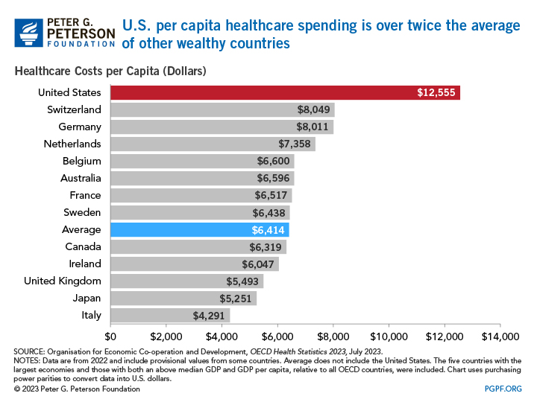

Slide 11
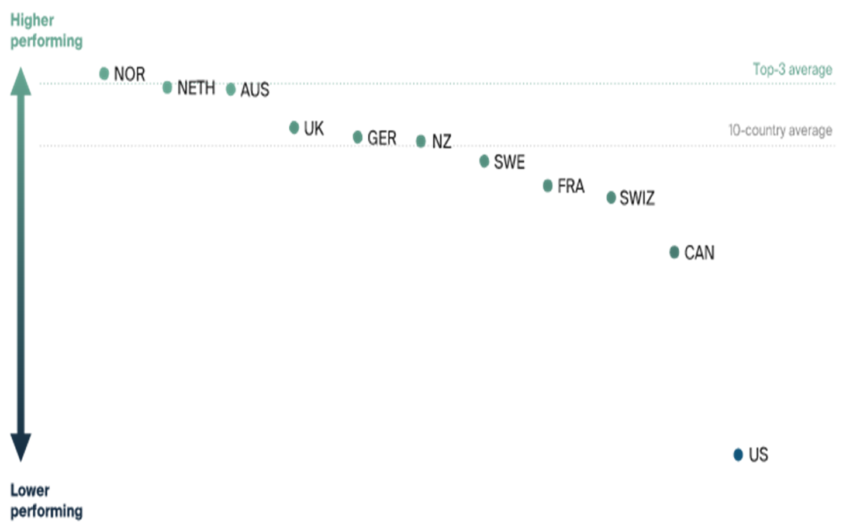
Comparative Health Care System Performance Scores (2021, Commonwealth Fund)

Slide 12
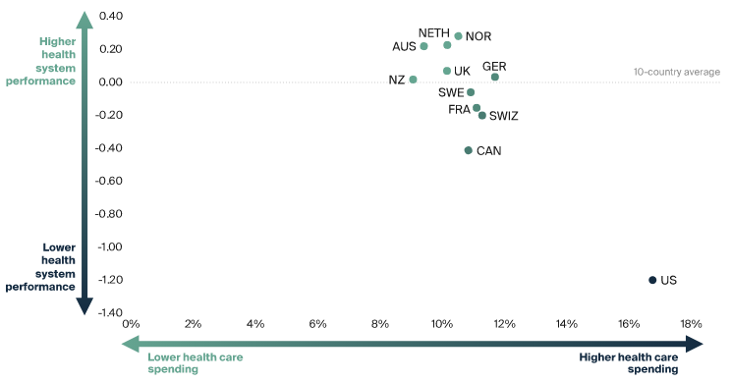
Health Care System Performance Compared to Spending, (2021, Commonwealth Fund)

Slide 13
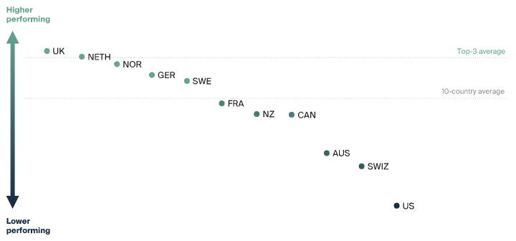
Health Care System Performance Scores: Affordability (2021, Commonwealth Fund)

Slide 14
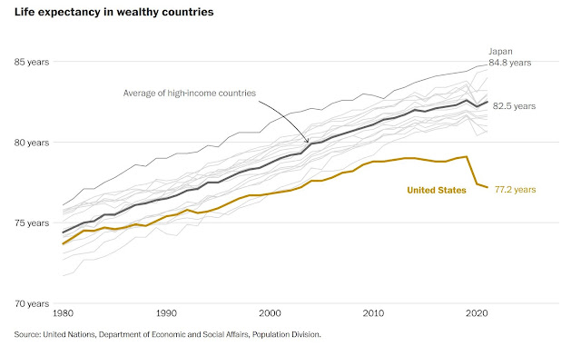

Slide 15
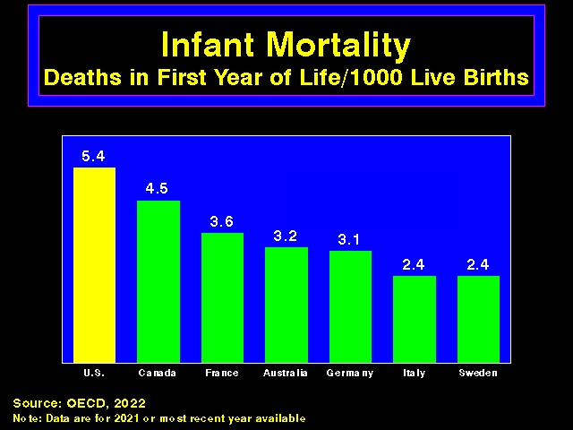

Slide 16
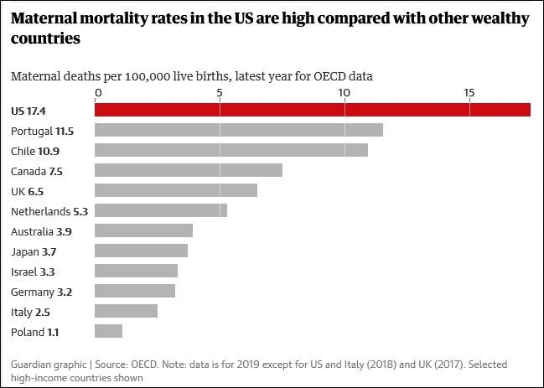

Slide 17
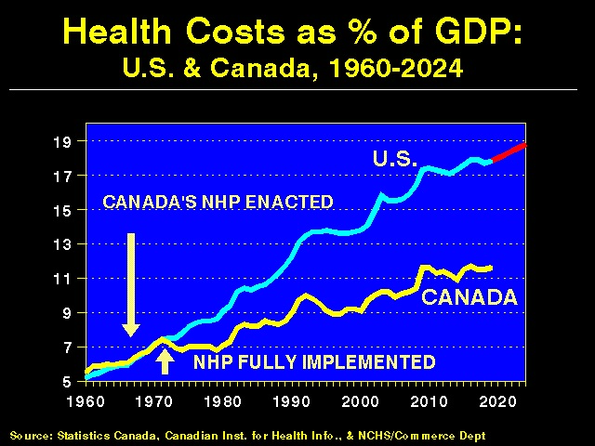

Slide 18
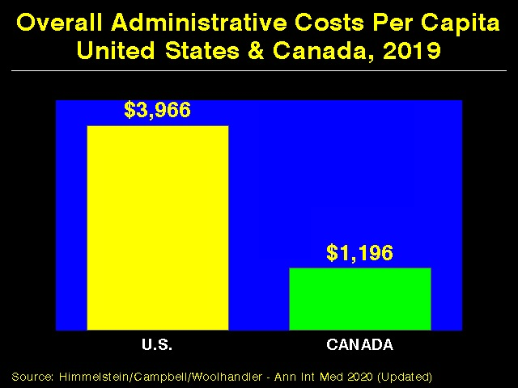

Slide 19
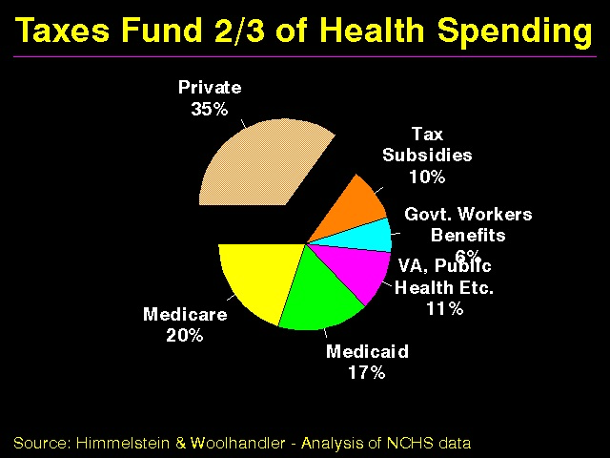

Slide 20
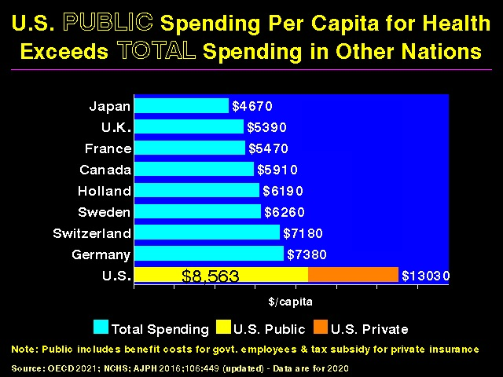

Slide 21
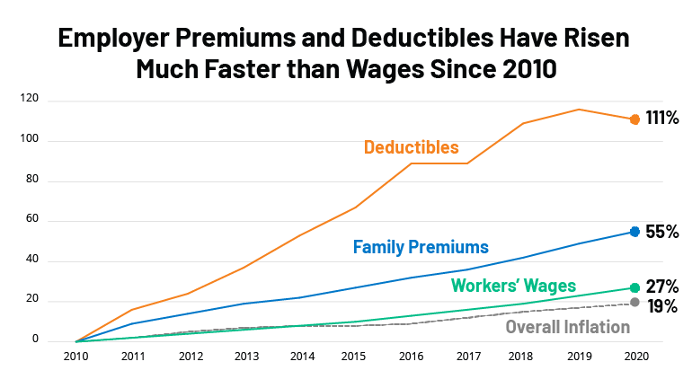

Slide 22
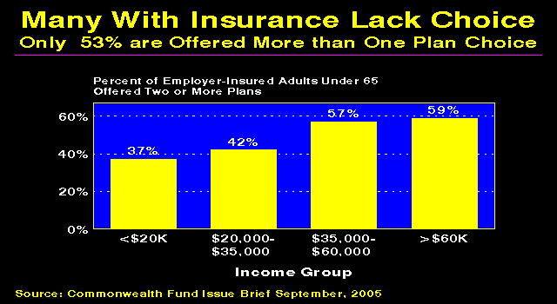

Slide 23
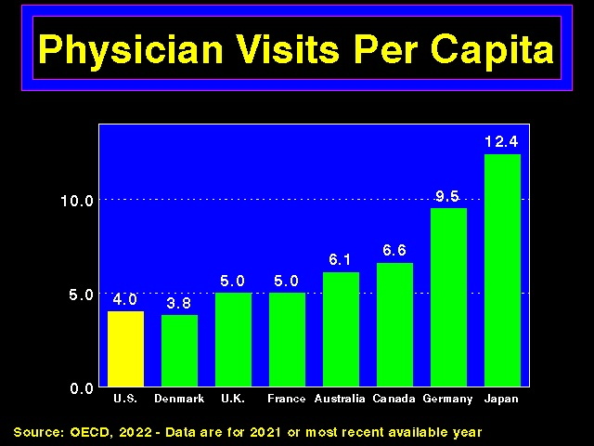

Slide 24
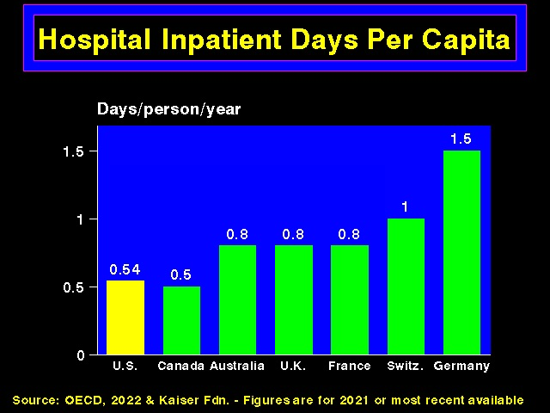

Slide 25
Health Insurance Industry
Consolidation leading to higher prices
Pre-existing conditions (illegal under PPACA)
Delisting
“Cherry picking” (since 5% of people account for 50% of health care costs, and 1% account for 20%); “lemon dropping”
E.g., have no specialist in network for a given specialty; limit access to needed meds (e.g., anti-HIV or chemo drugs)
Doctors being forced out of “narrow networks”
In response, many states have passed “any willing provider” laws

Slide 26
Surprise Medical Bills
Millions of Americans receive each year from health care providers that they are not able to select (e.g., ER physicians, anesthesiologists, ambulances)
Including 1/5 elective surgeries, 1/5 ER visits, 1/6 in-network hospitalizations
Average charge $1,200 - $2,000, can be as high as $100,000
High “trauma” fees for ER visits for minor injuries

Slide 27
Private Equity Takeover of Medicine
Private equity firms buying hospitals, physician practices, hospices, and ER doctor groups and moving the providers out of network to bill larger fees (then cut costs, “increase efficiencies” (often by staffing cuts and replacing MDs with mid-level providers), and sell in avg. 5 yrs for profit)
Investments tripled over 2010s
Patchwork of state laws
Inferior care

Slide 37
Health Insurance Industry
Consolidation leading to higher prices
Pre-existing conditions (illegal under PPACA)
Delisting
“Cherry picking” (since 5% of people account for 50% of health care costs, and 1% account for 20%); “lemon dropping”
E.g., have no specialist in network for a given specialty; limit access to needed meds (e.g., anti-HIV or chemo drugs)
Doctors being forced out of “narrow networks”
In response, many states have passed “any willing provider” laws

Slide 38
Surprise Medical Bills
Millions of Americans receive each year from health care providers that they are not able to select (e.g., ER physicians, anesthesiologists, ambulances)
Including 1/5 elective surgeries, 1/5 ER visits, 1/6 in-network hospitalizations
Average charge $1,200 - $2,000, can be as high as $100,000
High “trauma” fees for ER visits for minor injuries

Slide 39
Private Equity Takeover of Medicine
Private equity firms buying hospitals, physician practices, hospices, and ER doctor groups and moving the providers out of network to bill larger fees (then cut costs, “increase efficiencies” (often by staffing cuts and replacing MDs with mid-level providers), and sell in avg. 5 yrs for profit)
Investments tripled over 2010s
Patchwork of state laws
Inferior care

Slide 40
Surprise Medical Bills
2020 federal No Surprises Law requires health care providers to work with insurers to settle on a fair price, limits patient responsibility for out-of-network care (implementation 2022, ground ambulances exempt)
Federal law (2021) requires hospitals to disclose prices they quietly negotiate with insurers (prices vary greatly, most patients unaware, many hospitals have ignored law since penalties minimal)
2022 : only 1/5 hospitals compliant; only 2 fined as required

Slide 41
Prior Authorization
Onerous prior authorization requirements also delay (and deny) care
2022: 90%/97% of oncology/radiation oncology services required prior authorization under Medicare Advantage
2024: CMS rule requires prior authorization decisions be sent to patients and providers within 72 hours for expedited requests and within 7 calendar days for standard requests
Utilization management costs approximately $100 billion/yr, patients pay most of this

Slide 42
Denials of Claims
Millions/yr
Insurance company medical directors can rule on 10,000+ requests/yr
Identities often hidden, experience and qualifications sketchy, hx malpractice claims hound many
Often “unfightable,” except for later malpractice lawsuits (cost of doing business)
Cigna used algorithm to reject 300,000 claims over 2 months (without any MD review)

Slide 43
Health Insurance Industry
Drug tiering (keeps sickest patients away)
Charging uninsured 2-3X more
Hiring debt collection agencies, which sometimes hound patients in the ER (in violation of EMTALA)

Slide 44
Health Insurance Industry/Bureaucracy
Multiple transaction nodes: hospitals, physicians, insurance companies, middlemen, fees charged to providers for accepting electronic payment
Typical service industry has 0.85 administrative workers per specialized workers (e.g., education, law, financial industry)
Twice as many administrators as physicians
In health care, as opposed to say widget production, inefficiency is profitable

Slide 45
Health Insurance Industry/Bureaucracy
High administrative costs
34% in 2020 (vs. 2-3% for Medicare and Medicaid; private Medicare plans = 14%)
$471 billion/yr for billing and insurance related costs alone
No change with PPACA
Hospital bureaucracy consumes just over ¼ of hospital budgets
Highest at for-profit hospitals
No effect on quality of care

Slide 46
Health Insurance Industry/Bureaucracy
High administrative costs
Average full-time physician spends nearly $100,000/yr on billing and insurance functions
17,849 different billing codes (in 2011) - now 141,058
Administrative costs vary by type of visit/procedure

Slide 47
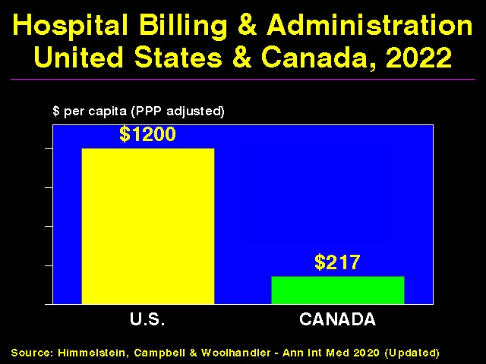

Slide 48
Health Insurance Industry
Large profit margins
Nation’s 5 largest health insurers control 83% of the insured market
Corruption
Lobbying
Loyalty: shareholders (not patients)
Amount actually spent on patient care referred to as “medical loss ratio”

Slide 49
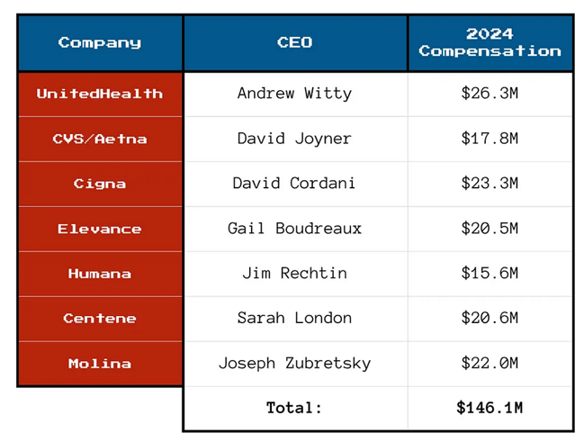
Health Care CEO Compensation, 2024

Slide 50
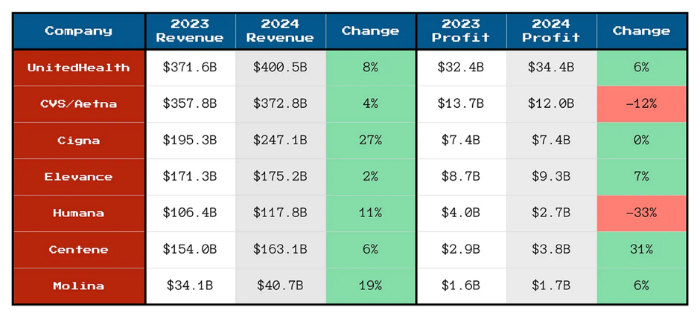
Health Insurance Company Profits

Slide 51
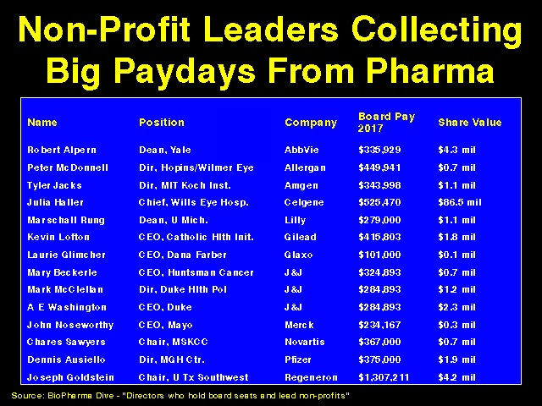

Slide 52
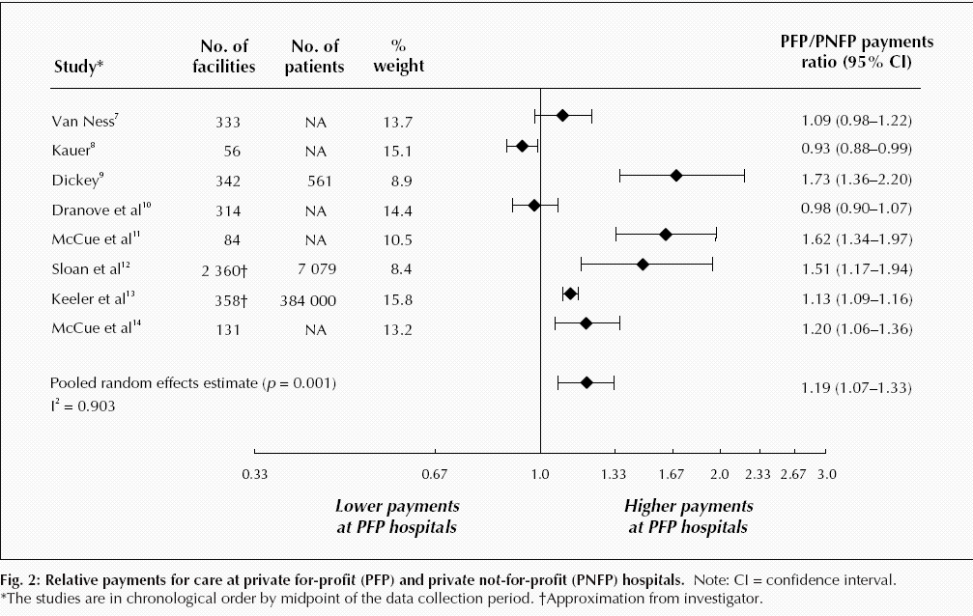
For-Profit Hospitals Cost 19% More
Source: CMAJ 2004;170:1817
Notes:
52

Slide 53
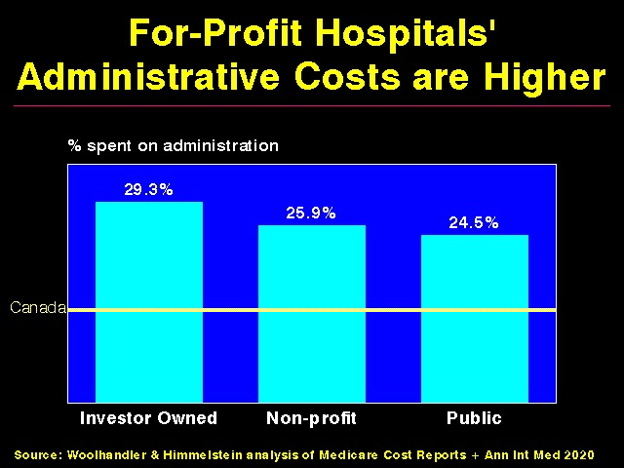

Slide 54
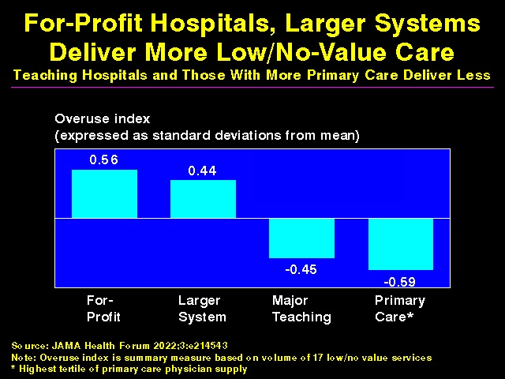

Slide 55
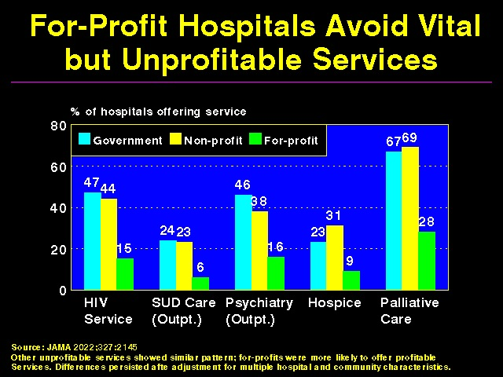

Slide 56
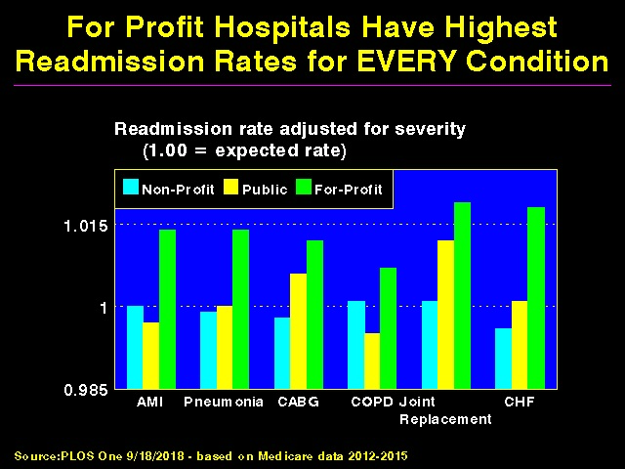

Slide 57
FFor-Profit Dialysis Clinics’ Death Rates are 7% Higher
3800 Excess Death Annually
Source: Dickman, Mirza et al. Int J Health Serv 2021;51:371

Slide 58
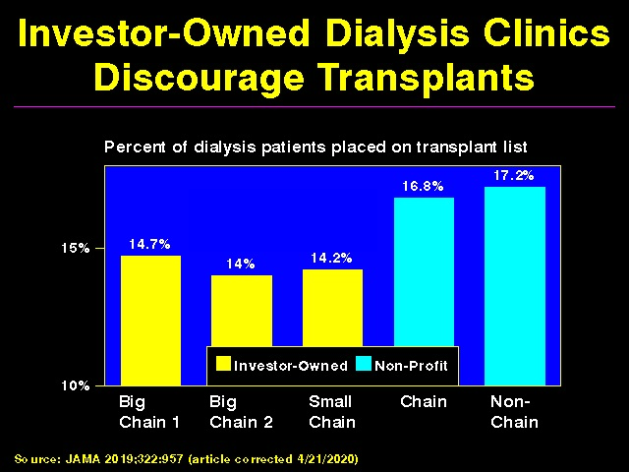

Slide 59
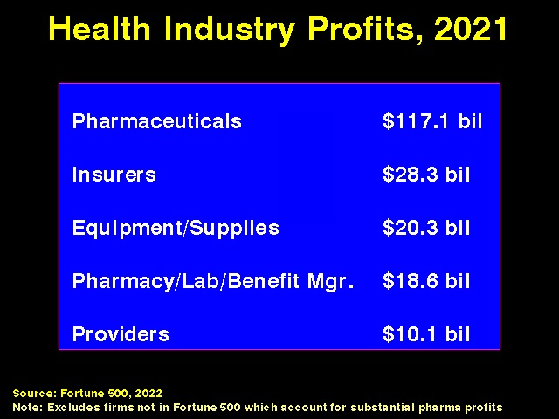

Slide 60
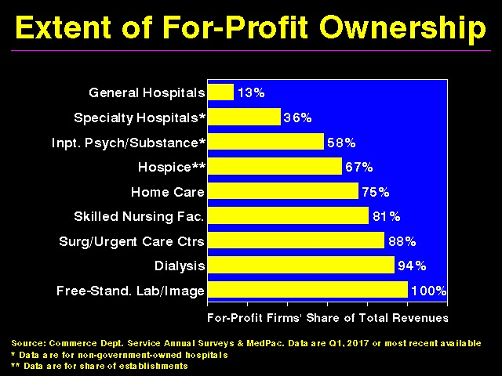

Slide 61
FFor-Profit Dialysis Clinics’ Death Rates are 7% Higher
3800 Excess Death Annually
Source: Dickman, Mirza et al. Int J Health Serv 2021;51:371

Slide 62
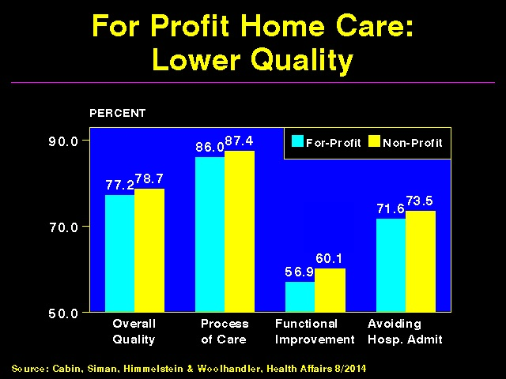

Slide 63
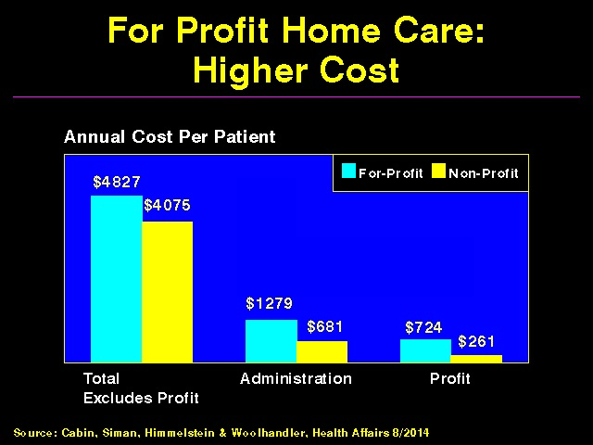

Slide 64
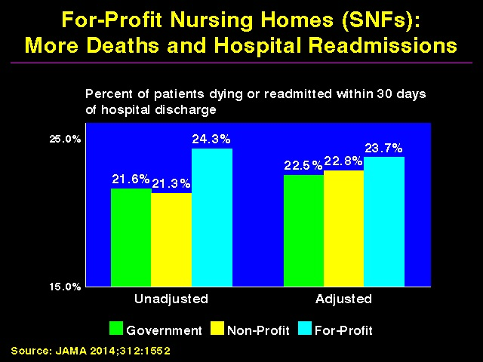

Slide 65
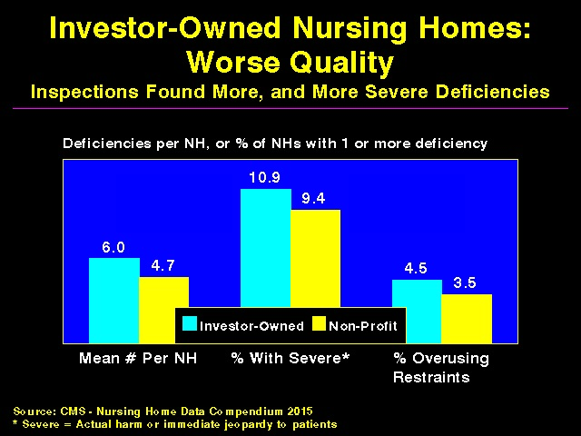

Slide 66
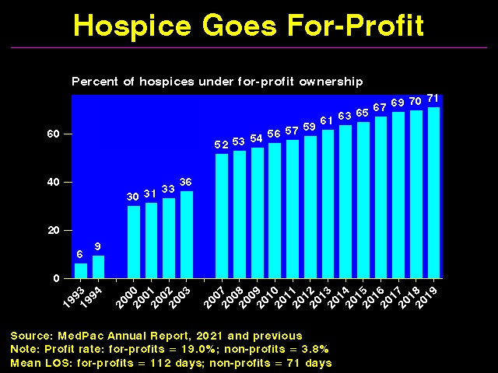

Slide 67
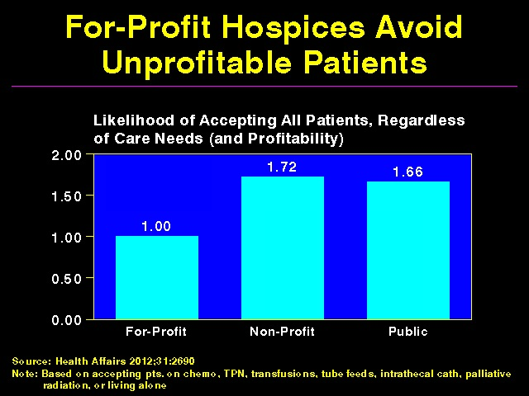

Slide 68
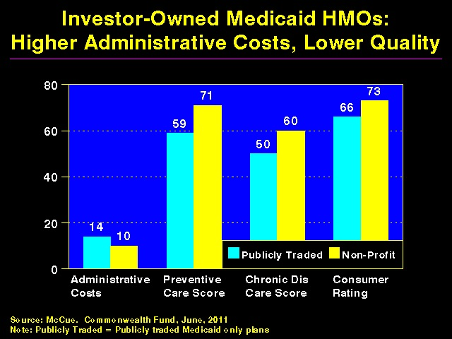

Slide 69
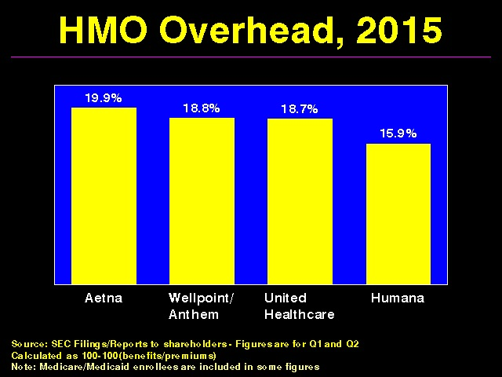

Slide 70
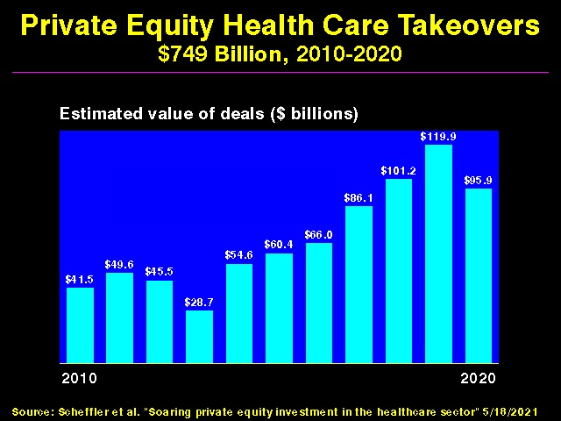

Slide 71
Wasteful Health Care Spending Annual Median Estimate (AJPH Dec 2020:1746)
Overuse: $451 billion
Missed prevention opportunities: $310 billion
Administrative waste: $281 billion
Clinical inefficiencies: $202 billion
Fraud and abuse: $185 billion
Excessive prices: $169 billion

Slide 72
Overuse
Overuse of diagnostic tests, medications, and therapeutic procedures
$765 billion wasted annually
$210 billion on unnecessary testing alone
Unnecessary testing causes up to 30,000 deaths/yr
See Scans and Scams webpage of phsj.org for a slide show covering unnecessary testing
Procedural variability

Slide 73
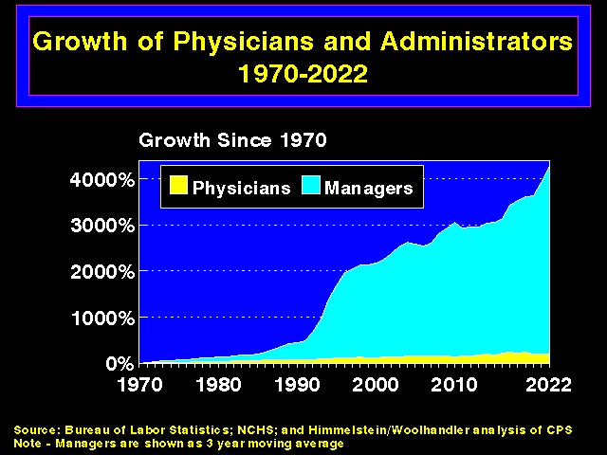

Slide 74
Pharmaceutical Industry
U.S. 4.5% of world’s population, accounts for 40% of global drug spending
US prescription drug costs high
$577 billion drug spending in 2021
36% increase in brand name drug costs between 2016 and 2020, 4X rate of inflation
Average cost of new drugs $2,115 in 2008, 180,007 in 2021
256% higher prices than in peer countries

Slide 75
Pharmaceutical Industry
US prescription drug costs high
Median annual profit margins of pharmaceutical companies almost double that of mean of other S and P 500 companies
Middlemen (pharmacies, pharmacy benefit managers, and hospitals and clinics that dispense drugs) account for 1/3 of costs
PBM market dominated by 3 companies

Slide 76
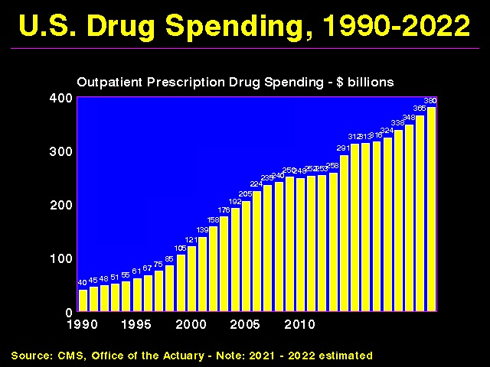

Slide 77
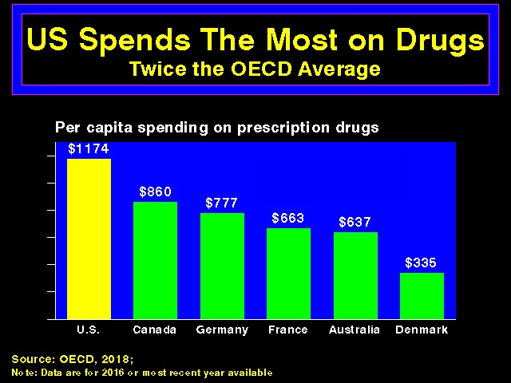

Slide 78
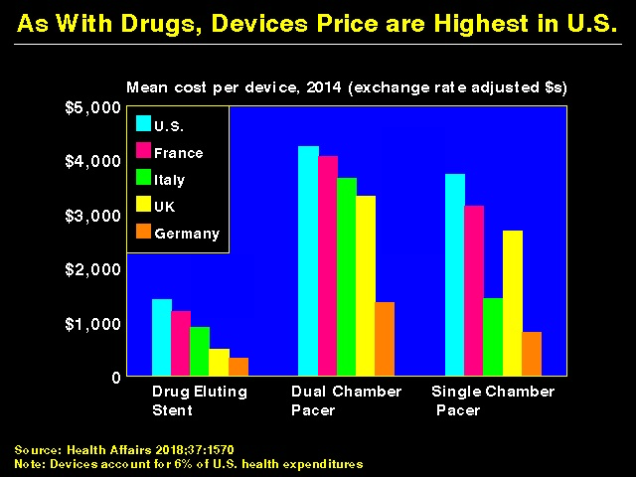

Slide 79
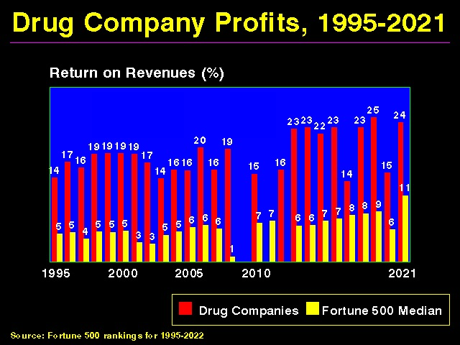

Slide 80
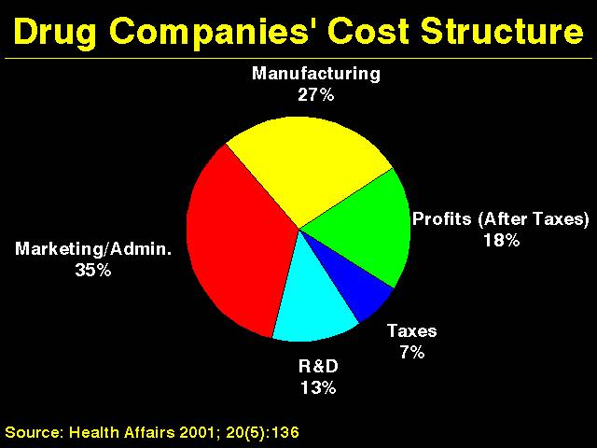
Drug Companies’ Cost Structure

Slide 81
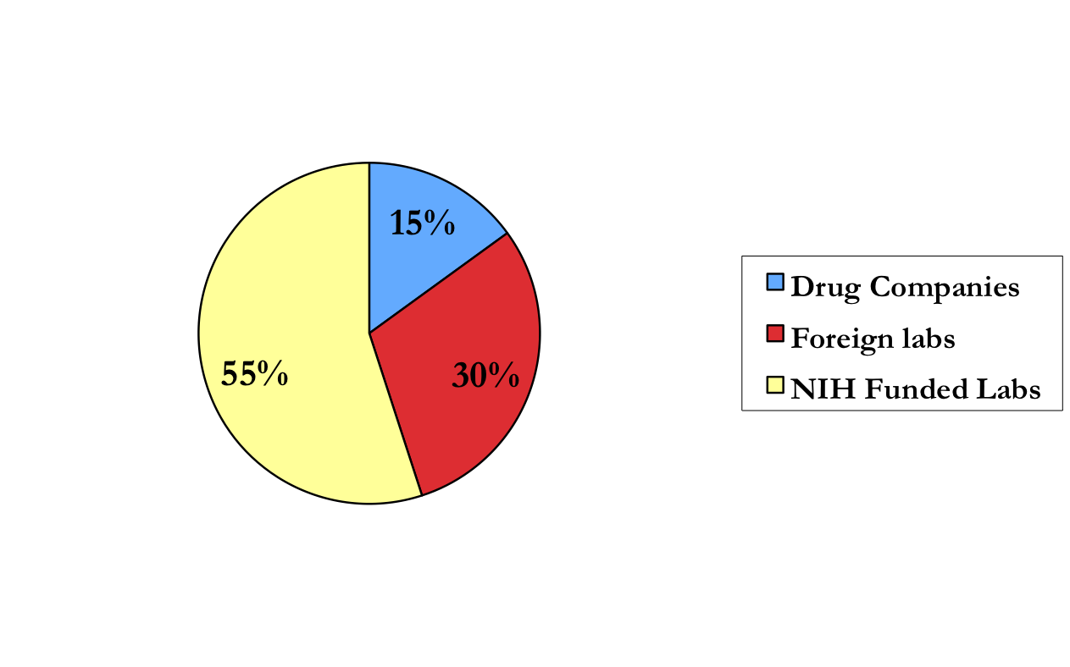
Innovation: Published Research Leading to Drugs

Slide 82
Pharmaceutical Industry
Only 10% of new drugs treat life-threatening conditions
92% of new drugs little or no better than pre-existing agents (or cause harm)
Thus only 1% of new drugs “life-saving”
Drug trials run by primary investigators with industry ties more then 3X likely to report positive results (after adjustment for multiple variables)

Slide 83
Government Paid Twice for Vaccines
Funded most of the basic science research underlying mRNA vaccines and that characterized the spike protein.
Spent at least $18 billion subsidizing vaccine makers’ research and production, purchased all doses used in US.
Firms refused to share vaccine recipe, limiting global production capacity and leaving billions unprotected.
Cost to manufacture mRNA vaccine: ~$2/dose for Moderna, ~$1/dose for Pfizer. Sale price ~$25/dose. (J Royal Soc Med 2021;114:502)
“Pfizer, BioNTech and Moderna will make pre-tax profits of $34 billion this year between them, which works out as over a thousand dollars a second.” (Peoples Vaccine Alliance)

Slide 84
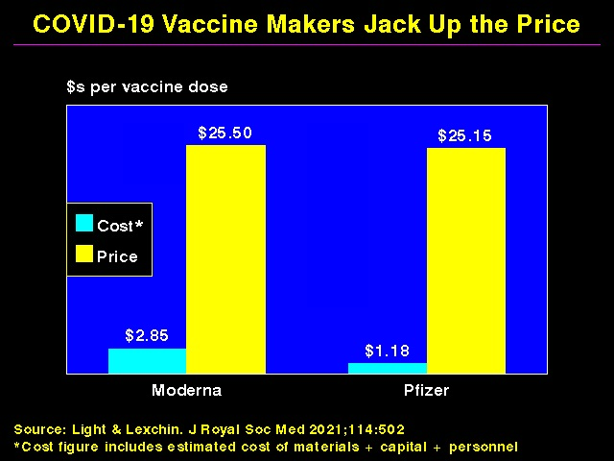

Slide 85
Pharmaceutical Industry
There is little correlation between the price of a particular drug and a company’s R&D investment, nor between a drug’s price and the cost of its production
Drug prices rising despite Trump tax cut lowering permanent tax rate from 35% to 21%

Slide 86
Corporations Dominate the Global Economy
69 of the world’s 100 largest economies are private corporations; 31 are countries
Wal-Mart has more annual revenue than Spain and Australia
Royal Dutch Shell > Mexico
United Health Group > Denmark and Saudi Arabia

Slide 87
Premature Deaths in the U.S.
10% due to inadequate medical care
60% due to behaviors, social circumstances, and environmental exposures

Slide 88
Address Social Factors Responsible for Illness and Death
Deaths in 2000 attributable to:
Low education: 245,000
Racial segregation: 176,000
Low social support: 162,000
Individual-level poverty: 133,000
AJPH 2011;101:1456-1465

Slide 89
Address Social Factors Responsible for Illness and Death
Deaths in 2000 attributable to:
Income inequality: 119,000 (population-attributable mortality – 5.1%)
Area-level poverty: 39,000 (population-attributable mortality – 1.7%)
AJPH 2011;101:1456-1465

Slide 90
Address Social Factors Responsible for Illness and Death
Deaths in 2000 attributable to:
AMI – 193,000
CVD – 168,000
Lung CA – 156,000
AJPH 2011;101:1456-1465

Slide 91
Deaths per year
Tobacco = 438,000 (+ 42,000 ETS)
Obesity = 300,000
Alcohol = 100,000
Microbial agents = 90,000
Toxic agents = 60,000 (likely higher)
Firearms = 35,000
Sexual behaviors = 30,000
Motor vehicles = 25,000
Illicit drug use = 20,000

Slide 92
Major Contributors to Illness and Death
Estimated that medical care accounts for only 10% of overall health
Social, environmental, behavioral, and genetic factors = 90%
Few physicians screen for SDOH
40% of US mortality due to tobacco, poor diet, physical inactivity, and misuse of alcohol
Every $1 invested in programs covering above items saves $5.60 in health care costs

Slide 93
Prevention
2-4% of national health care expenditures
Every $1 spent on building biking trails and walking paths would save nearly $3 in medical expenses
Every $1 spent on wellness programs, companies would save over $3 in medical costs and almost $3 in absenteeism costs by some estimates
Another study showed increased health behaviors but no differences in self-reported health, health care markers/use/spending, absenteeism, economic, or employment outcomes

Slide 94
Public Health Spending
Public health spending minimal
1.4% in 1960, 3.2% in 2002, 2.4% in 2019
Other wealthy OECD countries spend average of $2 on social services for every $1 spent on medical care (U.S. = $0.55)
Mortality rates fall 1-7% for every 10% increase in public health spending
If US welfare state was average (c/w OECD countries), life expectancy would be 3.8 yrs longer

Slide 95
Public Health Spending
Covid global death toll (through 4-24) = 7.1 billion (1.1 billion in US)
The US and the world are not prepared for future pandemics
Experts estimate $20 billion/yr cost to “pandemic proof the planet;” cost of covid pandemic to US through 8-21 = $16 trillion = approximately 90% of annual GDP
$29 trillion global cost (as of 1-23)

Slide 96
Compliance
33% of prescriptions go unfilled
Only 50-65% of patients take medicines as prescribed
Noncompliant patients more likely to be hospitalized and to die
Noncompliant patients have twice the annual medical care costs of those who are compliant
Cost, health literacy contribute to noncompliance
25% of Americans functionally illiterate; large majority health care-illiterate

Slide 97
Poverty and Hunger
US: 14% of residents and 19% of children live in poverty
Rates of poverty in Blacks and Hispanics = 2.5X Whites
Poverty associated with worse physical and mental health
Poverty = fourth leading cause of death in US, after heart disease, cancer, and smoking
Income inequality associated with higher death rates among those at low end of economic spectrum

Slide 98
Economic Disparities
Women 75 cents/$1 Men
Median income of black U.S. families as a percent of white U.S. families 62%
60% in 1968
63% for Hispanic families
Median net worth of white households 13X higher than black households; 10X higher than Latino households

Slide 99
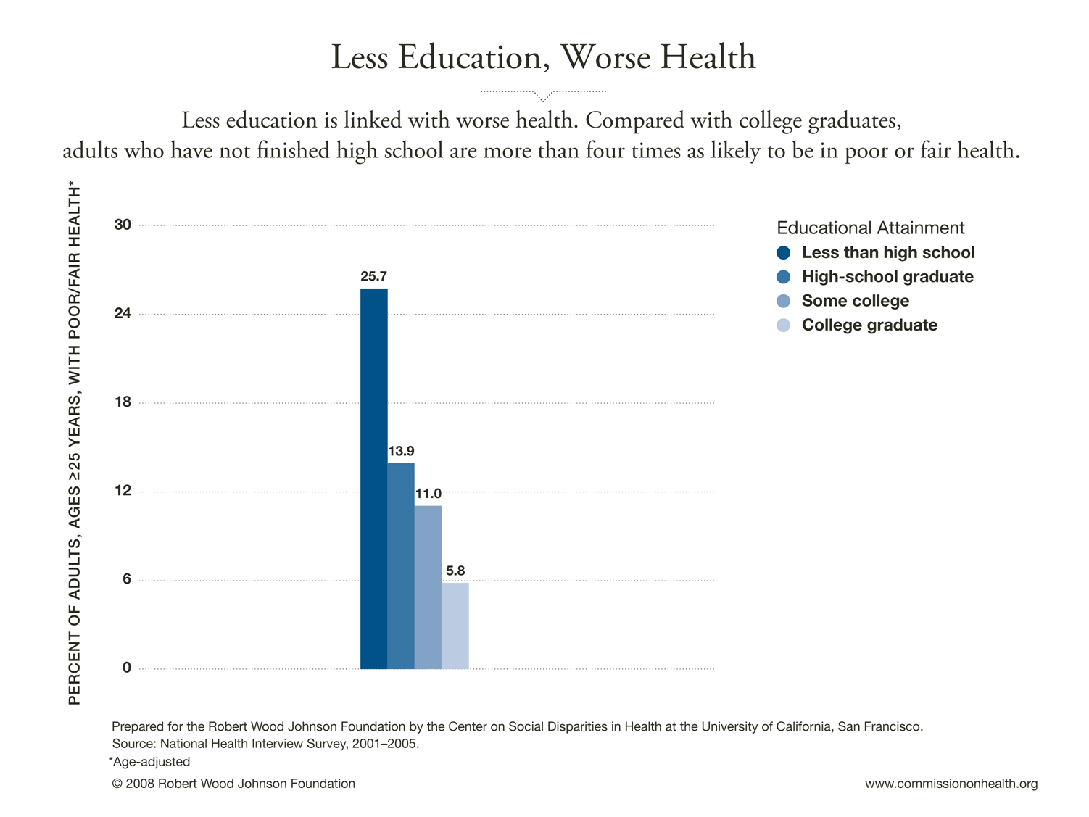

Slide 100
Educational Apartheid
High levels of de facto school segregation by race and SES
Gross discrepancies in per-pupil spending and teacher salaries
Achievement and graduation gaps growing

Slide 101
Patient Education
Patient education materials typically written at 10th-14th grade level
Average patient reads at 8th grade level
<50% of visits for major illnesses involve health education (across all provider types)

Slide 102
Language Barriers
2011 Communities Survey:
More than 60 million people in the U.S. speak a language at home other than English
42% of these speak English less than “very well”
Limited English proficiency associated with more liberal use of medical testing and higher rates of unplanned visits to the ER after hospital discharge
Civil Rights Act requires hospitals receiving federal money to provide language assistance, but underutilized

Slide 103
Education
Medical advances averted a maximum of 178,000 deaths between 1996 and 2002
Correcting disparities in education-associated mortality would have save 1.3 million lives during the same period
AJPH 2007;97:679-83

Slide 104
Benefits of Education
For every $1 spent on early childhood education, up to $17 are saved from increased school achievement, improved health, reduced crime, and reduced reliance on public assistance
Income increases 11% for every year of education
College graduates live 5 years longer than high school dropouts

Slide 105
Harms of Pseudoscience/Misinformation
Dramatic rise under Trump
Increasing polarization of U.S. society
Politicians, the media, religions all play role
Lack of health education at all levels
Especially notable during Covid epidemic

Slide 106
Racial Disparities: Health Care
Higher maternal and infant mortality
Higher death rates for most diseases
Shorter life expectancies for African-Americans
Not for Hispanic Americans (healthy immigrant effect and Hispanic paradox may be relevant, but largely due to decreased tobacco use)
Discrimination still common

Slide 107
Racial Disparities: Health Care
Shorter visits/fewer diagnostic tests / therapeutic procedures / pain medications
US spending on cystic fibrosis R & D/patient advocacy = 3X spending on sickle cell disease
CF afflicts 1/3 as many US citizens as SCD

Slide 108
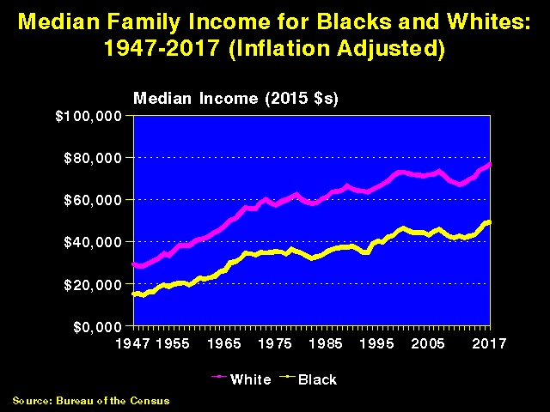

Slide 109
Racial Disparities in Health Care: African-Americans
Equalizing the mortality rates of whites and African-Americans would have averted 686,202 deaths between 1991 and 2000
Whereas medical advances averted 176,633 deaths
AJPH 2004;94:2078-2081

Slide 110
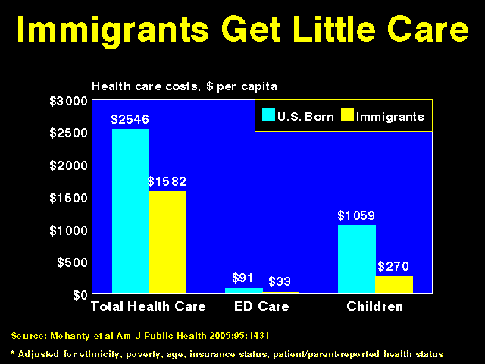

Slide 111
Undocumented Immigrants
Between 2012 and 2018, immigrants contributed $201 billion more in private insurance premiums than insurers spent on their care
Non-citizen immigrants accounted for nearly $117 billion of that surplus.

Slide 112
Immigrants and Health Care JAMA Netw Open. 2022;5(11):e2241166
Immigrants contributed $58.3 billion more in premiums and taxes in 2017 than insurers and government paid for their health care
Undocumented immigrants accounted for most (89.0%) of the surplus
US-born citizens incurred a net deficit of $67.2 billion

Slide 113
Immigrants and Health Care Intl J Hlth Serv 2018;48(4)
Immigrants use far less health care than non-immigrants (1/2 to 2/3 across all age groups) and make larger out-of-pocket payments
Immigrants effectively subsidize private insurance and some public insurance programs such as Medicare because they constitute a low-risk pool that pays more into the system (by way of premiums and tax contributions) than is paid out for their care

Slide 114
The Medical Brain Drain
U.S. is largest consumer of health care personnel
U.S. (4.5% of world’s population) accounts for 42% of global health care spending, has 8% of world’s doctors and 7% of world’s nurses
Five times as many migrating doctors flow from developing to developed nations than in the opposite direction
Even greater imbalance for nurses

Slide 115
Overconsumption (“Affluenza”)
U.S. = 4.5% of world’s population
Owns 50% of the world’s wealth
U.S. responsible for:
25% of world’s energy consumption
33% of paper use
72% of hazardous waste production

Slide 116
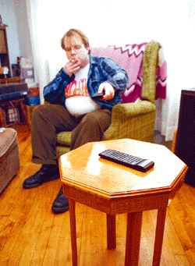
New Remote Control Can Be Operated by Remote: No More Leaning Forward To Get Remote From Coffee Table Means Greater Convenience For TV Viewers

Slide 117
But Are We Happier?
Stress up / satisfaction with life down
U.S. ranks 24th in citizen satisfaction with quality of life
Average American works 200 more hrs/yr than in 1960 (#1 in world)
Vacations shorter
Notes:
117
117

Slide 118
But Are We Happier?
No guaranteed paid sick or maternity leave
Although many cities, some states now guarantee
8/10 Americans want a new job

Slide 119
But Are We Happier?
Fewer close friends
Loneliness - common among the elderly
Linked to physical and cognitive decline and eclipses obesity as a predictor of early death
Pharmaceutical fixes

Slide 120
But are we happier?
8% of U.S. population suffers from depression
Anti-depressant use doubled between 1993 and 2005

Slide 121
US Charity Care Suffering
Free clinic demand increasing, more patients being turned away
Hospitals consolidating
Decreases competition, can increase costs
Hospitals turning to lucrative initiatives to improve financial situation
Cosmetic surgery, luxury clinics, aggressive billing practices (including charging uninsured more than insured and employing harsh debt collection practices), recruiting wealthy foreign patients

Slide 122
Maldistribution of Wealth
Top 62 billionaires worldwide worth $1.8 trillion, the combined income of bottom 3.5 billion people (1/2 of world’s population)
U.S: Richest 1% of the population owns 50% of the country’s wealth -poorest 90% own 30% -widest gap of any industrialized nation

Slide 123
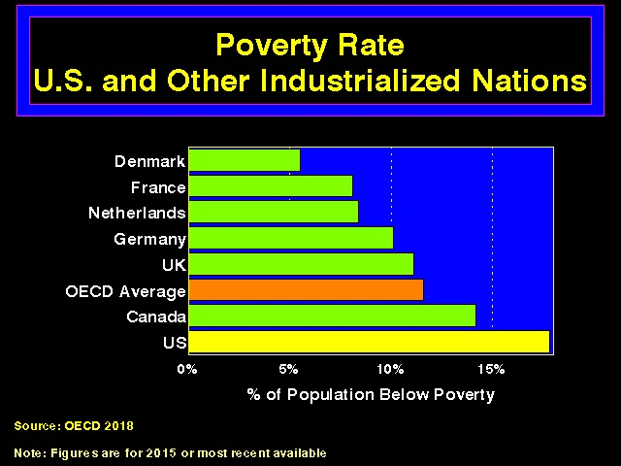

Slide 124
Income Inequality
Depression
Mental Illness
Obesity
Crime
Diminished trust in people and institutions

Slide 125
Maldistribution of Wealth is Deadly
880,000 deaths/yr in U.S. would be averted if the country had an income gap like Western European nations, with their stronger social safety nets
BMJ 2009;339:b4471

Slide 126
Maldistribution of Wealth
In countries with moderate levels of wealth, happiness is highest where income inequalities lowest and taxes most progressive
Major League Baseball: teams are more successful when players’ salaries are more equitably distributed
In more equal societies, people attend more cultural events, read more books

Slide 127
Maldistribution of wealth
Less than 4% of the combined wealth of the 225 richest individuals in the world would pay for ongoing access to basic education, health care (including reproductive health care), adequate food, safe water, and adequate sanitation for all humans
US citizens consume 80% of all opioid-based pain killers
50% of the world’s population live in countries that receive only 1% of the world’s opioid analgesics

Slide 128
Health Requires Equality
“All men are created equal”
Declaration of Independence
“Some people are more equal than others”
George Orwell

Slide 129

Hudson River, 2009

Slide 130
PPACA Patient Protection and Affordability Care Act
Problems:
Inadequate numbers of primary care providers
Less than ½ of adult Americans have a long-standing relationship with a PCP
33% of US doctors are primary care doctors (vs. 50-70% in other countries); 40% of doctors-in-training (2017)
Primary care panels average 2,000 patients

Slide 131
PPACA Patient Protection and Affordability Care Act
Problems:
Fewer primary care doctors leads to more (and sometimes unnecessary) use of more-expensive specialists
Large shortages in both primary and specialty physicians forecast for coming decade
Interest in primary care declining
5% of health care budget goes to primary care (vs. 10% in European countries)

Slide 132
PPACA Patient Protection and Affordability Care Act
Problems:
Inadequate numbers of primary care providers
1/3 of practicing primary care doctors would choose different specialty if starting over (vs. 90-95% of subspecialists)
2019: first year that number of osteopathic and foreign-trained doctors surpassed the percentage of US-trained doctors matching into primary care positions

Slide 133
Primary Care: Impossible Standards
Visit lengths too short (average 18 minutes)
Shorter visits associated with higher rate of inappropriate prescribing
Mean time for PCP to provide guideline recommended preventive, chronic disease, and acute care for a hypothetical panel of 2500 patients = 26.7 hrs/d
J Gen Intern Med. 2023 Jan;38(1):147-155

Slide 134
Problems
Average wait time in large metro areas for a new patient appointment = 24 days in 2017 (up 30% from 2014)
Communities with a high number of PCPs per capita have longer life expectancy, better outcomes, and lower medical costs (effect of more specialists in a community similar but lower)
But only 51% of physician visits in 2017 were with primary care doctors

Slide 135
Problems
High levels of burnout (better described as moral injury), career dissatisfaction, PTSD, depression, and suicide
Physicians have highest suicide rate of any profession (40%/130% (not typo) for men/women c/w general population)
Almost 50% of medical students during training – increases risk for depression and dropping out of school
Prevalence of depression (27%) and suicidal ideation (11%) high in medical students
Violence against health care providers increasing dramatically

Slide 136
Problems
High levels of burnout, career dissatisfaction, depression, and suicide
Majority of physicians take fewer vacation days than allowed, work during vacations, and only ½ have someone to cover their inbox while away
Resident burnout rates vary from 34% to 64%, depending on specialty (40% for primary care)

Slide 137
Problems
High levels of burnout, career dissatisfaction, depression, and suicide
Burnout associated with patient safety, professionalism, and patient satisfaction
Cost of burnout = $4.6 billion annually (turnover, reduced clinical hours, etc.)
Meanwhile, many physicians leaving the profession, retiring early, aging out
AAMC predicts shortage of 124,000 MDs by 2034

Slide 138
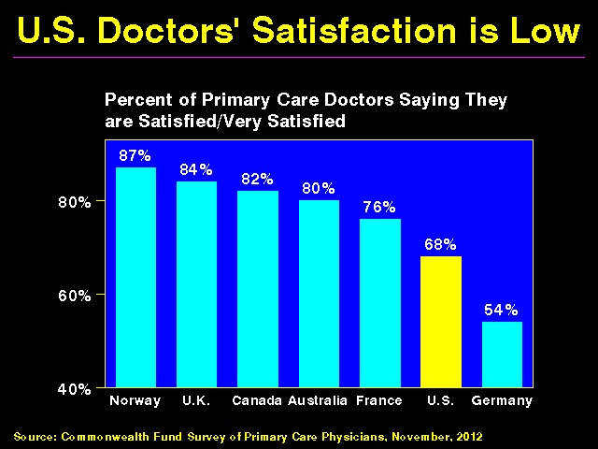

Slide 139
Trump Administration
Trump: narcissistic, sociopathic, xenophobic, racist, ignorant, anti-science, ecocidal, misogynistic, admitted sex offender/sexual predator
President, agency heads, and Congress undoing many public health initiatives
Large exodus of public health workers

Slide 140
Trump Administration
Trump/Republicans may overturn PPACA
2017: Trump eliminates CHIP program
2017: Trump places numerous restrictions on reproductive health care funding nationally and internationally (see Obstacles to Abortion and Comprehensive Reproductive Health Care slide show on Women’s Health page of phsj website)
2017: Trump stops reimbursing private insurers for reducing out-of-pocket expenses for lower-income individuals (previously part of PPACA)

Slide 141
Trump Administration
CDC:
Director Robert Redfield (2018-): Previous chair of Children’s AIDS Fund International (advocated abstinence-only education)
Director Brenda Fitzgerald (2017-18): Resigned when investments in tobacco and for-profit health care entities revealed
Thomas Frieden (2009-2017, Obama Appointee): Awaiting trial on sexual abuse and harassment charges

Slide 142
Trump Administration
National Guidelines Clearinghouse briefly shut down by Agency for Healthcare Research and Quality due to funding cuts
Trump’s Health and Human Services directors:
Tom Price: resigned after facing criticism for taking government trips on charter and military aircraft when less expensive commercial flights were available
Alex Azar: previously president of Eli Lilly drug company

Slide 143
Trump Administration
VA Secretary Shulkin involved in travel expenses scandal, ousted by Trump in favor of Ronny Jackson (Trump’s personal physician, who was not confirmed due to reports of harassment of co-workers, excessive drinking on the job, and improperly dispensing controlled substances)
VA now spends 30% of its clinical budget on outsourced care to private sector providers who cost more to deliver lower quality care

Slide 144
Trump Administration
Concierge physician Bruce Moskowitz, Marvel Entertainment CEO Ike Perlmutter, and attorney Mark Sherman (the Mar-a-Lago Crowd) form Trump’s inner circle of advisors on VA health care policy
Conflicts of interest uncovered by ProPublica Report, 2018

Slide 145
Trump Administration
2018: Open to proposals for work requirements for Medicaid
However, 80% of Medicaid patients are from working families, 60% work already
Of those who do not work, 35% are unable to due to disability or illness; 28% are taking care of family members; 18% are students; 8% are looking for work but cannot find it: 8% are retired: only 3% can possibly be defined as “able-bodied” not choosing not to work

Slide 146
Trump Administration
2020: Trump announces US to withdraw from World Health Organization
Absolute botching of coronavirus pandemic (US deaths could have been 40% lower had our rates mirrored those of other high-income nations, meaning 180,000 fewer lives lost – Lancet, 2-10-2021)
Proliferation of fake news, false claims by Republicans related to protecting those with pre-existing conditions

Slide 147
Lancet, 5-30-2020
Single-payer, universal health care system in the US would lead to a 13% savings in national health care expenditures ($450 billion/yr, in 2017 dollars)
Medicare for All bill
Would save more than 68,000 lives and 1.73 million life years every year c/w that status quo

Slide 148
Single Payer
Not socialism any more than having a police force and fire department which serve everyone or offering free public education to children through grade twelve is socialism
Imagine if insurance companies ran the fire department
Would not increase overall utilization (increased utilization by previously uninsured offset by small decreases in utilization among those previously covered, based on Canadian experience)

Slide 149
Recommendations for Medical Education and Practice
Decrease disparities in pay between generalists and subspecialists; increase pay for cognitive work; improve communication between PCPs and specialists
Uniform, centralized state licensing and credentialing processes

Slide 150
Recommendations for Medical Education and Practice
Improve prevention, identification, and treatment of mental illness and moral injury (burnout)
Eliminate socioeconomic/racial disparities (among faculty and students) and student mistreatment
Greater attention to public health and social justice, coordination of care with community social services

Slide 151
Am I Stoned?
A 1999 Utah anti-drug pamphlet warns:
“Danger signs that your child may be smoking marijuana include excessive preoccupation with social causes, race relations, and environmental issues”

Slide 152
What You Can Do
Educate yourselves and others
“Information is the currency of democracy” (Thomas Jefferson)
Take care of your body – you only get one (no trade-ins)
Live, laugh, and love – life is short
Join groups working to improve health care

Slide 153
Act Now!
"If you think you are too small to have an impact, try going to bed with a mosquito in your tent“
- African Proverb

