Slide 1
The US Health Care System:
From Crisis to Chaos
Martin Donohoe
TCH - Gen Med/AMU
Note: The views expressed in this talk represent are my own, not those of Canberra Health Service or TCH

Slide 2
Am I Stoned?
A 1999 Utah anti-drug pamphlet warns:
“Danger signs that your child may be smoking marijuana include excessive preoccupation with social causes, race relations, and environmental issues”

Slide 3
The State of U.S. Health Care is Not Good
Ranks 69th/191 countries
Poorest health among all rich nations
Ranks near the bottom among westernized nations in overall population health, life expectancy, infant and maternal mortality, etc.

Slide 4
Why?
Inadequate attention to social determinants of health
  Gender, racial, educational, and wealth disparities
Capitalist approach to medicine / profit motive
Large numbers of un- and under-insured patients
Inefficiencies throughout system
Not a government priority

Slide 5
Resources Adequate, but Many Unnecessary Deaths
U.S. has 4.5% of world’s population), 8% of world’s doctors and 7% of world’s nurses, and accounts for 42% of global health care spending,
27 million (8%) uninsured patients
  27,000 deaths/year
Millions more underinsured
  Remain in dead-end jobs; go without needed prescriptions due to skyrocketing drug prices
  200,000 deaths/yr

Slide 6
Access to Care
Inadequate numbers of primary care providers
Less than ½ of adult Americans have a long-standing relationship with a PCP
33% of US doctors are primary care doctors
  50-70% in other countries
Average wait time in large metro areas for a new patient appointment = 31 days

Slide 7
Access to Care
High levels of burnout (better described as moral injury), career dissatisfaction, PTSD, depression, and suicide
  Decreasing pool of PCPs
Fewer primary care doctors leads to more (and sometimes unnecessary) use of more-expensive specialists
Communities with higher number of PCPs per capita have longer life expectancy, better outcomes, and lower medical costs

Slide 8
Annual US Health Care Spending (2024) Center for Medicare and Medicaid Services
$4.9 trillion total
$1.6 trillion - hospital expenditures
$1.1 trillion - physician and clinical services expenditures
$467 billion - prescription drug spending
$1 trillion – administrative costs

Slide 9
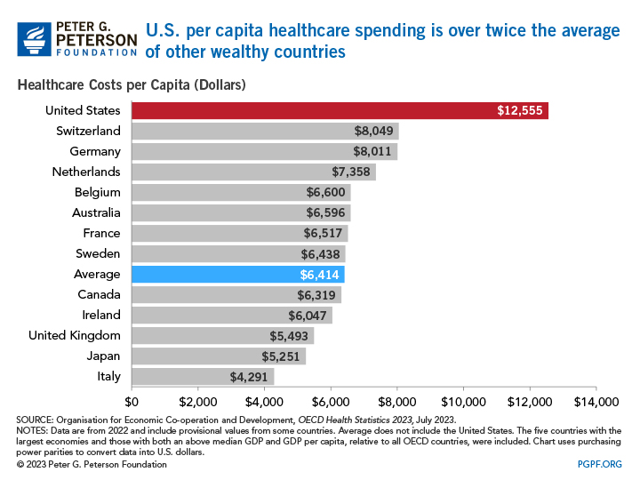

Slide 10
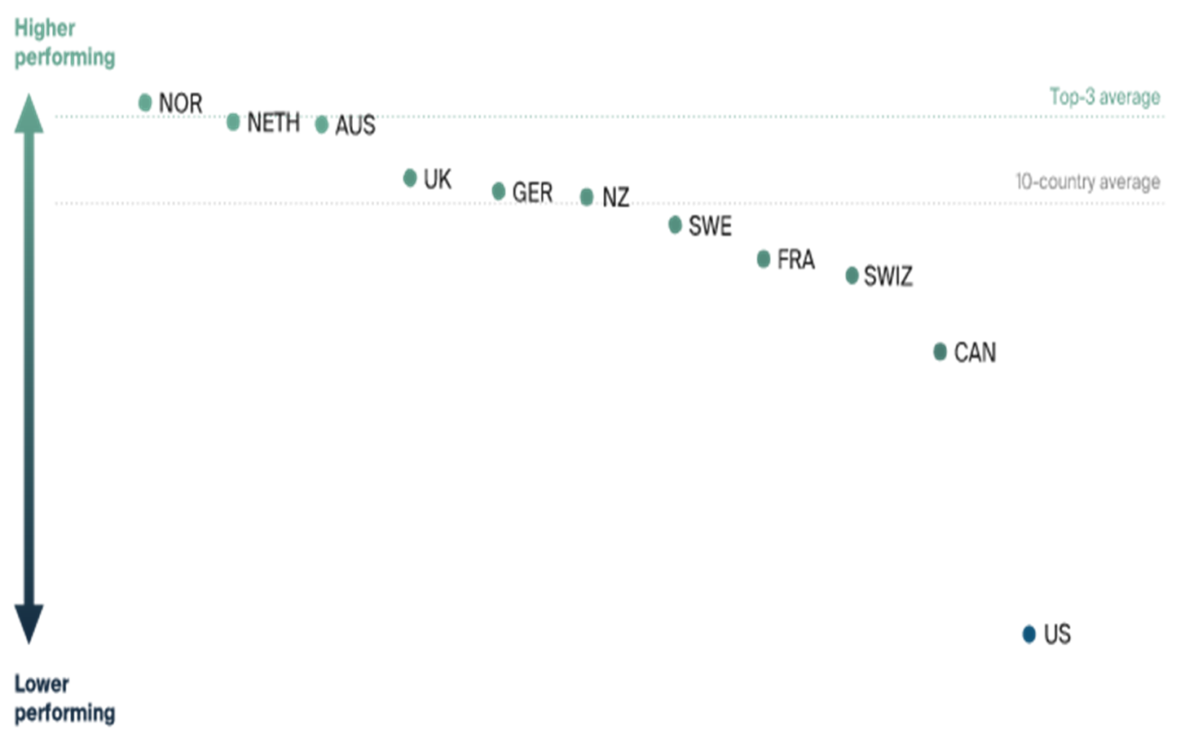
Comparative Health Care System Performance Scores
(2021, Commonwealth Fund)

Slide 11
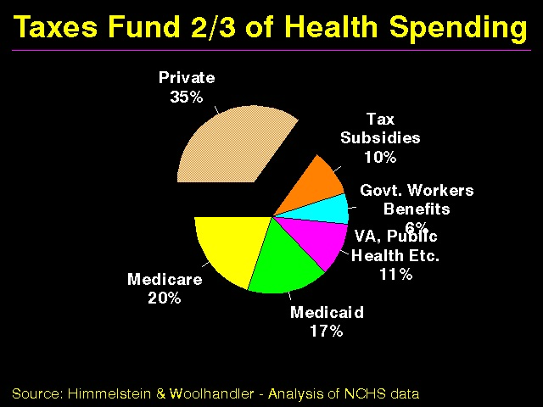

Slide 12
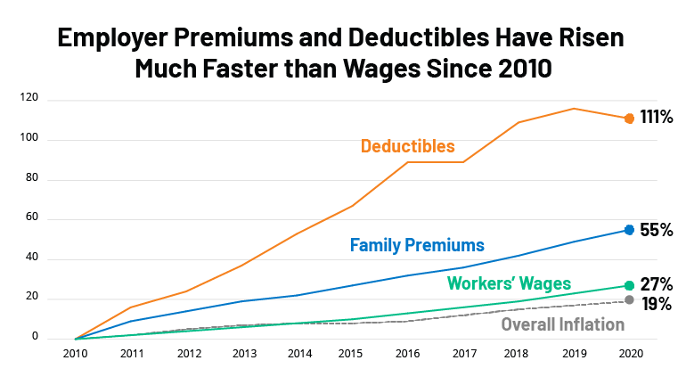

Slide 13
Health Insurance Industry
Consolidation leading to higher prices, limited choice of plans
Only ½ of insured have more option of than one plan
Charging uninsured 2-3X more
Not covering pre-existing conditions (until 2014)

Slide 14
Health Insurance Industry Tactics
“Cherry picking”
  Signing up groups of healthy individuals
“Lemon dropping”
  Delisting patients
  Having no specialist in network for certain specialties
  Limiting access to needed meds (e.g., anti-HIV or chemo drugs)

Slide 15
Health Insurance Industry
High administrative overhead
20-35% for insurance plans in 2020 (vs. 2-3% for Medicare and Medicaid)
$471 billion/yr for billing and insurance related costs alone

Slide 16
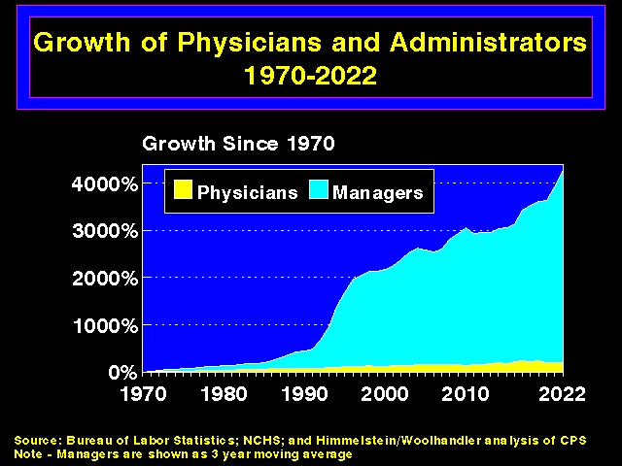

Slide 17
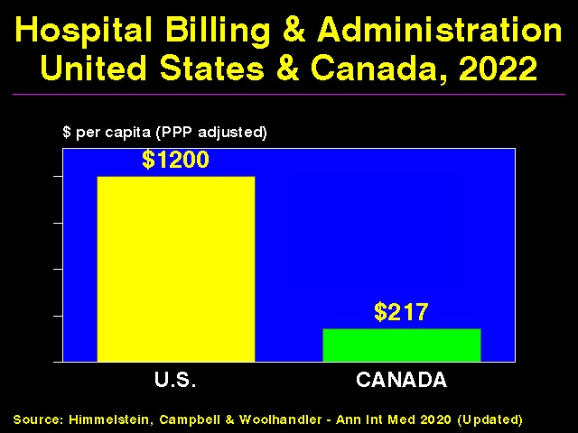

Slide 18
Administrative Waste
Utilization management costs approximately $100 billion/yr
  Patients pay most of this
Onerous prior authorization requirements which delay (and deny) care
  “Rationing by inconvenience”

Slide 19
Administrative Waste
Millions of claim denials/year
Deniers’ identities often hidden, experience and qualifications sketchy, history of malpractice claims, increasing use of algorithms
Often “unfightable,” except for later malpractice lawsuits (cost of doing business)

Slide 20
Administrative Waste
Multiple transaction nodes: hospitals, physicians, insurance companies, pharmacies, various middlemen
Typical service industry has 0.85 administrative workers per specialized worker (e.g., education, law, financial industry)
  Twice as many administrators as physicians
In health care, as opposed to say widget production, inefficiency is profitable

Slide 21
Health Insurance Industry/Bureaucracy
Hospital bureaucracy consumes just over ¼ of hospital budgets
    Highest at for-profit hospitals
    No effect on quality of care
Average full-time physician spends nearly $100,000/yr on billing and insurance functions
141,058 different billing codes

Slide 22
Health Insurance Industry
Large profit margins
Nation’s 5 largest health insurers control 83% of the insured market
Rife with corruption, fines considered a “cost of doing business”
Maintain control of politicians through extensive lobbying
Loyalty: shareholders (not patients)

Slide 23
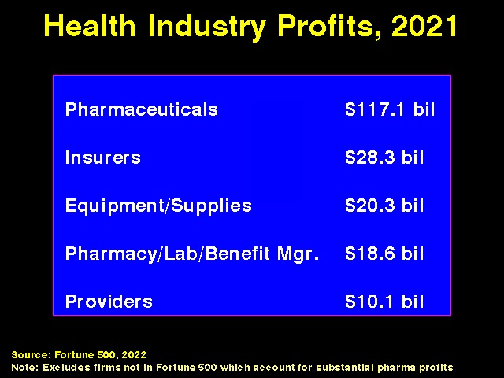

Slide 24
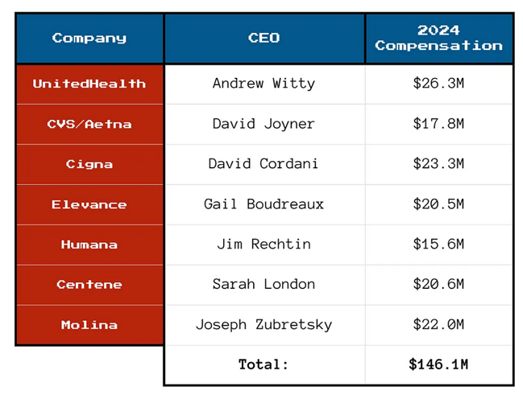
Health Care CEO Compensation, 2024

Slide 25
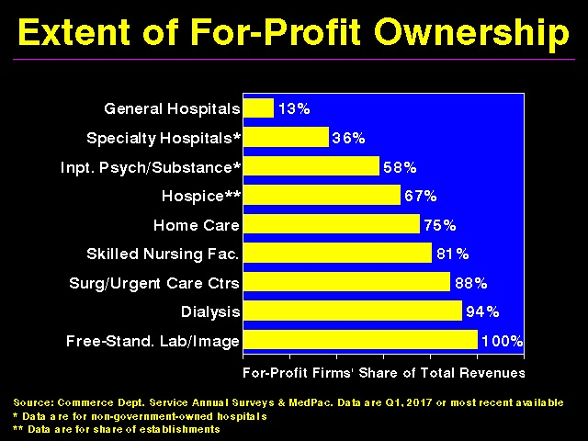

Slide 26
For-Profit Hospitals
Higher patient care and administrative costs
Higher death rates
Deliver more low value/no value care
Avoid vital but unprofitable servies (psychiatry, HIV, palliative care, ERs)
Have higher readmission rates for every condition

Slide 27
For-Profit Entities
Worse care and higher costs
  Dialysis centers
  Home care
  Nursing homes
  Hospices
Private equity firms

Slide 28
Wasteful Health Care Spending
Annual Median Estimate (AJPH Dec 2020:1746)
Overuse: $451 billion
Missed prevention opportunities: $310 billion
Administrative waste: $281 billion
Clinical inefficiencies: $202 billion
Fraud and abuse: $185 billion
Excessive prices: $169 billion

Slide 29
Pharmaceutical Industry
U.S. accounts for 40% of global drug spending
US citizens consume 80% of all opioid-based pain killers
US prescription drug and device prices 256% than in peer countries
Annual profit margins of pharmaceutical companies almost double that of other S and P 500 companies

Slide 30
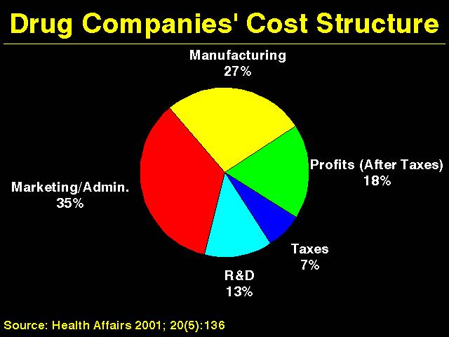
Drug Companies’ Cost Structure

Slide 31
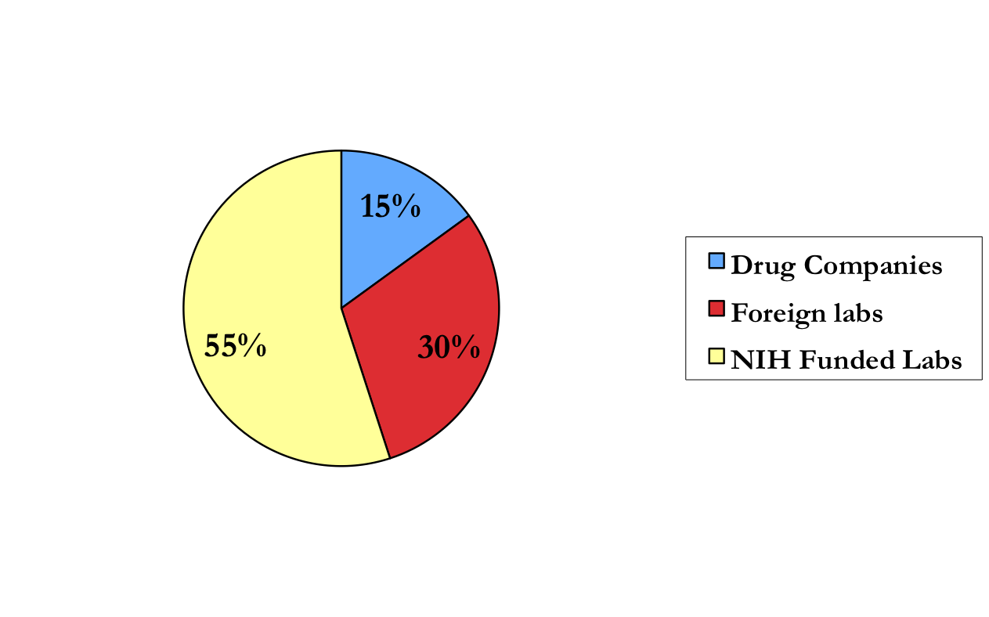
Innovation:
Published Research Leading to Drugs

Slide 32
Compliance
33% of prescriptions go unfilled
Only 50-65% of patients take medicines as prescribed
Noncompliant patients more likely to be hospitalized and to die
Noncompliant patients have twice the annual medical care costs of those who are compliant
Cost, health literacy contribute to noncompliance

Slide 33
Hunger and Poverty
14% of Americans / 19% of US children live in poverty
1.5 million homeless
Rates of poverty in Blacks and Hispanics = almost 3X Whites
Poverty associated with worse physical and mental health, poor cognitive development, less sleep

Slide 34
Gender and Racial Economic Disparities
Women 82 cents/$1 Men
Median income of black and Hispanic U.S. families as a percent of white U.S. families: 62%
  60% in 1968
Median net worth of white households 13X higher than black households; 10X higher than Latino households

Slide 35
Language Barriers
More than 60 million people in the U.S. speak a language other than English at home
  42% of these speak English less than “very well”
25% of Americans functionally illiterate
Large majority health care-illiterate

Slide 36
Racial Disparities in Health Care:
African-Americans
Higher maternal and infant mortality
Higher death rates for most diseases
Shorter life expectancies
Shorter visits/fewer diagnostic tests / therapeutic procedures / pain medications

Slide 37
Racial Disparities in Health Care:
African-Americans
Equalizing the mortality rates of whites and African-Americans would have averted 686,202 deaths between 1991 and 2000
  Whereas medical advances averted 176,633 deaths
    AJPH 2004;94:2078-2081

Slide 38
Major Contributors to Illness and Death
Medical care accounts for only 10% of overall health
Social, environmental, behavioral, and genetic factors = 90%
Few physicians screen for social determinants of health

Slide 39
Social Factors Responsible for Illness and Death
AJPH 2011;101:1456-1465
Deaths in 2000 attributable to:
  Low education: 245,000
  Racial segregation: 176,000
  Low social support: 162,000
  Individual-level poverty: 133,000
  Income inequality: 119,000
  Area-level poverty: 39,000
  AJPH 2011;101:1456-1465

Slide 40
Deaths per year
Tobacco = 438,000 (+ 42,000 ETS)
Obesity = 300,000
Alcohol = 100,000
Microbial agents = 90,000
Toxic agents = 60,000 (likely higher)
Firearms = 35,000
Sexual behaviors = 30,000
Motor vehicles = 25,000
Illicit drug use = 20,000

Slide 41
Public Health Spending Inadequate
Prevention accounts for only 2-4% of national health care expenditures
Every $1 invested in programs covering tobacco, alcohol, exercise, and nutrition saves $5.60 in health care costs
Other wealthy OECD countries spend average of $2 on social services for every $1 spent on medical care (U.S. = $0.55)
Mortality rates fall 1-7% for every 10% increase in public health spending
If US had a welfare state like other OECD countries, life expectancy would be 3.8 yrs longer

Slide 42
Benefits of Education
For every $1 spent on early childhood education, up to $17 are saved from increased school achievement, improved health, reduced crime, and reduced reliance on public assistance
Income increases 11% for every year of education beyond high school (aka college in Australia)
University graduates live 5 years longer than high school (college) dropouts

Slide 43
Education
Medical advances averted a maximum of 178,000 deaths between 1996 and 2002
Correcting disparities in education-associated mortality would have saved 1.3 million lives during the same period
AJPH 2007;97:679-83

Slide 44
Harms of Pseudoscience/Misinformation
Dramatic rise under Trump
Politicians, the media, religions all play role
Lack of health education at all levels

Slide 45
US Charity Care Suffering
Free clinic demand increasing, more patients being turned away
Hospitals consolidating
  Decreases competition, can increase costs
Hospitals turning to lucrative initiatives to improve financial situation
  Cosmetic surgery, luxury/concierge clinics, aggressive billing practices, recruiting wealthy foreign patients

Slide 46
Maldistribution of Wealth
Top 62 billionaires worldwide worth $1.8 trillion, the combined income of bottom 3.5 billion people (1/2 of world’s population)
U.S: Richest 1% of the population owns 50% of the country’s wealth
-poorest 90% own 30%
-widest gap of any industrialized nation

Slide 47
Income Inequality
Depression
Mental Illness
Obesity
Crime
Diminished trust in people and institutions

Slide 48
Maldistribution of Wealth is Deadly
880,000 deaths/yr in U.S. would be averted if the country had an income gap like Western European nations, with their stronger social safety nets
BMJ 2009;339:b4471

Slide 49
Maldistribution of wealth
Less than 4% of the combined wealth of the 225 richest individuals in the world would pay for ongoing access to basic education, health care (including reproductive health care), adequate food, safe water, and adequate sanitation for all humans

Slide 50
Trump Administration
Trump: narcissistic, sociopathic, xenophobic, racist, ignorant, anti-science, ecocidal, misogynistic, admitted sex offender/sexual predator
President, agency heads, and Congress undoing many public health initiatives
  Large exodus of medical providers, researchers, and public health workers

Slide 51
Trump Administration
Withdrawal from WHO
Elimination of Agency for International Development funding
  Estimated 1.6 million excess deaths in 2025
    US Office of Management and Budget, 2025
  9-14 million by 2030
    Lancet 2025(July), 406;10500:283-294; Lancet 2026(Feb) https://www.thelancet.com/journals/langlo/onlinefirst)

Slide 52
Trump Administration
Elimination of Agency for Healthcare Research and Quality
Gutting SNAP (Supplemental Nutritional Assistance Program) and housing benefits
10-17 million more uninsured expected (more deaths)
Tens to hundreds of thousands of excess deaths due to environmental policies

Slide 53
Trump Administration
Numerous restrictions on reproductive health care funding nationally and internationally
Supreme Court’s Dobbs decision overturned Roe v Wade, returning abortion laws to the states, with significant adverse impacts on abortion (and contraceptive) access, pregnancy complications, and infant mortality

Slide 54
Trump Administration
Cuts in international family planning programs could lead to 16 million unintended pregnancies, 1.9 million unsafe abortions, and over 34,000 preventable maternal deaths per year
  Guttmacher Institute, based on Center for Global Development Data - https://www.guttmacher.org/article/2025/03/foreign-aid-cuts-will-lead-34000-more-pregnancy-related-deaths-just-one-year
Botched coronavirus pandemic
  Excess US deaths could have been 40% lower had our rates mirrored those of other high-income nations, meaning 180,000 fewer lives lost
    Lancet Volume 397, Issue 10275, p705-753

Slide 55
Trump Administration Supporting Cast
Robert F Kennedy, Jr
  Once-respected environmentalist, now antivaxxer and superspreader of questionable/dangerous health practices
Mehmet Oz (Administrator of Centers for Medicare and Medicaid Services)
  Television promoter of unproven/dangerous supplements, promulgator of vaccine and covid misinformation
Many more

Slide 56
Possibly Off-Mark Criticisms of What Little I Know About the Australian System
Having multiple subspecialty teams leads to much wasted time (and possibly hard feelings) due to repeated phone conversations to determine where to house patients
  In the US, there are essentially three teams: medicine, surgery, and ICU
  All patients (except for simple surgical admissions) covered by medicine
  Subspecialists perform procedures and give advice on complicated patients
  Likely not changeable, due to nature of Australian medical training (in US, all medical subspecialists must first complete internal medicine training)

Slide 57
Possibly Off-Mark Criticisms of What Little I Know About the Australian System
Excessive delays in obtaining needed tests
  Leading to longer hospital stays (e.g., echoes, MRIs, endoscopies, respiratory swabs)
  Sometimes clinically-significant
  Cost of delays may exceed cost of paying more providers and having more available slots for imaging and procedures

Slide 58
What I Like About the Australian System
Everyone covered
Better social services, coordination of allied health with physicians
Superior antimicrobial stewardship
More attention to provider well-being
People are nice
No fear of ICE agents entering the exam room

Slide 59
Solutions
Empathic and equal provision of care to all individuals, regardless of financial resources, insurance status, race, gender, or sexual orientation
  Single payer system would save more than 68,000 lives and 1.73 million life years every year c/w status quo, be cost-saving, and not lead to overutilization
    See Physicians for a National Health Plan website for numerous references

Slide 60
Solutions
Elimination of socioeconomic/racial disparities
Greater attention to public health and social justice
Improved coordination of care with community social services
Better education, more responsible public media to counter pseudoscience and disinformation
  “Information is the currency of democracy” (Thomas Jefferson)

Slide 61
Congressional and Supreme Court Action
“A country is considered the more civilized the more the wisdom and efficiency of its laws hinder a weak man from becoming too weak or a powerful one too powerful.” (Primo Levi)
Notes:
61

Slide 62
Health Requires Equality
Ideal: “All men are created equal”
  Declaration of Independence
Reality: “Some people are more equal than others”
  George Orwell, Animal Farm

Slide 63

Hudson River, 2009

Slide 64
Advice to Everyone:
Act Now!
"If you think you are too small to have an impact, try going to bed with a mosquito in your tent“
- African Proverb

Slide 65
Resources
Public Health and Social Justice Website:
http://www.publichealthandsocialjustice.org or http://phsj.org
Articles, slide shows, syllabi, media work, links to thousands of organizations (open-access)
Physicians for a National Health Plan
https://pnhp.org/
Articles, open-access slide shows

