Slide 1
Cosmetic Surgery:
Past, Present and Future
Martin T Donohoe, MD, FACP

Slide 2
Cosmetic Surgery is a Branch of Plastic Surgery
Plastic surgeons repair congenital malformations (e.g., cleft lip and palate), disfiguring wounds, animal bites, burn injuries, and perform reconstructions after surgeries for chronic and/or malignant conditions
Cosmetic surgery is largely elective and designed to augment “normal” appearance

Slide 3
Plastic Surgery Charities
Operation Smile - correcting congenital defects in patients in the developing world
Mercy Ships – congenital defects, tumors, rickets-induced bone damage
Face-to-Face: The National Domestic Violence Project (sponsored by the Am Acad of Facial Plast and Reconstr Surgeons) – for domestic violence victims
Interplast

Slide 4
History of Reconstructive and Cosmetic Surgery
600 BC: Hindu surgeon reconstructs nose using a piece of cheek
By 1000 AD: rhinoplasty common
  Due to common practice of cutting off noses and upper lips of enemies
16th Century: Gaspare Tagliacozzi (“the father of plastic surgery”) reconstructs noses slashed off during duels by transferring flaps of upper arm skin
  Also used to reconstruct “saddle nose” deformity of congenital syphilis

Slide 5
History of Reconstructive and Cosmetic Surgery
1798: Term plastic surgery (from the Greek "plastikos," fit for molding), coined by Pierre Desault
19th century: developments in anesthesia and antisepsis make plastic surgery safer, techniques improve
Skills developed during the World Wars I and II applied to victims of birth defects and automobile and industrial accidents

Slide 6
History of Reconstructive and Cosmetic Surgery
Eugenics movement, post-WWII prosperity, rise of movies/TV all increase popularity of cosmetic surgery
1923: first modern rhinoplasty
1931: first public face lift

Slide 7
History of Reconstructive and Cosmetic Surgery
1950s: first hair transplants
1990s onward: more procedures carried out in doctors’ offices and free-standing surgical centers
2000s: Aesthetic medicine, medi-spas, luxury clinics
  < 500 medi-spas in 2003, 1750 in 2011

Slide 8
Medi-Spas
Generate $20 billion revenue annually in US (2025)
Offer cosmetic procedures, massage, aromatherapy, cosmeceuticals
  Many physicians not board-certified, often just take a brief course
Overseas medical spa tourism increasing

Slide 9
Motivations for Cosmetic Surgery
External: avoidance of ethnic prejudice; fear of age discrimination; coercion by spouse/parent/boss
Internal: desire to diminish unpleasant feelings like depression, shame, or social anxiety; to alter a specific feature they dislike; desire for a more youthful, healthy look that signals fertility (women); interest in developing a strong, powerful look that may facilitate career advancement

Slide 10
Motivations for Cosmetic Surgery
20% of women and 10% of men describe themselves as unattractive
Much higher than in the 1990s

Slide 11
Arguments for Cosmetic Surgery
Aging as a physical illness
  Well done face lift takes 9 yrs off appearance
Aging as a mental illness
Substitution of happiness for health as the goal of medical treatment
A business service provided to those who desire it, can pay, and accept the risks involved

Slide 12
Representations of Cosmetic Surgery in Women’s Magazines (2008 study)
Only 48% of articles in magazines like Cosmo and O, The Oprah Magazine discuss the impact of cosmetic surgery on emotional health
Most articles link cosmetic surgery with enhanced emotional well-being, regardless of the patient’s pre-existing emotional health

Slide 13
Cosmetic Surgery
< 8% of members of American Academy of Cosmetic Surgery are plastic surgeons
50,000 – 100,000 physicians who are not plastic surgeons perform cosmetic surgery

Slide 14
2022 National Plastic Surgery Statistics
Total cosmetic surgical procedures: 1.5 million
Total cosmetic minimally-invasive procedures: 24 million
Total reconstructive procedures: 1 million
Total Expenditures: $20 billion (2020)
- Source: American Society of Plastic Surgeons

Slide 15
Cosmetic Surgery
(2019 and 2022 Data)
93% of patients are women
70% Caucasian; 11% Hispanic; 9% African-American; 7% Asian-American; 3% other
Most report family incomes < $50,000
More popular on West Coast

Slide 16
Cosmetic Surgery
45% of patients have multiple procedures done at the same time
  Extremes known as “drastic plastic”
50% of patients are repeat patients

Slide 17
Cosmetic Surgery
Deaths/Complications rare but occur
  E.g., infections, bleeding, hyponatremia, allergic reactions, anesthetic complications
Revision rates as high as 10%
  E.g., face lift lasts 10 yrs

Slide 18
Cosmetic Surgery – Surgeon’s Fees
2025 prices – Physician Fee, Does not include anesthesia, OR facilities, other costs
1.6 million surgical procedures:
  Liposuction: $4,000 to $8,000
  Rhinoplasty: $6,324
  Breast augmentation: $4,300
  Blepharoplasty (eyelid reconstruction): $4,451
  Abdominoplasty (“tummy tuck”): $8,205
  Face lift: $8,584

Slide 19
Cosmetic Surgery – Surgeon’s Fees
2019 prices – Physician Fee, Does not include anesthesia, OR facilities, other costs
28 million minimally-invasive procedures:
  Botox procedure: $4240 (physician’s fee; drug costs $300-$600/session)
  Dermal fillers: $600 to $1,200/session
  Skin resurfacing (chemical peel, microdermabrasion: $1,489
  Skin treatment (laser hair removal, vein sclerotherapy (stripping): $582

Slide 20
Cosmetic Surgery:
Other Procedures
  Breast reductions
  Chemical peel
Forehead lift; Upper arm lift
Silicone injections for fuller buttocks/lips/breasts/muscle atrophy
    Illegal and dangerous
Injections of mesenchymal stem cells into face
Dermal microcoring to remove facial wrinkles.

Slide 21
Cosmetic Surgery:
Other Procedures
High pressure needle-free devices to inject lip and facial fillers – can cause serious injuries and skin damage
Buttock lift
Thigh lift
Liposuction
  Including abdominal etching surgery (“fake ab surgery”) – removes fat from around abdominal muscles so they appear more pronounced
Cryolipolysis (cool sculpting) and other non-invasive procedures
“The Mommy Makeover” increasingly popular (abdominoplasty and liposuction)

Slide 22
Most popular cosmetic surgical procedures for men (2025 stats)
Breast reduction: 20,879
Liposuction: 18,938
Blepharoplasty: 14,327
Rhinoplasty: 6,886
Facelift: 5,077

Slide 23
Other popular procedures for men
Botox injections
Scalp reduction (for male pattern baldness)
Cheek implants
Ear reshaping
Pectoral implants
Chin augmentation (implants)
Calf implants
Leg lengthening – modified Ilizarov procedure

Slide 24
Most popular cosmetic surgical procedures for women (2025 stats)
Liposuction: 298,258
Breast augmentation: 303,272
  Most are silicone implants
Abdominoplasty: 167,445
Breast life (mastopexy): 155,701
Blepharoplasty: 104,652

Slide 25
Cosmetic Surgery Worldwide
Countries with the most plastic surgeons: US, Brazil, China, India, and Japan
Country with the most cosmetic surgery operations per capita = Brazil
City in America with the most plastic surgeons per capita = San Francisco

Slide 26
History of Breast Augmentation
With a few exceptions, large breasts in vogue since antiquity
  Brassieres and corsets used to enhance size
19th Century: surgical breast enlargements attempted using ivory, glass, metal, rubber, and paraffin

Slide 27
History of Breast Augmentation
1895: Czerny performs first reported successful human mammary reconstruction
  actress who had undergone removal of a fibroadenoma
  transplanted lipoma from her hip
1903: Charles Miller inserts "braided silk, bits of silk floss, particles of celluloid, vegetable ivory, and several other foreign materials”
  granulomatous (foreign body) inflammatory reactions disfiguring and painful

Slide 28
History of Breast Augmentation
1903-1950s: petroleum jelly, beeswax, shellac, and epoxy resins used; use of paraffin caused cancers
Early 1950s: liquid silicone injections used
1962: first US woman to receive encapsulated silicone breast implants

Slide 29
History of Breast Augmentation
1992: FDA bans silicone breast implants except in strictly controlled trials for breast cancer reconstructive surgery due to reports linking the implants with a variety of connective tissue diseases and neurological disorders.
Subsequent analyses in 1990s showed no such links
2005: FDA allows silicone breast implants back on market (with registry)

Slide 30
History of Breast Augmentation
A minimum of 15% of modern silicone implants will rupture between the third and tenth year after implantation; 20% will require removal within 10 yrs
2019 FDA evaluation of long-term outcomes in 100,000 patients shows increased risk of Sjogren’s Syndrome, scleroderma, rheumatoid arthritis, stillbirth, and melanoma

Slide 31
History of Breast Augmentation
2019: FDA evaluation of 100,000 patients:
  Short term rupture risk: 2.5% saline, 0.5% silicone
  Short term capsular contracture: 5% silicone, 2.8% saline
  7 year reoperation rate 12% for primary augmentation, 25% for primary/revision reconstruction for silicone implants

Slide 32
History of Breast Augmentation
Silicone implants can absorb/concentrate some environmental toxins from the body
Today: fat transfer, newer generation silicone implants, saline implants, dermal fillers, Instabreast/Instabutt saline injections (about $5,000, last 24 hrs, for costume parties, Halloween, can lead to looseness/sagging once wears off)

Slide 33
History of Breast Augmentation
2007: Stem cells and fat derived from liposuction used to grow breast tissue in clinical trials in Europe
2008: Israeli surgeon develops “breast lift procedure” involving internal titanium bra with silicone cups
2008: MyFreeImplants.com
  Facilitates communication and funding

Slide 34
Breast Implant Complications
(most to least common)
Capsular contracture
Implant rupture
Hematoma
Wound infection
Increased risk of anaplastic large cell lymphoma with textured silicone implants (but only 1/30,000 lifetime risk and tumor is highly curable)
  Also seen with buttock textured silicone implants
  France, other countries have banned
  Squamous cell cancers also noted, rare

Slide 35
Breast Implant Complications After Surgery
Cosmetic implants – 12% after 5 yrs; 20% after 10 yrs
After prophylactic mastectomy – 30% after 5 yrs; 40% after 10 yrs
After mastectomy for breast cancer – 34% after 5 yrs; 50% after 10 yrs
  20% of breast implants done in breast cancer patients
Latest trend: microsurgical breast reconstruction using implants or autologous tissues

Slide 36
Poly Implant Prosthèse Controversy
PIP was world’s third largest maker of breast implants worldwide
  Shut down in 2010, government safety alerts in 2011/12
Contained industrial-grade silicone
300,000 to 400,000 implanted worldwide

Slide 37
Poly Implant Prosthèse Controversy
Disproportionately high rupture rates can cause inflammation and irritation
  No evidence for increased cancer risk, unlikely to cause long-term health problems
Some authorities recommend removal
PIP boss Jean Claude Mas arrested in France, may face manslaughter charges

Slide 38
Breast Implants and Imaging
Breast implants decrease sensitivity of screening mammography among asymptomatic women, but do not increase false-positive rate nor affect tumor prognostic characteristics
For women with silicone implants, some recommend screening for silent ruptures with MRI 3 yrs post-implant, then every two years
  Expensive, may not effect long-term health
  No special screening for those with saline implants

Slide 39
New Breasts for Graduating Seniors
8,320 breast augmentation procedures performed on 18-19 year olds in 2025
Previously done on younger children
  Phenomenon concerning for poor parenting, through the capitulation of financially well-endowed parents to the whims of their children, who likely have self-esteem problems and are not yet emotionally (nor perhaps even physically) mature
US and EU: breast augmentation surgery allowed on those under age 18 only for medical reasons

Slide 40
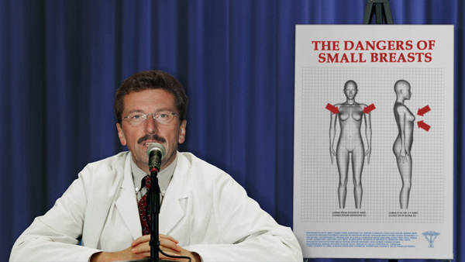
Headline from The Onion:
Plastic Surgeon General Warns of Small Breasts Epidemic

Slide 41
Penile Size
Ancient Greeks believed small penis was superior
Later, phallic identity and phallocentrism increasingly popular – “penis is central to man’s identity, virility”

Slide 42
Penile Size
55% of men satisfied with their penile size; 85% of women satisfied with their partner’s size
No correlation between any population, racial category, ethnicity, or shoe size and penile length

Slide 43
Penile Size and Penile Reconstructive Surgery
1971: First penile augmentation surgery
Girth enhancements with fat injections, Alloderm (derived from human skin)
Penile lengthening procedures
Complications: scar, keloid, penile lumps, sexual dysfunction, further penile shortening
Augmentation procedures not sanctioned by American Urological Association
First penile transplant (cancer) - 2016

Slide 44
Cosmetic Surgery Odds and Ends
Most common cosmetic procedure in Asia = eyelid surgery, to create a crease above the eye (up to 60% of Korean women)
“Smile lift” – popular in South Korea, curves lips into permanent smile
Trisomy-21 surgery (covered in ethical issues slide show)

Slide 45
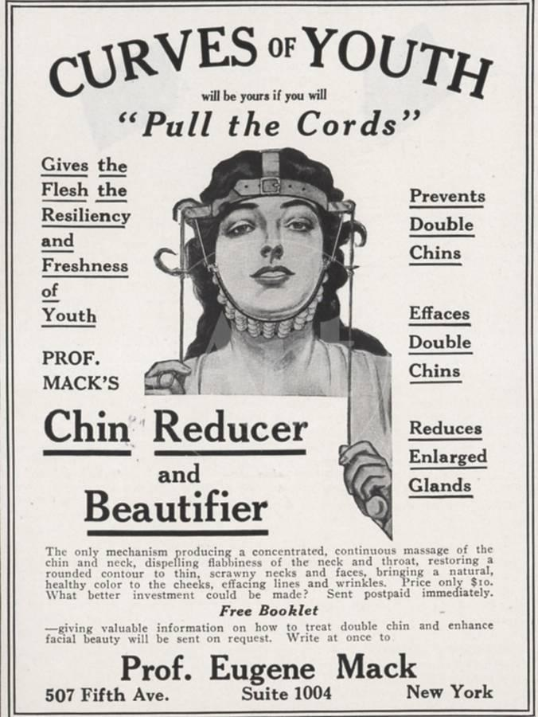

Slide 46
Reconstructive Surgery – The Latest
Hand transplants
Face transplants
  2005: first procedure on female dog-mauling victim (nearly 40 worldwide through late 2016, 2 associated deaths)
  15-20 hour procedure (including 5 hours for harvest); involves multidisciplinary team
  Ethical issues
Lifelong immunosuppression required

Slide 47
Cosmetic Neurology
Interventions to enhance the cognitive and emotional brain functions of the neurologically non-diseased
Currently being pursued by the pharmaceutical industry (via drugs to increase intelligence) and the military (via interventions to create more effective soldiers)

Slide 48
Cosmetic Military Neurology
“Go-go pills" (amphetamines) used by US soldiers in WW II
Modafinil (wakefulness-promoting agent) improves pilot alertness and performance in helicopter flight simulations.
Many military pilots today rely on caffeine and other stimulants, including amphetamines, to complete missions

Slide 49
Cosmetic Neurology
Raises concerns about:
  Distributive justice
  Informed consent
    In the military setting or in children

Slide 50
Cosmetic Surgery – The Fringes
The Jewel Eye: implantation of tiny platinum jewels into conjunctiva (20 minutes, $3900)
  Am Acad Ophth warns not proven safe
Umbilicoplasty, lengthening/shortening toes to improve “toe cleavage”, other
Cinderella surgeries on the feet (to allow women to wear pointy-toied shoes), fracturing and resetting jaw to alter smile, forehead implants

Slide 51
Cosmetic Surgery – The Fringes
Mustache implants – popular in Middle Eastern men
Vampire facial (Kim Kardashian) – injection of 2 tablespoons of blood into face

Slide 52
Cosmetic Surgery – The Fringes
Foreskin restoration
Skin tightening/vein stripping to improve look of “ring selfies”
Boot bulge (calf reduction) liposuction to allow women to fit into knee-high boots

Slide 53
Cosmetic Surgery – The Fringes
Vaginal rejuvenation (aka “aesthetic vaginal surgery,” aka labiaplasty) - tightening/alteration of angle/dimensions, partial labial excisions, fat injection into labia)
  Over 10.827 procedures in 2024 in U.S.
  Complications include infection, altered sensation (damage to clitoral nerves), dyspareunia, adhesions, and scarring
  ACOG: “safety and effectiveness have not been documented”

Slide 54
Cosmetic Surgery – The Fringes
Hymen reconstructive surgery
The Jade Lady Membrane Man-Made Hymen
  Marketed in China
  Blood-colored fluid released during sex
Labial dyes (“My New Pink Button”)
“G spot” injections

Slide 55
Cosmetic Surgery – The Fringes
Furries: lovers of anthropomorphized animals
  Surgical enhancements
  Conventions
Deliberate amputations of body parts
  Apotemnophilia – attraction to the idea of being an amputee (a paraphilia)
  Not to be confused with acrotomophiliacs – sexually attracted to amputees

Slide 56
Cosmetic Surgery – The Fringes
Wings, chimeras, and stem-cell cosmesis
Sarah Burge (born 1959) holds world plastic surgery record:
  Over 100 procedures
  Cost = $850,000
Celebrity plastic surgery:
  Michael Jackson, Pamela Lee, Meg Ryan, Cher (?), many others

Slide 57
Prime Time Cosmetic Surgery
ABC TV’s “Extreme Makeover”
Fox TV’s “The Swan”
MTV’s “I Want a New Face”
FX’s Nip Tuck
TLC’s Dr. Pimple Popper

Slide 58
Pets
Neuticles (artificial pet testicles) – since 1995
  “To boost your pet’s self-image”
  Typical pair costs $310
    Elephant neuticles the size of watermelons cost $2,800/pair
  Company claims over 500,000 sold through 2012
  Prior to FDA approval of human testicular prostheses in 1997, cancer victims would buy and have plastic surgeon install Neuticles

Slide 59
Pets
We value our pets, but…
  40,000 pets have had stem cell surgery
  Pet cloning
  Pet jewelry
  $18 billion/yr pet pharmaceutical market

Slide 60
Conclusions
Body modification common today and throughout history
Risks involved
Obesity a major public health problem
The body modification and weight loss industries marred by hucksterism, false claims and conflicts of interest

Slide 61
Conclusions
Beauty has different definitions in different times and in different cultures
The health professions can play a constructive role in supporting safe and healthy behaviors and promoting realistic ideals of beauty
More education needed at all levels

Slide 62
Covered in Other Slide Shows
Ideals of beauty and body modification
Female genital cutting
Body weight and the obesity epidemic
Ethical and policy issues

Slide 63
References
Donohoe MT. Beauty and body modification. Medscape Ob/Gyn and Women’s Health 2006;11(1): posted 4/19/06. Available at
http://www.medscape.com/viewarticle/529442
Donohoe MT. Cosmetic surgery past, present, and future: scope, ethics and policy. Medscape Ob/Gyn and Women’s Health 2006;11(2): posted 8/28/06. Available at http://www.medscape.com/viewarticle/542448

Slide 64
Contact Information
Public Health and Social Justice Website
http://www.phsj.org
martindonohoe@phsj.org

