Slide 1
Privacy: Drug Testing and Beyond
Scientific, Legal, Ethical, and Policy Issues
Martin Donohoe

Slide 2
Overview
Definitions: Substance Abuse and Drug Testing
Physician Substance Use and Abuse
Federal Drug Testing Policies
Physician Drug Testing

Slide 3
Overview
Drug Testing in Private Industry
The “Science” Behind Drug Testing
Physician Opinion Regarding Drug Testing
Conclusions

Slide 4
Overview
Testing and Treatment of Impaired Physicians
Drug Testing and the Erosion of Privacy/Ethical Issues
Alternatives to Drug Testing

Slide 5
Substance
Use and Abuse
Substance Use - the taking of legal or illegal substances which does not lead to impairment of performance
  US leads world in illegal drug use
Substance Abuse - repeated, pathological use with adverse health consequences, habituation, tolerance, withdrawal symptoms, and impaired performance

Slide 6
Worldwide Addiction Statistics
24% tobacco (40% of men, 9%of women)
5% alcohol (8% of men, 1.5% of women)
3.5% cannabis
< 1% other psychoactive drugs
0.3% inject drugs
49 million Americans have substance use disorder (2022)

Slide 7
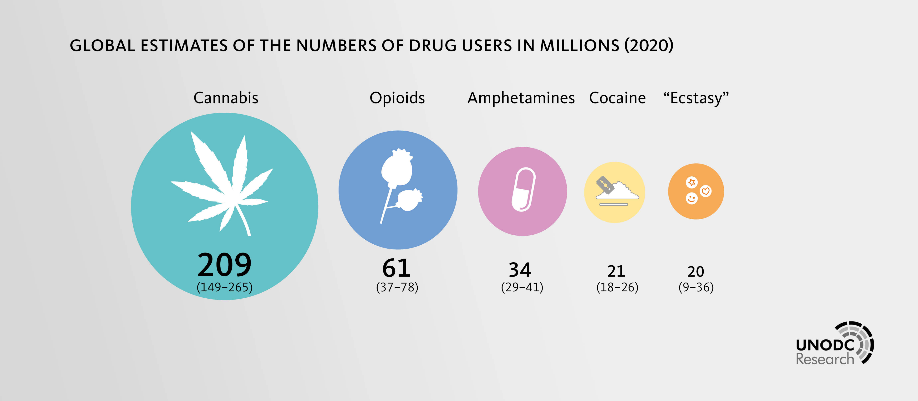

Slide 8
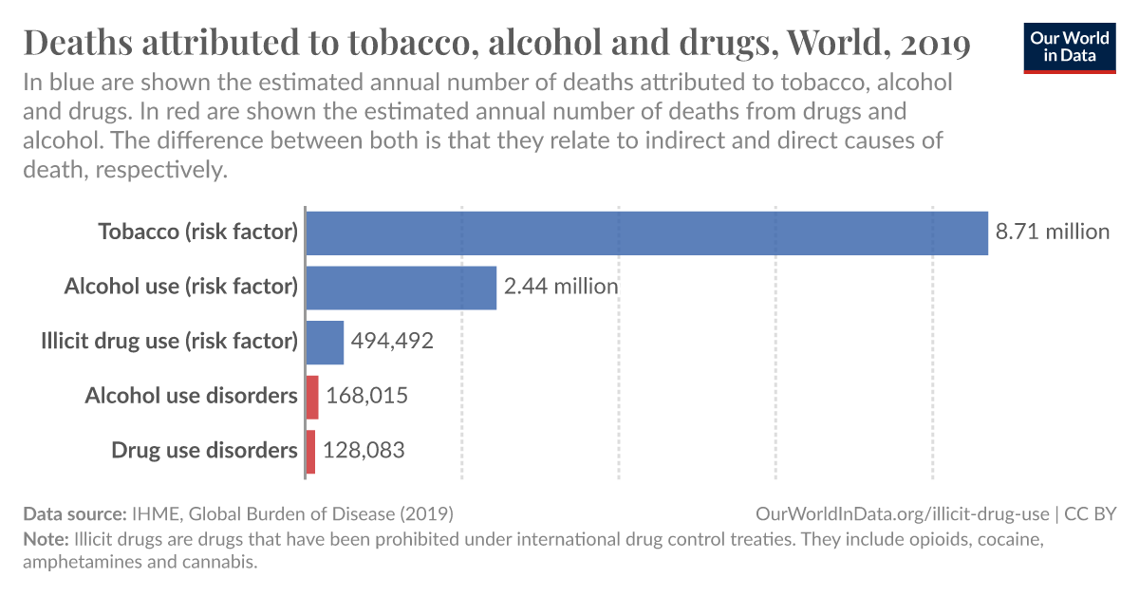

Slide 9
Drug Use and the Employed
71% of all drug users today in the U.S. over the age of 18 are employed either full or part-time (US Dept of Labor).
  More than 10 million workers

Slide 10
Drug Use and ER Visits
2.5 million drug-related ER visits
  500,000 - anti-anxiety and insomnia medications
  420,040 opioid
Opioids, cocaine, marijuana (now legal in some states), stimulants, etc.
Alcohol-related ER visits and hospitalizations increasing, especially among teens

Slide 11
Drug Use/Abuse
25 million people (14% of Americans over age 12) admit to driving under the influence at least once in the past year
  8% alcohol, 5% marijuana, 1% other drugs
  Only 1/200 to 1/2,000 impaired drivers caught
  Avg drunk driver makes over 80 trips under the influence before being stopped by police

Slide 12
Driving Under the Influence
4,000 killed annually in drug-related car accidents (likely much higher, as states that test for drugs after fatal accidents show 47% had used a prescription drug [most commonly opiates and other pain relievers], 37% marijuana, and 10% cocaine)

Slide 13
Drunk Driving
Each year, an alcohol ignition interlock could prevent 85% of alcohol-related road deaths (59,000 drunk-driving deaths) and over 1.25 million non-fatal injuries and save over $340 billion in injury-related costs
Assuming 100% accuracy and projected $400 per interlock cost, would pay for itself in 3 years

Slide 14
Drunk Driving
Breathalyzers often unreliable
  MA and NJ alone threw out 30,000 tests in 2019
  Roadside breathalyzers not admissible in court in most states, but trigger repeat test at police station (which also are unreliable)
Only accurate test is blood alcohol level

Slide 15
Drug Use/Abuse
31% of teens and 51% of adults 18-21 regularly consume energy drinks (dangerous levels of caffeine, bans on mixtures also containing alcohol)
11% of medical students at one university report misusing stimulants (almost all to increase alertness/energy and improve academic performance)
  Another report showed 10% lifetime use

Slide 16
Drug Use/Abuse
Up to 1/5 of college students have taken Adderal, Ritalin, or other prescription drugs to help with their work (6.4% use Adderall regularly, compared to 3% of age-matched non-students)
2% of jr high and 5% of high school students have used anabolic steroids in past year

Slide 17
Drug Use and Remote Work
1/5 US workers have used alcohol or drugs while working remotely
1/5 US workers have been under the influence during a virtual meeting
Increased absenteeism among substance abusers

Slide 18
Drug Use/Abuse
21st Century: dramatic rise in prescription opioid drug abuse
  3X amount prescribed in 2015 than in 1999
  4X amount prescribed than in Europe (2015)
  Fueled by pill mills
  FDA opioid approval process shoddy, incomplete

Slide 19
Drug Use/Abuse
21st Century: dramatic rise in prescription opioid drug abuse
  Opioid oversupply common after surgery
  ER visits for opioids up 99% between 2005 and 2015, hospital stays up 64% (1,000/d in 2016)
  Neonatal abstinence syndrome and maternal opioid-related diagnoses rising
  Opioid prescriptions rose through 2012, down 43% from 2012 to 2019

Slide 20
Drug Use/Abuse
Purdue Pharma (owned by Sackler family) launched Oxycontin in 1996
Aggressive marketing campaign focusing on Appalachia, due to high population of disabled workers, grossly minimizing risk of overdose
Highly profitable
Also profited from antidote, naloxone

Slide 21
Drug Use/Abuse
2019: Inspector General determines DEA let opioid production surge as opioid-related deaths surged
2019: Purdue Pharma declares bankruptcy – courts over-ruled, SCOTUS ruling pending (2024)

Slide 22
Drug Use/Abuse
Late 2020: Purdue Pharma plead guilty to federal criminal charges, paid over $8 billion in fines, and agreed to close down the company
  Federal government agreed not to pursue any criminal charges (beyond a prior misdemeanor conviction in 2007) against the company, including members of the Sackler family, who were not charged or admitted to any criminal wrongdoing)
    Contrast with local marijuana dealer

Slide 23
Drug Use/Abuse
Teva Pharmaceutical Company also fined
Founder of Insys Pharmaceuticals sentenced to jail for aggressively marketing opioid Subsys; company fined over $250 million
Johnson and Johnson fined almost $600 billion
  J and J reaches $$590 opioid settlement with Native American tribes (2022)

Slide 24
Drug Use/Abuse
Opioid settlement money being spent on overdose reversal drugs, addiction treatment and medication and wound care vans for injection-related infections, but also on law enforcement

Slide 25
Drug Use/Abuse
55,403 lethal drug overdoses in 2015
  20,101 (prescription opiates); 12,990 (heroin); Sum exceeds deaths from MVAs
67,367 overdose deaths in 2018 (down 5% from 2017)
  More than the number of US soldiers who died in Vietnam

Slide 26
Drug Use/Abuse
Fentanyl most common cause of drug overdose (often laced into other substances, e.g., amphetamines, xylazine [can cause severe, necrotic skin wounds], Benadryl, Tylenol, MDMA)
  Fentanyl 50X stronger than heroin, 100X stronger than morphine

Slide 27
Drug Use/Abuse
Other substances frequently adulterated:
  Cocaine with levamisole (dewormer which augments stimulatory affect, banned in 1999 due to risk of bone marrow suppression)
  MDMA (bath salts, LSD)

Slide 28
Drug Use/Abuse
Lethal drug overdoses down to 43,000 in 2017
Over 81,000 overdose deaths (May 2019 – May, 2020)
  Increase likely due to pandemic
Synthetic opioids most common, followed by prescription opioids, then heroin

Slide 29
Costs of Drug Abuse
Over 500,000 deaths from opioid overdoses in last 20 yrs
  Over 93,000 in 2020
Estimated costs of opioid epidemic $1.5 trillion (2020)
Doctors’ prescriptions for opioids down 44% between 2011 and 2020
  More using prescription drug monitoring programs

Slide 30
Drug Use/Abuse
Stimulant use rising
Benzodiazepine prescriptions more than tripled over last 20 yrs, overdoses more than quadrupled
Over 27,000 drug-dependent newborns, suffer for neonatal abstinence syndrome in 2013 (up from 5,000 in 2003)
  20/1,000 live births (2016)

Slide 31
Drug Use/Abuse
Chronic pain affects 50 million US adults (multiple treatment modalities available)
US citizens consume 80% of all opioid-based pain killers
50% of the world’s population live in countries that receive only 1% of the world’s opioid analgesics

Slide 32
Drug Use/Abuse
Estimated 2 million Americans hooked on prescription opioids, ½ million abuse heroin (80% of these transitioned from misuse of prescription opioids)
Life-threatening firewall still exists between medical and substance abuse records

Slide 33
Drug Use/Abuse
Up to 35% of patients prescribed opiates may not be taking them; 12% test positive for other illicit drugs (70% marijuana)
6% of Americans admit using another person’s pain medication; 5% another’s sleeping/anti-anxiety meds

Slide 34
Drug Use/Abuse
½ of older adults have leftover opioids after treatment, vast majority keep “in case pain returns”
Individual ER doctors underestimate their own opioid prescribing

Slide 35
Drug Use/Abuse
Some physicians may prescribe out of eagerness to please
  Denial of pain medication associated with lower patient satisfaction scores, which are used to rate doctors and hospitals
2022: SCOTUS requires that doctors provided a medically-unnecessary prescription AND knew as much (complicates attempts to prosecute pill mill doctors)

Slide 36
Drug Use/Abuse
Many states have laws requiring limits, guidance, and/or requirements related to opioid prescribing
Concerns that limits on opioid prescribing might increase illicit drug use/overdose
2018: Trump nominates former Rep. Tom Marino (R-PA) to lead Office of National Drug Control Policy; Marino withdraws nomination after reports that he spearheaded an effort to essentially stop policing opioid manufacturers

Slide 37
Drug Use/Abuse
15% of illegal drug users in the US purchased their drugs over the internet (often via the “dark web” using bitcoin (an untraceable currency)
Much fentanyl comes through China
  Trade war could curb Chinese cooperation in ebbing this flow

Slide 38
Drug Use/Abuse
Only 30% get medicine to treat addiction after overdose
  E.g., buprenorphine or methadone (effective, especially when combined with counseling)
  Trump administration pushing naltrexone (expensive, not-well-studied but heavily-marketed injectable form = Vivitrol) for addicted inmates prior to release
    Requires detox before treatment; could increase risk of OD, since reduces opioid tolerance

Slide 39
Civil Commitment for Substance Abuse
Increasingly popular, but effectiveness not scientifically supported
Most involve detox and abstinence, rather than medication and psychotherapy
Abstinence-based commitment may heighten risk of overdose, due to lowering of tolerance

Slide 40
Drug Use/Abuse
Naloxone (Narcan, reversal agent) available for addicts, family members, police and fire departments
    Injectable and nasal formulations
    Manufacturers dramatically raising prices, although available to public providers for less (auto-injectable $150; nasal spray $38)
    Indian suppliers charge as little as 15 cents/dose

Slide 41
Drug Use/Abuse
Naloxone (Narcan, reversal agent) available for addicts, family members, police and fire departments
    Direct pharmacy dispensing leads to significant decrease in fatal opioid overdoses (27% over 2 years)
    Mandated naoloxone co-prescription with narcotics could prevent 21,000 deaths over 10 yrs (more than restrictions on prescription opioids or expanding medications for addiction treatment)
      AJPH 2020;110:881
2023: Naloxone nasal spray available OTC

Slide 42
Drug Use/Abuse
Opioid vaccines (which would still allow use of some opioids for acute pain) under study
Kratom (unapproved, illegally promoted for opioid withdrawal) carries risk of OD, addiction, respiratory depression
  Also associated with salmonella outbreak

Slide 43
Drug Use/Abuse
USPSTF recommends all patients 18 and over be screened for illicit drug use and misuse of prescription medications
Most states have Prescription Monitoring Programs (opiate prescription databases)
  Use and accessibility varies
  In most states, law enforcement agencies can search without judicial approval or oversight
Removing legal barriers to sale and distribution of clean needles could markedly decrease risk of infections

Slide 44
Drug Use/Abuse
Repeal of Obamacare would take away addiction treatment for 3 million Americans
Trump has vowed to seek death penalty for opioid dealers (similar to Trump-admirer and Philippine President Duterte’s extrajudicial death squads)

Slide 45
Drug Use/Abuse
Dramatic rise in pharmacy robberies (for opiates)
Opioid makers and suppliers have spent almost $900 million over the last decade lobbying state and federal governments to block regulations, increase availability
Opiates less available in poor neighborhoods
  Implications for pain management

Slide 46
Costs of Drug Abuse
U.S. Senate Banking Committee estimates tht between $500 billion and $1 trillion of drug money are laundered each year through banks worldwide
  Approximately ½ through U.S. banks
Minimal oversight, penalties

Slide 47
Costs of Drug Abuse
Higher rates of accidents, injuries, and worker’s comp claims
44% of abusers have sold drugs to other employees
18% have stolen from coworkers to support their habit

Slide 48
Drug Use/Abuse and the Criminal Justice System
For more on drug use/abuse and the criminal justice system, see the Incarceration Nation slide show on the Criminal Justice System page of the phsj website

Slide 49
Drug Enforcment and Treatment
Only 1/10 of those needing treatment received it (in a specialized facility)
14,000 licensed addition treatment facilities in US
  Quality varies widely; only 1/5 accredited by Joint Commission
  Only 1/3 offer FDA-approved medications
  For-profit providers increasing

Slide 50
Drug Enforcment and Treatment
Barriers to drug treatment:
  Lack of health care coverage
  Not ready to stop
  Coverage inadequate (despite ACA) and/or costs too high

Slide 51
Drug Enforcment and Treatment
Law enforcement and interdiction: 55% of federal drug budget
Repealing paraphernalia laws would decrease risk of blood-borne infections
2021: First US supervised drug injection site opens in NY
  Vancouver experience shows decreased overdoses and deaths with no increase in nearby crime

Slide 52
Drug Enforcment and Treatment
Treatment and prevention: 45%
  For every dollar spent on treatment, $7 saved in health care and societal costs
  ACA requires insurers to for mental health services, including drug addiction at parity with physical illnesses
  Increasing alcohol taxes necessary (avg. = 10 cents per drink, societal costs 15X that)

Slide 53
Physician Substance
Use and Abuse
Prevalence data marred by over-reliance on:
  convenience sampling - self-report
  variable definitions of substance use and impairment.

Slide 54
Medical Student Substance
Use and Abuse
Medical students = age-matched peers (except for lower smoking rates)
  some studies suggest higher rates of alcohol abuse (associated with depression and burnout)
  30 day use:
    Alcohol 88%, cigarettes 10%, marijuana 10%, cocaine 2.8%, tranquilizers 2.3%, opiates 1.1%

Slide 55
Medical Student Substance
Use and Abuse
Caffeine used as stimulant, can cause rebound over-sedation
High use of non-caffeine stimulants
    20% lifetime use prevalence (vs. 7% for college students)
    15% use while in college or med school

Slide 56
Resident Physician Substance
Use and Abuse
3rd year Residents [<1 % felt dependent on any substance other than tobacco]
  30 day use:
    Alcohol 87% (5% daily), marijuana 7% (1.3% daily), 3.5% benzos (0% daily), 1.5% cocaine (0% daily)

Slide 57
Resident Physician Substance Use and Abuse
Higher rates of use in ER, Psych, and anesthesia residents
  0.9% of anesthesia residents have substance use disorder
Self-medication:
  early 1990s - benzos
  2000s - SSRIS for depression, antihistamines for sleep
    29% prevalence of depression in residents

Slide 58
Practicing Physician Substance Use and Abuse
Rates of use and abuse of tobacco, marijuana, methamphetamine, cocaine and heroin less than general population
Not at increased risk for alcoholism

Slide 59
Practicing Physician Substance Use and Abuse
10-15% of all healthcare professionals misuse drugs or alcohol at some point in their careers
  15% of surgeons met criteria for alcohol abuse in 2012 study (but low response rate)
Unsupervised use by MDs of benzos and minor opiates = 11% and 18%, respectively
  unknown if improves of impairs performance
Rates highest in anesthesia, emergency medicine, and psychiatry

Slide 60
Health Care Workers and Opioids
RNs, support workers, and social/behavioral health workers have double the risk of the general population of fatal opioid overdoses
Physicians do not show increased risk

Slide 61
Types of Drug Testing
Pre-employment testing
For-cause testing
Random, not-for-cause testing

Slide 62
Drug Testing to Monitor Chronic Pain Patients
Can be useful
30% of patients test negative for their prescribed drug (may represent diversion)
20% test positive for non-prescribed illicit drugs
50% of those with unexpected test results show no other signs of misuse

Slide 63
Federal Drug Testing Policies
Early 1970s: Navy, then other brances of the military
Late 1970s: prisons

Slide 64
Federal Drug Testing Policies
1986 -Reagan - Executive Order requiring federal agencies to institute drug testing programs
1988 - Federal Drug Free Workplace Act
  all recipients of federal government contracts of $25,000 of more/yr and all recipients of federal government grants must have written drug policies, establish a drug-free awareness program, and make a good-faith effort to maintain a drug-free workplace

Slide 65
Federal Drug Testing Policies
Omnibus Transportation Employee Testing Act of 1991
  employers required to test workers who apply for, or currently hold, safety-sensitive positions in the transportation industry
There are no federal laws that require private industries to have drug testing programs

Slide 66
Drug Testing, the Courts, and the States
Random drug testing programs upheld for locomotive engineers, airline pilots, boat operators (Navy), prison guards, police officers, those with top secret national security clearances
About 15 states have laws restricting private sector drug testing

Slide 67
Physician Drug Testing
1988 - American Hospital Assn. recommends that health care institutions adopt comprehensive policies to address substance abuse, including pre-employment testing, for-cause testing, and post-accident testing, regardless of job description.

Slide 68
Physician Drug Testing
American College of Occupational and Environmental Medicine: “Ethically acceptable, with appropriate constraints, to screen current and prospective employees for the presence in their bodies of drugs, including alcohol, that might affect their ability to perform work in a safe manner.”

Slide 69
Physician Drug Testing
American Society of Anesthesia recommends testing only for “reasonable suspicion” that a physician is under the influence of alcohol or drugs
AMA supports pre-employment drug screening [but not genetic testing]
2014: CA Malpractice ballot measure that would have mandated physician drug testing failed

Slide 70
OHSU’s Drug Testing Policy (late 1990s)
Mandated pre-employment and for-cause testing
- conducted through Oregon Medical Laboratories, owned by Peace Health (non-profit corporation)
Covers all direct patient care positions/safety-sensitive positions/special needs positions (residents - yes, medical students - no)

Slide 71
OHSU’s Drug Testing Policy (late 1990s)
Impetus
- only hospital in Portland without policy
- gestalt that it might weed out drug users/abusers
Criminal background checks (2/3 of states require for physician licensing)

Slide 72
OHSU’s Drug Testing Policy (late 1990s)
Approved by UMG
Little university-wide debate
Not in response to data on substance use/abuse/consequences at OHSU or outside complaints/litigation (1 for cause test performed in the last 5 years)

Slide 73
OHSU’s Drug Testing Policy (late 1990s)
Estimated cost: $25,000/year
- 800 x $30 pre-employment tests
- 10 x $100 for cause tests
Cost figures do not match OHSU’s other labs’ prices

Slide 74
Physician Drug Testing
Purported goals:
  create safer climate for patient care
  protect University or Institution from malpractice and wrongful hiring lawsuits
  promote positive view of institution from patients and other “health care consumers”

Slide 75
Physician Drug Testing
To date, no court has held an employer legally liable for not having a drug-testing program
Employers have incurred substantial legal cost defending their drug-testing programs against workers’ claims of wrongful dismissal

Slide 76
The Growth of Physician
Drug Testing
Late 1980’s/early 1990’s: 9-15% of hospitals required testing
1999: Two-thirds of 44 randomly selected large teaching hospitals had formal physician drug testing policies:
  for-cause and pre-employment testing most common
  13% mandated random testing
  policies vague on procedural details and unclear regarding responsibility for implementation of guidelines
  only half mentioned employee confidentiality; less than 50% of these were explicit regarding access to and storage of records

Slide 77
The Growth of Physician
Drug Testing
2002: 8% of anesthesia residencies employ random urine drug tests, but 61% of anesthesia department chairs would approve of such a program
  2016: Cleveland Clinic, MGH randomly test anesthesia residents

Slide 78
The Growth of Workplace Drug Testing
1987: 21% of American Management Association’s corporate members had instituted drug testing programs
1996: 81% of major U. S. firms tested for drugs

Slide 79
The Growth of Workplace Drug Testing
2011: 47% of employers conduct random drug tests (up from 39% in 2006) [Soc for Hum Res Mgmt]
Over 1,200 % increase in periodic and random employee drug testing among Fortune 1000 companies since 1987

Slide 80
School-Based Drug Testing
1998: Supreme Court let stand an Indiana decision extending testing from students athletes to students who enjoy “special privileges”
2002: “Vernonia School District vs. Acton”
  Supreme Court permits drug testing for students involved in extracurricular activities
  Local school board policies continued, added

Slide 81
School-Based Drug Testing
Substantial growth in number of schools requiring mandatory, random drug testing
  14% of US high schools (almost all test athletes, 65% test those involved in “extracurricular activities,” 28% test all students)
    Am J Publ Hlth 2008;98:826-8.

Slide 82
School-Based Drug Testing
  American Academy of Pediatrics opposes
  Primary care physicians lack knowledge, preparedness to perform and interpret drug tests
  93% of physicians who treat adolescents oppose random drug testing; 52% would not discuss results with parents

Slide 83
School-Based Drug Testing
Most commonly used tests miss nicotine, alcohol, Ecstasy (MDMA), Oxycontin, and inhalants
$70,000/yr. for weekly random testing of 75 students, millions allocated by governments already

Slide 84
School-Based Drug Testing
Costs borne to a small degree by Federal Government’s Safe and Drug-Free Schools Program
Individual schools and school districts cover portion of cost

Slide 85
School-Based Drug Testing
Corrections Corporation of America hired to do high school drug sweep in AZ (2012)
  Sign of increasing militarization of schools
  2013: TX high school using locator badges on all students
  ?more to come?
2011: Federal judge stops Linn State Technical College’s plan to drug test all first year (and some returning) students

Slide 86
School-Based Drug Testing
Private corporations [e.g., Roche Diagnostic Systems, the leader in workplace drug testing] often donate a portion of their services hoping to build future demand
Beverage companies sometimes pay a portion of costs in exchange for exclusive licensing arrangements

Slide 87
The Growth of Drug Testing
Hundreds of millions of drug screens/yr in U.S. (increasing), costing billions of dollars
Medicare spending skyrocketing, reimbursement rules favor individual tests rather than panels
Some chronic pain patients hit with huge, surprise bills for drug tests
Fraud widespread
Lucrative for private companies, clinics, and doctors

Slide 88
The Growth of Drug Testing
Fueled by popular misconceptions and hysteria
  “Signs that your child may be using marijuana include excessive preoccupation with the environment, race relations, and other social causes”
  (1999 Utah anti-drug pamphlet)
  Business interests [e.g., Institute for a Drug-Free Workplace, private companies (e.g., CertifiedBackground.com]
  P.R. campaigns of multi-billion dollar industry
  Junk science

Slide 89
The Growth of Drug Testing
Groups with a vested interest in promoting drug testing:
  The drug testing industry
    Lobbying groups include the Drugs of Abuse Testing Coalition and the Drug and Alcohol Testing Industry Association
  The alcohol industry
  The private prison industry
  The addiction recovery industry
  Entrepreneurs who own treatment centers and drug testing firms

Slide 90
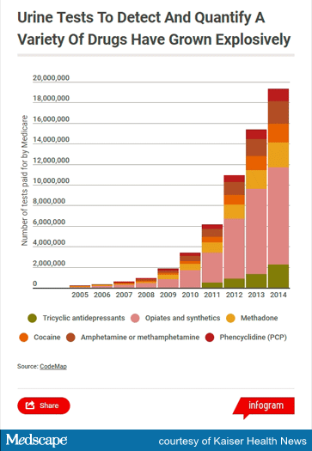

Slide 91
Approximate Drug Detection Time in the Urine (Mayo Clin Proc 2017;92(5):777
Alcohol 7-12 h
  Metabolite ethylglucuronide 2-5 d
  Blood alcohol level most accurate for acute intoxication
  Alcohol in hand sanitizers/mouthwash can cause false-positive urine drug tests

Slide 92
Approximate Drug Detection Time in the Urine (Mayo Clin Proc 2017;92(5):777
Amphetamine 48 h
Methamphetamine 48 h
Barbiturate
Short-acting (eg, pentobarbital) 24 h
Long-acting (eg, phenobarbital) 3 wk

Slide 93
Approximate Drug Detection Time in the Urine (Mayo Clin Proc 2017;92(5):777
Benzodiazepine
Short-acting (eg, lorazepam) 3 d
Long-acting (eg, diazepam) 30 d
    Note clonazepam (long-acting) metabolized to hard-to-detect product, thus false negatives possible
Cocaine metabolites 2-4 d

Slide 94
Approximate Drug Detection Time in the Urine (Mayo Clin Proc 2017;92(5):777
Marijuana
  Single use 3 d
  Moderate use (4 times/wk) 5-7 d
  Chronic use (daily) 10-15 d
  Chronic heavy smoker >30 d

Slide 95
Approximate Drug Detection Time in the Urine (Mayo Clin Proc 2017;92(5):777
Opioids
  Codeine 48 h
  Heroin (morphine) 48 h
  Hydromorphone 2-4 d
  Methadone 3 d
  Morphine 48-72 h
  Oxycodone 2-4 d
  Phencyclidine 8 d

Slide 96
Approximate Drug Detection Time in the Urine (Mayo Clin Proc 2017;92(5):777
Synthetic cannabinoids
  Single use 72 h
  Chronic use >72 h
  Synthetic cathinone (khat) Variable

Slide 97
The “Science” Behind Drug Testing: Costs
$35,000 - $77,000 for Federal Government’s Drug Testing Program to find one user
Most workers identified are occasional moderate users rather than drug abusers; more than half test positive only for marijuana

Slide 98
The “Science” Behind Drug Testing: Costs
If 1 out of 10 of test positives is a drug abuser [what many consider to be a high estimate], average cost of finding one drug abuser = $350,000 - $770,000
  If half of these would have been detected anyway, through other means, cost of drug testing to find one otherwise hidden drug abuser = $700,000 - $1.5 Million
Costs likely to be higher when physicians are tested due to lower rates of substance use and abuse

Slide 99
Problems With Drug Testing
Confirmatory tests (chromatography, spectroscopy) very accurate, but not foolproof
Differing rates of drug metabolism affect likelihood of positive results / racial and cultural variations

Slide 100
Problems With Drug Testing
False-Positive and False-Negative Results
  poppy seeds/opiods
  ibuprofen/cannabiniods
  tonic water/cocaine
  Robitussin/PCP
  alcohol lacing poorly recognized

Slide 101
Federally-Mandated Tests for Drugs of Abuse and Drugs That Can Cause False-Positive Preliminary Drug Tests
Amphetamines – ephedrine, pseudoephedrine, phenylephrine, amphetamines, dextroamphetamine, methamphetamine, selegiline, chlorpromazine, trazodone, bupropion, desipramine, amantadine, ranitidine, labetolol, metformin

Slide 102
Federally-Mandated Tests for Drugs of Abuse and Drugs That Can Cause False-Positive Preliminary Drug Tests
Cocaine metabolites – topical anesthetics containing cocaine (but not benzocaine, lidocaine, procaine, and tetracaine)
Marijuana metabolites – ibuprofen, naprosyn, dronabinol, efavirenz, hemp seed oil, baby wash products (soaps and shampoos)
  “Spice” (“K2”) - synthetic cannabinoids, missed by most screens

Slide 103
Federally-Mandated Tests for Drugs of Abuse and Drugs That Can Cause False-Positive Preliminary Drug Tests
Opiate metabolites – codeine, morphine, rifampin, fluoroquinolones, poppy seeds, quinine in tonic water, quinidine
Phencyclidine – ketamine, dextromethorphan

Slide 104
Problems With Drug Testing
Seriously impaired alcoholics, who far outnumber marijuana and opioid abusers, can be easily missed, despite the fact that their mental and physical impairments likely cause greater patient morbidity

Slide 105
Medical and Recreational Marijuana
38 US states and territories permit use of medical marijuana; 24 states and Washington, DC permit recreational use (as does Canada)
  3-4 times the THC of marijuana in the 1960s and 1970s (some estimates of street marijuana as high as 9-fold increase)

Slide 106
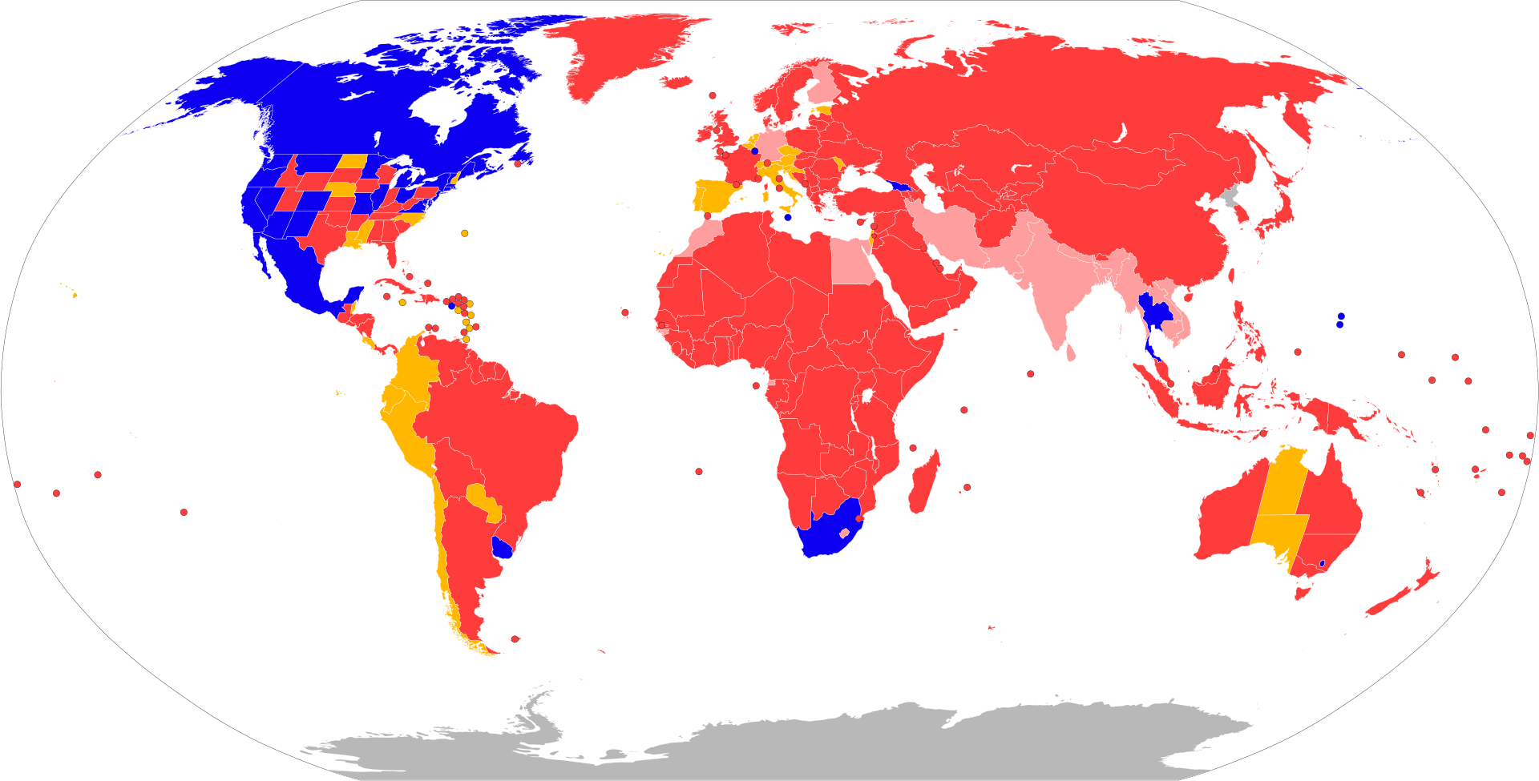
Recreational Cannabis
Blue – Legal; Red – Illegal; Yellow – Illegal but Decriminalized; Pink – Illegal but not Enforced

Slide 107
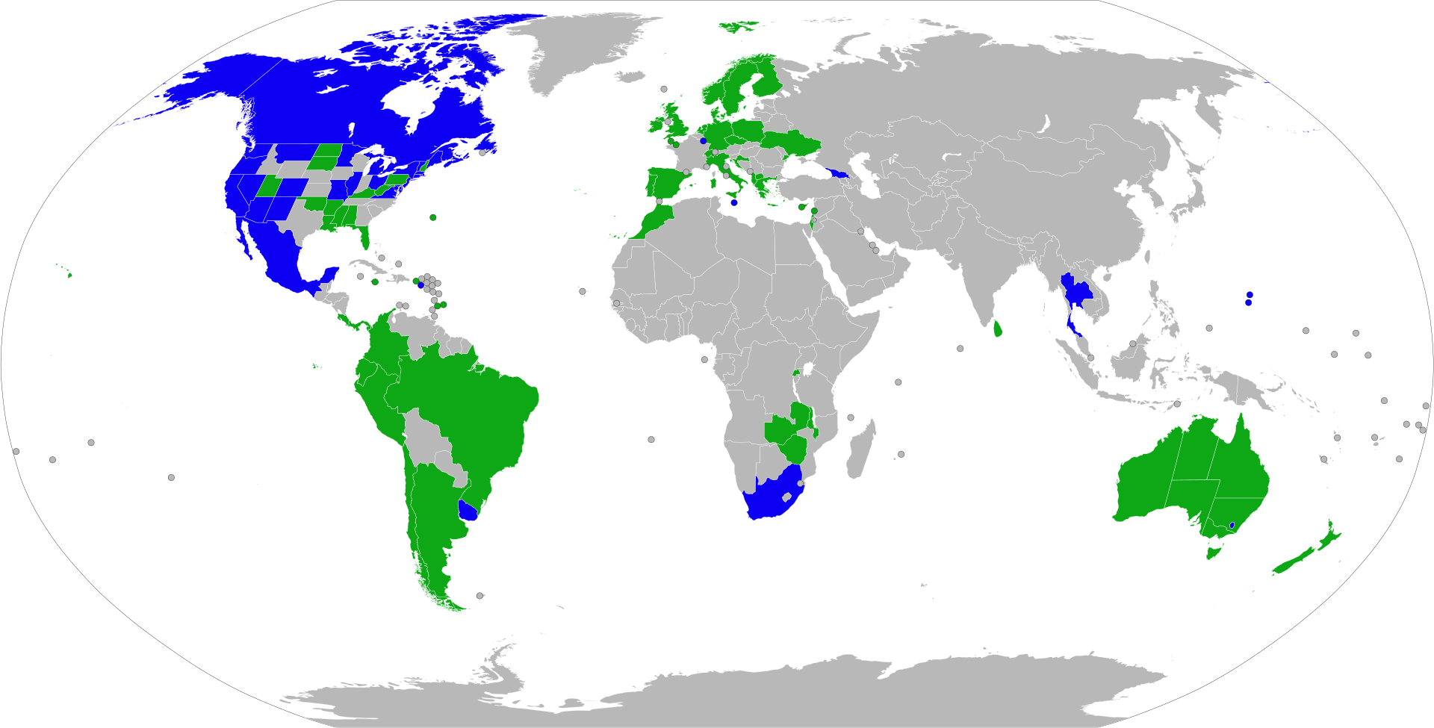
Cannabis Worldwide
Blue – legal for any use
Green – legal for medical use

Slide 108
Medical Marijuana
Strongest evidence of benefit for neuropathic pain, spasticity due to MS, and anorexia in the setting of critical illness
  Most common use for chronic pain
Little evidence of benefit for PTSD
Placebo-controlled trials may overestimate benefit due to inadequate blinding

Slide 109
Marijuana
Marijuana smokers exceed cigarette smokers for the first time (16% vs. 11%, 2022)
Marijuana use more than doubled 2006-2016, hit record levels in youth in 2022
Cannabis use disorder (affects 30% of users) and marijuana-related ER visits, hospitalizations, and poison center calls up dramatically

Slide 110
Marijuana
$13 billion cannabis industry in U.S. (2022)
Tobacco companies beginning to invest in cannabis
Community colleges offer courses to students eager to join burgeoning industry

Slide 111
Marijuana
States which legalized marijuana have experienced significant increases in marijuana-related DUIs, fatal car crashes, hospitalizations, and accidental ingestions by children
Marijuana retail establishments more common in lower SES and racial/ethnic minority neighborhoods

Slide 112
Marijuana
States where medical cannabis is legal have fewer opioid prescriptions and 25% fewer opioid painkiller deaths
  However, data on cannabis for pain control weak or inconclusive, except for neuropathic pain
  Cannabis should not be used as an opioid substitute

Slide 113
Marijuana
Marijuana linked to other drug use disorders, anxiety, depression, suicidality, psychotic symptoms and increased risk for schizophrenia, respiratory problems, arrythmia, coronary artery disease, MI, stroke, Cannabinoid Hyperemesis Syndrome (recurrent nausea and vomiting), lower sperm count and quality, increased risk of testicular cancer, Alzheimer’s disease, intellectual impairment (esp among teens), low birth weight, autism in offspring, and impaired driving
Regular use can increase post-op pain and nausea

Slide 114
Marijuana
Recent increase in use of synthetic cannabinoids
  May not show up on drug tests
Marijuana contains many of the components found in tobacco smoke
Second-hand exposure involves most of the thousands of chemicals, including many carcinogens, found in tobacco smoke
EMS (environmental marijuana smoke) likely carries same health consequences as ETS (environmental tobacco smoke) [See tobacco slide show on phsj website]

Slide 115
Marijuana
Marijuana can be detected for weeks after use
Passive exposure can result in a positive urine drug test
THC present in ½ of urine specimens of patients using external CBD oil for one month
Synthetic cannabinoids cannot be detected by most tests

Slide 116
Problems With Drug Testing
Multiple means of sabotaging tests and escaping detection exist
  adulteration
  dilution
  purchase of “drug-free urine”
Physicians largely ignorant of science, proper use of tests

Slide 117
Fooling Drug Tests?
The “personal detoxification industry” is booming
Most essentially worthless, easily detected by good drug labs
Drug Testing Integrity Act (2008)
  Illegal to buy, sell, manufacture, or advertise “cleansing” products that promise to help consumers “defraud a drug test”

Slide 118
Fooling Drug Tests?
Examples:
  Urinating then refilling bladder via concealed catheter with clean urine
    “Whizzinator” (prosthetic penis filled with clean urine) – Boxer Mike Tyson confessed in 2020 to using during his heyday as heavyweight champion

Slide 119
Fooling Drug Tests?
Examples:
  Detox drinks (“Ready Clean”) - vitamins and herbs to “clean the urine”
  Urine additives (“Urine Luck”) – contain oxidizers to block marijuana detection, but labs can detect the oxidizer

Slide 120
Fooling Drug Tests?
Examples:
  Mouth rinses ((“Saliva Cleanse”) – vitamins and herbs to “clean the saliva”
  Shampoos (“Clear Choice”) – claim to coat hair with detection blockers – shampoos, bleaches and dyes can alter drug concentrations in hair

Slide 121
Fooling Drug Tests?
Most common methods of cheating:
  Dilution (58%) - success rate 71%
  Substitution of artificial or clean sample (25%) – success rate 100%
  Adulteration with household products (17%) – success rate 75%

Slide 122
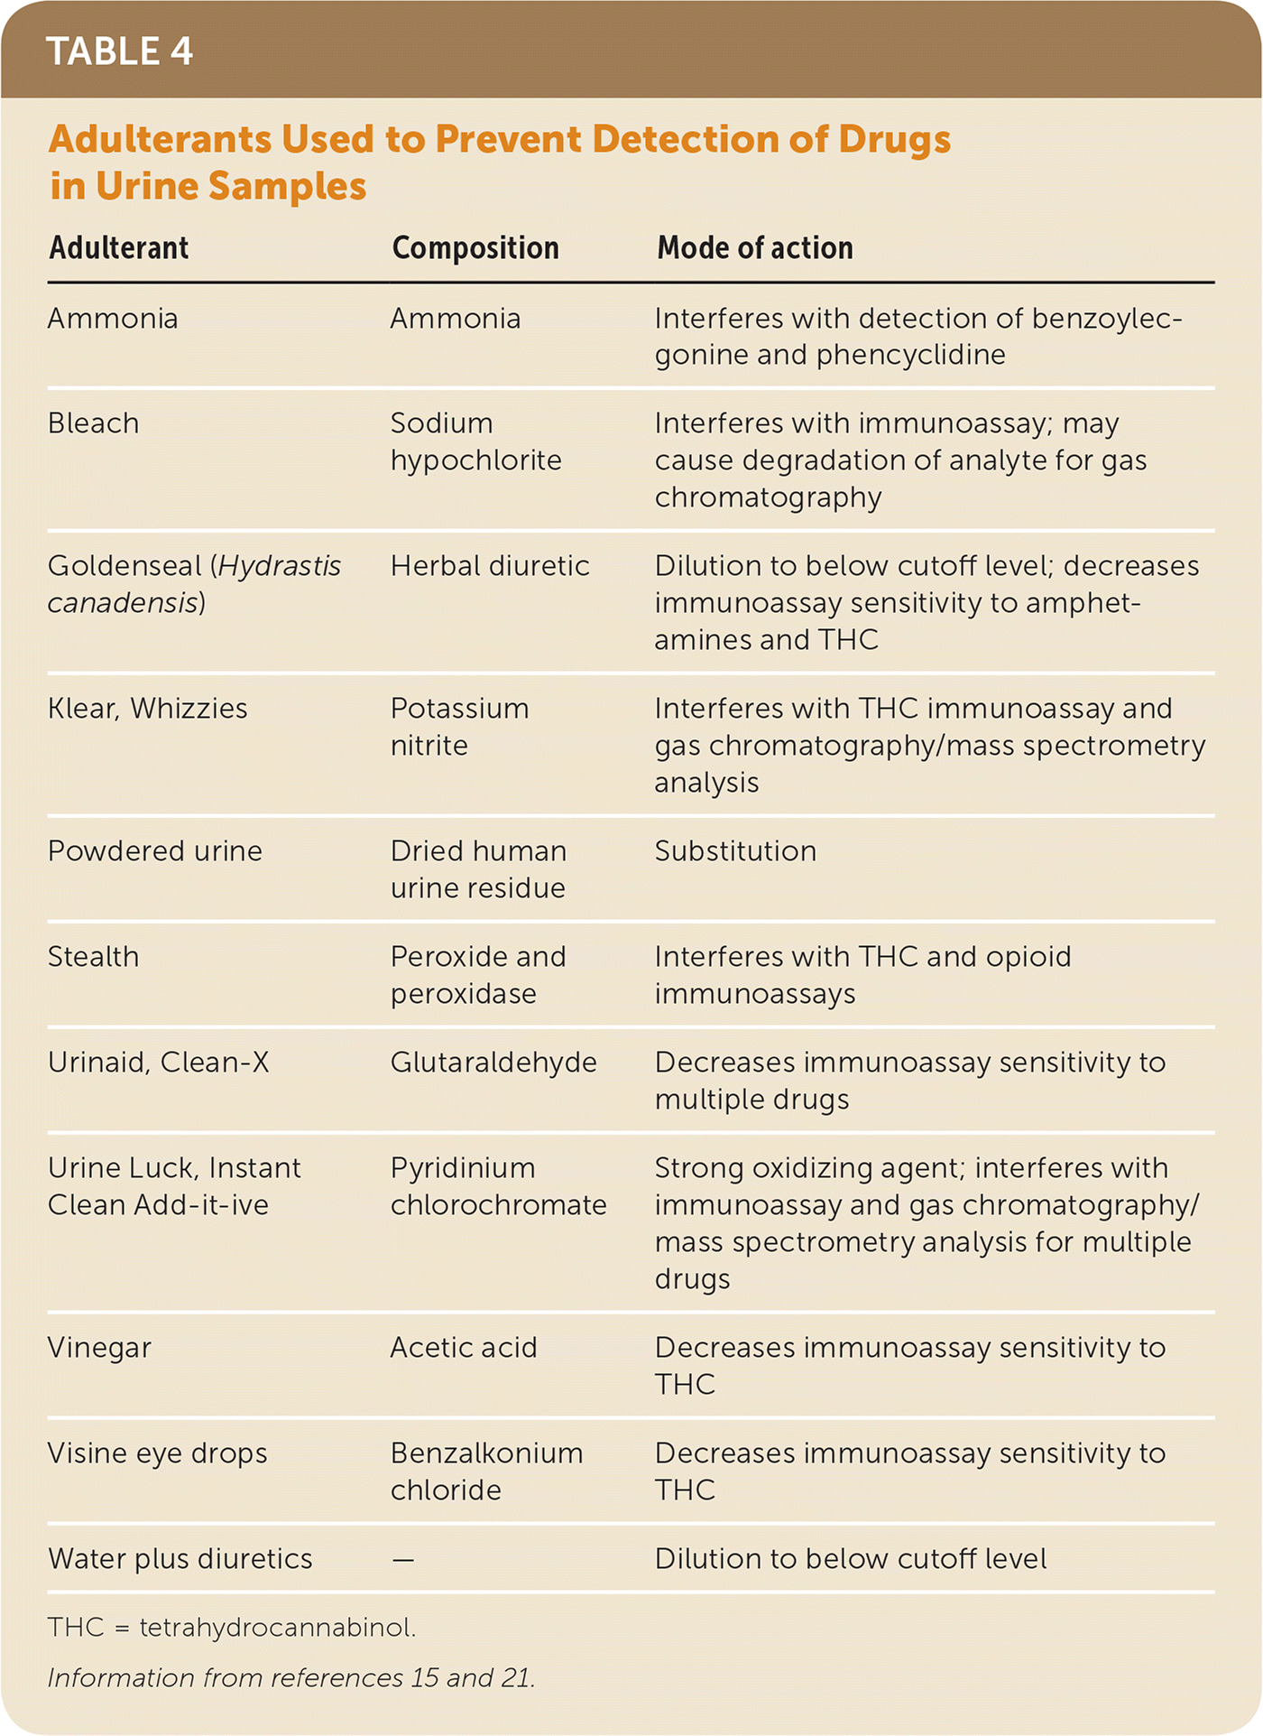

Slide 123
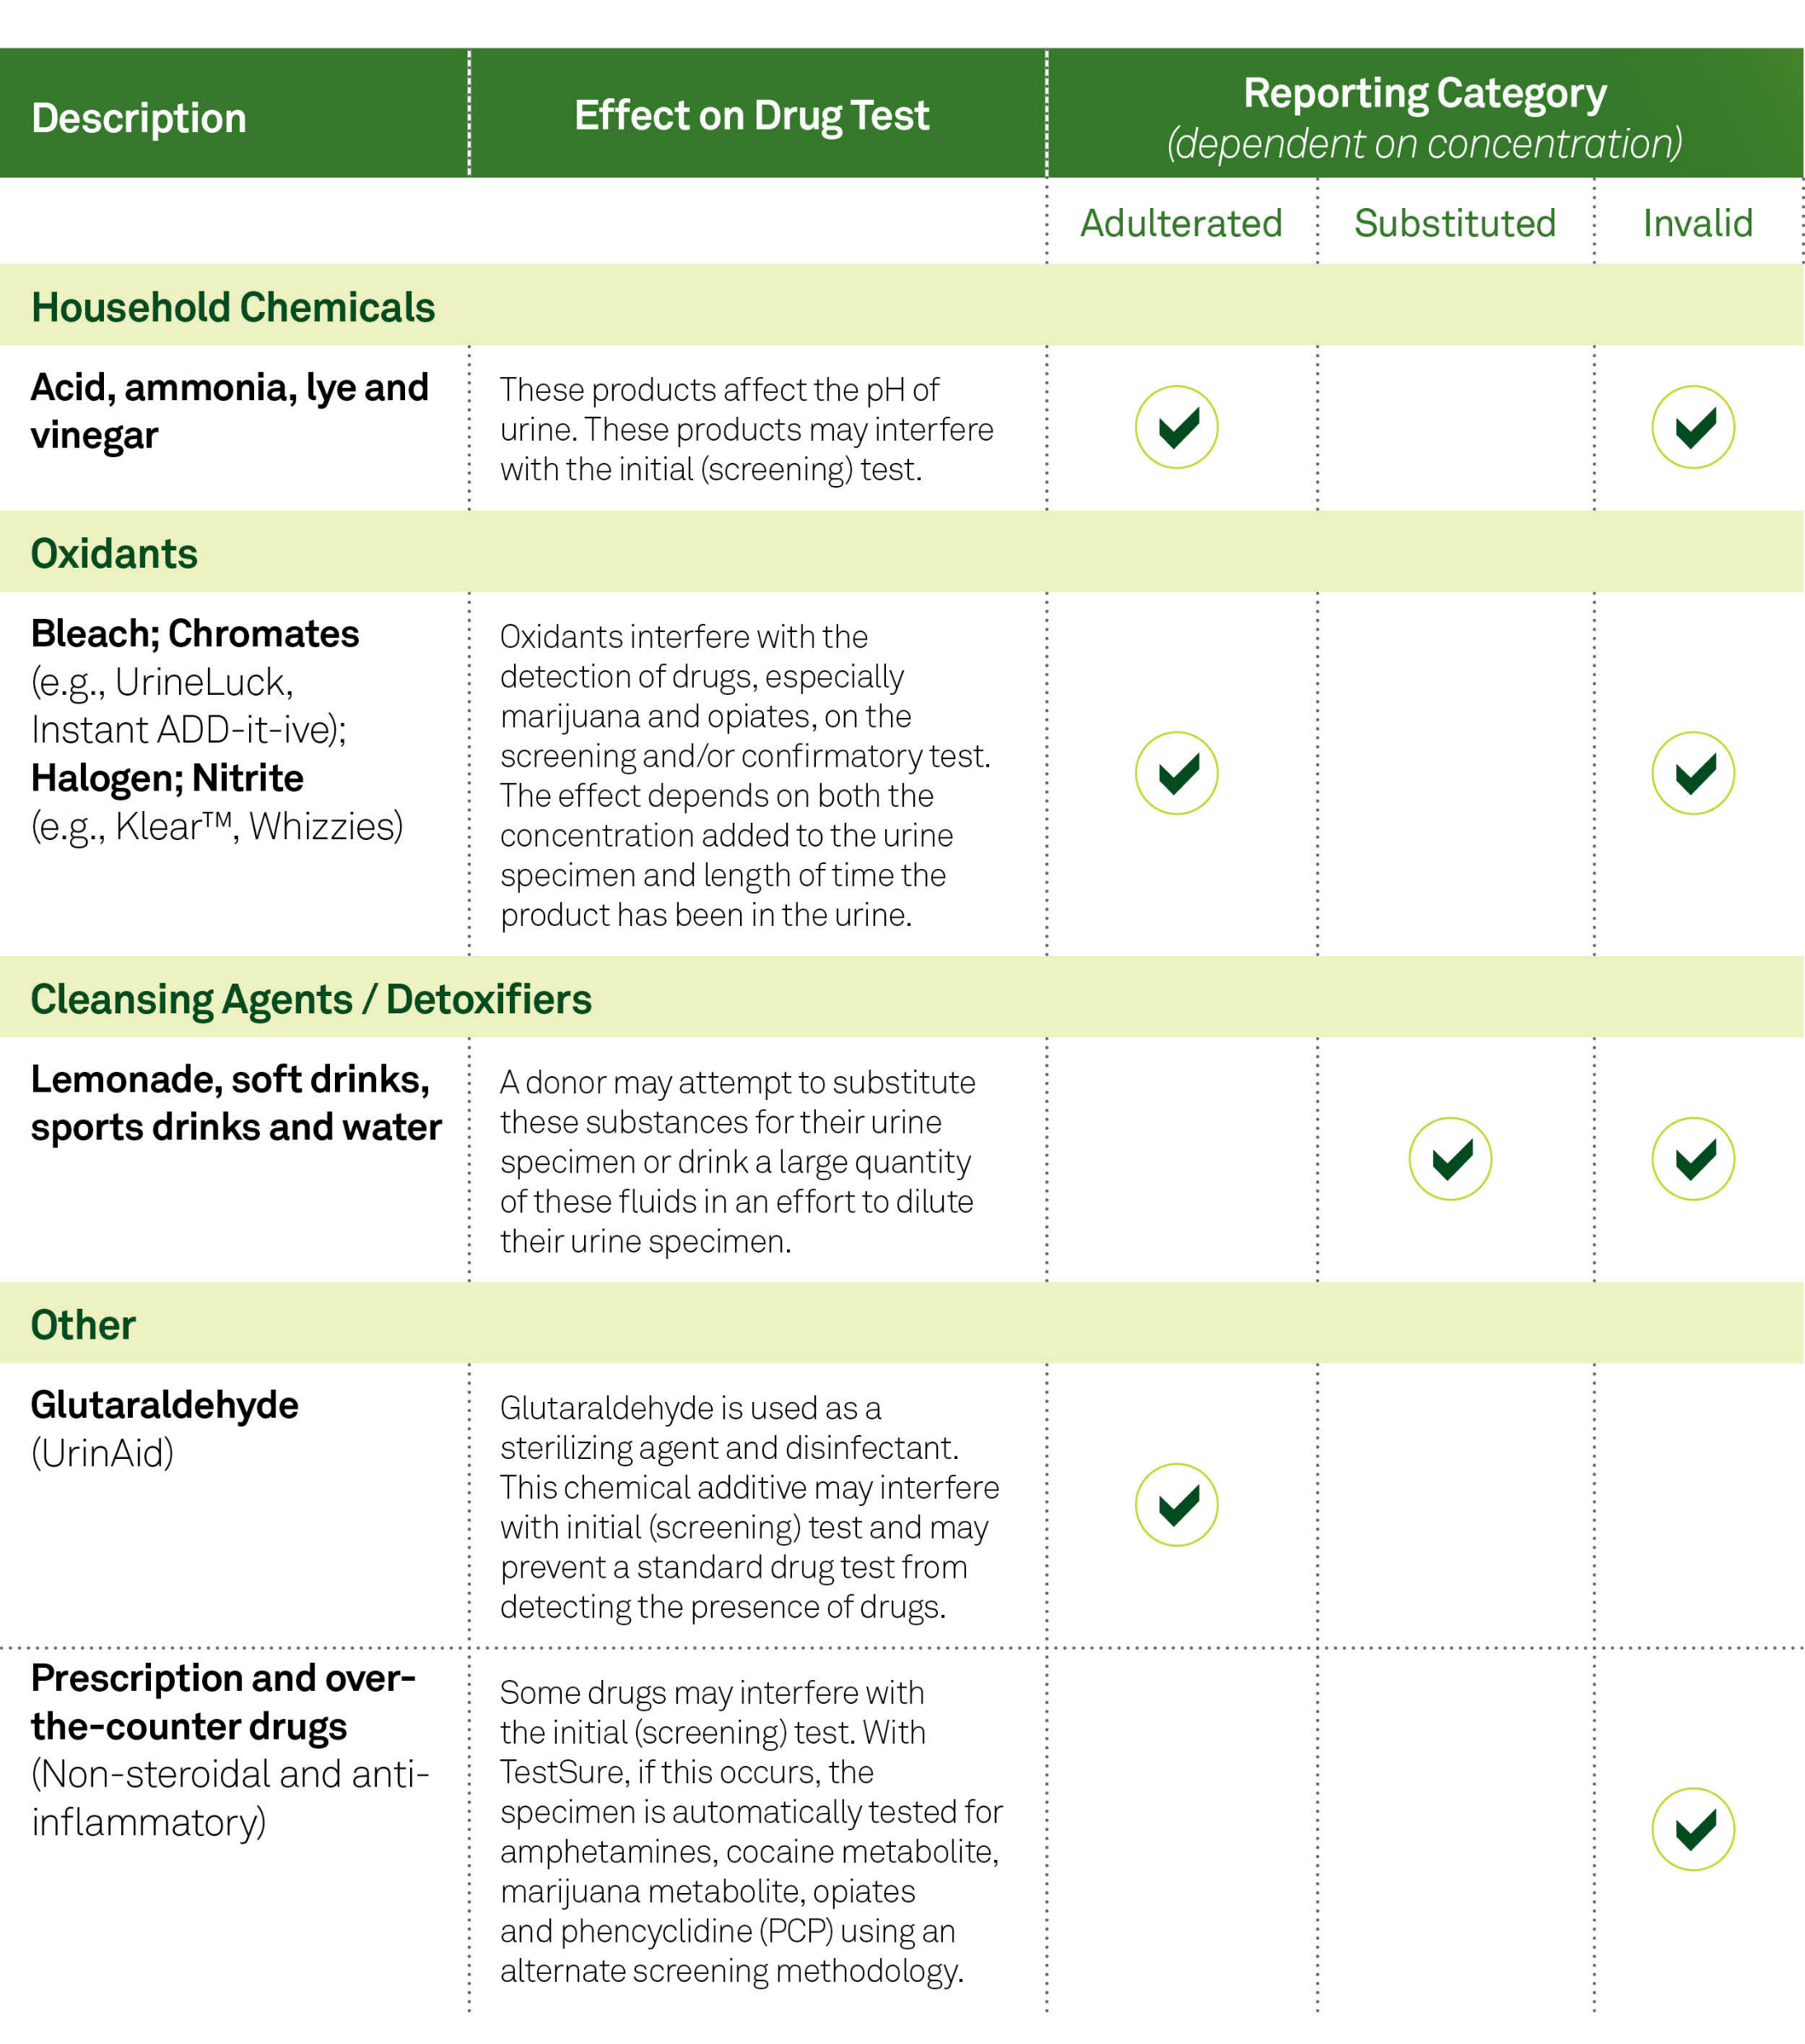

Slide 124
False-Positive Tests
Risk
  Inevitable, since no test is 100% specific
  For a non-drug user, the only type of positive test
Consequences
  Puts public reputation and future employability in jeopardy
  may disrupt long-standing relationships with patients
  threatens large public financial investment in training
  emotional and financial upheaval

Slide 125
Field Drug Tests
Use common by law enforcement, especially in southern states
Accuracy varies widely
33% false-positives in one study (1/2 of these no illicit drug involved)

Slide 126
Field Drug Tests
Many companies sell, but no central agency regulates manufacture and sale
Most crime labs do not test drug evidence
Poor more likely to take plea deals
Sentences can be long, consequences lifelong

Slide 127
Does Drug Testing Deter
Drug Use?
No (in workplace and among students)
Frequently cited estimates of lost productivity due to drug use are based on data that the National Academy of Sciences has concluded are “flawed”
Only 85 companies with drug testing have performed any cost benefit analysis

Slide 128
Does Drug Testing Deter
Drug Use?
Negative impact on workplace morale
Urine collection process degrading and demeaning, particularly when it involves direct observation

Slide 129
Does Drug Testing Deter
Drug Use?
Analysis of 63 high-tech firms in computer equipment and data processing industry showed drug testing reduced productivity by creating environment of distrust and paranoia, rather than in one which employees were treated with dignity and respect
Some employers have dropped pre-employment screening because it unduly hindered their ability to recruit skilled workers

Slide 130
Public Support for Various
Drug Abuse Policies (% favoring)
Anti-drug education in schools 93%
More severe criminal penalties 84%
Increase funding for treatment 77%
Increase mandatory drug testing at work 71%
Surprise searches of school lockers 67%
U.S. military advisers in foreign countries 64%

Slide 131
Public Support for Various Drug Abuse Policies (% favoring)
Mandatory drug testing of high school students 54%
Death penalty for smugglers 50%
U.S. aid to farmers in foreign countries not to grow drug crops 48%
Legalize all drugs 14%
One charity has paid over 1,300 drug and alcohol addicts to sterilize themselves!

Slide 132
Public Support of Americans for Marijuana
80% support medical use of marijuana
75% support a fine-only (no jail) for recreational users
40% support legalizing small amounts
But a majority oppose full legalization

Slide 133
Marijuana = $
Marijuana revenue over $70 billion/yr
  Only $25 billion of this is legal
  Increased use has increased crime
Marijuana - California’s biggest crop (grapes #2)
  Produces at least 8.6 million lbs/yr
  Street value = $13.8 billion
Big business entering field
Some states taxing

Slide 134
Marijuana = $
2024: 7 states, including CA, no longer allow employers to test and penalize workers for off-the-clock marijuana use
2022: Biden pardons individuals with federal marijuana possession charges
Should mandated reporting to the DMV of patients with conditions which may impair driving encompass marijuana use/abuse?

Slide 135
Physician Opinion Regarding Drug Testing is Mixed
Survey of practicing physicians in Midwest:
  60% -“infringed on rights to privacy”
  38% -“lack confidence in testing procedure”
  56% - “would submit to mandatory testing without protest”
  8% “would refuse”
  7% “would hospitalize their patients elsewhere”
  7% “would file a lawsuit”

Slide 136
Physician Opinion Regarding Drug Testing is Mixed
2014 survey:
  39% of US doctors support random physician drug testing (56% of European doctors)
  77% of US doctors would report and impaired physician (45% of European doctors)

Slide 137
Physician Opinion Regarding Drug Testing is Mixed
2020 Medscape survey:
  34% of internists and 38% of family physicians responding said physicians should submit to random alcohol and drug testing
  9/10 internists and family physicians would report a physician who occasionally seemed impaired, but most (60%/62%) would do so only after talking with the physician first

Slide 138
Physician Opinion Regarding Drug Testing is Mixed
1994 survey: Half of Family Practice Residency Directors opposed mandatory pre-employment drug testing
20% of senior medical students “would not rank” or “would rank lower” a program with mandatory pre-employment drug testing

Slide 139
Testing and Treatment of Impaired Physicians
Voluntary treatment programs for substance-abusing resident physicians supported by the Association of Program Directors in Internal Medicine
Programs for substance-abusing physicians available in almost all states and D.C.
  have been quite successful (22% test positive during treatment, but 80% abstinent and 71% still employed after 5 years)
  Oversight varies, some criticized

Slide 140
Testing and Treatment of Impaired Physicians
90% of state licensure applications ask about substance abuse, and inquire about functional impairment from substance abuse (not simply about substance use per se)
If physician self-reports and/or cooperates with treatment, state medical boards may not pursue disciplinary action
States split on physician requirement to disclose impaired or recovering status to patients as part of informed consent
Many physicians unprepared to/unwilling to report impaired colleagues

Slide 141
Disciplinary Actions Against Practicing Doctors, 2008-2010
-Public Citizen Health Research Group Reports
Information sources: State medical boards, U. S. Department of HHS, DEA, and FDA
5,721 serious disciplinary actions
  3/1,000 physicians
Less than 10% disciplined for substance abuse (76% between 2004 and 2020, so rapid increase)
State disciplinary rates vary widely
Physician misconduct often goes unreported

Slide 142
Disciplinary Actions Taken Against Doctors Cited for Substance Abuse
Action Number Percent
Revocation 71 2.9%
Surrender 111 4.5%
Revocation, Surrender, of
Controlled Substance License 116 4.7%
Suspension 293 11.8%
Emergency Suspension 136 5.5%
Probation 741 29.9%
-Public Citizen Health Letter 2000;16(9):5.

Slide 143
Disciplinary Actions Taken Against Doctors Cited for Substance Abuse
Action Number Percent
Restriction of Controlled
Substance License 143 5.8%
Fine 43 1.7%
Required to Enter and Impaired
Physician Program or
Substance Abuse Treatment 161 6.5%
Other Actions 665 26.8%
Total Actions 2480 100.0%
-Public Citizen Health Letter 2000;16(9):5.

Slide 144
Disciplinary Actions Taken Against Doctors
2003-2017: 1,354 doctors (0.2%) reported to National Practitioner Data Bank for sexual misconduct
  18% with multiple reports and/or malpractice payments
40% continue to hold active licenses
70% not disciplined by state medical board
States vary greatly in degree of response

Slide 145
Disciplinary Actions Taken Against Doctors
Disciplinary actions down between 2005 and 2022
76% primarily related to substance use, 12% to psychological impairment, 12% to physical impairment

Slide 146
Disciplinary Actions Taken Against Doctors
Public Citizen
By the end of 2021, 9,286 U.S. physicians have had five or more malpractice-payment reports filed with the NPDB since 1990.
  75% of these have never had a medical board licensure action of any kind, serious or nonserious.
16,287 physicians reported to the NPDB for clinical-privileges actions affecting their ability to practice for more than 30 days
  Only 51% have ever had any action, even a reprimand, reported by a state licensing board

Slide 147
Disciplinary Actions Taken Against Doctors
Public Citizen
888 physicians judged by their peers to be an immediate threat to health or safety
  Only 52% had ever had any licensure action taken against them.

Slide 148
“Go Directly to Jail”
To provide health care to burgeoning jail and prison populations, some states are hiring physicians who have been convicted of crimes or lost their medical licenses due to professional misconduct
- special licenses restrict MDs to treating prisoners

Slide 149
Drug Testing and the
Erosion of Privacy
Many programs require one to divulge prescription medications
  can cause false-positive or false-negative results
> 1/3 of members of American Management Association [the nation’s largest management development and training organization] tape phone conversations, videotape employees, review voicemail, and check computer files and e-mail

Slide 150
Drug Testing and the
Erosion of Privacy
Nearly half of Fortune 500 companies collect data on their workers without informing them
  a majority share employee data with prospective creditors, landlords, charities
  35% check medical records before hiring or promotion (HIPAA violation)
  35% of U.S. companies run a credit check as a condition for employment (up from 19% in 1996)

Slide 151
Drug Testing and the
Erosion of Privacy
  Some illegally check urine pregnancy test, using same sample obtained for pre-employment drug screening - 1988 Washington, D.C. P.D.
  Up to 10% use genetic testing for employment purposes
    DTC genetic tests available (cost $400 - $2000, inconsistent and often inaccurate results
  Genetic discrimination has been reported

Slide 152
Drug Testing and the
Erosion of Privacy
Database searches of applicants’ credit reports, driving and court records, and workers’ compensation claims
Pre-employment psychological testing (e.g., Meyers-Briggs – debunked)
Social networking site reviews
Some companies prohibit co-workers from dating, or ban off-the-clock smoking and drinking

Slide 153
Drug Testing and
The Erosion of Privacy
Public Video Surveillance Cameras (increasing daily):
  770 million worldwide (2019)
    Many defective
    Expected to exceed 1 billion by end of 2021
  5-6 million in England (1 million in London)
    Avg. Londoner monitored by over 300 cameras per day
  6,000 in Times Square
  Average American caught on camera over 75X/d
  Police asking owners of doorbell cameras to voluntarily share footage

Slide 154
Drug Testing and
The Erosion of Privacy
Public Video Surveillance Cameras (increasing daily):
  Very common in Asia (500,000 in Beijing)
    China creating national facial recognition database which also assigns a rating to individuals based on financial and governmental information
    China also DNA testing Uighurs to recreate facial features from DNA, match with surveillance footage (ongoing genocide)

Slide 155
Drug Testing and
The Erosion of Privacy
Public Video Surveillance Cameras (increasing daily):
  Market value = $18 billion worldwide ($4 billion in U.S.)
  Effective in decreasing crime in parking lots; possibly in public transportation facilities and other public areas
  Best when used in conjunction with super-recognizers (estimated 1-2% of population)

Slide 156
Drones
856,000 registered drones in US (early 2024)
  53% commercial
  47% recreational
Cost $100 to $3,000+

Slide 157
Drones
Over 6,000 close calls involving aircraft from early 2014 to early 2018
    Include instances of drones hitting passenger plane in Canada, US army helicopter, and person on the ground
    Multiple reports of flyovers of military installations and prisons (contraband) by private citizens

Slide 158
Drones
FAA requires registration, but otherwise regulation limited
  Fines possible, but only 32 incidents over last 4 yrs resulted in any enforcement action
  Efforts to require drone manufacturers to install crash avoidance systems and other safety features lacking
  Jamming/shooting down drones illegal
  Geofencing can be used to limit a drone’s range

Slide 159
Drones
  26 states have passed laws limiting drone use (many may not survive court challenges)
  2021: Federal government allows small drones to fly over people and at night; remote ID required by 2022-2023
  UPS, Alphabet’s Wing, Walmart all in or getting into drone delivery business

Slide 160
Drones
Can be used to track those tagged with semiconducting nanocrystals which generate unique spectral signatures
US military developing long-range facial recognition software for drones
  Accuracy problems, moreso for non-white faces
Potential for terrorism

Slide 161
Drug Testing and
The Erosion of Privacy
2012: U.S. Supreme Court rules tracking suspects via GPS without a warrant violates Fourth Amendment
Rise of robo-cops, excessive use of technology places innocent at risk of serious harm

Slide 162
Drug Testing and
The Erosion of Privacy
War of Terror being used to limit privacy, increase monitoring (2011 data)
  Millions of requests for cell phone records
  30,000 government security personnel monitoring domestic communication
  Cost to protect U.S. secrets est. $12 billion - $13 billion per year (up from $6 billion in 2002)

Slide 163
Drug Testing and
The Erosion of Privacy
92 million documents classified (vs. 6 million in 1995)
  Number of classified documents increasing by 50 million/yr; 9/10 classified documents really should not be classified per experts
  Over 2.8 million people have security clearances; 1.6 million can access confidential or secret information; 1.2 million have top secret clearance (2017)

Slide 164
Drug Testing and
The Erosion of Privacy
Federal Do Not Track Kids Act proposes to:
  prohibit internet companies from collecting information from children under 13 without parental consent and from teens without teens’ consent
  Prohibit companies from sending targeted advertising to kids and teens

Slide 165
Drug Testing and
The Erosion of Privacy
License-plate cameras
  Catch speeders, stolen cars
  Civil liberties issues
In one study, closed circuit TV operators watch blacks twice as often as whites and monitor 1//10 women for “voyeuristic” reasons
More street cameras led to 2% drop in crime; better streetlights – 20% drop

Slide 166
Drug Testing and
The Erosion of Privacy
Hospital Locator Badges
Hand hygiene monitor badges; Hygreen alcohol hand sensors; observation teams
Routine screening of health professionals for blood-borne viruses, other pathogens
Mystery patients (like secret shoppers)

Slide 167
Drug Testing and
The Erosion of Privacy
21 states still criminalize some forms of sexual intimacy between consenting adults (15 hetero- and homosexual, 6 homosexual only)
Checkmate – $49.95 semen test kit that enables suspicious spouses to check their better half’s underwear for signs of illicit liaisons

Slide 168
Drug Testing and
The Erosion of Privacy
$156 billion data brokerage industry
Some consumer data companies sell lists of rape victims, demented seniors, and HIV/AIDS patients to marketers
  Could lead to predatory marketing, increased risk of victimization
Laws weak, in some cases allow
Data often incorrect, hard to change

Slide 169
Drug Testing and the Erosion of Privacy
Child Monitoring: GPS-enabled cell phones
Philadelphia school captured photos of students using school issued laptop computer cameras at home
2010: U.C. Berkeley abandons voluntary freshman genetic test due to public outcry
2020-21: schools monitoring online behavior during testing to avoid cheating, prone to errors/false accusations

Slide 170
Drug Testing and the Erosion of Privacy
Child snitch programs:
- Pinkerton Services Group’s “Working Against Violence Everywhere”
- DARE - Recognize/Resist/Report (2003 GAO study reports DARE ineffective in combating drug use)
- Scholastic Crime Stoppers
- Students Against Violence Everywhere (SAVE)

Slide 171
Drug Testing and the Erosion of Privacy
DNA databases:
  Most industrialized countries
  Federal government and all 50 states
    Federal DNA Fingerprint Act keeps records of accused (2 million) and convicted (11 million) and refugees
    State and local databases include minors
    European Court of Human Rights ruled similar system in UK a violation of human rights
  For those convicted and, in some cases, those merely arrested (federal DNA database = CODIS – Supreme Court rules does not violate 4th Amendment)

Slide 172
Drug Testing and the Erosion of Privacy
DNA databases
  Some states store mandated genetic test data on newborns (yet newborn bloodspot screening valuable tool for researchers)
  2013: MI requires mothers who were younger than 16 at time of conception and who refuse to identify their babies’ father to give blood, which is stored and DNA tested to find perpetrators of statutory rape (3+ years older)

Slide 173
Genetic Testing: 23andMe
Backed by Google and run by Anne Wojcicki, ex-wife of Google founder Sergey Brin
Has partnered with dozens of universities and high schools (offering discounts on genetic testing and curricular materials)

Slide 174
Genetic Testing: 23andMe
Personal (limited) DNA screen $99, has been used by about 0.5 million people
  Cost of sequencing entire genome = $3,000 and falling
  Offered $99 test for 250 genetic conditions

Slide 175
Genetic Testing: 23andMe
2012: First patent – gene variant that may be protective against a rare genetic form of Parkinson’s Disease
  Gene patenting on hold per SCOTUS
2013: Awarded a patent to help parents create designer babies

Slide 176
Genetic Testing: 23andMe
  Partnered with Iceland’s Decode Genetics Inc. to offer more thorough personal genome analysis for $1000
  2013: Cease and desist order from FDA, which considers it a medical device requiring approval – suspended its genetic testing

Slide 177
Genetic Testing: 23andMe
  2015: FDA Oks tests for autosomal recessive conditions such as cystic fibrosis, sickle cell anemia, Tay-Sachs Disease, and Bloom Disease
  2017: FDA approves DTC testing by 23andMe for genetic predisposition to late-onset Alzheimer’s, Parkinson’s, celiac disease, alpha-1 antitrypsin deficiency, early-onset primary dystonia, Factor XI deficiency, Gaucher Disease I, G6PD deficiency, hereditary hemochromatosis, and hereditary thrombophilia

Slide 178
Genetic Testing: 23andMe
2018: FDA approves 23andMe’s DTC BRCA mutation testing kit ($199)
2018: 23andMe offers $100 ancestry tests, $200 ancestry and health tests, and a $749 premium service
Accuracy questionable

Slide 179
Genetic Testing: 23andMe
2018: GSK acquires $300 million stake in company to develop drugs more efficiently and to more quickly identify patients for clinical trials
  Access to 80% of 23andMe’s 5 million customers, who originally consented to have be involved in medical research (but not necessarily exclusively by, and for the benefit of, GSK)
2023: Massive data breach affecting almost 7 million customers, multiple lawsuits

Slide 180
Headline from “The Onion”
“New 23andMe Feature Connects Users To Others Who Share Genetic Tendency To Get Billed For $199”

Slide 181
Genetic Testing
Similar arrangements: Amgen acquired deCODE Genetics (Iceland, 2012), Regeneron Pharmaceuticals and Geisinger Health System teamed up in 2014; Roche acquired Foundation medicine and another cancer data company (2018)

Slide 182
Genetic Testing
EncrypGen: online database where individuals can upload their DNA, for either future clinical use or sale through regular or cryptocurrency for various uses
Nebula Genomics (founders include sequencing pioneer George Church)
  Offers exome testing for $300, whole genome testing for $1,000
  Customers can sell their data via cryptocurrency

Slide 183
Genetic Testing
2018: 23andMe agrees to obtain consumers’ separate express consent before turning over their individual egenetic information to businesses and insurers
2018: Estonia planning extensive nationwide genetic testing
2018: Chinese government requiring athletes who want to compete for the county in the 2022 Beijing Winter Olympic Games to have their genomes sequenced
2019: Senior Pentagon officials tell members of armed services to avoid home DNA tests, due to vulnerabilities

Slide 184
Genetic and Microbiome Testing
75,000 genetic tests currently on the market
  10 added/d
OTC genetic tests limited, unreliable
Increasing use of DNA and ancestry testing being used by law enforcement to solve cold cases
Personalized microbiome testing companies:
  uBiome, Thryve
  Privacy concerns

Slide 185
Blood Testing and Privacy
NCAA now mandates testing for sickle cell train for all student athletes
Texas ordered to destroy over 5 million blood samples taken from babies without parental permission which had been stored indefinitely for scientific research
Incomplete data collection can affect public health research and policy

Slide 186
The “Patriot Act”
Passed with minimal debate, most Congresspersons acknowledge not reading
Increased governmental and corporate secrecy – polluters subject to decreased public scrutiny
Erosion of civil liberties – deportations, accused held without charge/access to legal counsel
70,000 individuals on government’s list of suspected terrorists

Slide 187
National Defense Authorization Act
Signed by President Obama in 2012
Grants Pentagon right to: kidnap, indefinitely detain, torture, and kill foreigners and US citizens
No right of trial / legal representation
First explicit piece of legislation to repeal Bill of Rights

Slide 188
Foreign Intelligence Surveillance Act
Allows NSA to monitor Americans’ communications with foreigners overseas

Slide 189
Drug Testing and the Erosion of Privacy
Airport security “whole body imaging” scanners
  Personnel using to radiographically ogle women
  TSA now removing
More than 33,000 warrantless government searches of phones and laptops of international air travelers conducted in 2018
  2019: Federal court rules that such searches violate 4th Amendment

Slide 190
National Security Agency (NSA)
Federal air marshals still target citizens not suspected of a crime/under investigation/on terrorist watch list under “Quiet Skies” program to monitor “suspicious looking” individuals on planes
Occult “intelligence” bureaucracy with annual funding officially secret
  estimated at $52 billion

Slide 191
National Security Apparatus
Each day, intercepts 3 billion phone calls and billions of emails/instant messages/bulletin board postings/Google searches/etc.
FYI 1.4 million Americans hold top-secret security clearances
Dangers of too much data, missing real threats

Slide 192
National Security Agency (NSA)
Telecom and internet service providers complicit
Has spied on foreign governments
Agents have spied on prospective and former lovers

Slide 193
National Security Agency (NSA)
Has sparked international outrage
Revelations ongoing
Whistleblower Edward Snowden wanted by US government, hero to many
  Whistleblower protections weak
Abuses reminiscent of FBI’s COINTELPRO spying program started by J Edgar Hoover

Slide 194
National Security Agency (NSA)
Privacy and Civil Liberties Oversight Board (independent monitoring organization set up by Congress in 2007) report (2014) concluded that the NSA’s bulk data collection is illegal, probably unconstitutional under the First and Fourth Amendments, a serious, ongoing threat to Americans’ privacy and liberties – and is essentially useless at stopping terrorist acts

Slide 195
National Security Agency (NSA)
2015: USA Freedom Act signed into law, ends bulk collection of phone data, forcing NSA to return to courts to access data (but allows continued surveillance of domestic emails that “touch” a foreign server
2017: Number of phone calls and text message records collected by NSA up 3.5-fold over 2016

Slide 196
International Surveillance
Many African countries using Israeli company Circles’ surveillance technology to snoop on private citizens’ communications, crack down on dissidents

Slide 197
Drug Testing and the Erosion of Privacy
InfraGard: FBI/DHS program to recruit industry leaders for spying
Some states allow warrantless cell phone searches
FBI has digital archive of 96 million sets of fingerprints (convicted and accused criminals, including those exonerated)

Slide 198
Drug Testing and the Erosion of Privacy
2019: FBI and Customs Enforcement Agency expanding facial recognition database using state driver’s license pictures
  FBI now has access to almost 650 million photos in searchable form (unclear how many unique identities this represents)
  Facial recognition AI less accurate with darker skin

Slide 199
Drug Testing and the Erosion of Privacy
2019: consumer DNA-testing company grants FBI access to its nearly 2 million genetic profiles
Amazon sells its facial recognition technology to law enforcement agencies, despite high error rate (mistakes men for women 20% of time)

Slide 200
Drug Testing and the Erosion of Privacy
Clearview AI app allowed internet scanning for faces
  Database of billions of photos
  Customers have included FFBI, Secret Service, DEA, Postal Inspection Service
  Illegal in some countries (e.g., Canada, Australia)
  Disabled by Apple (2020)
  Admitted lost its entire client list to hackers (2020)
  Agrees not to sell its software to most companies in US (after lawsuit) (2021)

Slide 201
Drug Testing and the Erosion of Privacy
2019: San Francisco bans use of facial recognition technology by city agencies, including the police dept.
2020: Facial recognition software can identify 83% of anonymous cranial MRI research participants
2021: Facebook stops using facial recognition software

Slide 202
Drug Testing and the Erosion of Privacy
2021: Microsoft patents technology using AI to mimic the voices and personalities of dead people
2022: Bots better than humans at solving CAPTCHA puzzles
PimEyes: upload photo, scours web for pictures, potential for both good and evil (sketchy managerial structure)

Slide 203
Big boss is watching:
Percentage of companies that monitor employees’…
Website connections 66-76%
E-mail 43-55%
Activity via video camera 51%
Time on phone 51%
Keystroke analysis 45%

Slide 204
Big boss is watching:
Percentage of companies that monitor employees’…
Computer file content 50%
Time at keyboard 36%
Phone calls 22%
Voice mail 15%
Only DE and CT require employee notification
Average employee wastes 1.7 hours of an 8.5 hour workday (largely on personal internet use)

Slide 205
Corporate Espionage (http://www.corporatepolicy.org/spookybusiness.pdf)
Purposes include:
  Stealing business secrets for competitive advantage
  Undermine, destroy activist movements
  Determine “friendliness” of elected officials
Involves in-house security officers and private contractors

Slide 206
Corporate Espionage
Involves vulnerability research, computer hacking, obtaining phone records, wiretapping and voicemail hacking, computer theft, disinformation campaigns, investigating private lives of activists, infiltrating activist organizations, blackmail, and creating false dossiers to discredit activists

Slide 207
Corporate Espionage
Spies often former intelligence, military, and law enforcement officers
  Revolving door
  Active duty CIA officers may moonlight
  Government subsidy for private industry, since trained at government expense, skills benefit private industry

Slide 208
Corporate Espionage
Occasionally use students, academics
  E.g., students “volunteering” to wear wire to catch drug dealers in exchange for drug charges being dropped
Minimal legal consequences; adverse media exposure possible
Threat to democracy and civil society

Slide 209
Corporate Espionage
Involves world’s largest corporations
  E.g., Koch Industries, Walmart, Monsanto, Dow Chemical, Bank of America, Coca-Cola, Kraft, Chevron, Shell, BP, Burger King, Sea World, many others

Slide 210
Corporate Espionage
Targets include nonprofits, activists, and whistleblowers involved in environmental, anti-war, public interest, consumer, food safety, pesticide reform, union, nursing home reform, gun control, social justice, animal rights, and arms control issues
Domestic market worth nearly $50 billion/yr

Slide 211
Corporate Espionage
Methods:
  Posing as volunteers
  Using “patsies,” insiders who can be induced, willingly or under duress, to provide information
  Impersonating activists (creating false personae/documents) or journalists
  Dumpster diving

Slide 212
Corporate Espionage
Methods:
  Tapping phones and voice mail
  Casing offices, stealing files
  Hacking and disrupting computers
  Intimidation (e.g., trailing family members, blackmail)
  Inciting violence
  Disinformation campaigns

Slide 213
Corporate Espionage: HB Gary Federal
Hired by US Chamber of Commerce (major corporate lobbying group, largest corporate lobbying group by dollars spent) to investigate opponents, including their spouses, children, religious activities, and personal lives
We “propose to use the following tactics to mitigate the effects of adversarial groups: … discredit, confuse, shame, combat, infiltrate, fracture”

Slide 214
Corporate Espionage - Examples
Greenpeace
Center for Food Safety
Friends of the Earth
US PIRG
Environmental Working Group
Pesticide Action Network
Public Citizen
Wikileaks
Bhopal Justice activists
Occupy Movement
Others

Slide 215
Other Corporate Strategies
Corporate legal harassment
  e.g., SLAPP (Strategic Lawsuits Against Private Party) suits
Overuse of governmental subpoena power (“fishing expeditions”)
Stultifying effect on activist groups, researchers
Expensive for taxpayers and those being “investigated”
Slows scientific progress, alters research agendas, compromises peer review, inhibits social progress

Slide 216
Whistleblowers
Protections – False Claims Act, Whistleblower Protection Act, Sarbanes-Oxley Act, Dodd-Frank Act, Freedom of Information Acts, Unions
  Have led to increase in cases; over 700 whistleblower lawsuits in 2014; nearly $6 billion recovered by Justice Department in 2014; occasional criminal cases

Slide 217
Whistleblowers
Risks – most cases never go to trial; retribution and financial loss; psychological harms
  Obama Administration has pursued more whistleblowers in the name of national security than any other administration
Possible Gains: Ethical conduct/reputation, Qi Tam lawsuit payouts

Slide 218
Famous Whistleblowers
1777 – Samuel Shaw – torture of British officers by commander-in-chief of Continental Navy
  Led to Continental Congress unanimously passing first whistleblower protection law
1893 - Edmund Dene Morel – abuses by King Leopold in Congo Free State
1966 - Peter Buxton – Tuskeegee Syphilis Experiment

Slide 219
Famous Whistleblowers
1967 – John White – President Johnson’s lying about Tonkin Gulf Incident (used to justify Vietnam War)
1971 – Daniel Ellsberg – Pentagon Papers – lies about Vietnam War
1971 – Vladimir Kukovsky – abuses of Soviet psychiatry

Slide 220
Famous Whistleblowers
1986 – Mordechai Vananu – existence of Israeli nuclear weapons
1996 – Jeffrey Wigand – Brown and Williamson tobacco documents
2006 – Cate Jenkins – Environmental Protection Agency lying about risks associated with exposure to World Trade Center dust/toxins

Slide 221
Famous Whistleblowers
2009 – Wendell Potter – health insurance company malfeasance
2010 – Chelsea (formerly Bradley) Manning – U.S. Army abuses in Iraq and Afghanistan
2013 – Edward Snowden – National Security Agency spying on U.S. citizens

Slide 222
Privacy, Research, Informed Consent
Implied vs informed consent (e.g., health information used in subsequent research)
Data mining by corporations, websites
Research by companies using large databases (e.g., Facebook study on emotional states, OKCupid’s manipulation of compatible “matches”)
Tik Tok (Chinese-owned) felt by some to be a secret propaganda and surveillance tool

Slide 223
Health Care Websites/Databases
More than ½ of online health-related websites share information
Fewer than 1/3 of most commonly used health apps had no privacy policies (2014)
  Warning: “If an app is free, you are the product”
    Brian Barrett (wired.com)

Slide 224
Health Care Websites/Databases
Health care databases/EHRs increasingly popular
  Microsoft’s HealthVault, Google Health, Ascension (Google partner), Hu-manity (IBM partner)
  EHRs collect and share information (e.g., re pharmaceutical prescribing and use), often de-identified
  Multiple devices contain data (computers, tablets, smart phones, etc.)

Slide 225
EHRs/EMRs
Electronic health records/electronic medical records
Designed initially for billing, rather than clinical care
Multiple systems fail to communicate
  Improving
  One national system would raise serious privacy and hacking concerns

Slide 226
EHRs/EMRs
Templating, cut-and-pasting common
Uniqueness of patients’ stories lost
Major time sink and source of physician burnout

Slide 227
EHRs/EMRs
Vulnerable to shutdowns
  2014: 96% of 50 large, integrated institutions had at least one unplanned downtime in the past 3 yrs; 70% had at least one unplanned downtime greater than 8 hrs
  Sutter Health (largest health system in Northern California), crashed for about 36 hrs in May, 2018
Shutdowns cost hospitals at least $1 million/hr
Backup systems cost about $3 million, but few have invested in them

Slide 228
Health Care and Privacy
HIPAA does not specify who owns medical records
  NH – patients own them
  20 other states – physicians own them
  29 states – no legislation specifies ownership
$14 billion market in the legal buying, selling, and trading of personal medical data (2017)

Slide 229
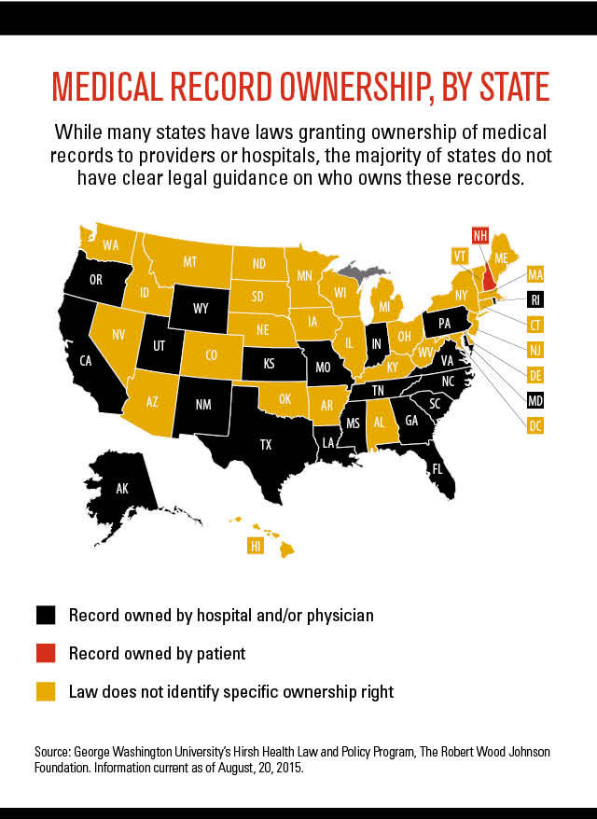

Slide 230
Health Care and Privacy
½ of Americans are concerned their health data could be lost, damaged, or corrupted
Two-thirds of Americans do not trust their HMOs to maintain confidentiality
  High profile breaches (e.g., Britney Spears, Michael Jackson, Farah Fawcett, Maria Shriver)

Slide 231
Health Care and Privacy
One in six American patients protects medical privacy by foregoing treatment, switching or lying to doctors, or paying out of pocket to avoid records of visits
  More recent study shows almost ½ of patients don’t share critical information with their doctors re mental health and sexual abuse

Slide 232
Privacy in Clinical Medicine
HIPAA (Health Insurance Portability and Accountability Act)
  Protects confidentiality of patients’ medical records
  Allows exceptions for general public health activities; reporting of child and elder abuse and domestic violence; product regulation by Food and Drug Administration; communicable disease control; workplace medical surveillance
  U.S. Customs and Border Protection agents may request mobile device (you can decline, citing HIPAA); other countries not bound by HIPAA

Slide 233
Health Care and Privacy
Legal requirements to disclose (in insurance contract fine print) can result in disclosure of health information to policy owners (employers, parents, for adults 18-25 under parents’ policies)
  Patients insured as dependents often act as though uninsured, undermining personal and social benefits of insurance and burdening safety net providers
  States have begun to address problem
  Single payer system would solve

Slide 234
Health Care and Privacy
Memorial Sloan Kettering Cancer Center licenses patients’ personal data to for-profit AI startup in which the hospital owns an equity stake
Controversies over reality medicine programs (e.g., Boston Med, NY Med)

Slide 235
Health Care Privacy Breaches Increasing
949 reported health care-related security breaches (2010-2013)
  29 million people’s confidential medical and/or financial information exposed
  Likely more
  VA biggest offender
2,149 breaches, comprising 176 million records (2010-2017); 40,099,751 records (2021)

Slide 236
Health Care Privacy Breaches/Mistakes
HHS requires reporting of privacy lapses involving over 500 patients (253 in 2015)
One study showed 1/3 Americans have been victims of healthcare breaches (Bitglass Healthcare Breach Report, 2016)
Incorrect data entry leads to about 1,000 “deaths”/month (same as HIV or homicide by firearm)

Slide 237
Health Care Privacy Breaches/Mistakes
71% of health care data breaches between 2009 and 2019 exposed protected health information and put 169 million patients at risk for identity or financial fraud [Ann Int Med 2019;72(2):159-60]
Digital attacks paralyzing hospitals/physicians’ offices up 1400% (2018-2019)

Slide 238
Health Care Privacy Breaches/Mistakes
HIPAA violation complaints up 39% between 2017 and 2021
Health care breaches affecting 500 or more individuals up 58% from 2017 to 2021
2020: 92 individual ransom attacks affecting over 600 separate clinics, hospitals, and medical organizations
  Estimated cost $21 billion

Slide 239
Health Care Privacy Breaches/Mistakes
Breeches more common around time of mergers (due to combining different IT systems)
Imaging studies, medical devices vulnerable to hacking; vulnerability warnings up sharply
Strong laws with serious consequences needed

Slide 240
Open Note Charts
5 million patients
Effects on outcomes, patient understanding, compliance, satisfaction promising, but still unclear
Effects on physician charting, defensive medicine unclear promising, but still unclear
21st Century Cures Act now provides immediate patient access to notes

Slide 241
Open Note Charts
Concerns:
  Patients misunderstanding medical terminology
  Patients self-censoring due to concerns family members may view (especially relevant to teenagers, for whom confidentiality laws vary from state to state)
    Exceptions exist to prevent parents from viewing notes, but those might raise suspicions and create conflict

Slide 242
Open Note Charts
Concerns:
  Physicians self-censoring to avoid conflict or legal liability (how to document concerns re patients faking injuries, opioid-seeking behavior, etc.)
  Having to write notes differently for patients with lower levels of reading comprehension
  Increased requests from patients to edit charts

Slide 243
Recording Physician-Patient Conversations
Controversial
May be surreptitious (federal law requires one party’s consent, some states require both parties’ consent)
Could help patient understanding, improve compliance/satisfaction
Could increase defensive medicine
Legal issues murky

Slide 244
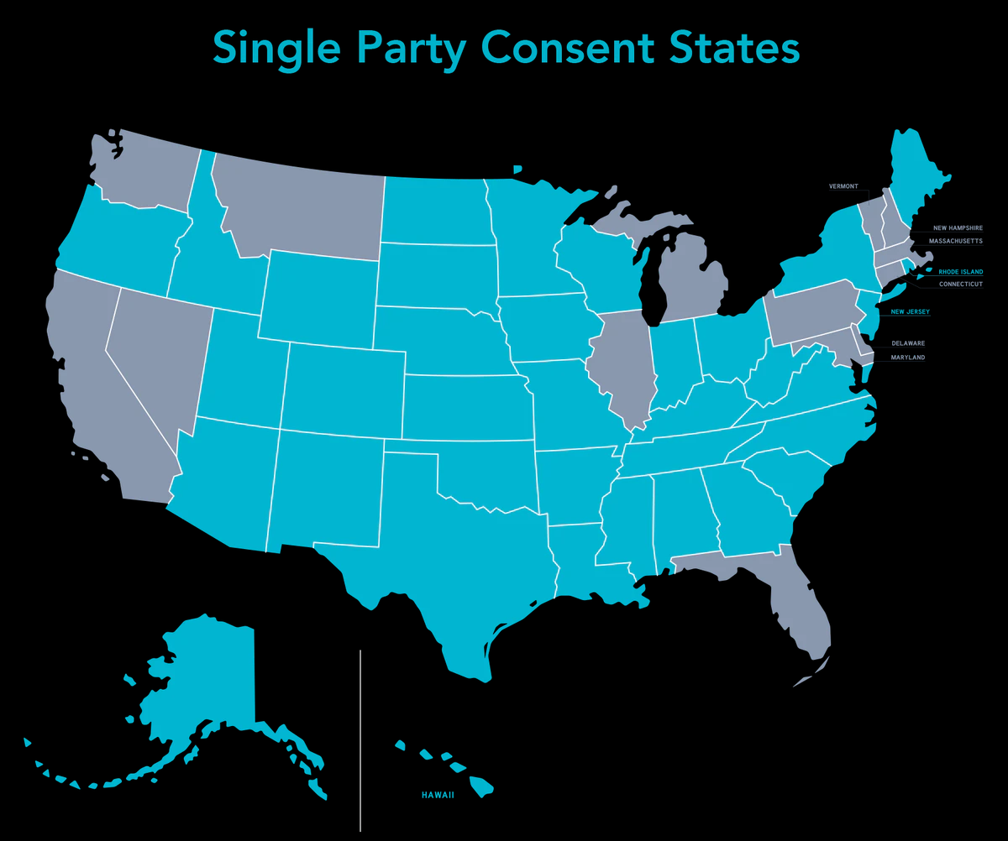
Single Party Consent States (in Blue)

Slide 245
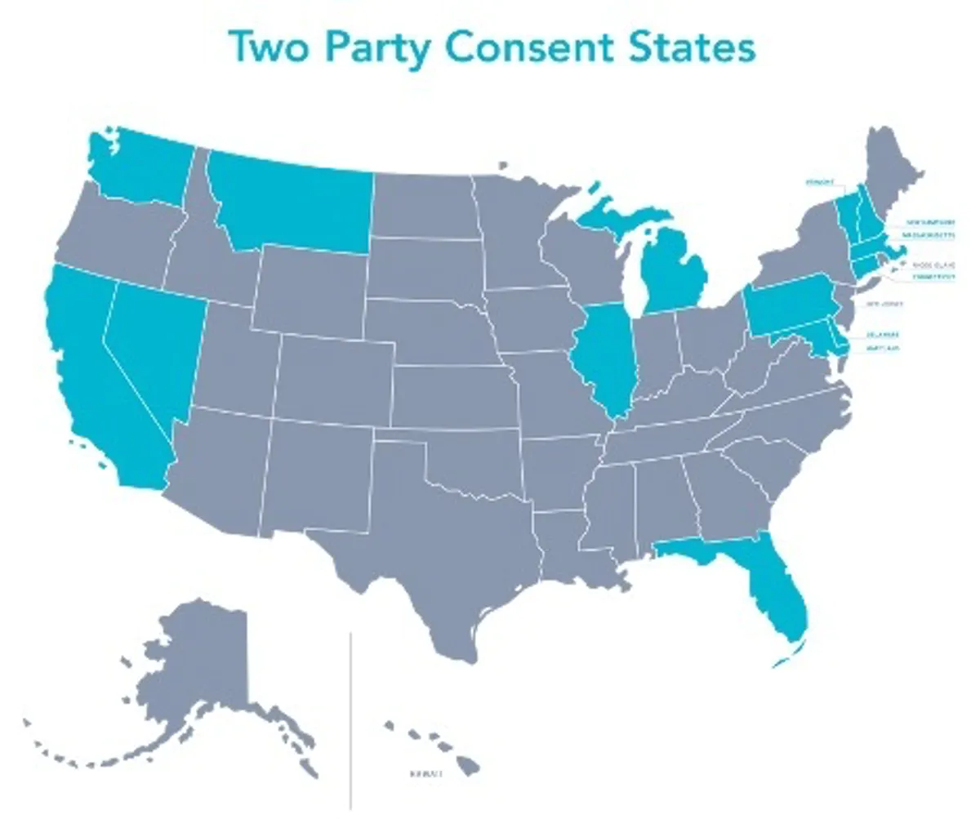
Two Party Consent States (in Blue)

Slide 246
Privacy in Clinical Medicine
Alternatives:
  Record beginning and end of visit
  Readable patient summaries
  Interdisciplinary visits
  Follow-up phone calls/visits
  Presence of patient advocates

Slide 247
Privacy in Clinical Medicine
Mystery/Simulated Patients
  40 companies nationwide (e.g., Healthcare Impression Management Services, Perception Strategies, etc.); some institutions hire mystery patients directly, others utilize employees
  Phone calls/actual visits to assess practice environment, physician communication, and medical decision-making
  Employed by clinics and used by researchers and activists (e.g., insurance status and appointment waiting time, provision of emergency contraception, etc.)

Slide 248
Privacy in Clinical Medicine
Mystery/Simulated Patients
  Costs vary – $25-$30 for phone calls, $125-$150 for visits, up to $1,250 for “comprehensive physician evaluations”
  Offshoot of mystery shopping industry, simulated patients in medical schools
  Types of Consent: None, advanced

Slide 249
Privacy in Clinical Medicine
Mystery/Simulated Patients
  Problems: Diverts care away from those who need it, can breed mistrust and doubt about real patients’ complaints (uses deceit in a professional field where truthfulness is a core value), exposures (physicians and faux patients)
Peer Q and A, feedback from colleagues, post-encounter surveys more helpful

Slide 250
Privacy in Clinical Medicine
Separate Records (e.g., HIV status [previously], mental health records)
  Could compromise care
  Physical, mental health intertwined
Model State Public Health Privacy Act
  Balances personal privacy and governmental security with public safety
  Many states have passed laws based on MSPHPA
  Useful in the event of epidemics, bioterrorism

Slide 251
The Slippery Slope of Workplace Drug Testing
Hair analysis for drug use, subject to external contamination from passive exposure and different sensitivities based on hair color (blacks > whites)
  Hair tests can stay positive for up to 3 months
  Increased melanin in dark-haired individuals binds some drugs for longer periods of time
  “unreliable and not effective” (FDA)

Slide 252
The Slippery Slope of Workplace Drug Testing
Urine testing for metabolites of medications used to treat conditions which may impair performance (depression, Parkinson’s disease, asthma)
Genetic testing for diseases that may effect the length of one’s potential career or insurance costs (Huntington’s or Alzheimer’s Disease, lipid disorders, diabetes, etc.)

Slide 253
The Slippery Slope of Workplace Drug Testing
Burlington Northern Santa Fe Railroad and Lawrence Berkeley National Laboratory have performed genetic tests on employees without their knowledge of consent
  Now illegal under GINA
fMRI (limited studies) for lie detection
Predictive policing

Slide 254
The Slippery Slope of Workplace Drug Testing
Polygraph testing (“Lie detectors”)
  Measures BP, HR, RR, and perspiration
  False positives and false negatives common
    Advice on how to “beat” test widely available on internet (drugs, relaxation, other measures)
  First used to secure a conviction in 1935
  Inventor later called it a “Frankenstein’s monster”

Slide 255
The Slippery Slope of Workplace Drug Testing
Polygraph testing (“Lie detectors”)
  Law enforcement agencies avid proponents
  1998: SCOTUS rules test unreliable, due to false positives and false negatives, but leaves decision to use up to states
  2019: 23 states still allow use in court, many require agreement of both parties
  NSA: “virtually useless”
  Yet some employers still use; required by many law enforcement agencies; required for security clearances

Slide 256
The Slippery Slope of Workplace Drug Testing
2011: Florida Governor Rick Scott (R) issues executive order requiring drug tests on current state workers and new applicants
2011: Scott signs bill requiring drug tests for TANF program
  positive test allows parent to choose another individual to receive benefits on behalf of children
  Aid recipients responsible for cost of tests ($30-$40)
  2.7% failed test

Slide 257
The Slippery Slope of Workplace Drug Testing
Florida Governor RickScott
  Former CEO of Columbia/HCA
  Fired after presiding over massive Medicare fraud that cost corporation $1.7 billion federal fine
  Then set up Solantic (FL chain of emergency care clinics); transferred ownership to his wife upon entering statehouse
    Solantic is in the drug-testing business!

Slide 258
The Slippery Slope of Workplace Drug Testing
Florida’s law struck down by courts after 4 months
  Appeals court agrees, voids law
Similar Michigan law struck down as unconstitutional in 2003
Wisconsin requires some food stamp applicants to submit to drug testing

Slide 259
The Slippery Slope of Workplace Drug Testing
War on the poor:
  9.6% of recipients of federal assistance abuse drugs (vs. 6.8% in general population) (2002 study; other studies note no difference)
70% of all drug users between 18 and 49 are employed full time

Slide 260
The Slippery Slope of Workplace Drug Testing
IN, MO, and AK have laws similar to Florida’s
Other states have pending legislation similar to Florida’s
Senate and House bills would require all 50 states to drug test all Temporary Aid for Needy Families (TANF) applicants and recipients

Slide 261
History of Privacy Protections in the U.S.
1st Amendment – right of belief
3rd Amendment – right to privacy within home
4th Amendment – protection against unreasonable search and seizure
14th Amendment – prohibition against deprivation of life, liberty, or property without due process; equal protection under the laws

Slide 262
History of Privacy Protections in the U.S.
1890 – Justices Brandeis and Warren – “the right to be let alone”
1965 – SCOTUS - right of married persons to obtain contraceptives
1967 – SCOTUS - overturns ban on interracial marriage
1972 – SCOTUS – right of unmarried persons to obtain contraceptives
1973 – SCOTUS – Rowe v. Wade – limited right to abortion (further delineated by SCOTUS in Planned Parenthood v. Casey, 1992)

Slide 263
Privacy Protections
Various federal and state laws re privacy, confidentiality, security, use, and disclosure of public health information
UN Declaration of Human Rights: “No one shall be subjected to arbitrary interference with his privacy, family, home or correspondence, nor to attacks on his honor or reputation”

Slide 264
Privacy Protections
Various federal privacy acts
Health Insurance Portability and Accountability Act (HIPAA)
State laws vary re privacy, confidentiality, security, use, and disclosure of public health information
2017: Trump overturns internet privacy protections created by FCC under Obama
  Allows internet service providers to track and sell customers’ online information with greater ease

Slide 265
Anti-Discrimination Protections
Federal Civil Rights Act of 1964: outlaws discrimination based on race, color, religion, sex, or national origin
Title IX: Bans discrimination based on sex in federally-funded education programs (including sports)

Slide 266
Anti-Discrimination Protections
2008: Federal Genetic Information Nondiscrimination Act
  Prohibits employers from hiring, firing, promoting, or placing employees on the basis of genetic information
  Bans health insurers from basing eligibility or premiums on genetics information
  Based on earlier European legislation

Slide 267
Anti-Discrimination Protections
2008: Federal Genetic Information Nondiscrimination Act (GINA)
  Does not apply in many states to life, LTC, housing, and disability insurance; lending; housing; and military, VA, HIS, or Federal Employee Health Benefits Program

Slide 268
Anti-Discrimination Protections
Many other western countries restrict use of predictive genetic test results by life insurers without any impact on viability of companies or widespread availability of policies, as traditional underwriting criteria capture vast majority of “high risk” applicants
However, ¼ of people who decline to participate in genomic-sequencing research cite fear of discrimination by life insurance companies as primary reason

Slide 269
Anti-Discrimination Protections
Unclear to what extent Fourth Amendment protections against unreasonable search and seizure and American with Disabilities Act may protect physicians with respect to disclosure of information or testing of bodily fluids
Court challenges to drug testing based on First, Fifth and Fourteenth Amendments and alleging violations of due process and equal protection have been generally unsuccessful

Slide 270
Drug Testing and Privacy/Confidentiality
No way to completely safeguard that information will not be shared with life, home, or health insurance companies [and by extension with pharmaceutical companies], or with future employers

Slide 271
Erosions of Privacy
Each year, 7-10% of the U.S. population are victims of identity fraud and 21% of those are repeat victims (Consumer Reports, 2020)
43 billion in fraud losses (2022)

Slide 272
Erosions of Privacy
47% of Americans had their personal information exposed by hackers in 2021
During covid’s online schooling, multiple educational apps and websites tracked children’s behavior without consent, then sold data to Google and Facebook
Amazon, Google, Facebook, and Apple have all listened in on private communications
  Can opt out
  Ring (closed circuit doorbell video company owned by Amazon) partnering with police

Slide 273
Erosions of Privacy
Popular medical apps routinely and legally share data
National Practitioner Identifiers easy to steal through public Centers for Medicare and Medicaid Services registry
  Potential for medical fraud, identity theft

Slide 274
Erosions of Privacy
Hackers funneled nearly $750 million out of 7,000 U.S. companies’ accounts between October, 2013 and August, 2015
  $1.2 billion from companies worldwide
Hackers steal approximately $300 billion worth of information/yr (from intellectual property to classified state secrets)

Slide 275
Erosions of Privacy
Stolen credit card numbers sell for $5 (2016)
Portion of EMR on a patient sells for $50 (2013)
Full EMR patient record sells for $300-$400 (2016)
EU now requires all new cars to include anti-speeding technology (can be over-ridden, for now) and black boxes (2024)

Slide 276
Erosions of Privacy
Russian hackers infiltrate US electrical grid (2016)
  Had ability to shut down power plants at will
  Attack on Ukraine’s grid led to extensive blackouts (2015)
Hilary Clinton’s private email server use
Russian hacking of 2016 presidential election, ads on Facebook, etc.

Slide 277
Erosions of Privacy
2016: Trump officials’ use of private email accounts (incl. Jared Kushner, members of the so-called voter fraud commission (which requested publicly available voter rolls from all 50 states (rejected by most)
Cambridge Analytica data hack of Facebook used in 2016 elections
Increasing hacks of voter data; sold on dark web

Slide 278
Erosions of Privacy
2017: Equifax security breach exposes sensitive financial data and social security numbers more than 145 million Americans
2018: Exactis (marketing and data aggregation firm with data on 218 million individuals) leak involving 340 million records
2019: Trump regularly using unsecured cell phone despite warnings of vulnerability to foreign surveillance

Slide 279
Erosions of Privacy
Stalkerware
  E.g., HelloSpy, FlexiSpy
  Employers, parents, and snooping partners main target audience for apps
  Leave victims vulnerable to stalking, violence, blackmail, fraud

Slide 280
Erosions of Privacy
Ransomware attacks on businesses and cities increasing, but decreased in 2020
  E.g., Baltimore, 2 cities in FL in 2019
Cities need recovery plans, backup systems on standby to avoid disruptions to services, huge costs

Slide 281
Erosions of Privacy
New privacy protections putting pressure on Facebook’s business model, which is to collect extensive data on its 2.2 billion users to better target them with advertising
  Plans to share data with American College of Cardiology and other medical institutions put on hold (2018)
  2019: Facebook and Google paying children 13-18 in exchange for access to their private messages, photos, videos, emails, web searches and browsing activity (for research purposes); Google halts program (2019)

Slide 282
Erosions of Privacy
Other hacks include Target (40 million credit and debit card numbers); Yahoo (all 3 billion accounts); LA Unified School District (and others)
Strava (fitness app) found to reveal military installations (2018)
ID theft protection:
  Major companies adding as a benefit (25% in 2015, 75% expected for 2018)
    56% of ID theft victims ask for time off work to deal with problem

Slide 283
Erosions of Privacy
Robocalls
  58.5 billion sent to Americans in 2019 (178 per person)
  4.9 million/hr in U.S. in 2020
  Some legitimate (surveys, political messaging, school closures), but many are scams using “spoofing software”to masquerade as a company or government agency
  Consumers may opt out (National Do Not Call List); must give consent for certain calls
  New consumer protection law signed late 2019, calls now illegal, fines increased

Slide 284
Fake News/Videos
Fake videos becoming indistinguishable from real videos
  Criminal and national security threat
  Threats to reputation, civil society, elections
  Impede public health response to pandemic
  Popular platforms (e.g., Facebook, Twitter) inadequately police

Slide 285
Privacy/Confidentiality
90% of US healthcare organizations exposed their patients’ data or were the victim of a security breach in 2012 and 2013
Pharmaceutical company data mining
  NH, ME now limit
  CVS offers up to $50 annual savings on medications to patients willing to give up HIPAA privacy rights
  Drug companies, drug benefit managers contacting patients to encourage use of lower cost narcotics (which carry higher abuse potential)

Slide 286
Health Insurance Data Mining
Health insurance industry has long history of “cherry picking” and “lemon dropping”
HIPAA protects medical information, but not demographic, economic, or lifestyle information
Thus, insurance companies mine data before deciding on insurability

Slide 287
Health Insurance Data Mining
Examples:
  Optum: Owned by United Health Group; has collected data on medical diagnoses, tests, prescriptions, costs, and socioeconomic data on 150 million Americans back to 1993
  LexisNexis: uses “442 non-medical attributes to predict a person’s medical costs” (e.g., cell phone numbers, criminal records, bankruptcies, property records, neighborhood safety, etc.)

Slide 288
Health Insurance Data Mining
Algorithms used to create “health scores” (like credit scores, but individuals cannot access)
Employers could use to select job candidates
Trump administration promoting short-term health plans, which allow insurers to deny coverage to sick patients

Slide 289
Health Care Privacy Breaches
Ransomware attacks on hospitals
  Increasing dramatically (1,400% from 2018 to 2019)
  Hundreds of hospitals affected (in the US and worldwide)
  Many hospitals delayed technology upgrades to avoid attacks
  Some hospitals have paid ransom to unlock clinical data
    Security experts recommend not paying, as this rewards cybercrime and does not fix security vulnerability

Slide 290
Health Care Privacy Breaches
Ransomware attacks on hospitals
  Back up systems helpful
  Hospital spend small portion of their IT budgets on cybersecurity
  Concerns raised over draining batteries or malicious reprogramming of implanted medical devices

Slide 291
Drug Testing and Privacy/Confidentiality
RFIDs (radio frequency identification tags): in credit cards, shipping containers, passports, pets, and consumer products
  Approved for use in humans by former HHS secty. Tommy Thompson (now a consultant for Applied Digital Solutions, owner of VeriChip)
  CEO has suggested use in soldiers, immigrants/guest workers
RFID chips can interfere with critical care medical equipment, cause sarcomas in mice

Slide 292
Drug Testing and Privacy/Confidentiality:
Helpful Developments
The “Tattletale Pill”
  Prescription drugs with microchips with digestible antennae alerts doctors/family members when pills taken
  May increase compliance, aid in research

Slide 293
Drug Testing and Privacy/Confidentiality:
Helpful Developments
National All Schedules Prescription Electronic Monitoring Reporting System (established 2005, vastly under-funded)
  Allows tracking of fraudulent prescriptions, controlled substance misuse and abuse
  An information tool, not a law enforcement tool

Slide 294
Testing Protocols
Which physicians should be tested
  Clinicians?
  Researchers?
  Administrators?
  How often?
  Who should have access to physicians’ test results [and potentially, by extension, other personal health data]

Slide 295
Conclusions Regarding Physician Drug Testing
All rational physicians are in favor of improving the health of their professional colleagues, providing treatment in the most expeditious and confidential manner for those who have exhibited strong evidence of job impairment, and ensuring the safe delivery of error-free care to their patients

Slide 296
Conclusions Regarding Physician Drug Testing
For-cause testing not unreasonable, with appropriate safeguards
  Post-incident testing (would occur more commonly) can contribute to decreased physician morale and increased defensive medicine

Slide 297
Conclusions Regarding Physician Drug Testing
Pre-employment and random not-for-cause testing
  unscientific
  ineffective
  costly
  public relations gimmick
  physician opposition
  legal ramifications
  ethical problems

Slide 298
Improving Job Safety and
Quality of Care
Consider alternatives to mandatory pre-employment and not-for-cause drug testing
Focus attention and resources on systems factors which cause or contribute to a majority of medical errors

Slide 299
Improving Job Safety and
Quality of Care
Invest in computerized medication ordering systems and more ancillary staff to assist residents in non-educational tasks which contribute to sleep-deprivation which intern can lead to errors
In 1999, the ACGME cited 30% of internal medicine residency programs for requiring their trainees to work more hours than regulations allow

Slide 300
Improving Job Safety and
Quality of Care
Encourage vigilance/confrontation/reporting of clearly impaired colleagues
Failure to police the profession
  ?secret patients, undercover providers?

Slide 301
Improving Job Safety and
Quality of Care
Reverse trend toward downsizing RNs in favor of less well-trained (but less expensive) LPNs and CMAs
Adherence to OSHA and EPA guidelines regarding workplace safety
Improved Waste Reduction/Management

Slide 302
Alternatives to Drug Testing
Promote reference checking of new staff members to appraise previous job performance
Train supervisors to identify, confront, and refer impaired physicians to drug treatment programs

Slide 303
Alternatives to Drug Testing
However,
  Only 2/3 of physicians agree with professional commitment to report impaired/incompetent physicians
  Only 2/3 of physicians with knowledge of impaired colleague reported him/her
    Most common reasons for non-reporting were “belief someone else taking care of problem,” “belief nothing would come of report,” and “fear of retribution”
  In another study, 87% of physicians would report, but most would speak with the impaired/incompetent physician first

Slide 304
Alternatives to Drug Testing
Employee Assistance Programs
Pay increased attention to physician job- and life-satisfaction [e.g., early identification and treatment of depressive disorders and marital discord]
Improve coverage of mental health and substance abuse treatment for medical students and residents (78% of U.S. medical schools require co-pay, most private insurance programs have annual limits)
  Improve access, acceptability, since few seek treatment

Slide 305
Alternatives to Drug Testing
2017 study: Nearly 40% of physicians would be reluctant to seek formal medical care for a mental health problem because of concern that this might put their medical license in jeopardy
FSMB asks members not to ask physicians about history of mental health disorders because doing so could violate ADA

Slide 306
Alternatives to Drug Testing
AMA and APA have stated that impairment and potential risk of harm to patients cannot be inferred from a diagnosis or treatment alone
2020: Hospitals can no longer ask MDs about history of mental health history
2023: 21 states no longer ask physicians broad questions about mental health and substance abuse when applying for a license

Slide 307
Alternatives to Drug Testing
Support knowledge testing [e.g., mandatory re-certification], periodic hospital re-credentialling, and skills appraisal by colleagues and supervisors

Slide 308
Alternatives to Drug Testing
Establish intermittent impairment testing program
  periodic evaluation of vision, reflexes and coordination
    “Critical tracking tests” – used by Air Force and NASA on test pilots, many governmental and private organizations
    Successful

Slide 309
Alternatives to Drug Testing
Establish intermittent impairment testing program
  can also uncover important physical disabilities [incl. dementia], mental illness, and sleep deprivation
    Estimated 8,000 doctors with full-blown dementia practicing
  Age-based testing increasing
  May lead to treatment and/or work-modification

Slide 310
Mandatory Cognitive Testing of Aging Physicians
1/8 U.S. doctors age 65 and older
Mean cognitive ability declines by 20% between ages 40 and 75 (large individual variation)
Studies of older clinicians mixed: some show better clinical knowledge, adherence to guidelines for screening/treatment/prevention; more show lower performance; no clear effect on outcomes, which are affected by practice volume

Slide 311
Mandatory Cognitive Testing of Aging Physicians
2015: AMA calls for guidelines on competency assessment testing for older physicians
2016: ACS recommends physical exams, visual testing and self-assessed neurocognitive testing (via online tools) with voluntary reporting starting between ages 65 and 70
2019: Society of Surgical Chairs calls for mandatory cognitive and psychomotor testing for surgeons 65 and older

Slide 312
Mandatory Cognitive Testing of Aging Physicians
UVa requires physical and mental testing beginning at age 70 for hospital privileges
Stanford requires physical exam and peer assessment starting at age 74.5 for hospital privileges; no longer requires cognitive screening

Slide 313
Mandatory Cognitive Testing of Aging Physicians
2020: Yale sued by Equal Opportunity Employment Commission, which states its policy requiring neuropsychological testing of clinicians over 70 violates the Age Discrimination in Employment Act; other lawsuits ongoing
  Yet some evidence Yale policy successful
?discriminatory?
?should all physicians be tested?

Slide 314
Alternatives to Drug Testing
If impairment testing suggests drug abuse, formal drug testing, treatment, and follow-up drug testing are not only reasonable, but also likely to benefit affected physicians and their patients
47 states and DC have active Physician Health Programs to help with substance abuse (and mental illness)

Slide 315
The “War on Drugs”
Racist beginnings (“Chinese Opium Act” , Hemp/Marijuana)
Newspaper publisher William Randolph Hearst demonized cannabis plant
  Hearst heavily invested in wood pulp newsprint, wanted to shut down hemp paper competition

Slide 316
The “War on Drugs”
1936: Church group produces film, “Reefer Madness”
1937: Federal government criminalizes production and sale of marijuana/hemp
Today:
  Hemp legalized by 2018 Farm Bill
  Marijuana is America’s largest cash crop
  Growing marijuana damages environment more than most crops
  Federal prisons overloaded with casual users

Slide 317
The “War on Drugs”
Interdiction
  e.g., $1.3 billion Columbia aid package (incl. use of biological weapons)
  7 U.S. military bases in Colombia
  Mexican drug war violence out of control, fueling anti-immigrant sentiment in U.S.

Slide 318
The “War on Drugs”
Punishment
- inequitable laws (crack vs powder cocaine)
- Fair Sentencing Act of 2010 adjusts penalties somewhat, but gaps persist
Education/Social Marketing
Prevention
- vaccinations

Slide 319
Decreasing Drug Use/Abuse
Treatment (dollar for dollar, much more effective than interdiction and/or punishment)
- needle exchange programs (MDs can prescribe clean needles to addicts in 48 states; pharmacists can dispense in 26 states)
- Law Enforcement Assisted Diversion (LEAD) imployed by many localities, for nonviolent offenders, decrease recidivism, increase housing and employment, save money
- chronic illness marked by relapse/non-compliance

Slide 320
Decreasing Drug Use/Abuse
Foreign Aid - social/agricultural vs. military
Interdiction
Medication for opioid use disorder
  Reduces addiction rates, overdose deaths, reduces risk of HIV and hepatitis C transmission, reduces risk of recidivism when provided to incarcerated individuals, improves quality of life
    Consider stopping routine drug testing in opioid use disorder treatment, as it may do more harm than good

Slide 321
Decreasing Drug Use/Abuse
Focus also on legal drugs
- alcohol: 93,000 deaths/year (3 million worldwide – 1/20 deaths)
While most states have banned dangerous, powdered Etoh, federal legislation is lacking
- tobacco: (hypocrisy of export business)
- 450,000 deaths directly, 50,000 deaths
indirectly per year
Promote Sound Science/Cost-Effective Policies/ Interventions

Slide 322
Privacy Protection
Know your rights
Limit your social media presence
Use security software, private browsing, and strong passwords
  2017: Trump signs legislation permitting telecom industry to sell consumers’ private internet browsing data
Never give out passwords, social security number, zip code, or phone number unless absolutely necessary

Slide 323
Privacy Protection
Safeguard financial information
Check credit reports
Set up a google alert
Pay companies to remove unwanted information online, if desired (can be expensive, incomplete)
Ask questions, beware of scams
Keep records of meetings, vet attendees when possible
File complaints, seek legal counsel when necessary

Slide 324
Websites
American Civil Liberties Union: https://www.aclu.org/
Electronic Frontier Foundation: https://www.eff.org/
Electronic Privacy Information Center: https://www.epic.org/
Government Accountability Project: http://whistleblower.org/
National Whistleblowers Center: http://www.whistleblowers.org/
Online Privacy Alliance: http://www.privacyalliance.org
Privacy Coalition: http://privacycoalition.org/
Privacy International: http://www.privacyinternational.org
Privacy Rights Clearinghouse: http://www.privacyrights.org/
Privacy.org: http://www.privacy.org/
U.S. PIRG: http://www.uspirg.org/home

Slide 325
Citation
Donohoe MT. Urine trouble: practical, legal, and ethical issues surrounding mandated drug testing of physicians. J Clin Ethics, 2005;16(1):69-81.

Slide 326
Contact Information
Public Health and Social Justice Website
http://www.publichealthandsocialjustice.org
http://www.phsj.org
martindonohoe@phsj.org

