Slide 1
Factory Farms, Antibiotics and Anthrax:
Putting Profits Before Public Health
Martin Donohoe, MD, FACP

Slide 2
Outline
Food Justice and Food Safety
Factory Farming
Agricultural Antibiotics
Cipro and Anthrax
Bayer
Conclusions

Slide 3
Food Safety/Food Justice
Poverty and hunger
Food waste
Environmental Degradation
  Climate change, loss of arable land, water shortages, soil erosion and contamination, pesticides, indoor smoke exposure from biomass

Slide 4
Food Safety/Food Justice
War
GMOs, biopharming
Hormones in the meat and milk supply (rBGH, others)

Slide 5
Problems with the Integrity of the Food System
Food-borne infections (1/6 Americans/yr)
  Vegetables and produce (esp. sprouts)
  Raw milk
  Norovirus (shellfish, salad, fecal-oral)
39% of seafood sold in US mis-labelled
Pink slime
  NH4OH-treated beef trimmings

Slide 6
Problems with the Integrity of the Food System
Inadequate funding of food inspection enterprise in U.S.
  FDA has 1,000 food inspectors responsible for 421,000 production facilities
  FDA inspects fewer than 8,000 facilities per year (down from 35,000/yr in 1970s)
  Melamine in Chinese milk, cadmium in Chinese rice, horsemeat in burgers in Europe, etc.
  Horsemeat in UK, EU

Slide 7
Problems with the Integrity of the Food System
Multiple food recalls
  3.7 million food items recalled in 1st half of 2015 because of viral or bacterial contaminants (vs. 5 million in 2014)
  2016: OIG (DHHS) finds FDA’s procedures to recall contaminated or misbranded foor are inadequate
  2024: 300 specific food recalls

Slide 8
Problems with the Integrity of the Food System
Toxic chemicals in global food system cause:
  $1.4-2.2 trillion/yr in healthcare costs (2-3% of global GDP)
  At least $0.6 trillion in environmental costs

Slide 9
Agricultural Production
10 billion land animals in the U.S. are raised for dairy, meat, and eggs each year
  9.2 billion chickens, 33.6 million cattle, 228,000 turkeys, and 129.9 million hogs slaughtered annually
60% of all mammal biomass on earth is livestock (mostly cattle and pigs), 36% humans, 4% wild animals

Slide 10
Farming
Burning fossil fuels to produce fertilizers for animal feed crops may emit 41 million metric tons of CO2 per year
Globally, deforestation for animal grazing and feed crops is estimated to emit 2.4 billion tons of CO2 every year

Slide 11
Factory Farming
Factory farms have replaced industrial factories as the # 1 polluters of American waterways
Factory farming accounts for 37% of methane (CH4) emissions, which has more than 20 times the global warming potential of CO2

Slide 12
Factory Farming
Large CAFOs make up 5% of livestock operations but produce more than 50% of food animals
21,000-24,000 CAFOs in U.S.
  Flourish thanks to indirect federal subsidies
  Not subject to Clean Air Act Standards

Slide 13
Factory Farming
1.4 trillion tons animal waste (450 million tons “dry waste”) generated/yr in U.S. (13 billion tons worldwide)
  10 x human waste (in U.S.)
  CAFOs responsible for 65% of animal manure in the U.S.

Slide 14
Factory Farming
Cattle manure 1.2 billion tons
  16kg livestock feces and urine produced for every 0.3kg steak
Pig manure 116 million tons
Chicken droppings 14 million tons

Slide 15
Factory Farm Waste
Overall number of hog farms down from 600,000 to 157,000 over the last 15yrs, while # of factory hog farms up 75%
  Most located in lower SES neighborhoods and those housing large minority populations
1 hog farm in NC generates as much sewage annually as all of Manhattan
  40X as many hogs as people in NC

Slide 16
Factory Farm Waste
Most untreated
Ferments in open pools
Seeps into local water supply, estuaries
  Kills fish
  Causes human infections - e.g., Pfisteria pescii, Chesapeake Bay
Fish farm waste may also contribute to the spread of antimicrobial resistance

Slide 17
Factory Farming
Manure can also contain traces of salt and heavy metals, which can end up in bodies of water and accumulate in the sediment, concentrating as they move up the food chain
When manure is repeatedly over-applied to farmland it causes dangerous levels of phosphorus and nitrogen in the water supply. In such excessive amounts, nitrogen robs water of oxygen and destroys aquatic life.

Slide 18
Factory Farm Waste
Creates unbearable stench
  Foul odors and contaminated water caused by CAFOs reduce property values in surrounding communities an estimated $26 billion nationally
  Foul odors linked to depression, fatigue, and confusion, decreased exercise/outdoor time

Slide 19
Factory Farm Waste
Widely disseminated by floods/hurricanes
Elevated levels of ammonia and nitrates in nearby waterways can kill fish/cause human illness (including blue baby syndrome)/spread E. coli and Enterococci

Slide 20
Factory Farm Waste
“Fair Agricultural Reporting Method Act” (2018)
  “FARM Act” (!)
  Preserves status quo of federal agencies not investigating nor making public levels of waste/pollutants

Slide 21
Risks to Farm Workers
Work conditions deplorable
  Undocumented workers, forced overtime, injuries, use of slave labor (e.g., court-ordered drug rehab clients forced to work for free)
Antibiotic-resistant infections
Carriage of antibiotic-resistant organisms
Higher rates of covid during pandemic due to Trump administration’s lack of health and safety measures

Slide 22
Risks to Farm Workers, Marine Life
Aerosolized pig brains associated with immune polyradiculoneuropathy (progressive inflammatory neuropathy) in pork processing plant workers
  ?Other similar illnesses?
Antibiotic-resistant land-based pathogens increasingly found in marine organisms
Widely circulating strains of E coli in poultry and meat match those associated with 8% of UTIs in women (22% in high poverty neighborhoods)
  Vegetarian women have lower risk of UTIs

Slide 23
Pesticides
5.6 billion lbs/yr pesticides worldwide (3 million metric tons of active ingredients)
  Over 1 billion lbs/yr in US
EPA: U.S. farm workers suffer up to 300,000 pesticide-related acute illnesses and injuries per year
  25 million cases/yr worldwide
NAS: Pesticides in food could cause up to 1 million cancers in the current generation of Americans

Slide 24
Pesticides
WHO: 1,000,000 people killed by pesticides every 6 years
US health and environmental costs $10-12 billion/yr

Slide 25
Fertilizer
Since 1960s, use of synthetic nitrogen fertilizers has increased 9-fold globally
Phosphorus use has tripled
Runoff damages coral reefs, creates aquatic dead zones

Slide 26
Ammonia
2/3 of emissions due to livestock waste, 1/3 due to nitrogen fertilizer use
Contributes to air pollution and acid rain
Global emissions doubled over last 70 yrs
Causes over 200,000 deaths/yr worldwide

Slide 27
Nanomaterials
Used in food preservation, packaging, and for antimicrobial effects (nanosilver)
Monsanto, ChemChina (bought of Syngenta), BASF, others produce
Nanoparticles can cross blood-brain barrier and enter cell nuclei
Not well-studied or regulated, but significant potential health risks

Slide 28
Agricultural Antibiotic Use
Almost 9 billion animals per year “treated” to “promote growth”
  Given in feed for cows and pigs, in water for poultry
  Claim: Larger animals, fewer infections in herd

Slide 29
Antibiotic Use
Global antibiotic use up 65% between 2000 and 2015 and another 16% between 2016 and 2023
US antibiotic use up 21% between 2016 and 2023
2025 shares of global agricultural antibiotic use: China (23%), the United States (13%), Brazil (9%), India (3%), and Germany (3%)
47 million outpatient antibiotic prescriptions (29% of total outpatient antibiotic prescriptions) unnecessary

Slide 30
Global Animal Pharmaceutical Market
2023 sales = US $48 billion
  Pets: 54%
  Livestock 56%
Main markets US (42%) and Europe (27%)
Top four companies account for almost half of all sales

Slide 31
Antibiotic Use
2018 Study:
  NPs and PAs 15% more likely than physicians to prescribe antibiotics to adults; no difference for children
  Among pediatric visits, older providers much more likely to prescribe antibiotics
  Prescribing rates 1/3 higher in urban vs rural practice areas

Slide 32
Antibiotic Use
Another 2018 Study:
  46% of urgent care clinic patients with an antibiotic-inappropriate respiratory diagnosis (e.g., allergies, common cold, influenza [antivirals useful for influenza]) prescribed antibiotics
  25% of ER patients
  17% of medical office patients
  14% of retail clinic patients

Slide 33
Antibiotic Use
US antibiotic prescribing rates twice that of similar nations (2020):
  17% of US antibiotic prescriptions given without an infection-related diagnosis
  20%-25% of outpatient antibiotic prescriptions among Medicaid recipients my be written without a clinic visit (although ½ associated with lab testing or home care services)
Good news: Hospital-acquired infections down 27% between 2015 and 2023 (biggest gains in catheter-associated UTIs and C diff

Slide 34
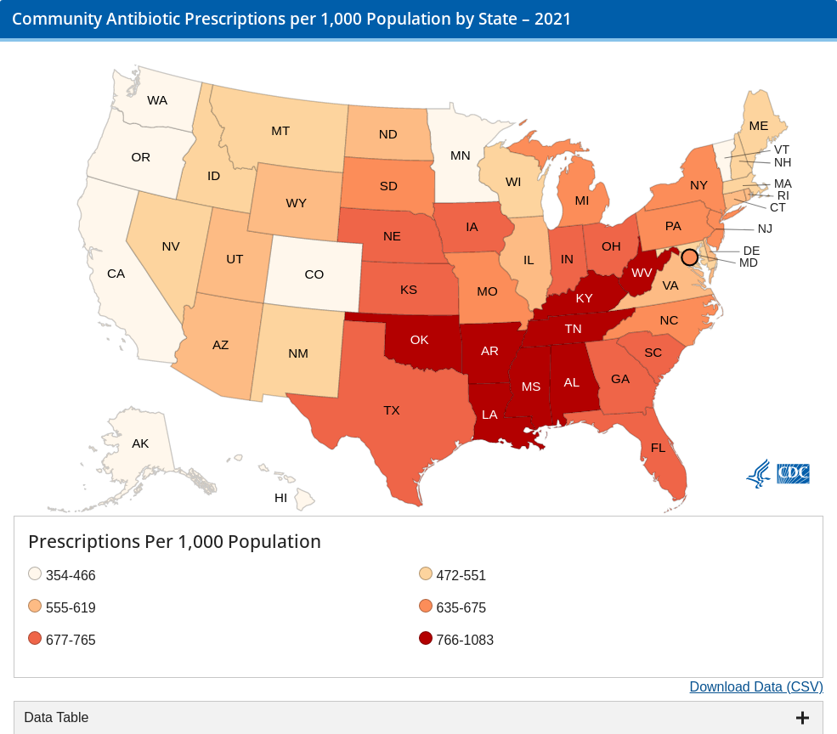
Geographic Variation in Antibiotic Prescriptions

Slide 35
Antibiotic Use
Non-therapeutic use – Animals: 71%
    Use up 50% over the last 15 years
Therapy – humans: 15%
  Note some category crossover
Therapy – livestock: 8% (10,000 tons of antibiotics/yr)
Companion animals constitute increasing reservoir of antibiotic-resistant organisms

Slide 36
Antibiotic Use
Sales/distribution of medically important antimicrobials approved for use in food-producing animals decreased by 36% from 2015 (the year of peak sales) through 2019
2019: 41% for use in cattle, 42% swine,10% turkeys, 3% chickens
Tetracyclines 67%, penicillins 12%, macrolides 8%, sulfas 5%, aminoglycosides 5%, lincosamides 2%, cephalosporins <1%, fluoroquinolones for <1%

Slide 37
Regulation of Agricultural Antibiotics
The FDA and the European Union have banned or phased out using medically important antibiotics specifically for production or growth promotion
Loophole: While labeling drugs explicitly for "growth promotion" is prohibited, farmers routinely use these same antibiotics for “disease prevention”

Slide 38
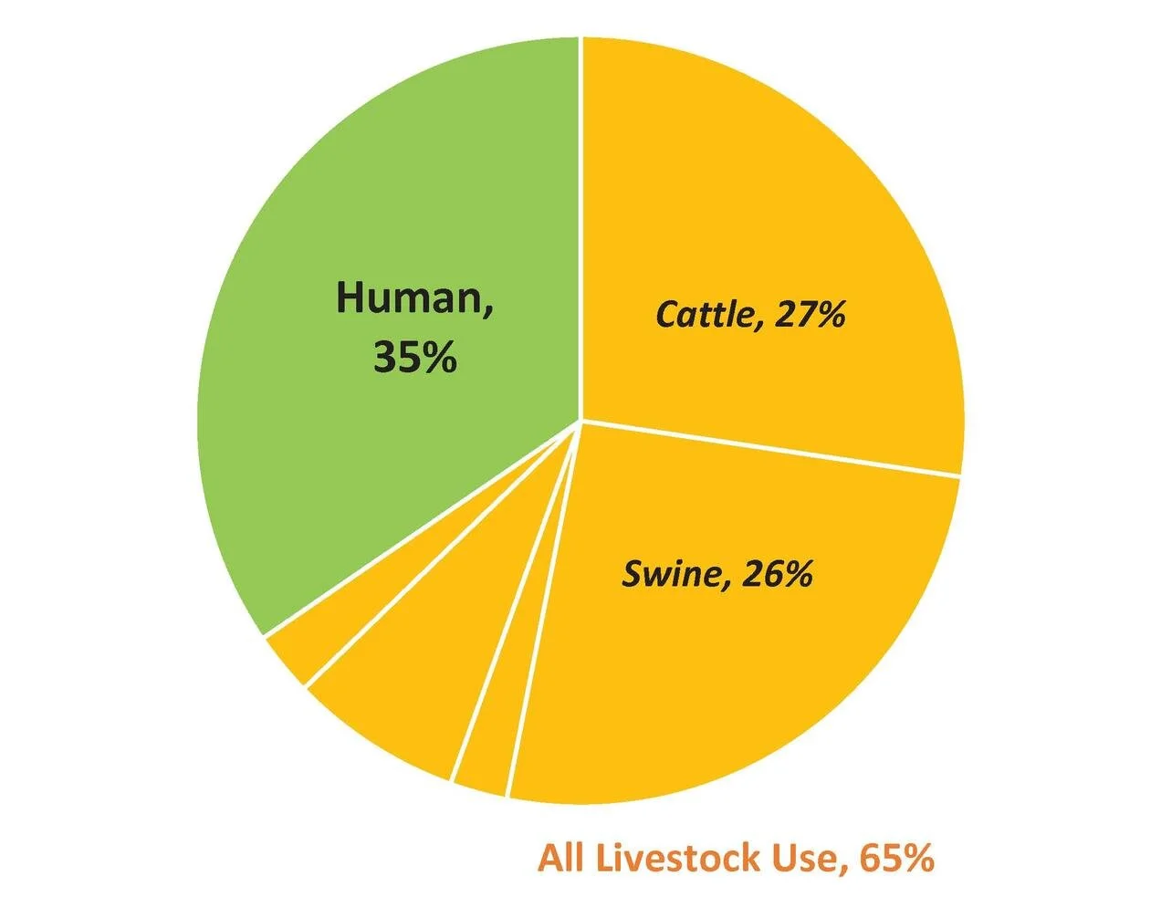
Medically Important Antibiotics Sold (U.S.) for Cattle Production, Other Livestock Production and Human Medicine (2017)

Slide 39
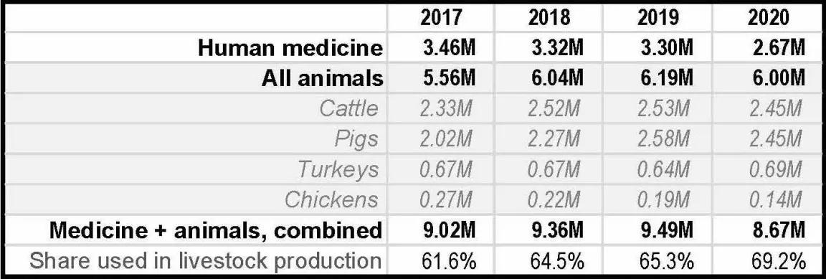
Antibiotic Use, Humans vs Animals

Slide 40
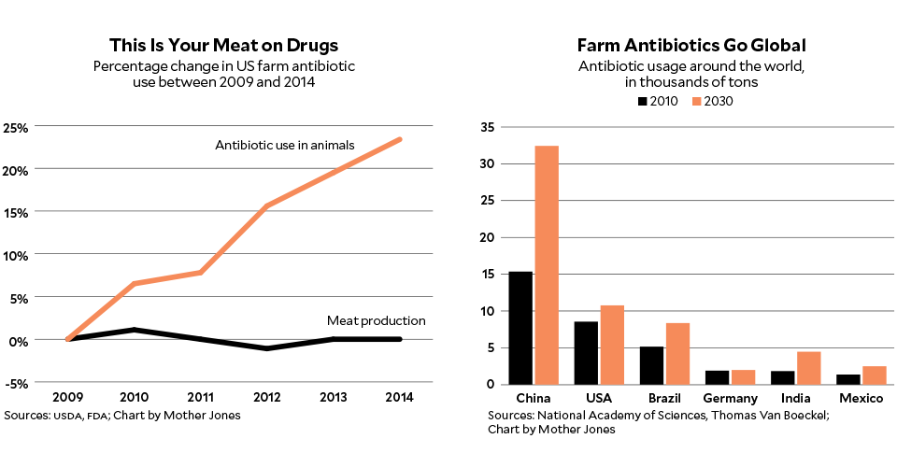
U.S. and Global Farm Antibiotic Use

Slide 41
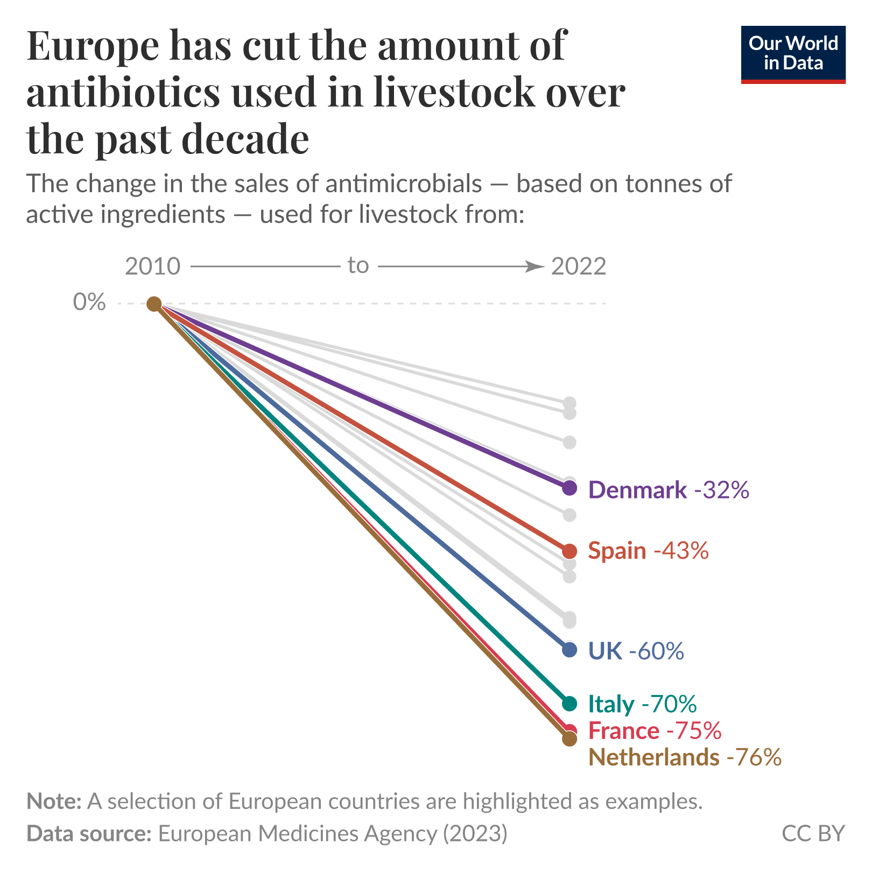

Slide 42
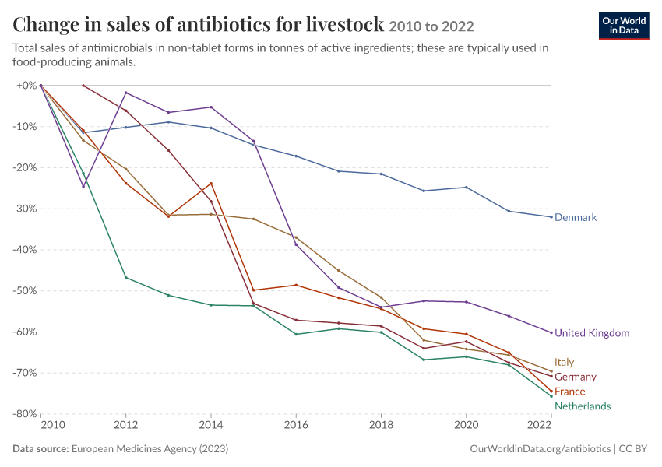

Slide 43
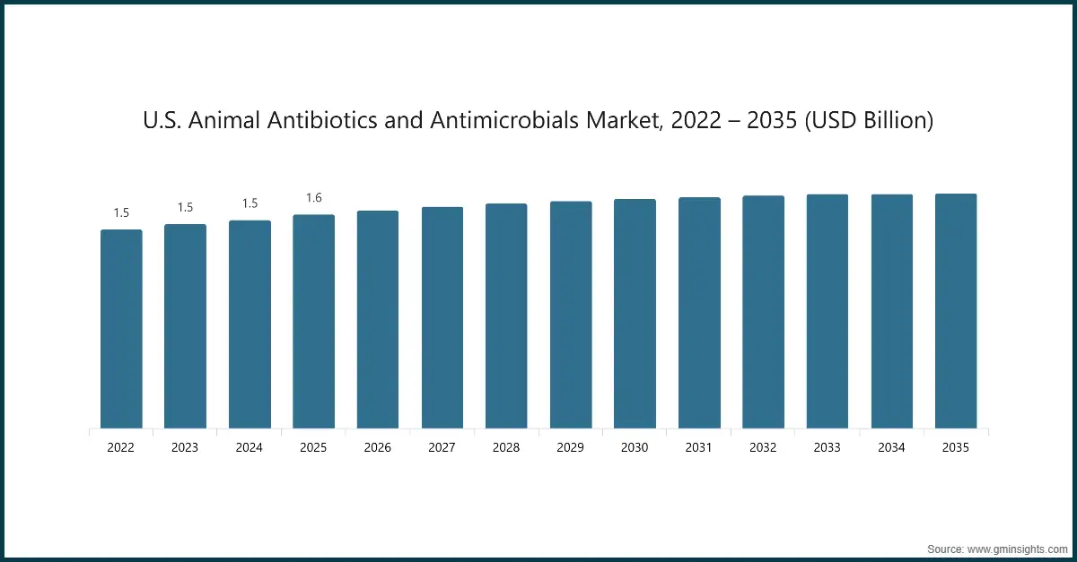

Slide 44
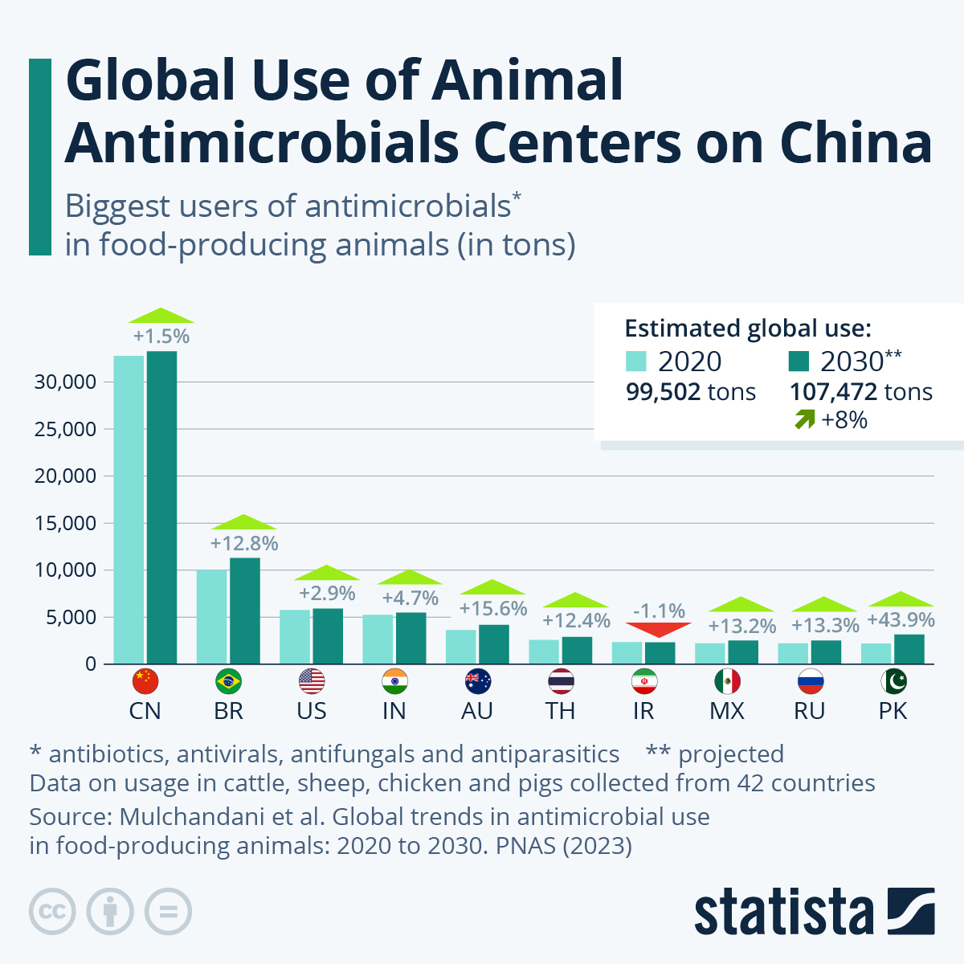

Slide 45
Global Human Antibiotic Use
Per capita consumption highest in industrialized countries (India>China>US)
20-50% inappropriate
Poor Southern hemisphere countries: lack of/delayed access to appropriate antibiotics kills more people than antibiotic resistance

Slide 46
Agricultural Antibiotic Use:
U.S. vs UK
U.S.:
  3X higher in chickens
  2X higher in pigs
  5X higher in turkeys
  12X higher in cows

Slide 47
Antibiotic Use
Other (soaps, pets, etc.): 10%
  97% sold over-the-counter (despite 2013 FDA rules)
  Worldwide, antibiotics among the most counterfeited medicines

Slide 48
Agricultural Antibiotic Use
84% of beef cattle, 83% of pigs, and 40-50% of poultry given non-therapeutic antibiotics
50-75% of antibiotics end up in waste stream (then soil and water)
  Dangerous levels most common in Asia and Africa

Slide 49
Antibiotic Class – Feed Additive Antibiotics
Penicillins – Penicillin
Cephalosporins
Tetracyclines - Chlortetracycline, Oxytetracycline
Aminoglycosides - Apramycin
Streptogramins - Virginiamycin
Macrolides - Erythromycin, Oleandomycin, Tylosin
Clindamycin (Lincosamide class) - Lincomycin
Sulfonamides - Sulfamethazine, Sulfathiazole

Slide 50
Citrus Farming
Streptomycin (an aminoglycoside) and oxytetracycline sprayed on orange trees to combat citrus greening disease
Can contribute to drug resistance in humans

Slide 51
Herbicides and Antibiotic Resistance
Glyphosate (Roundup) and Kamba (dicamba), two of the world’s most widely used herbicides, increase the rate of antibiotic resistance development in bacteria by a factor of up to 100,000 times

Slide 52
Dung, dung beetles, ivermectin, and agricultural antimicrobial overuse
Animals unload 100 billion tons dung/day worldwide
Dung beetles:
  Clear pastureland and open it for grazing
  Help cycle nutrients
  Aerate soil
  Disperse seeds
  Reduce methane output by 40%
  Do in 48 hrs what it would take nature a few yrs to accomplish
  Provide $910 million worth of “services”/yr in US and UK

Slide 53
Dung, dung beetles, ivermectin, and agricultural antimicrobial overuse
Dung beetle populations declining
Causes:
  Habitat loss for agriculture, etc.
  Poachers who kill 33,000 elephants and 1,200+ rhinos each year
  Ivermectin

Slide 54
Ivermectin
Anti-filarial drug essential in helping to (nearly) eliminate river blindness (onchocerciasis) in developing world
Treatment for elephantiasis (filariasis)

Slide 55
Ivermectin
One of the most widely used veterinary drugs
  Liver flukes, eye worms, lunworms, roundworms, mites, horn flies, ticks, heartworm, even head lice
Highly profitable (Merck)
  Merck has donated ivermectin to river blindness eradication campaign

Slide 56
Ivermectin
62%-98% ends up in highly toxic concentrations in dung → consumed by dung beetles
Disrupts dung beetles ability to use antennae to communicate, find mates, locate food
Extra 312 lbs dung/yr piles up when dung beetle populations drop

Slide 57
Ivermectin
Linked to decline of dung beetles (c.f., DDT – birds, diclofenac – vultures, neonicotinoids – bees)
Recommendations to limit use to actual infections, IV use, and use during cooler weather when dung beetles dormant

Slide 58
Ivermectin
Resistance emerging in some livestock parasites
Resistance in humans could be devastating (esp. viz a viz river blindness)

Slide 59
Fungicides
Liberally sprayed on fruits and vegetables worldwide
May be partly responsible for surges in aspergillosis (lung infection) and rise in Candida auris infections

Slide 60
Food-Borne Illnesses
CDC: 48 million people suffer foodborne illnesses each year in the U.S.
  128,000 hospitalizations
  3,000 deaths
  Increased risk of autoimmune disorders (GI, rheumatic diseases)
  > $156 billion/yr in medical costs, lost wages, and lost productivity

Slide 61
Food-Borne Illnesses
80% of foodborne illnesses in the U.S. caused by unknown agents
20% caused by 31 known pathogens
Top five: Norovirus, Salmonella, Clostridium perfringens, Campylobacter, and Staphylococcus aureus

Slide 62
Antibiotic-Resistant Human Food-Borne Infections
“Antibiotic use in food animals is the dominant source of antibiotic resistance among food-borne pathogens.” (CDC)

Slide 63
Antibiotic-Resistant Human Infections
3 million infections/yr and over 35,000 deaths/yr in the US
  Cost over $4.6 billion/yr
5 million deaths/yr worldwide
Associated with longer hospital stays, treatment with second- and third-line antibiotics that may be less effective, more toxic, and/or more expensive

Slide 64
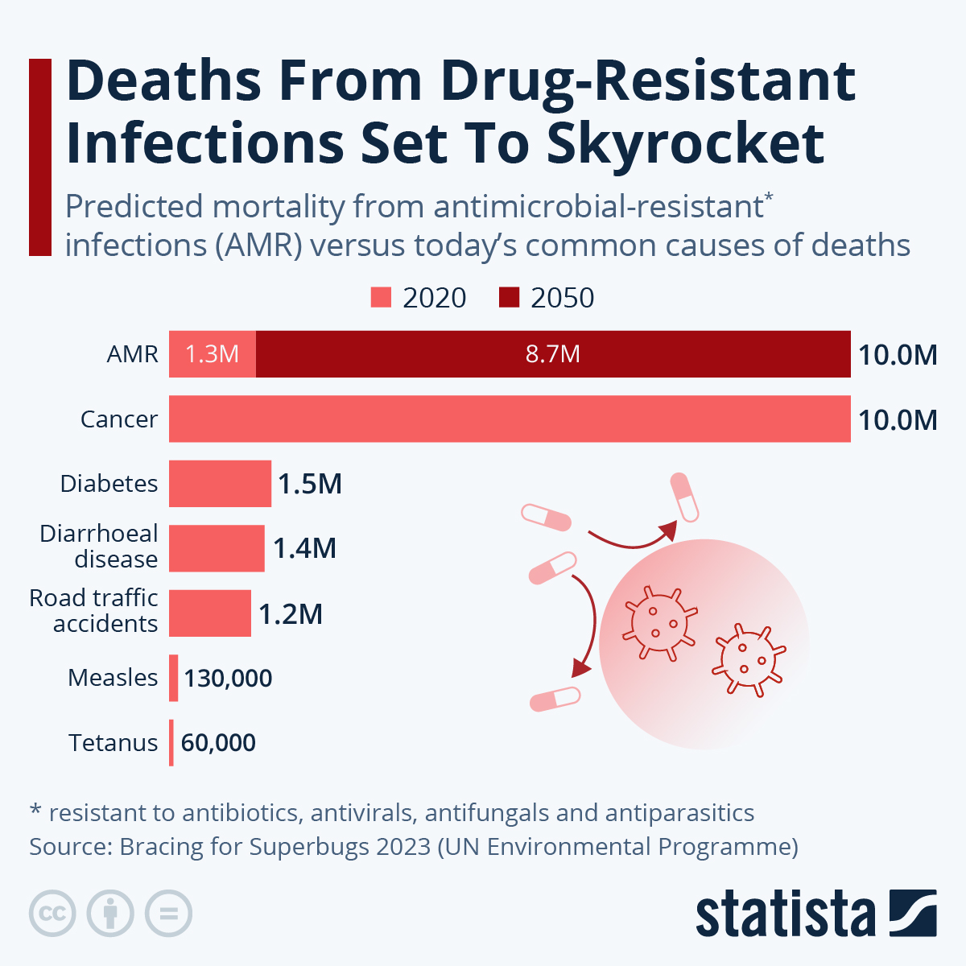

Slide 65
Antibiotic-Resistant Human Infections
High risk groups
  Very young
  Seniors
  AIDS, cancer, transplants, immunosuppressants
Many associated with inappropriate clinical use, prior appropriate use
  Treatment indication, choice of agent, or duration of antibiotic therapy is incorrect in 30% to 50% of cases
  For certain infections, shorter courses of therapy lead to equivalent or better outcomes

Slide 66
Human Microbiome
2 kg bacteria/100 kg individual
1 microorganisms / every human cell
  80% of human cells are erythrocytes
10,000 microorganism species / individual
8 million microbial coding genes/person (360 X number of human genes)
Everyone’s microbiome is different
Other animals each have their own microbiomes

Slide 67
Agricultural Antibiotic Overuse May Lead to Alterations in Human Microbiome
Changes linked to:
  immune system development and function
  autoimmune and allergic conditions
  hormonal and reproductive disorders
  diabetes
  Autism
  cancers

Slide 68
The Microbiome
Some companies offering human microbiome testing, clinical utility uncertain
Proposals to breed cattle to decrease components of their microbiome which contribute most to greenhouse gas emissions (14% due to beef and milk production); quicker alternative is a probiotic for cattle

Slide 69
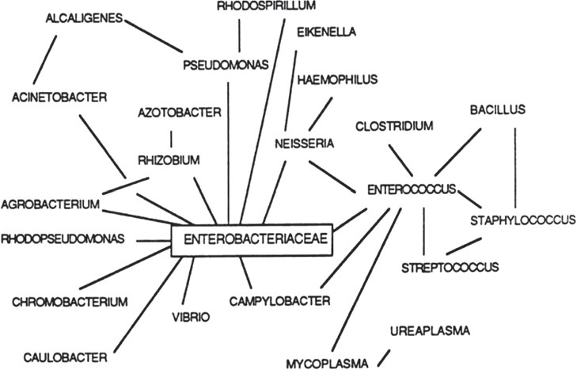
      Antibiotic resistant superbugs Share resistance genes with each other
Genetic exchange
among bacterial
species. This
process
demonstrates the
importance of
bacterial reservoirs
of resistance,
including both
pathogenic and
nonpathogenic
organisms .
Source: Ellen K. Silbergeld, Jay Graham, and Lance B. Price, Industrial Food Animal Production, Antimicrobial Resistance, and Human Health, Annu. Rev. Public Health 2008. 29:151–69

Slide 70
Consequences of Agricultural Antibiotic Use
Campylobacter fluoroquinolone resistance
  Campylobacter = most common food-borne bacterial infection in US
  1.5 million cases of diarrhea and 100 deaths per year
  Increased dramatically in 1990s and 2000s
  Resistance rate 25% (2011), up from 13% (1997)
  2009: Campylobacter found in 62%, Salmonella in 14%, and both in 8% of store-bought chickens
Salmonella: 1.35 million infections, 26,500 hospitalizations, and 420 deaths in the United States every year.
  Over 100,000 of these drug-resistant

Slide 71
Fluoroquinolone-Resistant Campylobacter Infections
Animal Use
  Sarafloxacin (Saraflox) – Abbott Labs – voluntarily withdrawn from market (2001)
  Enrofloxacin (Baytril) – Bayer – FDA withdraws approval (7/05)
Human Use
  Ciprofloxacin (Cipro) and moxifloxacin (Avelox) - Bayer

Slide 72
Consequences of Agricultural Antibiotic Use
Vancomycin-resistant Enterococcus faecium (VREF, due to avoparcin use in chickens)
Synercid (quinupristin and dalfopristin)-resistant infections (agent of last resort for vancomycin-resistant bacteria; due to Virginiamycin use)
Gentamycin- and Cipro-resistant E. coli in chickens
  Linked to E.coli UTIs in humans

Slide 73
Consequences of Agricultural Antibiotic Use
Methicillin-resistant Staph aureus (MRSA)
  Study of 5 U.S. cities show S. aureus contamination prevalent in meat samples:
    Turkey 77%
    Pork 42%
    Chicken 41%
    Beef 37%
    More than ½ multi-drug resistant (3 or more antimicrobials

Slide 74
Consequences of Agricultural Antibiotic Use
Methicillin-resistant Staph aureus (MRSA)
  49% of pigs and 45% of pig farmers harbor MRSA
  MRSA carriage higher in those living near cattle and pig farms
  One study found 30% of US grocery store pork cuts tainted with MRSA
  MRSA from animals thought to be responsible for more than 20% of human MRSA cases in the Netherlands

Slide 75
Consequences of Agricultural Antibiotic Use
Carbapenem-resistant Enterobacteriaceae
Colistin-resistant E coli superbugs

Slide 76
Regulatory Advances
FDA bans fluoroquinolone use in poultry (2005)
EU bans use of all antibiotic growth promoters (2006)
FDA bans off-label use of cephalosporins in food animals (2008); further restrictions (2012)
  However, use up 57% between 2009 and 2014
2010: FDA urges phasing out antibiotic use

Slide 77
Regulatory Advances
2012: FDA issues voluntary guidelines to reduce antibiotic use
2012/13: FDA considering banning PCNs and tetracyclines in food animals (2012/13)
2014: FDA states 25/26 companies asked to phase out “growth-promoting” antibiotics have done so

Slide 78
Regulatory Advances
2015: FDA regulations to end use of medically-important antibiotics for growth promotion by 2016
2015: Obama signs memorandum directing federally operated cafeterias to gradually begin serving meat produced with responsible antibiotic use
2015: FDA report reveals 62% of antibiotics used in food animal production important for human health

Slide 79
Regulatory Advances
2015: CA sets nation’s strongest restrictions on antibiotic overuse in farm animals
  No use for growth promotion
  Veterinarian prescription required for disease treatment (no OTC sales, which currently account for the bulk of purchases)
    AVMA found as much as 50% of antibiotics prescribed by veterinarians in U.S. unnecessary
  Creates antibiotic stewardship program and requires state Dept of Food and Ag to track antibiotic usage and resistance

Slide 80
Other Developments
2016: Federal government launches $20 million contest to develop rapid, point-of-care diagnostic tests to spot and identify antibiotic-resistant bacteria
  Related goal is to develop tests that distinguish between viral and bacterial infections, thus decreasing unnecessary antibiotic use in humans

Slide 81
Other Developments
2017: Court rules EPA must allow public access to industrial agriculture air pollution reports (including NH3, which decreases lung function in nearby residents)
2017: Study shows fewer antibiotic prescriptions being filled in U.S. over last 5+ years

Slide 82
Regulatory Advances
2017: FDA bans use of antibiotics to promote growth in farm animals (poultry and livestock antibiotic sales drop dramatically)
CVM implementing antibiotic stewardship and use reduction plans

Slide 83
Regulatory Advances
Other bills pending in Congress to improve data collection and reporting
AMA, AAP, APHA, IDS, UCS, Consumers’ Union, others all oppose non-therapeutic antibiotic use in livestock

Slide 84
Other Developments
Push for increased funding for ethnobotany
  Takes advantage of 400 million yrs of plant evolution in creating natural antibiotics
  Problem: Anthropocene/mass extinction underway
Development of bacteriophages as antibacterials increasing (already sprayed on food products, but do not have to be listed on labels)

Slide 85
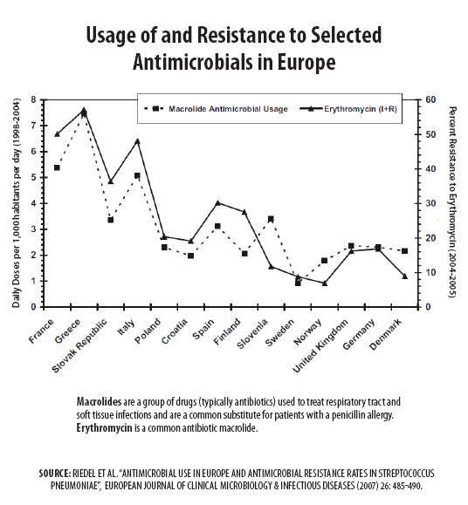

Slide 86
Other Developments
2016: McDonalds, Subway, Taco Bell, and Costco phasing out antibiotics
2017: Pizza Hut, KFC, and Burger King/Tim Hortons will stop using chicken raised on antibiotics important to human medicine

Slide 87
Other Developments
2018: San Francisco to require large grocery stores to report the use of antibiotics in livestock and poultry
2018: Restaurant Brands International to switch to chicken raised without antibiotics important to human medicine

Slide 88
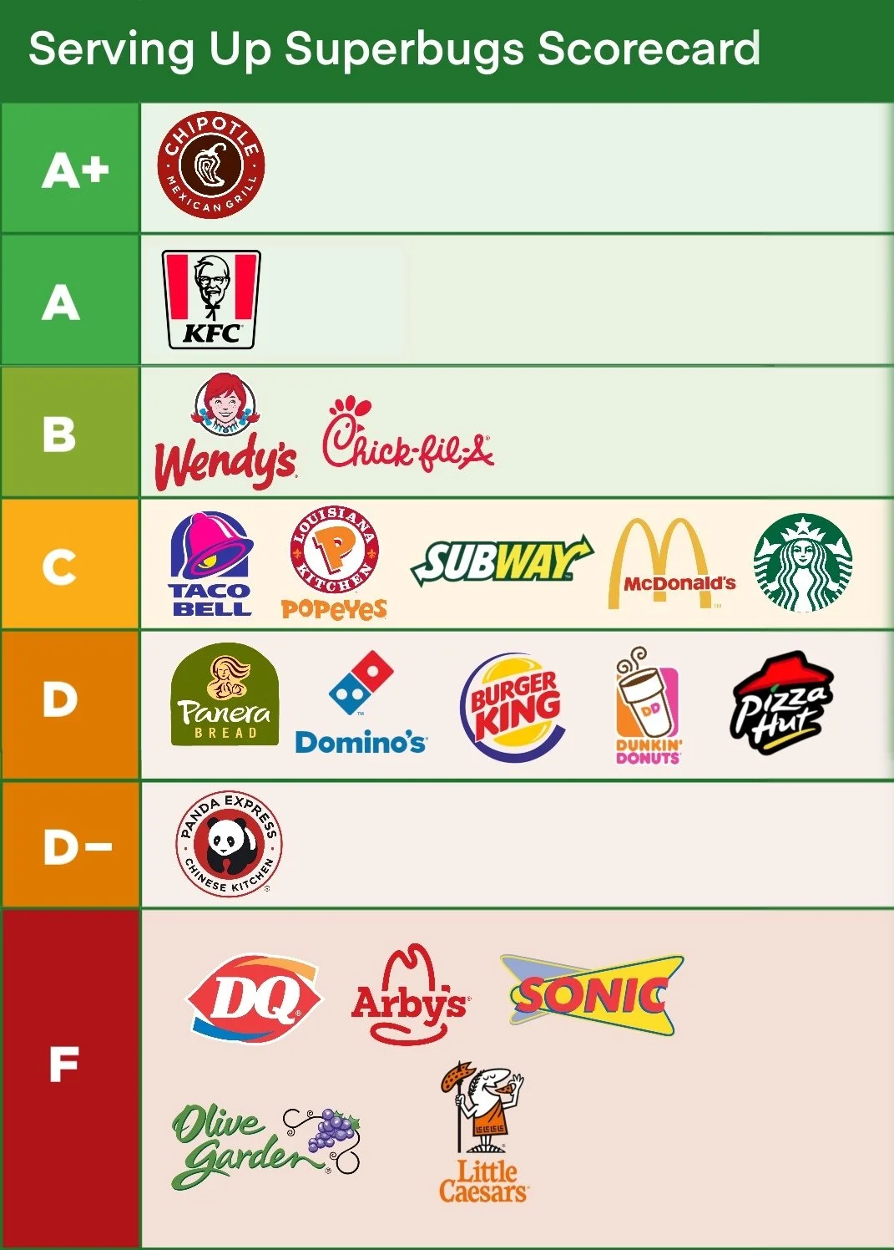

Slide 89
Agricultural Antibiotics
Three years after a Danish ban on routing use of antibiotics in chicken farming, the prevalence of antibiotic-resistant bacteria in chickens dropped from 82% to 12%

Slide 90
Antibiotic Use in Seafood
91% of US seafood imported
  Most from Asia
  FDA inspects 2% at most
Antibiotic overuse
Klebsiella resistant to up to 8 different antibiotics in 1/5 of Thai shrimp (largest importer) (FDA, 2012)
Nitrofurans (carcinogenic, banned in US) found in 1/5 of Asian shrimp (FDA, 2008)
Vietnamese shrimp with traces of fluoroquinolones
Antibiotic-resistant land-based pathogens increasingly found in marine organisms

Slide 91
Alternatives to Agricultural Antibiotic Use
Organic farming
  Organic farming and antibiotic-free farming associated ½ as likely to be contaminated with Salmonella
Decrease overcrowding
Better diet/sanitation/living conditions
Control heat stress

Slide 92
Alternatives to Agricultural Antibiotic Use
Vaccination
Increased use of bacterial cultures and specific antibiotic treatment in animals when indicated
Vegetarianism
Ban on non-therapeutic antibiotic use in US would increase per capita costs by $5-10 (National Research Council), but would decrease health care costs and other economic losses (likely by much more)

Slide 93
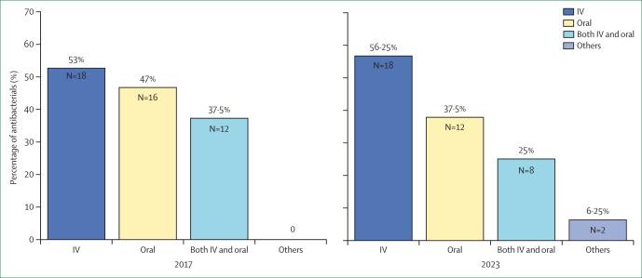
Proportions of candidate antibiotics in the 2017 and 2023 clinical pipelines by formulation
(Lancet 2025, 6;3100992;March)

Slide 94
Proportions of candidate antibiotics in the 2017 and 2023 clinical pipelines by formulation
(Lancet 2025, 6;3100992;March)

Slide 95
WHO Director-General Dr Margaret Chan (2011)
“In the absence of urgent corrective and protective actions, the world is heading towards a post-antibiotic era, in which many common infections will no longer have a cure and, once again, kill unabated.”

Slide 96
The Bad News
Agricultural antibiotic use in China dramatically increasing (pork), unregulated
“Right to Farm” Acts – to prevent lawsuits by neighbors of factory farms (for air and water pollution, property devaluation)
Antibiotics not very profitable for pharmaceutical companies, so development lags, many are redundant
  US needs a publicly-funded antibiotic development system

Slide 97
The Bad News
“Ag-Gag” laws in multiple states (aimed at preventing employees, journalists, and activists from exposing illegal or unethical practices)
Every state has laws barring cruelty to house pets, but almost none have laws safeguarding farm animals

Slide 98
The Bad News
Trump Administration, Republican-controlled Congress rolling back/eliminating many rules/laws
  Department of Agriculture Chair Sonny Perdue – subject of multiple ethics complaints as governor of GA
  Former lobbyists in key positions in the DOA
Biden Administration – Policies TBD

Slide 99
Corporations
Internalize profits
Externalize health and environmental costs

Slide 100
Corporate PR tactics
Characterize opposition as “technophobic,” anti-science,” and “against progress”
Portray their products as environmentally beneficial despite evidence to the contrary
Public Relations (Greenwash)
Sponsored educational materials
Co-opting academia
Lobbying, political donations

Slide 101
Agricultural/Biotech and Pharmaceutical Companies
Many major agricultural biotech companies also pharmaceutical companies (*):
  Novartis Seeds*
  Bayer CropScience*
  BASF*
  Dow*
  ChemChina (bought out Syngenta)
  Dupont/Pioneer

Slide 102
Pharmaceutical Industry
Influence over physicians through control of CME, gifts, research funding
Data mining of prescribing practices for marketing purposes
Conduct seeding trials to alter prescribing patterns
Secrecy, statistical torturing of data sets, selective publication

Slide 103
Pharmaceutical Industry
Effectively lobbied and threatened trade sanctions against developing countries in order to prevent production and importation of much cheaper, generic versions of life-saving anti-AIDS drugs
Sneak patent extensions / carve-outs into Congressional measures
Bayer/Cipro/Anthrax

Slide 104
Pharmaceutical Industry
The largest defrauder of the federal government (as determined by payments made for violations of the federal False Claims Act)
1991-2021:
  Pharmaceutical industry $18.1 billion
  Defense industry: $5.8 billion

Slide 105
Pharmaceutical Industry
Pay little to no US taxes by shifting profits overseas
Spent $457 million dollars on lobbying in 2025
  2.3 lobbyists for every member of Congress Congress
Revolving door between legislators, lobbyists, executives and government officials

Slide 106
Anthrax
Cipro – patent expired 2004
Doxycycline – generic
Penicillin - generic
Huge potential profits
  300 million Americans, others
  20-25% increase in Cipro sales one month after 2001 anthrax mailings, per the nation’s largest PBM

Slide 107
Cipro
Was best selling antibiotic in the world for almost a decade
Sales down since off patent, lower than levofloxacin and moxifloxacin
Gross sales (first quarter of 2008) = $242 million

Slide 108
Bayer and Cipro
1997 onward – Bayer pays Barr Pharmaceuticals and two other competitors $200 million not to manufacture generic ciprofloxacin, despite a federal judge’s 1995 decision allowing them to do so
  Ultimately absolved of wrongdoing: “anticompetitive effects … were within the exclusionary zone of the patent, and thus could not be redressed by federal antitrust law.”

Slide 109
Cost of Cipro
Drugstore = $4.50/pill
2002: US government agreed to buy 100 million tablets for $0.95 per pill (twice what is paid under other government-sponsored public health programs)
A full course of ciprofloxacin for postexposure prophylaxis (60 days) would then cost the government $204 per person treated, compared with $12 per person treated with doxycycline

Slide 110
Cost of Cipro
US government had the authority, under existing law, to license generic production of ciprofloxacin by other companies for as little as $0.20/pill in the event of a public health emergency
  It did not, but it cut a deal with Bayer to reduce the price of Cipro
Canada threatened to (but did not) override Bayer’s patent and ordered 1 million tablets from a Canadian manufacturer

Slide 111
Why?
Weakening of case at WTO meetings that the massive suffering consequent to 25 million AIDS cases in Sub-Saharan Africa did not constitute enough of a public health emergency to permit those countries to obtain and produce cheaper generic versions of largely unavailable AIDS drugs

Slide 112
Other Consequences
Opens door to other situations involving parallel importing and compulsory licensing
Threatens pharmaceutical industry’s massive profits
  the most profitable industry in the US

Slide 113
Other Consequences
Weakens pharmaceutical industry’s grip on legislators
  $240 million dollars spent on lobbying in 2015
  1,266 lobbyists (Over 2.3 for every member of Congress. 2016)
  Revolving door between legislators, lobbyists, executives and government officials

Slide 114
Bayer
Based in Leverkusen, Germany
Over 100,000 employees worldwide
Revenue: $50 billion (2024)
Profits: $30 billion (2024)
US = largest market

Slide 115
Bayer
Consists of Bayer HealthCare, Bayer MaterialScience, and Bayer CropScience
Pharmaceuticals
World’s leading pesticide manufacturer
One of world’s largest seed companies
Manufactures bis-phenol A (BPA)

Slide 116
Bayer
Number one biotech company in Europe (after 2001 purchase of Aventis CropScience)
2018: $62 billion takeover bid of Monsanto approved (Monsanto’s name dropped) – for Monsanto’s checkered history of malfeasance, see the GMOs and Biopharming slide show on the Food Safety/Food Justice page of PHSJ website at https://phsj.org/food-safety-issues/

Slide 117
Bayer
Controls over half of genetically-modified crop varieties up for approval for commercial use
Risks of GMOs / Opposition to labeling
See slide show on GMOs and Biopharming on the Food Safety/Food Justice page of PHSJ website at https://phsj.org/food-safety-issues/

Slide 118
History of Bayer
Established in 1863, began producing white phosphorus
  Today is sole US supplier
  Used for production of fertilizers, pesticides, detergents, and food additives
  Military use to create smoke screens, illuminate battlefields, and produce incendiary devices (can cause severe burns)
    Used by Israeli military against Palestinians and Lebanese

Slide 119
History of Bayer
Trademarked heroin in 1898
  Marketed as cough syrup for children “without side effects”, despite well-known dangers of addiction
Patented acetylsalicylic acid as aspirin in 1899
Produces Alka Seltzer

Slide 120
History of Bayer
WW I: invented modern chemical warfare; developed “School for Chemical Warfare”
WW II: part of IG Farben conglomerate, which exploited slave labor at Auschwitz, conducted unethical human subject experiments (including funding Mengele)
Manufactured and supplied Zyklon B (without usual odorant) to the SS for use in gas chambers

Slide 121
History of Bayer
24 board members and executives indicted in Nuremberg Trials
  13 received prison sentences
  Longest sentence to Fritz Meer
    Convicted for plunder, slavery, and mass murder
    Released from prison in 1952
    Chairman of supervisory board of Bayer 1956-1964

Slide 122
History of Bayer
Early 1990s – admitted knowingly selling HIV-tainted blood clotting products which infected up to 50% of hemophiliacs in some developed countries
  US Class action suits settled for $100,000 per claimant
  European taxpayers left to foot most of bill

Slide 123
History of Bayer
1995 onward - failed to follow promise to withdraw its most toxic pesticides from the market
Failed to educate farmers in developing nations re pesticide health risks

Slide 124
History of Bayer
1998 –pays Scottish adult volunteers $750 to swallow doses of the insecticide Guthion to “prove product’s safety”
  Sued the FDA to lift moratorium on human-derived data
2000 – cited by FDA and FTC for misleading claims regarding aspirin and heart attacks/strokes

Slide 125
History of Bayer
2000 – fined by OSHA for workplace safety violations related to MDA (carcinogen) exposures
2000 – fined by Commerce Dept. for violations of export laws

Slide 126
History of Bayer
2001 – FDA-reported violations in quality control contribute to worldwide clotting factor shortage for hemophiliacs
2002 - Baycol (cholesterol lowering drug) withdrawn from market
  Linked to 100 deaths and 1600 injuries
  Accused by Germany’s health minister of failing to inform government of lethal side effects for 2 months

Slide 127
History of Bayer
2006: Bayer CropScience genetically-modified, herbicide-tolerant “Liberty Link” rice contaminates U.S. food supply
  Bayer keeps contamination secret for 6 months, then US government takes another 18 days to respond
  Places $1.5 billion industry at risk

Slide 128
History of Bayer
“Liberty Link” rice contamination:
  9/06: 33/162 EU samples tested positive for Liberty Link contamination
  EU initially requires testing of all imported rice, then stops in response to US pressure
  Japan ban imports of US rice
  Over 1,200 lawsuits

Slide 129
History of Bayer
Worldwide cost estimates range from $740 million to $1.3 billion
Bayer loses first three cases for total $53.5 million
  Later agrees to pay up to $750 million to farmers in Missouri and 4 other states

Slide 130
History of Bayer
2007: Member of rubber cartel fined $356 million by European Commission
2007: Bayer suspends sales of Traysol (aprotinin) 2 years after data show increased deaths in heart surgery patients (Bayer withheld data)
2008: FDA warns Bayer re unapproved marketing claims for Bayer Women’s Low Dose Aspirin plus Calcium and Bayer Heart Advantage

Slide 131
History of Bayer
2008: Explosion at Bayer CropScience plant in Institute, WV, kills 2 workers
Above-ground storage tank that can hold up to 40,000 lbs of methyl isocyanate) located 50-75 ft from blast area
  Underground storage tank at plant site can store an additional 200,000 lbs

Slide 132
Comparison: Bhopal
50,000 to 90,000 pounds of methylisocyanate released in Union Carbide Bhopal, India explosion
  7000-10,000 dead within 3 days, 15,000-20,000 more over next 10 years; tens of thousands injured
  Persistent water and soil contamination

Slide 133
History of Bayer
2009: $4 million settlement reached re 2006 release of chemical odorant propyl mercaptan and organophosphate pesticide Mocap from Bayer Cropscience plant in Alabama in 2006, which caused 2 deaths
2009: Sued by CSPI for false claims about selenium in its “One A Day Men’s Health Formula” multivitamin reducing prostate cancer risk

Slide 134
History of Bayer
2009: Bayer ordered by FDA and a number of states attorneys general to run a $20 million corrective advertising campaign about its birth control pill Yaz
  Failed to inform FDA and public re elevated risks of VTE
  Facing over 10,000 personal injury lawsuits
    First 500 settled for over $100 million

Slide 135
History of Bayer
2009: Oregon taxpayers on hook for ¾ of cleanup costs for one of Oregon’s most contaminated dump sites (pesticides)
2010: FSA orders Bayer to stop misleading advertising re its IUD Mirena

Slide 136
History of Bayer
2010: Cited by Political Economy Research Institute as #1 toxic air polluter in the U.S.
2010: Loses cases to Dow AgroSciences LLC and Monsanto over patent infringement cases involving genetically-modified crops
2010: Fire at BayerCropScience Plant in India caused by leaking ethoprophos (toxic pesticide ingredient) kills one worker

Slide 137
History of Bayer
Late 1990s - 2010s: Bayer pesticides imidacloprid, and clothianidin implicated in (honeybee) “colony collapse disorder” (along with varroa destructor mites [spread deformed wing virus], fungal disease, aluminum, decline in goldenrod pollen protein[due in part to rising CO2])

Slide 138
History of Bayer
2010s: MRI contrast agent Magnevist contains Gadolinium (heavy metal), which may cause brain damage
2013: EU places 2 year moratorium on bee-harming neonicotinoid pesticides, including clothianidin and imidacloprid (which may also harm birds and mammals)

Slide 139
History of Bayer
2016: Seeks EPA re-registration of flubendiamide (used to control yield-damaging moths and worms in more than 200 crops), despite its own tests showing toxicity in high doses to river/pond invertebrates (food for fish)
2016: Compensates wine growers in multiple EU nations for 2015 crop damage possibly linked to its fungicide “Moon Privilege”

Slide 140
History of Bayer
2016: FDA adds boxed warning to permanent contraception device Essure due to risk of organ perforation, migration, allergic reactions, and pain
  Bayer facing almost 6,000 lawsuits in US
  Suspends sales outside U.S.
2018: Suspends sales in US
2019: Study finds patients with Essure more likely to need additional tubal resection or ligation vs. those undergoing conventional laparoscopic sterilization

Slide 141
History of Bayer
2015: Agrees to pay $5.6 million to resolve DOJ and EPA allegations of multiple violations (includes $975,000 penalty and funding for improved emergency preparedness and safety measures at four U.S. Bayer facilities)

Slide 142
History of Bayer
2018: Bayer acquires Monsanto
  Including legal liability re glyphosate and cancer (50,000 claims by 2024, despite $10 billion settlement of 75% of cases in 2020)
    See GMOs and Biopharming slide show)
  Loses 70% of shareholder value over next 5 yrs

Slide 143
History of Bayer
2019: Bayer and Johnson & Johnson (who market the blood thinner Xarelto [rivaroxaban] together) settled 25,000 lawsuits for $775 million with plaintiffs who claimed the companies had not properly warned patients about possible fatal bleeding as a result of ingesting the drug

Slide 144
History of Bayer
2019: Federal jury sided with Bayer in $600 million class action suit alleging the company misinformed consumers by promoting its One A Day vitamins as supporting cardiac health, vigorous immune systems and boosting user energy
2021: Multiple lawsuits related to Roundup and Dicamba – see https://phsj.org/food-safety-issues/ (160,000 for Roundup between 2015 and 2025)
As of 2025, Monsanto and Bayer have paid out $11 billion in settlements

Slide 145
Bayer’s Corporate Agenda
Bluewash: signatory to UN’s Global Compact
Greenwash: “crop protection” (pesticides)
Promotion of anti-environmental health agenda: “Wise Use,” “Responsible Care” movements

Slide 146
Bayer’s Corporate Agenda
Corporate Front Groups: “Global Crop Protection Federation”
Harassment / SLAPP suits against watchdog groups
  e.g., Coalition Against Bayer Dangers
Anti-union

Slide 147
Bayer’s Corporate Agenda
Lobbying / Campaign donations / Influence peddling:
  76 lobbyists plus member of numerous lobbying groups attacking “trade barriers” (i.e., environmental health and safety laws)
  Spent $9.1 million on lobbying in 2019
  Donated $196,000 to Republicans and $152,000 to Democrats in 2020
  Spent $9 million on 53 lobbyists in 2025

Slide 148
Bayer
Fortune Magazine (2001): one of the “most admired companies” in the United States
Multinational Monitor (2001, 2003): one of the 10 worst corporations of the year
Corporate Accountability International (2015): Worst global corporation

Slide 149
Trump Administrations
Agricultural antibiotic policy closely allied with agribusiness interests.
Rejected international efforts to curb farm drug usage, pushing back against WHO guidelines
Has permitted specific emergency agricultural applications of medically important antibiotics through agencies like the EPA
Cuts to food safety inspections facilitating outbreaks of food-borne infections

Slide 150
Conclusions
Triumph of corporate profits and influence-peddling over urgent public health needs
Stronger regulation needed over:
  Agricultural antibiotic use
  Drug pricing
Stiffer penalties for corporate malfeasance necessary (fines and jail time)
Important role of medical/public health organizations and the media

Slide 151
Reference
Donohoe MT. Factory farms, antibiotics, and anthrax. Z Magazine 2003 (Jan):28-30. Available at http://zmagsite.zmag.org/Jan2003/donohoe0103.shtml
GMOs and Biopharming slide show on the Food Safety/Food Justice page of PHSJ website at https://phsj.org/food-safety-issues/

Slide 152
Contact Information
Public Health and Social Justice Website
http://www.publichealthandsocialjustice.org
http://www.phsj.org
martindonohoe@phsj.org

