Slide 1
Food Safety and
Food Justice
Martin Donohoe

Slide 2
UN Declaration of Human Rights
“Everyone has the right to a standard of living adequate for the health and well-being of himself and of his family, including food, clothing, housing and medical care”

Slide 3
Food Justice: Overview
Agriculture - consequences
Biodiversity
  75% decrease over 20th Century
  Vulnerability to infestations (e.g., Irish potato famine)
  Svalbard Seed Bank; Global Genome Initiative
Deforestation
  Overpopulation, unsustainable agricultural practices

Slide 4
Food Justice: Overview
Soil erosion
Water availability
Health consequences of pesticide use

Slide 5
Agriculture
Responsible for:
  70% of fresh water use
  80% of world’s tropical and subtropical deforestation
  33% of human-caused greenhouse gas emissions

Slide 6
Corporate Control of Agriculture
U.S.: Monsanto, Novartis, Pioneer/Dupont, Aventis CropScience, Bayer CropScience, BASF, Syngenta, Dow
Mid 1970s – 7,000 seed companies (none controls over 0.5% of market)
2019 – 4 companies control 2/3 of global seed market (Bayer and BASF [German], Syngenta [China], and Corteva [US])
2021: 4 companies control 90% of global grain market (Cargill, ADM, Bunge, and Dreyfus)

Slide 7
Corporate Control of Agriculture
Four meatpackers control 60% of the US poultry market
Three companies control 85% and 75% respectively of the US beef and pork markets: JBS (Brazil), Tyson (US) and Smithfield (China)
Two companies control nearly half the US market for tractors and other farm machinery (and prohibit farmers from repairing their own machines)
Control/harassment of scientists

Slide 8
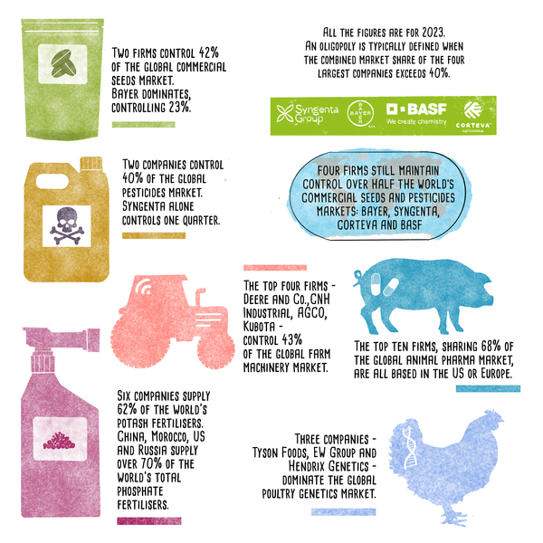

Slide 9
Industrial Food Production vs. Peasant Food Web
Peasant food web feeds 70% of world, using only 25% of food-production resources
Industrial food production:
  Only 24% of food produced actually reaches people (the rest is wasted in meat production inefficiencies; lost in transport, storage, and in the household; and diverted to non-food products)
  Every $1 spent on industrial food results in $2 in cleanup costs

Slide 10
Industrial Food Production vs. Peasant Food Web
Industrial food production:
  Uses 2-3 times more fossil fuel energy
  Responsible for 85-90% of all agricultural greenhouse gas emissions
  Damages 75 billion tons of soil annually (24 billion tons lost)
  Narrows crop genetic diversity by 75%
  Accelerates nutritional decline

Slide 11
Food Justice
Lobbying, governmental influence (revolving door)
Production and Distribution
  Local vs international, greenhouse gasses/global warming
Processing, transportation, and storage materials can account for up to ½ the cost of packaged foods
Diversion of food crops to biofuels

Slide 12
Poverty and Famine
U.S. Poverty
  15% (22% children)
  Racial disparities
Worldwide
  650 million lack access to safely managed drinking water
  1.6 billion lack adequate sanitation

Slide 13
Poverty and Famine
Worldwide, 5 billion people suffer from deficiencies of essential vitamins and minerals (iodine, vitamin E, calcium, iron, riboflavin, folate, and vitamin C)
Famine: 25,000 people die from hunger and hunger-related causes daily (equals almost 1/3 of immediate deaths due to atomic bombinb of Hiroshima)
Diarrheal diseases affect 10% of world’s population and kill 420,000 individuals each year

Slide 14
Poverty and Famine
World hunger rates decreasing: 19% (1990-92) to 8% (2025)
  Trump’s elimination of Agency for International Development funding caused an estimated 1.6 million excess deaths in 2025 and will cost a total of 9-14 million by 2030

Slide 15
Poverty and Priorities
Amount of money needed each year (in addition to current expenditures) to provide water and sanitation for all people in developing nations = $9 billion
Amount of money spent annually on cosmetics in the U.S. = $8 billion
One week of developed world farm subsidies = Annual cost of food aid required to eliminate world hunger

Slide 16
Foreign Aid
In total dollars: U.S. #1
As a % of GDP, U.S. ranks 21st among the world’s wealthiest nations
U.S. Aid: Over 1/3 military, 1/4 economic, 1/3 for food and development
Most U.S. aid benefits U.S. corporations
GM crops and food aid (Zambian famine, Africa - Wikileaks)
Notes:
16

Slide 17
Foreign Aid
0.19% of the total federal budget (vs. UN target of 0.7%)
  1.6% of the U.S. discretionary budget
On average, Americans think that 24% of the federal budget goes toward foreign aid
Notes:
17

Slide 18
Foreign Aid
Structural adjustment policies of World Bank, IMF, WTO force developing nations to convert from production of food crops for local consumption to profitable export crops
Land purchases by China, India, and Brazil in Africa
Notes:
18

Slide 19
Food Waste
45% of global food production is for animals
5% for making biodiesel and bioethanol
Of the rest, each year 2.9 trillion lbs (1/3) of global food production is not consumed
  $750 billion loss
  10% of greenhouse gas emissions

Slide 20
Food Waste
In the U.S., 53% is not consumed:
  20% lost during picking and sorting
  3% lost during storage and shipping
  2% lost during juice production, canning, or baking
  9% discarded at wholesalers and supermarkets
  19% uneaten and discarded in homes
    Rich waste more than poor

Slide 21
Pesticides
5.6 billion lbs/yr pesticides applied annually worldwide
  30% in US
  17,000 products
$73 billion market
  10 firms control 90% of market
US health and environmental costs $10-12 billion/yr
Notes:
21

Slide 22
Pesticides
EPA: U.S. farm workers suffer up to 300,000 pesticide-related acute illnesses and injuries per year
  25 million cases/yr worldwide
NAS: Pesticides in food could cause up to 1 million cancers in the current generation of Americans
WHO: 1,000,000 people killed by pesticides over the last 6 years
Notes:
22

Slide 23
Pesticides
Linked to autism, Parkinson’s Disease, Alzheimer’s disease, diabetes, obesity (with prenatal exposure), depression, ADHD
Autism spectrum disorders affect 2.5% of U.S. children

Slide 24
Pesticides
Children living on or near farms score 5 points lower on IQ tests and other mental and verbal tests
  May be due to pesticide exposure
  Over 260,000 child farm laborers in US
2015: EPA establishes minimum age (18) for farm workers applying pesticides to fields

Slide 25
Fertilizer
Since 1960s, use of synthetic nitrogen fertilizers has increased 9-fold globally
Phosphorus use has tripled
Over ½ of fertilizer used is wasted/not needed
Runoff damages coral reefs, creates aquatic dead zones

Slide 26
Agricultural Feed
Pounds of feed needed to produce one pound of body mass (feed conversion ratio):
  Cattle – 6.8
  Pigs – 2.9
  Broiler chickens – 1.7
  Fish 1.1 (salmon, slightly higher for other fish)

Slide 27
Soil/Water
Soil erosion has increased 60-fold over the past century
  Soil erosion exceeds soil formation
Global warming decreasing water tables
Water-intensive crops worsening drought situations
Industrial agricultural practices harm earthworms, which fertilize and aerate soil and help prevent soil erosion

Slide 28
Nanomaterials
Used in food preservation, packaging, and for antimicrobial effects (nanosilver)
Monsanto, Syngenta, BASF, others produce
Nanoparticles can cross blood-brain barrier and enter cell nuclei
Not well-studied or regulated, but significant potential health risks

Slide 29
Indoor combustion of coal and biomass
For cooking, heating and food preservation
  Used by 3 billion people worldwide
  Causes close to 2 million deaths/yr
  Associated with multiple pulmonary conditions
  Women and children predominantly affected
  Combining agricultural and kitchen waste with ash and char residue from cooking fires creates material highly resistant to decomposition – can be added to infertile/degraded soil to create highly-fertile, highly carbonated soil

Slide 30
Air Pollution
Black carbon and ground level ozone cutting crop yields by almost ½ in India
  Could be significant contributor to increasing famine

Slide 31
Agricultural Antibiotic Use
Agriculture accounts for 80% of U.S. antibiotic use
  Use up 50% over the last 15 years
Notes:
31

Slide 32
Antibiotic Resistant Pathogens
CDC: “Antibiotic use in food animals is the dominant source of antibiotic resistance among food-borne pathogens.”
US spends $66 billion/yr on food-borne antibacterial-resistant infections in humans (includes medical treatment, lost productivity, long-term complications, and deaths valued using statistical life methods)
US Preservation of Antibiotics for Medical Treatment Act, 2007 – still awaiting vote
Notes:
32

Slide 33
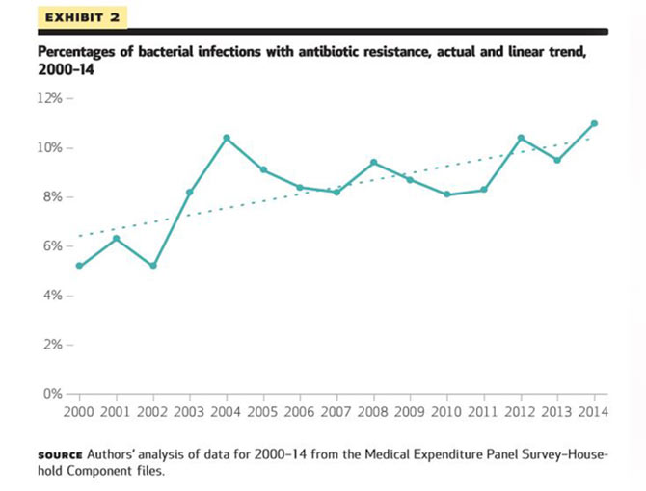

Slide 34
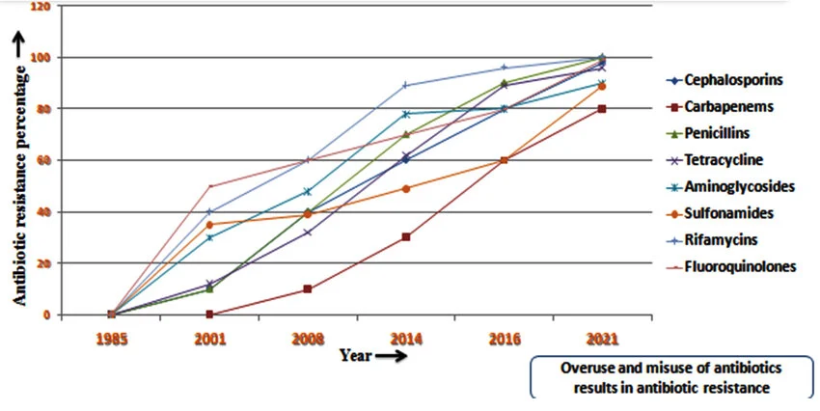

Slide 35
Genetically-Modified Crops
Over 30 countries, 210 million acres (4.2% of global farmland), commercialized 1994
Most soybeans, cotton, corn; other crops
80% herbicide-resistant (e.g., Roundup Ready soybeans); 20% produce their own pesticide (e.g., Bt corn)
No commercially available GE crop that is more drought-resistant, salt- or flood-tolerant, or which increases yields more than conventional crops

Slide 36
Genetically-Modified Crops: Risks
Contamination
  Financial consequences
Allergies
Superweeds
Changes in soil, soil bacteria
Altered nutritional value, potential adverse health effects
Increased herbicide/pesticide use

Slide 37
Biopharming
The engineering of plants to produce pharmaceuticals (enzymes, antibiotics, contraceptives, abortifacients, antibodies, chemotherapeutic agents, vaccines) and industrial chemicals)
Secrecy, violations, poorly regulated
Risks – similar to GM crop risks, and more
Widespread opposition (NAS, UCS, BMA, Consumers Union, others)

Slide 38
Other Issues
19% of U.S. food supply imported (including 52% of fresh fruits, 22% of fresh vegetables, and 85% of seafood)
  Major international seafood suppliers tainted by slavery, human rights abuses
Only 1.3% of imported food is inspected
COOL (Country of Origin Labeling) was to have started in the US in the mid-2000s, but repealed by the WTO

Slide 39
COOL:
Country of Origin Labeling
Heavy industry lobbying and large campaigns to fight mandatory COOL/support voluntary COOL
  Trade Associations / Big Agribusiness and grocers
WTO rules for Canada and Mexico, authorizes over $1 billion in retaliation against U.S. (2012)
  U.S. appeal refused (2015)
Congress repeals COOL (2015)

Slide 40
Problems with the Integrity of the Food System
Inadequate funding of food inspection enterprise in U.S.
  FDA has 1,000 food inspectors responsible for 421,000 production facilities
  FDA inspects fewer than 8,000 facilities per year (down from 35,000/yr in 1970s)
  Cuts under Trump II causing outbreaks of food-borne infections
  Conflicts of interest, revolving door with industry

Slide 41
Problems with the Integrity of the Food System
Inadequate funding of food inspection enterprise in U.S.
  2016: OIG (DHHS) finds FDA’s procedures to recall contaminated or misbranded foor are inadequate
  1/3 of U.S. food products (including 20% of fish) mislabeled
  E.g., FDA has no documents from the Flavor and Extract Manufacturers Association, despite declaring 2,700 flavoring chemicals as safe over the past 5 decades

Slide 42
Other Issues
Counterfeit Food (Europe, involves organized crime syndicates)
Melamine in Chinese milk, cadmium in Chinese rice, horsemeat in burgers in Europe, etc.
Genetic modification of vertebrates

Slide 43
Other Issues
Cloned meats
Artificial meat
Unhealthy changes to microbiome
Patenting life forms
Synthetic biology (Synbio)

Slide 44
Obesity Epidemic
1/3 of adults overweight, 1/3 obese
Health consequences
Economic and health care costs

Slide 45
Obesity
Public Health Approaches
Education
Exercise
Remove sodas (and HFCS-laden juices [and bottled water]) from schools/vending machines
Obesity report cards
Improve National School Lunch Program

Slide 46
Obesity
Public Health Approaches
Restrictions on Food Stamp use
Insurance discounts/surcharges
Menu labelling
Trans fat bans

Slide 47
Obesity
Public Health Approaches
Soda tax
Advertising restrictions/halting predatory marketing to children
Zoning laws for fast food outlets
Lawsuits

Slide 48
Recombinant Bovine Growth Hormone (rBGH)
aka recombinant Bovine Somatotropin (rBST), brand name Posilac©
  Monsanto → Elanco (Eli Lilly)
10% of U.S. dairy cows injected with rBGH (decreasing)
Used to increase milk production by cattle

Slide 49
rBGH
Marketed primarily to large dairy farms (LDFs), which are supplanting small dairy farms
LDFs have
  Worse environmental impact records
  Higher rates of workplace injuries
  Contribute to decreasing agricultural diversity

Slide 50
Effects of rBGH on Humans
Increases IGF-1
  Suspected contributor to breast, prostate and GI cancers
  May be partly responsible for earlier onset of puberty
  Causes 16 different harmful conditions in cattle

Slide 51
rBGH Worldwide
Canada, Australia, New Zealand, Japan, and the European Union have banned rBGH
The Codex Alimentarius, the UN’s main food safety body, has refused to certify rBGH as safe

Slide 52
rBGH Today
All fluid milk products in Oregon now rBGH-free
Most the top 100 U.S. dairies are now at least partially rBGH-free or have announced that they will be
  90% of US dairy now rBGH-free
All hospital systems in Oregon rBGH-free (many hospitals nationwide)
Starbucks (company-owned stores), Chipotle, others rBGH-free

Slide 53
Oregon Measure 27
GM Food Labeling (2002)
Required labeling of wholesale and retail GM foodstuffs
Defeated 70% to 30%
  Despite widespread public support for labeling
Opponents outspent proponents $5.5 million to $200,000
  Out of state ag biotech money
  Disinformation campaign

Slide 54
GM Food Labeling Today
Many countries ban or limit GM crop production and importation
State ballot measures and legislation (some passed) – see slide show on GMOs and biopharming on phsj website)

Slide 55
GM Food Labeling Today
2016: Federal Safe and Accurate Food Labeling Act (aka Dark Act – Denying Americans Right to Know Act) signed by Obama, requires limited/confusing labeling, overrides all local labeling laws, supported by industry
2016: Center for Food Safety wins lawsuit opposing “highly refined” loophole

Slide 56
Former Representative Kucinich’s House Bills
The Genetically Engineered Food Right to Know Act, or H.R. 6636
The Genetically Engineered Food Safety Act, or H.R. 6635
The Genetically Engineered Technology Farmer Protection Act, or H.R. 6637
Failed in US Senate (2013)

Slide 57
Former Representative Kucinich’s Failed House Bills
Mandate GMO labeling
Require proper GMO safety testing
Eliminate seed patenting
Increase rights and protections for farmers
  High suicide rates among farmers in US and worldwide
Prohibit sterile seeds
Allow farmers to save seeds

Slide 58
Former Representative Kucinich’s Failed House Bills
Administer full liability to biotechnology companies for damage caused by GMOs
Expand FDA oversight and increase regulations re biopharming
Prohibit open-air biopharming
Expand research to help developing nations feed themselves

Slide 59
Biopharming in Oregon
Bill passed OR Senate; no vote in House (2005)
  Opposition: agricultural biotech, Oregonians for Food and Shelter
Led to task force, which led to MOU (completed 2010)
ODA and Public Health Dept. must approve permits before field trials
FDA preliminary safety opinion required

Slide 60
Biopharming in Oregon
Public comment period, public meeting
Preference for non-food crops, secured indoor greenhouses
$10,000 fee to company
Company responsible for required remedial action

Slide 61
Eliminating Hunger
UN FAO: enough food produced daily to provide every living person with over 2700 calories/day
  Even so, 1/3 to ½ of the world’s food is wasted (40% in U.S.)
  1/3 animal feed
  5% used to produce biofuels
38 million Americans dependent upon SNAP (Supplementary Nutrition Assistance Program)
  Large cuts under Trump II
Hunger: solution requires political will

Slide 62
Suggestions for Activism
Support traditional/organic farming
  converts carbon from a greenhouse gas into a food-producing asset
Education (self, patients)
Op-eds
Vote

Slide 63
Suggestions for Activism
Lobbying
Work with groups (see phsj website “food safety issues” page)
  Oregon Physicians for Social Responsibility’s Campaign for Safe Food
Run for office

Slide 64
Speak Up
“The first job of a citizen is to keep your mouth open.”
- Günter Grass

Slide 65
Have Faith in Your Ability to Affect Change
"If you think you are too small to have an impact, try going to bed with a mosquito in your tent“
- African Proverb
Notes:
65

Slide 66
Public Health and Social Justice Website and Book
http://www.publichealthandsocialjustice.org
http://www.phsj.org
martindonohoe@phsj.org

