Slide 1
Health and Environmental Consequences of Genetically-Modified Foods and Biopharming
Martin Donohoe

Slide 2
Wendell Berry
“How we eat determines to a considerable extent how the world is used”

Slide 3
The Precautionary Principle
When evidence points toward the potential of an activity to cause significant, widespread or irreparable harm to public health or the environment, options for avoiding that harm should be examined and pursued, even though the harm is not yet fully understood or proven.

Slide 4
The Precautionary Principle
Give human and environmental health the benefit of doubt.
Include appropriate public participation in the discussion.
Gather unbiased scientific, technological and socioeconomic information.
Consider less risky alternatives.

Slide 5
Genetically-Modified Foods
Plants/animals whose DNA has been altered through the addition of genes from other organisms
  1973: first GE bacterium
  1973: GE mouse
  1974: GE tobacco plant
  1994: First commercially available crops hit market in (Flavr Savr tomato)

Slide 6
Genetically-Modified Foods
GM Crops grown commercially by 18 million of the world’s 513 million small farmers on over 210 million hectares spread over 32 countries (2024)
  Almost exclusively by large farmers
  Up from 4.3 million acres in 1996
  69 million hectares in U.S. (about 1/2 total land used for crops)

Slide 7
Genetically-Modified Foods
4% of all global agricultural land planted with GM crops
Most used for animal feed and biofuel production

Slide 8
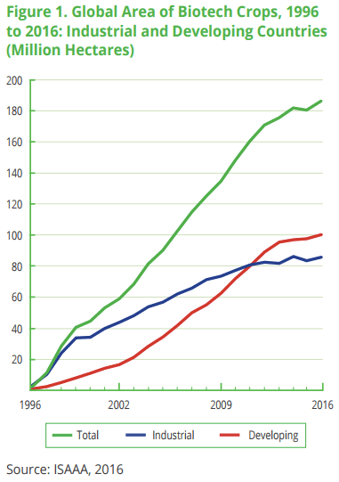

Slide 9
Genetically-Modified Foods
Top producers: United States, Brazil, Argentina, Canada, and India
Over 30 countries worldwide with GE crops under cultivation
  Top 10 account for 98% of global acreage

Slide 10
Genetically-Modified Foods
European Parliament has ruled that the biotech industry can grow and market new GMOs without any monitoring
    EU nations can opt-out of approvals of GM crops
Nevertheless, only small amounts grown in a few countries

Slide 11
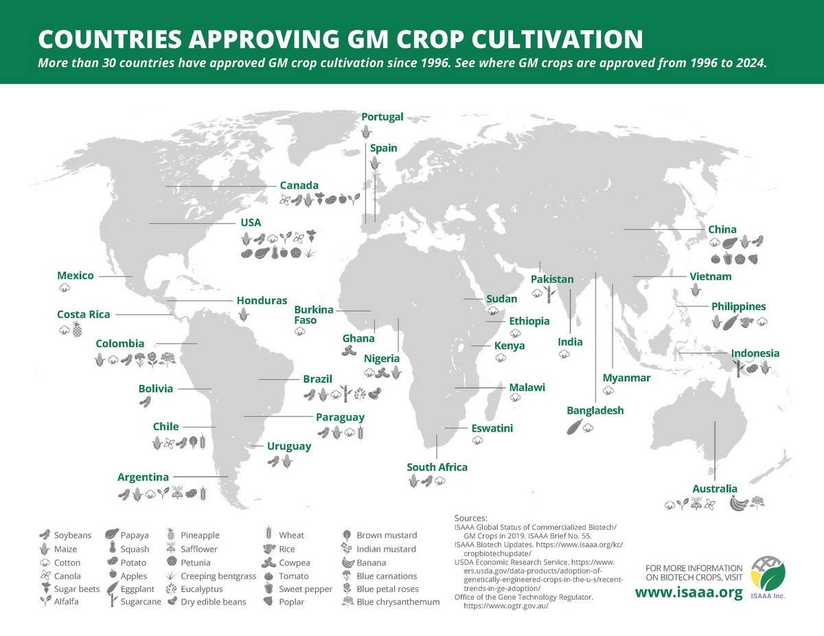

Slide 12
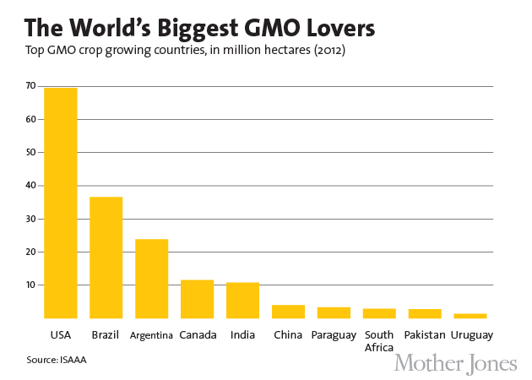

Slide 13
Genetically-Modified Foods
85% of processed foods available in the U.S. today come from GM crops
  Processed foods comprise 75% of world food sales
Global value of GE seeds sold annually = $30 billion
  U.S. farmers pay double to triple the coset of conventional seeds for GM seeds

Slide 14
Consolidation of Seed Market
Today less than 10 corporations control ¾ of global proprietary seed sales
  Bayer (including Monsanto post merger), Corteva, Syngenta, and BASF control 61% of global seed market
  Mid-1970s: none of the 7,000 seed companies controlled over 0.5% of world seed market
  94% of seed varieties have disappeared over the last century

Slide 15
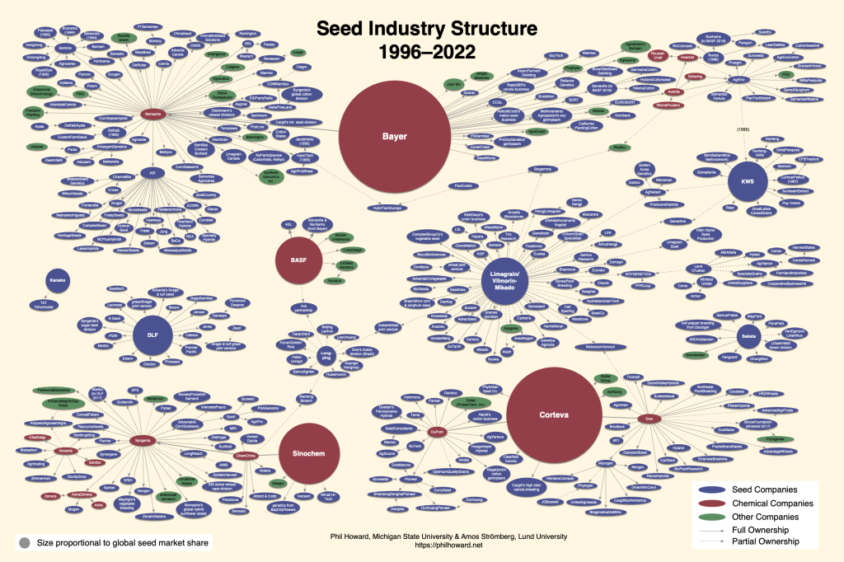

Slide 16
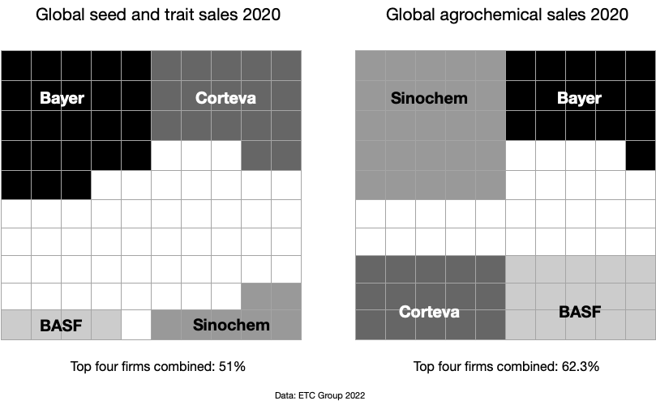

Slide 17
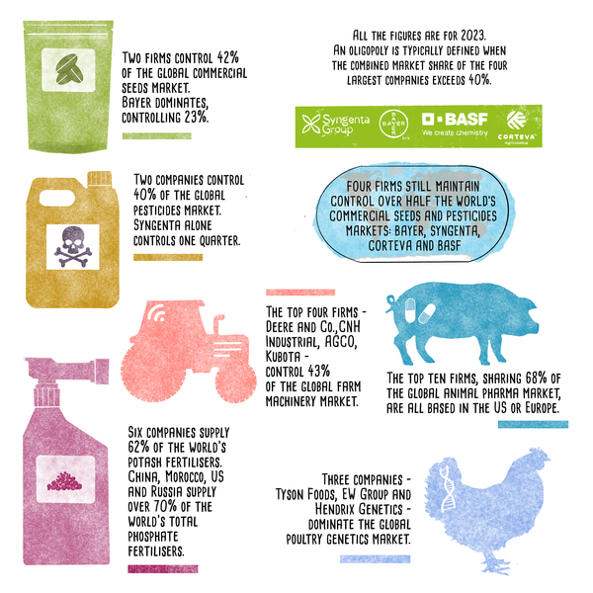

Slide 18
Consolidation of Animal Protein Market
Four companies control 85% of US cattle market
Retailers attempting to muscle in through opening own meat-packing plant (Wal-Mart) and farm to store poultry production operation (Costco)

Slide 19
Agricultural/Biotech Companies
Monsanto
  $7.9 billion profit on $14.6 billion revenues in 2017 (not available online in 2026)
  90% of GM seeds sold by Monsanto or by competitors that license Monsanto genes in their own seeds

Slide 20
Agricultural/Biotech Companies
    Monsanto
      UK employee cafeteria is GMO-free, Monsanto CEO (Hugh Grant, 2015 pay package $11.9 million) buys organic
      Gates Foundation invested in company
        GF has also partnered with corporate front group Sense About Science
      Supports secondary school “science education” through sponsored curricula
    Council for Biotechnology Information’s “Look Closer at Biotechnology”

Slide 21
Agricultural/Biotech Companies
Monsanto
  Sponsored Underground Adventure Exhibit at Chicago’s Field Museum, at which I photographed the following (ironic) quotes….

Slide 22
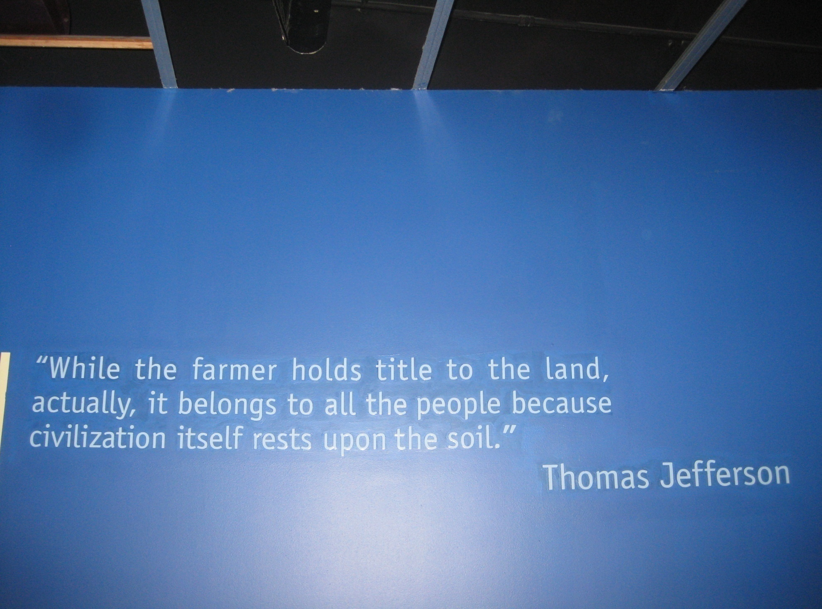

Slide 23
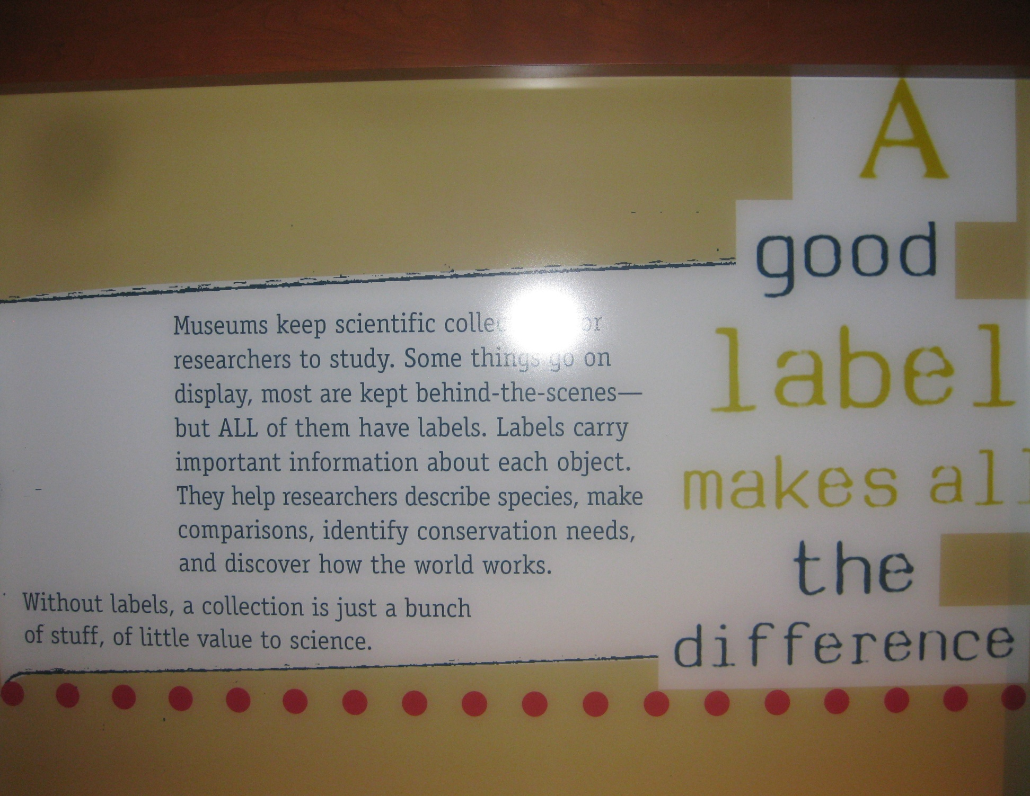

Slide 24
Monsanto Has Supported Labeling
When the EU adopted labeling in the late 1990s, Monsanto ran ads in the UK that read:
  “Monsanto fully supports UK food manufacturers and retailers in their introduction of these labels. We believe you should be aware of all the facts before making a purchase.”

Slide 25
Also Supporting Labeling
“What I learned is that adding a few words to a label has no impact on the price of making or selling food”
Scott Faber, former VP for Federal Affairs at Grocery Manufacturers Assn.:

Slide 26
Agricultural/Biotech Companies
Monsanto
      Support of land-grant universities
        Pays South Dakota State University president $400K/year for sitting on board of directors (president’s university salary $300K/year)
  Responsible for 56 Superfund sites

Slide 27
Agricultural/Biotech Companies
Monsanto
  Was subject of antitrust investigations (dropped by Obama administration)
  Under investigation by SEC for making cash payments to farmers to use its herbicides, bribing Indonesian environmental officials

Slide 28
Agricultural/Biotech Companies
Monsanto
  Fined for bribing Indonesian and Turkish officials to accept Bt plants
  Lied to workers for over 40 years about the safety of polyvinyl chloride (PVC)
  Accused of labor violations (including accusations of employing child labor by International Labor Rights Fund)

Slide 29
Agricultural/Biotech Companies
Monsanto:
  Found guilty of dumping tons of polychlorinated biphenyls (PCBs) in Alabama and covering up its actions for decades
  Being sued by multiple West Coast cities for harbor cleanup costs
  Fined in France for false advertising (2009)
  Found guilty in France of pesticide poisoning of farmer (inadequate product health warnings)

Slide 30
Agricultural/Biotech Companies
Monsanto
  Former managing director of Monsanto India reveals company used fake scientific data to get commercial approval for its products (2010)
  Ordered to spend up to $93 million on medical testing and cleanup of homes in West Virginia contaminated by production of Agent Orange and other chemicals

Slide 31
Agricultural/Biotech Companies
Monsanto
  Former Republican presidential candidate Mitt Romney consulted for Monsanto (through Bain Capital) from 1977-1985
  Companies tied to Blackwater (then Xe Services, now Academi) did “intel” for Monsanto
    Blackwater investigated for financial and human rights abuses in Iraq War

Slide 32
Agricultural/Biotech Companies
Monsanto
  Campaign contributions (2016 election cycle): over $600,000 through early 10-16
  U.S. Lobbying expenditures (2015): $4,330,000

Slide 33
Agricultural/Biotech Companies
Monsanto
  2013 Farm Bill almost included “Monsanto Protection Act”
    Attempt to require Agriculture Secretary to grant temporary permit for planting GM crops, even if federal court has halted planting pending and Environmental Impact Statement
  Recruiting food bloggers/mommy bloggers for PR

Slide 34
Agricultural/Biotech Companies
Monsanto
  Forbes magazine’s Company of the Year (2009)
  Forbes Magazine names Monsanto one of the “World’s Top 10 Most Innovative Companies” (2011)
  #1 on Corporate Accountability’s Corporate Hall of Shame list (2010)
  Named worst corporation of the year by Natural Society (2011)
  Consistently named to top 10 lists of world’s worst corporations

Slide 35
Agricultural/Biotech Companies
Many major agricultural biotech companies also pharmaceutical companies (*):
  Novartis Seeds*
  Aventis CropScience*
  Bayer CropScience* (purchases Monsanto, 2018; merger financed in part by Germany’s central bank using taxpayer money; Monsanto name dropped)
  BASF* (bought multiple seed and herbicide businesses from Bayer in 2017)
  Dupont/Pioneer (merged with Dow, 2015)
  Dow* (merged with Dupont, 2015)
  Syngenta* (acquired by ChemChina, 2016)
Public tribunal investigating most for human rights violations

Slide 36
Agricultural/Biotech Companies
Biotech companies conduct/sponsor much research
  Dangers include secrecy, suppression of data
  Large 2017 review of over 600 published studies on GM Bt crops showed 40% had conflicts of interest
    Presence of COI associated with 50% higher frequency of outcomes favorable to the GM crop company
Open-science movement would counteract

Slide 37
Agricultural/Biotech Companies
Companies sponsor professorships, academic research institutes
  Berkeley Plant Science Dept. – Aventis
  Iowa State - $500,000 gift from Monsanto to establish faculty chair in soybean breeding

Slide 38
Genetically-Modified Foods
Purposes: increase growth rate/enhance ripening, prevent spoilage, enhance nutritional quality, change appearance, provide resistance to herbicides and drought, alter freezing properties
  USDA (2006): Genetic engineering has not increased the yield potential of any commercialized GM crop
Tobacco industry attempting to develop GE-tobacco to enhance nicotine delivery

Slide 39
Genetic Modification of Conventional Crops (US/Worldwide)
95% of sugar beets
  Just over ½ of sugar comes from sugar beets (the rest comes from sugar cane)
94%/81% of soybeans
93%/26% of canola
90%/81% of cotton (oilseed rape)
88%/35% of corn
Corn and soy cover over half of US cropland

Slide 40
Genetic Modification of Conventional Crops (US/Worldwide)
Other crops
  Rice
  Tomatoes
  Potatoes
  Hawaiian papaya (resistant to ringspot virus)
  “Arctic Apples” (slow-browning – genes from one plant virus and 2 bacteria, Inextron)
    USDA approved (sales begin in US in 2017)
    Arctic avocados, pears, and lettuce planned

Slide 41
Genetic Modification of Conventional Crops (US/Worldwide)
Other crops
  Potato resistant to Colorado potato beetle
  Potato which masks signs of blackspot bruising
    Renounced by original developer
    Could lead to consumers ingesting unhealthy or toxic product

Slide 42
Genetic Modification of Conventional Crops (US/Worldwide)
Other crops
  Potato which produces less acrylamide (carcinogen produce during frying) through gene silencing
    Acrylamide produced from polyacrylamide, used in irrigation to stick degraded soil together so it won’t blow away (banned – and not even necessary – in organic agriculture)
    Acrylamide also used in herbicides to reduce spray drift and improve plant absorption
    Some GM potatoes (and corn) contain high levels of alpha-aminoadipate (neurotoxin) and tyramine (dangerous for those taking MAO inhibitors)

Slide 43
Genetic Modification of Conventional Crops (US/Worldwide)
Other crops
  Zucchini
  Crook neck squash
  Cassava (viral-resistance)
  Tearless onions
  Pink pineapples

Slide 44
Genetic Modification of Conventional Crops (US/Worldwide)
Other crops
  GE soybeans with marine algae genes producing omega-3 fatty acids (fish oil) in final stages of FDA approval; Camelina flax GM to produce omega-3s in field trials
  Plums (without stones)

Slide 45
Genetic Modification of Conventional Crops (US/Worldwide)
Other crops
  Bananas (fungal-resistance, ß-carotene, iron)
    Banana = most-consumed fruit in US
    Deadly Tropical Race 4 (TR4) virus, which infects Cavendish bananas, may spread to Latin America, which produces 80% of the world’s exports
    75 species and 500-1,000 cultivars of bananas exist worldwide, but Cavendish most commonly produced
    Risk of monoculture

Slide 46
Genetic Modification of Conventional Crops (US/Worldwide)
Other crops:
  Pink pineapple (“novel rose color,” Del Monte)
  Roses (novel colors)
  Thale cress (plant modified with gene from bioluminescent bacteria, designed to fluoresce, possibly replace electric lights)

Slide 47
Actual Characteristics of Genetically-Modified Crops
70-93% herbicide-resistant
  94% soybeans
  78% cotton
18% produce their own pesticide
  E.g., Bt corn, modified to produce insecticidal proteins such as Cry1Ab (active against corn borer)
8% produce their own pesticide and are herbicide-resistant
  76% corn

Slide 48
Genetically-Modified Foods
Newer crops resistant to 5 or more herbicides
SmartStax corn: combines 8 herbicide and insect-protection genes
  Approved in US, Canada, and Japan in 2009
2016: English scientists discover Monsanto’s Roundup Ready corn contains over 200 altered proteins and metabolites compared natural corn
  Another Monsanto GM corn found to carry a new allergen

Slide 49
Genetically-Modified Foods
Dow Agrosciences developing GE-corn, resistant to 2,4-D, one of the weed killers in Agent Orange
  Endocrine disruptor, teratogen, hazardous air pollutant, linked with hypothyroidism, immunosuppression, non-Hodgkin’s lymphoma and other cancers, Parkinson’s Disease
  2,4-D and added surfactants cause antibiotic resistance

Slide 50
Genetically-Modified Foods
2,4-D
  2014: USDA approves commercial planting
  2015: WHO calls “possibly carcinogenic”
  2016: EPA tries to vacate its 2014 approval, court rejects petition
  2017: EPA greenlights Dow’s Enlist Duo 2,4D GE crops

Slide 51
Genetically-Modified Foods
The Future
  “Genomically Recoded Crops”
  Similar to bacteria genetically engineered for a specific nutritional requirement for growth to occur
  GE bacteria already produce pharmaceuticals (e.g., insulin), yogurt, and polymers to create textiles
  GRCs “promise” is that they would not grow without a specific, unique, nutritional supplement
  Risk = interbreeding and altered requirements of native species

Slide 52
“Golden Rice”:
The Poster Child of GE
Purported to be the solution to the problem of Vitamin A deficiency in developing countries
Developed in 1999 by Swiss and German scientists, led by Ingo Potrykus
  Potrykus has accused GM opponents of “crimes against humanity”

Slide 53
“Golden Rice”:
The Poster Child of GE
Produced by splicing two daffodil and one bacterial gene into japonica rice, a variety adapted for temperate climates
First plantings began in 2015 in the Philippines
Currently not planted anywhere in the world, but approved for use in US, Canada, Australia, and New Zealand

Slide 54
Vitamin A Deficiency (VAD)
VAD afflicts 250 pre-school age children worldwide
Severe deficiency causes blindness (350,000 pre-school age children/year)
  Lesser deficiencies weaken the immune system, increasing risk of measles, malaria, other infectious diseases, and death (VAD implicated in over one million deaths per year)
Cases increased after Green Revolution led to replacement of rice production with monocultures, export crops, pesticides and fertilizers

Slide 55
Golden Rice
Produces β-carotene, which the body converts into Vitamin A (in the absence of other nutritional deficiencies - such as zinc, protein, and fats - and in individuals not suffering from diarrhea)
β-carotene degrades rapidly during storage and cooking; vacuum packaging necessary

Slide 56
“Not-So Golden” Rice
Crop not yet adapted to local climates in developing countries
  Types 1 and 2 utilize poorly-growing japonica rice, instead of indica rice
Amounts produced low: 3 servings of ½ cup/day of original version provides 10% of Vitamin A requirement (6% for nursing mothers) – current version promises 1 bowl = 60% of daily requirement

Slide 57
“Not-So Golden” Rice
Β-carotene is a pro-oxidant, which may be carcinogenic
Chinese children with vitamin A deficiency used for feeding trials of Golden Rice by Tufts University investigators (backed by USDA)
  Done without preceding animal studies
  Parents not informed re use of GM rice
    Violates Nuremberg Code

Slide 58
“Not-So Golden” Rice
Chinese Golden Rice Feeding Trial
  Published in Am J Clin Nutr (2011)
  Criticized in Nature (2012)
  Am J Clin Nutr to retract article (2014)
GM banana (Vitamin A) feeding trial planned for Iowa State students cancelled (2015)(unethical, would be illegal in Europe)
  HarvestPlus’ traditionally bred sweet potato contains much more β carotene

Slide 59
“Not-So Golden” Rice
Syngenta Golden Rice II (20 times more provitamin A) and GM potatoes recently developed
Third generation Golden Rice using indica rice being tested (japonica variety used in other iterations unpalatable, produced much less vitamin A)
Fourth generation GR also in testing

Slide 60
“Not-So Golden” Rice
Golden banana (modified with gene from Papua New Guinea banana – i.e., same genus) – approved for clinical trials in US
Rice modified with barley genes to decrease methane production (data lacking on overall effects on rice/methane production link)
GM rice containing iron and zinc
2018: FDA approves sale of version while acknowledging no nutritional benefits

Slide 61
“Not-So Golden” Rice
All generations still show low and variable amounts of vitamin A
All interfere with other basic plant metabolic pathways
  E.g., color, flowering, yield
No generation adequately tested for safety
Gene flow demonstrated, can lead to contamination of wild and weedy rice populations

Slide 62
Curing Vitamin A Deficiency
VAD can be cured:
  With breast milk and small to moderate amounts of vegetables, whose cultivation has decreased in the face of monoculture and export crops
    E.g., cassava, mangoes, yellow corn, yams, canteloupes, papaya, carrots, red curry peppers, cabbage, spinach
  Diversification necessary, since rice provides majority of calories for ½ world’s population
  Conventional breeding and marker-assisted selection
  With political and social will

Slide 63
Poverty, Hunger, and Micronutrients
More than 2 billion people worldwide suffer from micronutrient deficiencies
Cost of providing vitamin A and zinc supplements to malnourished infants and toddlers under age 2 = $60 million/year
  Benefits (including prevention of blindness and malnutrition) > $1 billion/yr
Cost of providing iron and iodized salt = $286 million/year
  Benefits (including prevention of iron-deficiency anemia, cretinism) = $2.7 billion/yr

Slide 64
Measure 27
November, 2002 Oregon ballot
Required labeling of genetically-engineered foods sold or distributed in the state
Wholesale and retail, e.g., supermarkets
  Not cafeterias, restaurants, prisons, bake sales, etc.

Slide 65
Measure 27
Defeated 70% to 30%
Surprising, since multiple polls conducted by the news media, government and industry show from 66-90% of US citizens favor labeling (most polls at higher end); only 7% oppose labeling
  2008 NY Times/CBS News poll: 53% of Americans say they won’t buy GM food
  Biased British Food Journal Study

Slide 66
Measure 27
Opponents outspent proponents $5.5 million to $200,000
Similar to defeat of measure to establish public ownership of utilities (vs. PGE/Enron) in Portland, OR
  Public power advocates outspent $2 million to $25,000
  Most opposition money from outside Oregon

Slide 67
Measure 27
Vast majority of opposition funding from corporations headquartered outside state:
  Monsanto, Dupont, Syngenta, Dow Agro Sciences, BASF, Aventis, Hoechst, and Bayer Crop Science

Slide 68
Measure 27
Aided by PR and political professionals
Hid behind scientific-sounding “advocacy” groups – e.g., The Council for Biotechnology Information
  Members include all the major GM seed producers
  Sponsors a disinformation website, GMOAnswers.com

Slide 69
Corporate Opposition to Measure 27
Vested interest in spreading deliberate misinformation about the initiative to keep the public ignorant of the adverse consequences of their profit-driven manipulation of the world’s food supply
Aided by U.S. ignorance re extent of, risks of GM crops (knowledge levels much higher in EU)
Poor reporting by media (often parrots corporate line

Slide 70
Measure 27 Opponents’ Other Activities
Chemical weapons:
  Hoechst (mustard gas), Monsanto (Agent Orange, PCBs, dioxins), Dow (napalm)
Other weapons:
  Dow, Dupont
Pesticides:
  Monsanto (DDT), Dow (dioxins, PCBs, Dursban)

Slide 71
Measure 27 Opponents’ Other Activities
Ozone-destroying chlorofluorocarbons:
  Dupont and Hoechst (merged with Rhone Poulenc to form Aventis) major producers
Other toxins:
  Dupont (PFOA, major component of Teflon)
Agricultural Antibiotics:
  Many companies – overuse of agricultural antibiotics on factory farms is the #1 cause of antibiotic-resistant food-borne infections in humans

Slide 72
Opposition Tactics
Claimed measure would unfairly hurt Oregon farmers, grocers, restaurants, schools and non-profit groups
  No commercial GE crops grown in Oregon
  Grocers, restaurants, schools and non-profit groups not affected

Slide 73
Opposition Tactics
Funded commercial diatribes describing increased, onerous and complicated government oversight
Frightened public with unfounded fears of increased costs (including tax increases) of up to $500 per family

Slide 74
Opposition Tactics
Labeling did not increase costs of food in any of the other countries with labeling laws
Consumers Union – no increased costs expected with Oregon Measure 92
ECONorthwest study - $2.30/person/year

Slide 75
Opposition Tactics
Labels are changed frequently – think “New and Improved”
Scott Faber, former VP for Federal Affairs at Grocery Manufacturers Assn.
  “What I learned is that adding a few words to a label has no impact on the price of making or selling food”

Slide 76
Opposition Tactics
Accused Measure’s supporters of being “against national policy and scientific consensus”, “technophobic,” and “anti-progress”
Argued that labels would provide “unreliable, useless information that would unnecessarily confuse, mislead and alarm consumers”
Portrayed their products as environmentally beneficial in the absence of (or despite the) evidence to the contrary

Slide 77
Opposition Tactics
Claimed USDA, EPA and FDA evaluate safety of GE products from inception to “final approval”
  USDA deals with field testing, EPA with environmental concerns, FDA considers GE foods equivalent to non-GE foods
  USDA has approved 100% of over 80 biotech crop applications
  USDA allows biotech developers to conduct own environmental assessments

Slide 78
Opposition Tactics
Claimed USDA, EPA and FDA evaluate safety of GE products from inception to “final approval”
  EPA requires only short-term animal testing (30-90 days, which is how long most industry studies last)
  EPA requires longer testing for drugs and pesticides
  Industry selects which data to submit
    Similar to cherry-picking by pharmaceutical companies, before medical journals began requiring pre-registration of clinical trial protocols
    Link between industry affiliation and favorable study outcomes

Slide 79
Opposition Tactics
Claimed USDA, EPA and FDA evaluate safety of GE products from inception to “final approval”
  FDA policy on GE foods overseen by former Monsanto attorney Michael Taylor, who became a Monsanto VP after leaving FDA
  Conflicts of interest ubiquitous in FDA approvals of food additives determined to be GRAS (generally recognized as safe)

Slide 80
Opposition Tactics
Claimed USDA, EPA and FDA evaluate safety of GE products from inception to “final approval”
  Corporations do most testing, are not required to report results to government
  Conflicts of interest ubiquitous
    Professional conflicts strongly associated with outcomes favorable to commercial interests

Slide 81
Corporations Dominate Oregon Politics
Lowest corporate tax rate of all US states (2016)
  Large cuts in public services
Oregon corporate income taxes have decreased dramaticallyover the past 12 years
In the 2015-2016 budget cycle, corporations paid just 7% of all Oregon’s income taxes, compared to 18% from 1973-75
2/3 of Oregon’s corporations pay Oregon’s only $10 (no disclosure law)

Slide 82
Corporations Dominate Oregon Politics
Oregon was one of only six states to allow unlimited corporate campaign contributions
  But Citizens United ruling allows unlimited “independent” expenditures
Corporations outspend labor unions 5-1 and massively outspend all other progressive groups and causes put together
Measure 97 (on 2016 ballot) would have increased corporate tax rates, fund education and health care
  Defeated 59% to 41%

Slide 83
Post-Measure 27 Activities
Ongoing vigorous lobbying campaign to pass bill pre-empting any locality in Oregon from passing a labeling bill
2004: Vermont requires labeling of GM seeds
2005: Alaska becomes first state to require labeling of GM fish (bill unanimously passes both House and Senate)
2010: Alaska requires GE food labeling

Slide 84
Post-Measure 27 Activities
2012: 18 states considering labeling laws and/or ballot initiatives
  2013: Maine passes GE food labeling measure
  2013: nearly half of all states have introduced measures requiring labeling or banning GMOs

Slide 85
Post-Measure 27 Activities
28 states have passed seed pre-emption laws (“Monsanto Laws”) to forbid passage of labeling statutes (including OR)
  Original model bill drafted by American Legislative Exchange Council (Koch brothers) in 2013
Vermont considering bill to make seed companies, instead of farmers, liable for damage from GM plants

Slide 86
CA Proposition 37
Failed despite initial widespread public support for labeling
    Lost 51% to 49%
Media disinformation campaign
Heavy spending by corporate interests
  proponents outspent $45 million to $9 million

Slide 87
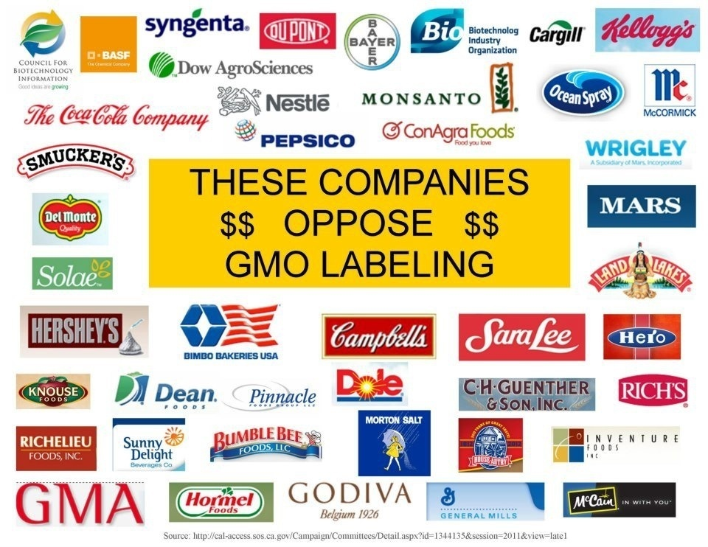

Slide 88
Post-Measure 27 Activities
Scientific-sounding front groups: Council for Biotechnology Information (Dow, Dupont, Monsanto, others), Sense About Science, American Crop Protection Association, GMO Answers, Cornell Alliance for Science, Genetic Literacy Project, International Life Science Institute, American Council on Science and Health (see slide show on this group on phsj website at https://phsj.org/wp-content/uploads/2017/03/Confronting-Pseudoscience-and-Threats-from-a-Corporate-Front-Group-The-American-Council-on-Science-and-Health-2.ppt

Slide 89
Post-Measure 27 Activities
Monsanto, DuPont, and Dow donate millions to NAS
Companies pay to have articles ghost-written, then signed by “independent” scientists
  E.g., Kevin Folta (University of Florida), who did lucrative consulting with Bayer ($200,000, repeatedly denied by Folta) while promoting GM crops, also promoted a Twitter account @askepticalnurse (the nurse in question was actually a cosmetologist)
Monsanto – “Let Nothing Go” program to counter/silence online dissent, discredits journalists

Slide 90
Post-Measure 27 Activities
Between 1999 and 2009, agribusiness spent $500 million lobbying to ease GM oversight, push GM approvals, and prevent GM labeling
  $127 million in 2016
Monsanto: 9 in-house lobbyists, another 13 at private firms
  Spent $4.6 million on lobbying in 2016

Slide 91
Post-Measure 27 Activities
Nationwide: lawsuits against farmers
  Over 700
    Many brought by Monsanto (75 employee, $10 million legal division)
  Most farmers settle; settlement terms often sealed
  2012: Federal Court dismisses class action suit by over 300,000 farmers and 4,500 farms against Monsanto for its “seed police” lawsuits

Slide 92
Post-Measure 27 Activities
But some successful lawsuits by farmers to collect damages for lost crops and lost profits due to GM contamination
Other farmers’ lawsuits pending

Slide 93
Post-Measure 27 Activities
USDA considering compensating farmers harmed by contamination
Laws proposed to prevent lawsuits against farmers affected by contamination (“adventitious spread”)
Oregon Right to Know Genetically Engineered Food Act – Proposition 92

Slide 94
Post-Measure 27 Activities:
Federal Safe and Accurate Food Labeling Act
aka Dark Act – Denying Americans Right to Know Act) signed by Obama (2016)
  Supported by the “National Uniformity for Food Coalition,” an industry group started by the Grocery Manufacturers Association
  Food and agricultural biotech firms and trade associations spent $572 billion dollars on lobbying and campaign contributions from 2000-2010

Slide 95
Post-Measure 27 Activities:
Federal Safe and Accurate Food Labeling Act
aka Dark Act – Denying Americans Right to Know Act) signed by Obama (2016)
  Requires limited/confusing labeling
  Overrides all local labeling laws, supported by industry
  Center for Food Safety, others file lawsuit opposing

Slide 96
Post-Measure 27 Activities:
Federal Safe and Accurate Food Labeling Act
Costs of appeals to FDA could be up to $80 million annually (per CBO)
  Appeals could take years

Slide 97
Food Labeling in the U.S.
Vitamin, mineral, caloric and fat content
Sulfites (allergies)
Source of proteins (vegetarians [6% of U.S. population], vegans [3%])
Kosher/Hallal
  Kosher definition includes non-GMO
Not from concentrate

Slide 98
Food Labeling in the U.S.
Recycled contents
Wild
Union made
Made in USA
Federal government does not require labeling for GM foods, products from animals fed GM foods

Slide 99
Food Labeling in the U.S.
Former President GW Bush opposed labeling of GM foodstuffs
Senator Obama supported labeling (2007)
  President Obama has not stated an opinion
APHA favors labeling

Slide 100
Food Labeling in the U.S.
Obama- and Biden-era Secretary of Agriculture Tom Vilsack
  Supporter of biopharmed crops
  Named Governor of the Year by Biotechnology Industry Organization
  Originated seed pre-emption bill (to strip local governments from GE and biopharmed crops) when governor of Iowa

Slide 101
COOL:
Country of Origin Labeling
2002 Farm Bill mandated USDA begins COOL in 2004
85% favor COOL, 74% support Congress making COOL mandatory, 55% have “little or not much trust” in industry to provide voluntary COOL

Slide 102
COOL:
Country of Origin Labeling
COOL for seafood went into effect in 2005
COOL for meats, fresh/some frozen fruits and vegetables, nuts took effect in 2008
  Processed foods exempted

Slide 103
COOL:
Country of Origin Labeling
Heavy industry lobbying and large campaigns to fight mandatory COOL/support voluntary COOL
  Trade Associations / Big Agribusiness and grocers
WTO rules for Canada and Mexico, authorizes over $1 billion in retaliation against U.S. (2012)
  U.S. appeal refused (2015)
Congress repeals COOL (2015)

Slide 104
Cloned Meats
Approved by the FDA, 2008
  EU has production, but not importation of food and other products from clones
No requirement for labeling
Problems:
  Very expensive, ?growth potential?
  2007: 90% pre-natal failure rate

Slide 105
Cloned Meats
Problems
  Surrogate suffering – spontaneous abortions, “large offspring syndrome” leading to early-term and stressful C-sections
  Post-natal health problems:enlarged tongues, heart/lung/liver/brain damage, kidney failure
  High doses of hormones, antibiotics required (pre- and post-natally)

Slide 106
Cloned Meats
NAS (2004): It is “impossible to draw conclusions about the safety of food from cloned animals”
Next up, synthetic, laboratory-produced meat and chicken (vat-etarian meat
  Up to 25X higher carbon footprint due to production of components
Impossible Burger (plant-based with added GM heme to make burgers appear to “bleed”)
Mid-2020s: market has tanked for GM meats

Slide 107
GE Food Labeling Worldwide
European Union has required since 1998
  European Court of Justice rules public must have access to information re the location of GM crops (2009)

Slide 108
GE Food Labeling Worldwide
64 countries, including Japan, China, Australia, Brazil, India, Russia, South Africa, and Malaysia require labels
  Yet Japan allows 5% GMO contamination, loopholes exempt 90% of Australian foods from labeling, etc.
  2015: Russia, Ukraine bans all GM products

Slide 109
GE Foods Worldwide
Many countries ban planting and the importation of GE foods from the U.S. and elsewhere
  EU lifted ban in 2003 due in part to U.S./Canada/Argentine lawsuit against EU through WTO
  NSW government banned until 2006

Slide 110
WTO Suit Against EU for Import Restrictions on GMOs
WTO ruled against EU (2006)
  Details of secret proceedings leaked to press
  WTO acknowledged that their decision based on trade, and that they were not qualified nor obligated to consider health and environmental consequences

Slide 111
GE Food Labeling Worldwide
Many European countries have banned GMO crops (see later slide)
164 local governments in EU have banned or come out against GE crops
European public strongly opposed to GMO foods
  But, since 1/05, at least 12 GM seeds approved for planting in various EU countries
  Nevertheless, almost 50 GM crops used for animal feed approved in EU
50% of US adults wary of health effects, 40% neutral, 88% agree harm human health, 77% agree harm environment (Pew Research Center Survey, 2020)

Slide 112
GE Food Labeling Worldwide
2014: EU allows individual states to make own decisions on growing GM crops
U.S. government and agribusiness companies pressuring EU to allow GM food imports through Transatlantic Trade and Investment Partnership Agreement
2019: Many European nations have failed to develop testing methods for imported crops, potentially exposing public to illegal GMOs

Slide 113
Government and Industry
Revolving door between industry and federal regulatory agencies
Silencing dissent; firing dissenters
Pseudoscience

Slide 114
Benefits of Labeling GE Foods
Prevent allergic reactions
  Soybeans modified with Brazil nut genes (noted pre-marketing, never commercialized)
Allow vegetarians to avoid animal genes
  Tomatoes with flounder genes (Flavr Savr tomato - antifreeze properties, consumer demand low in test-marketing) – caused stomach bleeding in rat tests
  Ice cream with ocean pout gene (“smoother and creamier” – from Unilever…subsidiary Ben and Jerry’s opposing, since Ben and Jerry’s GM-free)
  “Arctic” – GM apple that won’t brown when cut

Slide 115
Benefits of Labeling GE Foods
Heighten public awareness of genetic engineering
  Millions of Americans eat GM foods every day without knowing it
  Large majority favor labeling
  Only 26% of Americans believe they have eaten GM foods
  40% believe unsafe to eat, support ban

Slide 116
Benefits of Labeling GE Foods
Grant people freedom to choose what they eat based on individual willingness to confront risk
Ensure healthy public debate over the merits of genetic modification of foodstuffs

Slide 117
Health and Environmental Risks of GE Foods
Allergies and toxicities from new proteins entering the food supply
  Eosinophilia Myalgia Syndrome from Showa Denko’s GE-L-tryptophan supplements in 1980s
    FDA covered up
  Bt corn increases sensitivity of mammals to other allergens, increases levels of cytokines and interleukins involved in various autoimmune diseases
    Monsanto data shows Bt proteins expressed by GM plants significantly more toxic than natural Bt toxins

Slide 118
Health and Environmental Risks of GE Foods
Allergies and toxicities from new proteins entering the food supply
  Bt corn toxic to caddisflies, a food resource for fish and amphibians
  Bt toxin can affect bee learning, may contribute to colony collapse disorder

Slide 119
Health and Environmental Risks of GE Foods
Allergies and toxicities from new proteins entering the food supply
  Bt found in blood of 69% of non-pregnant women, 93% of pregnant women, and 80% of fetuses
  GM peas (with bean gene) cause lung inflammation in mice – trial stopped
  GM soy and corn reduce fertility, increase miscarriages, cause GI tract inflammation and hemorrhagic bowel disease in pigs
  New, allergenic proteins in GE soy in South Korea

Slide 120
Food Allergies
3-4% of adults, up to 8% of children and adolescents in the U.S. (FDA)
  Peak between ages 3 and 5
  40% severely affected (wheezing, anaphylaxis, etc.), especially teenage boys

Slide 121
Food Allergies
Food allergies and anaphylaxis may be on the rise
  NAS states insufficient evidence (2016)
  Hospitalizations for food allergies triple 1998 – 2018 in UK (but deaths down)
  ?Partly due to increased recognition and reporting
  ?Partly due to GMOs?
  May be reduced by early introduction of allergenic foods
Asthma twice as common in children with food allergies

Slide 122
Food Allergies
30,000 ER visits and 150-200 deaths/yr
90% caused by ingredients containing protein derived from milk, eggs, fish, crustacean shellfish, tree nuts, peanuts, wheat and soybeans (FDA requires food labeling for these ingredients)
  70% of children outgrow milk and egg allergies by early adolescence

Slide 123
Health and Environmental Risks of GE Foods
Secret Monsanto report found that rats fed a diet rich in GM corn had smaller kidneys and unusually high white blood cell counts
Monsanto’s MON 863 YieldGard Rootworm (GM) Maize damages rats’ livers and kidneys
  Bt eggplant shows similar damage
  Planted in US, Canada, S Africa, Japan, Philipines
  Contamination events
  EU has banned

Slide 124
Health and Environmental Risks of GE Foods
Russian Academy of Sciences report found up to six-fold increase in death and severe underweight in infants of mothers fed GM soy
Austrian study shows impaired fertility in mice fed GM maize
Bt cotton reported to cause skin and respiratory illnesses/allergies in workers in Philippines

Slide 125
Health and Environmental Risks of GE Foods
Altered nutritional value of foodstuffs
Transfer of antibiotic resistance genes into intestinal bacteria or other organisms, contributing to antibiotic resistance in human pathogens
Horizontal gene transfer of gene inserted into GM soy to DNA of human gut bacteria
  Soy allergies increased by 50% after introduction of GM soy into the UK

Slide 126
Health and Environmental Risks of GE Foods
Animal data suggest DNA can be taken up intact by lymphocytes through Peyer’s patches of small intestine and complete genes may pass from food to human blood
Animal studies show adverse effects on multiple organs, including tumors, changes in immune cells and increases in inflammatory mediators, and premature death

Slide 127
Health and Environmental Risks of GE Foods
Seralini et. al. (Food and Chemical Toxicology, 2012)
  2-yr rat feeding study
  Rats fed GM maize (Monsanto’s NK603) and/or low levels of Roundup
  Found severe organ damage, particularly to liver, kidneys, and pituitary gland AND higher mortality AND increased tumors

Slide 128
Health and Environmental Risks of GE Foods
Seralini et. al. (Food and Chemical Toxicology, 2012)
  Study retracted through a non-transparent process after industry backlash and the journal’s hiring of a former Monsanto employee as an associate editor

Slide 129
Health and Environmental Risks of GE Foods
Seralini et. al. (Food and Chemical Toxicology, 2012)
  Journal editor A Wallace Hayes acknowledges that nothing about the study violated the Committee on Publication Ethics’ criteria for retraction, but gives reason that study’s findings are inconclusive (as are many scientific studies’ findings)

Slide 130
Health and Environmental Risks of GE Foods
Seralini et. al. (Food and Chemical Toxicology, 2012)
  Hayes previously VP of biochemical and biobehavioral research at RJ Reynolds, worked as consultant to Monsanto just prior to being hired as editor (still listed as emeritus editor as of 2017)
  Outcry among scientists, ethicists
  Republished in Environmental Sciences Europe (2014)

Slide 131
Health and Environmental Risks of GE Foods
Follow-ups to Seralini study (Antoniou et al., 2015):
  Used female mice from Seralini study, evaluated over 2-yr period
  More than 4,000 genes in liver and kidneys had changed levels of expression (compared with controls)
    Many involved in organ damage
Subsequent feeding studies show higher death rates in rats fed Roundup-tolerant crops

Slide 132
Health and Environmental Risks of GE Foods
Latest technology = RNA interference
  GE crops that produce dsRNA to silence genes AND sprays containing dsRNA (e.g., Monsanto’s SmartStax Pro and similar spray)

Slide 133
Health and Environmental Risks of GE Foods
Micro RNA and short interfering RNA not destroyed during digestion, absorbed, can affect gene expression in animals and humans
  2012 paper showed snippets of RNA (affecting a cholesterol-regulating gene) from food plants in livers of mice which consumed plants
  E.g., Above spray can affect ladybug gene

Slide 134
Health and Environmental Risks of GE Foods
Monsanto conducted feeding studies of GM potatoes (which had been declared unsafe in rats) on Russian prisoners in 1998 (kept secret until 2007)

Slide 135
Health and Environmental Risks of GE Foods
Increased pesticide use when pests inevitably develop resistance to GE food toxins
  5.6 billion lbs/yr pesticides applied annually worldwide
  30% in US
  Reproductive and neurotoxic effects

Slide 136
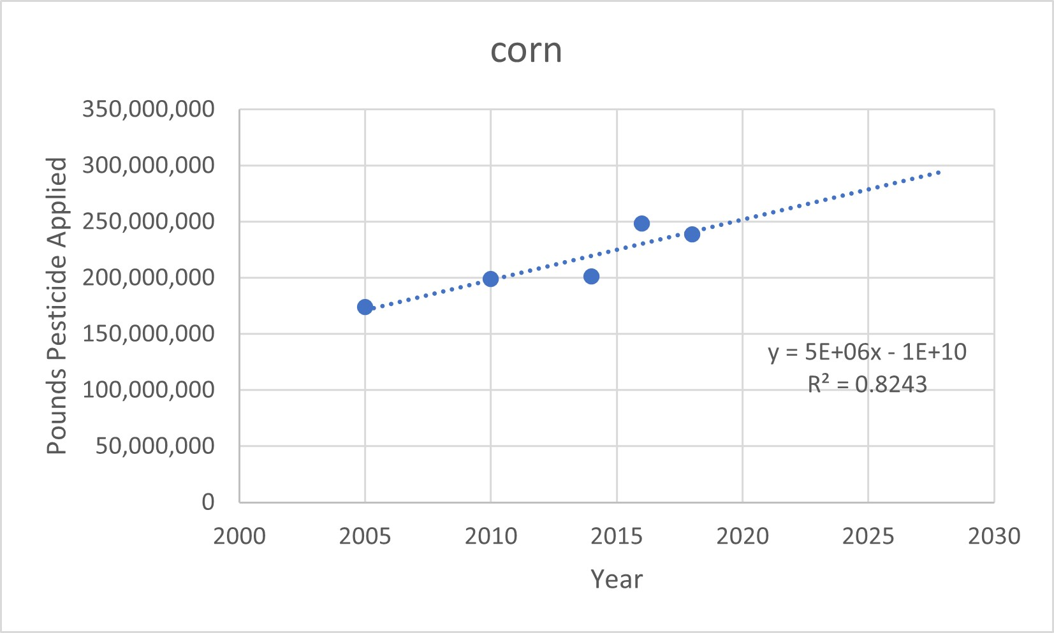
Pesticide Use Increasing (USDA)

Slide 137
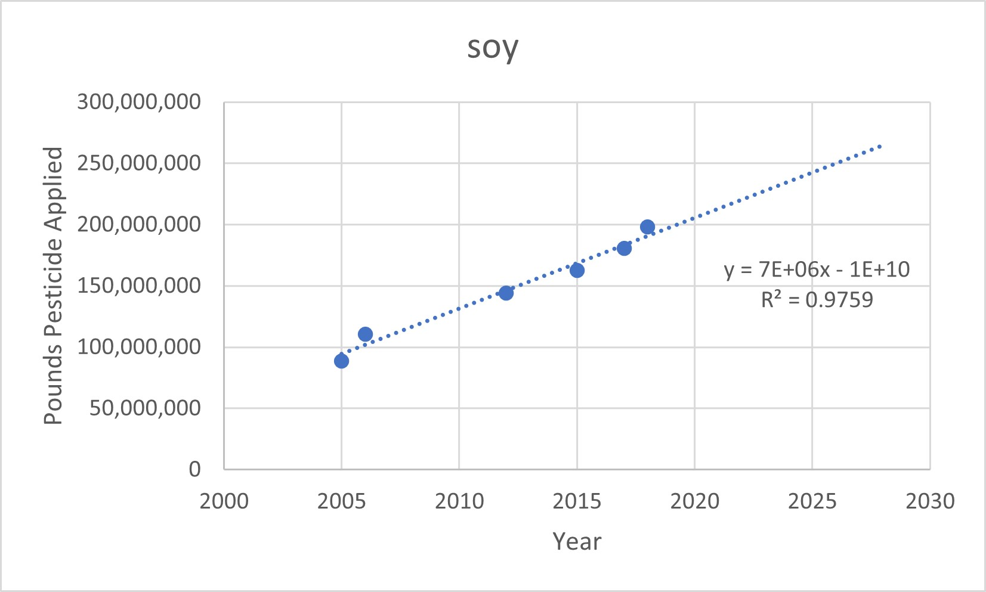
Pesticide Use Increasing (USDA)

Slide 138
Health and Environmental Risks of GE Foods
Greater herbicide use
  Confirmed by multiple studies
  U.S. 1.6 billion kg (19 % of global use[8.6 billion kg]) applied 1974-2014
  15-fold increased use since “Roundup Ready” crops introduced in 1996

Slide 139
Health and Environmental Risks of GE Foods
Greater herbicide use
  2/3 of total U.S. glyphosate use in U.S. from 1974-2014 sprayed between 2004 and 2014 (globally 72 %)
    ¾ lb/acre sprayed on cropland in US, ½ lb/acre worldwide (2014)
    280 million lbs of glyphosate used annualy in US (2012-2018)

Slide 140
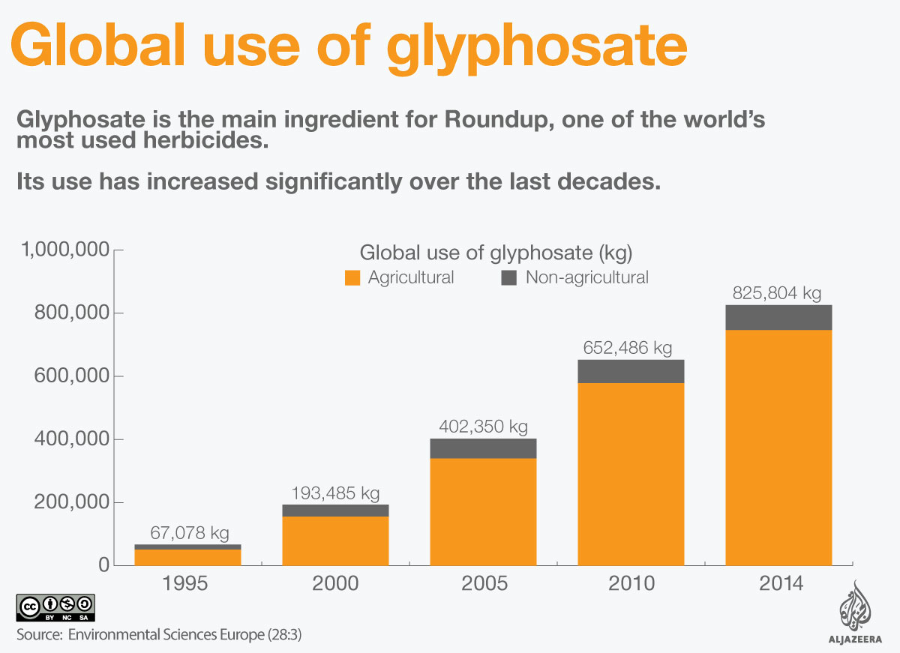

Slide 141
Herbicide Resistance
International Survey of Herbicide Resistant Weeds (2016):
464 unique cases of herbicide-resistant weeds globally among 249 species
Weeds have developed resistance to 22 herbicide sites of action and to 159 different herbicides
Herbicide-resistant weeds found in 86 crops in 66 countries.

Slide 142
Herbicide Resistance
Glyphosate used on over 100 different crops in U.S.
At least 14 weed species in the US have developed glyphosate resistance, affecting over 60 million acres of farmland
  (32 species worldwide)
2015: EPA announces management plan

Slide 143
GM crops and Herbicide Use
  2,4-D resistant already identified (e.g., waterhemp, horseweed)
Dicamba-resistant soybeans, corn, and cotton (Monsanto) approved by USDA and EPA (with safeguards)
  Dicamba volatile, spreads; harms milkweed plants (monarch butterfly habitat); very toxic to fruit, nut, and vegetable plants; may be toxic to oak trees; harms bird habitat
  Pigweed resistance already noted
  Dicamba massively increases rate of development of bacterial antibiotic resistance; increases risk for numerous cancers

Slide 144
GM crops and Herbicide Use
BASF’s isoxaflutole (permitted for use in US) – likely carcinogenic
Mid 2020s: Bayer introduces Vyconic soybeans, the first to feature 5 herbicide tolerances

Slide 145
Health and Environmental Risks of GE Foods
Greater herbicide use
  Glyphosate-tolerant plants require 14-20% more water
  Glyphosate adversely affects root growth by altering local biota; reduces micronutrients necessary for human and animal health (e.g., dairy cows); enhances growth of aflatoxin-producing fungi
    Aflatoxin causes liver cancer

Slide 146
Health and Environmental Risks of GE Foods
Glyphosate (Roundup)
  Toxic to DNA, blood cells, male reproductive function placenta, and animal embryos; increases tumors in lab animals; greatly increases antibiotic resistance
  Increases production of bufadienolides (main compounds of chemical defense) in toads, making them more potentially deadly to their predators
    Including invasive Australian cane toad
  Linked to over 40 plant diseases
  Small concentrations adversely affect fish DNA

Slide 147
Health and Environmental Risks of GE Foods
Glyphosate (Roundup)
  Linked to over 40 plant diseases
  Small concentrations adversely affect fish DNA
  Babies in rural US counties where glyphosate used born slightly earlier and underweight, leading to $1 billion/yr in additional health care costs (PNAS, 2025)

Slide 148
Health and Environmental Risks of GE Foods
Dramatic increase in herbicide use since GMOs developed
  Herbicide use leads to fungal root infections and may increase pesticide use, since many bugs seek out sick plants
  Increases fungicide use, contributing to increased resistance of pathogenic fungi to anti-fungal drugs (e.g., Aspergillus, Candida)

Slide 149
Health and Environmental Risks of GE Foods
Dramatic increase in herbicide use since GMOs developed
  Harmful to monarch butterflies (over 90% decline, due to glyphosate damage to milkweed plants -- monarchs’ only food source and where they lay their eggs -- in Midwest, where monarchs lay their eggs, and to deforestation in Mexico, where they winter); yet population in Mexico starting to increase

Slide 150
Health and Environmental Risks of GE Foods
Herbicides increase relative abundance of soil bacterial species carrying antibiotic resistance genes and lead to more frequent movement of antibiotic resistance genes between bacteria

Slide 151
Health and Environmental Risks of GE Foods
2015: U.S. government to spend $2 million on milkweed and other butterfly friendly plants (on which monarchs feed and lay their eggs)
US hopes to plant more milkweed, Mexico hopes to move butterflies to higher altitude (more fir trees – monarch habitat in Mexico)

Slide 152
Health and Environmental Risks of GE Foods
Glyphosate (Roundup)
  Contains arsenic, lead, chromium, and nickel at levels well above those permitted in drinking water
  Derived from elemental phosphorus extracted from buried phosphate rock
  Phosphorus released by breakdown, leading to eutrophication in water bodies near areas of agricultural use
  Runoff damages coral reefs
  Decreases soil biodiversity

Slide 153
Health and Environmental Risks of GE Foods
Glyphosate (Roundup)
  Refining of ore produces radioactive byproduct (“slag”), which contains radium, as well as mercury, cadmium, and selenium
    U.S. Mercury emissions topped only by 2 coal plants
  Monsanto’s mine near Soda Springs, ID is an active Superfund site contaminating soil, water, and air of Soda Springs and nearby Pocatello, ID (mine still active)

Slide 154
Health Risks of GE Foods
Glyphosate (Roundup)
  In use since 1970s
  Monsanto knew of cancer risks in 1990 (per EPA documents)
    Over 100,000 lawsuits against Monsanto ongoing; $289 million judgement in CA, reduced by judge to $78 million, for groundskeeper who developed NHL

Slide 155
Health Risks of GE Foods
Glyphosate (Roundup)
  2016: EPA states likely not carcinogenic
  2017: CA declares carcinogenic
  2016: FDA plans to test certain foods for glyphosate residues (plans dropped in 2017)
  2017: EPA’s Office of Inspector General investigating possible collusion between Monsanto and former top EPA official who provided favorable assessments of glyphosate
  2019: EPA removes cancer-warning label; California to keep its label

Slide 156
Health Risks of GE Foods
Glyphosate (Roundup)
  US cities ban/restrict use (e.g., Los Angeles; Miami; Portland, OR; Austin; Seattle)
    New York state; London, England
  Countries banning or restricting use include France, Italy, Germany, Austria, Vietnam, Saudi Arabia, etc.
  2023: Bayer stops producing glyphosate for household use

Slide 157
Health Risks of GE Foods
Glyphosate:
  Probable human carcinogen (International Agency for Research on Cancer, WHO)
  European Food Safety Agency (EFSA) dismisses link after counsel from EPA officer (Jess Rowland) allegedly linked to Monsanto; decision also based on assessment plagiarized from industry reports per European Parliament Report
  Int’l Fed of Gyn and Ob (FIGO) calls for phaseout

Slide 158
Health Risks of GE Foods
Glyphosate:
  Investigation uncovers alleged email from Rowland to Monsanto official Dan Jenkins stating, “If I can kill this, I should get a medal”
  Widely used in U.S./world, approved for continued use in E.U. through end of 2017; Germany, France, and Italy ban (2018)

Slide 159
Health Risks of GE Foods
High glyphosate (Roundup – Monsanto, now Bayer, world’s best-selling pesticide) residues in diet
  Linked to sterility (male and female), miscarriage, birth defects, endocrine disruption, diabetes, liver disease (NAFLD, even at low doses), kidney disease, respiratory problems, neurobehavioral problems, neurological disorders (including Alzheimer’s and Parkinson’s), rheumatoid arthritis, AML, Non-Hodgkin’s Lymphoma (in cattle and humans), hairy cell leukemia, multiple myeloma, breast cancer, melanoma, brain cancer, photosensitivity, osteoporosis and fractures, alterations in plant and human microbiomes, other conditions and over 40 plant diseases
  Bayer also produces copanlisib, drug to treat lymphoma

Slide 160
Health and Environmental Risks of GE Foods
High glyphosate (Roundup) residues in diet
  Alterations in microbiome
    May suppress growth of beneficial gut bacteria, leading to overgrowth of pathogenic bacteria
    Suppresses antagonistic effect of enterococci on Clostridium – may account for increases in Botulism in cattle and MRSA and CRE infections in humans

Slide 161
Health and Environmental Risks of GE Foods
Massively increases rate of development of bacterial antibiotic resistance
Glyphosate breakdown releases phosphorus into water bodies, contributing to harmful algal blooms

Slide 162
Health and Environmental Risks of GE Foods
High glyphosate (Roundup) residues in diet
  Chelates copper, manganese, and other ions – possible link with Alzheimer’s Disease
  Interferes with cytochrome P450 enzymes, enhancing damaging effects of other drugs and environmental toxins
  Commercial formulations of glyphosate (and other pesiticides) contains “inert” adjuvants, including nano products (trade secrets)
    All commercial glyphosate samples studied are more toxic than pure glyphosate

Slide 163
Health and Environmental Risks of GE Foods
High glyphosate use linked with chronic kidney disease epidemic in developing world
  Possibly via carrier or vector for heavy metals
  Dehydration, other pesticide exposures likely also contribute

Slide 164
Health and Environmental Risks of GE Foods
2020: EPA draft biological evaluation shows glyphosate likely to injure or kill 93% of the plants and animals protected under the Endangered Species Act and adversely modifies critical habitat for 759 endangered species (96% of all species for which critical habitat has been designated)

Slide 165
Health and Environmental Risks of GE Foods
2023: Bayer stops selling glyphosate in US
2026: Trump issues executive order to increase domestic production of glyphosate citing Defense Production Act (since glyphosate can be used as a defoliant in military operations)
Glyphosate approved for use in EU through 2033

Slide 166
Health and Environmental Risks of GE Foods
Diquat = replacement for glyphosate in US
  Now in Roundup
Banned in EU, UK, China
Triggers inflammation, alters microbiome, and may cause permanent kidney damage, lung/liver inflation
Suspected neurotoxin, may be linked to Parkinson’s Disease
Carcinogenic
With chronic exposure, could be 200X as toxic as glyphosate

Slide 167
Health and Environmental Risks of GE Foods
See Earth Open Source’s report on Roundup on phsj website, “Food Safety Issues” page

Slide 168
Health and Environmental Risks of GE Foods
Diets of placebo group laboratory rodents commonly contain Roundup-tolerant GM crops and glyphosate residues
    May impact result of testing of drugs, environmental toxins

Slide 169
Yield Changes since GE Crops Introduced
No change in yields of herbicide-tolerant corn and soybeans
Insect-resistant Bt corn yields up 3-4%
Non-GE plant breeding and farming methods have increased yields of major grain crops from 13-25%

Slide 170
Health and Environmental Risks of GE Foods
Use of herbicide-resistant GM crops claimed to allow for no-till agriculture (vs. ploughing), which helps sequester carbon in the soil
No-till agriculture: Purported to prevent erosion, retain moisture, leave soil ecosystems intact, decrease carbon emissions
  Per Nature review (2014), the role of no-till agriculture in mitigating climate change is “widely overstated”

Slide 171
Health and Environmental Risks of GE Foods
GM crops have had minimal effect on use of no-till agriculture
But more pesticide runoff from no-till fields than ploughed fields
Alternatively, use of cover crops increase yield/income, even after accounting for their costs

Slide 172
Health and Environmental Risks of GE Foods
Regenerative Farming:
  Involves use of cover crops, crop diversification, reduced or no tillage, reduced chemical and fertilizer application, rotational livestock grazing
  Potential for environmental and productivity gains

Slide 173
GE Crops and Herbicide/Insecticide Use
    Overall insecticide use down 123 million pounds between 1996 and 2011
    But pests now becoming resistant, so insecticide use starting to increase
      Use up 1/3 in cotton
      Bt corn now stacked with total 4 toxins

Slide 174
GE Crops and Herbicide/Insecticide Use
    Meta-analysis of Bt corn and cotton (2013):
      5/13 major pests resistant (compared with 1 in 2005)
    Goss’s Wilt (bacterial disease) spreading across midwest (2013)
      Crop rotation and increased genetic diversity could stop

Slide 175
Bt Plants
    Bt cotton growth in China leads to population explosion of previously insignificant adult mirid bugs, which are now rampaging through fruit orchards and cotton fields
    2009: GM cotton contaminates animal feed in West Texas
Bt cotton destroyed by mealy bug; harvests in India decline dramatically, contributing to suicides among farmers
  Indonesia outlawed Bt cotton

Slide 176
Bt Plants
Bt corn more susceptible to aphids, bollworms, rootworms
  Corn now stacked with 4 toxins, rootworms and earworms resistant to all 4
Bt corn linked to decrease in symbiotic soil fungus that promotes water/nutrient/CO2 exchange
Pink bollworms thriving on Bt cotton in India

Slide 177
Bt Plants
Bt-resistant insects also noted in Puerto Rico and South Africa (moths) and U.S. (beetles)
2010: India halts release of GM brinjal (i.e., aubergine, eggplant) – developer aware of animal toxicities prior to release
2012: India establishes 10 year moratorium on field trials of Bt crops, yet in 2020 bt cotton still most widely planted crop in India (by acreage)

Slide 178
Health and Environmental Risks of GE Foods
Acrylamide released from polyacrylamide (added to commercial herbicide mixtures to reduce spray drift) = neurotoxin, reproductive toxin, and carcinogen
Non-target insects dying from exposure to pesticide-resistant crops
  Ripple effects on other organisms
GM cyanobacterium (designed to convert sunlight, water and carbon dioxide into diesel fuel), other biofuels perpetuate reliance on fossil fuels, worsening global warming

Slide 179
Pesticides
Based on the poison gasses developed in WW I
Vandana Shiva: “We are eating the leftovers of World War I”

Slide 180
Pesticides
5.1 billion lbs/yr pesticides (herbicides/insecticides/fungicides) applied to crops annually worldwide (30% in US)
$73 billion worldwide market (2025)
  17,000 products; 10 firms control 90% of market
81% increase in worldwide pesticide use 1990 to 2020
Top 4 pesticide producers: Bayer, BASF, Cortena, Syngenta (70% of global sales)

Slide 181
Pesticides
CA, NY, and OR are the only states currently tracking pesticide sales and use
  OR system under-funded
Many pesticides used in U.S. banned in other countries
  Pesticides banned in the EU account for more than one quarter of all U.S. agricultural pesticide use

Slide 182
Pesticides
US health and environmental costs $10-12 billion/yr
Annual costs due to loss of lifetime income in EU at least €125 billion
EU has targeted 50% reduction in pesticide use by 2030
  Has banned pesticides in parks, playgrounds and playing fields

Slide 183
Pesticides
EPA estimates U.S. farm workers suffer up to 300,000 pesticide-related acute illnesses and injuries per year; 385 million cases/yr worldwide, including 11,000 fatalities (BMC Public Health, 12-7-2020, up from 25 million in 1990, WHO)
  44% of farmers/agricultural workers (or 860,000 individuals) poisoned each year
NAS estimates that pesticides in food could cause up to 1 million cancers in the current generation of Americans

Slide 184
Pesticides
200,000 deaths/yr worldwide (UN, WHO) – almost all in developing world where use of obsolete pesticides is common
Estimated 14 million people have died from suicide using pesticides since the “Green Revolution” of the 1960s

Slide 185
Pesticides
Even so, the EPA and NAS have OK’d human subject testing…..
Monsanto’s Roundup purchased by US government for aerial spraying in Colombia as part of “War on Drugs”
  2015 – Colombia to stop allowing spraying of Roundup
  2020 – Trump successfully pressures Colombia to resume spraying

Slide 186
Pesticides
Pesticides inhibit nitrogen fixation, decrease crop yields
  Cereals being GM to fix nitrogen from the atmosphere being considered for pollution control
Evidence suggests these actually promote pests (vs. natural pesticides)
    30% of medieval crop harvests were destroyed by pests vs. 35-42% of current crop harvests
  Suggests organic farming may be more cost-effective

Slide 187
Pesticides
Linked to autism, Parkinson’s Disease, Alzheimer’s disease, ALS, diabetes, obesity (with prenatal exposure), depression, ADHD, sleep disorders, and hematological malignancies
Autism spectrum disorders affect 2.5% of U.S. children
Children living on or near farms score 5 points lower on IQ tests and other mental and verbal tests
  May be due to pesticide exposure

Slide 188
Phosphate in Fertilizers
Agricultural runoff contributes to toxic algal blooms, dead zones
  U.S. uses 22 million tons of fertilizer/yr
  For every ton of fertilizer applied to farmers’ fields, 1,200 lbs wasted due to inefficiency (and 400 lbs of that enters streams and aquifers)
    Cover crops (vs. leaving land fallow) would decrease runoff
  Rising temperatures worsen blooms
  Will increase with expected increased rainfall

Slide 189
Algae
Cyanobacteria (blue-green algae can cause gi illness, skin rashes, are hepatotoxic, and may cause liver cancer)
Global warming expected increasing algal blooms

Slide 190
Phosphorus
Phosphorus in dishwater detergents contributes to eutrophication, harmful algal blooms
  Banned in 16 states
Phosphorus
  World supply of phosphorus running critically low
  Composting would recycle, return to soil

Slide 191
Ammonia
Contributes to air pollution and acid rain
Global emissions doubled over last 70 yrs
2/3 of emissions due to livestock waste, 1/3 due to nitrogen fertilizer use
Causes over 200,000 deaths/yr worldwide

Slide 192
Toxins
Body burden of industrial chemicals, pollutants and pesticides high
  Environmental Working Group (2004) found 287 pesticides, consumer product ingredients, and wastes from burning coal, gasoline, and garbage in umbilical cord blood
    Many other compounds not even tested; numbers undoubtedly higher

Slide 193
Health and Environmental Risks of GE Foods - Superweeds
Genes, initially designed to protect crops from herbicides, being transferred to native weeds
Creation of herbicide-resistant “superweeds” – largely due to overuse of herbicides (gene transfer to native weeds from GM crops less likely, but possible – e.g., bentgrass)

Slide 194
Superweeds
2011: 130 types, 21 species identified worldwide, 10 in the U.S. covering 12.6 million acres in 40 states (out of 400 million U.S. farmland acres) – fivefold increase compared with 2007
Cover 60 million acres in US (2026)
Also found in Australia, China, and Brazil, elsewhere

Slide 195
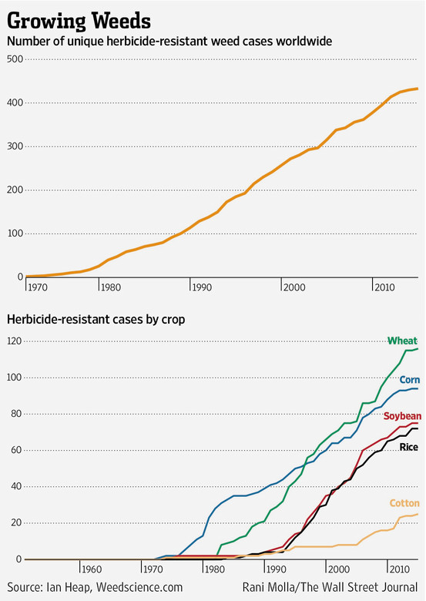

Slide 196
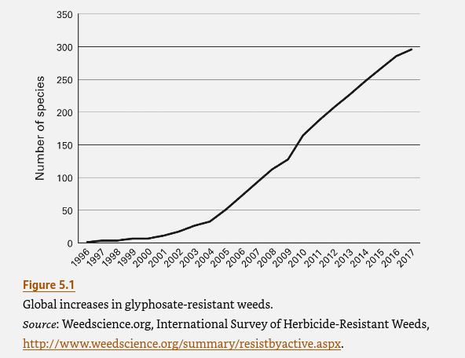

Slide 197
Superweeds in the U.S.
Herbicide-resistant oilseed rape has transferred gene to charlock weeds in U.K.
Glyphosate (Roundup)-resistant palmer amaranth (pigweed) in MO and GA, ryegrass in CA, kochia weed (fireweed) in Kansas and Canada, waterhemp and giant ragweed in Iowa, Johnsongrass and maretail in multiple states

Slide 198
Other Methods of Weed Control
Letting fields go fallow
Rotating crops
Hand-weeding
“Natural” herbicides

Slide 199
Health and Environmental Risks of GE Foods
GE plants and animals interbreeding with wild relatives
  Spread novel genes into wild populations
    Herbicide-resistant oilseed rape genes found in turnips
  21% of U.S. farmers in violation of EPA rule requiring GE fields to contain at least 20% non-GE crop
  ¼ to 1/3 of Mexican corn samples contaminated; Columbian coca plants

Slide 200
Genetic Modification of Conventional Crops
First commercialized in the U.S. in 1994
About 23% of the total 2,970 million acres crops harvested during this period
Vast majority of herbicide-tolerant crops resistant to glyphosate (Roundup, Monsanto) – known as “Roundup Ready”

Slide 201
Roundup
Glyphosate (Monsanto): found in more than 700 products (including for home gardens)
Sales exceeded $5 billion worldwide in 2014
Roundup revenues rose from 2007-2010, then dropped in face of competition from low-priced generics made in China

Slide 202
Roundup
2012: Jury awards $1 billion to Monsanto in patent infringement lawsuit against Dupont over Roundup Ready seed technology
2013: Dupont agrees to pay $1.75 billion to Monsanto over several years in exchange for broad access to Monsanto technologies
  In exchange, $ 1billion jury verdict (and other suits) tossed out

Slide 203
Roundup
Roundup Ready 2 ready for market (uses same gene as RR 1, just placed in a different spot in the genome)
  Designed to maintain market share when RR 1 goes off patent
2016: EU grants Roundup approval through end of 2017

Slide 204
GE Crop Contamination
448 contamination incidents involving 63 countries from 1996-mid 2016
GM Contamination Register: http://link.springer.com/article/10.1186/s40550-014-0005-8

Slide 205
GE Crop Contamination
1/3 of cases involved 33% GE rice, 25% GE corn, 9% GE soy, 6% GE flax
50% of cases involve GE crops originating in US
Affected countries more than double the number of countries where GM crops are grown
At least 17 illegal releases

Slide 206
GE Crop Contamination
Monsanto (1998): Uncontrolled field test of GE (“Naturemark” NewLeaf) potatoes in Georgia (in Eastern Europe) contaminated crops in Georgia, Russia, and Azerbaijan
Crop yields fell by ½ to 2/3
Many farmers went into debt
Non-food GE potatoes (Amflora) approved for planting in UK and Sweden (2010)

Slide 207
GE Crop Contamination
Canadian farmer Percy Schmeiser’s fields contaminated by pollen from nearby GM canola
  Sued by Monsanto
    One of over 700 similar GE-based lawsuits (many brought by Monsanto), costing US farmers tens of millions of dollars
  Canadian Supreme Court ruled that Monsanto’s patent valid, Schmeiser’s fine negligible, Monsanto owns Schmeiser’s crops

Slide 208
GE Crop Contamination
Percy Schmeiser
  Schmeiser then sued Monsanto over new contamination – case settled, Monsanto paid for cleanup, Schmeiser covered all court costs
  Percy and Louise Schmeiser receive 2007 Right Livelihood Awards (the “alternative Nobel Prize”)

Slide 209
GE Crop Contamination
California law now protects farmers from unknowingly violating patent infringement rules
  Similar legislation pending in other states
2011: Monsanto’s new Technology Stewardship Agreement transfers all liability for contamination to farmers

Slide 210
GE Crop Contamination
Starlink Incident (2000)
  Unapproved corn contaminates food supply
    Aventis and EPA fail to notify public; discovered and reported by Friends of the Earth
  $1 billion in food recalls; Aventis pays $500 million to farmers and food producers and processors

Slide 211
GE Crop Contamination
Starlink Incident (2000)
  Less than 1% of corn grown; 12% contaminated
  2003 – 1% of corn still tests positive
  2013 – Starlink corn found contaminating food in Saudi Arabia

Slide 212
GE Crop Contamination
Prodigene Incident (2002)
  GM corn, engineered to produce a pig vaccine, contaminates soybeans in Nebraska and Iowa
  USDA fines Prodigene $250,000; reimbursements to farmers over $3 million
  Prodigene responsible for multiple other violations

Slide 213
GE Crop Contamination
Syngenta illegally distributed hundreds of tons of GM corn, tagged with antibiotic resistance genes, to farmers between 2001 and 2004
  Fined $1.5 million by EPA in 2006
  Syngenta facing civil trial in Germany for concealing toxic effects of Bt corn on cattle

Slide 214
GE Crop Contamination
Syngenta continues to export 41,000 tons of highly lethal pesticide Paraquat to developing world
  Has caused thousands of accidental deaths and suicides worldwide
  Company fined £ 220,000 by British government in 2014 after over 3 tons spilled in industrial accident at manufacturing plant
  Outlawed by UK in 2007; China (world’s largest producer, phasing out its use as of 2017)

Slide 215
GE Crop Contamination
Syngenta faces lawsuits by 355,000 corn growers claiming $13 billion in losses due to contamination by dicamba GE corn (and loss of export markets); soybeans also damaged in multiple states
  2017: loses $218 million jury trial to Kansas farmers
  2017: Settles with more than 100,000 farmers in GE corn marketing scandal

Slide 216
GE Crop Contamination
2018: Some states have banned use of dicamba
2020: US Appeals Court rules EPA approval of dicamba illegal; EPA continues to allow use of dicamba purchased before ruling
2026: Trump EPA reapproves dicamba

Slide 217
GE Crop Contamination
Native Mexican corn varieties contaminated by GE corn
  GM corn now banned in Mexico due to court rulings (2015); Mexico to phase out all glyphosate-treated imports, including corn for livestock, by 2024
  Then ban overturned in 2024
Peruvian corn crops contaminated with GM corn
  Yet GM products cannot be planted, harvested, or sold legally in Peru

Slide 218
GE Crop Contamination
Dow AgroScience GM corn contaminates 53,000 acres in US in 2007
Canadian flax exports contaminated with GE flax devastates flax export sales to Europe (2009)

Slide 219
GE Crop Contamination
Accidental contamination of GE corn in Ireland and throughout Germany (2010)
Australian baby formula contaminated with GM soy (2010)
GM contaminated Canadian flax leads to dramatic reduction in EU imports (2010-

Slide 220
GE Crop Contamination
Corn contamination events have wiped out US corn exports
Concern that Syngenta’s Enogen (“Trojan corn”), engineered for optimal ethanol production to turn its own starch to sugar, may contaminate food corn and turn corn chips and cereals soggy

Slide 221
GE Crop Contamination
Contamination of wild creeping bentgrass with Roundup-resistant Scotts Miracle-Gro/Monsanto GM variety in Oregon (8/06) – whistleblower went public after USDA and Oregon DOA refused to notify public
  Designed to “revolutionize golf course maintenance”
  Contamination found well beyond “buffer zone”
  Threatens $374 million Oregon grass seed market
  Threatens Willamette daisy

Slide 222
GE Crop Contamination
USDA fines Scotts maximum penalty of $500,000
    True costs of contamination likely to be much higher
Scotts fined $12.5 million for illegally including insecticides in bird food products and for submitting false documents to EPA and state agencies (2012)

Slide 223
GE Crop Contamination
U.S. Court of Appeals upholds federal judge’s overturning USDA’s approval of Roundup Ready alfalfa (9/08), re-affirms decision (6/09)
2010: Supreme Court lifts ban
2011: USDA allows unrestricted commercial planting of GM alfalfa

Slide 224
GE Crop Contamination
7% of growers of organic corn, soybeans, and canola reported GM contamination in 2001 study
  Contamination more common today
Canada: Herbicide resistance found to have spread from GM canola to wild relative by pollination
Canola has transferred herbicide-resistance to wild mustard weeds

Slide 225
GE Crop Contamination
Roundup-resistant Johnsongrass contamination in Argentina
Japan: Transgenic canola found growing near some ports and roadsides
  Since canola not grown commercially in Japan, imported seeds likely escaped during transportation to oil-processing facilities

Slide 226
GE Crop Contamination
Heinz baby food sold in China found to contain illegal GM rice containing Bt toxin gene sequences
Syngenta found to be conducting illegal trial with GM soybeans in Iguacu National Park in Brazil
Syngenta found responsible in Brazilian court for murder and attempted murder of rural workers opposed to GMOs

Slide 227
GE Crop Contamination
GM foods found in 1/3 of National Wildlife Refuges in the Southeastern US
2012: Federal court bans GM crop plantings on NWRs and orders mitigation
  2014: Fish and Wildlife Service to comply
  2024: Department of Interior reverses ban

Slide 228
GE Crop Contamination
Bayer CropScience herbicide-tolerant “Liberty Link” rice contaminates food supply (2006)
  Bayer keeps contamination secret for 6 months, then US government takes another 18 days to respond
  Places $1.5 billion industry at risk
  Worldwide cost estimates range from $740 million to $1.3 billion
  Bayer loses first three cases for total $53.5 million
    Later agrees to pay up to $750 million to farmers in Missouri and 4 other states

Slide 229
GE Crop Contamination
EU initially requires testing of all imported rice, then stops in response to US pressure
  EU lifts ban (2010)
Japan/South Korea ban imports of US rice
China may be first developing country to allow the sale of GM rice (huge market)
  But, System of Rice Intensification plan (which can dramatically increase yields and lower water use) favored by many

Slide 230
GE Crop Contamination
Bayer keeps contamination secret for 6 months, then US government takes another 18 days to respond
9/06: 33/162 EU samples tested positive for Liberty Link contamination
Former USDA Secretary Mike Johanns: “I didn’t ask where [the contaminated samples] came from…I can’t tell you if it came from this state or that state.” (8/18/06)

Slide 231
GE Crop Contamination
2013: GE wheat found in OR
  Last test plot in OR was 2001 (test plots in ND since 2011)
2014: GE wheat contamination found in MT
Small amount of WA state alfalfa crop contaminated with GM alfalfa
Alberta wheat contamination

Slide 232
GE Crop Contamination
Long-term effect on economy concerning
  Oregon’s wheat crop valued at $300 million - $500 million (depending on yield and price)
  US exports ½ of wheat crop
  Fortunately no GM wheat entered commercial market
  2014: Monsanto settles with Pacific NW wheat growers for $2.1 million

Slide 233
GE Crop Failures
Bt cotton in India led to increased insecticide use, failed to increase yields, led to epidemic of suicides
  Shame of unpaid debt (including for Bt crops) key contributor
India’s cotton production way down, imports cotton from US
Three varieties of Monsanto’s GM maize failed to produce crops in 2008/9 in South Africa
  Commercial farmers compensated, but barred from speaking to media or public
Others

Slide 234
Economic Risks of GE Crop Contamination
Recent studies have cast doubt on the economic utility of GM crops for farmers in North America
  Lower yields
  Higher input costs
  2001-2013: Price of Monsanto GE soybeans and corn seeds more than doubles

Slide 235
Economic Risks of GE Crop Contamination
Contamination could be devastating for local farmers
  Buffer zones inadequate
Agriculture major industry in Oregon
Oregon agricultural production $6.8 billion (2021)
  $968 million organic market (2021)
  491 organic farms (2026)

Slide 236
Effects on Organic Farmers
17,181 organic farms in U.S. (2025)
Costs to prevent GM contamination = $6,532 - $8,500
May be much higher, as other estimates show cost of planting required buffer zone = $2,500 to $25,000 per year AND cost of delayed planting $300 to $5,000 per year
Pesticide drift can also harm organic farmers

Slide 237
Response to Contamination
The most common response to contamination worldwide is for companies and governments to raise the allowable contamination threshold
  UK Environment Minister (7/06) calls for “pragmatic co-existence”: “In the real world, you can’t have zero cross-pollination”
  EU labeling rules now allow 0.9% contamination in “GM-free” foods

Slide 238
Toxicity of U.S. Agriculture
Agriculture sector contributes to more than 12,000 premature deaths (2018) from particulate matter due to air pollution
48-fold increase in toxicity to insects (1998-2018)
  40% of world’s insects facing extinction in next two decades

Slide 239
Health and Environmental Risks of GE Foods
GE crops out-competing, or driving to extinction, wild varieties, or becoming bio-invaders in neighboring farms or other ecosystems
GE plants adversely altering soil bacteria and consequently soil quality

Slide 240
Pesticides/GE Foods Likely Contributing to Decline in Honeybee Populations
Pollinators provide estimated $15 billion in annual ecosystem services (mostly pollinating food crops)
  $12 billion from honeybees
  1.4 billion jobs worldwide depend on pollinators

Slide 241
Pesticides/GE Foods Likely Contributing to Decline in Honeybee Populations
Pollinators play a key role in 35% of global food production, are responsible for 40% of world’s micronutrient production
90% decline in pollinators over last 2 decades
40% of bees at risk of extinction per UN

Slide 242
Pesticides/GE Foods Likely Contributing to Decline in Honeybee Populations
Neonicotinoids (main culprit, most widely used pesticide in the world) applied to nearly 100% of US corn and majority of US soybean crops – major contributor to honeybee die-offs; harm songbird/interfere with their migration
  2018 review of over 200 studies shows little effect on crop yields

Slide 243
Pesticides/GE Foods Likely Contributing to Decline in Honeybee Populations
Cry1Ab protein present in Bt crops affects learning responses associating nectar sources with odorants
Smartstax soybeans contain clothianidin, an insecticide implicated in colony collapse disorder (honeybee die-offs)
Glyphosate exposure impairs bee learning

Slide 244
Neonicotinoid Pesticides
Multiple agents approved by EPA
2017: Federal Court rules EPA systematically violated the ESA during approval
2018: USFWS allows on national wildlife refuges
Temporary ban in EU since 2013, but many countries have allowed use due to loopholes
2019: US EPA bans use
Possible replacement, Sulfoxaflor, also toxic to bees
Robo-bees under study

Slide 245
Pesticides/GE Foods Likely Contributing to Decline in Honeybee Populations
Other possible causes of colony collapse disorder also exist (e.g., varroa destructor mites [spread deformed wing virus], fungal disease, aluminum, decline in goldenrod pollen protein[due in part to rising CO2]; glyphosate)

Slide 246
Health and Environmental Risks of GE Foods
Further decrease in agricultural biodiversity
  UN FAO estimates 75% of the genetic diversity in agriculture present at beginning of 20th Century lost
Unknown effects on integrity of global food supply from large-scale genetic rearrangements

Slide 247
Health and Environmental Risks of GE Foods
Some corporations producing GE foods have not been able to get insurance due to excessive liability risks
Deutsche Bank (Europe’s largest bank) has advised large institutional investors to sell their shares in GE companies
The Large Scale Biology Corporation (formerly Biosource Genetics), the first company to try to produce plants genetically-modified to make drugs and industrial chemicals, went bankrupt in 1/06

Slide 248
Failure of Regulatory Oversight
“The Department of Agriculture has failed to regulate field trials of GE crops adequately”
  Department of Agriculture’s Office of Inspector General, 1/06
Required environmental impact and endangered species analyses rarely performed
2011: USDA begins pilot deregulation program allowing biotech firms to conduct environmental reviews of their own GM crops

Slide 249
Failure of Regulatory Oversight
Nearly 1/5 FDA scientists “have been asked, for non-scientific reasons, to inappropriately exclude or alter technical information or their conclusions in an FDA scientific document”
  Similar to global warming report from NASA, Plan B EC data, Medicare Part D data, etc.
  A new “Dark Ages” for US science
FDA under-funded and under-staffed
    Only ¼ of FDA’s resources allocated to food program, down from ½ in 1972

Slide 250
Obama Administration Officials Had Links to/Support Biotech Crops
  Agriculture Secretary Tom Vilsack: once named Governor of the Year by Biotechnology Industry Organization
  Former USDA Chief Scientist Roger Beachy (founding president of non-profit research institute founded by Monsanto) – resigned May, 2011
  Chief Negotiator on Agricultural Issues in Global Markets Islam Siddiqui: former pesticide lobbyist
  USDA General Counsel Ramona Romero previously corporate counsel to DuPont

Slide 251
Obama Administration Officials Had Links to/Support Biotech Crops
DOA Under Secretary for Agriculture for Research, Education and Economics Catherine Wotecki: former global director of scientific affairs for junk food giant Mars, Inc., ties to Monsanto
Director of the U.S. Agency for International Development Rajiv Shah: previously worked for Bill and Melinda Gates Foundation, a big proponent of GE crops and significant investor in Monsanto

Slide 252
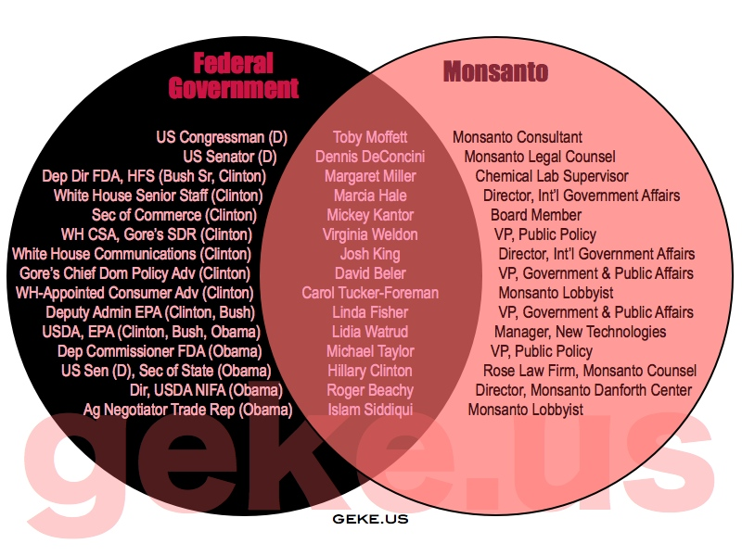

Slide 253
Government Support for Biotech Crops
Supreme Court Justice Clarence Thomas: former General Counsel for Monsanto (Bush I appointee)

Slide 254
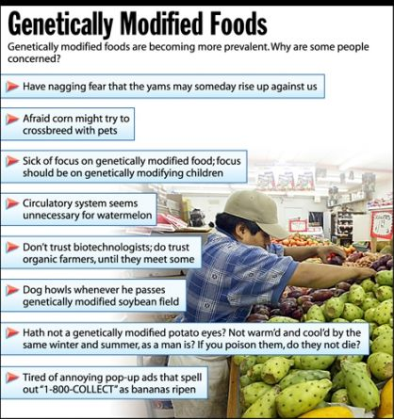

Slide 255
Biopharming
The engineering of plants to produce pharmaceuticals such as enzymes, antibiotics, contraceptives, abortifacients, antibodies, chemotherapeutic agents, other medications, vaccines, and industrial and research chemicals
None yet approved by FDA for marketing

Slide 256
Biopharming
Rationale:
  Farmers/farms cheaper than technicians/manufacturing plants
  Inexpensive scale-up and scale-down; hire or fire contract farmers
  Seeds/silos may be cheap storage system
  ?Cheaper drugs? – doubtful given history of pharmaceutical industry pricing patterns; also, multiple externalized costs

Slide 257
Biopharming
Approximately 400 field tests worldwide since 1991 (101 in U.S.); 187 tests worldwide (2022-2023)
  None yet in Oregon
    U of Wisconsin trial of alfalfa genetically-modified to produce amylase and lignin peroxidase approved in 1995, apparently did not go through
  USDA does not regulate indoor biopharm crops

Slide 258
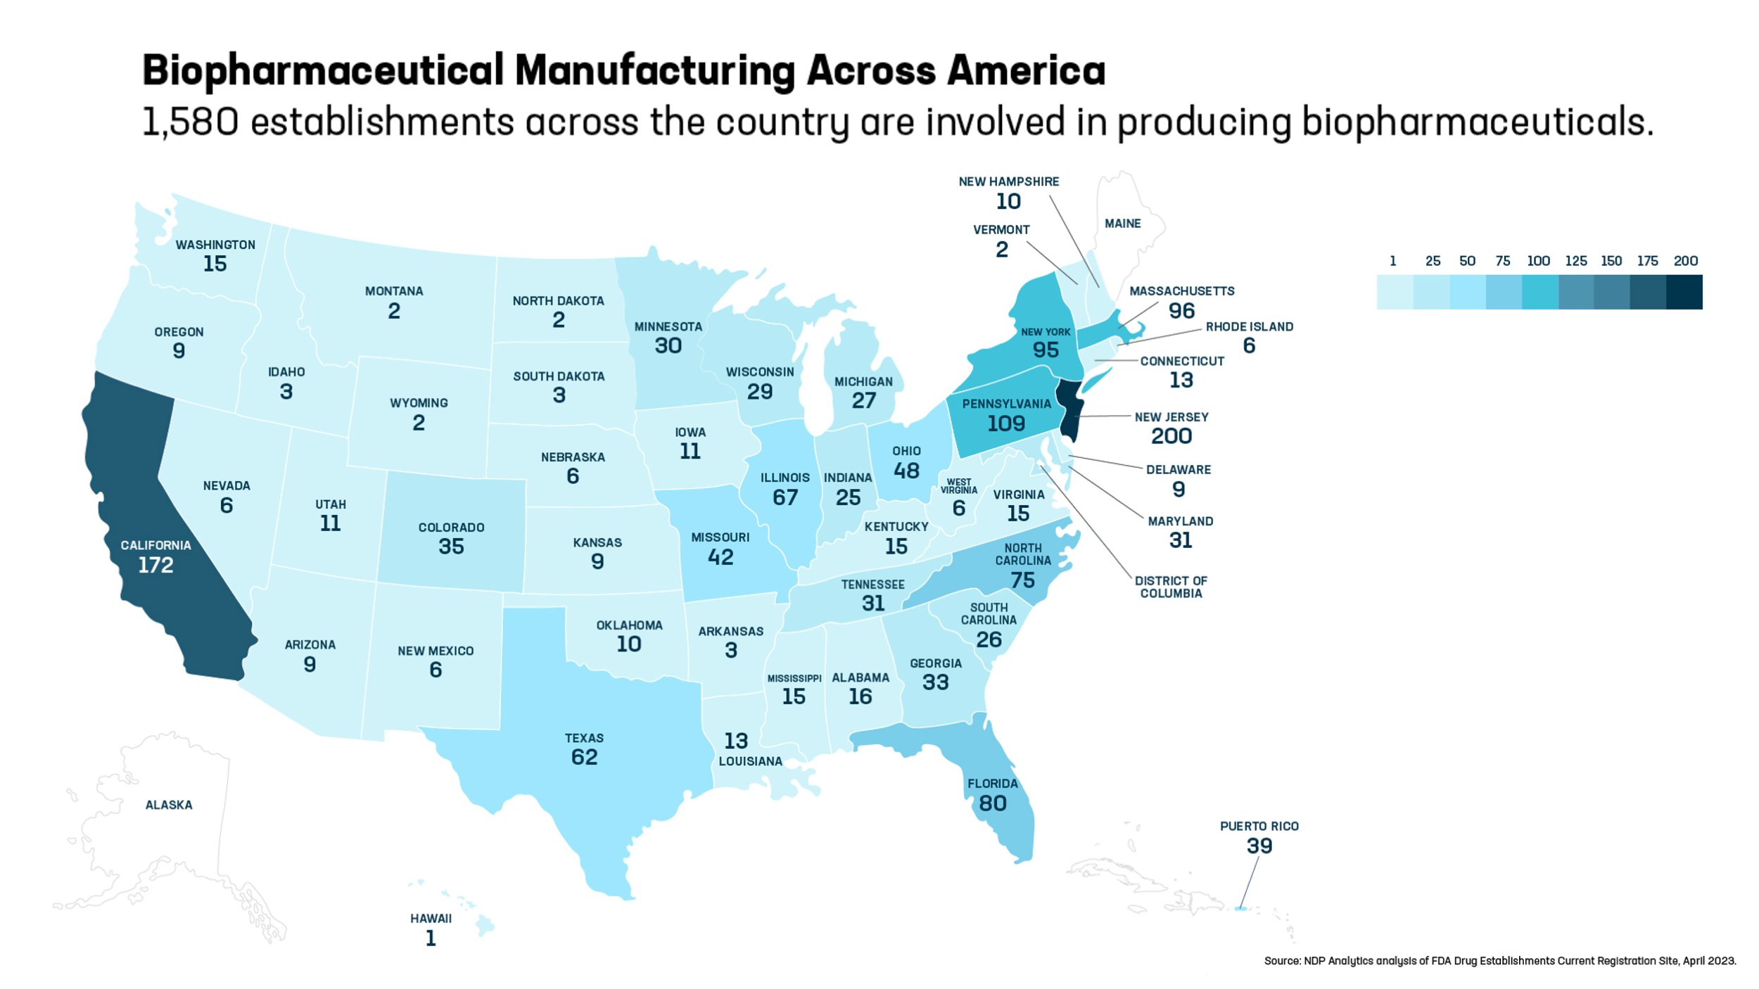

Slide 259
Biopharming
Hawaii – second most tests; most fragile ecosystem
Risks similar to GE crops
  e.g., cases of food crop contamination reported
    Prodigene incident, Starlink incident
  Concerns that pharma trait could increase in frequency and concentration reaching dangerous levels in unwitting consumers

Slide 260
Biopharming
More than 15 companies, along with 5 universities, involved in US (75 companies worldwide)
  Missouri has subsidized a biopharm research center
Ventria Bioscience to plant rice genetically-engineered to produce lactiva and lysomin (anti-diarrheals) in Kansas, despite contamination of Mexican rice by US GM rice

Slide 261
Biopharming
USDA conceals crop locations from public and neighboring farmers, in most cases hides identity of drug or chemical being tested, citing trade secrets
  Even state agriculture regulators often unaware of info re drug or chemical involved

Slide 262
Major Biopharm Crops
Corn
Soybeans
Tobacco
Rice
Other organisms:
  Fish: tilapia/clotting factor VII
  Cattle: biopharming via milk

Slide 263
Examples of biopharmed crops
Drug/Chemical | Use | Test Crop
Laccase | Textiles, adhesives | Corn
Folic acid Vitamin D | Vitamin Vitamin | Tomatoes
Erythropoeitin | Anemia | Tobacco

Slide 264
Examples of biopharmed crops
Drug/Chemical | Use | Test Crop
Essential fatty acids | Cell membrane production | Soybeans
SARS vaccine | Immunization | Tomato
Vaccine against pollen allergies | Immunization | Rice

Slide 265
Examples of biopharmed crops
Drug/Chemical | Use | Test Crop
Traveler’s and other Diarrheas (*including use of human genes in outdoor plants, such as E. coli enterotoxin) | Immunization/ Drug | Rice, Potatoes and Corn

Slide 266
Examples of biopharmed crops
Drug/Chemical | Use | Test Crop
Insulin | Treatment of Diabetes | Safflower
Insulin-like Growth Factors | Diabetes, Growth, Carcinogen | Rice

Slide 267
Potentially Harmful Biopharmaceuticals
Substance | Use | Known or Potential Effects
Acanthocyanin in tomatoes | Antioxidant, anti-cancer agent | Unknown
Aprotinin in corn | Blood clotting | Pancreatic disease, allergic reactions

Slide 268
Examples of biopharmed crops
Lycopene in pineapples (turns pineapples pink) | Anti-oxidant | Cancer risk reduction
Oilseeds producing enhanced omega-3 fatty acids | Omega-3 fatty acids | Cardiovascular disease; however, oils used caused wing deformities in cabbage white butterflies

Slide 269
Potentially Harmful Biopharmaceuticals
Substance | Use | Known or Potential Effects
Anti-sperm antibody in corn | Contraception | Adverse reproductive impacts
Trypsin in corn | Enzyme - research, industrial uses | Occupational asthma
Avidin in corn | Research | Vitamin B deficiency, allergic reactions

Slide 270
Potentially Harmful Biopharmaceuticals
Substance | Use | Known or Potential Effects
Ebola immune complex in Nicotiana benthamiana | Vaccine against highly pathogenic, dangerous virus | Immune system effects
Taliglucerase alfa in carrots (Elelyso, Protalix Biotherapeutics) | Gaucher’s Disease | Two similar drugs made in mammalian cells already available

Slide 271
Potentially Harmful Biopharmaceuticals
Substance | Use | Known or Potential Effects
Tricosanthin in tobacco | Failed anti-HIV drug | Highly toxic - allergic reactions, induced abortions
Alpha-amylase in corn | Digests starch to sugars (aids biofuel production) | unknown

Slide 272
Other Biopharmed Crops Under Investigation
Plastic polymer in switchgrass
Anti-HIV monoclonal antibody in Agrobacterium
Interleukin-10 in tobacco plants
Bioglow (grow in the dark tobacco plant – purpose?)
Malaria vaccine components in green algae
GABA in tomatoes (to “reduce stress and improve sleep” – now being sold in Japan by Sanatech)

Slide 273
Plant cell culture “biopharming”
Dow AgroSciences has won USDA approval of a chicken vaccine against Newcastle Disease produced in fermented tobacco plant cells
Anti-HPV vaccine in tobacco cell chloroplasts
Not strictly biopharming; more like cell culture

Slide 274
Opposition to Biopharming
National Academy of Sciences
Union of Concerned Scientists
British Medical Association (favors moratorium on all GM foods)
Consumers Union

Slide 275
Opposition to Biopharming
Grocery Manufacturers of America
National Food Processors Association
Organic Consumers Association
Friends of the Earth
Others

Slide 276
Biopharm Proponents Claims Inflated/Unrealistic
Containment-related costs may equal or exceed purported reduced drug production costs
Increased economic liabilities assumed by food manufacturers, farmers, and pharma crop companies for potential contamination of food supply

Slide 277
Biopharm Proponents Claims Inflated/Unrealistic
Farmers are unlikely to be major beneficiaries:
  Market forces, including foreign competition, will drive down farmer compensation
  Acreage required very small compared with commodity crop acreage, such that only a small number of growers will be needed

Slide 278
Biopharm Proponents Claims Inflated/Unrealistic
Rural communities are unlikely to be major beneficiaries unless:
  The local pharma crop brings in substantial research contracts for universities and private research firms
  Pharmaceutical processing companies locate in the area
  Land grant university public funding relatively flat while private funding growing rapidly

Slide 279
Biopharming in HI:
First Federal District Court Ruling (8/06)
USDA violated the Endangered Species Act and the National Environmental Policy Act in granting pharma crop permits in HI
  Failure to protect HI’s 329 endangered and threatened species
  Failure to conduct even preliminary investigations prior to its approval of the plantings
Appeals expected

Slide 280
Genetic Modification of Lower Life Forms
Human microbiome project expected to lead to many GM bacteria to treat various conditions
  E.g., GM Lactobacillus acidophilus for Crohn’s Disease
GE algae (for use as fuel): dangers include worldwide spread and possible weaponization to destroy fish stocks

Slide 281
Genetic Modification of Fungi
Metarhizium anisopliae fungi genetically-modified with human antibody and scorpion toxin genes under investigation for malaria control
  These fungi can infect anopheles mosquitoes, which carry malaria parasite

Slide 282
Genetic Modification of Invertebrates
Jellyfish green fluorescent protein inserted into a variety of organisms
Silkworms modified to produce spider silk (which can then be used in surgical thread or bulletproof vests
Genetically-modified mosquitoes and aquatic invertebrates for biocontrol

Slide 283
Genetic Modification of Trees
Purposes:
  Faster growing, stronger wood, greater wood and paper yields
  Hardier trees requiring less chemical bug and weed killers
    Yet Roundup-Ready poplar first GM-tree, and Bt-poplars among first trees marketed

Slide 284
Genetic Modification of Trees
Purposes:
  Disease-resistance
  Cold-tolerance
  Decrease amount of toxic chemicals needed to process trees into paper
  Change color when exposed to bioterrorism agents

Slide 285
Genetic Modification of Trees
Purposes:
  Mercury-splicing bacteria for soil cleanup
    Removes Hg²⁺ ions from contaminated soil and converts it into volatile elemental mercury, which is released into the atmosphere, is converted by phytoplankton to organic mercury, is dispersed widely, and then works its way up the food chain
    Danbury, CT field trials (hat making industry – the “Danbury shakes”)
      Supported by EPA

Slide 286
Genetic Modification of Trees
230 experiments thus far involving at least 16 countries and 24 species, more than half since 2002
  Sites kept secret
    One Canada plot of Bt spruce and poplars planted outside Quebec City, 2006
  Trees sterile

Slide 287
Genetic Modification of Trees
Hawaiian papaya trees (genetically-modified to resist ring spot virus) – devastated $22 million papaya economy, as Canada and Japan refused to purchase
    Deregulated by APHIS, 2009
    Resistant papaya developed through conventional breeding
    Viral mutations arising

Slide 288
Genetic Modification of Trees
ArborGen’s GE loblolly pine engineered to have more dense wood
Planting of over 250,000 ArborGen GE Eucalyptus trees planned for seven states southern U.S. (incl. FL) – awaiting USDA approval
  Designed to tolerate cold, grow fast
  To feed biomass facilities

Slide 289
Genetic Modification of Trees
GE Eucalyptus
  May spread outside natural geographic boundaries (are considered invasive pests in CA and FL)
  Deplete water table (require twice as much water)
  Flammable - increase risk of fires
  Would worsen global warming

Slide 290
Genetic Modification of Trees
GM poplar trees modified to produce extra sugars for use in biofuels
  GE poplar and pine also being engineered for lower lignin content…but lignin helps maintain structural integrity and helps repel pests and pathogens
GE citrus designed to resist “greening disease” undergoing field tests in Florida

Slide 291
Genetic Modification of Flowers
GM dandelion modified to produce latex that doesn’t polymerize when exposed to air (to decrease latex allergies)
GM petunias (African Suncet petunias, sold by Sears/others) GM to appear orange, red, and purple
  Found in EU, Finland
  USDA required US distributors to destroy plants
GM plants designed to make their own fertilizer under study
Houseplants modified to break down pollutants

Slide 292
Genetic Modification of Trees
Risks same as for GE crops
UN Convention on Biological Diversity has called for moratorium (3/06)

Slide 293
Genetic Modification of Vertebrates
Proposals to breed cattle to decrease components of their microbiome which contribute most to greenhouse gas emissions (14% due to beef and milk production); quicker alternative is a probiotic for cattle
Proposals to breed cattle to decrease components of their microbiome which contribute most to greenhouse gas emissions (14% due to beef and milk production); quicker alternative is a probiotic for cattle

Slide 294
Genetic Modification of Vertebrates
Contains growth hormone gene from chinook salmon and genetic on-switch from the ocean pout)
  Designed for more rapid growth (18 months to maturity, vs. 3 yrs)
  Aquabounty states it will only produce sterile females

Slide 295
Genetic Modification of Vertebrates
Farmed salmon fed synthetic pigments (petrochemical dyes)
Fish farms becoming toxic toilets due to localized waste, synthetic chemicals
Concern for increased alterations in seafood disease patterns and antimicrobial resistance
Fish farm waste may also contribute to the spread of antimicrobial resistance

Slide 296
Genetic Modification of Vertebrates
2017: Up to 80% of farmed salmon in B.C. infected with piscine reo-virus
  Associated with heart-and-skeletal muscle inflammation disease in salmon
  Concerns re spread from farmed “Atlantic” salmon to wild salmon (virus has been found in some pacitic wild salmon)

Slide 297
Genetic Modification of Vertebrates
Concerns re Aquabounty GM salmon:
  Lower jaw deformities with always-on growth hormone make them voracious eaters, could outcompete wild fish if escape
  Up to 15% may escape pens and interbreed with wild stocks, decreasing the species’ reproductive fitness (5% sterile, most weak)

Slide 298
Genetic Modification of Vertebrates
Concerns re Aquabounty GM salmon:
  Hybridize with wild brown trout
  Susceptible to Infectious Salmon Anemia virus
  Salmon lice infections plaguing salmon farms
    Cost salmon farming industry $1 billion in 2016
  GE salmon have higher levels of IGF-1 (associated with increased cancer risk)
  Lower omega-3 to omega-6 ratio
  No published human or animal feeding trials

Slide 299
Genetic Modification of Vertebrates
Farmed salmon already contain lower levels of omega-3 fatty acids, higher levels of PCBs
WA, OR and MD have banned
Multiple grocery outlets refuse to sell
2016: FDA bans import and sale pending development of labeling guidelines
2019: Ban lifted
2020: Harvesting in US begins, Company has GE trout and tilapia under development
2024: Aquabounty ceases US and Canadian production of GM salmon

Slide 300
Genetic Modification of Invertebrates
Sterile male Aedes GM mosquitoes tested in Cayman Islands and Brazil; both countries, and Malaysia, cancelled testing
Plans for releases in Panama (Florida Keys plan dropped)
2021: experimental releases in Florida and Texas approved by EPA, beginning in 2021
Limited to no public consultation/notification

Slide 301
Genetic Modification of Invertebrates
Eliminating Aedes mosquito could result in explosion of more aggressive disease-carrying mosquitoes (e.g., Aedes albopictus [Asian Tiger mosquito], which carries dengue, zika, and chickungunya
  Oxitec aware that this might then require release of its GE Aedes albopictus)
  Brazilian study led to increasing robustness of of disease-bearing mosquitoes, genomes of modified insects showing up in wild ones

Slide 302
Genetic Modification of Invertebrates
Designed to compete with wild males to combat dengue fever, yellow fever, zika virus (incidence climbing, 50 million to 100 million infected in more than 100 countries, 10,000 fatalities/yr)
  Tested in Australia, Indonesia, Brazil, Vietnam, Africa (where volunteers are paid 69 cents/hr to allow themselves to be bitten by mosquitoes, risking malaria, in a trial funded in part by the Gates Foundation)
2021: Data show genetic switch not foolproof, with some “sterile” insects reverting to being fertile

Slide 303
Genetic Modification of Invertebrates
  Common bacteria Wolbachia pipientis already known to eliminate dengue virus (and malaria) without harming mosquitoes (infected males unable to reproduce; only females bite)
    Early trials show success in combating dengue and zika
  Microsporidia-infected Anopheles mosquitoes can block malaria transmission
  NIH-developed dengue vaccine looks elicited strong immune response in recent trials
  Zika funds running out (Congress failing to act due to Republicans’ desire to keep any funding from Planned Parenthood)

Slide 304
Genetic Modification of Vertebrates and Invertebrates
Oxitec (Oxford U. investor, acquired by Inextron [which also owns AquaBounty] in 2016, close ties with Syngenta – now ChemChina)
  Developing other forms of GM agricultural pests to combat resistant pests caused by use of Bt maize, soybeans, and cotton (GE bollworms, diamondback moths)
Japan planning to market GI-red sea bream with more muschle mass

Slide 305
Genetic Modification of Vertebrates and Invertebrates
Oxitec
  Field testing female diamondback moths which die before reaching adulthood (to combat these agricultural pests and decrease insecticide use)
  Has developed sterile Mediterranean fruit flies (but dead larvae remain inside olives and fruit)

Slide 306
Genetic Modification of Vertebrates and Invertebrates
Oxitec
  Released genetically-modified mosquitoes in Florida in 2025
    Infants were supposed to die, but some survived and bred with wild varieties
  Oxitec also producing Wolbachia-infected mosquitoes in Brazil

Slide 307
Genetic Modification of Vertebrates and Invertebrates
2020: Precigen planning to sell off GM Arctic Apple, Aquabounty GMO salmon, and Oxitec GM mosquito businesses, mostly to Third Security (venture capital firm)
2026: Aquabounty has ceased all aquaculture operations
2026: No GM salmon being sold anywhere in the world

Slide 308
Genetic Modification of Invertebrates
GM Mediterranean fruit flies with “pre-pupal female lethality” (only males survive, dead female larvae effects on plant unknown, overall effects unknown
GM silkworms modified with spider gene to produce hybrid fibers
Concerns re potential for weaponization of GM insects

Slide 309
Genetic Modification of Vertebrates
GM tadpoles designed to fluoresce in presence of toxins
California banned sale of GM Glofish (created via insertion of jellyfish and sea anemone genes), zebra fish that glow in the dark
  Escaped into wild in Brazil
  Other glowing fish designed to identify environmental toxins

Slide 310
Genetic Modification of Vertebrates
“Ruppy” (Ruby Puppy)
  Glows red under UV light
  Developed in South Korea, 2009, using red fluorescent gene from sea anemones
Artist Eduard Kac:
  glow-in-the-dark rabbit
  “plantimal” (petunia-human hybrid)

Slide 311
Genetic Modification of Vertebrates
“Popeye Pig” – Pig GM with spinach gene, designed to have less saturated fat
Pigs modified with roundworm gene to make their own (heart healthy) omega-3 fatty acids
  Accidentally turned up in poutry feed sold throughout Ontario(2004)

Slide 312
Genetic Modification of Vertebrates
1980s: US DOA funded research creating GM pigs with hGH gene – led to birth of sickly, infamous Beltsville pigs
Goats GM to make anti-nerve gas agent
Oncomouse – GM to predispose it to cancer (used in research)
Knock-out mice (lacking gene regulating fear)!

Slide 313
Biopharming of Vertebrates
Mousepox virus GM to produce IL-4 (immunocontraceptive) inadvertently killed 3/5 of infected mice, even those genetically resistant to mousepox
Transgenic sheep produce alpha-1-antitrypsin
Transgenic pig produce no alpha-gal sugar on cells’ surfaces (FDA-approved for human consumption and to treat alpha-gal syndrome)

Slide 314
Biopharming of Vertebrates
“Enviropig” – GM modified with E. coli and mouse DNA to digest phytates, decrease phosphate in excrement
  Phytase (pig feed supplement) does same thing
  Pigs on small farms eat grass, so minimal phytates
  Pig feed can already be supplemented with phytase
  Idea shelved (2012)

Slide 315
Biopharming of Vertebrates
Pigs modified to produce proteins in their semen
GM chickens resistant to avian flu

Slide 316
Biopharming of Vertebrates
Cows modified to produce “human” milk or insulin
Cloned cows genetically-modified so that udders produce lysozyme (a bactericidal protein) and lysostaphin (which promotes resistance to Staph aureus, the major cause of mastitis)

Slide 317
Biopharming of Vertebrates
Hens engineered to produce miR24 (experimental melanoma drug) and human interferon-beta-1a (multiple sclerosis treatment) and to pass on these genes to the next generation
Rats GM to secrete malaria vaccine in their milk

Slide 318
Biopharming and Genetic Modification of Vertebrates
2009: FDA approves first drug produced by vertebrate biopharming (goat milk Atryn, Ovation Pharmaceuticals, for hereditary antithrombin deficiency)
  EU recently declined to approve drug

Slide 319
Genetic Modification of Vertebrates
2011: USDA OIG criticizes USDA for lacking coordinated oversight of regulations behind R and D of GE animals and insects
2012: Proposal to genetically modify human embryos to make all humans intolerant to red meat (to combat global warming and overuse of water); other proposals involving GM to combat climate change

Slide 320
Transhumanism
Belief that humans should use science and technology to overcome human limitations (aging, disease, and cognitive constraints) and enhance their abilities
Modern rebranding if eugenics
Use can involve genetic modifications, cloning
  E.g., brainless cloning of “replacement bodies”
  Cloning of pets already marketed

Slide 321
Transhumanism
Supported by tech bros
Jeffrey Epstein provided large amounts of funding to Peter Thiel’s projects, George Church’s research
Tech bro Sam Altman and crypto leader Brian Armstrong backing Preventive (company working towards creating gene edited embryos)
Others working on for profit comprehensive genetic embryo screening companies
Controversial experiments taking place in Prospera (libertarian crypto-financed enclave in Honduras)

Slide 322
Human-Animal Hybrids
Inter-species breeding (ape-man, Ilya Ivanovich Ivanov, Guinea, 1927)
Stalin attempted to create interspecies (half-men/half-apes) “super-warriors”
2008: First GM human embryo created

Slide 323
Human-Animal Hybrids and More
2011: Chimeric monkey created from 6 different parents
UK scientists have created over 150 human-animal hybrid embryos to develop embyronic stem cells
2019: Chinese researchers use CRISPR/Cas9 to create monkeys demonstrating increased anxiety, depression, and schizophrenia-like behaviors

Slide 324
Human-Animal Hybrids and More
2019: First human-monkey chimera embryo created; transgenic monkeys created with human gene suspected of playing role in human intelligence (microcephalin gene)
  Monkeys did better on memory tests, brains took longer to develop (like human brains), brain size unchanged
Future research could involve FOXP2 (the “language gene”)
Current?: de-extincting Neanderthal using human womb
Ethical, animal rights issues

Slide 325
Patenting Life Forms
More patenting of life-forms, turning common goods into corporate commodities
  Patenting of living organisms ruled permissible by U.S. Supreme Court in Diamond v. Chakrabaty, 1980 (oil-digesting bacterium)

Slide 326
Patenting Life Forms/Genes
Over 4,300 patents taken out on human gene sequences (and 47,000 issued for intervention involving genetic material)
    All known human genes patented

Slide 327
Patenting Life Forms/Genes
Lawsuits from patients, others challenging claims
  2010: Federal judge rejects gene patents; recombinant DNA patents still allowed
  2011: Federal appeals court reverses ruling, allows gene patenting
  2013: Supreme Court rules against patenting human genes (but OKs patenting novel DNA)

Slide 328
Patenting Life Forms/Genes
20% of human genome included in patent claims (34% of identified genes)
  Including BRCA-1 and -2 (breast and ovarian cancer), congenital long QT syndrome, CFTR (linked to cystic fibrosis)
  2023: After a company had attempted to patent the genetic materials used in the BRCA (familial breast and ovarian) tests, SCOTUS unanimously holds that naturally occurring DNA segments are products of nature and are not eligible for patient protection

Slide 329
Patenting Life Forms
Nearly ¾ of patents taken out by U.S. corporations based on publicly-financed research
Chilling effect on research

Slide 330
Patenting Life Forms
J Craig Ventner Institute has filed application to patent a minimal genome
  400 genes required to sustain life
  Aim is to corner market in synthetic life forms designed to produce ethanol or hydrogen fuel
KSU and DuPont accused of violating UN Convention on Biological Diversity and Bolivian law through biopiracy of herbicide-resistance gene

Slide 331
Synthetic Biology (Synbio)
Creation of DNA and organisms from scratch
  E.g., bacteria
  Nature relies on 20 amino acides, DNA code can accommodate up to 64
  aka “genetic engineering on steroids”
Global market value $19 billion (2025); expected to reach $62 billion by 2030

Slide 332
Approaches to Synbio
Biobricks: Open-source DNA sequences synthesized, then genetically engineered into organisms
Minimal Genome Synbio: Producing an organism with the minimum number of genes to survive, then adding DNA sequences to produce fuels, medicines, industrial chemicals

Slide 333
Approaches to Synbio
Xenobiology: Creating alternative genetic systems, e.g., with “suicide genes,” or via “mirror biology” (organisms that can survive but not reproduce with wild relatives)
  Can involve use of XNA – xeno nucleic acid (complementary to DNA, yet structurally unique; works with xeno, or artificial, proteins)

Slide 334
Approaches to Synbio
Xenobots: made from frog embryo stem cells reshaped into specific “body forms” by supercomputer
  Potential: clean up radioactive waste, collect ocean microplastics, deliver medicines inside body, scrape out clogged arteries, repair birth defects, heal wounds, reprogram tumors into normal tissue, and reverse aging

Slide 335
Applications of Synbio
Protocells: Use of combinations of inanimate chemicals to create “protocells” (life without DNA)
Biofuels
  Synbio organisms which break down biomass into fuel
  Organisms designed to produce fuel directly
Industrial chemicals

Slide 336
Approaches to Synbio
Natural product substitutes
  E.g., rubber, vanilla, palm oil
Biomedical applications
  Artemisic acid, vaccine production
Mirror cells (opposite chirality to natural life): potential medical, information storage, and bioengineering uses, but many unknowns and hypothesized risks to life on earth

Slide 337
Risks of Synbio
Release into wild
Displacement of wild populations
Extinction
Pollution
Ecosystem disruption
Creates new bioeconomy
Non-democratic
Ignores precautionary principle

Slide 338
Synthetic Biology (Synbio)
2001: 100% fatal mouse pox virus accidentally created in Australian lab; genetic makeup published
2002: Polio virus created at SUNY Stony Brook over two years
2004: Synthetic virus made in 14 days

Slide 339
Synbio and Patents
2005: Mt Sinai, CDC researchers resurrect lethal 1918 flu virus and publish details of complete genome sequence
2008: Agribusiness has applied for over 500 patents for “climate ready genes”
2000s: Ventner Institute applies for numerous process and outcome patents

Slide 340
Synbio and Patents
2010: Ventner Institute creates first “synthetic cell” – Mycoplasma capricolum cells controlled by a laboratory-assembled genome of Mycoplasma mycoides
2012: Nature published instructions on how to create plague virus
2012: Erasmus Medical Center/University of Wisconsin bird flu (H5N1) experiments published (highly controversial)

Slide 341
Synbio
2018: NIH lifts 3 year ban on synbio for influenza, SARS, and MERS
Controversy over origins of coronavirus (Covid) – origins in raccoon dogs and foxes in wet markets in Wuhan, China, or through gain of function research laboratory leak
  2025: Trump signs broad executive order limiting gain of function research, which could stop not only dangerous research but important vaccine and cancer treatment studies

Slide 342
Synbio and Beyond
Biohackers (home and community laboratory creation of GM organisms)
DARPA Biodesign Project to create living, breathing creatures with possible military applications
Creating human brain organoids in the lab, including gene variants lost during evolution

Slide 343
Synbio and Beyond
Next up: cloning of extinct species, “Pleistocene rewilding” Plant “rewilding” (GM using genes from ancient, extinct plants) proposed
  Wooly mammoths, dire wolf, moa, chickens reverse-engineered to be more like dinosaurs
    Colossal Biosciences (started by (e.g., George Church, Harvard)
  Actual unicorns proposed

Slide 344
CRISPR
(Clustered Regularly Interspaced Short Palindromic Repeats)
Aka Marker-Assisted Selection/Genome editing
Complex of Endonuclease + guide RNA + gene for desired protein created in lab
In cell’s nucleus, RNA guides endonuclease to appropriate section of DNA, where endonuclease splits DNA
Gene for desired trait inserted into DNA

Slide 345
CRISPR
(Clustered Regularly Interspaced Short Palindromic Repeats)
Both cis- and transgenic applications
Potential for decreased agricultural antibiotic use, more efficient land use, reducing or eliminating diseases, increasing availability of transplantable organs
DARPA largest funder
USDA will not regulate, EPA may, FDA may; American Society of Human Genetics say OK with appropriate safeguards
EU considers GMOs, labeling and regulations apply

Slide 346
CRISPR - Examples
Herbicide- resistant oilseed rape (first commercially available product)
Wheat resistant to powdery mildew fungus
Non-browning mushroom
Red-fleshed apples
Tropical Race-4 virus-resistant Cavendish bananas
“Moneymaker” brand extra-sweet tomatoes

Slide 347
CRISPR - Examples
Beef cattle with larger muscles
Beef cattle that only produce males (for more efficient feed-to-meat conversion)
Chickens that only produce female offspring (for egg-laying)
Chickens resistant to bird flu
Beef cattle lacking horns (to avoid painful dehorning; note male and female cows grown horns)

Slide 348
CRISPR - Examples
Dairy cattle resistant to tuberculosis and to sleeping sickness parasite
Hamsters with blocked vasopressin receptor to make them less aggressive
Cashmere goats with longer hair
Pigs resistant to influenza, porcine reproductive and respiratory syndrome
Pigs to grow human organs

Slide 349
CRISPR - Examples
Micropigs (growth hormone gene deleted) – for pets, less expensive lab animals
Disease-resistant mosquitoes
Rats less able to breed
Albino lizard
Ants that cannot smell

Slide 350
CRISPR - Examples
Brawny beagle dogs
Hypoallergenic dogs and cats
Pigs resistant to swine flu
Macaques with sleep disorders

Slide 351
CRISPR - Examples
Coffee beans without caffeine
Mice that don’t get fat
Salmon that don’t lay eggs
Tinkering with photosynthesis genes to improve effiency/yields

Slide 352
CRISPR - Examples
2017: Use in human embryos (which were destroyed)
2018: Thalassemia, sickle cell disease begin in humans – by mid 2020s Casgevy (increases production of normal hemoglobin) approved by FDA
2018: Chinese produce gene-edited twins to be immune to HIV, studies show they may not be
  2019: Lead scientist sentenced to 3 y in prison on charges of illegally practicing medicine

Slide 353
CRISPR - Examples
2020: Safety assessment trials of CRISPR-edited immune cells in cancer patients
2020: about ½ of CRISPR-edited human embryos contain major unintended edits (deletions or additions of DNA directly adjacent to edited gene)
2021: Proof of principle treatment of beta-thalassemia using CRISPR to disrupt a portion of gene involved in hemoglobin production published

Slide 354
CRISPR – Risks
Inserted genes only work well in certain genetic backgrounds and environments
Risk of insertion of carrier-bacteria DNA, with unintended consequences

Slide 355
CRISPR – Risks
Risks include off-target cuts/insertions and unintended mutations (both very common, seen up to 50% of the time)
  E.g., unwanted mutations in rice plants and mice, oversized tongues in “lean” rabbits, additional vertebrae in pigs; resistance to ampicillin and neomycin in dehorned cattle
  Risks also include destabilization of ecological food webs, facilitation of invasive species
Prime editing (cuts one instead of both DNA strands) promises to reduce errors, since less off-target editing

Slide 356
CRISPR – Risks
Most research geared at generating higher profits, rather than helping poor farmers
DIY gene-editing kits available
Raise similar concerns viz a viz intellectual property rights and effects on traditional and organic agriculture

Slide 357
Harassment of Scientists
Ignacio Chapela – Mexican Corn contamination
  U.C. Berkeley, Novartis
Arpad Pusztai – adverse renal, immunological, and growth effects of GM potatoes in rats
  British Government, Rowett Research Institute

Slide 358
Harassment of Scientists
Similar to previous harassment of
  Derek-Bryce Smith and Herbert Needleman (lead poisoning)
  Betty Dong, UCSF (Synthroid, Boots-Knoll Pharmaceuticals)
  Nancy Oliveri, University of Toronto (desferoxamine, Apotex)

Slide 359
Harassment of Scientists
Similar to previous harassment of
  Tyrone B Hayes, U.C. Berkeley (atrazine toxicity – turns male frogs female, Syngenta)
    Massive PR campaign
    2012: Syngenta agrees to pay $105 million to nearly 2,000 communities to pay for filtering atrazine out of water supply
US government has paid PR firm to track and vilify critics of GMOs and pesticides

Slide 360
Harassment of Scientists
Monsanto (later bought by Bayer): created “intelligence fusion center” to “monitor and discredit” journalists and activists; withholding data, publication delays
By 2025, Bayer had coughed up more than $10 billion in legal costs
2026: Trump’s Fish and Wildlife Service deems atrazine safe (in opposition to 2021 EPA decision)

Slide 361
The (Biotech) War on Iraq
Mesopotamia’s fertile crescent (Iraq) where agriculture began
Order 81 of Coalition Provisional Authority sets regulations favoring the patented seeds of large multinationals
Texas A and M has begun a $107 million program to “re-educate” Iraqi farmers to grow industrial-sized harvests for export

Slide 362
Famine and GE Foods
Countries/corporations who control GE seeds and plants attempted, through the UNFAO and the WHO, to use the famine in Zambia (early 2000s) to market GE foods through aid programs, even though…
USAID contributed over $100 million to GM crop profects in Africa between 2001 and 2022
More than 45 African and other countries expressed a willingness to supply local, non-GE relief

Slide 363
Famine and GE Foods
Zambia did not wish to pollute its crops with GE foods, which would have prevented it from exporting home-grown crops to many other countries which do not accept GE imports (further weakening its already fragile economy)

Slide 364
Famine and GE Foods
Zimbabwe, Malawi, and Angola have also refused GM food aid
Companies donated $4 million worth of hybrid fruits and vegetables to Haiti after 2010 earthquake to open Haitian market

Slide 365
Famine and GE Foods
Each year hundreds of tons of GMO food, often unlabeled, are sent by the U.S. to developing countries
Diversion of food crops to biofuels contributing to rise in food prices
  1/3 of corn production in US

Slide 366
U.S. Promotion of GM Crops
Current U.S. agriculture and trade policy heavily promotes GM crops in Africa
  2009 Global Food Security Act mandates use of GM food for food aid
Wikileaks documents show US pressuring EU, new Zealand, and African nations to accept GM crops
Africapitalism (a type of philanthrocapitalism)

Slide 367
Agriculture
Agriculture = largest industry on earth
  Responsible for:
    70% of fresh water use
    80% of world’s tropical and subtropical deforestation
    33% of human-caused greenhouse gas emissions

Slide 368
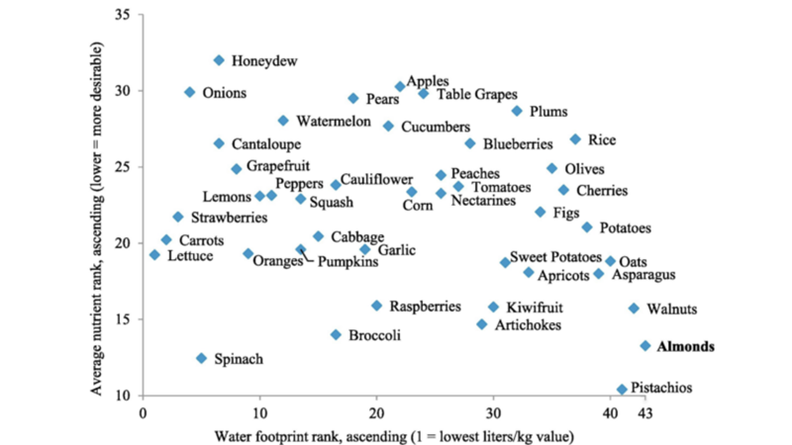
Nutritional Value vs. Water Consumption

Slide 369
Agricultural Employment
Agriculture accounts for 70% of employment and 35% of GNP in sub-Saharan Africa
Only 1.5% of US workforce employed in agriculture (vs. 84% in 1810, 41% in 1900)

Slide 370
GE Foods and World Hunger
2.2 billion people experience moderate or severe food insecurity
733 million people hungry/malnourished
1.5 billion adults overweight, 1 billion obese
Hunger and malnutrition kill over 3 million children per year worldwide
We are close to utilizing the sustainable limit of 15% of the Earth’s surface that can be exploited for crop production

Slide 371
GE Foods and World Hunger:
Terminator and Traitor Technologies
Genetic Use Restriction Technology (“GURT”)
  v-GURTS (aka “terminator technology”): Makes seeds sterile, via insertion of gene that stops manufacture of protein needed for germination, so they cannot be cropped and resown

Slide 372
GE Foods and World Hunger:
Terminator and Traitor Technologies
Genetic Use Restriction Technology (“GURT”)
  t-GURTS (aka “traitor technology”): Inserts modifying gene such that genes governing good growth, germination, and other desirable characteristics can be activated only when the plant is sprayed with a proprietary chemical, which is sold separately

Slide 373
GE Foods and World Hunger:
Terminator Technology
Overturns traditional agricultural practices of over a billion farmers
  Instead of saving seeds for the next year’s crop, forced to buy seeds annually from biotech companies
Terminator plants still produce pollen, and their genes could make non-GM crops sterile as well

Slide 374
GE Foods and World Hunger:
Terminator Technology
In 2000, the world’s governments imposed a de facto moratorium on developing, or even testing, the technology under the UN Convention on Biological Diversity
U.S., Canada, Australia, New Zealand, and UK trying to overturn
Upheld by UN CBD in 3/06
Terminator technology opposed by World Council of Churches
Monsanto ultimately decided not to commercialize terminator technologies

Slide 375
GE Foods and World Hunger
GE foods promoted as the solution to world hunger
  No commercially available GE crop that is drought-resistant, salt- or flood-tolerant, or which increases yields (USDA)
  Monsanto/BASF’s drought-tolerant corn(DroughtGard) approved (2011), but no better than regionally-adapted varieties of conventional corn

Slide 376
GE Foods and World Hunger
GE foods promoted as the solution to world hunger
  Argentina has approved drought-resistant GM soybean (with gene from a naturally drought-resistant sunflower)
  Over 150 drought-resistant corn hybrids produced by conventional crossbreeding increase crop yields by up to 30%

Slide 377
GE Foods and World Hunger
If GE crops were designed to eliminate world hunger, they would be:
  Able to grow on substandard or marginal soils
  Able to produce more high-quality protein with increased per-acre yield, without the need for expensive machinery, chemicals, fertilizers or water

Slide 378
GE Foods and World Hunger
If GE crops were designed to eliminate world hunger, they would be:
  Engineered to favor small farms over larger farms
    Small scale producers grow 70% of the world’s food
  Cheap and freely available without restrictive licensing
  Designed for crops that feed people, not livestock

Slide 379
GE Foods and World Hunger
Undermine food and nutritional security, food sovereignty and food democracy
One week of developed world farm subsidies = Annual cost of food aid to eliminate world hunger

Slide 380
GE Foods and World Hunger
Increasing reliance on GE food
  Consolidates corporate control of agriculture
    Crops supplied mainly by a handful of multinational corporations
  Transmogrifies farmers into bioserfs

Slide 381
GE Foods and World Hunger
There is already enough food to feed the planet
  UN FAO: Enough food to provide over 2700 calories/day to every person
  Almost ½ of American food goes to waste

Slide 382
Food Waste
Each year, 2.9 trillion lbs of food (1/3 of world production) is not consumed
  $750 billion loss
21% of US water and 18% of US cropland goes to food that will never be consumed
33% of food grown in US either unharvested or left behind in fields because growers suspect it will not meet buyers’ specifications

Slide 383
Food Waste
In the U.S., 53% is not consumed:
  20% lost during picking and sorting
  3% lost during storage and shipping
  2% lost during juice production, canning, or baking
  9% discarded at wholesalers and supermarkets
  19% uneaten and discarded in homes
    Rich waste more than poor

Slide 384
GE Foods and World Hunger
Feeding everyone requires political and social will
Ironic that the U.S., home to many GE firms, has rates of child poverty and hunger among the highest in the industrialized world

Slide 385
GE Foods and World Hunger
UN Committee on Economic, Social, and Cultural Rights (2008): Poverty exacerbated by GM seeds
UN International Assessment of Agricultural Knowledge, Science, and Technology for Development (2008): “GE crops are unlikely to achieve the goal of feeding a hungry world”

Slide 386
GE Foods and World Hunger
World food prices rising dramatically
  GM seed prices have increased dramatically (463% between 1990 and 2020, largely due to market concentration)
  US food bank demand up, supplies down
  Future wars
World hunger will not be solved through large-scale molecular manipulation of food crops whose cultivation has been carefully perfected over 10,000 years

Slide 387
US Farm Bills
Most money goes to large agribusiness
Crop subsidies allow land to lie fallow, artificially inflate prices

Slide 388
Monetization and Food Aid
  US food aid purchased from already-subsidized US agribusiness
  US shipping lines transport food to aid organizations in developing countries
  Undermines local farmers and destabilizes local agriculture

Slide 389
Monetization and Food Aid
  US spends $3-$5 billion/yr to prop up prices of GM crops on world market
  EU has almost entirely phased out monetization
  UN World Food Programme (the world’s largest distributor of food aid) has rejected monetization and refuses monetized food aid

Slide 390
Consolidation and Industrialization of US Agriculture
6.8 million farms in 1935 (1.9 million in 2025)
The average farmer now feeds 129 Americans (vs. 19 in 1940)
Americans spend less than 10% of their incomes on food, down from 18% in 1966
Subsidies mean one dollar can buy 1,200 calories of potato chips or 875 calories of soda or 250 calories of vegetables or 170 calories of fresh fruit

Slide 391
Global Warming, Agriculture, Nutritional Changes, and Obesity
Rising atmospheric CO2 levels increases photosynthesis, causing fruits and vegetables to produce more sugars
Under industrial agriculture, crops bred for higher yields (i.e., more sugars, less vitamins/minerals/proteins)

Slide 392
Industrial Food Production vs. Peasant Food Web
Peasant food web feeds 70% of world, using only 25% of food-production resources
Industrial food production:
  Only 24% of food produced actually reaches people (the rest is wasted in meat production inefficiencies; lost in transport, storage, and in the household; and diverted to non-food products)
  Every $1 spent on industrial food results in $2 in cleanup costs

Slide 393
Industrial Food Production vs. Peasant Food Web
Industrial food production:
  Uses 2-3 times more fossil fuel energy
  Responsible for 85-90% of all agricultural greenhouse gas emissions
  Damages 75 billion tons of soil annually
    24 billion tons lost
  Narrows crop genetic diversity by 75%
  Accelerates nutritional decline

Slide 394
Solutions
Outlaw GM crops
Labeling Laws
  Found in 64 countries
  China, Brazil, and India are the only major producers of GM crops that also require labeling
  Favored by UN Food Safety Arm
  AMA opposes labeling, but favors premarket safety testing and encourages further study

Slide 395
Solutions
Labeling laws
  Allow informed consumer choice
  Rep. Dennis Kucinich’s House bills to require labeling, prohibit sterile seeds, allow farmers to save seeds, expand FDA oversight, increase regulations re biopharming, prohibit open-air biopharming, and expand research to help developing nations feed themselves

Slide 396
Solutions
Labeling laws
  GE Food Right to Know Act voted down by Senate (2013)
  Overturn Dark Act (2016)/ oppose in courts
Expose and oppose industry attempts to pre-empt labeling initiatives/laws

Slide 397
Solutions
GM-free zones
  >4500 in Europe (but EU allows GM crops to be used without labeling in animal feed)
  Others in Canada, Australia, and the Philippines

Slide 398
Solutions
GM-free countries
  France (ban rejected by EFSA)
  Switzerland
  Greece
  Germany
  Austria
  Italy
  Cuba
  Venezuela

Slide 399
Solutions
GM-free countries
  Thailand
  Peru
  Ireland
  Hungary
  Bulgaria
  Scotland
  Wales
  Luxembourg

Slide 400
Solutions
Norwegian government built artificial cave in frozen mountain at edge of Arctic Circle (Svalbard) to preserve 2 million varieties of seeds
  Has more than 1 million samples so far, representing the germ plasm of over 4,000 distinct food crops
  Climate change threatens cold storage
Other seed banks
Global Genome Initiative – 200,000 DNA samples and counting

Slide 401
Solutions
2010: U.S. federal judge orders halt to planting of GM sugar beets in U.S. until USDA complete and Environmental Impact Statement
  2011: Appeals Court upholds decision
  Late 2011 - USDA announces partial deregulation; 2012 – complete deregulation
  GM sugar beets account for 95% of sugar beets grown in U.S.
  ½ of U.S. sugar supply from beet sugar

Slide 402
Solutions
2010: U.S. fails to get UN’s Codex Alimentarius to state that there is no difference between GE and non-GE foods
  Only 3 countries support U.S. position
2011: Codex prohibits legal challenges by WTO to countries adopting GM labeling laws

Slide 403
Solutions
New ballot initiatives and legislation
  Marin, Mendocino, Santa Cruz, and Trinity Counties (CA) ban GMO crops
  San Juan Islands (WA) ban GMO crops (2012)
  Bans defeated in Sonoma, Butte, Humboldt, and San Luis Obispo Counties
  CA bill to allow farmers to sue GM-crop manufacturers

Slide 404
Solutions
New ballot initiatives and legislation
  Arkansas banned GE rice
  2010: Alaska requires labeling of GE fish, has now banned GE salmon
  2012: Cincinnati requires labeling of GE foods

Slide 405
Solutions
2010: EU to allow national bans on GM crops (but may make it easier for EU-wide ban)
2012: BASF halts development of GM crops in Europe

Slide 406
Solutions
New ballot initiatives and legislation
  CA biopharm moratorium (pending legislation)
  2013: nearly half of all states have introduced measures requiring labeling or banning GMOs
  2013: CT and ME pass labeling laws (partially linked with each other and with VT measure)
    2015: Federal judge upholds VT law

Slide 407
Solutions
New ballot initiatives and legislation
  CA Prop 37 (GMO labeling – failed, 2012)
  2013: WA ballot initiative fails 55% - 45%
    Opponents outspent proponents $22 million to $8 million
    No campaign – all but $600 (six hundred) from Grocery Manufacturers Association and ag-biotech corporations
    Yes campaign – 16,400 donors
      GMA (now Consumer Brands Association) ordered to pay record-setting $18 million penalty for violating WA campaign laws to conceal identities of donors that contributed to its $11 million outlay)

Slide 408
Solutions
Danish law compensates farmers whose fields have become contaminated with GMOs; government seeks recompense from the farmer whose field originated the genetic contamination, assuming the culprit can be pinpointed

Slide 409
Solutions
2013: Monsanto withdraws all pending GM crop applications in Europe (but will continue with MON810 maize planting, although most EU nations seek to opt-out from MON810 cultivation)
  2017: MON810 only GM crop currently grown in EU

Slide 410
Solutions
2013: EU freezes approval of GE crops until 2014
2013: USDA approves Non-GMO Project certification/label for meat and liquid egg products from animals that did not consume GM-feed
2014: EU allows nations to ban GMOs, even if EU has approved cultivation

Slide 411
Solutions
New ballot initiatives and legislation
  2014: Vermont bill requires manufacturers of GM seeds to label and register their products (enforcement starts 2016; trade group lawsuit pending)
  Minnesota gives its DOA the power to regulate all GE crops; commissioner has authority over GE plantings

Slide 412
Solutions
New ballot initiatives and legislation
  Hawaii law places 10-year moratorium on GE coffee (overturned by federal court) and taro (upheld by federal court (2009-19)
  But labeling measure fails to make it out of committee (2013)

Slide 413
Solutions
New ballot initiatives and legislation
  But Kauai County limits GM plantings (2013) and require pesticide disclosures (up to 17X greater pesticide spraying/acre than in continental US
  2014: Maui and Molokai temporarily ban GMOs
    Federal judge suspends ban

Slide 414
Solutions
New ballot initiatives and legislation
  2016: 9th Circuit Court of Appeals rules against Maui ban
  As of 2026, all Hawaiian county-level GMO bans or moratoriums have been invalidated

Slide 415
Solutions
New ballot initiatives and legislation
  Moscow now requires labeling of GM foods
  2014: Jackson and Josephine Counties (in Southern Oregon’s Rogue Valley) passed GM ban
    2015: Federal court upholds ban

Slide 416
Solutions
New ballot initiatives and legislation
  2014: OR Proposition 92 (GM labeling ballot initiative)
    Similar measure in CO
    OR Measure barely failed, CO measure failed badly
      OR: Supporters spent $9 million; opponents $21 million (most expensive ballot measure in OR history

Slide 417
Solutions
New ballot initiatives and legislation
  2014: OR Governor Kitzhaber (resigned) was planning to introduce legislation to require OR DOA to map GE crop locations and establish buffer and exclusion zones
  2014: LA City Council considering ban and labeling measure, then dropped

Slide 418
Solutions
  2014: Bill pre-empting OR communities from passing labeling laws or rules signed by governor
    Jackson County exempted; Josephine County planning court challenge; Lane County moving ahead with possible 2016 ballot initiative
  2015: Labeling bills proposed in IN and MN

Slide 419
GM Food Labeling Today
2016: Transgenic Contamination Prevention Bill (OR) – in committee
2016: Federal Safe and Accurate Food Labeling Act (aka Dark Act – Denying Americans Right to Know Act) signed by Obama
  Requires limited/confusing labeling
  Overrides all local labeling laws, supported by industry
  Center for Food Safety, others file lawsuit opposing

Slide 420
Solutions
2017: OR lawmakers considering bills to:
  Allow farmers to sue GE producers if seeds found to contaminate their traditional or organic crops
    Also allows individuals to sue if GE organisms found on public land in their neighborhoods
  Restore local control over GE crops (and to allow Josephine County to move ahead with its ban)

Slide 421
Solutions
National Bioengineered Food Disclosure Standard (US law, enacted 2016, fully enforced 2022)
  Requires disclosure of detectable modified genetic material in food
    “Bioengineered” or Contains a bioengineered ingredient”; QR code; USDA required to rewrite labelling rule by 2028

Slide 422
Solutions
National Bioengineered Food Disclosure Standard (US law, enacted 2016, fully enforced 2022)
  Exemptions
    Highly refined ingredients, animal products, restaurant foods, and small manufacturers
  Overrules state labelling laws (e.g., Vermont, Connecticut, Maine)

Slide 423
GM Food Labeling Under Trump
Trump administration
  Anti-science
  Anti-regulation
  Heavy corporate influence on administrators
Biden administration – policies TBD

Slide 424
Failure of Regulatory Oversight
  USDA is considering blocking imports of GMOs into US (even though many are the same products of US and multinational corporations already planted in the US)
    Reasons - Foreign GMOs
      Would threaten US agriculture
      May affect the health of US citizens
      May affect the environment

Slide 425
Oregon Biopharm Bill
Passed OR Senate, did not come up for vote in OR House
However, led to establishment of task force by governor (2007), then…
State negotiated MOU with the OR Department of Agriculture and the OR Health Division and wrote OR-specific rules (2010)

Slide 426
Oregon Biopharm MOU
Both ODA and Public Health Dept. directors must approve biopharm crop permits before field trials
Permits ODA and public health officials to view confidential business information re: biopharm crops
  Contingent upon MOU to be written with USDA

Slide 427
Oregon Biopharm MOU
Requires FDA preliminary opinion on safety of biopharm crop and disclosure to state officials
Calls for a public comment period and a public meeting in the county in which biopharm crop planting is proposed

Slide 428
Oregon Biopharm MOU
Expresses preference for non-food crops, or crops grown indoors in a secure greenhouse; require written justification for outdoor food crops
Charges the biopharm company up to $10,000 to the state to cover costs of increased monitoring
Requires applicants to pay the costs of any required remedial action

Slide 429
Solutions
Cartagena Protocol on Biosafety (of the Convention on Biological Diversity)
  Agreed upon by 130 nations in 2000
  Went into effect in 2003 after 50 nations signed
  Allows countries to bar imports of GMO seeds, microbes, animals or crops that they deem a threat to their environments

Slide 430
Solutions
Cartagena Protocol on Biosafety
  Does not cover processed foods made from GMO crops
  Requires international shipments of GMO grains to be labeled
  U.S. has not signed/ratified, and actively opposes

Slide 431
Solutions
Cartagena Protocol on Biosafety
  Nagoya – Kuala Lumpur Supplementary Protocol on Liability and Redress (adopted 2010) – provides international rules and procedure on liability and redress from damage to biodiversity resulting from GM organisms

Slide 432
Solutions
Campaign finance reform – local and national
Public education – particularly in science/environmental science
Close revolving door between industry and government regulatory bodies

Slide 433
Solutions
Involve religious groups
  Genetic modification listed as one of Vatican’s seven “modern deadly sins”
  Popes Benedict and Francis oppose GMOs
  Interfaith Center on Corporate Responsibility’s 2008 boycott against sugar made from Monsanto’s GM sugar beets

Slide 434
Solutions
Support local, organic agriculture and patronize farmers’ markets
  Average American meal travels 1500-2000 miles to reach your table
  17X fewer fuel costs for local foods
  Significant carbon sequestration
  Avoids redundant trade

Slide 435
Solutions: Organics
Worldwide organic market $364 billion (2026)
  U.S. $92 billion (2025)
99 million hectares (2023)
4.5 million producers (2022)
Account for 6% of U.S. food sales (2025)
US organic acreage in early 2020s = 2.3 million hectares (vs 14.6 in EU, thus much of the organic food consumed in the US is imported)

Slide 436
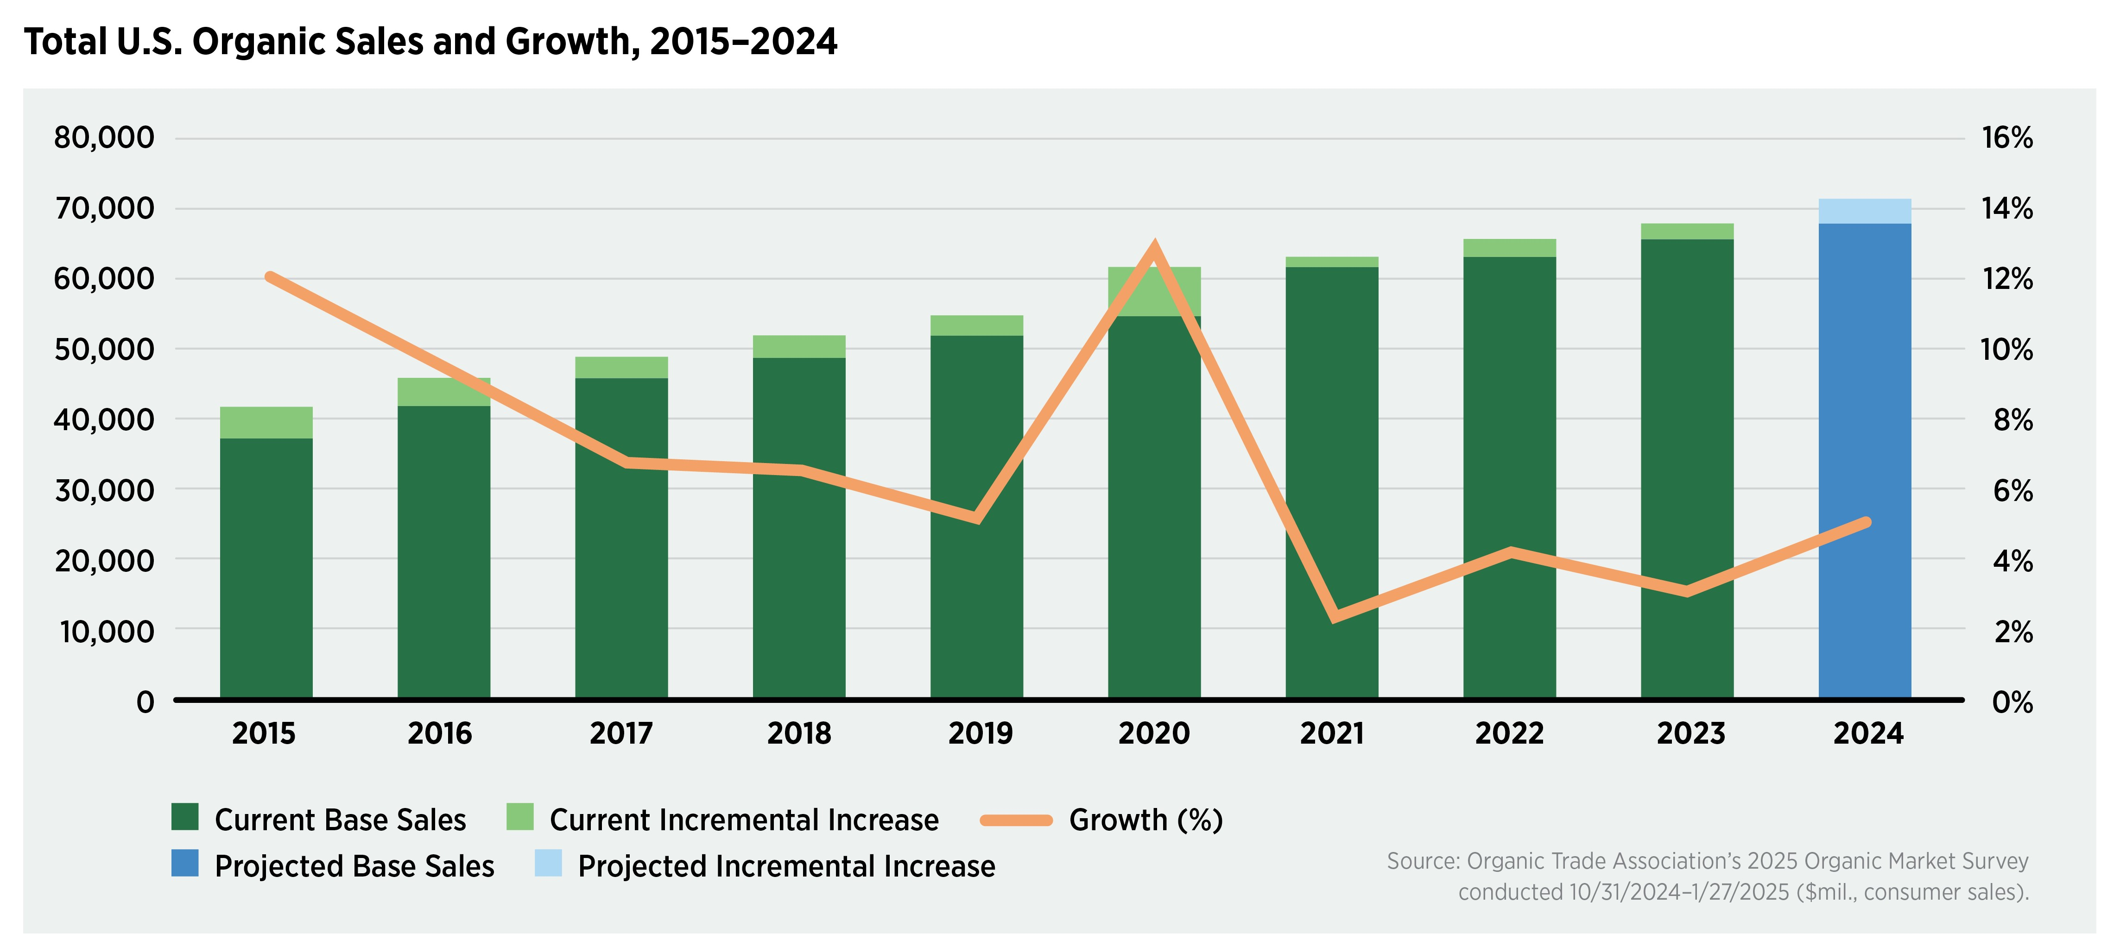

Slide 437
Solutions: Organics
Big Organic taking over industry (PepsiCo, Coca-Cola, ConAgra, General Mills, Kraft, M and M Mars)
  Many are members of the Grocery Manufacturers Association, which has lobbied and spent heavily against labeling laws

Slide 438
Solutions: Organics
National Organics Standards Board stacked with agribusiness executives
Organic food in Europe can contain maximum 0.9% GM content
  5% in U.S.

Slide 439
Solutions: Organics
Organic farming produces higher yields than non-organic farming; uses 45% less energy, less water, and no pesticides; increases soil carbon (converts carbon from a greenhouse gas into a food-producing asset);releases 40% fewer carbon emissions; and is associated with a 10-fold higher concentration of earthworms in the soil (c/w industrial agriculture)

Slide 440
Solutions: Organics
Proposals to breed cattle to decrease components of their microbiome which contribute most to greenhouse gas emissions (14% due to beef and milk production); quicker alternative is a probiotic for cattle
Organic foods contain up to 20% higher mineral and vitamin content and 30% more antioxidants, lower levels of toxic metals
Organic meats and milk have 50% higher amounts of healthful omega-3 fatty acids

Slide 441
Solutions: Organics
Consumers willing to pay substantial premiums to avoid GE foods
Whole Foods stores to label GMO foods by 2018
McDonalds refuses to buy GM potatoes
General Mills drops GMOs from regular Cheerios
Organic industry being “taken over” by Wal-Mart, Coca-Cola, Phillip Morris, etc.
“Natural” does not mean organic

Slide 442
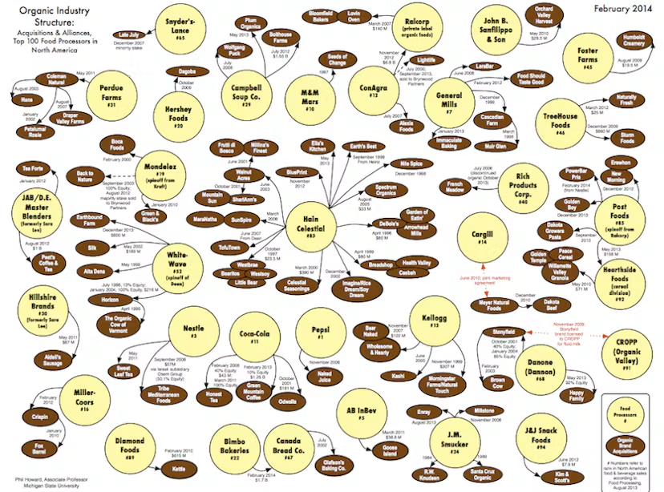

Slide 443
Solutions
Consumer-supported agriculture co-ops
  Over 7,000 in U.S.
Support family farms; oppose factory farms
Purchase heirloom fruits and vegetables; plant heirloom seeds
  Passed from one generation of family farmers and gardeners to the next
  Help to preserve agricultural biodiversity
  Exquisite taste

Slide 444
Solutions
Oppose unfair farm subsidies
  10% of U.S. farms receive 65% of subsidies; 50% receive just 2%
    Since 2000, $1.3 billion paid to individuals who do no farming
  72% of all food sold in U.S. comes from 7% of U.S. farms

Slide 445
Solutions
Support independent research
  GM seeds only recently (2010) made available to “independent” scientists within the USDA
  Sponsored researchers must sign confidentiality agreements
Avoid over-fished species/GE fish

Slide 446
Solutions
Consider vegetarianism
  Or decrease meat intake (US annual adult consumption = 198 lbs; global avg 75 lbs)
  Decreased red meat consumption associated with reduced mortality
Entomophagy (insect-eating)/insect farming

Slide 447
Solutions
Shun the highly-processed, genetically-manipulated comestibles available in large grocery chains and the fried, fat-filled foodstuffs found in fast food franchises
  1950: American farmers captured 50¢ of the avg. dollar spent on food
  2024: 12¢
  Vast majority now goes to food processors, food marketers, and agricultural input suppliers

Slide 448
Solutions
Oppose IMF, World Bank, and WTO structural adjustment programs which exacerbate hunger in the developing world by forcing debtor nations to restructure their agricultural base toward export crops and away from nutritional foodstuffs for local consumption
Arctic Doomsday Seed Vault: will safeguard 4.5 million seeds

Slide 449
Solutions
Support increased research and subsidies for traditional agriculture
  Organic
Industry estimates cost of developing a single GE trait = $100 million
  Classical breeding = $1 million

Slide 450
Solutions
Support equitable distribution of agricultural resources among populations worldwide
Support increased, non-GM agricultural aid to developing nations

Slide 451
Solutions
Crop rotation, integrated pest management to preserve soil, reduce synthetic pesticide use
Ban neonicotinoids
2017 Study (Nature Plants, 1,000 farms, multiple crops): Using lower levels of pesticides results in 86% of farms showing increased production, no farms showing decreased production, and 78% equally or more profitable

Slide 452
Solutions
Reduce food waste
  E.g., Illegal to throw out unsold food before its expiration date (law requires donation to food banks/shelters instead)
Eat ugly

Slide 453
PSR Campaign for Safe Food
Biopharm Bills:
  4-year moratorium on growing biopharm or industrial crops in an outdoor environment (food and non-food) – passed State Senate (2005); no hearing in State House (2005)
  State Biopharm Commission (2006)
  2007 – new, weaker bill passed – authorizes MOU between OR DOA/DPH with USDA re oversight, creates monitoring fees

Slide 454
PSR Campaign for Safe Food
Biopharm bills:
  ME enacts moratorium on outdoor planting of biopharmed crops (2009)
  Other states with pending legislation: CA, CO, HI, MA, TX
  CA bill would ban outdoor cultivation of pharma crops
  HI bill would prohibit cultivation of industrial and pharmaceutical chemicals in food or feed crops, ban outdoor testing of such crops, and create a regulatory tracking system

Slide 455
PSR Campaign for Safe Food:
Other Issues
Recombinant bovine growth hormone in dairy cattle
Health and environmental risks of food irradiation
  Particularly school lunch programs
Factory farming, hormone and antibiotic use

Slide 456
PSR Campaign for Safe Food:
Other Issues
Carbon monoxide to keep meat red
GE foods in feedstocks
Agricultural antibiotic overuse
Nanotechnology and food

Slide 457
PSR Campaign for Safe Food: Available Resources
Fact Sheets on biopharming, rBGH, and food irradiation
rBGH-free Dairy Products Guide
This presentation and others on the phsj website
Detailed scientific references
Donohoe MT. Genetically-Modified Foods: Health and Environmental Risks and the Corporate Agribusiness Agenda. Z Magazine 2006 (December):35-40. Available at http://zmagsite.zmag.org/Dec2006/donohoe1206.html
Multiple organizations listed on PHSJ website “food safety issues” page under “external links”
http://www.NonGMOShoppingGuide.com

Slide 458
References/Sources
NUMEROUS peer-reviewed scientific articles, many of which are cited in reports from the following organizations:
Union of Concerned Scientists (Food and Agriculture pages): http://www.ucsusa.org/
Consumers Union: http://consumersunion.org/
Center for Food Safety: http://www.centerforfoodsafety.org/

Slide 459
References/Sources
GM Watch: http://www.gmwatch.org/
Earth Open Source: http://earthopensource.org/
  GMO Myths and Truths: http://gmomythsandtruths.earthopensource.org/
Food and Water Watch: http://www.foodandwaterwatch.org/

Slide 460
Oregon Right to Know Act
Proposition 92
http://oregonrighttoknow.org/

Slide 461
Contact Information
Public Health and Social Justice Website
http://www.publichealthandsocialjustice.org
http://www.phsj.org
martindonohoe@phsj.org

