Slide 1
Incarceration Nation
Health and Welfare in the US Prison System
Martin Donohoe

Slide 2
Overview
Epidemiology of Incarceration
The Prison-Industrial Complex
Prison Health Care
The Death Penalty
Suggestions to Improve the Criminal Justice System and Reduce Crime

Slide 3
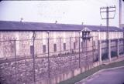

Slide 4
“The mood and temper of the public in regard to the treatment of crime and criminals is one of the most unfailing tests of any country. A calm, dispassionate recognition of the rights of the accused and even of the convicted criminal, ... [and] the treatment of crime and the criminal mark and measure the stored-up strength of a nation, and are the sign and proof of the living virtue within it.”
Winston Churchill

Slide 5


Slide 6
Lockup
1,566 state prisons
98 federal prisons
3,116 local jails
1,323 juvenile correctional facilities
181 immigration detention facilities
80 Indian country jails
Other: military prisons, civil commitment centers, state psychiatric hospitals, and prisons in the U.S. territories

Slide 7
Jails vs. Prisons
Jails: Persons awaiting trial or serving sentences up to one year
  Most inmates stay < 1 month
  74% not convicted
Prisons: Convicted persons serving longer sentences

Slide 8
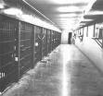

Slide 9
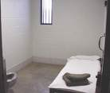

Slide 10
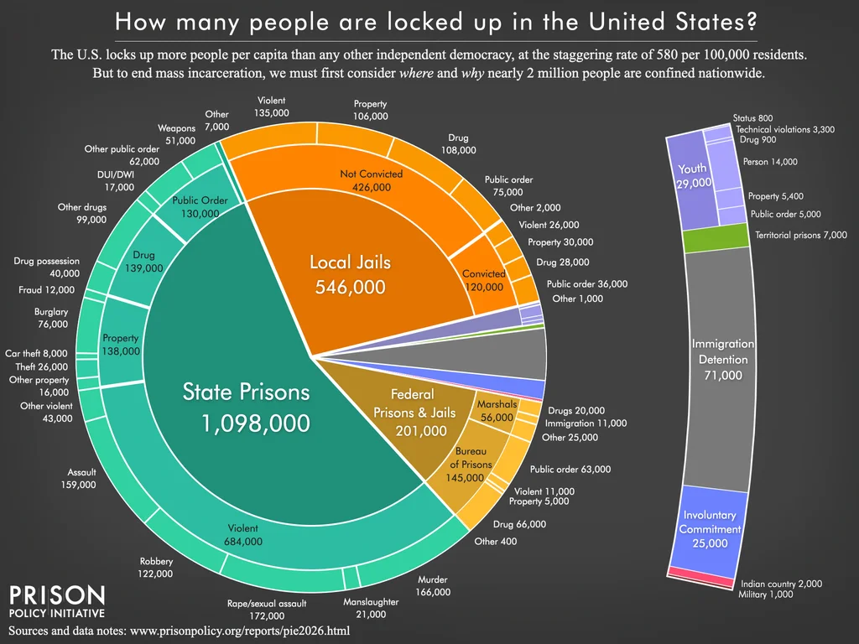

Slide 11
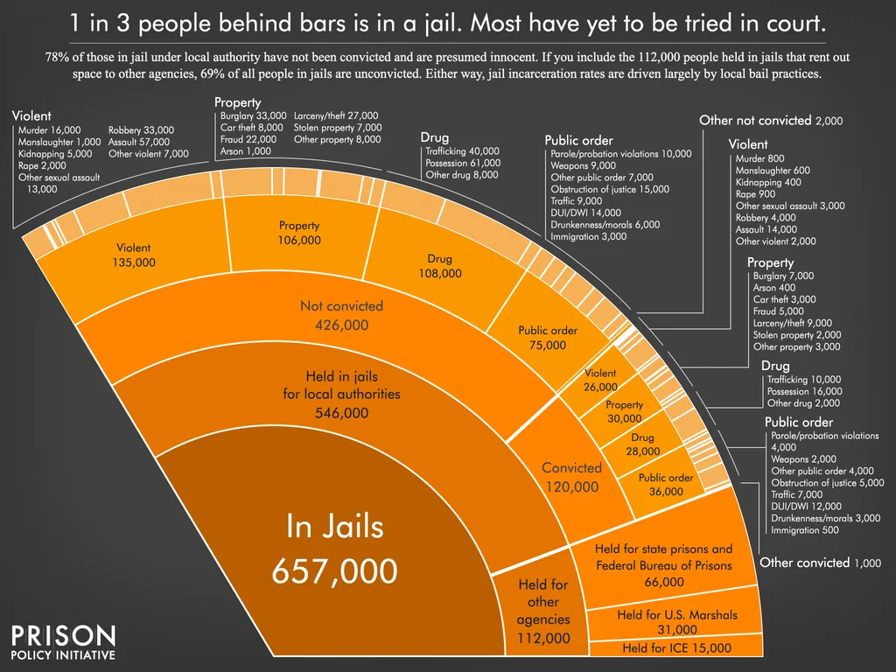

Slide 12
Lockdown:
Global Incarceration Rates
World prison population at least 10.4 million
  El Salvador has world’s highest incarceration rates (gangs)
  1.7 million prisoners in China (population 3x that of U.S.)

Slide 13
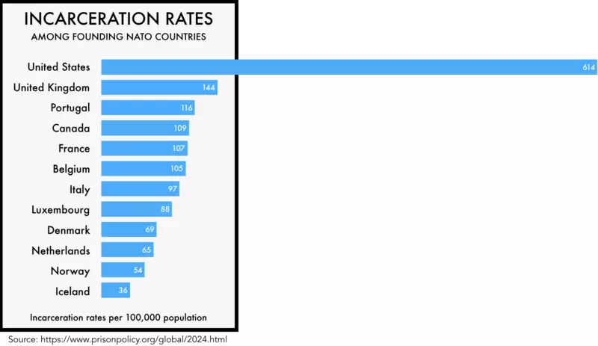

Slide 14
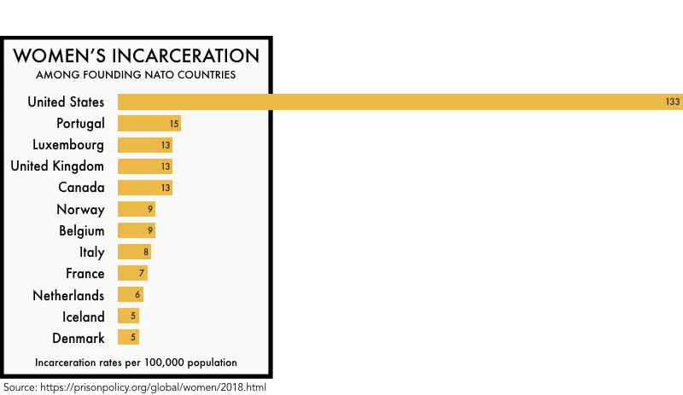

Slide 15
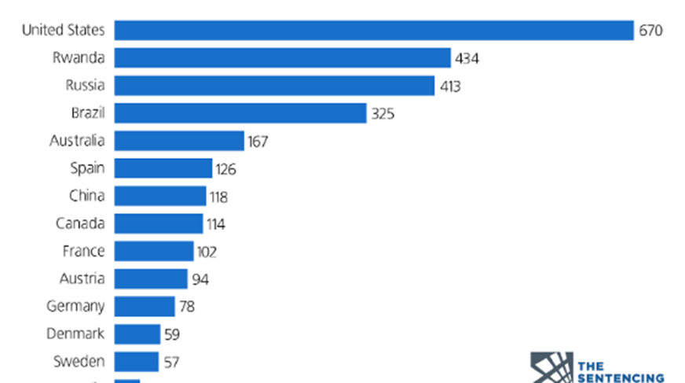
International Rates of Incarceration (2019)

Slide 16
Lockdown:
US Incarceration Rates
US incarceration rate highest in world (20% of world’s incarcerated population, despite having only 5% of world’s population)
  4X global average
  6X Britain, Canada, France
  Louisiana has highest state rate

Slide 17
Lockdown:
Incarceration Rates
US (2026): 5.5 million under correctional supervision (behind bars, on parole, or on probation) - 1/67 adults (vs. 1/77 in 1982)
  1.9 million behind bars
    Includes 168,000 women, 60,000 youths

Slide 18
Lockdown:
US Incarceration Rates
7.6 million Americans arrested each year
  7 million adults, 500,000 juveniles
1.3 million imprisoned
650,000 released
  67% of these will be re-imprisoned within 3 yrs
45% of state prisoners incarcerated for violating parole or probation

Slide 19
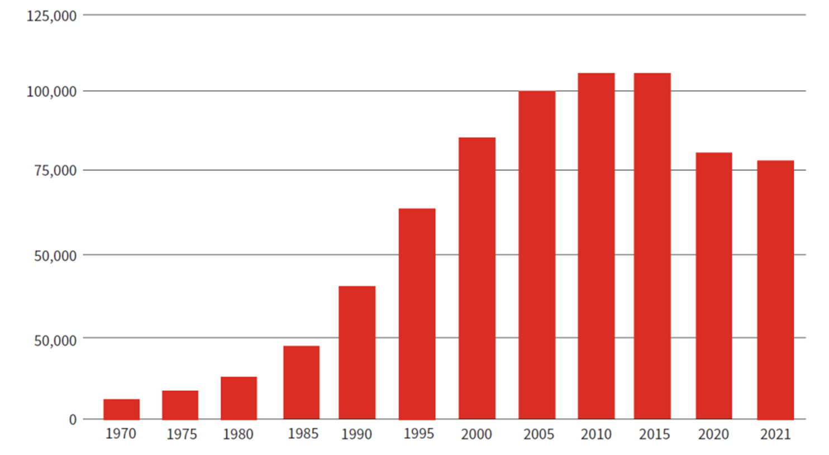
U.S. State and Federal Prison Population 1925-2021 (Sentencing Project)

Slide 20
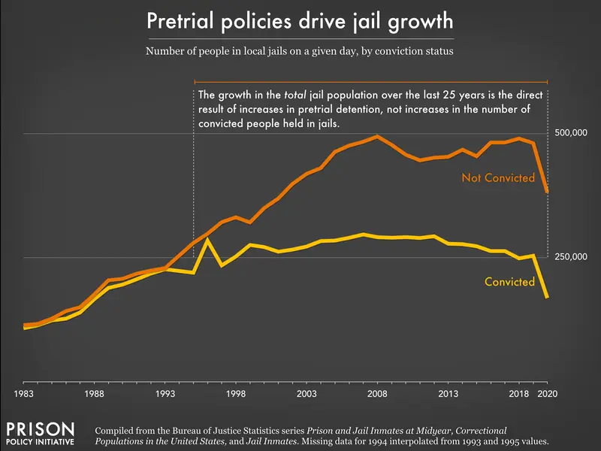

Slide 21
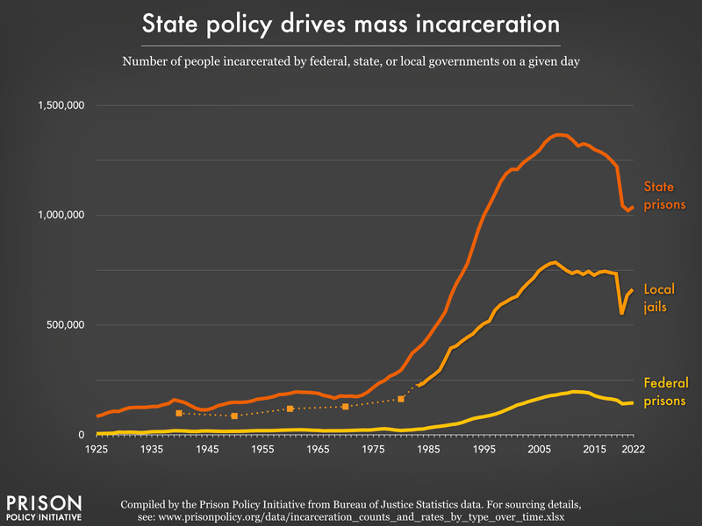

Slide 22
Lockdown:
US Incarceration Rates
220% increase in # of people behind bars from 1990-2014
Crime rate down 25% compared with 1988
Incarceration rates 1/7 of today’s rate in 1960s, yet crime rates similar
Almost 1/3 US adults (70 million people) have a criminal record, 8% have a felony record

Slide 23
Lockdown:
US Incarceration Rates
# of women behind bars up 750% from 1980
Pre-incarceration income 41% below that of non-incarcerated, age-matched population
Disabled 3-4 times more likely to be incarcerated

Slide 24
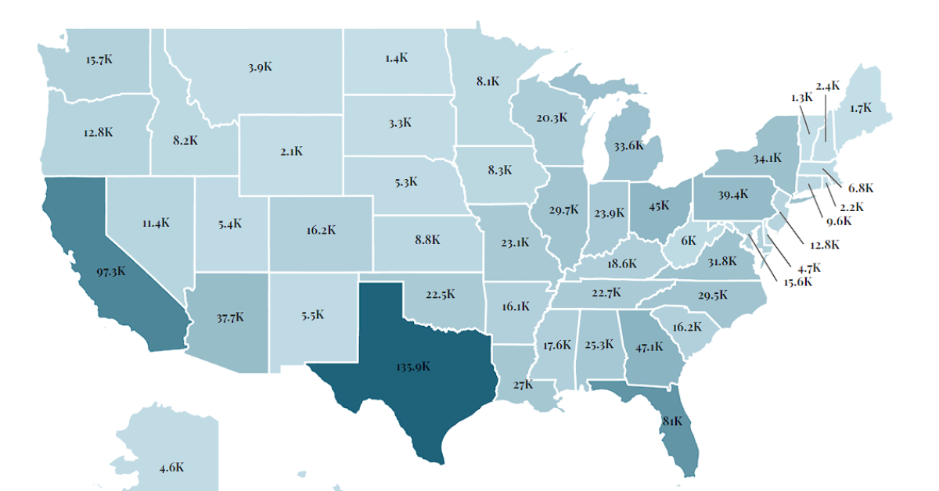
Prison Population by State (2023)

Slide 25
Lockdown:
US Incarceration Costs
Direct costs to local/state/federal governments $180 billion/yr for corrections/policing/criminal court systems; Social costs over $800 billion
Costs: $30,000/yr for prison spot; $70,000/yr for jail spot

Slide 26
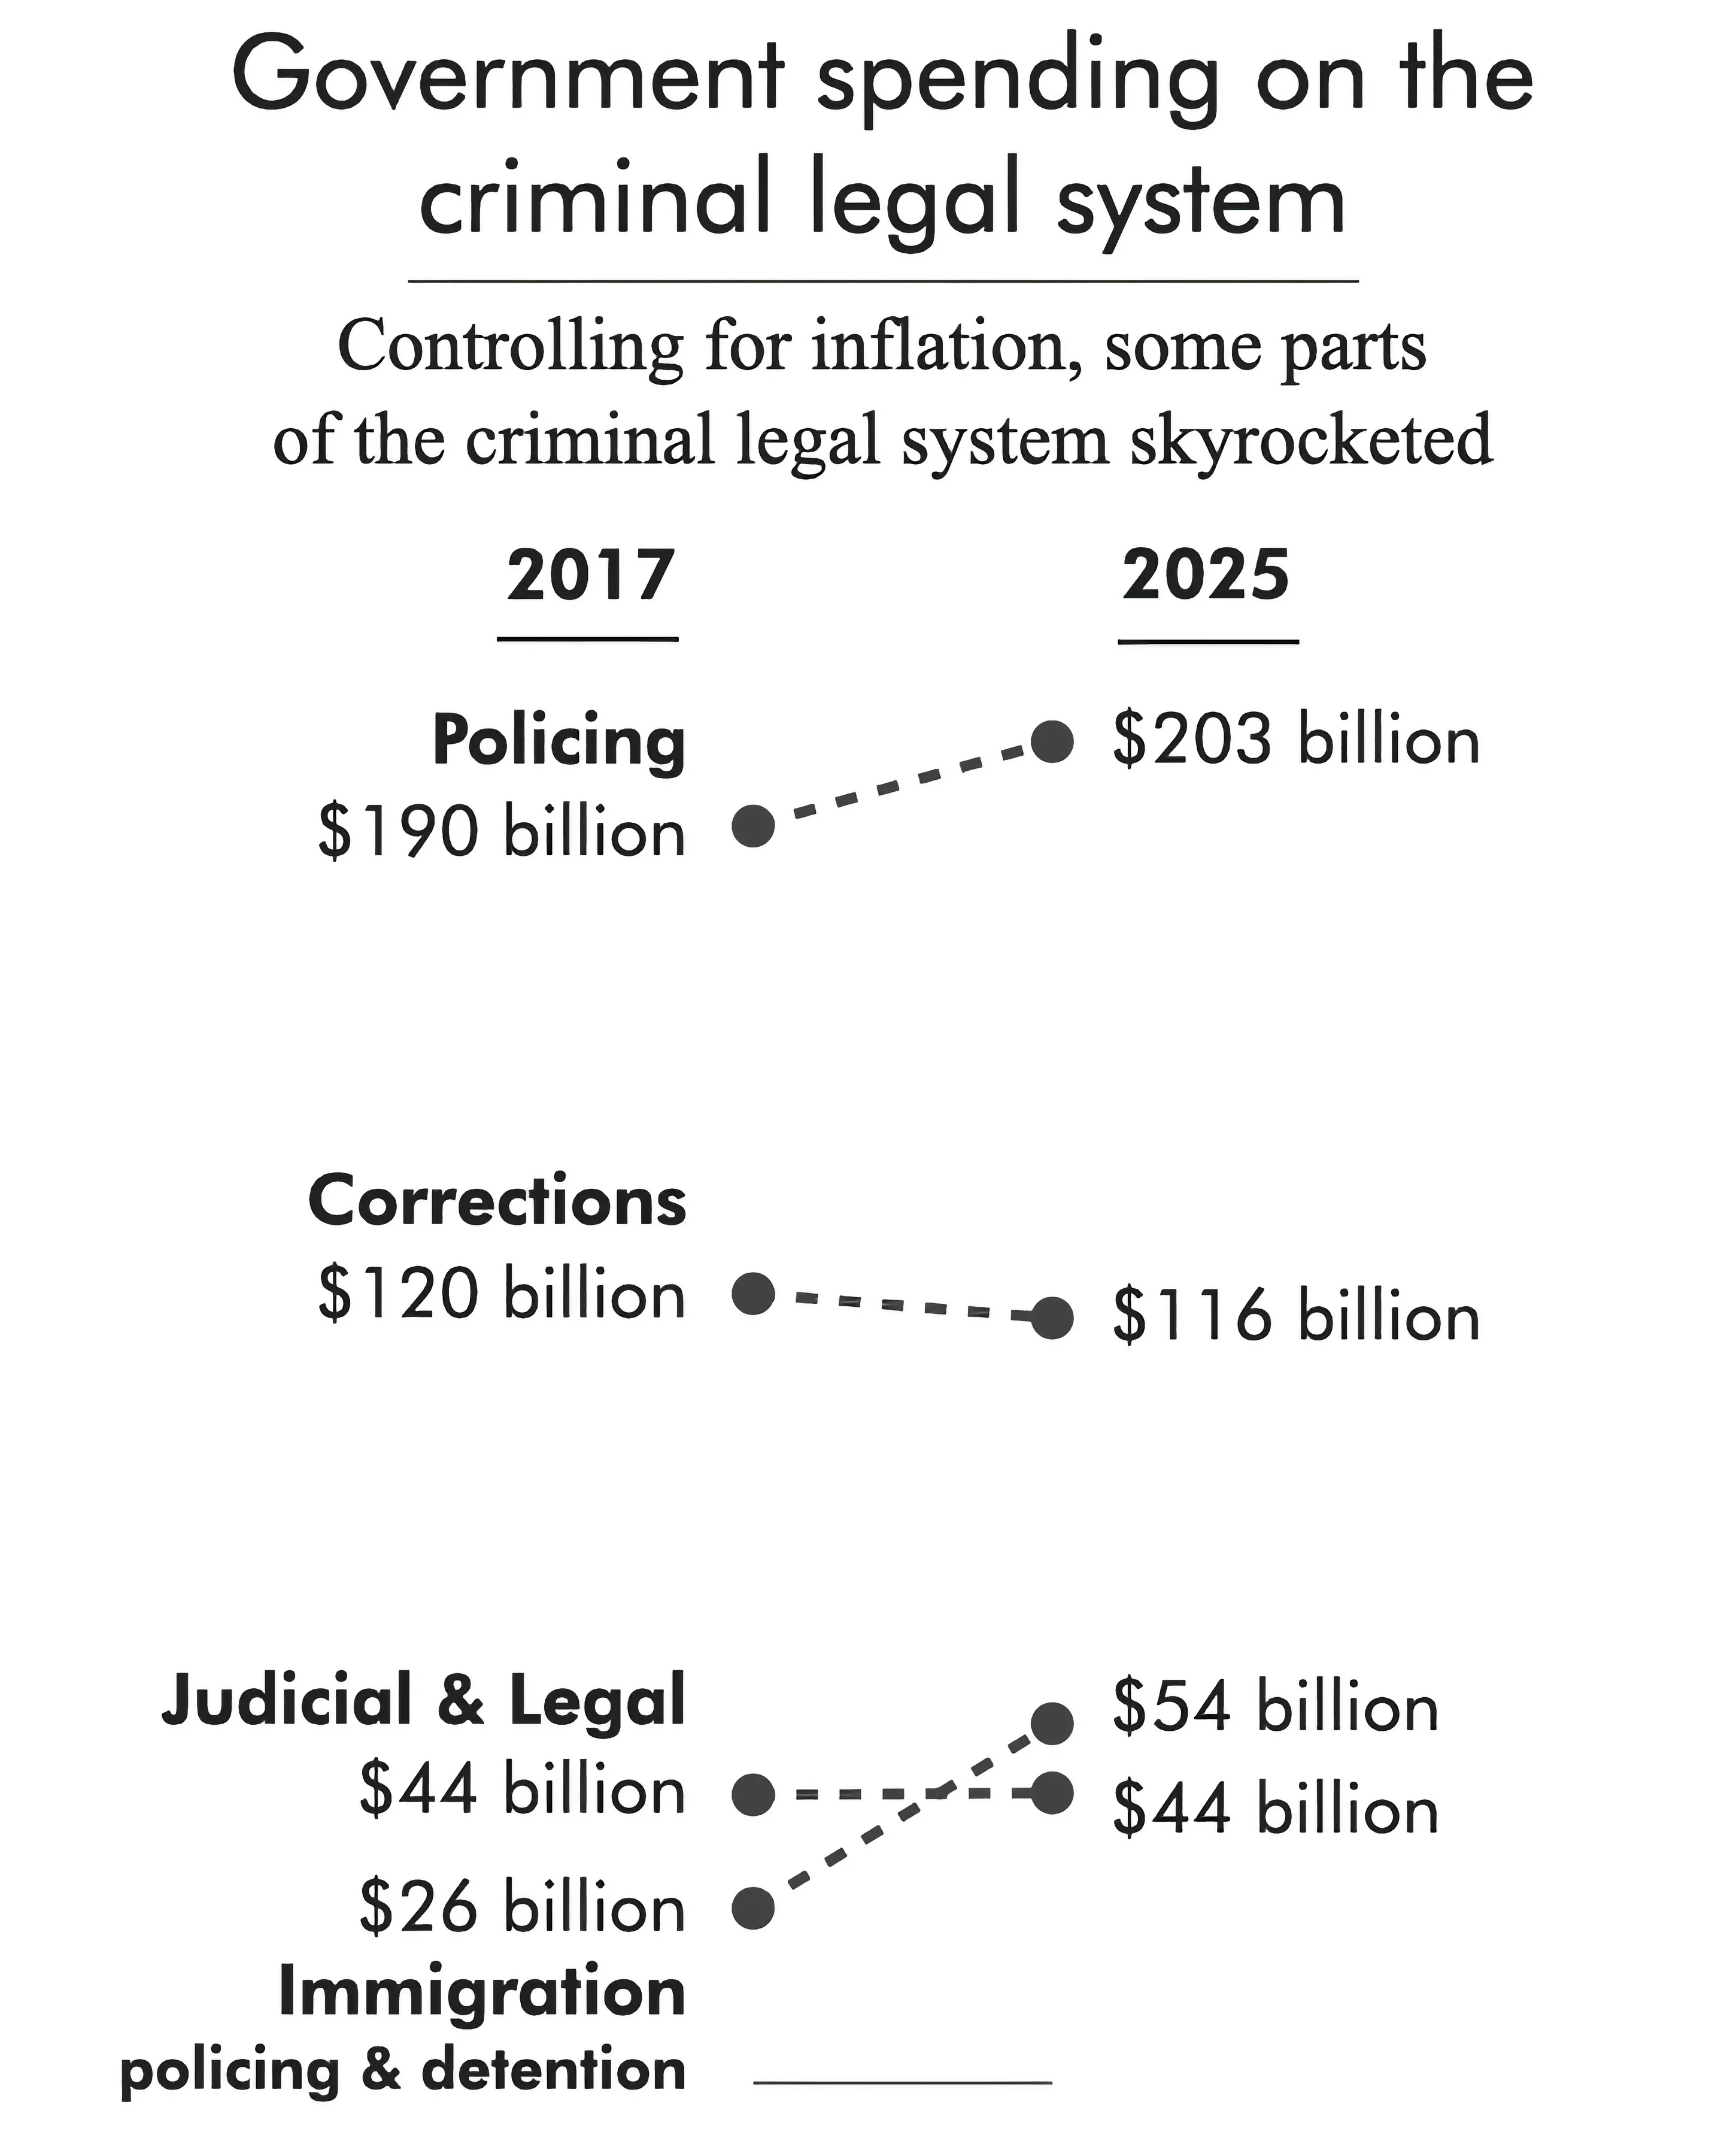

Slide 27
Lockdown:
US Incarceration Costs
U.S. employs more than 2X more correction officers/capita and 30% fewer police officers/capita than global average
  2021: More private security guards than sworn law enforcement officers (trend sparked in part by longer police response times)
  Most major cities have at least three times as many private security guards on the streets as officers
  Annual revenue of private security services over $40 billion
  Consolidation into just a few firms
Jails and prisons often located in low-income communities/communities of color and often on or near environmentally-polluted sites

Slide 28
Women Behind Bars
History of bias
  Medieval witch hunts
  Salem Witch Trials
  Victorian Era double standards

Slide 29
Women Behind Bars
Today:
  190,600 women (plus 808,700 under probation or parole)
    834% increase over last 40 yrs
  80% lack HS degree
  15% homeless in preceding year

Slide 30
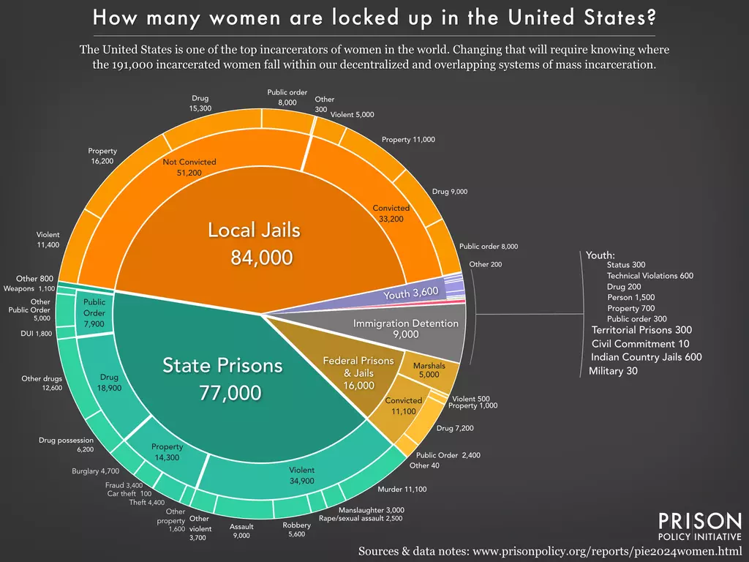

Slide 31
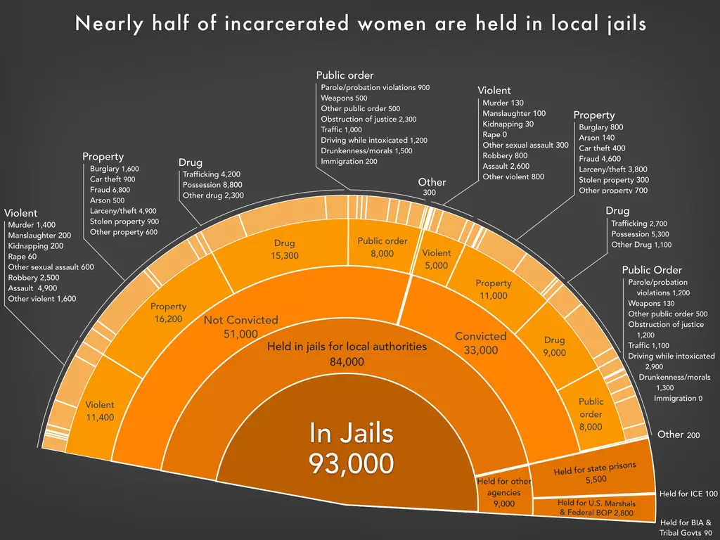

Slide 32
Women Behind Bars
  Serve proportionally more sentences for nonviolent offenses compared to men
  Greater difficulty affording bail to avoid pretrial detention
  More likely than non-incarcerated women to have suffered physical, emotional, or sexual abuse prior to incarceration

Slide 33
Women Behind Bars
  3-10% are pregnant upon entry
  58% are mothers of minor children
  Most states either do not compile data on mothers in prison or have unreliable data

Slide 34
Children of Incarcerated Parents
  1400 children born to incarcerated women/yr
    Shackling prohibited in federal prisons, still allowed in 10 state prisons
  Abortion access very limited
  2.7 million children currently have a parent incarcerated
    1/28 of children (most commonly father)
    1/9 African-American children
8% of U.S. children have experienced a parental incarceration
10% of mothers’ minor children end up in care of family member (vs. 90% of children of male prisoners)

Slide 35
Children of Incarcerated Parents
Twice as likely to carry diagnosis of depression, ADHD, and conduct disorder
More likely to experience anxiety, PTSD, and illicit drug use
Less likely to complete high school
More likely to do jail time themselves

Slide 36
Prisoner Marriage
Prisoners in the U.S. have a constitutional right to marry, established by the Supreme Court in Turner v. Safley (1987).
  Right is subject to "substantial restrictions" and security concerns, meaning inmates must get approval from the prison warden or authorities, and they generally do not receive conjugal visits.

Slide 37
Sexual Orientation and Incarceration
5.5%/3.3% of men in prisons/jails gay or bisexual (3.6% in entire US population)
33.3%/26.4% of women in prisons/jails lesbian or bisexual (3.4% in entire US population)
Incarceration rate of LGB adults 3x higher than overall US incarceration rate
Lifetime incarceration rate of 19% - 65% for transgendered women

Slide 38
Kids on the (Cell) Block
27,000 youths confined in juvenile detention facilities, jails, and prisons (another 2500 juveniles held in adult facilities)
Males 74% of juvenile arrests; 86% of detainees
Overcrowding and violence rampant
  2000 injuries and 1000 suicidal acts per month

Slide 39
Kids on the (Cell) Block
Recidivism rates as high as 40%
Populations in decline, due to decreasing arrests, decreasing crime (except for murder), alternative sentencing agreements, covid

Slide 40
Juveniles/Adults
Trend toward trying juveniles as adults
Opposed by PHR based on:
  Neurological research relevant to moral development and culpability
  Studies on recidivism in adolescents
  Desirability of rehabilitation

Slide 41
Bail
70% of those charged with felony assigned bail money
Median bail (varies by crime, state):
  Misdemeanors: $2,500
  Felonies: $10,000
  Drug offenses: $5,000
  Property crimes: $3,000

Slide 42
Bail
Poor, racial minorities less likely to be able to afford bail
Median pre-incarceration income for those jailed = $15,109
$2.6 billion/yr profitable bail bond industry (fees typically 10% of bail)

Slide 43
Protecting the Innocent
Many of those arrested have inadequate representation
Prosecutorial misconduct rarely investigated/prosecuted
Court dockets crowded

Slide 44
Protecting the Innocent
94% of state and 97% of federal convictions are the result of plea bargains
  Many plead guilty who are, in fact, innocent
  Alford pleas common (defendant pleads guilty while asserting his innocence for the record, but no further investigation into possible prosecutorial misconduct and, in most jurisdictions, bars defendants from bringing civil lawsuits)
  Better funding of public defenders needed

Slide 45
Forensic Evidence
Many well-accepted forms of evidence over-rated (eyewitness testimony) or flat-out unscientific (bite mark analysis, firearms identification, latent fingerprint and footwear analyses, polygraph testing)
  Per DOJ’s National Commission on Forensic Science, President Obama’s Council of Advisors on Science and Technology, and the NAS)
    2017: Atty. Gen. Sessions refused to extend term of NCFS

Slide 46
Schools or Prisons:
Misplaced Priorities
The US spent an average of $31,286 per year on each inmate; K-12 schools spend an average of $12,756 per student annually
1985-2000: state spending on corrections grew at 6X the rate of spending on higher education
Overall funding for prisons up 141% since 1986
State budgets for public universities down 20% since 2008
2013: 11 states spent more on incarceration than on higher education

Slide 47
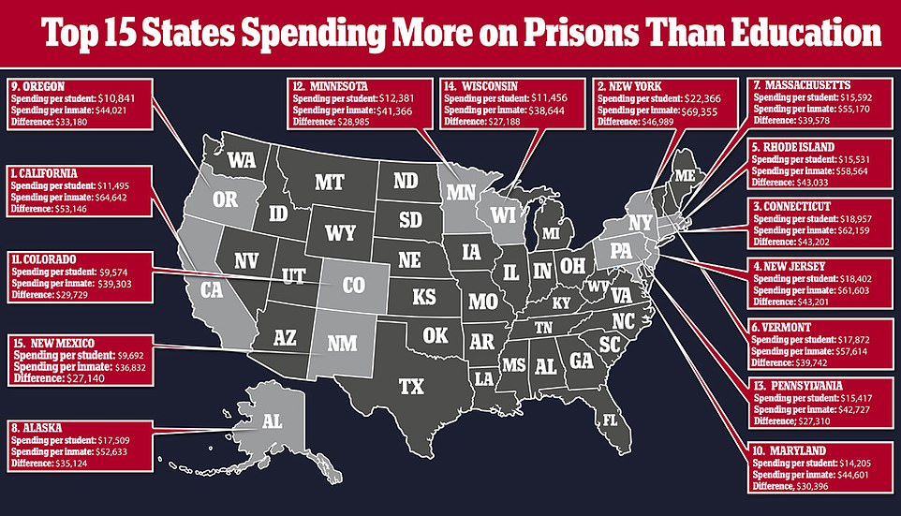
Schools vs Prisons (K-12)

Slide 48
Schools or Prisons:
Misplaced Priorities
Consequence: higher education more expensive
  Increasingly out of reach for middle class and poor
  Fuels cycles of poverty and crime

Slide 49
Schools or Prisons:
Misplaced Priorities
“There was a proposition in a township there to discontinue public schools because they were too expensive. An old farmer spoke up and said if they stopped the schools they would not save anything, because every time a school was closed a jail had to be built. It's like feeding a dog on his own tail. He'll never get fat. I believe it is better to support schools than jails.”
Mark Twain

Slide 50
Prison Guards
Trump administration has curtailed federal prison guard hiring, thus inadequately trained teachers, health care professionals, and secretaries fill in
  Minimal training
  Diverts them from their usual duties

Slide 51
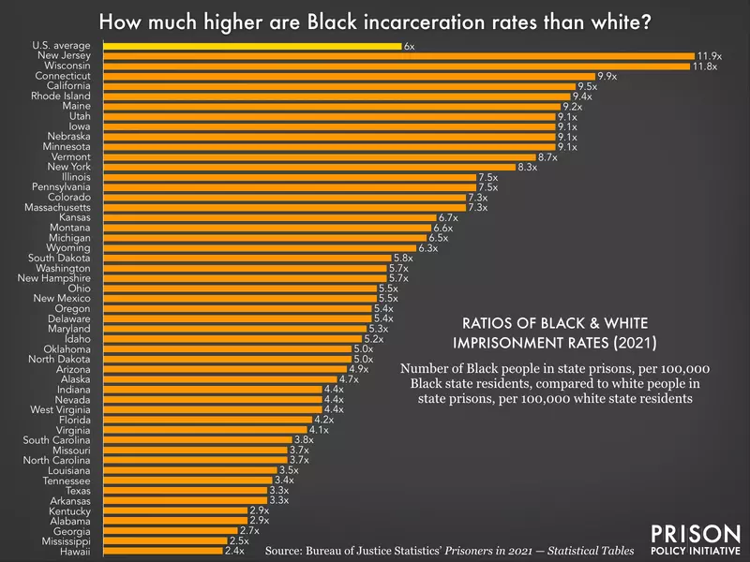

Slide 52
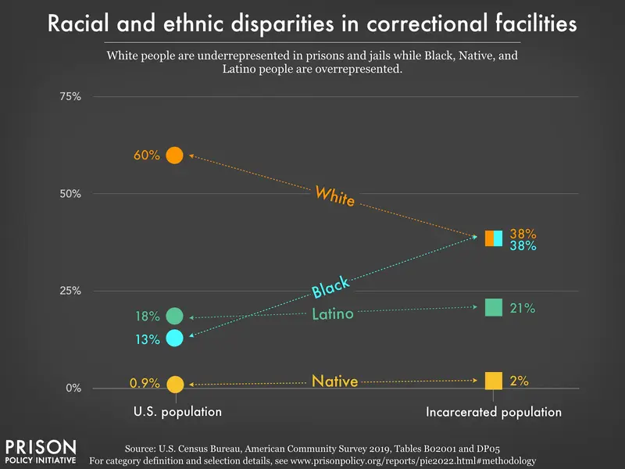

Slide 53
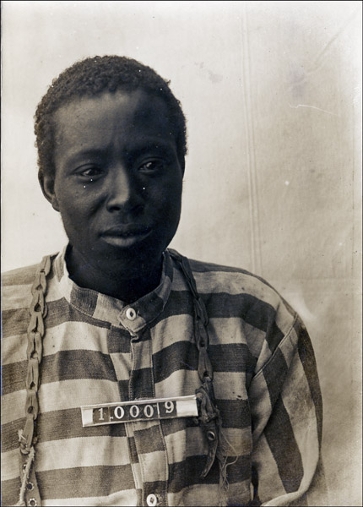

Slide 54
Race and Detention
African-American youths vs. white youths:
  6X more likely to be sentenced and incarcerated
  9X more likely to be charged with a violent crime
Latino vs. white youths:
  2X length of stay for drug offenses
Latino incarceration rates rising dramatically
Republican-appointed judges sentence blacks to jail terms an average of 7.8 months longer than whites (Democrat-appointed judges 4.8 months longer)

Slide 55
Racism in the Criminal Justice System
Violent crime associated with poverty, not race
Persons of color are more likely than whites to be:
  Stopped by the police (e.g., “Driving while black”, “Stop and frisk”)
  Abused by the police
  Handcuffed when stopped by the police
  Arrested
Police use force on about 300,000 people/yr, injuring 1/3 of them
  Most common stun guns
  200,000 additional incidents of threats of force

Slide 56
Racism in the Criminal Justice System
Persons of color are more likely than whites to be:
  Denied bail
  Charged with a serious crime
  Under-represented on juries
  Convicted
  Receive a harsher sentence

Slide 57
Race and Detention
Minority youths more likely to be sent to adult courts
Risk assessments (some done by for-profit companies) designed to choose prisoners for early release unscientific, racially-biased

Slide 58
Police Shootings
1,278 persons killed (2025)
  Blacks 2.6X more likely than Whites to be killed
  Native Americans 2.2
  Latinos 1.3

Slide 59
Police Shootings
Reasons: seen with weapon (11%), traffic violation escalation (9%), mental health/welfare check (8%), domestic disturbance (6%), no offense alleged (6%), other alleged nonviolent offense (22%), claims of violent offenses/serious crimes (38%)
    Other studies show 27% involve a mental health crisis
    36% of victims had been fleeing the scene

Slide 60
Immigration and Incarceration
13% of US population foreign-born
Until recently (Trump/ICE), 5% to 11% of US prison population not US citizens
  Now 34%, but ¾ of these are sentenced for immigration “crimes”
Immigrants less likely to be criminals than native-born US citizens (even after accounting for fact that many immigrant “criminals” incarcerated for immigration offenses)

Slide 61
Immigration Detention Centers
Run by Immigration and Customs Enforcement, a branch of DHS
  Haphazard network of governmentally- and privately-run jails
  Private prison industry heavily involved
    ¾ of detainees (vs. 9% of state and federal prisoners)
    CoreCivic (formerly Corrections Corporation of America) largest

Slide 62
Immigration Detention Centers
Large numbers of detainees (“War on Immigration”)
  91% increase between 2003 and 2018
  Was fastest-growing form of detention in U.S. (209,000 in 2009; 380,000-442,000 in 2017; 250,000 in 2021, 300,000 in 2022)
    61% have no criminal record; most others have minor offenses (e.g., traffic violations)
    Over 200 detention centers nationwide
    Biden policies limiting number of border crossings and monitoring programs dramatically decreased populations (30,000 in 2023)

Slide 63
ICE Detention Facts (2026)
Record single-day detention peak | 70,766 people on January 24, 2026 — highest in U.S. history
Mid-January 2026 high estimate | More than 73,400 people detained on a single day (Vera Institute)
Population as of April 4, 2026 | 60,311 people in ICE detention
Population at start of 2025 | Approximately 39,000 people
% increase since Jan 2025 | Over 75% growth in detained population
% with no criminal conviction (April 2026) | 70.8% — roughly 42,722 individuals
% with no criminal conviction (Feb 2026) | 73.6% — approximately 50,000 of 68,000

Slide 64
ICE Detention Facts (2026)
Facilities in use (Feb 2026) | 456 facilities (ICE acknowledged only 220 publicly)
Mega-facilities (1,000+ detainees/day, March 2026) | 20 facilities across 11 states — 19 of 20 privately operated
Average daily cost per detainee (2025) | $152 per day
Alternative to Detention (ATD) daily cost | $4.20 per day per person
Deaths in ICE custody since Jan 2025 | 47 people (as of April 2026)
Deaths in 2026 alone | 16 deaths — one every 6.3 days

Slide 65
ICE Detention Facts (2026)
ICE removals FY2026 (Oct 2025–Apr 2026) | 234,236 total removals
Daily removal rate (March 2026) | 1,286 removals per day
$45 billion detention funding (OBBBA, 2025) | Available through FY 2029
ICE daily arrests (March 2026) | 955 ICE arrests per day
Largest single facility (FY2026 avg) | Camp East Montana, El Paso, TX — 2,505 detainees/day

Slide 66
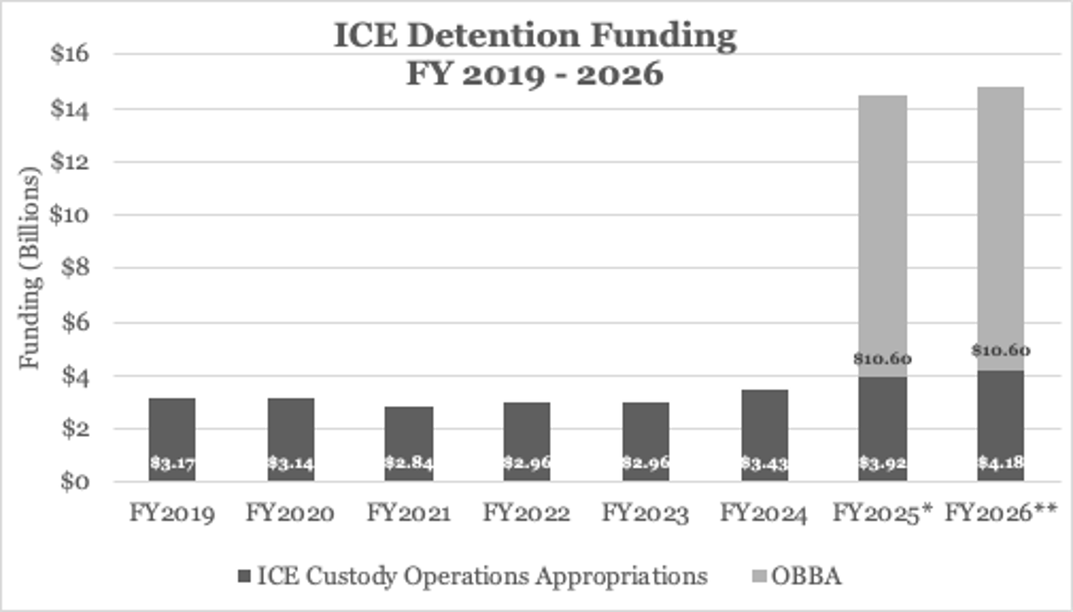
ICE Detention Funding Dramatically Increasing Under Trump II

Slide 67
Immigration Detention Centers
Ankle bracelets cost $3-4/day; monitoring apps $1/day, but privacy violations common
  Lucrative business

Slide 68
Immigration Detention Centers
Run by Immigration and Customs Enforcement, a branch of DHS
  Haphazard network of governmentally- and privately-run jails
  Lucrative business
High rates of infectious disease (e.g., Covid, influenza, varicella, even mumps)
  Covid largely responsible for dramatic increase in prison deaths

Slide 69
Immigration Courts
Underfunded, understaffed, judges and attorneys (often volunteer lawyers) overworked
Huge backlog of cases (2.1 million in 2022)
Outdated paper filing system
Public often denied access to charging documents, evidence, and routine judicial decisions
ICE officers not obligated to appear

Slide 70
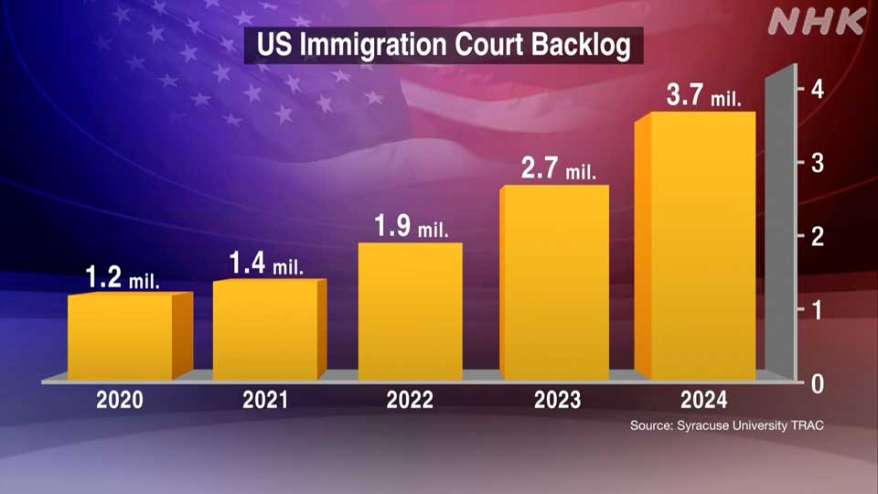

Slide 71
Immigration Courts
Noncitizens protected against unlawful search and seizure and self-discrimination, but do not have right to a government-funded lawyer
  Most lack legal representation
  Those with representation are 10 times more likely to win their cases
Children often represent themselves (even as young as 3yo)

Slide 72
Immigration Detention Centers / Guantanamo
Abuses common, including over 100 deaths since late 2003
Guantanamo, overseas black-ops sites (extraordinary rendition)
  92% were never involved with al-Qaeda (per government data)

Slide 73
The “War on Drugs”
Majority of US detainees non-violent drug offenders
  Cultural stigmatization of drug use/abuse
  Increasing numbers of prosecutors
  Violence thriving among young men deprived of a faith in their upward mobility, making drug dealing an attractive economic opportunity
  Mandatory sentences leading some violent offenders to plead to lesser drug charges, since vast majority of cases decided by plea bargain and violent crimes more difficult to prosecute

Slide 74
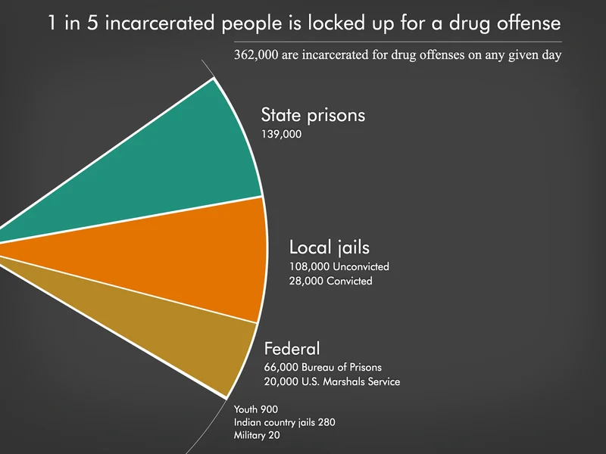

Slide 75
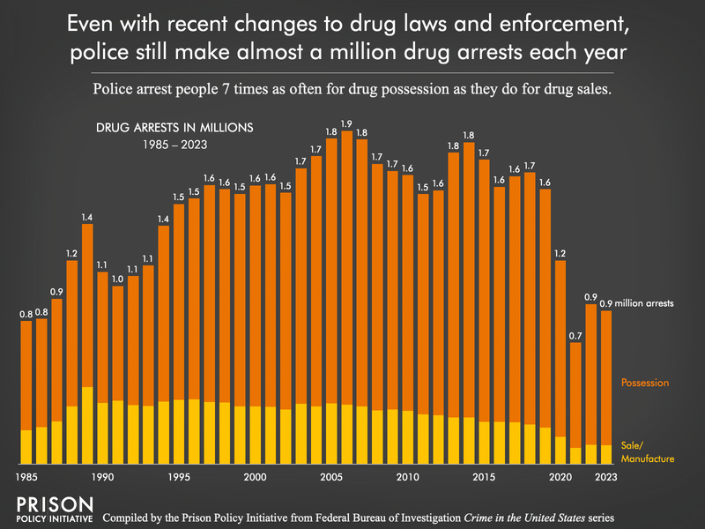

Slide 76
The “War on Drugs”
Racist origins:
  Chinese Opium Act
  Criminalization of marijuana
Drug users:
  ¾ of European-American ancestry
  15% African-American
    37% of arrestees
    59% of those convicted
Uneven sentencing laws:
  Crack vs. powder cocaine

Slide 77
The “War on Drugs”
Worldwide prevalence of illicit drug use in prisons = 22-48%
  Injection drug use = 6-26% (1/4 of these began injecting while in prison)

Slide 78
The “War on Drugs”:
Alternatives to Mass Incarceration
Rehabilitation, restitution, and community service
  Favored by majority of Americans for drug use and possession
Shift money from military interdiction and intervention to peasant farm aid
Education and social marketing

Slide 79
The “War on Drugs”:
Alternatives to Mass Incarceration
Vaccinations
Methadone/buprenorphine for opiate detoxification
Research into other detox/abstinence-promoting agents
Treat substance abuse as chronic disease

Slide 80
The “War on Drugs”:
Alternatives to Mass Incarceration
All methods more cost-effective than interdiction and punishment
Arizona mandates drug treatment instead of prison for first-time nonviolent drug offenders
  $2.7 million savings in first year

Slide 81
The “War on Drugs”:
Alternatives to Mass Incarceration
2013: US Attorney General Holder announces plan to reduce sentences for non-violent offenders
2013: US will not prosecute users of small amounts of medical marijuana
2020: First Step Act
  Early release for some offenders, easing of mandatory minimums, judges given more leeway in sentencing, retroactively applies 2010 Fair Sentencing Act (reducing disparities between sentences for offenses involving powder vs. crack cocaine)

Slide 82
The Criminalization of Homelessness
Laws re sleeping/sitting/storing personal property, loitering/jaywalking/open containers, begging/panhandling, sharing food
“Quality of life” laws re public activities and urination when no public facilities available
Selective enforcement

Slide 83
The Criminalization of Homelessness
Sweeps of city, often involving destruction of important personal documents and medications
Exacerbate problem
  Move homeless away from services
  Lead to criminal record, further impairing employability

Slide 84
The Criminalization of Homelessness
Can violate civil rights
Solution: Improved access to housing and services, etc.

Slide 85
Policing for Profit
Law enforcement agencies allowed to seize cash, cars, property, and other assets from those suspected of crimes
  Breach of Constitutional due-process rights
Those not convicted must go to court to reclaim assets
  Many lack resources to fight long court battle

Slide 86
Policing for Profit
Federal Justice Department Fund $94 million in 1986, $4.5 billion in 2014
State and local police seized $2.5 billion in cash from 62,000 people between 2001 and 2014
  Proceeds used to pad agencies’ budgets, buy new equipment, salary bonuses

Slide 87
Policing for Profit
2026: 34 states require criminal conviction in most or all forfeiture cases
Need for more state and federal laws to protect the innocent

Slide 88
Corporate Crime:
Silent but Deadly
$426 billion/yr to $1.7 trillion/yr (vs. $15 billion for burglary and robbery)
  Only $7 billion recovered
  Fines for corporate environmental and social abuses minimal/cost of doing business
Incarceration rare
Some corporations linked to human rights abuses in US and abroad
Most lobby Congress to weaken environmental and occupational health and safety laws

Slide 89
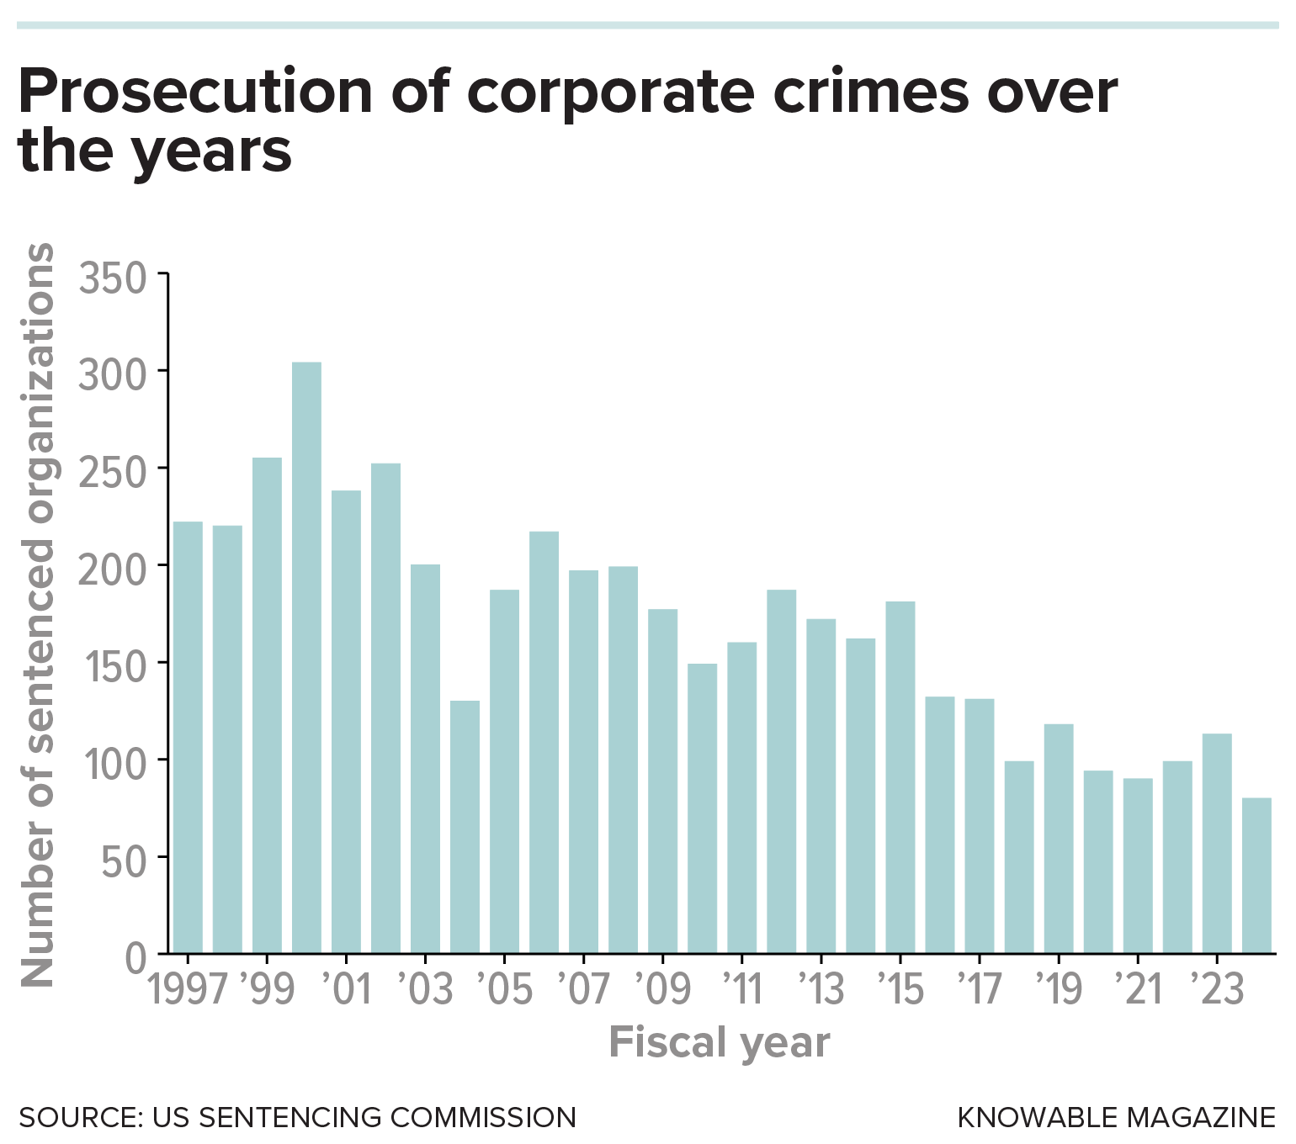

Slide 90
Corporate Crime
“The [only] social responsibility of business is to increase its profits.”
Milton Friedman
“Corporations [have] no moral conscience. [They] are designed by law, to be concerned only for their stockholders, and not, say, what are sometimes called their stakeholders, like the community or the work force…”
Noam Chomsky

Slide 91
Corporate Crime
“Corporation: An ingenious device for obtaining individual profit without individual responsibility.”
Ambrose Bierce
“A criminal is a person with predatory instincts who has not sufficient capital to form a corporation.”
Howard Scott

Slide 92
The Mentally Ill and Violent Crime
4 % of violent crimes in U.S. perpetrated by the mentally ill
2.3% of Americans in good mental health commit a violent act in the course of a year
  7% of those with schizophrenia or a major mood disorder
  9.7% of substance abusers
  12-22% of those with a serious mental illness have perpetrated violence in the last 6-18 months

Slide 93
The Mentally Ill and Violent Crime
Public misinformed about the link between mental illness and violence (media partly to blame)
Those with a serious mental illness are nearly 12X as likely as the average person to be the victim of a violent crime, 8 X as likely to commit suicide, and 16X more likely to be killed by police
Increasing and potentially dangerous use of ketamine by EMS to tranquilize suspects for law enforcement purposes (not treatment)
30% of chronically homeless are mentally ill
  Homeless mentally ill at highest risk of violence

Slide 94
Prisons:
De facto mental institutions
Prisons primary supplier of mental health services in US
House 3X more seriously mentally ill than mental hospitals
Jails and prisons – 356,000
State mental hospitals – 35,000
40% lifetime incarceration rate for individuals with serious mental illness

Slide 95
Prisons:
De facto mental institutions
3 largest mental health facilities in U.S. = Rikers Island (NY), Los Angeles County Jail, Cook County Jail (Chicago)
More than 80% of states have < ½ minimum number of psych beds needed, so many patients languish for days in ERs

Slide 96
Prisons:
De facto mental institutions
20% of female (14% of male) prisoners and 32% of female (26% of male) jailed individuals suffer from serious psychological distress
1/6 prisoners diagnosed as mentally ill
  Women > Men
  2/3 of juveniles
5% actively psychotic
10% receive psychotropic medications
Only 35% of those in prison (7% of those in jail) receive mental health treatment while incarcerated

Slide 97
Prisons:
De facto mental institutions
Mentally ill subject to victimization, solitary confinement (torture)
  1/12 sexually victimized at least once over 6 months, compared with 1/33 for those without mental illness
Guards inadequately trained to manage

Slide 98
Prisons:
De facto mental institutions
Over 1/3 of prison/jail mental health professionals admit to feeling that their ethics were regularly compromised
Pervasive fear of security staff retaliation if they report abuse of patients
Mental health professional organizations disengaged from prison health care issues, few providers have any experience

Slide 99
Prisons:
De facto mental institutions
“Prison Litigation Reform Act” bars lawsuits by inmates for mental or emotional injury, including humiliation, mental torture, and non-physical sadistic treatment
  Violates UN Convention Against Torture

Slide 100
Isolation/Solitary Confinement
1/5 U.S. prisoners spend time in solitary confinement each year
  130,000 on any given day (more than 1/20)
  10,000 have spent 3+ yrs in solitary
  Dramatic increase during covid pandemic

Slide 101
Isolation/Solitary Confinement
Torture
  U.S. Supreme Court labels as “cruel and unusual punishment” (2011)
Can cause/worsen mental illness
2016: Obama issues executive order banning solitary confinement in federal prisoners for juveniles and adults convicted of low-level infractions, increasing amount of time other prisoners allowed outside of isolation cells

Slide 102


Slide 103
Jail and Prison Overcrowding
9 states and federal prison system at 100%+ capacity in 2020
1/11 prisoners serving life sentence
  ¼ of these without possibility of parole
13 of 15 hottest states lack universal air conditioning in their prisons
Most states have some facilities that are not fully air conditioned (70% of Texas prisons without air conditioning during summer, 2023)
Climate change/heat waves making conditions worse

Slide 104
Reasons for Overcrowding
“War on Drugs”
Mandatory Minimums
  2013: Federal prosecutors to stop requesting
Repeat Offender laws
  28 states have some form of “three strikes laws”

Slide 105
Reasons for Overcrowding
Truth in Sentencing regulations
Decreased judicial independence
Immigration violations (30% of federal inmates)

Slide 106
The Prison-Industrial Complex
Private for-profit prisons incarcerated 90,873 American residents in 2022 (8% of total state and federal prison population)
Since 2000, the number of people housed in private prisons has increased 5%
Private prisons currently hold 7% to 8% of incarcerated in the US

Slide 107
The Prison-Industrial Complex
18 corporations guard 115,000 prisoners in 158 private prisons in 27 states (federal sites included)
  Majority of contracts with state and local governments include bed guarantees (“lockup quotas”)
Only UK has higher proportion of private prisoners than US

Slide 108
Private prison boom over past 15 years
Reasons:
  Prevailing political philosophy which disparages the effectiveness of (and even need for) government social programs
  Often-illusory promises of free-market effectiveness
      Despite evidence to contrary (e.g., Medicare/Medicaid, water privatization, etc.)
  Increasing demand from ICE and USMS

Slide 109
The Prison-Industrial Complex
Leading trade group:
  American Correctional Association
For-profit companies involved:
  Core Civic (formerly Corrections Corporation of America) controls 42% of private U.S. prisons; GEO Group (formerly Wackenhut) controls 32%
  Together these two companies control majority of private prison and associated services market
  Spend large amounts on lobbying, political contributions

Slide 110
The Prison-Industrial Complex
For-profit companies involved:
  Correctional Medical Services
  Others (Westinghouse, AT&T, Sprint, MCI, Smith Barney, American Express, Merrill Lynch, Fidelity, Shearson-Lehman, Allstate, GE, Wells Fargo [7% owned by Warren Buffet’s Berkshire Hathaway])

Slide 111
Core Civic
Formerly Corrections Corporation of America
Largest for-profit prison corporation
More than 92,000 prison and immigrant detention “beds” in 20 states and DC
  2/5 in for-profit prisons (3/4 of immigrant detainees)
$1.85 billion in gross revenue; $122 million profits (2022)
Largest detainer of undocumented immigrants
  Facilitated by Arizona’s SB1070 (stop and check ID if suspect undocumented immigrant) and similar laws in UT, IN, GA, AL, and SC

Slide 112
Core Civic
Formerly Corrections Corporation of America
Earns between $100 and $210 per prisoner per night
Accused of paying lower salaries and providing less training than state-run prisons
AZ: Hired to high school drug sweep

Slide 113
The Prison-Industrial Complex
Aggressive marketing to state and local governments
  Promise jobs, new income
Rural areas targeted
  Face declines in farming, manufacturing, logging, and mining
Companies offered tax breaks, subsidies, and infrastructure assistance
Rural economies ultimately suffer

Slide 114
Private Prisons
Hire fewer guards, pay them less, and give them less training
Provide fewer educational, medical and enrichment services to inmates
Have more security violations than public prisons
Higher rates of inmate-on-inmate and inmate-on-staff assaults
Throw more inmates into solitary confinement
Use prison lockdowns more frequently

Slide 115
The Prison-Industrial Complex:
2001 Bureau of Justice Study
Average savings to community 1%
Does not take into account:
  Hidden monetary subsidies
  Private prisons selecting least costly inmates
    c.f., “cherry picking” by health insurers
  Private prisons attract large national chain stores like Wal-Mart, which:
    leads to demise of local businesses
    Shifts locally-generated tax revenues to distant corporate coffers

Slide 116
The Prison-Industrial Complex:
Politically Well-Connected
Heavily lobbies Congress and state legislators
  E.g., private prison industry donated $1.6 million to candidates/parties/outside spending groups in 2016 elections
  2004: $100,000 from CCA to indicted former House Speaker Tom Delay’s (R-TX) Foundation for Kids
    Delay’s brother Randy lobbied TX Bureau of Prisons on behalf of GEO

Slide 117
The Prison-Industrial Complex:
Lobbying
Spent over $4 million lobbying legislators and DHS between in 2023
GEO Group and CoreCivic spent combined $2.6 million on lobbying in 2018
GEO Group donated $250,000 to Trump’s Inaugural Committee in 2021

Slide 118
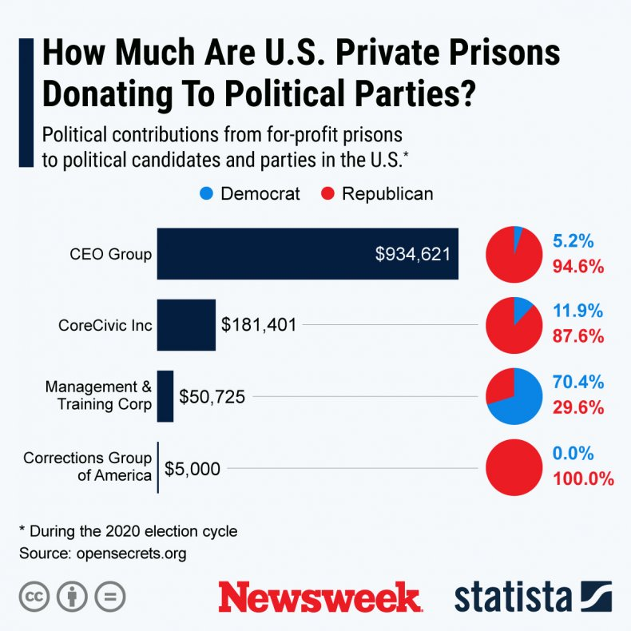

Slide 119
The Prison-Industrial Complex:
Politically Well-Connected
More money given to Republicans than Democrats
Revolving door between corporate executives and federal and state prison bureaus

Slide 120
The Prison-Industrial Complex:
Abuses
Some paid for non-existent prisoners, due to inmate census guarantees
School to prison pipeline
  E.g., two judges in PA convicted of jailing 2000 children in exchange for bribes from private prison companies (2009)

Slide 121
The Prison-Industrial Complex:
Abuses
Prison phone companies:
  Charge exorbitant rates
    Family members not able to talk with loved ones experience negative health consequences
  90% of prison phone service controlled by 3 companies
Return of debtors’ prisons (1/3 of states, in violation of 1983 Supreme Court ruling)
  Facilitated by for-profit debt supervisor companies

Slide 122
The Prison-Industrial Complex:
Abuses
“Alternatives to Incarceration” Industry
  Pay-only probation = debt collection masquerading as probation supervision
  Halfway houses
  Residential treatment facilities
  Electronic monitoring companies
  All managed by for-profit companies

Slide 123
The Prison-Industrial Complex
2016: Justice Dept. announces plan to end use of private prisons to house federal inmates (approximately 22,000 individuals = 12% of the federal prison population) over the next few years
  Decision did not apply to vast majority of inmates, who are held in state prisons
  Trump administration overturns policy 2017, leading to increasing private prison profits; then Biden banned private federal prisons; then Trump II overturned that ban

Slide 124
The Prison-Industrial Complex
2020: Major private prison banking partners commit to ending ties with for-profit prisons
2021: Biden directs AG not to renew federal contracts with private prisons
  2025: Trump reverses policy
2024: Biden signs Federal Prison Oversight Act

Slide 125
Jails for Jesus:
Faith-Based Initiatives
Increasing presence
Politically powerful
Most evangelical Christian
Supported financially by George W Bush’s Faith-Based Initiatives Program
  e.g., Prison Fellowship Ministries – founded by Watergate felon Charles Colson in 1976

Slide 126
Jails for Jesus:
Faith-Based Initiatives
Offer perks in exchange for participation in prayer groups and courses
  Perks: better cell location, job training and post-release job placement
  Courses: Creationism, “Intelligent Design”, “Conversion Therapy” for homosexuals

Slide 127
Jails for Jesus:
Faith-Based Initiatives
Some programs promise to cure sex offenders through prayer and Bible study
  Rather than evidence-based programs employing aversion therapy and normative counseling
Highly recidivist and dangerous criminals may be released back into society armed with little more than polemics about sin

Slide 128
Back on the Chain Gang:
Prison Labor
AL and AZ still have actual chain gangs
Provides inmates with opportunity to earn money for release
5000 inmates in majority of states working in private sector companies

Slide 129
Private Companies Profiting from Prison Labor
McDonald's
Wendy's
Wal-Mart
Starbucks
Sprint
Verizon
Victoria's Secret
Fidelity Investments
Macy’s
Target
Dell
AT&T
Toys R Us

Slide 130
Back on the Chain Gang:
Prison Labor
61% federal prisoners working for Federal Prison Industries
Federal prison industry produces 100% of military uniforms, helmets, bullet-proof vests; 36% of home appliances; 21% of office furniture; license plates; face masks; and some airline parts and medical supplies

Slide 131
Back on the Chain Gang:
Prison Labor
Wages:
  Range from $0.10 to $0.65 per hour; determined by your program or assignment
  Majority of prison population earns $0.25/hr or less
  Immigrants under-paid, GEO Group lost WA lawsuit in 2021 for this
  Inmates paid $2.56/day to fight CA wildfires in 2018, but training inadequate and some fire departments won’t hire convicted felons

Slide 132
Back on the Chain Gang:
Prison Labor
More than 80% of incarcerated laborers do general prison maintenance (cleaning, cooking, repair work, laundry, etc.)
Pay averages 13 to 52 cents/hr
  Seven states pay nothing for the vast majority of prison work.
Some do dangerous work (firefighting, meat processing, hurricane response, hazardous cleanups)

Slide 133
Back on the Chain Gang:
Prison Labor
Most of pay withheld for taxes, room and board expenses, and court costs
Low wages mean released prisoners have little money upon release, making crime an attractive or desperate option

Slide 134
Objections to Prison Labor
Undercuts unions
Shifts manufacturing and service jobs from law-abiding poor to incarcerated
  Exacerbates exodus of jobs overseas
    Laws ban importation of goods made by prison laborers, but poorly enforced

Slide 135
Health Issues of Prisoners
Each year of incarceration shortens a person’s future life by 2-5 yrs
Family members of incarcerated have 2.6 yr shorter life expectancy

Slide 136
Health Issues of Prisoners
(18-65yo, c/w general public)
1.2X odds of having HTN
1.3X asthma
4.2X hepatitis
4.8X cervical cancer
15%-25% serious psychological distress (vs 5% general population)

Slide 137
Health Issues of Prisoners
At least 1/3 of state and ¼ of federal inmates have a physical impairment or mental condition
  Infectious diseases: HIV, Hep B and C, STDs (including HPV→cervical CA)
    E.g., hep C (17% of inmates, vs. 1% of general population), HIV (1.4% at any given time, but 1/7 U.S. HIV patients pass through a correctional facility each year)

Slide 138
Infectious Diseases
HIV rates: 5-fold higher than in general population
  3.5% women; 2.2% men (reverse of sex ratio in general public)
  Minority of correctional facilities offer CDC-recommended opt-out testing
  Annual incidence of new infections very low
  Many patients drop out of care post-release

Slide 139
Infectious Diseases
TB rates 4X higher
Covid outbreaks
  Deaths rose nearly 50% during pandemic
  Some institutions allowed early release, some states decreased prosecutions, numbers have since rebounded

Slide 140
Infectious Diseases
Hep C rates 10-20X higher
  1/3 HCV-infected people imprisoned each year
    Most unaware of infection, untreated
    Screening recommended, but only a few carry out
    Highly treatable, but treatment expensive and most inmates not treated
      Consequences: cirrhosis, hepatocellular carcinoma, liver failure, and death

Slide 141
Infectious Diseases
Sex between inmates, while common (1/3, mostly without protection), is illegal in almost every state
Over 10% of inmates get a new tattoo while incarcerated, generally using homemade, shared implements
Foodborne disease outbreaks much more common than in general population

Slide 142
Health Issues of Prisoners
At least 1/3 of state and ¼ of federal inmates have a physical impairment or mental condition
  Mental illness
  Dental caries and periodontal disease
  Usual chronic illnesses seen in aging population
2017: Federal prisons required to provide female inmates with a range of free feminine hygiene products

Slide 143
Substance Abuse
52% of state and 34% of federal inmates under influence of alcohol or other drugs at time of offenses
Rates of acute alcohol and opiate intoxication among arrestees at least 12% and 4%, respectively
  28% of jails detoxify arrestees
Very few prisons provide evidence-based treatment of opioid addiction (perpetuates opioid epidemic); high rate of overdose immediately post-release

Slide 144
Substance Abuse
65% of U.S. jail inmates have substance abuse disorders
  Diversion of prescribed opiates surprisingly uncommon behind bars
Worldwide prevalence of illicit drug use in prisons = 22-48%
  Injection drug use = 6-26% (1/4 of these began injecting while in prison)

Slide 145
Substance Abuse
Women have higher rates of drug dependence but lower rates of alcoholism
70-80% of inmates use tobacco products
  Despite widespread bans, black market thrives and bans poorly enforced

Slide 146
Health Care/Nutrition
44% of state and federal prisoners experience chronic disease (vs. 31% general population)
Typical nutrition low-nutrient, high in starches and processed meats, low in fruits and vegetables
  6X more likely than general population to be sickened from spoiled or contaminated food than general population
  Food insecurity common post incarceration

Slide 147
Health Care/Nutrition
Improved diets would be money-saving
  Can be achieved through prison-agricultural systems, which improve mental health, reduce recidivism, and provide job skills

Slide 148
Inmate Deaths
At least 6,865 inmate deaths in 2025 (47% increase from 2019, despite 10% decrease in overall prison population)

Slide 149
Top Ten Ways People Died Behind Bars
Unavailable or Unspecified: 44%
Cardiac Arrest, Heart Attack, Cardiopulmonary Or Cardiovascular Disease: 11%
Cancer: 8%
Hanging: 6%
Organ Failure, Sepsis, Ulcer, Diabetes Or Pneumonia : 6%
Respiratory Or Pulmonary Disease: 5%
Overdose: 5%
Covid-19: 4%
Unspecific Natural Cause: 3%
Suicide (Other Method): 2%
(2023, The Marshall Project, Bureau of Justice Assistance)

Slide 150
Arrest-Related Deaths
Federal law enforcement agencies reported 104 arrest-related deaths and 456 deaths in custody in 2023
2016 to 2023: Average of 76 arrest-related deaths and average of 495 deaths in custody each year.

Slide 151
Arrest-Related Deaths
Other Data
1900 arrest-related deaths in 2022
Homicides 47%; suicides 26%; deaths from natural causes 13%; accidents 13%
89% of decedents in arrest-related deaths male, 69% white, and 62% ages 25 to 44.
60% during service of arrest warrant

Slide 152
Inmate Deaths
7,000 deaths in custody in 2022
Black prisoners have ½ mortality of Black non-prisoners (fewer alcohol- and drug-related deaths, lethal accidents, and chronic diseases; guaranteed health care)
White prisoners have 12% higher mortality than White non-prisoners (higher death rates from infections, including HIV and hepatitis)

Slide 153
Pregnant Inmates:
A High-Risk Obstetrical Population
Up to 20,000 incarcerated women pregnant (3-10%)
Higher rates of alcohol and tobacco abuse
More medical co-morbidities
Less antenatal care
Increased odds of low birth weight and pre-term birth in those under 40

Slide 154
Pregnant Inmates:
A High-Risk Obstetrical Population
Adolescents particularly high risk
1/3 of juvenile facilities provide prenatal services
30% offer parenting classes
High risk for abuse and neglect post-release

Slide 155
Perinatal Shackling of Prisoners
Mostly for those convicted of drug crimes
Still permissible for 2/3 of female inmates, despite federal and state directives and laws to eliminate
Applied more frequently to poor and to racial and ethnic minorities

Slide 156
Perinatal Shackling of Prisoners
39 states, D.C., and the federal government restrict shackling of pregnant women and ban it entirely during labor and delivery (some exceptions)
Only 13 states ban it broadly throughout pregnancy, labor, postpartum, and during transport
Some states allow physician to immediately remove the restraints if necessary
Some states require that correctional staff stand outside the room for privacy considerations during childbirth

Slide 157
Pregnant Inmates:
A High-Risk Obstetrical Population
Detainees of Immigration and Customs Enforcement (ICE) exempt from prohibitions
ACOG, AMA, APHA, ABA (“except in extraordinary circumstances”), UN, Amnesty International oppose

Slide 158
Perinatal Shackling of Prisoners
Shackling pregnant inmates
  Risk for falls, difficulty with giving birth (risks to mother and newborn), difficulty with bonding and breast feeding
  Dehumanizing, cruel and unusual punishment
Congressional Dignity for Incarcerated Women Act (pending) would outlaw perinatal shackling, including in DHS facilities

Slide 159
Pregnant Inmates:
A High-Risk Obstetrical Population
Prison Ob/Gyn care considered a specialty service
More vulnerable to budget cuts
Post-discharge maternity case management can offset risks for women released before due dates
  Programs rare/under-funded

Slide 160
Protecting the Health and Wellness of Babies and Pregnant Women in Custody Act (pending)
Would establish care standards for federal facilities requiring access to medical and mental health services, as well as education around parental rights and lactation.
Would restrict when pregnant women can be placed in restrictive housing, ban the Federal Bureau of Prisons (BOP) and U.S. Marshal Service from placing pregnant women in solitary confinement during the third trimester and require the BOP to evaluate pregnant women to determine if their pregnancy is high-risk.

Slide 161
Prison Health Care
“A society should be judged not by how it treats its outstanding citizens but by how it treats its criminals.”
Fyodor Dostoevsky

Slide 162
Prison Health Care
Estelle v. Gamble (US Supreme Court, 1976): affirms inmates constitutional right to medical care (based on 8th Amendment prohibiting cruel and unusual punishment)
Amnesty International and AMA have commented upon poor overall quality of care

Slide 163
Prison Health Care
40% provided by government entities
60% provided by private corporations
Private care often substandard

Slide 164
Prison Health Care
Since 1998, state corrections health care costs have increased by over 300%
50% of those in state prisons have health insurance before arrest (2016)

Slide 165
Prison Health Care
After release, nearly all ex-prisoners eligible for Medicaid under PPACA
  Only 42 states and DC follow
  Only1/5 emerging inmates between 2013 and 2015 signed up (due to failure to cover, difficult enrollment procedures, ineffective/understaffed insurance brokers)
Ex-inmates 12X more likely to die in 2 weeks post-release than general population
  2026 study shows that coverage reduced all-cause mortality

Slide 166
Prison Health Care
Some doctors unable to practice elsewhere have limited licenses to work in prisons
Some government and private institutions require co-pays
  Discourages needed care; increases costs

Slide 167
Examples of Substandard Prison Health Care
Correctional Medical Systems (largest/cheapest)
  Numerous lawsuits/investigations for poor care, negligence, patient dumping; opaque accounting of taxpayer dollars
Prison Health Services
  Cited by NY state for negligence/deaths; subject of >1000 lawsuits; under investigation in VT

Slide 168
Examples of Substandard Prison Health Care
California’s state prison health care system placed into receivership
  1 unnecessary death/day
  $5 co-pays limit access
  Almost 50,000 released, noted to have been held under “inhumane conditions” (US Supreme Court)

Slide 169
Abuse of Female Prisoners
Rape and abuse of female prisoners rampant
  1/8 juveniles and 1/20 adults raped while in custody
Perpetrators seldom face charges
Correctional authorities deny seriousness of problem

Slide 170
Abuse of Female Prisoners
Girls entering juvenile justice system:
  92% have been emotionally, physically, or sexually abused
  40% have been raped
Women on death row:
  1/5 have been sexually assaulted while in prison
  1/3 report being watched by corrections officers while toileting/showering/dressing

Slide 171
Sexual Assault and Rape of Incarcerated Men
1/5 men in state prisons report pressured or forced sex during incarceration; 7% report rape
4.5% of men in state and federal prisons sexually victimized annually
  Rates much higher among non-heterosexual inmates (many engage in “protective” pairing / “protective” prostitution)
Gang culture contributes to prison rape

Slide 172
Prison Rape
Prison Rape Elimination Act (2003)
Established Prison Rape Elimination Commission to develop standards for reforms
Recommendations released 2012
  Emphasis is on prevention-first measures, staff and inmate education, and transparent oversight

Slide 173
Prison Health Care
UNOS position paper: Excluding convicted prisoners from receiving medical treatment, including organ
US Supreme Court (Washington v. Harper) allows forcible treatment of inmates under certain conditions (i.e., medicating schizophrenics)

Slide 174
Rehabilitation and Release
Over 650,000 prisoners released each year
  4-fold increase over 1980
  97% of all prisoners eventually return to the community
  67% of those released re-imprisoned within 3 yrs
  1990s: funding for rehab dramatically cut

Slide 175
Rehabilitation and Release
Newly released and paroled convicts face restricted access to federally-subsidized housing, welfare, and health care
  Some localities prohibit rental discrimination against ex-cons
½ of state correctional facilities provide only a 1-2 week supply of medication

Slide 176
Rehabilitation and Release
Access to mental health services shortly after release associated with nearly 40% reduction in short-term recidivism
Wait times for Medicare, Medicaid, and Social Security benefits up to 3 months
  Build Back Better Act proposed use of Medicaid funds starting 30 days pre-release, to help prevent lapses in care, since average jail detention 26 days
  Did not pass

Slide 177
Rehabilitation and Release
Released inmates have high risk of death
1/70 former inmates hospitalized for an acute condition within 1 week of release; 1 in 12 within 3 months
  2.5X similar non-incarcerated population
80% of former inmates have at least one chronic condition
  Only 25% visit a doctor in the year following release

Slide 178
Rehabilitation and Release
Drug felons in 18 states permanently banned from receiving welfare
High risk of death in first few weeks after release, mostly due to homicide, suicide, and drug overdose; higher risk lifelong due to suicide, chronic illness, exposure to neighborhood violence and development of stress-related diseases
  27% of adult suicides occur in formerly incarcerated persons (within 2 yrs of release)

Slide 179
Ex-offenders have poor job prospects
Little education and job skills training occur behind bars
  Budget cuts have decimated library programs, many books banned
  GED programs reduce recidivism, decrease costs
Most prisoners released with $50 to $100 “gate money” and a bus ticket
Limited resumés, background checks

Slide 180
Ex-offenders have poor job prospects
60% of employers would not knowingly hire an ex-offender
  10 states and dozens of cities ban employment discrimination against ex-convicts
High rates of criminal recidivism

Slide 181
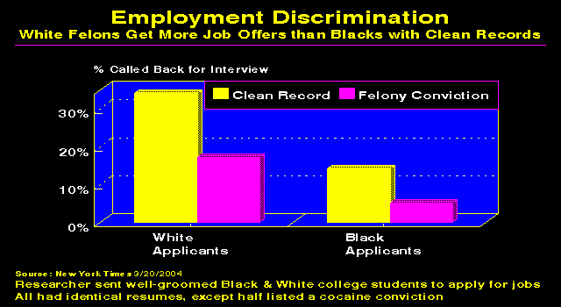

Slide 182
Barriers to re-unification of children with released mothers
Short timelines: parental rights can be terminated if child in foster care for 15 out of last 22 months
Lack of contact with children, often due to distance
Lack of affordable child care
Restrictions on public assistance after release for certain offenders

Slide 183
Disenfranchisement of convicts and ex-felons
Only Maine, Vermont, and D.C. allow prisoners to vote
23 states automatically restore voting rights upon release from prison
15 states restore rights after completing parole or probation.
10 states where additional restrictions apply, such as waiting periods or special restoration procedures for certain crimes

Slide 184
Disenfranchisement of convicts and ex-felons
4.6 million US citizens disenfranchised due to criminal convictions
  Includes 1.2 million women
  Includes 2.2 million who have served their sentences
6% of African-American men disenfranchised (vs. 1.7% of non-African-Americans); higher rates also noted for LatinX Americans
Possible role in election outcomes

Slide 185
Incarceration and Census
Census counts incarcerated as living in location of prison, not their usual communities
Skews representation and government benefits to rural, predominantly white areas and away from urban communities of color
  “prison gerrymandering”
  Some states trying to counter

Slide 186
The Death Penalty
The Supreme Court’s endorsement of capital punishment “was premised on the promise that capital punishment would be administered with fairness and justice. Instead, the promise has become a cruel and empty mockery. If not remedied, the scandalous state of our present system of capital punishment will cast a pall of shame over our society for years to come.”
Justice Thurgood Marshall, 1990

Slide 187
The Death Penalty
As one whose husband and mother-in-law have died the victims of murder … I stand firmly and unequivocally opposed to the death penalty ... An evil deed is not redeemed by an evil deed of retaliation. Justice is never advanced in the taking of a human life. Morality is never upheld by a legalized murder.”
Corretta Scott King

Slide 188
The Death Penalty: Methods of Execution
Ancient times through 18th Century:
  Crushing by elephant
  Crucifixion
  The Brazen Bull
  Ling Chi (death by 1000 cuts – outlawed 1905)
  Cave of Roses
  Keelhauling
  Spanish Donkey (Wooden Horse)

Slide 189
The Death Penalty: Methods of Execution
18th- 20th Century:
  Hanging (last use in Delaware, 1996)
  Firing squad (few so far – e.g., GA, SC - allowed in 5 states)
  Guillotine (debuted 1792, outlawed 1977)
1608-1972: Est. 15,000 sanctioned killings in U.S.

Slide 190
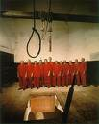
Hanging

Slide 191
Electric Chair
1880s: NY begins use of electric chair
  Invented by dentist Alfred Southwick
  Thomas Edison lobbies for use, to capture larger share of energy market from competitor George Westinghouse
  Other states soon adopt
  No longer used as of 2008
    But, in 2023, SC allows option

Slide 192
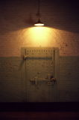
Electric Chair

Slide 193
Gas Chamber
Cyanide gas introduced in 1924
  2022: AZ to allow use of Zyklon B (cyanide gas, used in Nazi death chambers)
2024: AL executes prisoner by nitrogen hypoxia
  3 other states allow

Slide 194
Lethal Injection
Developed by anesthesiologist Stanley Deutsch
  Inexpensive, fast, “extremely humane”
First use in Texas in 1982
Now predominant mode of execution (over 900 since 1982)

Slide 195
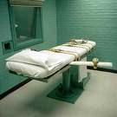
Lethal Injection

Slide 196
Lethal Injection
Death cocktail (3 drug regimen developed by OK pathologist Jay Chapman in 1970s as a way to “humanely” kill inmates):
  Anesthetic (sodium thiopental)
  Paralytic agent (pancuronium)
  KCl (stops heart)
  OH using thiopental alone

Slide 197
Lethal Injection
19 states, including TX, prohibit use of pancuronium and other neuromuscular blockers to kill animals
Manufacturers of drugs targeted by protesters

Slide 198
Lethal Injection
Numerous states have laws shielding the source of drugs used
Some pharmaceutical companies refuse to supply drugs
  Prisons then turn to compounding pharmacies
Trump Justice Department stated FDA has no jurisdiction over death penalty drugs
Biden administration has not changed policy

Slide 199
Death Penalty Not Humane
Georgia Supreme Court (2001) rules electrocution violates prohibition against cruel and unusual punishment
  Causes “excruciating pain…cooked brains and blistered bodies”
Electrocution deemed cruel, struck down in last remaining state (Nebraska) in 2008

Slide 200
Death Penalty Not Humane
Lethal injection:
  88% of lethal injectees had lower levels of anesthesia than required for surgery
  43% had concentrations consistent with awareness
  Lancet 2005;365:1361

Slide 201
Death Penalty Not Humane
While a state court judge ordered halt to lethal injections, the US Supreme Court (Baze v. Rees) upheld Kentucky’s lethal injection method in 2008
5/08: Georgia resumes lethal injection
1/14: Ohio executes prisoner using only midazolam and hydromorphone, called cruel and unusual punishment; Louisiana plans same mixture (2015 – SCOTUS OKs use)

Slide 202
Death Penalty Not Humane
9/14: OK botches lethal injection – prisoner dies after 43 minutes (other examples, some lasting over 1 hour)
2015: OK to allow use of nitrogen gas (lack of oxygen causes asphyxiation)
2020: SCOTUS upholds lethal injection, rules that possible gruesome nature of death irrelevant and that any method of execution is legal unless it “cruelly superadds pain”
2022: 7/20 lethal injections botched

Slide 203
The Death Penalty:
Law and Epidemiology
1972: US Supreme Court (Furman v. Georgia) temporarily halts executions
  States rewrite death penalty laws
1976: US Supreme Court (Gregg v. Georgia) rules new state laws allowing death penalty constitutional

Slide 204
The Death Penalty:
Law and Epidemiology
27 states and federal government now allow capital punishment
  23 states have outlawed capital punishment
Since 1976, 32 states have executed 1,681 prisoners (including 18 women)

Slide 205
The Death Penalty:
Law and Epidemiology
Texas leads all other states by wide margin
George W. Bush (“Executioner in Chief”) presided over 152 (higher rate than TX former Governor Rick Perry, but Perry’s total higher at over 230)
  1/3 of these represented by attorneys sanctioned for misconduct
  Mocked Karla Faye Tucker on “Larry King Live”
  Bush claims death penalty infallible

Slide 206
Death Penalty
Over 60% of the world lives in a country where there is capital punishment
2009: 714 outside China, 52 in U.S., 1000s in China
2011: European Union prohibits trade in death penalty drugs, thus prohibiting use
2012: 682 outside China; 3,000 in China

Slide 207
Death Penalty
2025: 47 in U.S. (up from 25 in 2024)
Almost all executions carried out by just 5 states: TX, MO, FL, OK, and GA
Trump pro-death penalty; Congress and 11 states pass laws in 2025 to expand death penalty

Slide 208
Death Penalty
2025: 2707 worldwide (17 countries)
  Iran: At least 2,159 executions
  Saudi Arabia: At least 356
  Yemen: 51 executions
  Plus thousands in China

Slide 209
Death Penalty
Late 2020/Early 2020: Attorney General Barr rushing to execute federal prisoners before Biden Administration takes over
  First federal executions in over 15 years
Biden: Backed off on promise to abolish federal death penalty

Slide 210
Death Penalty Costly
Up to 10X more expensive than life without parole
Extra $1 million to $2 million costs to taxpayers (2.3 million in TX; in 2000, FL spent more than $51 million more in administering the death penalty than it would have cost to punish all offenders with life without parole)

Slide 211
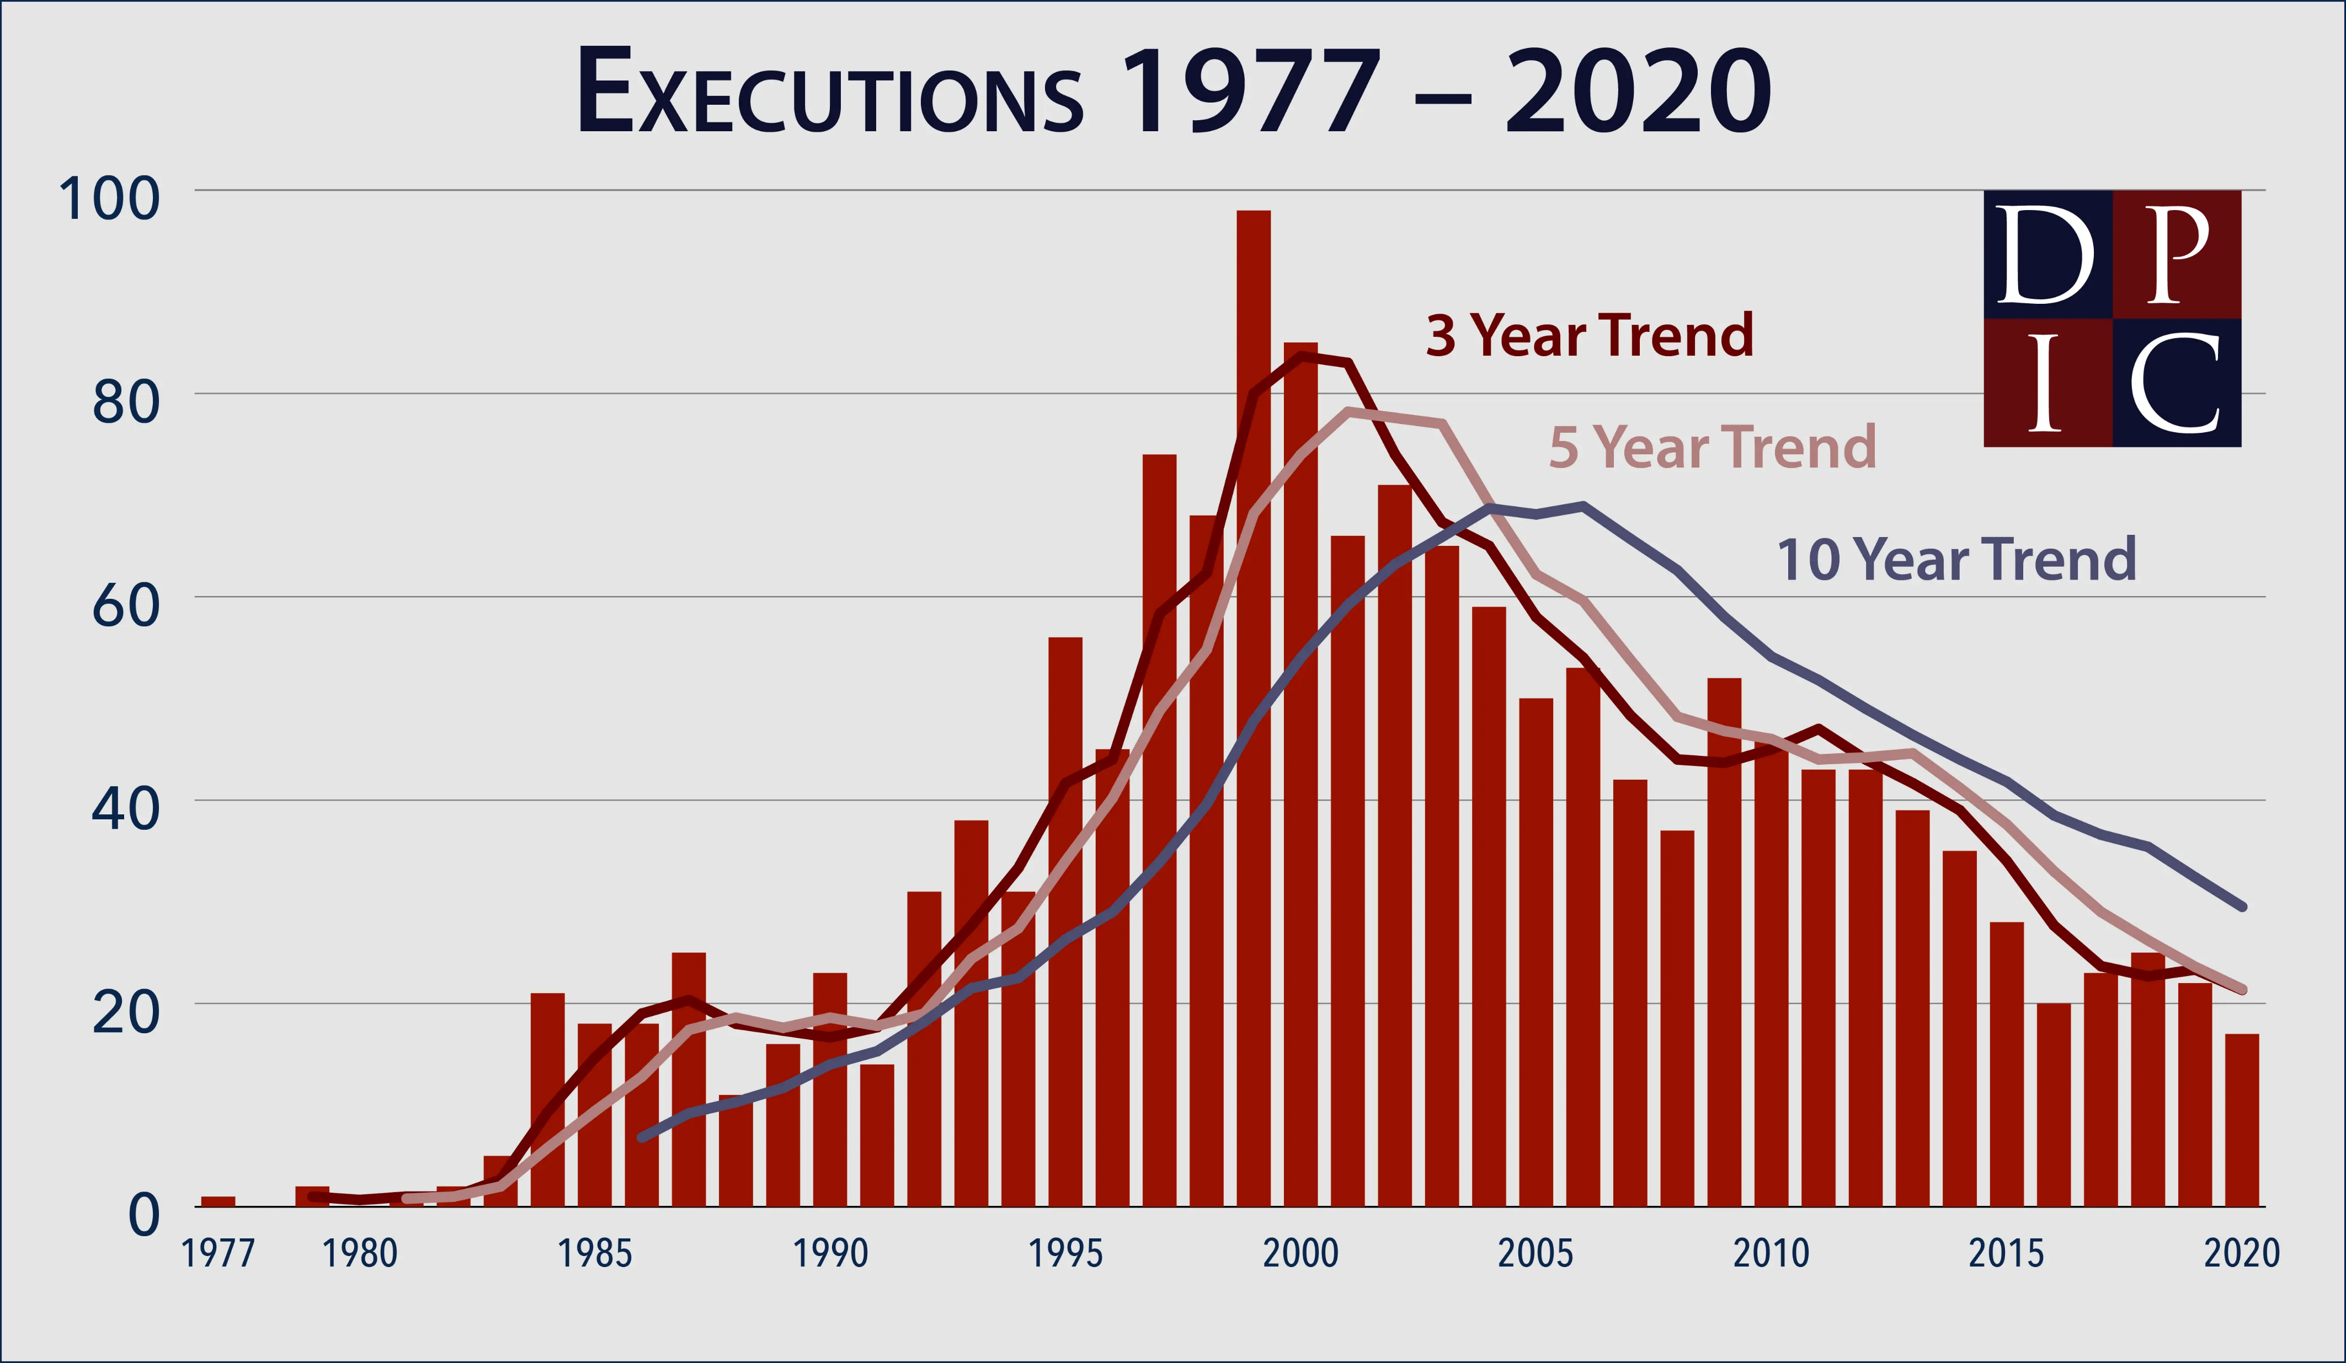

Slide 212
Top 10 Countries that Conducted the Most Executions in 2021 (Amnesty International)
China — 1000+
Iran — 314+
Egypt — 83+
Saudi Arabia — 65
Syria — 24+
Somalia — 21+
Iraq — 17+
Yemen — 14+
United States — 11
South Sudan — 9+

Slide 213
Death Penalty Worldwide
2015: At least 1,634 people executed in 25 countries
2019: At least 657 people in 20 countries
56 countries (plus Taiwan and the Palestinian Territories) execute civilians
Lethal injection replacing shooting in China

Slide 214
Death Penalty Worldwide
2021: 108 countries (and growing) have abolished death penalty in law for all crimes; 144 in law or practice; 28 have not executed anyone in the past 10 years; and 55 countries still retain the death penalty for ordinary crimes

Slide 215
Death Penalty Worldwide
Japan: only other industrialized country that has the death penalty
Afghanistan permits death penalty for conversion from Islam to another religion

Slide 216
Death Penalty Worldwide
Iran permits death penalty for adultery, homosexuality, and operating a brothel
China permits death penalty for financial crimes
U.S. has executed 3 non-citizens, in violation of Vienna Convention on Consular Relations

Slide 217
Death Row
Approximately 2000 individuals (2026)
  Highest numbers in CA, FL, and TX
  Including 45women
    10% of all U.S. murders committed by women
    Small fraction ever executed
23 death sentences in 2025 (50 in 2022, 315 in 1996)
Life expectancy 11-14 years

Slide 218
Death Row
Racism in sentencing
  black murders white more likely to be sentenced to death than white murders black
  felony murder charges (allows any participant in a dangerous crime to be charged with murder if a death occurs during that crime, even if they did not kill anyone or intend for a person to die) more common among poor and racial minorities

Slide 219
Death Penalty
Death sentences more common in rural areas than urban areas
Jury selection eliminates any potential juror who opposes capital punishment (“Death qualification”)

Slide 220
Death Penalty:
Costly
Since 1976, an extra $1 to $4 billion has been spent to implement the death penalty
  CA estimates $308 million per execution
  CA spends $184 million per year on death row inmates over cost of life without possibility of parole
  2014: Federal judge rules CA’s death penalty unconstitutional (“dysfunctional,” “arbitrary”); overturned one year later
  No CA executions since 2006

Slide 221
Death Penalty:
Not a Deterrent
Extensive criminological data agree death penalty not a deterrent to violent crime
  In some cases, it may be an incitement
  Death penalty states do not have lower homicide rates than states without capital punishment

Slide 222
The Death Penalty:
Errors and Exonerations
Serious constitutional errors mar 2/3 of capital cases
  Unqualified attorneys, sleeping lawyers, prosecutorial misconduct, improper jury instructions
1972 – mid 2023: 192 people released from death row due to evidence of innocence (after an avg. of 10.6 yrs.)
  DNA testing, genetic geneology, Innocence Project
  The true suspects and/or perpetrators have been identified in about 1/2 of the DNA cases

Slide 223
Reasons for Exoneration in Death Penalty Cases
Official misconduct: 68%
Perjury or false accusation: 62%
Misleading forensic evidence: 29%
Inadequate legal defense: 25%
Mistaken witness identification: 19%
False confession: 13%

Slide 224
The Death Penalty:
Errors and Exonerations
65 percent have been financially compensated.
  36 states, the federal government, and DC require compensation
  Awards vary from state to state
  Nearly $4 billion paid between 1989 and 2023

Slide 225
The Death Penalty:
Errors and Exonerations
More difficult to exonerate women through DNA evidence, as victims more often family
  Almost 2/3 of exonerated women’s “crimes” were actually suicides or accidents
  Over 1/3 of exonerated women convicted using false or misleading forensic evidence

Slide 226
The Death Penalty:
Errors and Exonerations
6% served time on death row
  Another 5% were charged with capital crimes but not sentenced to death
Average length of time served by exonerees = 13.5 yrs

Slide 227
Errors and Exonerations
National Registry of Exonerations (2023 data): 153 exonerations
  84% people of color
  85% of homicide convictions caused by government misconduct (few consequences)
Police unions often serve as barriers to accountability for misconduct

Slide 228
Errors and Exonerations
1/3 of eyewitness identifications in criminal cases are wrong
Eyewitness misidentification responsible for 70% of convictions overturned by DNA evidence

Slide 229
The Death Penalty:
Errors and Exonerations
Many individuals convicted based on unreliable testimony of jailhouse informants
False confessions common
  Coercion, mental exhaustion, mental impairment
  1969 US Supreme Court decision allows police to lie to suspects during interrogations
    Still legal for adults in all 30 states: 3 states prohibit lying to minors

Slide 230
The Death Penalty:
Errors and Exonerations
Estimated 10% of U.S. adults exonerated of crimes falsely confessed
¼ of those cleared by DNA testing had confessed to police
Open interrogation would discourage false confessions, decrease costs of appeals
  Multiple states require videotaping of interrogations and confessions

Slide 231
Errors and Exonerations
Justice for All Act (2004):
  Grants inmates convicted of federal crimes right to DNA testing to support claims of innocence
  Increases financial compensation due wrongfully convicted federal prisoners
  Some states lack such safeguards; others eliminating them

Slide 232
Errors and Exonerations
2012: SCOTUS guts 2012 Martinez v Ryan safeguards, now convicted defendants at fault for failure to bring a trial ineffectiveness claim in state court
“Anti-terror” legislation limits rights of appeal for convicted

Slide 233
The Death Penalty:
Public Opinion
1994: 80% favor
2012: 57% feel death penalty has been unfairly applied, and 73% are somewhat or very concerned that innocent persons have been executed
2014: 63% favor
  < 1/2 when choice of life without parole alternative

Slide 234
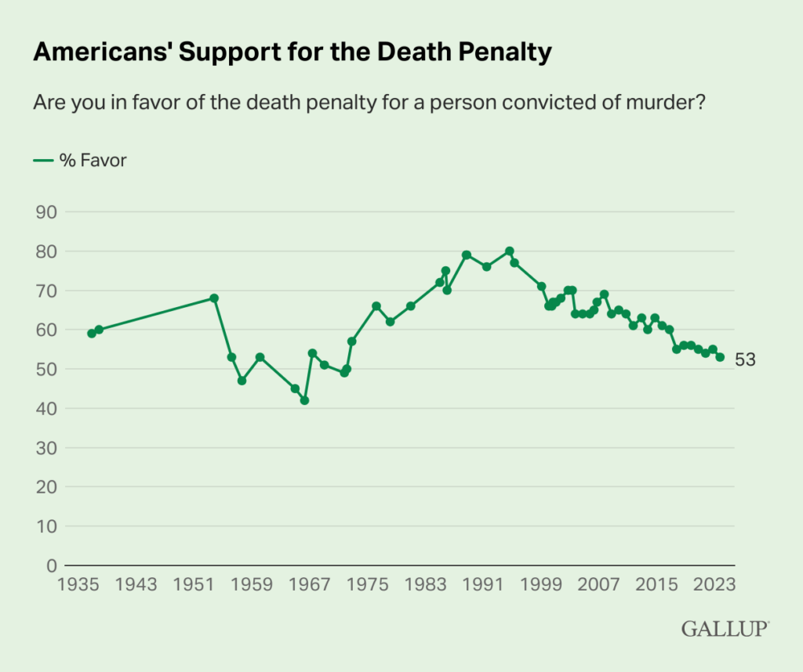

Slide 235
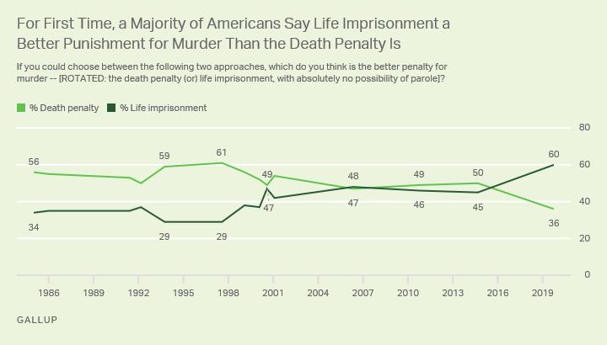

Slide 236
Death Penalty:
Moratoria
23 states and D.C. have banned
Philadelphia, Pittsburgh, and San Francisco (among others) have called for moratorium
ABA, UN Commission on Human Rights, Amnesty International, and Human Rights Watch oppose

Slide 237
The Death Penalty and Juveniles
Roper v. Simmons (US Supreme Court, 2005) rules death penalty unconstitutional for youths under age 18 at time of crime
  Between 2002 and 2005, US only country to legally and openly execute juvenile defendants
7 international treaties prohibit execution of juveniles
  Including Convention on Rights of the Child, which the US has not signed

Slide 238
Life Without Parole and Youth
2,900 American youths sentenced to life without parole from the 1940s to mid 2026
  2,091 still serving sentence
  28 states and DC have outlawed
  Violates Convention on Rights of the Child
Blacks 10X more likely than whites to receive this sentence
Per HRW, only 3 nations currently have people serving life without parole for crimes they committed as juveniles (may be more)

Slide 239
Life Without Parole and Youth
Graham v Florida (U.S. Supreme Court, 2010) outlaws life without parole for non-homicide crimes
Miller v Alabama and Jackson v Hobbs (US Supreme Court, 2012) outlaws life without parole for juvenile homicide offenders
Montgomery v. Louisiana (2017): SCOTUS invalidates all existing juvenile life without parole sentences
  Sentences being re-evaluated

Slide 240
The Death Penalty and the Mentally Ill
Nearly half of those executed between 2000 and 2015 had been diagnosed with a mental illness or substance abuse disorder as adults
1986: US Supreme Court (Ford V. Wainwright) rules execution of mentally ill unconstitutional
  Louisiana only state that prohibits forcing antipsychotic drugs on prisoners to make them sane enough to execute

Slide 241
The Death Penalty and the Mentally Handicapped
2002: US Supreme Court (Atkins V. Virginia) rules execution of mentally handicapped unconstitutional
  At least 34 mentally handicapped executed between 1976 and 2002

Slide 242
The Death Penalty and the Mentally Handicapped
Others executed since 2002
States determine definition of “mentally-impaired”
  GA: defendant must prove mental impairment beyond a reasonable doubt
  TX: executed prisoner with IQ of 61 (2012)
  Amnesty International has criticized
  2014: SCOTUS rules FL cannot use an IQ cutoff to determine mental impairment

Slide 243
The Death Penalty and Health Professionals
AMA, APHA, ANA, and ABA (anesthesiologists) oppose participation of health professionals in executions
Only 7/35 death penalty states incorporate AMA ethics policy, including barring doctors from taking an active role in the death chamber

Slide 244
The Death Penalty and Health Professionals
Some states provide immunity to doctors participating in executions by preventing medical boards from taking disciplinary action against them
Many states also provide anonymity

Slide 245
The Death Penalty and Health Professionals
2001:
  3% of physicians aware of AMA guidelines prohibiting physician participation
  41% would perform at least one action in the process of lethal injection disallowed by AMA

Slide 246
The Death Penalty and Health Professionals
Country’s leading executioner, Dr. Alan Doerhoef (40 lethal injections), acknowledges mistakes in “transposing numbers,” reprimanded by Missouri for not disclosing malpractice lawsuits

Slide 247
The Death Penalty and Health Professionals
2008: Director of Health Services for WA state prison system resigns to protest execution
2009: NC Supreme Court overturns 2007 NC Medical Board ban on physician participation in executions

Slide 248
The Death Penalty and Health Professionals
2012: Medical Association of Georgia (President = former AMA President Donald Palmisano) refuses to sanction involvement of Dr. Carlo Musso in lethal injection death

Slide 249
Biden Administration
Backed off on promise to abolish federal death penalty

Slide 250
Trump Administrations
Trump: narcissistic, sociopathic, poorly-educated, racist, xenophobic, ecocidal, militaristic, misogynistic, admitted sex offender
  Convicted felon (NY, 34 counts)
  Adjudicated rapist
Racist advisors (e.g, Bannon,Gorka) Cabinet/administration loaded with corporate representatives interested more in profits than people

Slide 251
Trump Administrations
Rise of Trump/alt-right/militias/neo-Nazis/KKK
Pardoning of racist/profiling/ex-sheriff/ convicted felon Joe Arpaio
Increasing civil unrest
Pardoning of 1,500 January 6 US Capital invaders

Slide 252
Trump Administrations
Militarization of police
ICE agents rounding up US citizens, undocumented individuals, those seeking asylum, children
  Over 60,000 in ICE custody (12/25)
Killing protestors (so-called “antifa”)
Deporting individuals to countries (home or other) where they face imminent threats of violence and death

Slide 253
Trump Administrations
SCOTUS rules Trump essentially immune from prosecution
SCOTUS appointments will change interpretation of law for decades, set back Civil Rights Movement

Slide 254
Trump
Racist, xenophobic comments
Comments often drawn from unreliable and/or alt-right sources
Fuel racist/anti-immigrant sentiments, foment hatred and violence
Diminish democracy, encouraging racist/anti-immigrant groups in other countries, including U.S. allies
Pending treason and other trials

Slide 255

“Federal Officials Investigating Man Posting Racist Attacks Online Armed With Millions Of Explosives”
Headline from The Onion, 7-19

Slide 256
Former Attorney General Jeff Sessions
Previously Alabama senator
Consistently opposed immigrant rights legislation

Slide 257
Former Attorney General Jeff Sessions
Called the work of the ACLU, the National Council of Churches, and the NAACP “Un-American”
Said the NAACP “force(s) civil rights down the throats of people”
  “The NAACP hates white people; they are out to get them. That is why they bring these lawsuits, and they are a commie group and a pinko organization as well.”

Slide 258
Former Attorney General Jeff Sessions
Accused by African-American Assistant US Attorney of calling him the “n-word” and “boy”
On the Ku Klux Klan: “I thought those guys [the KKK] were OK until I learned they smoked pot.”

Slide 259
Racism
Racist violence on the rise in the U.S. and throughout the world, especially under demagogues and dictators
2018: 7% of Americans support “white nationalism,” 39% believe white Americans are “under attack”
2022: 20% have a favorable view of white nationalist groups

Slide 260
Summary
US world’s wealthiest nation
Incarcerates greater percentage of its citizens than any other country
Criminal justice system marred by racism
Prisoner health care substandard
Until recently, US executed juveniles and mentally handicapped

Slide 261
Summary
US continues to execute adults
Drug users confined with more hardened criminals in overcrowded institutions
  Creates ideal conditions for nurturing and mentoring of more dangerous criminals
Punishment prioritized over rehabilitation

Slide 262
Summary
Convicts released without necessary skills to maintain abstinence and with few job skills
Poor financial and employment prospects of released criminals make return to crime an attractive or desperate survival option

Slide 263
Summary
US criminal justice system marked by injustices, fails to lower crime and increase public safety
Significant portions of system turned over to enterprises that value profit over human dignity, development and community improvement

Slide 264
Policies to Reduce Adverse Health Effects of Incarceration and Facilitate Prisoner Re-entry
Change focus of drug war from interdiction and incarceration toward treatment
  Increase use of drug courts: reduce recidivism by 1/3 and are cost-saving
Reduce over-crowding
Improve quality of health care and substance abuse services

Slide 265
Policies to Reduce Adverse Health Effects of Incarceration and Facilitate Prisoner Re-entry
Develop gender-specific programs
Improve discharge planning and provide links with community service providers
Expand and improve vocational and employment programs for inmates and ex-offenders
Reduce stigmatization of ex-offenders
Clean slate laws to expunge juvenile record after a certain period of good behavior

Slide 266
Policies to Reduce Adverse Health Effects of Incarceration and Facilitate Prisoner Re-entry
Hire more police officers
  $10 billion would decrease crime by 5-16%, with a net societal benefit of $4-30 billion (WH Council of Economic Advisors, 2016)
Increased funding of public defenders
De-corporatize prison-industrial complex
  2016 – Justice Dept. to phase out use of private prisons
  Policy reversed under Trump; reinstated under Biden (2021), re-reversed under Trump II
[Portions of above 3 slides adapted from Freudenberg NM. Am J Publ Hlth 2002;92(12):1895-9.]

Slide 267
Policy Benefits
Reduce drug use and criminal recidivism
Improve healthcare of ex-offenders and the general public
  Decreased transmission of infectious diseases
  Fewer acts of violence by intoxicated or untreated mentally ill
Improve family and societal cohesion
  Expand victim outreach courts involving plea bargains
Save money

Slide 268
Capital Punishment and the Promotion of Peace
Killing to show that killing is wrong makes no sense
  Perpetuates the cycle of violence
The death penalty is more than unjust – it is immoral and not compatible with the promotion of peace

Slide 269
Peace and Justice
Fostering peace requires holding government accountable for creating a fair criminal justice system that combines reasonable punishment with restitution and the smooth re-entry of rehabilitated criminals into society

Slide 270
Pressure/divest from companies producing components of the lethal injection cocktail
Sodium thiopental
  Abbott Laboratories, Inc.
  Alternative = pentobarbital (Nembutal) – Lundbeck Pharmaceuticals no longer supplyling to U.S. prisons (2011)
Pancuronium Bromide
  Abbott Laboratories, Inc.
  Baxter Healthcare Corp.
  Wyeth Pharmaceuticals
  Gensia Sicor Pharmaceuticals, Inc.

Slide 271
Pressure/divest from companies producing components of the lethal injection cocktail
KCl
  Abbott Laboratories, Inc.
  American Pharmaceutical Partners, Inc.
  Amerisource Bergen
  B. Braun Medical, Inc.
  Baxter Healthcare Corp.
  Cardinal Health (National Pharmpak Services, Inc.)

Slide 272
Role of Health Professionals in Creating a Fair Criminal Justice System
Address social ills that foster substance abuse and other crimes
  Especially rising gap between rich and poor, haves and have nots
Speak out against injustice, racism, and the death penalty

Slide 273
Role of Health Professionals in Creating a Fair Criminal Justice System
Educate students and colleagues regarding the criminal justice system and the death penalty
Refuse to participate in any way in capital punishment

Slide 274
Conclusion
Hold government accountable for creating fair system that combines reasonable punishment with restitution and smooth re-entry of rehabilitated criminals into society

Slide 275


Slide 276
Reference
Donohoe MT. Incarceration Nation: Health and Welfare in the Prison System in the United States. Medscape Ob/Gyn and Women’s Health 2006;11(1): posted 1/20/06. Available at http://www.medscape.com/viewarticle/520251

Slide 277
Organizations and Websites Re Death Penalty
National Coalition to Abolish the Death Penalty
  www.ncadp.org
Death Penalty Information Center
  www.deathpenaltyinfo.org
Prison Policy Initiative
  https://www.prisonpolicy.org/
American Civil Liberties Union
  www.aclu.org

Slide 278
Organizations and Websites Re Death Penalty
The Quixote Center
  www.quixote.org
The Innocence Project
  www.innocenceproject.org
Physicians for Human Rights
  www.phrusa.org
Amnesty International USA
  www.amnestyusa.org

Slide 279
Race
See slide show on the economic, health, and human rights issues of racial and ethnic minorities on the Public Health and Social Justice website

Slide 280
Unethical Human Subject Experimentation Involving Prisoners
See slide show on the history of human subject experimentation, from the Nazis to the present, on the Public Health and Social Justice website

Slide 281
Contact Information
Public Health and Social Justice Website
http://www.phsj.org
martindonohoe@phsj.org

