Slide 1
Weighty Matters:
Public Health Aspects of the Obesity Epidemic
Martin T Donohoe

Slide 2
Average height and weight of Americans
Men: 5’9”, 200 lbs
Women: 5’4”, 162 lbs

Slide 3
Definitions
BMI (Body Mass Index) =
  weight (kg)/height squared (meters squared)
Overweight: BMI ≥ 25
Obese: BMI ≥ 30
Many physicians suggest BMI over 30 should be overweight, over 35 obese, since health outcomes data not convincing
Many (including AMA) disagree with BMI criteria (race-dependent, does not distinguish muscle from fat)

Slide 4
Definitions
Direct body fat measurement with DEXA most accurate screening tool
Waist to height ratio and waist-hip ratio
  The latter is more effective in determining heart disease and mortality risks
  Metabolic abnormalities linked more with visceral adipose tissue than subcutaneous adipose tissue
Fat/bone ratio also promising

Slide 5
Obesity
1950: ¼ of Americans overweight or obese (BMI > 25)
2017: “Overfat” (90% of American males, 80% of American females) – weight high enough to cause harm
2021: 31% overweight, 42% obese (BMI > 30), 9% morbidly obese (BMI > 40)
  Men and women nearly equal; morbid obesity more common among women

Slide 6
Obesity
19% of American children are obese, another 16% overweight (rates up 10-fold over last 4 decades); 6% morbidly obese
  14% of preschool children / 18% of grade schoolers / 21% of teens are obese
  80% of obese children become obese adults

Slide 7
Obesity
More common among lower income individuals, rural Americans, Hispanics, and African-Americans; less common among Asian-Americans
  Cultural explanations, food insecurity (linked to both binge eating disorder and obesity), fast food restaurants, neighborhood safety

Slide 8
Obesity and Pregnancy
Proper weight gain during pregnancy depends on BMI
1/3 of women gain too much weight during pregnancy
  1/3 proper amount, 1/3 too little
  Excessive weight gain most common in women who were already overweight before pregnancy

Slide 9
Obesity
Worldwide over 2.5 billion adults are overweight or obese (over 1 billion of these are obese, doubling since 1990)
  390 million children age 5-19 are overweight or obese (16% of these obese, 4-fold increase compared to 1990)
  Overweight/obesity → 2.8 million deaths/yr

Slide 10
Obesity
U.S. has highest rates in world (37% for OW and obesity vs. 30% Canada, 25% Mexico, 5% Japan)
  Nearly double the OECD average
  US also has world’s highest rate of chronic conditions
  Rate down 3% over last few years due to new drugs/surgeries
1/3 of US house pets are obese (obese masters tend to have obese pets)

Slide 11
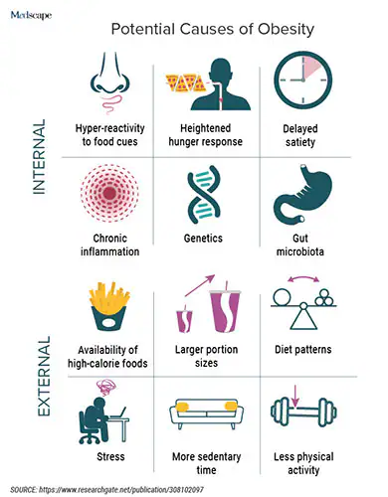

Slide 12
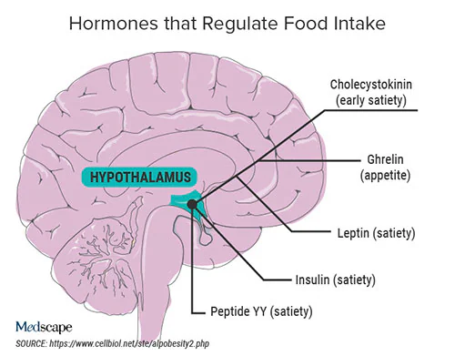

Slide 13
Causes of and Contributors to Obesity
Energy in > energy out (3500 extra calories of food leads to approximately 1 lb wt gain)
Poor diet
Poor hydration
Inadequate exercise (also linked with poor academic performance)

Slide 14
Causes of and Contributors to Obesity
Inadequate/irregular sleep
Car culture – less walking/bicycling
Excessive television watching

Slide 15
Causes of and Contributors to Obesity
Genetic factors (estimates range from 1% to 75% of cases, best estimate is that genes account for as much as 21% of BMI variation)
  97 distinct genetic variations associated with obesity or body-mass index
  FTO (fat mass and obesity) gene began to influence BMI in 1940s (technological advances/less activity and increased availability of high calorie processed foods)

Slide 16
Causes of and Contributors to Obesity
Hormones, neurochemicals, and environmental obesogens (including leptin, ghrelin, phthalates, BPA, PCBs, PBDEs, PFOA)
  Phthalates common in fast foods
  PFOA/PFOS slow metabolism, found in almost all Americans’ blood
Air pollution
Noise pollution

Slide 17
Causes of and Contributors to Obesity
Snacking on high glycemic foods during late pregnancy
Maternal smoking
Viruses and bacteria – microbiome
Infections in infancy
Antibiotic use in pregnancy, +/- early infancy (in absence of infection), and childhood (alter microbiome)

Slide 18
Causes of and Contributors to Obesity
Human microbiome being altered by diet, overuse of antibiotics, household disinfectants and endocrine disruptors, etc.
Mass extinction of healthy bacteria underway (including those involved in digestion and mucosal protection against microbes and endotoxin)
Calls for microbiome repopulation of Western guts, even development of storage repository of healthy bacteria
Microbiome might control up to 10% of body weight

Slide 19
Causes of and Contributors to Obesity
Sugar substitutes:
  May increase appetite for sweet foods and promote overeating
  Some promote gut dysbiosis
  Can increase inflammation

Slide 20
Causes of and Contributors to Obesity
Sugar substitutes:
  Can increase risk of MI/CVA
  Aspartame should be avoided in people with PKU; some studies suggest link with cancer
  Erythritol linked to blood clotting, MI, CVA, and death

Slide 21
Obesity
Medications: e.g., OCPs, antidepressants, antipsychotics, etc.
Hypothyroidism
Cushing’s Syndrome
Other illnesses and genetic disorders

Slide 22
Causes of and Contributors to Obesity
C-section
High birth weight in mothers who gain excessive weight during pregnancy
  Mother’s BMI otherwise has limited influence on child’s BMI, although does influence her teenager’s BMI, likely due to genetic and environmental factors
Both large and small babies, as opposed to normal birthweight babies, prone to obesity
94% of mothers of overweight toddlers see child’s size as normal

Slide 23
Causes of and Contributors to Obesity
Shorter or no breastfeeding
Lack of mother-child bonding in infancy
Childhood trauma
Menopause (attenuated by exercise)

Slide 24
Causes of and Contributors to Obesity
Childhood ability to delay gratification
Parents frequently fail to recognize childhood overweight and obesity
Approximately ¾ describe their children as “about the right weight)
Perception: many overweight and obese individuals think there is nothing wrong with their weight

Slide 25
Obesity
More prevalent in adults with sensory, physical and mental health conditions
  Healthy diet may help prevent depression and anxiety
More common in bisexual and lesbian women, less common in homosexual males

Slide 26
Obesity Prevention
Ideal diet:
  45-65% of calories from CHOs
  20-35% from fat
  10-35% from protein
Average daily consumption up 570 calories compared with 1970s

Slide 27
Obesity Prevention
Pescetarian diet best, followed by vegetarian/vegan, followed by omnivore diet, with keto and paleo diets the worst for human health and the environment
Mediterranean and DASH diets good
  Seafood, veggies, olive oil, low salt, etc.
Time-restricted eating helpful, relatively easy to do

Slide 28
Obesity Prevention
Ideal exercise = 1 hour per day
  30% of Americans get regular exercise, 40% get none; 25% of American children and teenagers (and only 10% of high school students) get recommended amount
  Only 27% of men qand 19% of women meet recommended exercise guidelines
Exercise associated with education, income, being married (single status associated with strengthening exercises, primarily in men), West Coast, suburbs

Slide 29
Obesity
Responsible for 300,000 US deaths/year (nearly 1/5) (2.8 million/yr worldwide)
  vs. 480,000/year from smoking (440,000 direct, 40,000 environmental tobacco smoke)
  Decreases in life expectancy and increase in early mortality similar to that seen with smoking

Slide 30
Obesity vs. Smoking
Smoking causes greater health burden from premature deaths than from disability and activity limitations
Obesity causes greater burden from disability and activity limitations than from premature deaths

Slide 31
Sequelae of Obesity
Heart disease; Arrhythmia (50% higher risk of atrial fibrillation); Hyperlipidemia
Type II Diabetes: 1998 – 4.9%; 2000 – 6.5%; 2010 – 8%; 2023 – 10% (38% pre-diabetes – up to 50% chance of developing diabetes over 5-10 yrs)
  ¼ with diabetes and 9/10 with pre-diabetes unaware
  Epidemic of type II diabetes in children

Slide 32
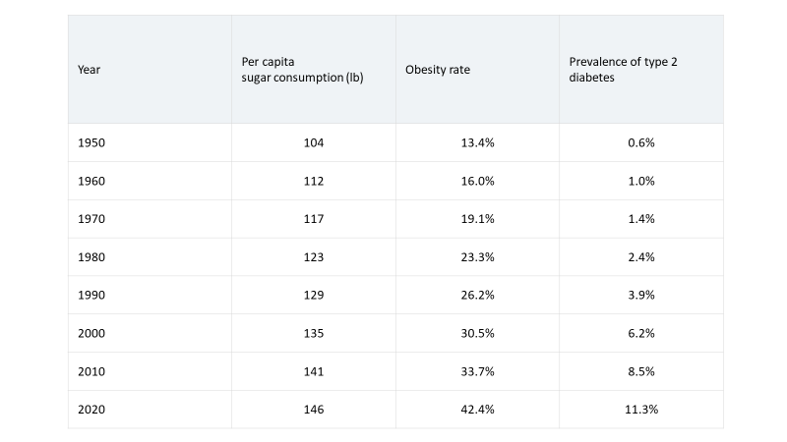

Slide 33
Sequelae of Obesity
Cancer (e.g., breast, uterine, ovary, cervical, esophageal, stomach, colorectal, gall bladder, renal, liver, thyroid, multiple myeloma)
  25% of cancers attributable to obesity (33% when add poor nutrtition and inactivity, higher percentage in women) in U.S. (5% worldwide, but increasing)
    30% due to smoking

Slide 34
Sequelae of Obesity
Fatty liver (NASH)
  Higher risk than heavy alcohol consumption
    Over ½ of Americans think calories from alcohol are “different than other calories”
Gallstones
Sleep apnea

Slide 35
Sequelae of Obesity
Pseudotumor cerebri
Venous thromboembolism
GERD
Worsening of asthma
Urinary incontinence

Slide 36
Sequelae of Obesity
Increased predisposition to food allergies, higher IgE levels
Childhood asthma and eczema linked to fast food
Weakened immune systems; lower CD4 response to HAART in HIV+ patients
Higher rates of infection/sepsis after trauma

Slide 37
Sequelae of Obesity
Poor wound healing
Increased risk of skin infections
UTIs
Possible increased risk of melanoma and inflammatory dermatoses (e.g., psoriasis)
Psoriatic arthritis

Slide 38
Sequelae of Obesity
Weaker bones
Lower levels of vitamin D
Osteoarthritis
Gout
Loss of brain tissue, dementia
Multiple sclerosis
Depression, anxiety, and suicide

Slide 39
Sequelae of Obesity
Decreased testicular function; erectile and ejaculatory dysfunction in men
  But not sexual dysfunction in women
Decreased fertility, lower sperm quantity and quality
Endometriosis

Slide 40
Sequelae of Obesity
Earlier menarche (4 months)
  Associated with increased risk of breast cancer
Associated with high risk sexual behavior in adolescent girls (as is underweight)
Less use of contraception
Oral contraceptives less effective (IUD more effective)

Slide 41
Sequelae of Obesity
Less likely to breast feed
Higher rates of unintended pregnancy and abortion
Increased risk of C-section
Associated with fetal/infant death, autism/cerebral palsy/developmental disorders

Slide 42
Sequelae of Obesity
Increased risk of diabetes, obesity, heart attack, stroke, multiple birth defects (including congenital heart disease), and psychosis among offspring
Increased loneliness
  Obesity + loneliness increases risk of all cause death by 36% c/w obesity alone
  ¼ of all Americans lonely; obesity patients at higher risk of loneliness
Decreased effectiveness of common vaccines

Slide 43
Sequelae of Obesity
Childhood exposure to intimate partner violence against mother associated with adult obesity
Decreases in social and physical functioning
Increases in chronic pain
Decrease in some health-related quality of life (QOL) measures
  Obesity in adolescents confers same risk for premature death in adulthood as smoking > ½ ppd
  Severely obese children and adolescents have QOL similar to those with cancer

Slide 44
Sequelae of Obesity
Barrier to preventive care?
  e.g., probably mammograms and Pap smears (despite higher rates of breast and cervical cancer)
  20% more likely to have false-positive mammograms
  Reluctance to being weighed a common barrier

Slide 45
Sequelae of Obesity
Marginalization, discrimination, bullying
Higher risk of dying in motor vehicle accident
Lower life expectancy
Worse school performance
Less likely to wear seatbelts; more likely to die in auto accidents
More strongly associated with chronic medical conditions and reduced health-related quality of life than smoking, heavy drinking or poverty

Slide 46
Economic Consequences of Obesity Increasing Dramatically
Obesity-attributable national expenditures (U.S. and Canada, 2009) = $319 billion ($127 billion/yr health care + $49 billion lost productivity due to excess mortality + $43 billion lost productivity caused by disability
Economic costs of overweight and obesity in the U.S. (2018) =$1.7 trillion ($480.7 billion in direct health-care costs and $1.24 trillion in lost productivity)

Slide 47
Medical Costs
Over 20% of total U.S. healthcare expenditures
Childhood obesity cost $14 billion in direct health care expenses (2019)
$238 per capita worldwide attributable to childhood overweight and obesity (2022)
Costs will rise as population ages
Limits transplant donor pool

Slide 48
Economic Consequences of Obesity
Half of costs covered by Medicare, which now classifies obesity as a disease
Increased costs of care due to:
  Prescription drugs
  More complications from surgery
  Increased lengths of stay
  Increased use of health care services during pregnancy

Slide 49
Economic Consequences of Obesity
Costs to business:
  Lost productivity
  Absences
  Underperformance
  Higher insurance premiums
Obesity contributes to increasing carbon emissions and global warming, decreased water availability

Slide 50
Military Consequences of Obesity
1/20 U.S. would-be military enlistees rejected because of a criminal record
1/4 to 1/3 rejected because of physical unfitness and weight concerns

Slide 51
Nutritional Changes and Obesity
Agriculture
  10,000 years ago
  Benefits: community, local food production
  Adverse consequences: class-based, hierarchical societies; large-scale warfare; sedentary lifestyles; dramatically decreased crop and game diversity; corporate control of agriculture and poverty

Slide 52
Nutritional Changes and Obesity
Rising atmospheric CO2 levels increases photosynthesis, causing fruits and vegetables to produce more sugars
Under industrial agriculture, crops bred for higher yields (i.e., more sugars, less vitamins/minerals/proteins)

Slide 53
Nutritional Changes and Obesity
Increases in portion size
Spread of fast-food franchises since the mid-20th Century
Use of artificial sweeteners and trans fatty acids in processed foods
High levels of consumption of sugar- and caffeine-containing sodas
  In part a consequence of increased salt intake
  Soft drink consumption linked to violent behavior in children

Slide 54
Nutritional Changes and Obesity
(Youth, Estimated percentage of total energy, 1998-2018)
Ultraprocessed foods up from 61% to 67%
Unprocessed or minimally processed foods down from 29% to 24%
Sugar sweetened beverages down from 11 to 5%
Ready to heat/eat ultraprocessed foods up from 2% to 11%

Slide 55
Nutritional Changes and Obesity
Strong association between ultraprocessed foods and risk of obesity, diabetes, cancer, GI disorders (including NAFL [red meat also increases risk of NAFL]), CV risk factors, fragility, and mortality
Can be as addictive as nicotine

Slide 56
Fast Foods and Supersizing
Portion sizes and restaurant dinner plates have increased over last half century
Americans spend about one-half of their food budgets and consume about one-third of their calories outside the home
Fast food spending increased 18-fold since 1970
  $570 billion revenues/yr worldwide
  over $200 billion per year in U.S. (up from $6 billion in 1970)

Slide 57
Fast Foods and Supersizing
U.S. food industry produces 3800 cal/person/day
  Average caloric need only 2500 calories/person/day
Americans average 11% of total daily calories from fast food
On any given day, 8% of Americans eat at McDonalds
  14,000 stores in U.S. alone

Slide 58
Fast Foods and Supersizing
Fast food industry CEOs averaged $24 million compensation in 2013; $5 million to $34 million annual salary range for top 10 fast food CEOs in 2018
  > 4-fold increase since 2000
  > 1,200X average fast food workers (whose salaries have increased 0.3% since 2000) for these top 10 companies
  Average fast food CEO salary = $1.2 million, 66X higher than avg. full-time worker salary ($19,000)

Slide 59
Fast Foods and Supersizing
Predatory wage policies subsidized by U.S. taxpayers
Almost 950,000 fast food workers receive federal and state aid worth $7 billion
Support raising minimum wage and single payer health care

Slide 60
Fast Foods and Supersizing
Typical American eats 30 pounds of French fries per year
McDonalds’ fries in 1955: 2.4 oz. / 210 calories
  Today 7 oz. / 610 calories
1916: typical bottle of Coca Cola = 6.5 oz. / 79 calories
  Today 16 oz. / 194 calories

Slide 61
Las Vegas’ Heart Attack Grill
Diners (patients) wear hospital gowns over their clothes and have their pulses checked by waitresses (nurses)
Home of the Quadruple Bypass Burger
Anyone over 350 lbs eats for free
2012: Pitchman dies at age 51 of heart attack

Slide 62
Fast Foods and Supersizing
Some mega-sized fast food burgers on the market today contain > 1000 calories
Even Joy of Cooking recipes have shown increases of 33% in caloric density and portion size since 1940s
Fast food companies “leanwashing” themselves

Slide 63
Fast Foods and the Inner Cities / Poor Communities
Fast food outlets target poor inner city communities
  Food swamps/food deserts
  Also rapidly expanding into developing world
Meals inexpensive and convenient
  Helps consumers working two jobs, raising children solo or lacking inadequate kitchen facilities

Slide 64
Fast Foods and Children
Fast food industry directly targets children
  Produces 20% of Saturday morning television
  Offers prizes and inducements based on characters which appeal to youngsters, often in collusion with motion picture industry

Slide 65
Fast Foods and Children
McDonalds holds McTeachers Nights, where teachers work behind the counter and serve their students in exchange for a small donation to their schools
  Schools keep average of only $1.18/student
  Regular McDonalds workers hours cut
  LAUSD shuts down program (2017); California Teachers Association opposes

Slide 66
Fast Foods and Children
Fast food restaurants clustered around schools
  Students in proximate schools eat fewer servings of fruits and vegetables, consume more soda, and are more likely to be overweight
Fast food diet linked to worse academic performance and increased risk of dementia/Alzheimer’s Disease

Slide 67
Fast Foods and Hospitals
Some US hospitals have regional and national fast food franchises located on the grounds of their main medical centers (more data needed, few studies available)
  42% of 234 academic-affiliated hospitals surveyed in 2006
  2015: 208 hospitals surveyed – 20% with fast food chains on campus, including 20 McDonald's, 18 Wendy's and five Chick-fil-A

Slide 68
Fast Foods and Hospitals
Fast food franchises in US hospitals:
  2023: At least 18 hospitals in U.S. have fast food restaurants within their walls (1/3 = McDonald’s)
  Sends the wrong message to patients and their families about optimal nutrition
Health Care Without Harm – Healthy Hospitals Initiative

Slide 69
Sodas and Artificial Sweeteners
High fructose corn syrup (55% fructose, 45% glucose) - artificial sweetener added to many products, including sodas and fruit drinks
  1,000+% increase in consumption over last few decades (more soda sold in U.S. than in any other country)
    Good news: intake of sugar-sweetened beverages down slightly among most groups from 2003 to 2016

Slide 70
Sodas and Artificial Sweeteners
High fructose corn syrup
  Fructose twice as sweet as glucose, metabolized primarily by liver (glucose by all cells) – association of obesity with fatty liver (25% of US adults, over 70% of type 2 diabetics, 75-92% of morbidly obese)

Slide 71
Sodas and Artificial Sweeteners
Consumption of fast and junk foods begins early in life
  3-10% of US infants and toddlers eat candy daily
  Soda consumption linked to inattention aggression in children
  4-23% consume sweetened soda beverages

Slide 72
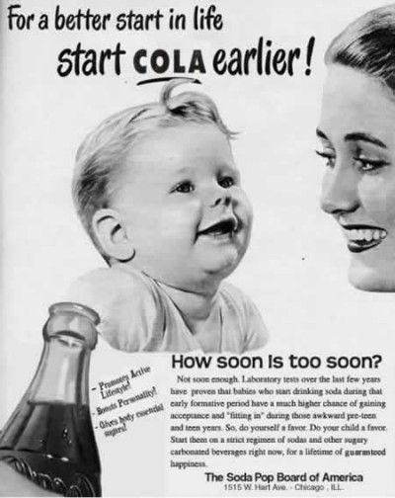

Slide 73
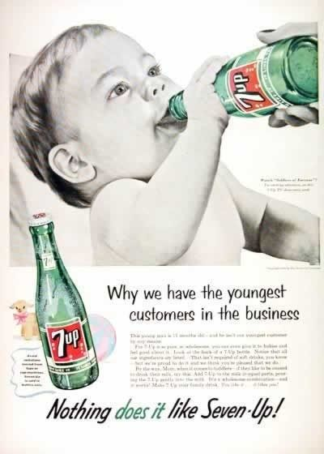

Slide 74
Sodas
Soft drinks account for 20-24% of calories for 2- to 19-year-olds
  Associated with tooth decay and decreased consumption of fruits and vegetables
  Associated with gout
  Increases risk of obesity, DM II, CV disease, breast cancer

Slide 75
Sodas
Even artificially-sweetened soft drink consumption associated with heart disease, stroke, cancer, and increased mortality
  May represent reverse causality, no evidence of effect on blood glucose/diabetes and obesity hormones
Not recommended for weight loss
Saccharine – linked to bladder cancer; aspartame – possible carcinogen per IARC (2023)

Slide 76
Sodas
200,000 deaths worldwide/yr attributed to sugary drinks
Global soft drink market worth nearly $417 billion (2021)

Slide 77
Sodas
Majority of adults drink soda daily
  Per capita soda consumption more than doubled between 1970 and 1998, from 24 gallons per year to 53 gallons per year (recent dramatic decrease to 48 gals/yr in 2022)
  “Big Gulp” and “Super Big Gulp”

Slide 78
Sodas
Products heavily marketed, celebrity endorsers
E.g., Michael Jackson and Beyonce for Pepsi, Lebron James – Coke
Overweight Americans who drink diet sodas eat more food – ?feel “permission” to eat more food
    Yet diet drinks may control cravings

Slide 79
Sodas and Caffeine
70% of soft drinks consumed in US contain caffeine
Evidence suggests that the mood-altering and physical dependence-producing effects of caffeine (a central nervous system stimulant) have contributed to high rates of consumption of caffeinated soft drinks
Sugar is addictive
High fructose corn syrup-containing products also frequently contaminated with mercury

Slide 80
Sodas and Caffeine
Soda’s addictive properties put imbibers at risk of caffeine-withdrawal symptoms such as headache
Other caffeinated beverages: e.g., Red Bull
Yet, drinking coffee causes activation of brown adipose tissue (higher thermogenesis, ? if due to caffeine, further research needed)
Diet soda drinkers may have increased risk of obesity, DM II, and CAD, and CHF per earlier studies….2023 meta-analysis shows no risk, possible mild weight loss benefit

Slide 81
The National School Lunch Program
NSLP gives schools more than $6 billion/yr to offer low-cost meals to 29 million schoolchildren at over 100,000 schools and childcare centers
Kids eat free if their parents earn less than 130% of the poverty level; small charge if parents earn up to 185% of the poverty level

Slide 82
The National School Lunch Program
Began in 1946
Reimburses schools $3.11 to 3.28 per meal
  Cost = $14.1 billion per year (2019)
Administered by USDA

Slide 83
The National School Lunch Program
Pre-2010
Conflicting missions of providing healthy meals to children, regardless of income, subsidizing agribusiness, and shoring up demand for beef and milk
Historically, meals emphasized meat and dairy products at the expense of fruit and vegetables, contained high levels of fat, and failed to meet government’s own, inadequate, nutritional standards, which were out of date with current science and had not been updated since the 1970s

Slide 84
The National School Lunch Program
Pre-2010
81% of schools serve lunches exceeding 30% fat content, less than 45% serve cooked vegetables other than potatoes (usually French-fried), 42% don’t serve daily fruits and vegetables, and less than 10% serve legumes
Overemphasis on milk products may increase long-term the risk for breast cancer, particularly if the milk comes from cattle treated with rBGH
Does not help to establish good nutritional habits

Slide 85
The National School Lunch Program
Helpful changes to program made in 2010, after passage of Healthy, Hunger-Free Kids Act
More fresh fruits and vegetables available, more kids choosing healthy options
Rules cover fat, meat, and vegetables, but no limits on sugar
  Exception: Smart Snacks in Schools guidelines prohibit vending machines with snack bars/treats exceeding 200 cals or containing trans fats

Slide 86
The National School Lunch Program
Between 2003 and 2018, percentage of poor nutritional quality food consumed from schools declined from 55% to 24%
  Most of change subsequent to passage of 2010 law, which required students be offered fruits and vegetables daily and limited number of calories based on children’s ages
  Simultaneously, unhealth food consumed from grocery stores by children decreased from 53% to 45% (however, 2/3 of children’s food from grocery stores, only 9% from school)
2014: New meal standards limit amount of added sugars

Slide 87
The National School Lunch Program
Dramatic changes in NSLP unlikely to occur given political clout wielded (and campaign dollars donated) by beef and dairy industries
2017: Trump administration loosens requirements on milk, whole grains, and sodium
Trump’s Department of Agriculture Chair Sonny Perdue – subject of multiple ethics complaints as governor of GA
  Former lobbyists in key positions in the DOA

Slide 88
The National School Lunch Program
¾ of school districts report unpaid student meal debt
Trump era: USDA prevents schools from using federal funds to pay off meal debts, which are rising
Some schools/districts publicly shaming indebted students, requiring after-school chores, offering cold or lower quality meals, firing cafeteria workers who serve indebted students, preventing students from graduating, even threatening to put kids in foster care
  A few states have passed laws prohibiting shaming of students with unpaid school lunch debts
  Some students turning to crowdfunding to eat

Slide 89
Pouring Contracts and Soda Consumption
“Pouring rights” contracts with soda manufacturers
  Signed by cash-strapped school districts to gain additional income to compensate for cuts in educational and athletic programs
  2012: 10 of the largest 25 school districts have or are considering agreements
    Yet ads generate < 0.05% of school revenues
  Conflicts with schools’ responsibility to teach proper nutrition

Slide 90
Pouring Contracts and Soda Consumption
In return for the placement of soda machines on campus and exclusive marketing rights to the districts’ children, companies sponsor sports and other extracurricular activities
  Rooftop ads
  T-shirt suspension and free speech

Slide 91
Pouring Contracts and Soda Consumption
Some school districts have banned the sale and marketing of soda (e.g., Los Angeles)
  May not decrease overall soda consumption
  Vending machines substituting juice made with HFCS, bottled water

Slide 92
Pouring Contracts and Soda Consumption
Federal law now requires school districts to have nutritional wellness policies in place
  These will be strengthened over the coming few years, and should help to curb pouring contracts

Slide 93
Pouring Contracts and Soda Consumption
2006: Coca-Cola, Pepsi, and other soft drink manufacturers announced new voluntary policies to remove soda and other sugary drinks from schools nationwide
  Led to decreases in numbers of drinks bought
  ?effect on calories
Nevertheless, soft drink advertising still reaches students through television and magazine advertisements and via Channel One

Slide 94
Supplemental Nutrition Assistance Program (SNAP)
Formerly known as food stamps
Serves 41 million people each month (2022)
  Avg. benefit = $4/day or $1.33/meal (2022)
  Higher subsidies associated with increased vegetable consumption in trial

Slide 95
Supplemental Nutrition Assistance Program (SNAP)
Use of benefits for non-essential items (e.g., hot food and food for on-premises consumption) and products with adverse health effects (e.g., tobacco and alcohol) prohibited
USDA recently refused states’ requests to eliminate SNAP benefits for sugar-sweetened beverages
  Possibly secondary to industry pressure

Slide 96
Exercise
IOM recommends exercise one hour of exercise per day, double the 1996 recommendation by the Surgeon General
70% of American adults are not active in their leisure time; 40% are not active at all
US children spend 93% of their lives indoors (less than most prisoners)

Slide 97
Exercise and School
1/3 of children do not participate in the minimum recommended level of physical activity
Number of children taking part in physical education courses has dropped significantly, in part due to school funding cuts
Daily physical education associated with better school attendance, more positive attitudes about school, and better academic performance

Slide 98
Exercise and Poor Communities
Neighborhoods with high levels of minorities and individuals of low socioeconomic status have paucity of facilities that enable and promote physical activity, such as parks and gymnasia

Slide 99
Exercise and Poor Communities
Healthy weight status associated with amount of local park space
Perception of one’s neighborhood as less safe is also associated with an increased risk of overweight in children
  Fear of exercising outdoors

Slide 100
Worrisome Trends
Television
  Average American watches over 4 hours of TV daily
  Average American child aged 8-18 spends 8 hrs/day using an electronic device or watching TV (poorer households – more screen time)
  TV sets now outnumber homes in America

Slide 101
Worrisome Trends
Competitive video gaming
  Multi-billion dollar industry
  World’s fastest growing spectator sport
  E-sports tournaments and live streams drew more unique viewers in 2017 than watched all NFL regular season games combined

Slide 102
Worrisome Trends
Smartphones
  Average American checks his/her smartphone 150 times/d
  Average US teen:
    Spends 9 hrs/d using social media (8-12 year olds = 6 hrs/d)
    Sends/receives almost 100 text messages/d

Slide 103
Television and the Internet
Average youth spends 67% more time watching TV per year than he/she spends in the classroom
  32% of children aged 2-7 have TVs in their rooms (65% of children aged 8-18)
  Diminishes parental control over viewing time and content

Slide 104
Television and Overeating
Increases in television viewing are associated with increased calorie intake among youth
  Especially of calorie-dense low-nutrient foods of the type promoted on TV

Slide 105
Marketing
Businesses spend estimated $11 billion annually marketing food and drinks in the US ($2 billion marketing to kids)
American children exposed to 36,500 food ads/yr (or 10/day)
  3/4 for candy, cereal, and fast food

Slide 106
Marketing
IRS rules allow corporations to deduct advertising expenses from income taxes
Convenience/fast foods and sweets over 80% of foods advertised during children’s programming
African-American-oriented television airs far more junk food ads targeted at kids than general-oriented networks
“Mommy bloggers” paid by industry to promote certain foods

Slide 107
Marketing
WHO recommends food marketing curbs
Chile limits, Quebec and Sweden have banned
Neither FTC nor FCC has authority to limit advertising, despite the fact that children are vulnerable to exploitive advertising messages and unable to discern truth from fiction in ads

Slide 108
Marketing
2007: Kelloggs restricts food marketing to children
2011: Jack-in-the-Box stops including toys in kids’ meals
2015: Disney to ban junk food ads on children’s TV and radio programs
2016: UK bans ads for unhealthy food targeted at children from TV, radio, cinema, newspapers, magazines, and online and social media
Coca-Cola funds Global Energy Balance Network (emphasizes exercise, de-emphasizes diet) [and scientists who do the same]

Slide 109
Television
Overweight and obese characters under-represented
  Men 25%; Women 10%
  Obese and overweight characters less likely to be considered attractive, to interact with romantic partners, or to display physical affection
  Perpetuates stereotypes
  Weight loss shows: e.g., “Biggest Loser,” My 600 Pound Life” - ?Helpful?

Slide 110
Stigmatization
Reality: the overweight and obese suffer from stigmatization
  Overweight and obese women are less likely to be offered college admission, get fewer promotions and face more job discrimination
  Not true for heavyset men
  6 cities ban discrimination against the overweight in hiring
  ADA protects obese (disability)
    EU’s top court ruled obesity a disability
  Weight discrimination potential contributor to obesity

Slide 111
The Food Industry and Medical Groups
Medical groups have taken money from food companies (troubling conflict of interest):
  American Dietetic Association:
    Published “Straight Facts about Beverage Choices,” supported by grant from National Soft Drink Association
    Has accepted money from Coca Cola, Mars, Hersheys, other corporations
  AAFP’s magazine, “Family Doctor: Your Essential Guide to Health and Well Being,” marinated in ads from junk food companies, including McDonalds, Kraft (maker of Oreo cookies), and Dr. Pepper

Slide 112
The Food Industry and Medical Groups
  Cadbury Schweppes (makers of Dr. Pepper and chocolate candies) donated a few million dollars to the American Diabetes Association (ADA) in exchange for getting to use ADA label on its diet drinks

Slide 113
Donations from Coca-Cola to Major Professional Organizations (2009-2015)
  American Academy of Pediatrics - ($3 million)
    Largest sponsor of its HealthyChildren.org website; ended relationship in 2015
American College of Cardiology - $3.1 million
American Cancer Society - $2 million

Slide 114
Donations from Coca-Cola to Major Professional Organizations and Research Universities
Academy of Nutrition and Dietetics (largest U.S. organization of dieticians) - $1.7 million (ended relationship in 2015)
Between 2010 and 2015, 5 universities received research grants whose contracts would have allowed the company to quash results (although these were discovered, and thus results not silenced)

Slide 115
The Food Industry and Medical Groups
  AAFP partnership with Coca-Cola to support its family doctor website - $3.5 million (AAFP ends relationship in 2015)
American Academy of Pediatric Dentistry
  Accepted $1 million donation from Coca Cola (2003)
  Claimed that “the scientific evidence is certainly not clear on the exact role that soft drinks play in terms of children’s oral disease” (2011)
    Contradicted earlier statement on dental caries

Slide 116
The Food Industry and Medical Groups
  Coke spent $120 million for research and academic sponsorships between 2010 and 2015
  Yale School of Medicine fellowship in obesity studies sponsored by PepsiCo
  American Heart Association has accepted money from similar companies, and allows its label on certified “heart-healthy” products

Slide 117
The Food Industry and Medical Groups
  CDC has accepted money from Coca Cola and PepsiCo
    Trump administration CDC Director Brenda Fitzgerald accepted $1million from Coca Cola when GA State Commissioner of Health to fight childhood obesity (has said she would take industry money as CDC director also)
2021: Coca-Cola ends its long association with the International Life Sciences Institute (powerful food organization known for its pro-sugar research and policies)

Slide 118
The Food Industry and Research/Publications
Sugar industry paid for and helped develop an influential literature review published in NEJM in 1967, which had a major influence on dietary sugar recommendations over subsequent decades
  Promoted low fat/high carbohydrate diets, leading to unknown number of new cases of obesity and diabetes
  Funding/participation not disclosed
  2 Harvard researchers (Drs Mark Hegsted and Robert McGandy) paid total $48,900

Slide 119
The Food Industry and Research/Publications
2016 analysis of 60 trials, systematic reviews, and meta-analyses
  All 26 articles showing no link between sugar-sweetened beverages and the risk of obesity or diabetes were industry-funded
  Only 1/34 studies showing a positive association was industry-funded
2018: multiple big name food manufacturers leaving the Grocery Manufacturers Association (large lobbying group)

Slide 120
From Soda to Bottled Water
Coca-Cola and PepsiCo both produce bottled water
  Coke: Dasani (tap water), others
  PepsiCo: Aquafina (tap water)
Produces massive waste, expensive, highly profitable (overtook soda sales in 2017)

Slide 121
Bottled Water
Bottled water a $304 billion/yr profit-driven industry
  Over 50% of population drinks
  Number one selling beverage in U.S.
  14 billion gallons/yr in U.S. (more than soda); average annual per capita consumption 42 gallons
Lacks essential minerals, fluoride

Slide 122
Bottled Water
Costs 1,400 to 3,000 times more than tap water
Uses up to 2,000 times more energy to produce than tap water
45% is tap water

Slide 123
Bottled Water
Ratio of amount of water needed to produce 1 plastic bottle to amount of water in the bottle = 2:1
Weaker standards, dangers of plastics, energy costs/global warming, reduction of local water tables, recycling rate of plastic bottles only 23%
Microplastics (ubiquitous in environment) may increase fat absorption

Slide 124
Bottled Water
“Water is an efficient product. It is a product which normally would be free, and it is our job to sell it.”
  Suez CEO Gerard Mestrallet

Slide 125
Coca-Cola’s Human Rights and Environmental Abuses
Guatemala bottling plants excoriated by human rights groups for labor rights violations, including rape, murder, and attempted murder
Bottled water operations in India are depleting local water tables (soda contaminated with pesticides and heavy metals)

Slide 126
Food Producers and Obesity
Sugar producers, the packaged food industry, and producers of high fructose corn syrup sweetener:
  Contribute generously to politicians
  Top executives among President George W Bush’s biggest fundraisers
  Have exercised political influence to weaken food standards and labeling laws in the US and to pressure the WHO to weaken its anti-obesity guidelines

Slide 127
US Agricultural Subsidies
  Since the 1960s, US agricultural subsidies have caused real (inflation-adjusted) price of
  Fats and oils to decrease by 10%
  Sugars and sweets to decrease by 15%
  Carbonated drinks to decrease by 34%
  Fresh fruits and vegetables to increase by 50%

Slide 128
Fruits and Vegetables
About1/10 of Americans meet guidelines for fruit and vegetable intake
Over 127,000 deaths/yr from cardiovascular disease could be prevented and $17 billion health care costs saved if Americans simply ate the recommended daily amount of fruits and vegetables

Slide 129
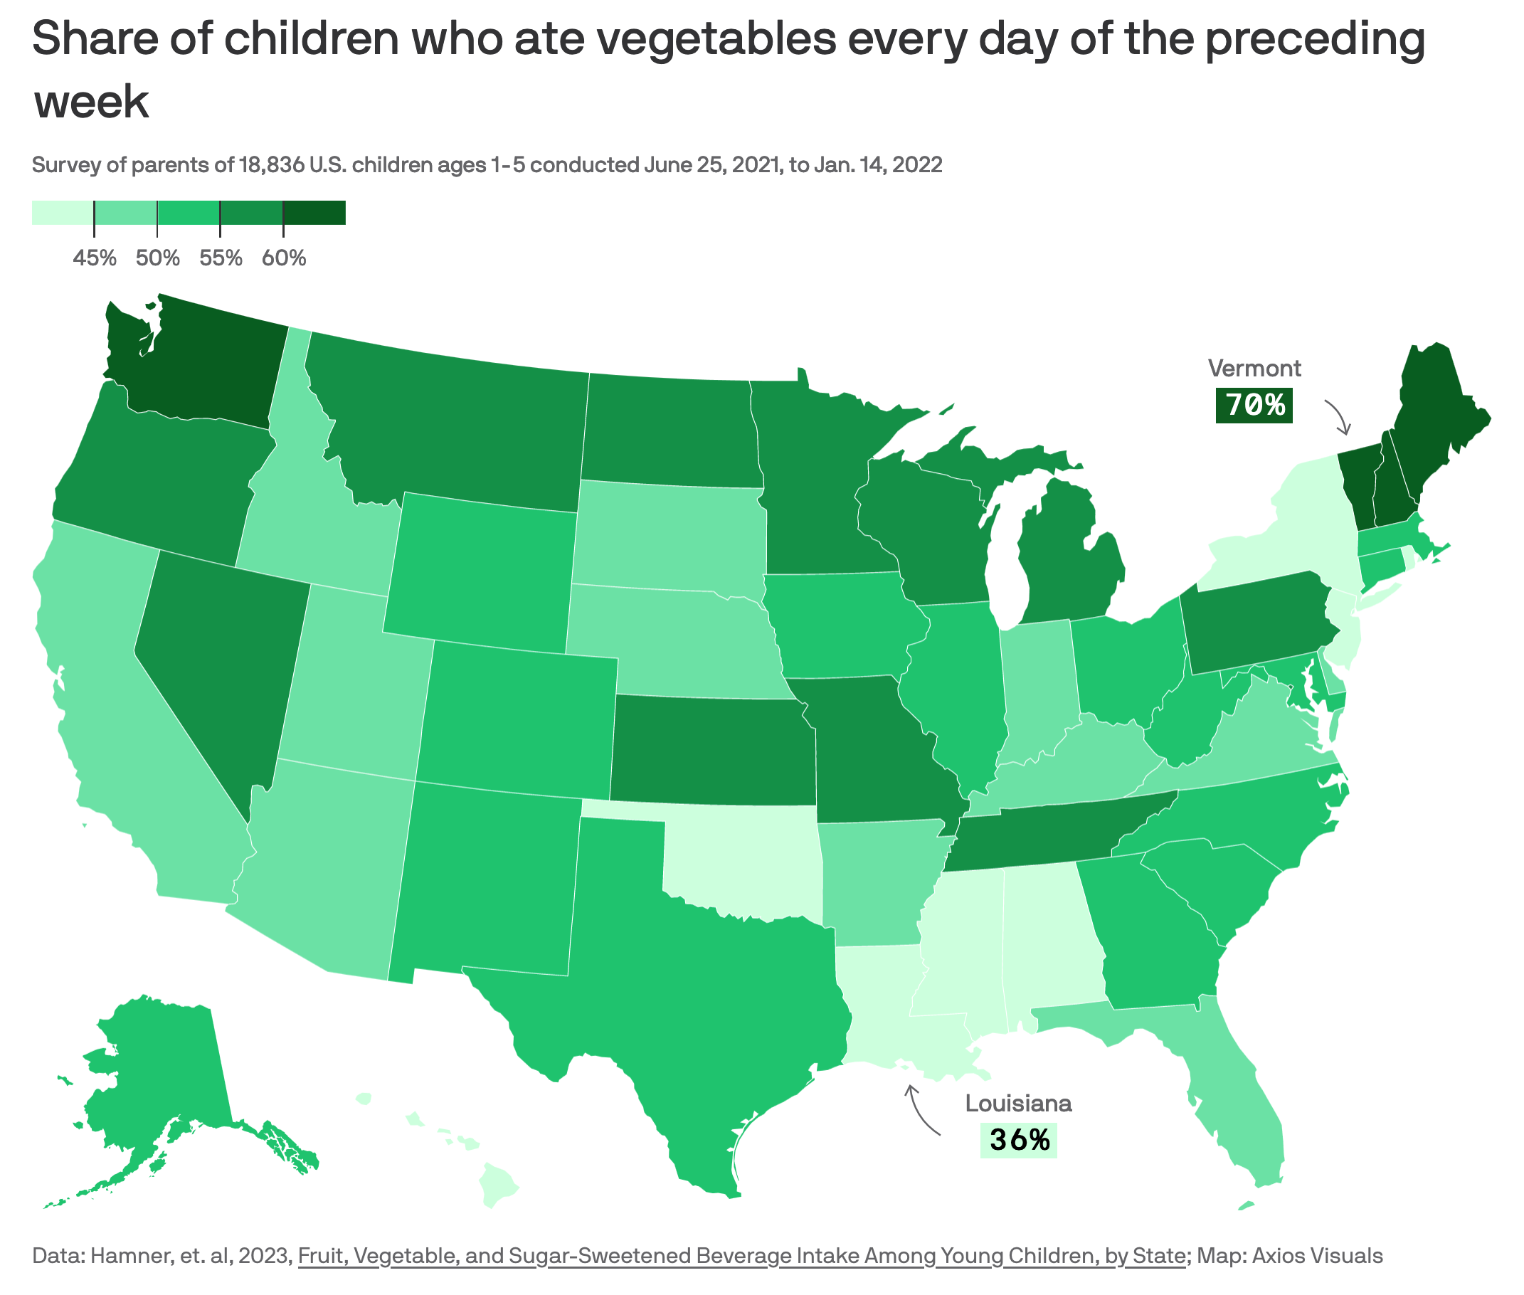

Slide 130
Consolidation and Industrialization of US Agriculture
6.8 million farms in 1935 (vs. < 2 million today)
The average farmer now feeds 129 Americans (vs. 19 in 1940)
Americans spend less than 10% of their incomes on food, down from 18% in 1966
Subsidies mean one dollar can buy 1,200 calories of potato chips or 875 calories of soda or 250 calories of vegetables or 170 calories of fresh fruit

Slide 131
The Obesity Economy
Plus-size apparel market worth almost $25 billion
Half of all U.S. women wear size 14 or larger
  1985: average size was 8.70

Slide 132
The Obesity Economy
XXXL sized clothes; oversized autos, furniture, and coffins, and specialized medical equipment such as lifts, special chairs and toilets
SWA requires obese to buy extra seat
  Other airlines considering

Slide 133
Obesity Worldwide
America’s weight problem is occurring in the midst of a global epidemic of overweight and obesity
  Worldwide 2.5 billion adults are overweight or obese (1.5 billion overweight, 1 billion obese)
Migration from countries with lower rates of cancer and more healthy diets (e.g., many SE Asian nations) adopt American diet within a generation
  Become more overweight/obese and suffer higher rates of cancer and obesity-related illnesses
Cultural export of fast food outlets / supersizing

Slide 134
Underweight and Pathological Eating Behaviors
Abnormal self-image
Prevalence of eating disorders has risen in US and developing countries
  Consequence (in part) of media’s depiction of “ideal” (excessively thin) woman
66% of women and 52% of men report feelings of dissatisfaction or inadequacy regarding their body weight

Slide 135
Underweight and Pathological Eating Behaviors
60% of girls in grade 9-12 trying to lose weight
  24% of boys
#1 wish of girls aged 11 to 17 is to lose weight
Women more likely to judge themselves overweight when they are not
  Men the opposite

Slide 136
Underweight and Pathological Eating Behaviors
Women who desire to lose weight more likely to do so in the hopes of improving their appearance
  Men more likely to be concerned about future health and fitness
Body image distress classified as a psychological disorder (body dysmorphic disorder)

Slide 137
Underweight and Pathological Eating Behaviors
5-10 percent of females / 1-2% of males have some form of eating disorder
  Adolescent girls:
    anorexia nervosa (0.5%)
    bulimia (1-2%)
DSM-V recognizes “Binge Eating Disorder”
  Seen in 10-20% of obese, also in normal weight individuals

Slide 138
Underweight and Pathological Eating Behaviors
20% of female athletes have an eating disorder
Male and female high school athletes at high risk for risky weight-control behaviors
  E.g., restricting food intake, vomiting, over-exercising, using diet pills, inappropriately taking prescribed stimulants or insulin, and using nicotine

Slide 139
Underweight and Pathological Eating Behaviors
Some adolescents dehydrate by restricting fluid intake, spitting, wearing rubber suits, taking daily steam baths and/or saunas, and using diuretics or laxatives
Concern that some people with anorexia might use unauthorized GLP-1 RAs

Slide 140
Consequences of Abnormal Weight Loss Behaviors
Delayed maturation
Impaired growth
Menstrual irregularities / amenorrhea
Infections
Dental problems / tooth decay
Eating disorders
Depression
Alternatively, such behaviors can be a sign of depression or verbal, physical, or sexual abuse

Slide 141
The Role of the Media
Media images contribute to misguided perception of the “ideal” body
  Models today weigh 23% less than average women; 1986: 8%
  Dimensions of the average fashion model: 5’9”, 110lbs
  Dimensions of average American woman: 5’4”, 164 lbs

Slide 142
The Role of the Media
Waist-to-height ratio:
  Barbie Doll 25%
    Lifesize Barbie would have a 17” waist
  Ken Doll 36%
  Female college swimmers 42%
  Male college swimmers 43%
  General healthy cutoff 50%

Slide 143
Modeling Schools for Teens
Create unrealistic expectations
Only a very “select” few models achieve financial success
  Of these, beginners earn $1500 per day, those in the top tier $25,000 per day, and supermodels $100,000 or even more per day)

Slide 144
Modeling
Almost ½ of 500 models studied were malnourished by WHO standards
Some major fashion locales (e.g., Paris, Milan, Madrid, Israel) now require minimum BMI of 18 (not NYC)
2016: London banned “unrealistic body images” from public transportation system

Slide 145
Food Insecurity and Hunger
Worldwide, hunger-related causes kill 9 million people annually, or 25,000 people each day, as many people in just over 3 days as died in the atomic bombing of Hiroshima
US faces increasing mal-distribution of wealth and significant levels of poverty and hunger
  12 million children live in poverty (1/6), and 4 million go hungry each day

Slide 146
Food Insecurity and Hunger
USDA: Up to 50 million Americans/12% of US households suffer from food insecurity (limited or uncertain availability of nutritionally adequate and safe foods or limited or uncertain ability to acquire acceptable food in socially acceptable ways)
Another 4% face outright hunger (the uneasy or painful sensation caused by the recurrent lack of access to food)

Slide 147
Waste
Meanwhile, American households waste over $43 billion worth of food per year
  1,400 calories per day (40% of food supply) wasted
  3 times as much as in 1985

Slide 148
Gluttony and Eating Contests
International Federation of Competitive Eating sponsors more than 150 annual gorgefests
  Chicken wings, oysters, jalapenos, etc.
  Official newsletter: “The Gurgitator”
  Nathan’s Annual Fourth of July Hot Dog Eating Contest
    The World Cup of food bolting
    Past winners have consumed over 60 wieners and buns in just ten minutes

Slide 149
Treatments for Obesity
Decrease caloric intake (especially simple carbohydrates and trans-fatty acids)
Eat slowly
Drink two glasses of water before eating
Exercise more
Get adequate sleep
Behavioral modification

Slide 150
Treatments for Obesity
Enlist familial and social support network
Economic incentives (?sustainability)
Rule out contributing factors (e.g., hypothyroidism)
Treat associated conditions / sequelae

Slide 151
Treatments for Obesity
Adults should receive 45% to 65% of calories from carbohydrates, 20%-35% from fat, and 10%-35% from protein
2/3 of women and 1/3 of men with BMI > 27 have attempted weight loss
  Most who initially succeed regain lost weight within 5 yrs
Diet and lifestyle: average 5% to 10% weight loss

Slide 152
Treatments for Obesity
Commercial weight-loss programs
  Jenny Craig and Weight Watchers most successful (4.9% and 2.6% greater weight loss at 12 mos c/w counseling and education alone)
    2023: Weight Watchers acquired telehealth platform Sequence, now in online obesity drug prescription business
  Nutrisystem shows potential (3.8%, but less well-studied)

Slide 153
Treatments for Obesity
In some countries, insurance companies cover obesity treatment
  Most in the U.S. do not, although they do cover myriad expensive health consequences of obesity
Americans spend an estimated $30 billion each year on diet pills, diet foods, exercise videos, health club dues, and other weight loss tools
Weight loss product scams are the most common type of product-related fraud (FTC)

Slide 154
Treatments for Obesity
Weight loss drugs are a billion dollar per year business in the US and growing
Nearly 5 million US adults used prescription weight loss pills between 1996 and 1998; less than 1/50 eligible patients using in 2017
  However, ¼ of users were not overweight
  Use especially common among women
  [Slentrol – 1st FDA-approved weight loss drug for dogs]

Slide 155
Treatments for Obesity
Drug therapy may be appropriate for patients with a BMI > 30 or a BMI > 27 with additional risk factors
Less than 1/50 eligible patients taking (85% of these taking phenteramine)
2 drug combinations offer greater benefit with fewer side effects
Discontinue if weight loss less than 5% over 12 weeks

Slide 156
Weight Loss Medications
(2016 systematic review, meta-analysis)
Over 1 yr, 23% % of patients taking placebo lost at least 5% of body weight
Amount of weight loss over placebo at 1 yr
  Orlistat (Xenical) - 2.6 kg
  Liraglutide – 5.3 kg
  Naltrexone SR/Bupropion SR (Contrave) – 5.0 kg
  Lorcaserin (Belvique) – 3.2 kg (withdrawn from mkt)
  Phenteramine + Topirimate ER (Qsymia) – 8.8 kg

Slide 157
Treatments for Obesity
Fenfluramine and dexfenfluramine taken off market in 1997
  Numerous reports of cardiac valvulopathy
Orlistat (Xenical) = inhibits intestinal lipases
  Side effects include GI discomfort, fecal urgency, liver failure, oxalate-induced kidney injury, pancreatitis, and neuropsychiatric symptoms

Slide 158
Treatments for Obesity
Naltrexone SR/Bupropion SR (Contrave)
  Side effects: N, HA, elevated BP and HR
  Black box warning re suicidality and neuropsychiatric events

Slide 159
Treatments for Obesity
Lorcaserin (Belvique) - serotonin agonist:
  Appetite suppressant
  Improves glycemic control, hypertension, lipids
  Side effects: URIs, HA, N; may increase risk for tumors, depression, and valvulopathies
  Does not increase risk of major adverse cardiac events or stroke
  Increases risk of cancer
    Withdrawn from market, 2020

Slide 160
Treatments for Obesity
Phenteramine + Topirimate ER (Qsymia) – sympathomimetic anorectic + antiepiliptic drug
  Plateau for weight loss
  Favorable effects on HbA1c, HTN, HDL
  Unlikely to cause valvulopathy
  Topirimate teratogenic (orofacial clefts)

Slide 161
Treatments for Obesity
Sibutramine (Meridia) = SSRI/NARI
  Average weight loss 4.2 kg over one year
  Can increase heart rate and blood pressure
  2010: Withdrawn from market due to increased risk of stroke and MI

Slide 162
GLP-1 (Glucagon-Like Peptide) Receptor Agonists
Mimic incretin hormone GLP-1
Enhance insulin secretion
Suppress inappropriate glucagon release
Reduce appetite
Decrease caloric intake
Delay gastric emptying
    Current evidence does not support extension of preoperative fasting (no increased risk of aspiration, but may lead to dehydration, nausea, and anxiety)

Slide 163
GLP-1 RAs
Indications:
  DM2
  Obesity and weight management
  Cardiovascular disease in obesity and DM2 (and DM1 in tirzepatide study)
    Decrease Major Adverse Cardiac Events

Slide 164
GLP-RAs
Indications:
  To reduce risk of CKD progression in patients with DM2
  Metabolic-Associated Steatohepatitis (MASH) with fibrosis
  Moderate to severe OSA
  Adolescents 12 and older with severe obesity

Slide 165
GLP-1 RAs
Other benefits:
  Reduced risk of progression from normal to prediabetes and from prediabetes to diabetes
  78% decreased risk for death and 44% reduction in major cardiovascular events (including 46% reduction in CHF and 65% reduction in stroke) in psoriasis patients

Slide 166
GLP-1 RAs
Other benefits:
  65% decreased risk for alcohol misuse
  49% decreased risk for substance misuse
  May be beneficial for chronic migraine
  May decrease risk for dementia

Slide 167
GLP-1 RAs
Other benefits:
  May reduce cancer risk (excess body weight associated with 8% of cancer cases and 6.5% of cancer deaths), meta-analysis equivocal
  Decreased risk of gout
  Decreased risk of hospitalization
  Lower health care costs

Slide 168
GLP-1 Systematic Review (2026)
Head-to-head trials favored semaglutide, tirzepatide, cagrilintide-semaglutide vs liraglutide.
Weight loss tracked fat + lean mass loss; BP gains not proportional to weight reduction.

Slide 169
Treatments for Obesity – GLP-1 Agonists
Tirzepatide improves body weight and body composition in DM 1 and DM 2
Semaglutide (glucagon-like peptide-1 agonist, Ozempic, Wegovy)
  17% weight loss (8X more than placebo)
  In patients with preexisting CV disease and overweight or obesity but without DM, reduces incidence of death from cardiovascular causes, nonfatal MI, and nonfatal stroke (mean f/u 40 mos.) – SELECT TRIAL

Slide 170
Treatments for Obesity
Semaglutide
  Improvements in symptoms and functional capacity in patients with obesity and CHFpEF over one year, independent of LVEF
  Compounded and mail order versions potentially dangerous; increased poison center calls

Slide 171
Treatments for Obesity
Semaglutide
  Expensive: Approximately $1,500/month, not covered by Medicare/Medicaid, many insurance companies
    Manufacturer Novo Nordisk stock quadrupled between 2018 and 2023; was Europe’s most valuable company in late 2023; market capitalization in 2024 exceded the annual economic output of its home country, Denmark)

Slide 172
Treatments for Obesity
Semaglutide
  Weight loss plateaus; must be taken for 12-18 months; if not continued, patients may regain lost weight
    Just over ½ of patients D/C at one year
  Tested on endangered monkeys
  Hollywood/influencer drug of choice

Slide 173
Treatments for Obesity
Liraglutide (GLP-1 and glucose-dependent insulinotropic polypeptide agonist)
  7% weight loss, risks include pancreatitis and possibly increased incidence of thyroid and breast cancers, very expensive
  Tirzepatide (similar) – may be as effective as gastric bypass and laparoscopic sleeve gastrectomy (with lifelong treatment)

Slide 174
GLP-1 Systematic Review (2026)
38 RCTs; 25,816 adults with overweight/obesity, no diabetes.
Placebo-subtracted weight loss: liraglutide ~6%, semaglutide 15%, tirzepatide 19%.
Emerging multiagonists: amycretin ~24%, retatrutide ~22% placebo-subtracted weight loss.

Slide 175
Side Effects of GLP-1 Agonists
N/V, AP, C/D, “Ozempic face,” hair loss, pancreatitis, possibly thyroid tumors (avoid in patients with personal or family history of medullary thyroid cancer), GERD, gastroparesis (need to D/C one week before anesthesia to avoid N/V, AKI, hypoglycemia), intestinal obstruction, SI

Slide 176
Side Effects of GLP-1 Agonists
Tendon ruptures, fractures at higher doses, optic neuropathy at higher doses, reduced salivary flow increases risk for tooth decay, gum disease, halitosis; rarely false positive ethanol level (due to gut dysbiosis and increased glycosuria, especially in those with auto-brewery syndrome); onycholysis

Slide 177
Cautions with GLP-1 RA Drugs
Avoid with hx pancreatitis or GP, pregnant/trying to conceive/nursing
  Can decrease effectiveness of oral contraceptives by delaying gastric emptying (which may in turn also amplify drug interactions)
Important to maintain adequate nutrition (especially vitamin B12, calcium, and vitamin D)
Important to maintain protein intake and exercise to maintain muscle mass

Slide 178
Treatments for Obesity
GLP-1 Agonists expensive (over $1,000/month)
  1/3 as pricey in UK
Not yet cost-effective (as of 2025) unless prices come down significantly
Treat and Reduce Obesity Act in Congress would require Medicare Part D to cover
  Projected cost could exceed entire Part D budget

Slide 179
Treatments for Obesity
Non-prescription supplements can be dangerous
  Most common in North America and among adolescent girls
    Prevalence 5.5%, lifetime prevalence 9%-10%
    Fueled by social media
  Unregulated with respect to purity, composition, and effectiveness
  Multiple contaminants (especially stimulants)
  Especially avoid compounds containing ephedra
    Banned by FDA, but still found in a number of preparations sold in the US and purchased abroad

Slide 180
Treatments for Obesity
Future pharmaceutical treatments will likely be directed against hormones involved in the regulation of satiety, such as leptin and ghrelin, and may include vaccines

Slide 181
Treatments for Obesity
Other agents may act on adiponectin or irisin (the latter affects brown/white fat ratio)
  White fat stores calories, brown fat burns calories / generates heat
Lacing food with fat-trapping microbeads
Transcranial stimulation to quell cravings
Nasal “contact lens” placed in nares, directs airflow to lower respiratory tract thus by passing the olfactory system (not FDA-approved)

Slide 182
Surgical Treatments for Obesity
BMI > 40 (or BMI > 35 with DM2 or OSA) may be eligible for bariatric surgery
Procedures include vagal nerve blockade (minimal weight loss, potential adverse consequences), Roux-en-Y gastric bypass (best outcomes), vertical sleeve gastrectomy, stapled gastroplasty, duodenal swithch, adjustable gastric banding, gastric balloon, and duodenal-jejunal bypass liner (experimental EndoBarrier, lines first 60cm of SI)

Slide 183
Surgical Treatments for Obesity
Designed to reduce stomach size and control caloric intake
280,000 procedures performed annually
  Very small percent of eligible adults undergo procedure; some teens now getting
  Women 80% of patients
  Less common among African-Americans

Slide 184
Surgical Treatments for Obesity
Substantial health benefits common
  Average weight loss after 1 yr/3 yrs/7 yrs:
    62%/71%/55% with Roux-en-Y gastric bypass (but only 21% more than controls at 10 yrs)
    43%/55%/47% with gastric banding

Slide 185
Surgical Treatments for Obesity
Substantial health benefits common
  Other studies show most patients lose 1/3 of total body weight at 12-24 months post-op
  Excess weight loss of up to 70% possible
  15% of lost weight regained within 5 years in up to 50% of patients

Slide 186
Surgical Treatments for Obesity
Substantial health benefits common
  Resolution of HTN in 68%
  Resolution of dyslipidemia in 71%
  Resolution of diabetes in 1/3 to ¾ of patients
    Decreased risk of microvascular complications in pre-diabetics
    Decreased retinopathy in type 2 diabetics
  Decreased hepatic fibrosis

Slide 187
Surgical Treatments for Obesity
Substantial health benefits common
  Up to 65% lower risk of death; reduced risk of MI, CVA; improvements in fibrosis/decreased progression of cirrhosis in NAFLD
  Improvements in memory function

Slide 188
Surgical Treatments for Obesity
Substantial health benefits common
  Increased chance of pregnancy
  Decreased urinary incontinence
  Substantial reduction in death from multiple cancers (43%) and malignant melanoma (obesity a risk factor for melanoma)

Slide 189
Surgical Treatments for Obesity
Perioperative mortality 0.4%
Reoperation rate = 7%-26% (higher for gastric bypass and for gastric band, lower for gastric sleeve)
  Gastric banding less commonly used today
Perioperative mortality 0.03% to 0.2%
Complication rates almost 20-30% over a 180-day period

Slide 190
Surgical Treatments for Obesity
Side effects include dehydration, nausea/vomiting, reflux, dumping syndrome, marginal ulcer, gallstones, anastomotic stricture, bowel obstruction, internal hernia, hypoglycemia, and nutritional and electrolyte abnormalities
Increased risk of alcohol abuse, depression, suicide, and hip/femur/pelvic fractures post-gastric bypass surgery

Slide 191
Surgical Treatments for Obesity
Sleeve gastrectomy/gastric bypass more effective/cost effective than GLP-1 receptor agonists
Liposuction (including abdominal etching or “fake ab surgery”) and cryolipolysis (cool sculpting) – see “Cosmetic Surgery – Past, Present and Future” slide show on phsj website
Other methods of non-invasive fat removal

Slide 192
Typical Costs of Obesity Surgeries (U.S., 2026)
Without Insurance: $15,000–$30,000+ for most procedures (gastric sleeve, bypass)
Gastric sleeve: $9,500–$23,000. coveredusa.org
Gastric bypass: $20,000–$35,000 (avg. $25,000)
Gastric balloon: $3,500–$8,000
Cash‑pay bundles often include surgeon, facility, anesthesia, and standard follow‑up
Surgeries are cost-effective long-term

Slide 193
Other Invasive Treatments for Obesity
VBLOC Vagal Blocking therapy
  Implanted neuroregulator; 8.5% wt loss over 12 months; reversible
Reverse feeding tube (AspireAssist, developed by Segway inventor Dean Kamen)
  Removes 30% of consumed calories; weight loss at 1 yr 12% vs 4% controls

Slide 194
Other Invasive Treatments for Obesity
Gastric balloon pills (swallowed, removed vie endoscopy after 6 months)
  Risks include overinflation, acute pancreatitis
Transpyloric shuttle intragastric device
Liposuction (localized)

Slide 195
Treatment of Obesity in Children
Lilraglutide, semaglutide, phenteramine, and topiramate FDA approved for children 12 and over
  No drugs approved for children less than 12
Bariatric surgery safe and effective age 12 and over
AAP recommends aggressive identification and treatment

Slide 196
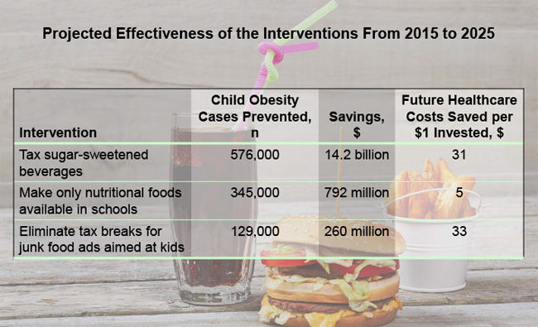
Public Health Measures to Reduce Obesity
The most cost-effective ways to reduce childhood obesity rates
CHOICES Program

Slide 197
Public Health Measures to Reduce Obesity
DHHS’s Healthy People 2010 objective: reduce prevalence of obesity to 15%
<1/2 of obese US adults visiting a primary care physician counseled about weight loss
  Those counseled twice as likely to attempt weight loss
  44% of US physicians overweight or obese – less likely to counsel

Slide 198
Public Health Measures to Reduce Obesity
Need for improved health care provider education in nutrition and increased use of nutritionists in primary care settings
  Would likely be cost-saving
School- and community-based health education campaigns tailored to cultural background, gender, and age group

Slide 199
Public Health Measures to Reduce Obesity
Media health messages to correct misperceptions regarding weight and promote healthy behaviors
Enhanced, science-based public school health curricula
  Not corporate-sponsored (e.g., “Count Your Chips” computational skills curriculum, sponsored by National Potato Board, others)

Slide 200
Public Health Measures to Reduce Obesity
Obesity report cards
  20 states
  23% of US elementary schools
Lincoln University in PA requires students with BMI > 30 to pass a physical fitness test to graduate

Slide 201
Public Health Measures to Reduce Obesity
More healthful school and hospital cafeteria meal choices
No fast foods, soda pop machines, or exclusivity contracts in schools (consider elimination of HFCS-laden juices and bottled water sales also)
  Enhanced state funding for public education
Provision of healthier menu options in federally-sponsored school lunches increases student participation in NSLP

Slide 202
Public Health Measures to Reduce Obesity
Use of local produce from community-supported agriculture, especially organics, would decrease adverse consequences of pesticides on the environment and amount of harmful greenhouse gasses produced in transportation of food over long distances

Slide 203
Public Health Measures to Reduce Obesity
School wellness policy provision included in the Child Nutrition and Women, Infants and Children Reauthorization Act of 2004 mandates that schools participating in federal nutrition programs create wellness policies on how to improve students’ nutrition and health as well as set guidelines for all foods sold in schools by 2006

Slide 204
Public Health Measures to Reduce Obesity
Pedestrian malls
Recreational centers, parks, and workplace gyms
Requiring physical education at school
Providing insurance coverage for membership in athletic clubs and insurance discounts for participation in exercise programs

Slide 205
Public Health Measures to Reduce Obesity
Alabama: $25/month health insurance surcharge on state workers whose BMI exceeds 35 and who fail to enroll in a free wellness program and “show progress”
State workers, however, pay lower rates for lower BP, FBS, cholesterol, and weight, or if they see a doctor to address health problems or participate in an exercise class

Slide 206
Public Health Measures to Reduce Obesity
PPACA (ObamaCare) allows employers to charge obese workers 30%-50% more for health insurance if they decline to participate in a qualified employee wellness program

Slide 207
Public Health Measures to Reduce Obesity
Comprehensive employee wellness programs yield average reduction in healthcare expenditures of 26%
Several state insurance plans impose a $25/month surcharge on smokers
Others give up to 20% premium reductions to those who meet certain health guidelines

Slide 208
Public Health Measures to Reduce Obesity
Enhanced health insurance coverage for obesity prevention and treatment
  Adjusted premiums based on weight in several states
Health and life insurance companies own 1.9 billion of stock in the 5 leading fast food companies (2010)

Slide 209
Public Health Measures to Reduce Obesity
Airline’s requiring obese passengers on full flights to rebook or purchase two seats
Child abuse/child custody statutes
Purge governmental bodies of those with industry connections

Slide 210
Public Health Measures to Reduce Obesity
Laws to prohibit weight discrimination (MI only state, others considering)
  Have broad popular support
  Some doctors refuse to treat obese patients (higher risk of surgical complications, etc.)
Fat Acceptance/Celebration
  Fat Studies
  National Association to Advance Fat Acceptance

Slide 211
Public Health Measures to Reduce Obesity
Provision of nutrition information on restaurant menus
  Consumers strongly support
  Required in NYC (upheld by federal appeals court in 2009)
  Consumers underestimate calorie content of restaurant food by 28-48%

Slide 212
Public Health Measures to Reduce Obesity
Provision of nutrition information on restaurant menus
  Effective in in decreasing calorie consumption (2025 meta-analysis)
  Required by PPACA for many restaurants, other establishments starting 2017
    2017: Ag Dept extends deadline, may scrap

Slide 213
Public Health Measures to Reduce Obesity
As of January 1, 2006, all conventional food items must include information re the amount of trans fatty acids they contain
CA, NYC, Philadelphia, Cleveland have banned use of artificial trans-fatty acids in restaurants
  Less than 2% of NYC restaurants using trans fats (2009)
  Trans-fatty acid levels among NYC adults declined significantly among restaurant patrons between 2004 and 2014
2008: McDonalds eliminating trans fatty acid cooking oils

Slide 214
Public Health Measures to Reduce Obesity
IOM supports front-of-package labeling for calories, sugar, fat, and sodium using simplified system (sugar labeling alone could prevent a million cases of diabetes and CV disease and save $62 billion in societal costs)
2014: FDA announces overhaul of nutritional labels
  Greater emphasis on total calories, added sugars, and certain nutrients (potassium, vitamin d)
  2017: FDA delays implementation until 2020/21 for large/small companies

Slide 215
Public Health Measures to Reduce Obesity
2015: FDA sets 2018 deadline to eliminate trans fats altogether
  Could prevent 20,000 heart attacks and 7,000 deaths from heart disease per year; decrease dementia
    MIs and CVAs down 6% 3 yrs post ban in some NY counties
  Cost of implementation estimated at $6 billion
  Health care and other cost savings: estimated $140 billion over 20 years

Slide 216
Public Health Measures to Reduce Obesity
Denmark, Sweden, Iceland, Switzerland have banned trans-fats (other countries considering)
2018: WHO calls for elimination of trans fats by 2023
Some claim that these compounds add flavor and texture to fried foods, but suitable, less dangerous cooking oil substitutes are available

Slide 217
Public Health Measures to Reduce Obesity
Prohibit distribution of toys and promotional games and presence of play equipment and video games at fast food outlets
Require fast food restaurants to locate minimum distance from schools and playgrounds
Limit per capita number of fast food outlets in a community

Slide 218
Public Health Measures to Reduce Obesity
Limit proximity of fast food outlets to each other
Charge fee to fast food outlets and use proceeds to mitigate the impact of poor nutritional content
Prohibit drive-through service
Supersize soda bans (NYC) - invalidated by federal judge

Slide 219
Public Health Measures to Reduce Obesity
Majority of Americans believe the government should be involved in fighting obesity, particularly by regulating marketing of “junk foods” to kids
40 states tax non-nutritious foods (e.g., soft drinks and candy)
  1cent/oz tax could reduce consumption of sugared beverages by up to 15%
At least 4 states have passed laws preempting local sugar-sweetened beverage taxes

Slide 220
Public Health Measures to Reduce Obesity
Taxes on sugar-sweetened beverages recommended by IOM and APHA, which could (over 10 years)
  Reduce soda consumption by 10-50% (multiple studies), while increasing average price of soda by 1.3 cents/oz
  Prevent 26,000 premature deaths
  Save over $17 billion in medical costs

Slide 221
Public Health Measures to Reduce Obesity
Food and beverage industry fighting back against government-mandated efforts (expensive, intense lobbying)
  Soda companies spent over $100 million between 2009 and 2014 to defeat proposed sugar taxes (including in NY)
  Over 130 countries and many U.S. jurisdictions (e.g., Berkeley, Philadelphia, SFO, Seattle, Oakland, Albany, Boulder, Cook County [including Chicago]) have 1-2 cents/oz soda taxes (no state or federal taxes)

Slide 222
Sugar-Sweetened Beverage Taxation (AJPH 2019;109(2):276)
A national $0.01/oz SSB tax would save $46 billion in lifetime health care costs (assuming the tax is fully passed through to higher retail prices)
Government would gain net $107 billion from tax revenue and lower health care costs
Employers would save $16 billion in health care costs
Consumers would benefit through through decreased consumption expenses and lower health care costs

Slide 223
Implementation of First US Sugar-Sweetened Beverage Tax
Berkeley, CA, 2015-19
No retailer raised food prices
  Argues against industry’s claim that the SSB tax would function as a “grocery tax”
Revenue allocations over $9 million for public health, nutrition, and health equity through 2021

Slide 224
Seattle’s Sugary Drink Tax (2018-2023)
20% increase in the price of taxed beverages.
22% decline in volume sold of taxed beverages up to two-years post-tax.
No evidence of crossborder shopping in response to tax
Only moderate substitution to untaxed beverages (4-5%) and calories sold of sweets (3-4%).
Revenue $22 million/yr, reinvested in food and nutrition measures

Slide 225
Public Health Measures to Reduce Obesity
England, France, Mexico, Portugal, Hungary, India, Chile, and South Africa tax sugar-laden beverages
  Mexican tax decreased soda sales (more among lower SES households), but led to increased bottled water sales (same in Berkeley)
  England taxes manufacturers, not consumers

Slide 226
Public Health Measures to Reduce Obesity
Warning labels on sugar-sweetened beverages (bills proposed in CA, NY, and WA)
Warning labels on ultra-processed foods
9 other countries require warning labels on unhealthy foods and sugar-sweetened beverages
Lawsuits against purveyors of junk foods to reclaim health care costs (some states considering class action suits)
Add “exercise equivalents” to food labels

Slide 227
Public Health Measures to Reduce Obesity
Healthy Checkout Ordinance (Berkeley, CA) - large grocery stores must stop selling junk food and candy in checkout aisles
Farm subsidies for healthy foods, not animal feed and fuel for automobiles
Food as medicine Medicaid waivers (in pilot phase)
True cost accounting
  Food priced based off its societal costs, including costs to people’s health

Slide 228
Conclusions
Epidemic of obesity in US and worldwide
Serious health and economic consequences
Multi-tiered approach necessary to combat

Slide 229
Covered in Other Slide Shows
Ideals of beauty and body modification
Cosmetic surgery
Female genital cutting
Ethical and policy issues

Slide 230
References
Donohoe MT. Weighty matters: public health aspects of the obesity epidemic. Part I – Causes and health and economic consequences of obesity. Medscape Ob/Gyn and Women’s Health 2007 (posted 12/12/07). Available at http://www.medscape.com/viewarticle/566056
Donohoe MT. Weighty matters: public health aspects of the obesity epidemic. Part II – Economic Consequences of Obesity, the “Obesity Economy,” and the Role of Nutrition, Exercise, and Television. Medscape Ob/Gyn and Women’s Health 2008 (posted 1/04/08). Available at http://www.medscape.com/viewarticle/566349?src=mp
Donohoe MT. Weighty matters: public health aspects of the obesity epidemic. Part III – A look at food and beverage industries. Medscape Ob/Gyn and Women’s Health 2008 (posted 3/25/08). Available at http://www.medscape.com/viewarticle/568110_print
Donohoe MT. Weighty matters: public health aspects of the obesity epidemic. Part IV – Obesity worldwide, pathological underweight, and gluttony. Medscape Ob/Gyn and Women’s Health 2008 (Posted 3/19/08). Available at http://www.medscape.com/viewarticle/571497_print
Donohoe MT. Weighty matters: public health aspects of the obesity epidemic. Part V – Treatments and public health approaches to combating the problem. Medscape Ob/Gyn and Women’s Health 2008 (posted 4/10/08). Available at http://www.medscape.com/viewarticle/571139_print.

Slide 231
Contact Information
Public Health and Social Justice Website
http://www.phsj.org
martindonohoe@phsj.org

