Slide 1
Ignorance, Pseudoscience, and Democracy
Martin Donohoe

Slide 2
Carl Sagan
“I have a foreboding of an America in my children's or grandchildren's time -- when the United States is a service and information economy; when nearly all the manufacturing industries have slipped away to other countries; when awesome technological powers are in the hands of a very few, and no one representing the public interest can even grasp the issues;

Slide 3
Carl Sagan
when the people have lost the ability to set their own agendas or knowledgeably question those in authority; when, clutching our crystals and nervously consulting our horoscopes, our critical faculties in decline, unable to distinguish between what feels good and what's true, we slide, almost without noticing, back into superstition and darkness...

Slide 4
Carl Sagan
But if the citizens are educated and form their own opinions, then those in power work for us. In every country, we should be teaching our children the scientific method and the reasons for a Bill of Rights. With it comes a certain decency, humility and community spirit. In the demon-haunted world that we inhabit by virtue of being human, this may be all that stands between us and the enveloping darkness.”

Slide 5
Overview
Pseudoscience/Ignorance
Health, Environment
Public Education, Journalism, Advertising, Lobbying, Public Relations, Religion
Politics and Elections
Threat to Democracy

Slide 6
Thomas Jefferson
“Information is the currency of democracy”

Slide 7
Lies and Manipulation
Jonathan Swift: “Falsehood flies and the truth comes limping after it”
Adolf Hitler: “If you tell a big enough lie and tell it frequently enough, it will be believed.”
“Those who can make you believe absurdities can make you commit atrocities” - Voltaire

Slide 8
Lies and Manipulation
Herman Goering: “Of course, the people don’t want war…but…the[y] can always be brought to do the bidding of the leaders. That is easy. All you have to do is tell them they are being attacked and denounce the pacifists for lack of patriotism and exposing the country to danger. It works the same way in any country.”

Slide 9
Pseudoscience
Statements, beliefs, or practices that are claimed to be both scientific and factual but are incompatible with the scientific method

Slide 10
Pseudoscience
Examples:
  Astronomy: astrology, Apollo moon landing hoax
  Geography: Bermuda Triangle
  Biology: cryptozoology (Bigfoot, Yeti, etc.)
  Psychology: conversion therapy, polygraph
  Paranormal: channeling, dowsing, ESP

Slide 11
Pseudoscience
Characterized by contradictory, exaggerated or unfalsifiable claims
Rely on confirmation bias rather than rigorous attempts at refutation
Lack of openness to evaluation by other experts

Slide 12
Pseudoscience
Absence of systematic practices when developing hypotheses
Continued adherence long after experimentally discredited.
Underlying agenda (e.g., corporate profit, religion)

Slide 13
Characteristics of Pseudoscience
Indifferent to facts and valid evidence
Looks only for evidence supporting hypothesis
Relies heavily on subjective validation
Depends on arbitrary conventions of human culture, rather than on unchanging regularities of nature

Slide 14
Characteristics of Pseudoscience
Avoids putting its claims to meaningful tests
Often contradictory
Deliberately creates mystery where none exists, sometimes by omitting important details
Does not progress
Attempts to persuade with rhetoric, propaganda and misrepresentation

Slide 15
Characteristics of Pseudoscience
Appeals to false authority, emotion, sentiment, or distrust of established facts
Extraordinary claims and fantastic theories
Often described by an invented vocabulary of words with ambiguous meanings
Relies on anachronistic thinking
Appeals to vanity, fear, magical thinking or desperation

Slide 16
Characteristics of Pseudoscience in Medicine
Relies on anecdotes and testimonials
Products often claim to be effective against a wide range of unrelated diseases
Quick, dramatic results promised for one-time therapies; frequent re-treatments/maintenance treatments required for ongoing therapies
Expensive

Slide 17
Characteristics of Pseudoscience in Medicine
Disclaimers couched in pseudo-medical jargon
Claims that “Western Medicine” is dangerous
Practitioners advise, “Don’t trust your doctor”
Claims of “no side effects”
Products claimed to be “natural” – usually are not

Slide 18
Examples of Pseudoscience in Medicine
Historical: bloodletting, purging, trephining, mercury for syphilis
Contemporary: therapeutic touch, psychosurgery, Reiki, homeopathy, most naturopathic remedies, stem cell and platelet injection clinics (unproven, lucrative, even major academic institutions)
  Benefits often due to time with patients, active listening, emphasis on mental health, convincing practitioners, suggestible patients

Slide 19
Examples of Pseudoscience in Medicine
Direct-to-consumer genetic testing
Whole body CT scans
Over-testing in concierge/luxury primary care
Celebrities:
  Oprah Winfrey (large audience, promotes fake healers/whole body CT scans, mentored Dr Oz, who promulgates quackery)
  Gwyneth Paltrow (GOOP)

Slide 20
How Quackery Harms
Health dangers: cyanide toxicity from laetrile, electrolyte imbalances from coffee enemas, quadriplegia from cervical spine manipulations
Cost
Delays in seeking care
Perpetuates pseudoscience, undermines scientific medicine

Slide 21
Recognizing Health Scams
Claims pitched directly to the media, rather than via publication in peer-reviewed journals
Discoverer says that a powerful establishment is trying to suppress his or her work
Appeals to false authorities, emotion, or magical thinking
Scientific effect involved at the very limits of detection

Slide 22
Recognizing Health Scams
Evidence for test or treatment anecdotal / relies on subjective validation
Promoter states a belief is credible because it has endured for centuries
Need to propose new laws of nature to explain an observation

Slide 23
Vaccination
Childhood vaccinations saved over 150 million lives between 1949 and 2024
  3 million lives/yr
Over 30,000 doses/second worldwide
Serious adverse events extremely rare

Slide 24
Vaccination
53% of Americans think vaccines are safe and effective, 16% believe they are unsafe, and 1/3 oppose mandatory childhood vaccination (pre-covid)
  Vaccine suspicion increased with Covid, despite the Covid vaccine being the most-studied single intervention in the history of medicine
  Covid vaccines averted 2.5 million deaths and saved 15 million life years between 2020 and 2024
Discredited “research” linking vaccines to autism
  Promoted by MAHA, RF Kennedy

Slide 25
Vaccination
Measles outbreaks among unvaccinated, putting others at risk (need 95% community coverage to avoid outbreaks)
Mumps outbreaks expected next
Then rubella?
One person infected with measles can potentially infect 15 others; mumps 14; rubella 6-7; polio 5-7; Covid 3)

Slide 26
Vaccination
All states require childhood vaccination for school entry
  All states have medical exemptions
  29 states and Washington D.C. allow religious exemptions
    None of the world’s seven major religions forbid vaccines, indeed all encourage them
  18 allow religious and/or personal exemptions
  4 states do not allow any exemptions
    One of these, MS, has lowest rate of vaccine-preventable diseases

Slide 27
Vaccination
Supreme Court has consistently ruled that states are not constitutionally required to permit religious or philosophical exemptions
Many state bills proposing elimination of child vaccine requirements for school attendance
1/6 parents have delayed or skipped at least one childhood vaccination (2025)

Slide 28
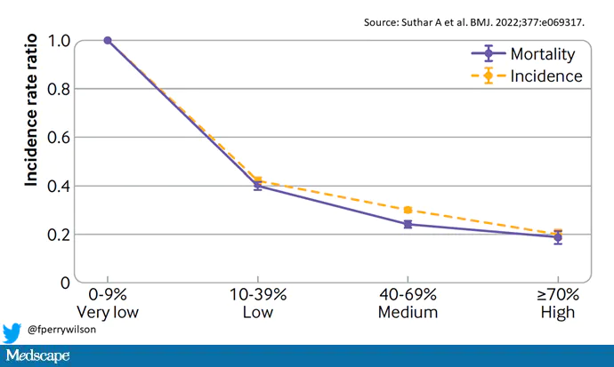
Mortality/Incidence of Covid vs Community Vaccine Uptake (pre-delta variant)

Slide 29
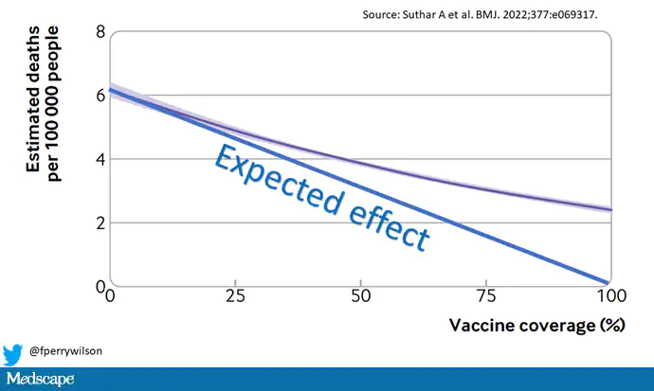
Mortality/Incidence of Covid vs Community Vaccine Uptake (including delta variant)

Slide 30
Alternative Medicine and Cancer Care
40% of Americans believe alternative cancer therapies alone can cure cancer
Alternative-only cancer care linked to 2.5-fold increased mortality risk
  5-fold for breast and colorectal cancer

Slide 31
Fluoride
63% of Americans receive fluoridated water
  The rest rely on supplements
  86% total use
Prevents dental caries; when water fluoridation ends, incidence of caries increases by 50%
  Dental caries causes chronic inflammation, which is associated with the development of heart disease

Slide 32
Flouride
At doses used, fluoride is safe and effective
  With high doses (rarely seen): Dental and skeletal fluorosis, neurocognitive deficits
Elimination of fluoridation could lead to 25 million additional children with dental caries and $10 billion additional spending over 5 years
81% of Americans support or do not oppose water fluoridation
  Small but vocal 6% support total ban (early 2000s)
Two states (UT and FL) and over 240 local communities have banned water fluoridation (2025)

Slide 33
Pseudoscience and Abortion
Majority of U.S. states have implemented at least 2 abortion restrictions not backed by scientific evidence
False links with breast cancer, infertility, and depression
Proposed anti-abortion bill in Ohio requiring doctors to re-implant ectopic pregnancies into the uterus
  Physiologically impossible
  Doctors not complying would face charges of “abortion murder,” punishable by life in prison

Slide 34
Pseudoscience – Abortion and Childbirth
Crisis pregnancy clinics: peddle misinformation about abortion increasing risk of subsequent infertility and breast cancer, causing fetal pain
Freebirth Societies: giving birth at home without any prenatal care, ultrasounds, or health professionals in attendance
  Dangerous to mothers and newborns
  Industry revenues over $13 million 2018 to 2024

Slide 35
Pseudoscience and Abortion
Abortion very safe procedure/woman’s right
Restrictions limit access to abortion, raise costs, and increase unwanted pregnancies
Women denied abortion are more likely to:
  Experience serious complications from the end of pregnancy including eclampsia and death
  Stay tethered to abusive partners

Slide 36
Pseudoscience and Abortion
Women denied abortion are more likely to suffer anxiety and loss of self-esteem in the short term
Less likely to have aspirational life plans for the coming year
Implications for offspring
Dobbs decision/post-Dobbs landscape – see Women’s Health page of phsj website

Slide 37
Ignorance of Geography
Percent of US teens unable to locate the following on a map:
  United States – 11%
  Pacific Ocean – 29%
  Japan – 58%
  United Kingdom – 68%

Slide 38
Ignorance/Pseudoscientific Beliefs
37% of US citizens do not believe in evolution (2024) and 40% believe that humans and dinosaurs definitely or probably coexisted (2025)
  Only 12% of U.S. Protestant pastors believe in evolution
  20% of high school biology teachers are creationists

Slide 39
Pseudoscientific Beliefs
40% - 70% believed in global warming in the 2000s, now almost 90% (although only 60% alarmed or concerned)
85% believe places can be haunted (2024)
42% believe in UFOs; 10% report having seen one (2024)
41% believe in ghosts (2024)
Over 40% do not know what July 4 commemorates (2023)
27% believe in reincarnation (2024)

Slide 40
Pseudoscientific Beliefs
27% 2/3 of Americans believe they have had a paranormal experience (2022)
believe in astrology (2024), higher among millenials
24% believe they can psychically sense others’ emotional “auras” (2022)
18% believe their homes are haunted (2022)
26% believe in Bigfoot; 16% believe in the Loch Ness Monster (2026)

Slide 41
Ignorance/Pseudoscientific Beliefs
16% believe that people with the “evil eye” can cast curses or harmful spells
27% of Americans don’t know whether an atomic bomb has ever been dropped (2025)
26% of Americans don’t know the earth revolves around the sun (2025)
  Copernicus – 16th Century
Only 1/3 Americans can name a living scientist

Slide 42
Ignorance/Pseudoscientific Beliefs
Some states require instructors to teach “creation science,” “intelligent design,” and “climate change skepticism”
Americans rank last overall in environmental attitudes and habits (survey of 20 developed countries, 2014)
  Those who are less green feel less guilt

Slide 43
Environmental Ignorance
A majority of Americans believe that electricity in the U.S. is produced in nonpolluting ways
  Only 25% know that majority (80%) comes from oil, natural gas, coal and wood
33% assume that spent nuclear fuel (from our 104 plants) is stored “in a deep underground facility in the West”
  Only 17% are aware that it is mostly stored on-site at powerplants pending a long-term solution

Slide 44
Ignorance/Pseudoscientific Beliefs
Percent of Americans who think:
  Global warming will harm plant and animal species (72%)
  Future generations of people (72%)
  The world’s poor (69%)
  People in developing countries (68%)
  People in the United States (65%)
  People in their community (52%).
Belief in no harm means no need to change policies

Slide 45
Ignorance/Pseudoscientific Beliefs
Use of dietary supplements common (1/3 adults and children took, although just over half were multivitamins and vitamin D; $55 billion spent in 2020; over 100,000 different products available, vs. 1,000+ prescription drugs), despite:
  Lack of regulation by FDA
  No to minimal data for many
  Adverse reactions common
    23,000 ER visits and over 2,000 hospitalizations annually

Slide 46
Scientific Ignorance
Would you sign a petition to ban dihydrogen monoxide?
1. It can cause excessive sweating and vomiting
2. It is a major component in acid rain
3. It can cause severe burns in its gaseous state
4. It can kill you if accidentally inhaled
5. It contributes to erosion
6. It decreases effectiveness of automobile brakes
7. It has been found in tumors of terminal cancer
patients

Slide 47
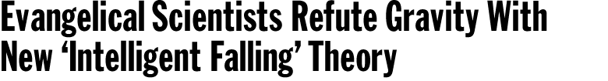

Slide 48
Many (Most?) Published Research Findings are False (PLOS Med 2005;2(8)e124)
Reasons:
  The smaller the studies conducted in a scientific field, the less likely the research findings are to be true
  The smaller the effect sizes in a scientific field, the less likely the research findings are to be true
  The greater the number and the lesser the selection of tested relationships in a scientific field, the less likely the research findings are to be true

Slide 49
Many (Most?) Published Research Findings are False (PLOS Med 2005;2(8)e124)
Reasons:
  The greater the flexibility in designs, definitions, outcomes, and analytical modes in a scientific field, the less likely the research findings are to be true.
  The greater the financial and other interests and prejudices in a scientific field, the less likely the research findings are to be true
  The hotter a scientific field (with more scientific teams involved), the less likely the research findings are to be true.
However, most medical interventions are helpful, and most scientific investigations lead to significant gains in practical knowledge

Slide 50
Public Education in Disarray
U.S. Schools ranked lowest among western nations
Inadequate funding, decaying infrastructure
Underpaid/undervalued teachers
School boards censoring books, altering curricula, distorting history (e.g., slavery)
Sex ed topics poorly taught or ignored altogether

Slide 51
Public Education in Disarray
Moms for Liberty and other groups hounding parents, teachers, and reasonable school board members
  MFL head and husband involved in threesome sex scandal, allegations of rape by husband; former Pennsylvania head registered sex offender
National HS graduation rate stagnant at 65-70%
College tuition costs rising

Slide 52
Television and the Media
Smartphones - Average US teen spends 9 hrs/d using social media (8-12 year olds = 6 hrs/d)
The average American youth spends 900 hrs/yr in school, 1,500 hrs/yr watching TV
By age 65, the average American will have spent 9 yrs watching TV

Slide 53
Social Media
Facebook, Google, YouTube, Pinterest, Twitter, Instagram, Reddit, Match Group, Amazon, others
Some school districts outlaw cell phone use in schools
Some countries outlaw social media use by children less than 16yo

Slide 54
Artificial Intelligence
What goes in determines what comes out
Over-reliance on AI and proliferation of misinformation on the web can adversely affect decision-making
Financialization (profit motive) risks platform decay
Need for more public oversight

Slide 55
Journalism
Local newspapers closing, consolidation of major media outlets
  5 corporations control majority of US media (down from 50 in 1983)
Most owned by multinational, multi-billion dollar corporations involved forestry, defense, real estate, fossil fuels, big agriculture, etc.
  Stories suppressed
Predatory scientific journals – operate online, not peer-reviewed, charge for publication, unreliable

Slide 56
Journalism
Dramatic drops in numbers of journalists
“Fake news” epidemic; rent-a-crowds; deep fake videos; propaganda (Fox News)
Journalists under attack
  Guardians of the Truth named TIME Magazine’s Persons of the Year, 2018
  Trump administration ridiculing, threatening journalists, television personalities

Slide 57
Global Warming: Controversial?
Of 928 articles in peer-reviewed scientific journals, 0% were in doubt as to the existence or cause of global warming
Of 636 articles in the popular press (NY Times, WaPo, LA Times, WSJ), 53% expressed doubt as to the existence (and primary cause) of global warming
  Desire to appear “fair and balanced” creates false equivalency
Science 2004;306:1686-7
(Study covers 1993-2003)

Slide 58
Corporations Spread Misinformation
Advertising:
  “The art of convincing people to spend money they don't have for something they don't need.” (Will Rogers)
US: $1.2 trillion/yr worldwide (2025); over $350 billion/yr in U.S. (2024)
  US largest spender
10% of a two-year old’s nouns are brand names
The average American can recognize over 1,000 corporate logos, but fewer than 10 local plants and animals

Slide 59
Corporate Spread Misinformation
Astroturf - artificially-created grassroots coalitions
Corporate front groups
Sponsored curricula (environmental health, nutrition)
Public relations:
  $105 billion worldwide industry (2025)
  PR flacks outnumber journalists in the US

Slide 60
Edward Bernays, Pioneer of Corporate PR and Propaganda
"Those who manipulate the unseen mechanism of society constitute an invisible government which is the true ruling power of our country. We are governed, our minds molded, our tastes formed, our ideas suggested largely by men we have never heard of. →

Slide 61
Edward Bernays, Pioneer of Corporate PR and Propaganda
In almost every act of our lives, whether in the sphere of politics or business, in our social conduct or our ethical thinking, we are dominated by the relatively small number of persons who understand the mental processes and social patterns of the masses. It is they who pull the wires that control the public mind.”

Slide 62
Corporate Front Groups
The American Council on Science and Health
Koch Institute
American Legislative Exchange Council (ALEC)
National Wilderness Institute
The Foundation for Clean Air Progress
Council for Biotechnology Information
Sense About Science

Slide 63
Sponsored Environmental
Educational Materials
Corporate-sponsored and supported by a loose coalition of antiregulatory zealots, corporate polluters, lapdog scientists and misguided parents

Slide 64
Sponsored Environmental
Education Materials (Examples)
Exxon’s “Energy Cube”
-“Gasoline is simply solar power hidden in decayed matter”
-“Offshore drilling creates reefs for fish”
- Exxon deliberately hid data showing fossil fuels can contribute to devastating climate change since the 1970s, instead spread disinformation

Slide 65
True Cost of Fossil Fuels
Worldwide annual fossil fuel subsidies = $1.5 trillion (2025)
  Does not include other costs of fossil fuels related to climate change, environmental impacts, military conflicts and spending, and health impacts.
Including externalities, the unpaid costs of fossil fuels are upward of $7 trillion annually (2022 data)
  $19 million/day)

Slide 66
Sponsored Environmental
Education Materials (Examples)
International Paper
-“Clearcutting promotes growth of trees that require full sunlight and allows efficient site preparation for the next crop”
Pacific Lumber Company
-“The Great American Forest is. . . renewable forever”

Slide 67
Sponsored Environmental
Education Materials (Examples)
American Coal Foundation 4th grade lesson packet entitled “The United States of Energy”
  Omits mention of toxic waste, mountaintop removal, and greenhouse gasses
American Nuclear Society’s “Activities with the Atoms Family”
Dow’s “Chemipalooza”

Slide 68
Lobbying (2025)
Source: Open Secrets
Approximately 13,340 full-time, registered lobbyists
24 per member of Congress
$5 billion annual spending

Slide 69
Lobbying
Estimates of return on lobbying range from $28 to $212 for every $1 spent (higher values more likely)
Oxfam study (2008-14) of 50 major US corporations found return of $130 in tax breaks and $4,000 in tax subsidies for every $1 spent on lobbying
Return on campaign contributions for elections for the most politically active companies = $760 per $1 spent

Slide 70
Polluting Industries’ Political Influence
Oil, gas, and coal companies spent $354 million in campaign contributions and lobbying and received $29 billion in federal subsidies over the 2015-16 election cycle
  $8,200 return on investment

Slide 71
Lobbying/Campaign Contributions
Corporations vastly outspend all single-issue ideological groups combined (e.g., labor, pro-choice, anti-abortion, feminist and consumer organizations, senior citizens, etc.)
Richest 0.01% of American voters account for over 40% of political contributions; 0.5% for 50%
Koch brothers spent $33 million (2023); Sheldon and Miriam Adelson shelled out over $113 million in support of Republican candidates (2018)

Slide 72
Lobbying
Federal lobbying groups spent $3.2 billion in 2015
All single-issue ideological groups combined (e.g., pro-choice, anti-abortion, feminist and consumer organizations, senior citizens, etc.) spent under $100 million

Slide 73
Lobbying (2012)
Corporations spent $86 for every $1 spent by civic groups
Corporations spent $56 for every $1 spent by labor unions

Slide 74
Business vs Labor Spending, 2023-2024
Business:
  Total $6,116,305,625
  Democrats (not a typo) $2,134,267,244
  Republicans $1,654,234,059
Labor:
  Total $264,185,277
  Democrats $67,233,527
  Republicans $9,291,581

Slide 75
Political Spending
Corporations vs. Labor
U.S. Chamber of Commerce spent $5.7 million on federal elections (2022); $327 million on federal lobbying in 2022
  Former CEO Tom Donahue was the highest-paid corporate trade group chief (2020 salary $7.1 million)
AFL-CIO and SEIU (two largest labor unions) spend $6 million combined
2023: All state and federal lobbying hits record $5.6 billion

Slide 76
Lobbying Expenses
(2025, Open Secrets)
Health: $868 million
Communications/Electronics: $666 million
Finance, Insurance, and Real Estate: $711 million
Energy and Natural Resources: $485 million
Agribusiness: $219 million

Slide 77
Lobbying Expenses
(2025, Open Secrets)
Defense: $191 million
Education: $124 million
Human Rights: $82 million
Non-profit institutions: $70 million
Labor: $57 million

Slide 78
Lobbying/Campaign Contributions
Congresspersons spend up to five hrs/d raising money, then many evenings at fundraisers
50% of Senators and 42% of Representatives become lobbyists after leaving office
Lobbying promotes international non-cooperation/isolationism

Slide 79
U.S. Supreme Court Decisions
Citizens United v. Federal Election Commission (2010): “Corporations are people”
  No limits on corporate campaign spending
  Yet corporations are not considered persons when it comes to liability for causing harm to the environment or the public’s health
McCutcheon v. Federal Election Commission
  Limits on individual contributions to national parties and federal candidate committees are unconstitutional
“We have the best Congress money can buy” (Will Rogers)

Slide 80
Congressional Wealth and Influence
Median wealth of Congressperson = $1 million (vs $193,000 for average American household) [2023]
½ of legislators are millionaires (vs. 1% of U.S. citizens)
  10% of Congress owns 80% of Congressional wealth
Congress frequently grants itself cost of living increases in salary

Slide 81
Congresspersons and Stock Trading
The STOCK Act (2012) prohibits members of Congress from using non-public information for private profit and requires timely disclosure of financial trades.
  However, ongoing concerns regarding compliance and potential conflicts of interest
TRUST in Congress Act (pending vote) aims to ban or restrict individual stock ownership in favor of blind trusts

Slide 82
Anti-Science Legislators
Members of the House Science Committee (2012)
  Paul Broun (R-GA): Evolution, embryology, and the Big Bang Theory are “lies straight from the pit of hell”
  Ralph Hall (R-TX): Agreed with TX Governor Rick Perry (later US Energy Secretary) that climate scientists are involved in a conspiracy to receive research funding
  Todd Akin (R-MO): “If it’s legitimate rape,” women will not get pregnant (lost 2012 election)

Slide 83
Infringements on Freedom of Speech
35 states have considered or enacted legislation restricting the right to protest
  Most relate to fossil fuel protests
  Some involve race)
Similar to SLAPP Suits (Strategic Lawsuits Against Private Parties)
  31 states and DC have anti-SLAPP laws
Food Disparagement Laws (13 states)

Slide 84
Trump Administration
Trump: Prevaricator-in-Chief (30,573 lies/misstatements over first 4-yr presidency)
Trump’s cabinet, advisors had extensive backgrounds and connections with polluting industries and little scientific expertise
de facto science advisor Michael Kratsios was a 31 yo with a degree in political science and no scientific training

Slide 85
Trump Administration
Ecocidal/xenophobic/unjust policies
Eliminated numerous lifesaving and health-promoting federal regulations; halted research; silenced scientists
Thoroughly botched coronavirus pandemic response
Sewed mistrust of scientists, law enforcement and intelligence agencies
Wreaked havoc with judicial system
  Pardoned convicted felons who happen to be loyal supporters

Slide 86
Trump Administration and the Rise of Pseudoscience/Misinformation
Dramatic rise
  Trump himself and un(der)qualified agency appointees
Increasing polarization of U.S. society
Politicians, the media, religions all play role
Lack of health education at all levels
Social media and “news” organizations complicit – e.g., Twitter (X), Facebook, Fox, etc.

Slide 87
Trump Administration and the Rise of Pseudoscience/Misinformation
Especially notable during Covid epidemic (vaccine misinformation, hydroxychloroquine and ivermectin recommendations)
  Insurance subsidized well over $100 million worth of ivermectin treatments
  Estimated 17,000 deaths in 6 countries (including US) from hydroxychloroquine use during hospitalization in first wave of covid pandemic
  US has highest per capital death rate from covid
  Over 200,000 covid deaths in US due to shunning covid vaccine
  2022: SCOTUS stops OSHA’s nationwide vaccinate-or-test policy

Slide 88
Trump Administration
Trust in CDC way down
  White House pressured CDC to limit information regarding vaccine effectiveness
½ of Americans believe in at least one major medical conspiracy (most common is the the FDA is suppressing “natural” cures for cancer to benefit drug companies)
States passing laws to limit public health interventions

Slide 89
Trump Administration
25% of population feels ok to harass public health officials because of businesses closing, 21% feel OK to threaten the, 50% trust science reporting “not much” or “not at all” (2021, post-vaccine rollout) – even though none actually closing businesses
  Actual threats rose dramatically, many left the profession
  Small group of about 50 individuals responsible for social media spread, news media complicit

Slide 90
Biden Administration
Trying to overcome laissez faire attitudes toward/persistent misinformation re covid vaccine (and other vaccines)
  Vaccine rates significantly down
WH Office of Science and Technology Policy issues new framework for scientific integrity protections
However, gag order on federal scientists issued in early 2023; already in place for USDA since 2013; requires scientists to seek agency approval before discussing findings; may be unconstitutional

Slide 91
Trump Administration II
Grossly unqualified appointees
  Charlatans like Dr Mehmet Oz (Chief of Medicare and Medicaid Services) and Robert F Kennedy, Jr (Secretary of Health and Human Services)
Dismantling research enterprise
Threatening universities, which have capitulated through money and silence

Slide 92
Trump Administration II
States banning books, libraries under threat
Elimination of SDH/race in grants
MAHA movement
Loss of trust in American medicine
Decreasing vaccine uptake associated with measles epidemics, more expected

Slide 93
Trump Administration – Social Murder
Withdrawal from WHO
Elimination of Agency for International Development funding
  Estimated 1.6 million excess deaths in 2025
    US Office of Management and Budget, 2025
  9-14 million by 2030
    Lancet 2025(July), 406;10500:283-294; Lancet 2026(Feb) https://www.thelancet.com/journals/langlo/onlinefirst)

Slide 94
Trump Administration – Social Murder
Elimination of Agency for Healthcare Research and Quality
Gutting SNAP (Supplemental Nutritional Assistance Program) and housing benefits
10-17 million more uninsured expected (more deaths)
Tens to hundreds of thousands of excess deaths due to environmental policies

Slide 95
Trump Administration – Social Murder
Numerous restrictions on reproductive health care funding nationally and internationally
Supreme Court’s Dobbs decision overturned Roe v Wade, returning abortion laws to the states, with significant adverse impacts on abortion (and contraceptive) access, pregnancy complications, and infant mortality

Slide 96
Trump Administration – Social Murder
Cuts in international family planning programs could lead to 16 million unintended pregnancies, 1.9 million unsafe abortions, and over 34,000 preventable maternal deaths per year
  Guttmacher Institute, based on Center for Global Development Data - https://www.guttmacher.org/article/2025/03/foreign-aid-cuts-will-lead-34000-more-pregnancy-related-deaths-just-one-year

Slide 97
Trump Administration – Social Murder
Botched coronavirus pandemic
  Excess US deaths could have been 40% lower had our rates mirrored those of other high-income nations, meaning 180,000 fewer lives lost
    Lancet Volume 397, Issue 10275, p705-753

Slide 98
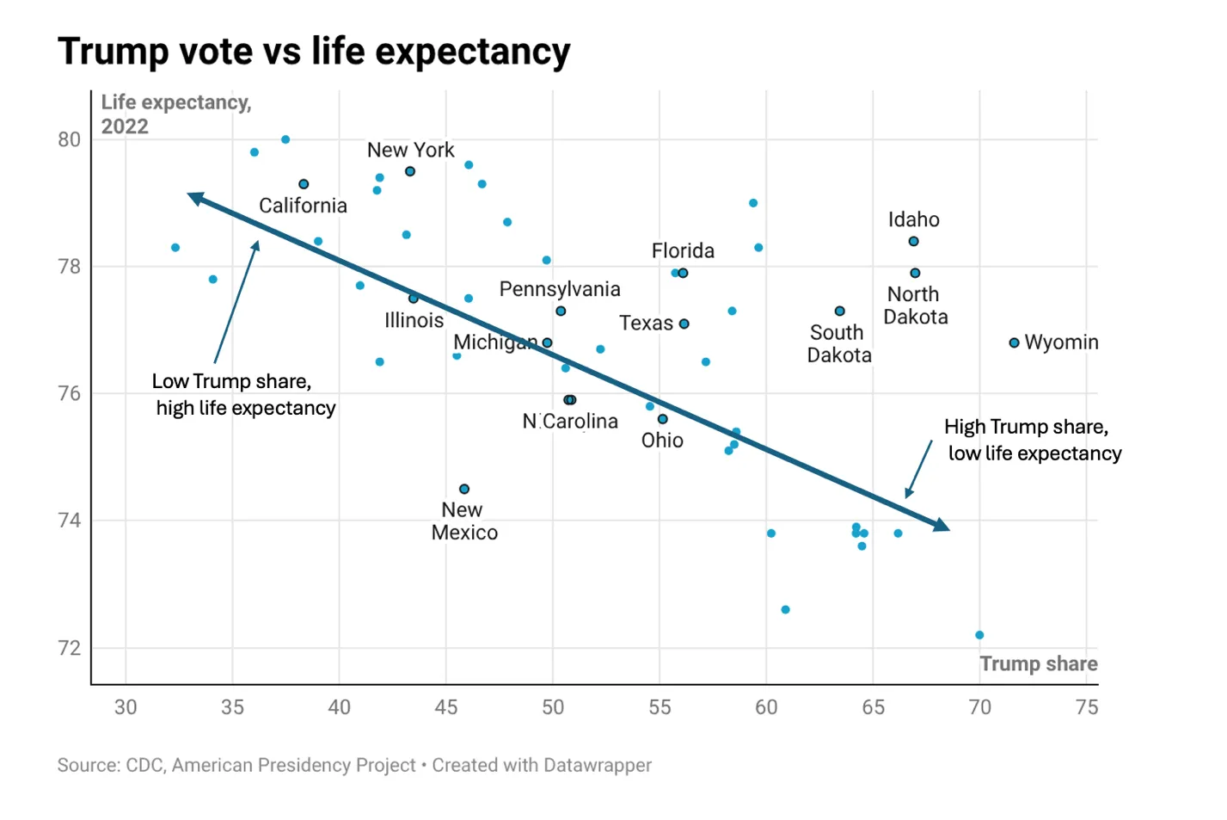

Slide 99
Social Murder
Botching of coronavirus pandemic (US deaths could have been 40% lower had our rates mirrored those of other high-income nations, meaning 180,000 fewer lives lost – Lancet, 2-10-2021)

Slide 100
Social Murder
Extremely conservative estimate (JAMA 2018;319:2261-2) is that Trump environmental agenda will lead to 80,000 extra deaths/decade and respiratory problems for many more than 1 million people
Updated ProPublica study (https://www.propublica.org/article/trump-climate-rollbacks-heat-deaths - 2025) estimates 1.3 million additional temperature-related deaths over the next decade

Slide 101
Words of Wisdom
“Lies are cheap, the truth takes hard work”
“Nothing can keep (government) right but (the people’s) vigilant and distrustful superintendence” – Thomas Jefferson
“A nation of sheep will beget a government of wolves” – Edward R Murrow

Slide 102
Religion in the U.S.
85% of US citizens call themselves Christian
Misinterpretation of the Bible common
  Only 40% of Americans can name more than 4 of the 10 commandments
  50% can cite any of the four authors of the Gospels
  12% believe Joan of Arc was Noah’s wife
Literal reading of Bible verses promotes magical thinking, misogyny, and discrimination

Slide 103
Disturbing Bible Quotes
Non-virgins should be stoned – Deuteronomy 22:20-21
If you disobey God, you will eat your babies – Leviticus 26:27-30
No bastards may enter the church – Deuteronomy 23:2
Cursing at your parents warrants death – Leviticus 20:9

Slide 104
Religion in the U.S.
“Most Americans have replaced the Christianity of the Bible, with its call for deep sharing and personal sacrifice, with competing creeds”
  Bill McKibben
  Stress personal responsibility over collective action and celebrate financial success
  75% believe the Bible teaches that “God helps those who help themselves” (Ben Franklin)

Slide 105
Defrauding and Undermining Trust in Democracy Via Election Rigging (Sci Am, Sept, 2019, 67-71)
Attempted Russian interference in 2016 and 2018 elections
  Russia and China in 2020
40 states use voting machines over a decade old, with outdated, easily hackable software
25 states do not have complete paper trails; 38 states do not require post-election audit prior to certification of results
Ballot design outsourced to just a few vendors (e.g., one company programs machines for 2,000 jurisdictions across 34 states from a central location)

Slide 106
Defrauding and Undermining Trust in Democracy Via Election Rigging (Sci Am, Sept, 2019, 67-71)
Possible Outcomes of Interference:
  Small changes in vote counts could swing elections and be statistically similar to polling results, especially with gerrymandering
  Real-time manipulation of machines in just one state could swing presidential election without being recognized
  Malicious code disabling voting machines on election day, requiring another election

Slide 107
Defrauding and Undermining Trust in Democracy Via Election Rigging (Sci Am, Sept, 2019, 67-71)
Imagine the consequences of false election results coming out after a new administration is in power
What if nation-state that engineered false results then blackmails president?
Only few hundred million dollars needed to safeguard elections with mandated paper trails

Slide 108
Manipulating Elections in Plain Site
Voter Restriction Measures:
  Purging voter rolls of those who have not recently voted
  Photo ID requirements
  Limits on number of polling sites and poll hours
  Elimination of Sunday voting
  Long waits
  Limits on early voting

Slide 109
Manipulating Elections in Plain Site
Voter Restriction Measures:
  Requiring college students to vote in their parents’ (not their campus’) precincts
  Gerrymandering districts
  Intimidation and trickery

Slide 110
Manipulating Elections in Plain Site
Stated aim: eliminate voter fraud
  Yet, between 2000 and 2010: 643 million ballots cast in general elections, 441 killed by lightning, 13 credible cases of in-person voter impersonation
  Recent study of 146 million registered voters found 10 cases of voter impersonation
  No voter fraud in 2020 presidential election except a few attempts by Trump supporters
Result: disenfranchisement of tens of millions of voters, mostly poor, elderly, racial minorities, and college students

Slide 111
Solutions
Increase funding of public education, higher salaries for teachers
Independent scientific review of school curricula
Accurate health curricula, especially sex education
Stronger, better funded public health system

Slide 112
Solutions
Campaign finance reform
Greater public participation in democracy, research funding and agenda setting, and scientific decision-making
Limits on corporate power
Higher standards of journalism and cooperation of scientists with journalists
Limits on social media

Slide 113
Solutions
Recognition of personal biases, common fallacies, how to spot fake news –including required courses and integration into all subjects
Combats Dunning-Kruger Effect (“ignorance begets confidence”)

Slide 114
Evaluating Potential Fake News
Who is making claim? Credentials? Motives?
Premises of claim? Flaws?
Own assumptions? Flawed?
Alternative explanations? Consider the opposite
Evidence for claim?
Seek further information
Cross check on fact-checking websites (Snopes, Politifact, TruthOrFiction.com)

Slide 115
Solutions
Safeguard elections
Safeguard democracy
Active resistance from people and institutions
Otherwise, pseudoscience, fake news, lies from those in authority, trials without witnesses, pardons of serious felons who happen to be major political donors, complicity by representatives with a narcissistic sociopath, and unsecured elections will undermine our faith in the basic institutions of civil government and, ultimately, destroy our country from within

Slide 116
Words of Wisdom
“The most common way people give up their power is by thinking they don’t have any” – Award-winning writer Alice Walker
“I am no longer accepting the things I cannot change. I am changing the things I cannot accept.” – Activist Angela Davis

Slide 117
African Proverb
If you think you are too small to have an impact, try going to bed with a mosquito in your tent

Slide 118
Public Health and Social Justice Website
http://www.publichealthandsocialjustice.org
or
http://www.phsj.org
Prescription for Justice
TV, YouTube, KBOO Radio
Martin Donohoe
martindonohoe@phsj.org

