Slide 1
Scans and Scams:
Necessary and Unnecessary Screening Tests
Martin Donohoe

Slide 2
Outline
Evidence-based screening
Appropriate and unnecessary testing
Risks of unnecessary testing
Unnecessary testing and luxury care
Recognizing health scams
Current pseudoscience / anti-science
Conclusions and Suggestions

Slide 3
Criteria for Evidence-Based Screening
Disease reasonably common, significantly affects duration and/or quality of life
Existence of acceptable, effective treatment(s)
Asymptomatic period during which detection and treatment can improve outcome
Treatment during asymptomatic period superior to treatment once symptoms appear
Test safe, affordable, adequate sensitivity and specificity

Slide 4
Evidence-Based Screening: Examples
Blood pressure monitoring (age>21)
Cholesterol tests (ages 35-65)
Oral glucose tolerance testing during pregnancy
HPV testing/Pap smears
  But much overuse, 75% of annual cervical cancer screenings unnecessary in one study
  HPV vaccine uptake 60% (2023)

Slide 5
Evidence-Based Screening: Examples
Mammography (biennial age 40-74)
  May decrease death rate from breast cancer by up to 20% (but no change on all-cause mortality)
  FDA requirement and profusion of breast density laws (requiring notification of benefits and/or coverage of costs of adjunctive ultrasound in women with dense breasts)
    Supplemental MRI may be recommended (better than US)
  ½ of American women have at least one false alarm over 10 yrs

Slide 6
Cost-Saving Interventions
One time colonoscopy (age for first screening now 45, due to increasing numbers of cases in younger patients)
Condom distribution
Safety belt laws
Hip protectors for elderly women at risk for falls
Streetlights

Slide 7
Low Cost/QALY Interventions
HIV testing of donated blood
Most immunizations
Pap/HPV screening
Screening for DM2 and DM retinopathy
Smoking cessation education

Slide 8
Low Cost/QALY Interventions
Air bags in autos
Restrictions on cell phone use in cars
Publicly-accessible automated external defibrillators
Suicide prevention programs

Slide 9
Underuse of Appropriate Screening Tests
Most Americans do not get recommended preventive tests (which are covered under PPACA)
Cancer screening rates higher than almost every other country, yet still inadequate:
  Breast cancer: 80%
  Cervical cancer: 75%
  Colorectal cancer: 67%
  Lung cancer: 20%
Paid sick leave associated with higher screening rates
Higher out-of-pocket costs decrease screening rates

Slide 10
Excessive Phlebotomy of Hospitalized Patients
Phlebotomy can cause patient discomfort, sleep deprivation, and hospital-acquired anemia (although only in certain patient populations), sometimes leading to additional testing, prolonged hospitalizations, unnecessary transfusions, and increased mortality for patients with cardiopulmonary diseases
  Actual effect on overall costs low

Slide 11
Preoperative/Routine Screening Tests Overutilized/Rarely Helpful (UptoDate)
Routine preoperative laboratory tests have not been shown to improve patient outcomes among healthy patients undergoing surgery
  85% unnecessary in one study
Routine testing in healthy patients has poor predictive value, leading to false-positive test results and/or increased medicolegal risk for not following up on abnormal test results

Slide 12
Recommendations for Preoperative ScreeningTests (UptoDate)
Baseline Hg for patients 65 or older who are undergoing major surgery and for younger patients undergoing surgery that is expected to result in significant blood loss (not necessary for younger patients undergoing minor surgery unless the history suggests anemia)

Slide 13
Recommendations for Preoperative ScreeningTests (UptoDate)
Do not check electrolytes, blood glucose, liver function, hemostasis, or urinalysis in the healthy preoperative patient
Check pregnancy test in all reproductive age women prior to surgery, rather than using history alone to determine pregnancy status

Slide 14
Recommendations for Preoperative ScreeningTests (UptoDate)
Do not check Cr, except:
  For patients over 50 undergoing intermediate or high-risk surgery
  For younger patients suspected of having renal disease
  When hypotension is likely during surgery
  When nephrotoxic medications will be used

Slide 15
Recommendations for Preoperative ScreeningTests (UptoDate)
Do not ordering an EKG for asymptomatic patients undergoing low-risk surgical procedures (consider for average risk operations)
Check EKG in patients with known CAD, significant arrhythmia, PAD, cerebrovascular disease, or other significant structural heart disease, except for those undergoing low-risk surgery

Slide 16
Recommendations for Preoperative ScreeningTests (UptoDate)
Do not order routine preoperative CXRs or PFTs in healthy patients
Obtain preoperative CXR in patients with cardiopulmonary disease and those older than 50 years of age who are undergoing abdominal aortic aneurysm surgery or upper abdominal/thoracic surgery

Slide 17
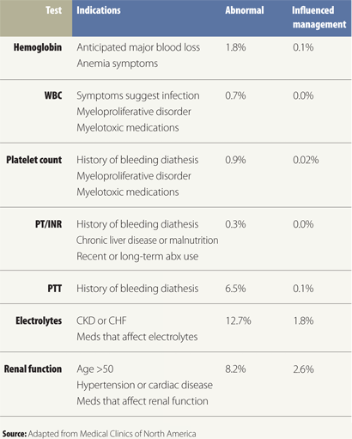
Preoperative Tests Before Elective Surgery

Slide 18
Unnecessary Testing
Early radiography for non-specific LBP
Annual EKGs on low risk patients without symptoms
Pre-op CXRs on patients with unremarkable H and Ps
Brain imaging with simple syncope or migraine and normal neurological exam
  Unnecessary brain imaging for primary headache disorders costs over $1 billion/yr

Slide 19
Unnecessary Testing
Too frequent colonoscopies, Pap tests, ovarian cancer screenings
46% to 74% of typical cancer screenings in patients above age cutoffs
  Age 75 for colorectal cancer, 74 for breast cancer, 65 for cervical cancer
Routine subspecialty visits
See “Choosing Wisely” (ABIM Foundation)

Slide 20
Unnecessary Testing
Routine fetal ultrasonography
  Average number required = 2 (conservative estimate shows current number over 5)
  Keepsake ultrasounds: $27 to $200
  Tom Cruise/Katie Holmes personal US machine (cost $15,000 - $200,000) for daily use

Slide 21
Unnecessary Testing
Routine fetal ultrasonography
  Vertebrate data suggest prolonged and frequent use of fetal US can cause fetal anomalies (heats tissues, produces tiny bubbles/cavities)
  Keepsake ultrasounds focus on face, could affect brain development
  FDA: “unapproved use of a medical device”
    May also violate state laws and regulations

Slide 22
Diagnostic Errors
Arise in 10%-15% of patient encounters
Time constraints during diagnostic process = factor that most hinders physicians’ ability to make diagnosis

Slide 23
Diagnostic Yield: Utility and Reimbursement
Diagnostic yield
  History = 75%
  Physical exam = 10-15%
  Testing = 10%
US reimbursement system financially incentivizes in reverse order
14% of cancers found through screening
  Multicancer detection kits may dramatically increase

Slide 24
Overuse
Overuse of diagnostic tests, medications, and therapeutic procedures
  $765 billion wasted annually
    $210 billion on unnecessary testing alone
    Unnecessary testing causes up to 30,000 deaths/yr

Slide 25
Overuse of Diagnostic Testing
Lake Wobegon Effect
  Most “average” patients are at below average risk (i.e., median risk is below average risk)
  Thus, for many interventions, expected benefit is lower for “average” patients

Slide 26
Overuse of Diagnostic Testing
Patients report higher satisfaction with care when x-rayed and/or scanned
  But symptoms may not decrease
Patients overestimate benefits of testing, underestimate risks of harm
Physicians eager to please
But continuity of care associated with decreased overuse

Slide 27
Wasteful Healthcare Spending
Estimated cost of excessive medications, labs, and radiographic procedures = $200 - $250 billion (imaging $100 billion+)
50-70% of physicians acknowledge ordering unnecessary tests or procedures at least once per week

Slide 28
Wasteful Healthcare Spending
Defensive medicine accounts for estimated 1/5 CT scans; inaccessibility of prior studies another 1/5
Adding diagnostic tests supports upcoding for hospitalizations and clinic visits, thus increasing costs/reimbursement
Physicians paid per procedure order more procedures than physicians paid on capitation basis

Slide 29
Wasteful Healthcare Spending
Oncologists reimbursed for administering chemotherapy administer more (and more expensive) agents
Estimated $800 billion (1/3 of all healthcare spending) wasted in unnecessary diagnostic tests, procedures and extra days in the hospital
  EHRs lead to increased testing

Slide 30
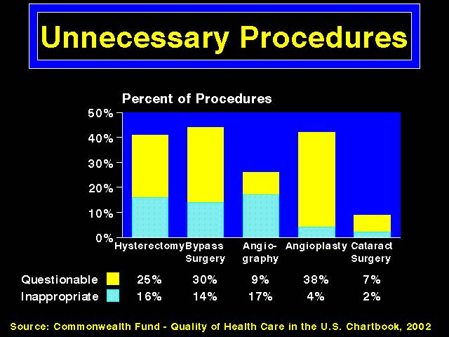
Unnecessary Procedures

Slide 31
Most Common Low Value Surgeries
Lown Institute, 2020 Data
Stents for stable CAD
Vertebroplasty for osteoporosis
Hysterectomy for benign disease
Spinal fusion for back pain
Inferior vena cava filter
Carotid endarterectomy
Renal stent
Knee arthroscopy

Slide 32
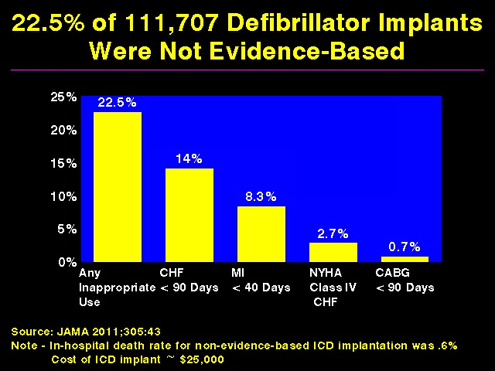

Slide 33
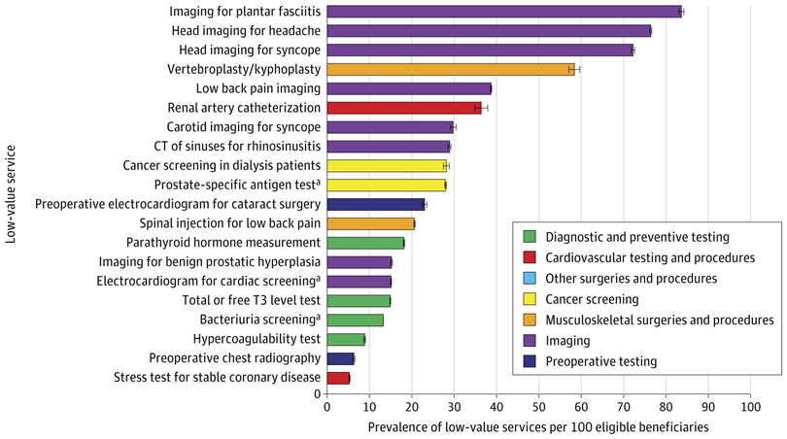
Top 20 Most Prevalent Low-Value Services Among Medicare Beneficiaries, 2018-2020 JAMA Health Forum | Vol. 6, No. 8

Slide 34
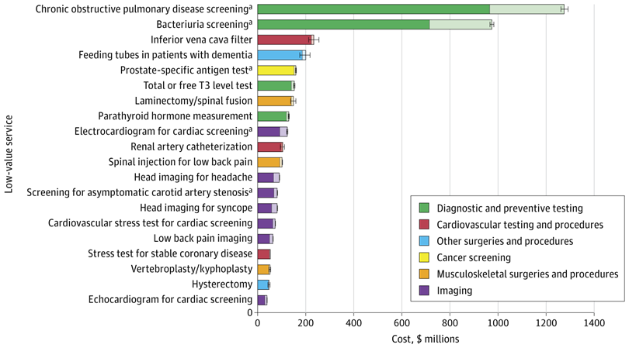
Potential Annual Savings Associated With Top 20 Low-Value Services Among Medicare Beneficiaries
JAMA Health Forum | Vol. 6, No. 8

Slide 35
Full Body CT Scans
Popularity increased after Oprah Winfrey underwent testing in 2001
Self-referral body imaging centers proliferating
Highly profitable

Slide 36
Full Body CT Scans
Typical costs for full body CT scans $1000-$2000
2004 survey of 500 Americans
  85% would choose a full-body CT scan over $1000 cash
2005 study:
  86% of patients had at least one abnormality
  Mean = 3 abnormal findings per patient

Slide 37
Full Body MRIs
2020s: increasing popularity - social media blitz (e.g., Kim Kardashian)
  $2500/scan
  Over 100,000 screened
  1-2/100 show cancer
    Most of these either low risk or advanced
    No evidence of improved health or mortality benefit
    Possibility of harms
Not recommended

Slide 38
Full Body CT Scans are Opposed by
FDA
AMA
ACR
ACC
ACS
AHA
Many other professional organizations

Slide 39
Marketing Scans
Companies market in areas of higher SES, including via Groupon discount coupons
Prey on fear of heart disease and cancer, and on the natural desire to detect health problems early in hopes of achieving a cure, or at least avoiding potentially disfiguring or toxic therapies
Some companies offering SPECT brain scans to diagnose and manage neuropsychiatric problems (including to children)

Slide 40
Radiologic Imaging
691 million radiology exams/yr in US (2016, most recent data available as of 2026)
  74 million CT scans
  13.5 million nuclear medicine exams
  45 million mammograms
  275 million conventional radiographic and fluoroscopic procedures

Slide 41
Radiologic Imaging
Overall cost $130 to $150 billion/yr in US
  9% of hospital operating costs
  6-7% of personal health care costs
  Includes all forms of imaging plus facility fees and professional costs
  Fastest growing component of medical costs (#2 = pharmaceuticals)

Slide 42
Radiologic Imaging
Utilization driven by introduction of new technologies, new uses for existing technologies, self-referral, patient demand, and defensive medicine
FDA estimates 30%-50% of imaging tests unnecessary
Some data show defensive medicine might be effective against malpractice suits

Slide 43
Changes in Radiologic Imaging
1996-2010
Radiography: 1.2% annual increase
Angiography/flouroscopy: 1.3% annual increase
Nuclear medicine: 3% annual decrease
Ultrasonography: 3.9% annual increase
  Use doubled
CT scans: Use quadrupled
  Decrease in all noninvasive diagnostic imaging and in CT scans noted 2010-2015

Slide 44
Increases in Radiologic Imaging, 2000-2016
Scans per 1,000, U.S. / Ontario, Canada
Ultrasound: 324 to 495 / 332 to 580
CT: 204 to 428 / 161 to 409
MRI: 62 to 139 / 13 to 89

Slide 45
Radiologic Imaging in the U.S.
2019
245 CT scans / 1,000 people (215 in 2013)
118 MRIs / 1,000 people (91 in 2013; Canada less than half this)

Slide 46
Radiologic Imaging is Expensive
Institute of Medicine estimates $30 billion wasted annually on unnecessary imaging (2012)
Adding a CT scan to an ER visit (for any cause) can double Medicare reimbursement

Slide 47
Radiologic Imaging is Expensive
93 million CT scans performed in 62 million patients 2023
Compared to 2.7 million in 1995; 69 million in 2007; and 74 million in 2016
  Estimated that 40% unnecessary
  Number of preventable duplicates very low per one study

Slide 48
Radiologic Imaging is Expensive
Overall Medicare imaging costs more than doubled from 2000-2006 (to $14 billion)
  2009 costs down to $12 billion
Use of CT scans for ER patients with respiratory symptoms quadrupled between 2001 and 2010 with no measurable clinical benefit

Slide 49
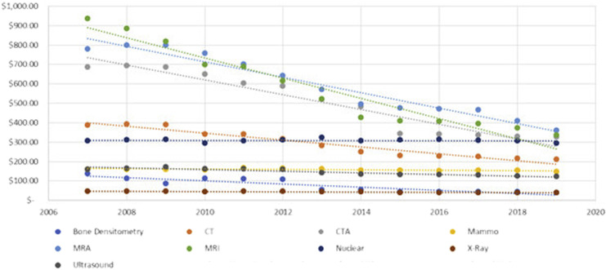
Mean adjusted Medicare national reimbursement rates by imaging modality from 2007 to 2019

Slide 50
Benefits of Diagnostic CT scans
Decreased cancer mortality
Decreases in exploratory surgeries
Decreased time to triage of patients, especially trauma patients

Slide 51
?Value of Radiologic Imaging?
Lumbar spine imaging for uncomplicated lower back pain (i.e., no significant trauma, fever, steroids IVDU, etc.) very common but without benefit

Slide 52
?Value of Radiologic Imaging?
CT/MRI ordered in 6% of ER visits in 1998; 15% in 2007; 27% in 2019 (MRI in 1.8% of ER visits in 2019)
  Most common reasons = flank pain, AP, HA
    CT scans solely for HA rarely influence management or outcome (CA risk from scan approximately 1/20,000)

Slide 53
?Value of Radiologic Imaging?
However, no change in percent of patients admitted to hospital or to ICU
1/3 show incidental findings (most of which are not reported to patients)
Having a PCP significantly reduces the odds of ER visit imaging

Slide 54
?Value of Radiologic Imaging?
Use of head CT and MRI for headache almost doubled between 1990 and 2000, use remains high
  10% of ER visits involve a head CT, leading to a neurological diagnosis in 1/5 cases
Use of CT for dizziness in ER up from 10% of visits (1995) to 25% of visits (2004) without increase in CNS diagnoses
25% of CT and MRI studies at one academic institution unnecessary

Slide 55
?Value of Radiologic Imaging?
1/3 of the 4.25 million CT scans performed each year on children felt to be unnecessary
  Will result in est. 4,870 cancers
  ¼ pediatric patients with isolated headache gets at least one head CT (minimal yield, dangerous)

Slide 56
“Epidemic” of Thyroid Cancer in Korea, US
100-fold increase over less than one decade in one study; another estimated overdiagnosis of cancer = 20%
May be due to widespread screening
Exposure to flame retardants (ubiquitous in household furnishings) another contributor
Entire increase due to detection of papillary thyroid CA (up to 1/3 of adults may harbor small papillary thyroid CAs)
  However, these are associated with exposure to flame retardants (ubiquitous)

Slide 57
“Epidemic” of Thyroid Cancer in Korea, US
Mortality rate unchanged
Of those undergoing surgery, 11% developed hypoparathyroidism, 2% vocal cord paralysis
USPSTF recommends against screening asymptomative adults

Slide 58
Thyroid Nodules
Found in up to 75% of thyroid ultrasounds, 25% of contrast-enhanced chest CT scans, 5%-18% of neck CT and MRI scans
For nodules found by CT or MRI, evaluate further with US if suspicious features (e.g., local invasion or cervical lymphadenopathy)

Slide 59
Thyroid Nodules
For nodules found by CT or MRI, if no suspicious features:
  Nodules ≥ 1.0 cm in patients < 35 yo, and nodules ≥ 1.5 cm in patients > 35 yo should be evaluated with US
  Purely cystic nodules have < 1% risk of malignancy, require no bx or further w/u

Slide 60
Radiologic Imaging is Expensive
U.S. physicians order 7 times more CT scans than UK doctors (3X French doctors, 2X German doctors)
US has almost twice the number of MRI machines per capita than any other country except for Japan
Many CT/MRI/other scans ordered because of defensive medicine
Radiology benefits managers

Slide 61
Radiologic Imaging is Profitable
1/6 physician practices owns advanced imaging equipment (CT and/or MRI)
  “medical arms race”
Cardiologists/vascular surgeons earn 36%/19% of their Medicare revenue from in-office imaging
  Installation of CT scanners in US cardiology practices tripled between 2006 and 2008

Slide 62
Radiologic Imaging is Profitable
Screening CT coronary angiography now a Medicare covered benefit in all 50 states
Medicare covers LDCT lung cancer screening in high risk patients; Medicaid coverage spotty
Device manufacturers strong lobby

Slide 63
Radiologic Imaging is Profitable
Ownership of scanners by physicians growing dramatically
  FDA now requires physicians to declare ownership of imaging devices/facilities to patients
Physicians who self-refer for scans conduct twice as many imaging procedures

Slide 64
Radiologic Imaging is Profitable
Physicians with a financial stake in radiology clinics or who own scanners order substantially more scans (often when outside scan already completed)
  E.g., orthopedic surgeons with a financial interest in an MRI scanner have 86% higher rate of negative scans
2011: CO fined Heart Check America $3.2 million for conducting coronary CT scans on patients without appropriate physician referrals

Slide 65
Radiologic Imaging is Expensive
Texas state law requires health insurers to cover costs of screening CT coronary angiograms and carotid ultrasounds
  ACC supported, AHA did not take a stand
  Based on SHAPE guidelines sponsored by Pfizer (not peer-reviewed)
  No peer-reviewed evidence that carotid ultrasound screening of asymptomatic individuals lowers ipsilateral stroke rate (may actually cause more harm than good)
Florida considering similar law

Slide 66
Radiation Exposure
[in mSv (1 mSv = 100 mREM)]
Average Whole Body Radiation Exposure in U.S. : 6.2
Worker exposure (mSv/yr over background):
  Airline pilot and crew = 3.1
  Nuclear power plant worker = 1.9
  Astronaut on space station = 72

Slide 67
Airport and Other Scanners
Previously used backscatter
Minimal exposure for most
Some concerns re quality and consistency of scanners
Scanners also used in prisons (10-50X radiation dose, but still very small)

Slide 68
Airport and Other Scanners
Airport X-ray scanners banned in Europe (radiofrequency, or millimeter wave, scanners used instead)
U.S. airports have transitioned to mm wave scanners
  use radio waves, so no ionizing radiation
  higher false positive rate
TSA can mandate scan, even if traveler asks to opt out and get full-body pat-down instead

Slide 69
Airport and Other Scanners
Drive-by X-ray scanners being used in NYC at special events and during street patrols
See slide show on physician drug testing and privacy on phsj website for more details

Slide 70
Radiation Exposure
Most data on radiation risk involves whole body exposure (e.g., Hiroshima and Nagasaki)
Effective dose (whole body dose) used to estimate cancer risks, rather than locally absorbed dose

Slide 71
Effective Radiation Dose to Entire Body in mSV (1 mSv = 100 mREM)
Annual background radiation in U.S. = 3-4 (can be as high as 20 if altitude and radon-heavy soil exposure included)
Maximum allowable occupational exposure to radiation workers = 50

Slide 72
Effective Radiation Dose to Entire Body in mSV (1 mSv = 100 mREM)
Airport scanner = 0.0001
Domestic airline flight (5 hrs) = 0.0165
Smoking (1ppd x 1 yr) = 0.36 (may be higher due to polonium in cigarettes)

Slide 73
Effective Radiation Dose to Entire Body in mSV (1 mSv = 100 mREM)
Extremity XR, bone density scan = 0.001
Dental XR = 0.005
CXR = 0.02
Mammogram = 0.4
Abdominal XR = 0.7
Lumbar spine XR = 1.5

Slide 74
Effective Radiation Dose to Entire Body in mSV (1 mSv = 100 mREM)
Head CT = 2
Chest CT = 7
Low dose Chest CT = 1.5
CTPA = 10-15
V/Q scan = 2
Bone scan = 4
Abdominal CT = 8
Pelvic CT = 6

Slide 75
Effective Radiation Dose to Entire Body in mSV (1 mSv = 100 mREM)
CT coronary artery calcium testing = 3
Diagnostic cardiac catheterization = 11.4
Myocardial perfusion study = 14 (20% higher dose than used in most other countries, without any additional benefit)
Percutaneous Coronary Intervention = 15
CT coronary angiography = 16
Whole body CT = 50 - 100

Slide 76
Effective Radiation Dose
Adding additional phases (e.g., arterial/venous) increases effective dose)
Multiple scans common in patients with both acute and chronic conditions
  E.g., MI patients undergo an average of 15 radiographic procedures, and 1/3 receives > 100 mSv

Slide 77
Cancer Risk from Radiographic Imaging
Could cause up to 2% of cancer deaths within 2-3 decades
Projected 29,000 excess cancers due to the 72 million CT scans (necessary and unnecessary) performed in 2007
2023 data shows estimated 103,000 radiation-induced cancers from CT exposure
For every 10 mSv exposure, cancer risk increased by 3% over 5 yrs
Compared with a 40 yr old pt, a 20 yr old has double and a 60 yr old has ½ the risk of CA from a single imaging test

Slide 78
Cancer Risk from Radiographic Imaging
Those with chronic illnesses at higher risk
Females at higher risk due (combination of organ-specific radiosensitivity and statistically longer lifespan)
Skin, breasts, thyroid most vulnerable

Slide 79
Cancer Risk from Radiographic Imaging
Scans of children, serial scans carry higher risks
Average U.S. child undergoes 8 imaging procedures by age 18 (85% radiographs, 8% CT scans)
  Childhood CT scans increase risk for leukemia and brain cancer

Slide 80
Cancer Risk from Radiographic Imaging
Risk of CA from abdominal CT scan ranges from 1/300 to 1/2,000 – yet such scans can decrease admissions from ER by 18%
Estimates for CT coronary angiography lower, however many patients undergo multiple procedures
Thyroid shielding recommended for all CT and angiographic procedures

Slide 81
Risks of Screening CT Scans
Physicians and general public unaware of amounts of radiation (and risks) involved
  ?Adequacy of informed consent?
1/3 of scans avoidable or could be replaced by ultrasounds or MRIs
Possible benefit is pinpointing patients with low BMD / higher fracture risk

Slide 82
Other Risks of CT Scans
False positive findings: ¼
Intravenous contrast-induced renal failure: 1/150 (14% risk of AKI)
  1/500 of these fatal
Intravenous contrast-induced severe allergic reaction: 1/5,000 (1/500 if history of asthma)

Slide 83
Beware
Radiation doses from CT scanners may be highly variable between institutions and cases of faulty CT scanners delivering dangerous doses have been reported
Except for mammography, there are no federal guidelines regarding radiation doses

Slide 84
Medical Imaging and Radiation Exposure
1950s: Radiation dose from CXR 20X larger than today
1980: Medical imaging responsible for 15% of U.S. radiation exposure
2010: 50% (30% from cardiac imaging)
  Defensive medicine, high tech approaches contribute
1/270-4,000 women and 1/600-13,500 men will develop cancer from a single heart scan (vs. 1/3 lifetime risk of developing cancer)

Slide 85
Medical Imaging and Radiation Exposure
2010: FDA launches initiative to reduce unnecessary radiation from medical imaging
Studies suggest most CT radiation could be reduced 50% without loss of image utility
Newer machines deliver lower radiation doses without compromising image quality
  Infant and child settings available

Slide 86
Trauma Patients
Pan scans for trauma patients (head to pubic symphysis) expose patients to 20 mSv or more (double the amount that would cause 1 future cancer in 1,000 40 yr old adults
More focused scans for trauma patients safe and effective

Slide 87
Medical Imaging and Radiation Exposure
Peer feedback and clinical decision support systems reduce physician overuse of radiographic testing
Patients’ radiation exposure should be measure and tracked
  CA law requires all hospitals to keep electronic database (2012); other states considering similar laws

Slide 88
Possible Benefits of Coronary CT Scans
May be somewhat helpful in intermediate risk patients (additive to Framingham Risk Score)
  AHA/ACC recommend consideration of use if uncertainty whether or not cholesterol-lowering therapy needed
In low to intermediate risk ER patients with CP, CT coronary angiography (in combination with EKGs and cardiac enzymes) can lead to earlier discharge and decrease length of stay and hospital charges and higher rates of detection of CAD

Slide 89
Possible Benefits of Coronary CT Scans
Meta-analysis (JAMA Int Med 2017;177(11):1623-31) with mean f/u of 13 months showed that compared with functional stress testing, CCTA is associated with:
  Reduced incidence of MI
  Increased incidence of invasive coronary angiography, revascularization, CAD diagnoses, and new prescriptions for ASA and statins
  However, no associated reduction in mortality or cardiac hospitalizations

Slide 90
Possible Benefits of Coronary CT Scans
4-year study screening asymptomatic diabetes showed increase in aggressiveness of therapy, but little effect on mortality or nonfatal cardiovascular events

Slide 91
Risks of Coronary CT Scans
CT coronary angiography the equivalent of 600 CXRs
  CT coronary artery calcium testing involves much less radiation 3 mSv vs. 16 mSv effective dose)
May increase risk of heart disease
Can cause implanted medical devices to malfunction
Mean radiation dose much higher in low- and lower-middle-income countries

Slide 92
CT Pulmonary Angiography
Only 3% of ER CTPA scans done for suspicion of pulmonary embolus are positive for a PE
  Only 45% recommended by guidelines
  Overdiagnosis of low-risk subsegmental Pes
    Dx of PEs up 80% from 2001-2008, without increased mortality
    5.3% of those anticoagulated for subsegmental PEs experience bleeding; only 0.7% experience recurrence

Slide 93
CT Pulmonary Angiography
5X the radiation exposure compared to V/Q scan
Consider V/Q scanning when CXR normal

Slide 94
Screening with CXRs/CT scans for Lung Cancer
Annual CXR screening for lung cancer does not reduce lung cancer mortality (PLCO trial, subjects included current, former, and non-smokers, mostly the latter)
International Early Lung Cancer Action Program (non-randomized) showed benefit of CT screening, but follow-up non-randomized study showed no benefit

Slide 95
Screening Smokers with CT scans for Lung Cancer
Screening all current and former smokers in the United States for lung cancer with a CT scan would identify more than 180 million lung nodules, the vast majority of which would be benign
  Millions of patients with nodules could needlessly undergo invasive needle lung biopsies and/or removal of parts of their lungs, resulting in many cases of impaired breathing, pneumothorax, hemorrhage, infection, and even death

Slide 96
National Lung Screening Trial (NLST)
Asymptomatic patients age 55-74 with at least 30 pack-yr history of smoking
3-year study, one scan per year
More cancers identified with low dose helical CT than CXR (control) and decrease in lung cancer and all-cause mortality (7%, or 1/300 individuals screened)

Slide 97
National Lung Screening Trial (NLST)
CXR
  Sensitivity = 74%
  Specificity = 91%
Low-dose CT:
  1.5 mSv (vs. 7 mSv for regular chest CT)
  Sensitivity = 94%
  Specificity = 73%
  PPV less than CXR but more sensitive in detecting early-stage cancers

Slide 98
National Lung Screening Trial (NLST)
8.6 million Americans eligible for screening
12,250 deaths could be delayed or prevented annually (7% of lung cancer deaths)
Almost 20% of identified lung cancers indolent (overdiagnosis)

Slide 99
Low-dose CT for Lung Cancer Screening
LDCT now recommended by ACS/ALA/ACCP/NCCN/ for current or former smokers age 55-80 with a smoking history of at least 20 pack-years and who currently smoke or quit within the past 15 years, and who have good life expectancy and are able and willing to have potentially curative lung surgery
The number of cancers avoided by quitting smoking equals the number of lives saved by lung cancer screening

Slide 100
Low-dose CT for Lung Cancer Screening
2015: CMS will cover, despite advisory committee opposition
2015: 6.8 million smokers eligible for LDCT
  Only 263,700 received it (3.9%, 2015); 2% (2016); 1%-2% (2017)
  ?Due in part to ostrich effect? (common for colorectal cancer screening)
2018: only 4.2% of eligible patients screened
2022: up to 18%

Slide 101
Low-dose CT for Lung Cancer Screening
2021: USPTF lowers age to 50, smoking hx to 20 pack-yrs (additional 14.5 million adults now eligible)
  More African-Americans now eligible (have lower rates of smoking but higher rates of lung CA)
2021: 1.4 million US adults eligible, only 5.8% screened
2025: 20% screened

Slide 102
2021 c/w 2013 USPTF Recommendations
22% vs 14% of population “ever eligible”
Lung cancer deaths averted 514/100K vs 381/100K
Life yrs gained 6807/100K vs 4882/100K
False positives 2.2/person screened vs 1.9/person screened
Overdiagnosed lung CA cases 88/100K vs 69/100K
Radiation-related lung CA deaths 36/100K vs 21/100K
JAMA 2021:988

Slide 103
Low-dose CT for Lung Cancer Screening
NNS to prevent 1 lung cancer death = 194-330
NNH = 1 lung cancer death/2,500 scans
20% of scans show nodules
  90% of these benign
Scans can show evidence of undiagnosed COPD and airflow obstruction
  Estimated 80% of individuals with COPD undiagnosed

Slide 104
Low-dose CT for Lung Cancer Screening
1-4% of abnormal scans lead to further procedures
4.3 harmful events per 10,000 population screened
Other study showed complication rates of 22%/24% for invasive diagnostic procedures for lung abnormalities in large national cohort of patients aged 55-64 and 65-77, with costs per complication ranging from $6,320 to $56,845
JAMA Int Med 179(3):324

Slide 105
Low-dose CT for Lung Cancer Screening
Contrast material not needed (one major reason scan orders denied)
  2022 critical shortage of contrast material; resolved
CXR and sputum cytology both considered ineffective for screening
AI may be more effective than radiologists at reading scans (fewer false positives and false negatives)

Slide 106
Low-dose CT for Lung Cancer Screening
Emphysema found in 39% of lung cancer screening participants (4/5 of these previously diagnosed)
20% of lung cancer patients never-smokers (vs. 9% in early 1990s)
  Possibly secondary to ETS, pollution, radon, particulate matter
Lung cancer mortality down 50% among men (1990 to 2017) and 26% among women (2002 to 2017)
  Mostly driven by decreases in smoking prevalence

Slide 107
Low-dose CT for Lung Cancer Screening
  Incremental cost/QALY $43,000 for current smokers
  $615,000 for former smokers
  $32,000 - $52,000 for those at high risk of lung cancer
  $123,000 to 269,000 for those at medium to low risk
  NEJM 2014:371;19:1798

Slide 108
Low-dose CT for Lung Cancer Screening
  Incremental cost/QALY
    Could be lower with enhanced risk-based screening (based on age, smoking history, race, sex, body mass index, education, family history of lung cancer, and whether the person has emphysema (JAMA 2017;315(21):2300)
  E.g., detection rates double in urban, largely black cohort (NLST)

Slide 109
Scientific and policy issues re NLST Trial and Screening (J Freeman, Med and Soc Justice Blog 11/10)
Cost of screening 30 million people per year = $12 billion ($400/CT) or $40/U.S. citizen/yr
Cost/life saved = $3 million
Multiple additional real and potential costs
Risks of CT scans, although Low Dose CT used (20% radiation compared with conventional CT)
?Quality of life of those “saved”?

Slide 110
Scientific and policy issues re NLST Trial and Screening (J Freeman, Med and Soc Justice Blog 11/10)
Study cost $250 million
    This amount could train 333 family physicians
The $12 billion implementation costs could be used to train 16,000 family physicians per year, which over 30 yrs would supply an adequate primary care workforce to cover the entire nation’s needs
Money could also be used for other needs (i.e., smoking cessation, etc.)

Slide 111
Low-dose CT for Lung Cancer Screening
2,000 high risk VA patients aged 55-80 screened with low-dose CT
Found lung CA in 1.5%
60% had abnormal scans (1 or more pulmonary nodules) – 98% false positives; 40% had other incidental findings
For every 1,000 persons scanned, 10 would be diagnosed with early-stage lung CA, 5 with late-stage lung CA, and 20 will undergo bronchoscopy and/or thoracotomy
  VHA Lung Cancer Screening Demonstration Project, JAMA Int Med 2017;177(3):399-406

Slide 112
Veterans Health Administration Experience (JAMA Intern Med. 2017;177(3):399-406)
4246 patients met criteria for LCS; 2106 screened
1257 patients (60%) had nodules; 1184 (56%) required tracking, 42 (2.0%) required further evaluation but the findings were not cancer, and 31 (1.5%) had lung cancer
Emphysema, other pulmonary abnormalities, and coronary artery calcification, were noted on the scans of 857 patients (41%)

Slide 113
Veterans Health Administration Experience (JAMA Intern Med. 2017;177(3):399-406)
302 false positive scans / 1 lung cancer death prevented in highest-risk quartile (NNS = 552)
Over 500 false-positive scans / 1 lung cancer death prevented in other quartiles

Slide 114
NELSON Study
N Engl J Med 2020;382:503-513
Randomized, controlled trial looked at 53,454 high-risk patients ages 55 to 74 years with at least a 30-pack-year history of smoking
To reduce the false-positive rate in NLST, Lung-RADS (Lung Imaging Reporting and Data System) raised the threshold for a positive screen from 4 mm to 6 mm for a nodule and required a size of at least 20 mm for ground-glass nodules

Slide 115
NELSON Study
9.3% of scans indeterminate
2.2% of scans positive, yielding 0.9% lung cancer detection rate
50% of cancers identified were stages IA
  Additional 19% IB
  70% of cancers stage III/IV in control arm
CT scanning decreased mortality by 26% in high-risk men and 39%-61% in high-risk women over 10-year f/u

Slide 116
Multicentric Italian Lung Detection (MILD) Study
Ann Oncol 2019; 30(7):1162
Annual or biennial screening of high-risk population for 6 years; 10 year followup
39% reduced risk of lung cancer mortality at 10 years; 20% non-significant reduction of overall mortality
Benefits continued through year 10

Slide 117
Increasing Inappropriate Use of LDCT Lung CA Screening
JAMA Int Med 2017:177(3):439-441
2010-2015: LDCT screening in pts meeting NLST criteria increased from 3.2% to 6.0% of eligible population (abs. inc. = 130,000 pts.)
LCS increased in pts. younger than 55 (0.9% to 4.9%, 65,000)
LCS increased in pts. who did not meet smoking criteria guidelines (2.1% to 3.8%, 204,000)

Slide 118
Guidelines Too Strict?
JAMA Network Open 2025;8(11)e2546222
Changing age range to 40-85 and including those with 10 or more pack yr history increases detection rate and could prevent an additional 26,124 deaths/yr
  $81,000/QALY
    $13,000 - $50,000 for breast cancer
    $10,000 - $40,000 for colon cancer screening

Slide 119
Lung Cancer
4700 cases/yr in adults under age 50
20,000 deaths/yr in never smokers
2025: Only 60% of Medicare beneficiaries with a positive lung cancer screening result received guideline-concordant diagnostic follow-up within one year

Slide 120
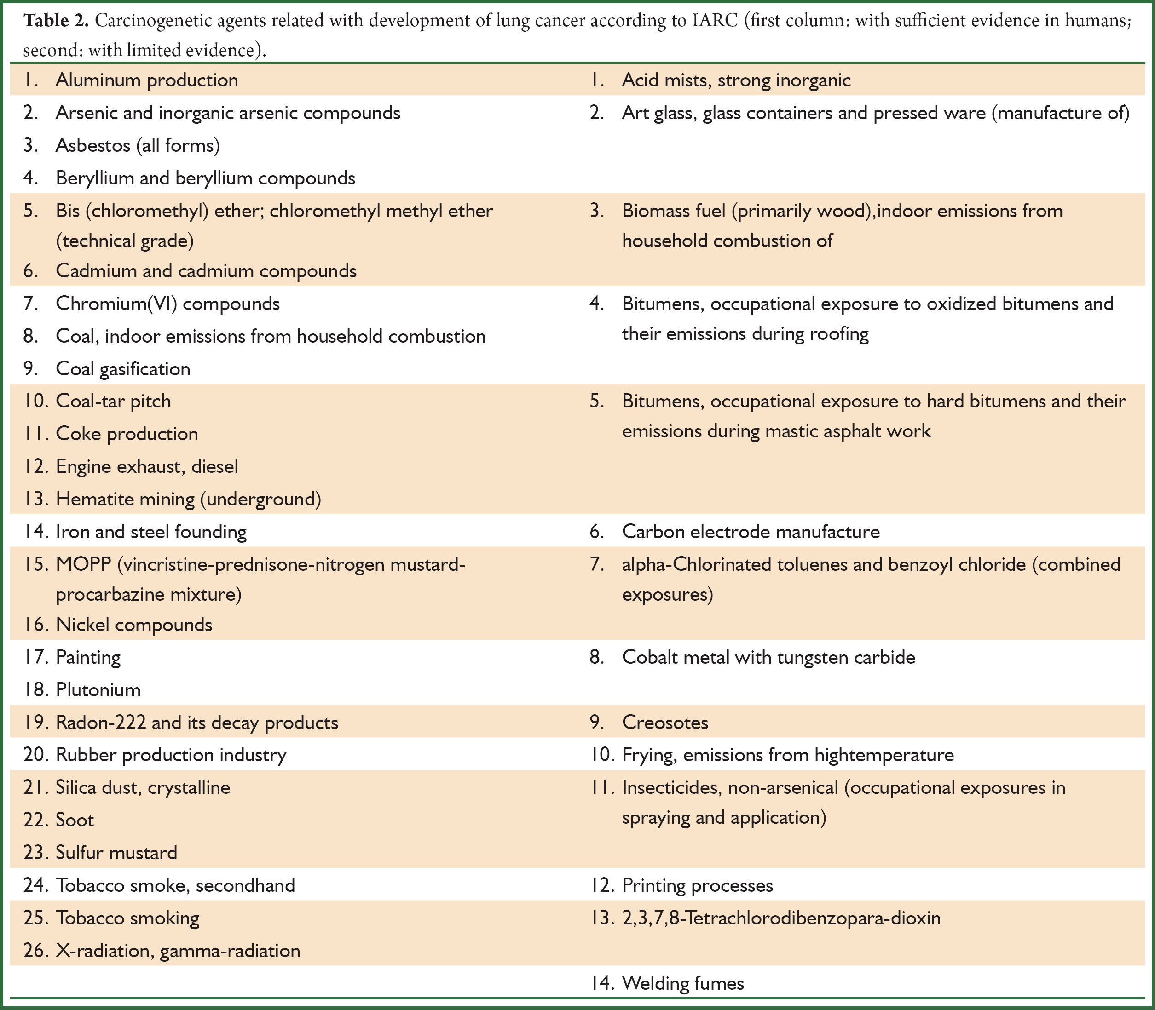
NCCN Recommends Screening in those over 50 with > 50 py smoking history and at least one additional lung cancer risk factor

Slide 121
Other Tests of Dubious Benefit
Majority of routine pre-op labs
Nearly half of early re-screening colonoscopies, over 40% of repeat endoscopies
  Yet almost ½ of those with a positive FIT test do not get a follow-up colonoscopy
  62% of high-risk patients with polyps had delayed or no surveillance colonoscopies after 10 yrs

Slide 122
Other Tests of Dubious Benefit
Direct-to-consumer personal genome/endocrine/fertility/STD/heavy metal/lyme disease testing kits
  Most marketed without any prior regulatory review; potentially risky; less than ½ HIPAA-compliant
  Several states prohibit without involvement of a physician

Slide 123
Other Tests of Dubious Benefit
Metabolic screens
Iridology
Pulse and tongue diagnosis
Stool microbiome analysisElectrodiagnosis
Hair, urine and stool analyses
Applied kinesiology
Some forms of acupuncture

Slide 124
Other Tests of Dubious Benefit
Private companies offering DTC lab testing
  E.g. Anylabtestnow
Consequences: Unnecessary anxiety, ineffective and/or unsafe treatments → disease progression

Slide 125
Risks of Unnecessary Testing
False-positive test results extremely common among asymptomatic individuals
Multiple tests increase likelihood of false-positive results
  Can lead to further unnecessary investigations, additional patient costs, heightened anxiety, and risk to future insurability

Slide 126
Risks of Unnecessary Testing
Conversely, true positive results can lead to over-diagnosis of conditions that would not have become clinically significant, thus leading to further risky interventions and possibly adverse effects on mental health
Recent charges, convictions of doctors performing unnecessary tests/surgeries

Slide 127
Unnecessary Testing Common in Luxury Care Clinics: Examples
Percent body fat measurements
CXRs in smokers and nonsmokers 35 and older to screen for lung cancer
Electron-beam CT scans and stress echocardiograms to look for evidence of coronary artery disease in asymptomatic, low risk patients (400,000 in 2007)
Carotid ultrasounds to assess stroke risk
  Peggy Fleming promoting

Slide 128
Unnecessary Testing Common in Luxury Care Clinics: Examples
Abdominal-pelvic ultrasounds to screen for liver or ovarian cancer
  CA-125 testing (with or without pelvic ultrasound) of post-menopausal women may prevent ovarian cancer death (but NNS high and only 1/3 women who underwent surgery had ovarian cancer; findings preliminary; ?cost effectiveness?)
    Subsequent study showed no mortality benefit and many unnecessary surgeries, some with major complications
  Others note that screening pelvic exams have no effect on morbidity or mortality from benign and malignant gynecological conditions

Slide 129
Luxury Care is Unfair
Technician and equipment time diverted to produce immediate results
Patients jump the queue in the radiology and phlebotomy suites
Tests for other patients with more appropriate/urgent needs may be delayed

Slide 130
Many Luxury Care Clinics are Associated with Academic Medical Centers
Sullies these institutions' images as arbiters of evidence-based medicine
Unnecessary testing sends mixed message to trainees and patients about when and why to use diagnostic studies

Slide 131
Luxury Care and Academic Medical Centers
Facilitates erosion of professional ethics by perpetuating a two-tiered system of care within institutions that have been the traditional healthcare providers to the indigent and where clinicians in training learn professional ethics

Slide 132
Luxury Care
Runs counter to physicians' ethical obligations to contribute to the responsible stewardship of health care resources
While some might argue that if patients are willing to pay for scientifically unsupported testing, they should be allowed to do so, such a 'buffet' approach to diagnosis over-medicalizes healthcare and makes a mockery of evidence-based medicine

Slide 133
Recognizing Health Scams
Claims pitched directly to the media, rather than via publication in peer-reviewed journals
Discoverer says that a powerful establishment is trying to suppress his or her work
Appeals to false authorities, emotion, or magical thinking
Scientific effect involved at the very limits of detection

Slide 134
Recognizing Health Scams
Evidence for test or treatment anecdotal / relies on subjective validation
Promoter states a belief is credible because it has endured for centuries
Need to propose new laws of nature to explain an observation

Slide 135
Educational Deficits Perpetuate Unnecessary Testing
Inadequate funding of science and health education means individuals may lack skepticism necessary to recognize unwarranted testing
  Patients and doctors overestimate benefits and underestimate risks of cancer screening tests
    Screening tests in those with advanced cognitive impairment, limited life expectancy, and pre-existing metastatic cancer not uncommon

Slide 136
Environment of Anti-Science/Pseudoscience
Erosion of science under the Bush administration:
  Appointments to key scientific bodies based on corporate connections and political or religious ideology, rather than scientific expertise
  Excessive corporate influence over legislation
  The rewriting and even suppression of scientific policy statements
Continues under Obama

Slide 137
Conclusions
Query healthcare providers about sources of reliable information
Consult providers before obtaining screening and/or diagnostic tests or undergoing alternative treatments

Slide 138
Conclusions
Radiation stewardship is key, including use of alternative modalities and improvements in consent process
Development of ultra-low dose CT ongoing
Need for increased physician awareness, individualized data, and improvements in patient consent process

Slide 139
Conclusions
Unnecessary testing common among both traditional and alternative medical providers

Slide 140
Suggestions
Improved science and health education, more nuanced and responsible communication of medical information by the media, enhanced scientific integrity of governmental bodies, eliminating -- or at least limiting the expansion of -- luxury care, longer clinic visits, and better communication between patients and healthcare providers would all help contribute to increased use of appropriate, less harmful screening practices (along with less use of unnecessary tests) and to enhanced health outcomes

Slide 141
Papers/References
Donohoe MT. Unnecessary Testing in Obstetrics and Gynecology and General Medicine: Causes and Consequences of the Unwarranted Use of Costly and Unscientific (yet Profitable) Screening Modalities. Medscape Ob/Gyn and Women’s Health 2007. Posted 4/30/07. Available at http://phsj.org/?page_id=30
Papers on luxury care available at http://phsj.org/luxury-care-concierge-care/
For more information on MRI scans, corporate profits, and risks of gadolinium, see papers and slide show on GE at https://phsj.org/environmental-health/

Slide 142
Contact Info
Martin T Donohoe
http://www.publichealthandsocialjustice.org
http://www.phsj.org
martindonohoe@phsj.org

